Slide 1
Uniform mean flow
Uniform mean fields

Slide 2
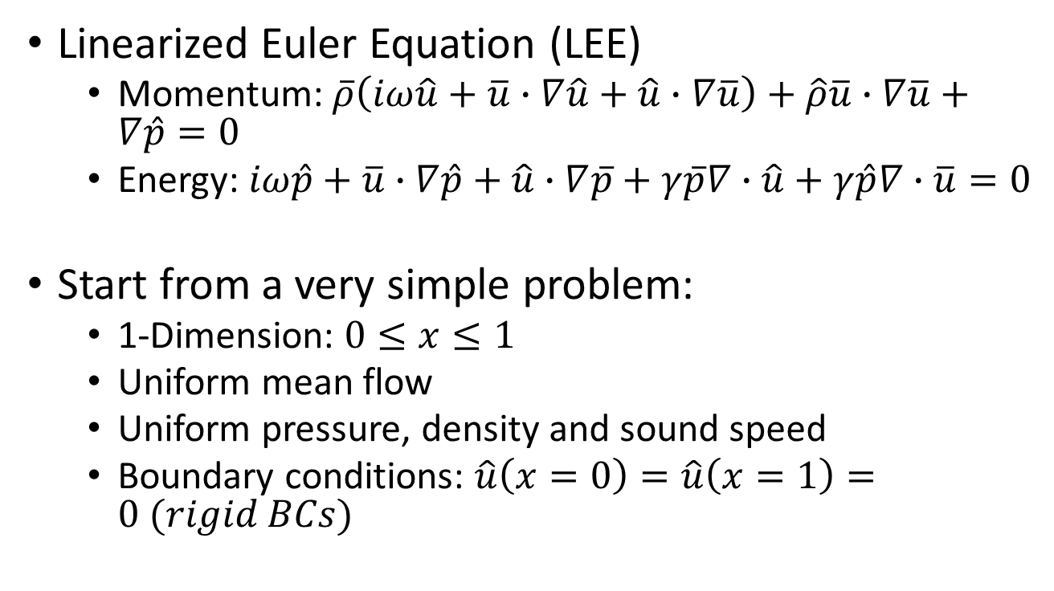
COMSOL: WEAK FORM PDE
Linearized Euler Equation (LEE)
  Momentum: $\overline{ρ}\left(iω\hat{u}+\overline{u}∙∇\hat{u}+\hat{u}∙∇\overline{u}\right)+\hat{ρ}\overline{u}∙∇\overline{u}+∇\hat{p}=0$
  Energy: $iω\hat{p}+\overline{u}∙∇\hat{p}+\hat{u}∙∇\overline{p}+γ\overline{p}∇∙\hat{u}+γ\hat{p}∇∙\overline{u}=0$
Start from a very simple problem:
  1-Dimension: $0≤x≤1$
  Uniform mean flow
  Uniform pressure, density and sound speed
  Boundary conditions: $\hat{u}\left(x=0\right)=\hat{u}\left(x=1\right)=0 (rigid BCs)$

Slide 3
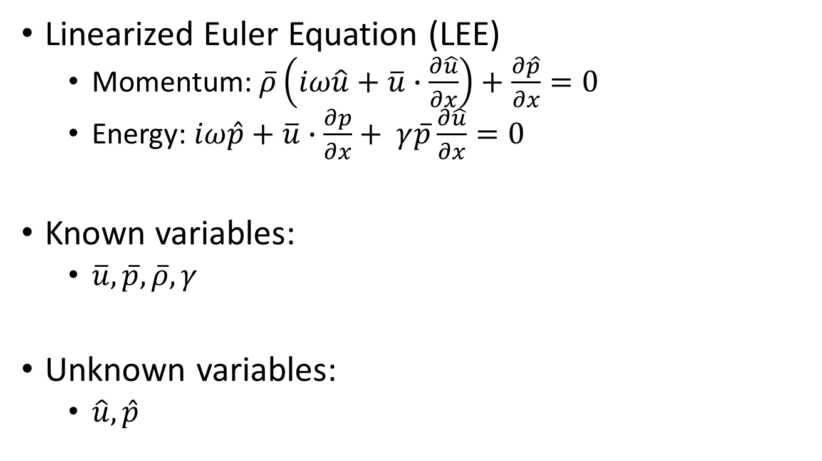
COMSOL: WEAK FORM PDE
Linearized Euler Equation (LEE)
  Momentum: $\overline{ρ}\left(iω\hat{u}+\overline{u}∙\frac{∂\hat{u}}{∂x}\right)+\frac{∂\hat{p}}{∂x}=0$
  Energy: $iω\hat{p}+\overline{u}∙\frac{∂p}{∂x}+ γ\overline{p}\frac{∂\hat{u}}{∂x}=0$
Known variables:
  $\overline{u}, \overline{p}, \overline{ρ}, γ$
Unknown variables:
  $\hat{u}, \hat{p}$

Slide 4
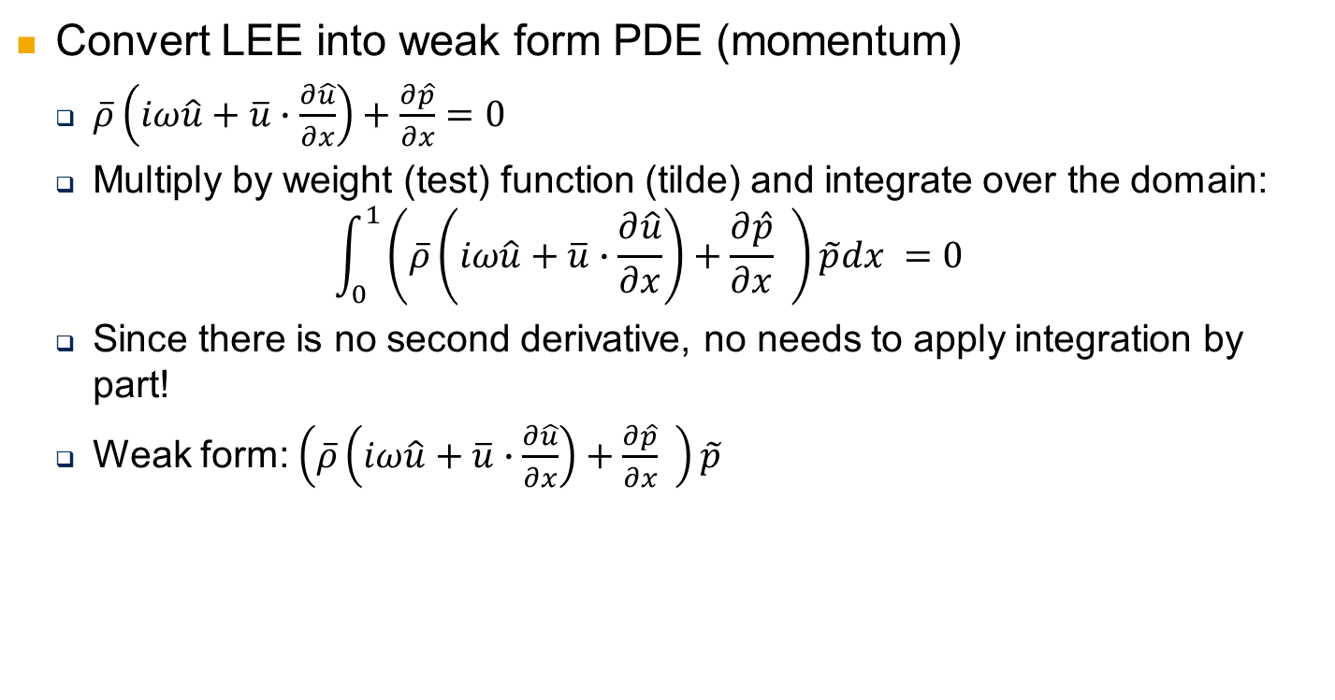
COMSOL: WEAK FORM PDE
Convert LEE into weak form PDE (momentum)
  $\overline{ρ}\left(iω\hat{u}+\overline{u}∙\frac{∂\hat{u}}{∂x}\right)+\frac{∂\hat{p}}{∂x}=0$
  Multiply by weight (test) function (tilde) and integrate over the domain:
  $$\int_{0}^{1}{\left(\overline{ρ}\left(iω\hat{u}+\overline{u}∙\frac{∂\hat{u}}{∂x}\right)+\frac{∂\hat{p}}{∂x} \right)\tilde{p}dx }=0$$
  Since there is no second derivative, no needs to apply integration by part!
  Weak form: $\left(\overline{ρ}\left(iω\hat{u}+\overline{u}∙\frac{∂\hat{u}}{∂x}\right)+\frac{∂\hat{p}}{∂x} \right)\tilde{p}$

Slide 5

COMSOL: WEAK FORM PDE
Convert LEE into weak form PDE (energy)
  $iω\hat{p}+\overline{u}∙\frac{∂p}{∂x}+ γ\overline{p}\frac{∂\hat{u}}{∂x}=0$
  Multiply by weight (test) function (tilde) and integrate over the domain:
  $$\int_{0}^{1}{\left(iω\hat{p}+\overline{u}∙\frac{∂p}{∂x}+ γ\overline{p}\frac{∂\hat{u}}{∂x}\right)\tilde{u}dx }=0$$
  Since there is no second derivative, no needs to apply integration by part!
  Weak form: $\left(iω\hat{p}+\overline{u}∙\frac{∂p}{∂x}+ γ\overline{p}\frac{∂\hat{u}}{∂x}\right)\tilde{u}$

Slide 6
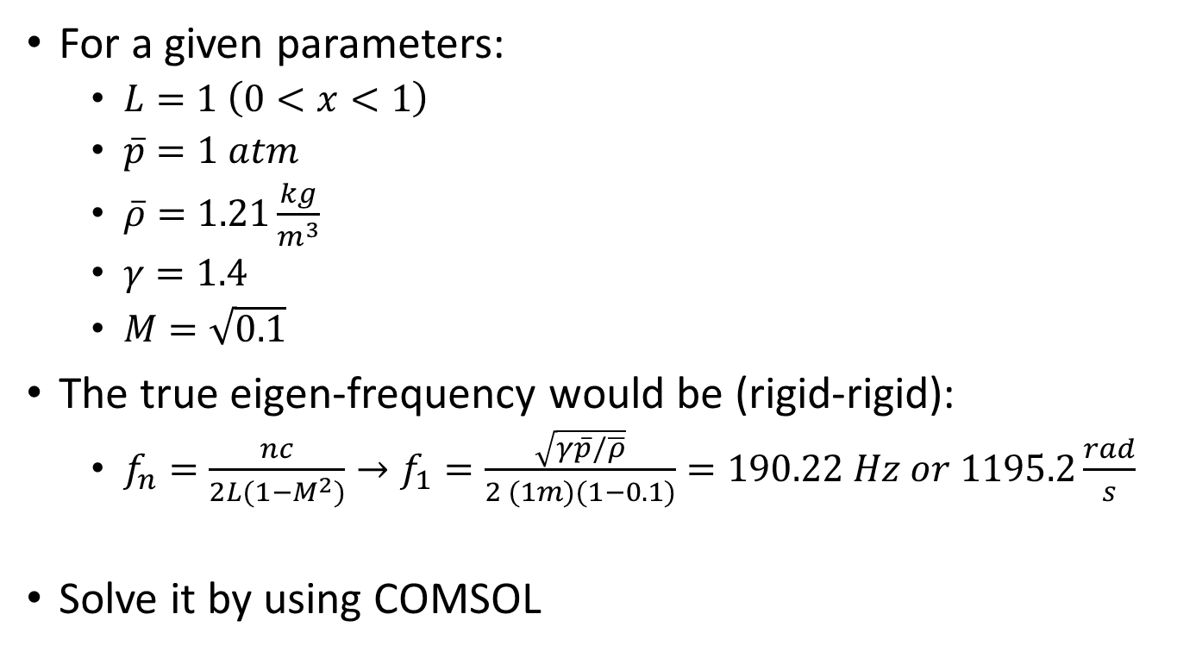
COMSOL: WEAK FORM PDE
For a given parameters:
  $L=1 \left(0<x<1\right)$
  $\overline{p}=1 atm$
  $\overline{ρ}=1.21\frac{kg}{m^{3}}$
  $γ=1.4$
  $M=\sqrt{0.1}$
The true eigen-frequency would be (rigid-rigid):
  $f_{n}=\frac{nc}{2L(1−M^{2})}→f_{1}=\frac{\sqrt{γ\overline{p}/\overline{ρ}}}{2 (1m)(1−0.1)}=190.22 Hz or 1195.2\frac{rad}{s}$
Solve it by using COMSOL

Slide 7
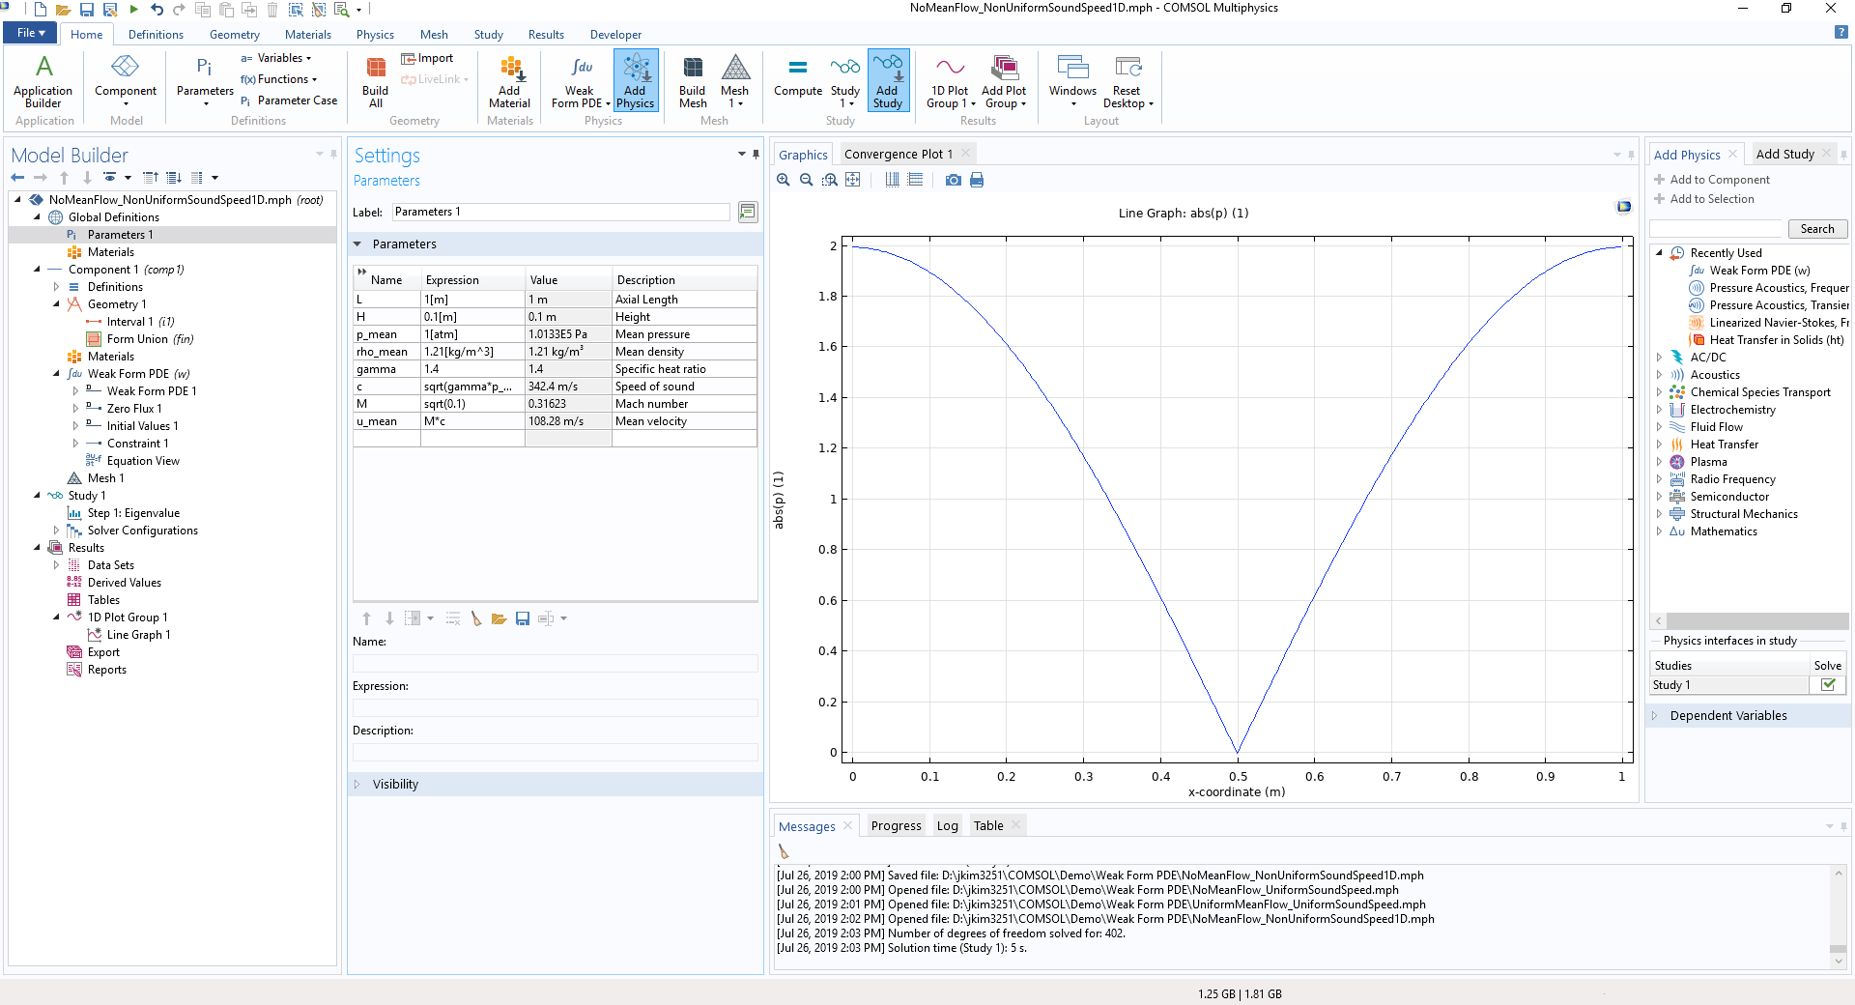
COMSOL: WEAK FORM PDE
Define given parameters

Slide 8
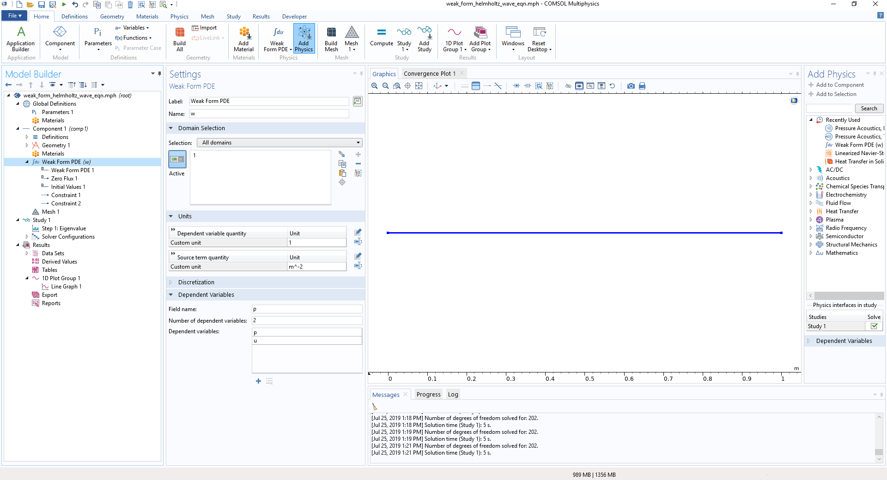

COMSOL: WEAK FORM PDE
Add variables: $\hat{p}$ and $\hat{u}$

Slide 9
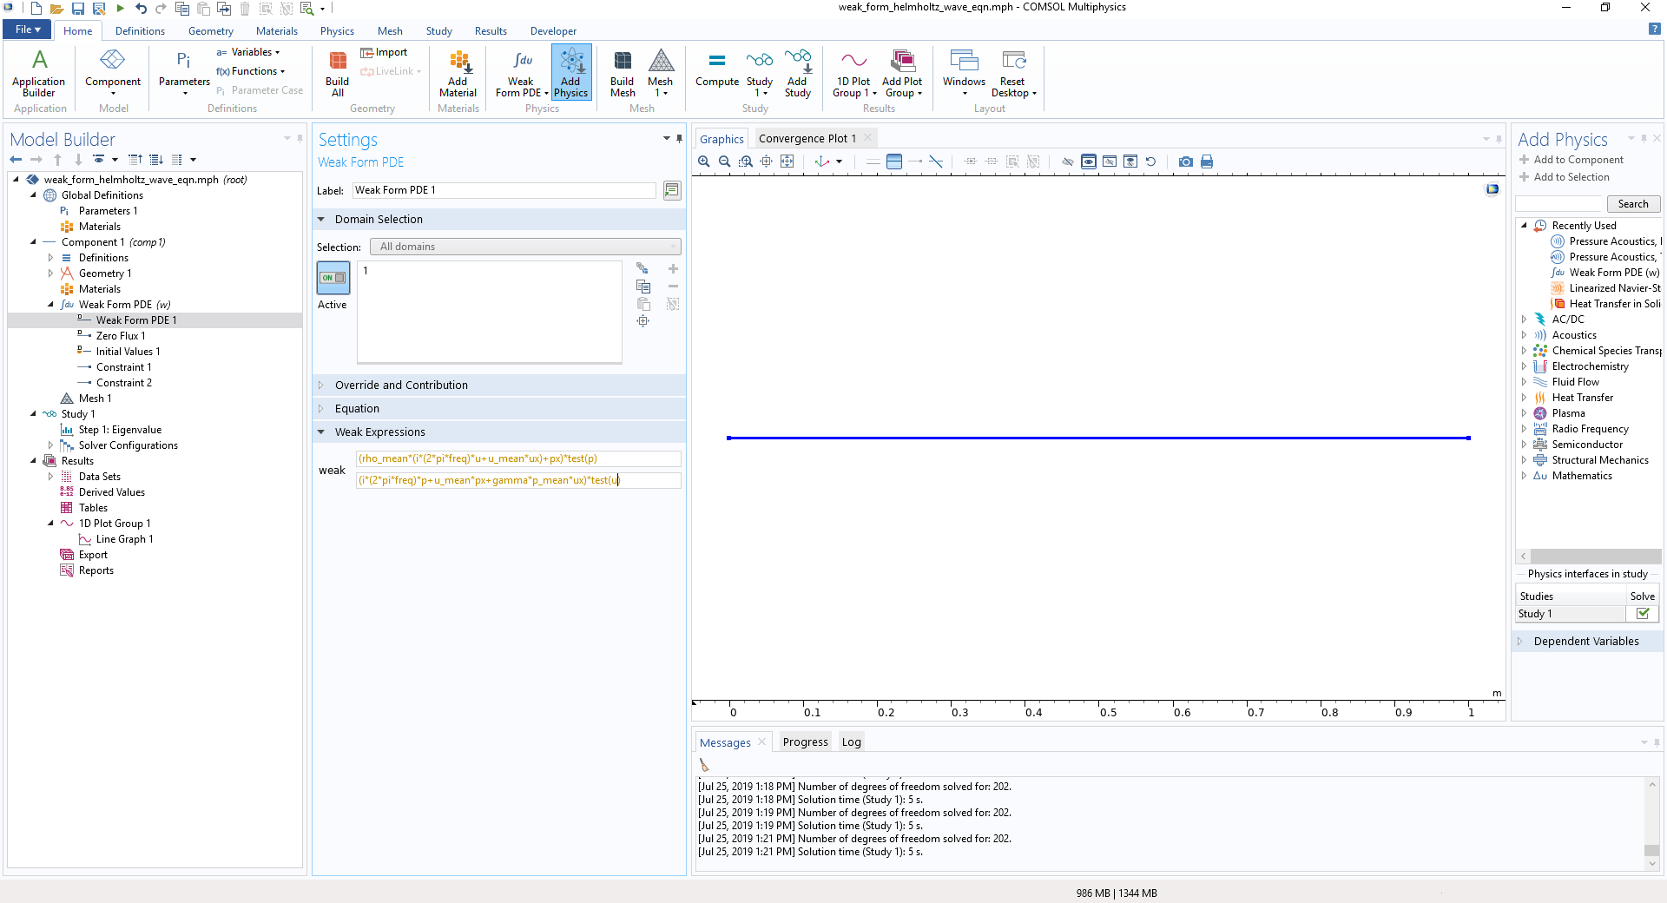

COMSOL: WEAK FORM PDE
Write weak form PDE:$\left(\overline{ρ}\left(iω\hat{u}+\overline{u}∙\frac{∂\hat{u}}{∂x}\right)+\frac{∂\hat{p}}{∂x} \right)\tilde{p} \&\left(iω\hat{p}+\overline{u}∙\frac{∂p}{∂x}+ γ\overline{p}\frac{∂\hat{u}}{∂x}\right)\tilde{u}$
Do not include $i (imaginary)$ in the equation as it is already built in COMSOL

Slide 10
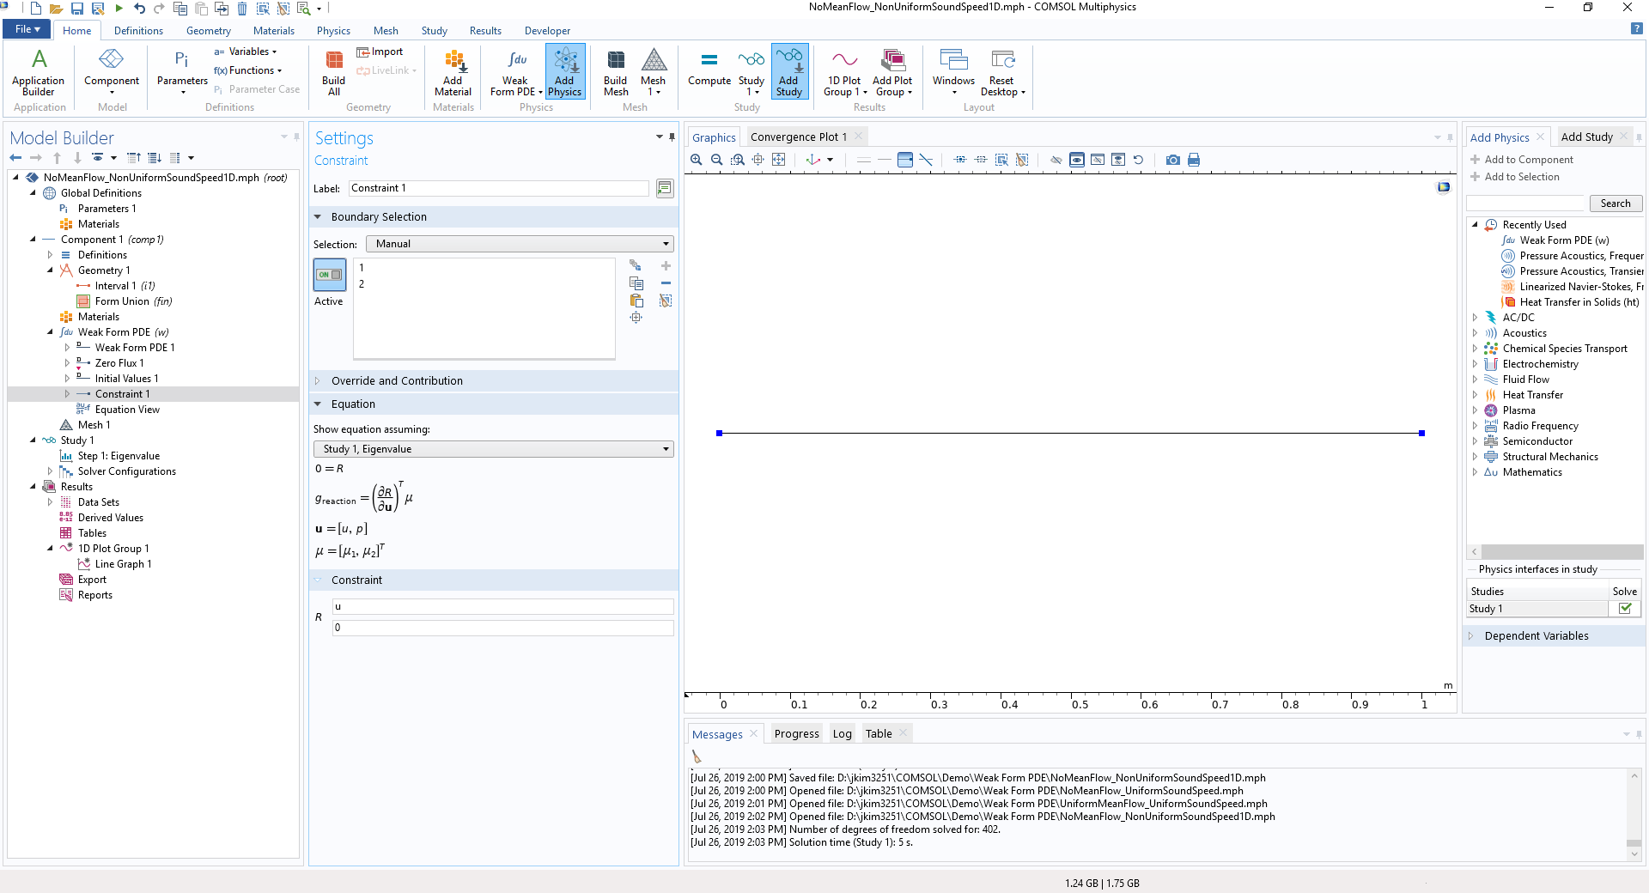

COMSOL: WEAK FORM PDE
Add BC: $\hat{u}\left(x=0,1\right)=0$
* You can specify pressure release BC by writing $p$ instead of $u$

Slide 11
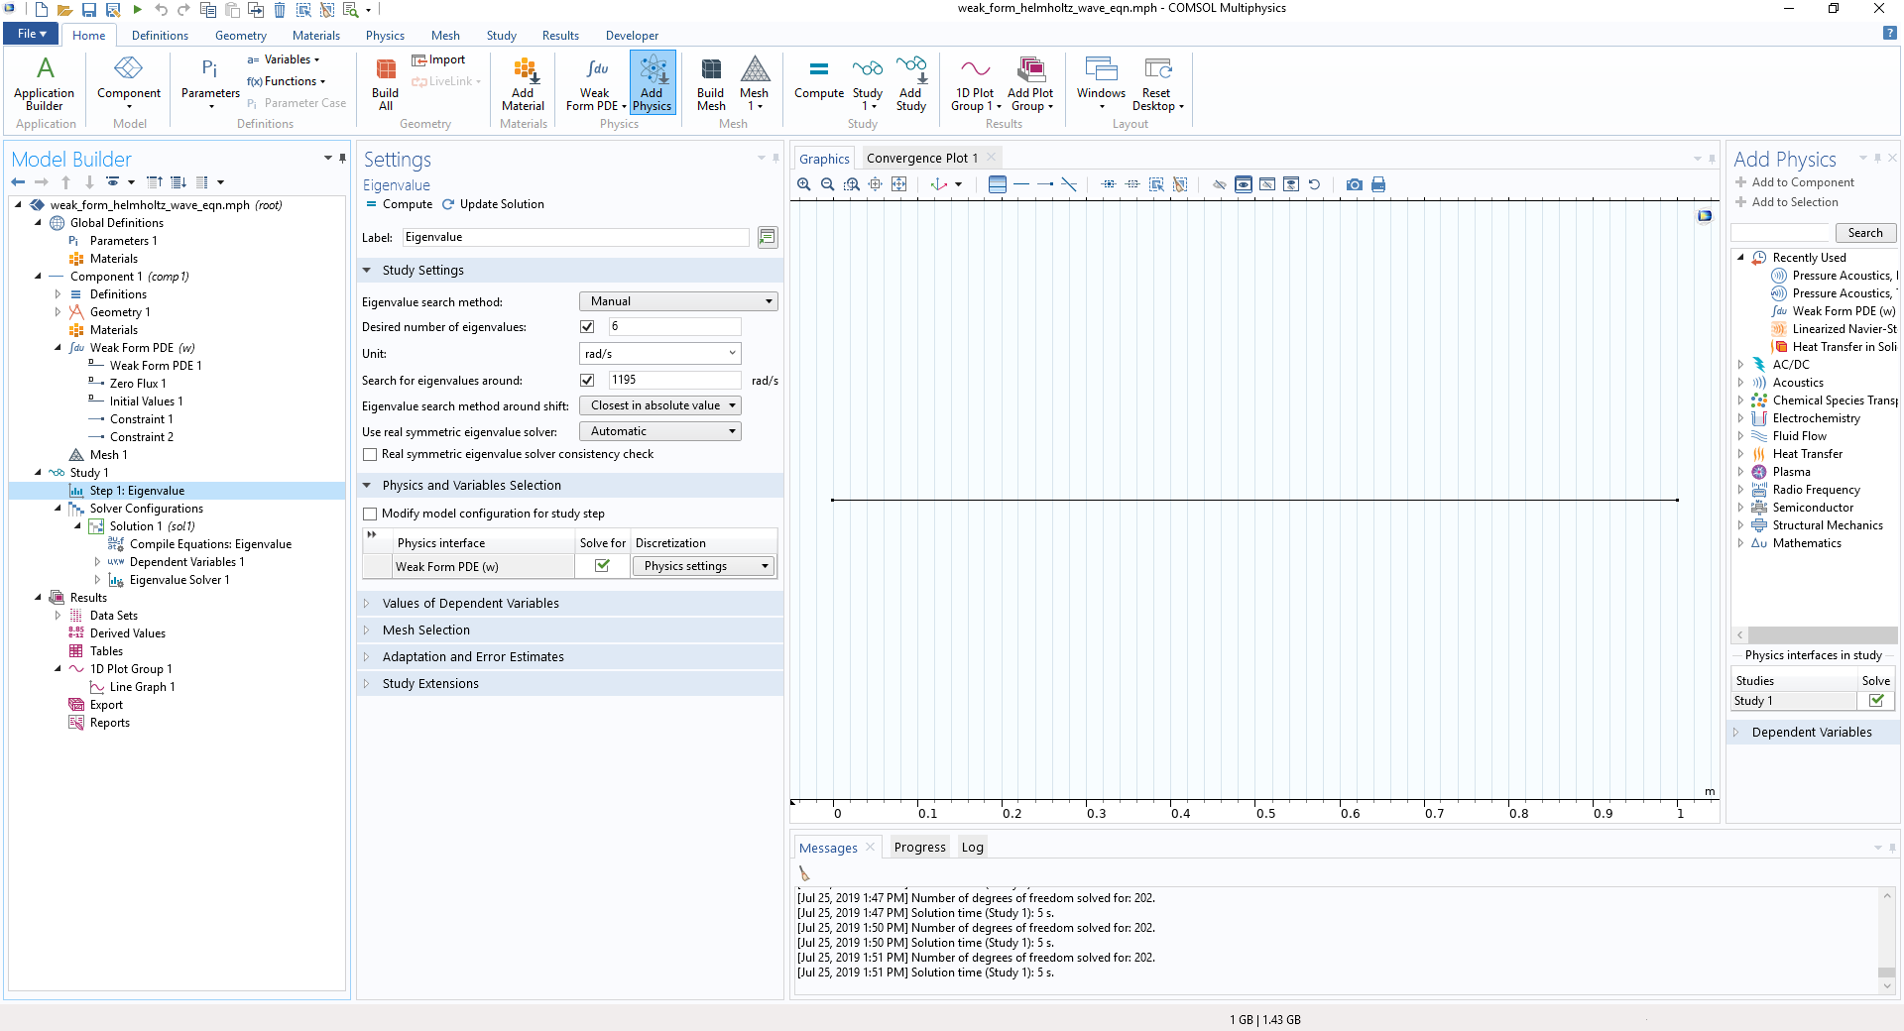
COMSOL: WEAK FORM PDE
Solve for eigenvalue around 1195 rad/s

Slide 12
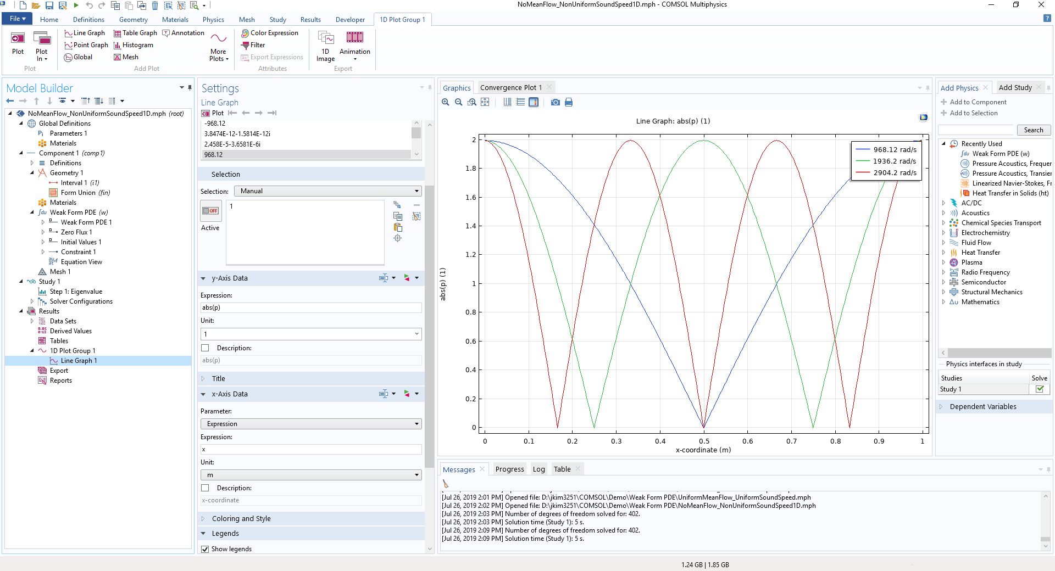
COMSOL: WEAK FORM PDE
The first eigenfrequency (968.17 rad/s) does not matches
the theoretical value (1195.2 rad/s)!

