Slide 1
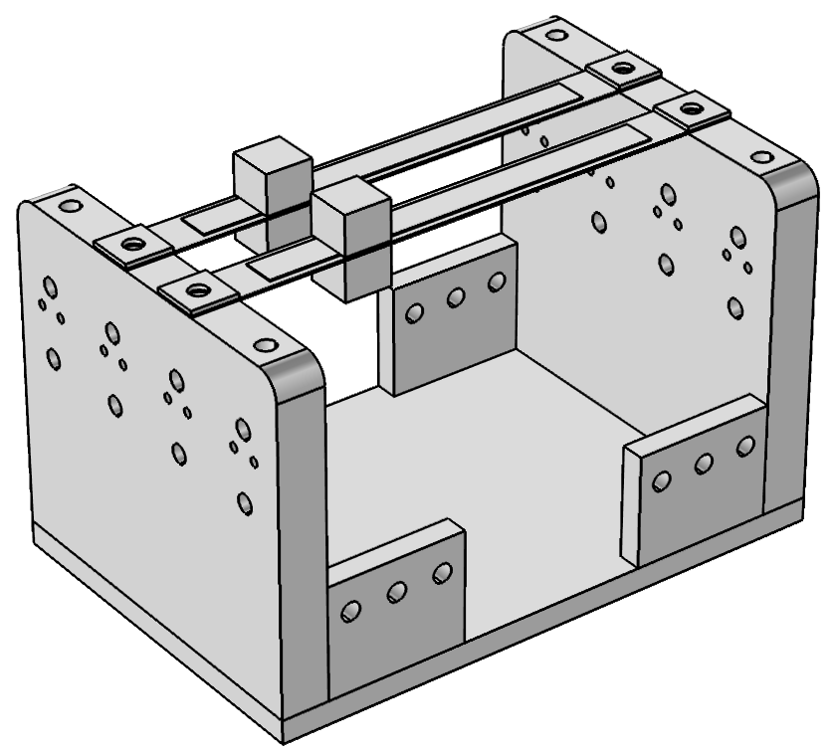
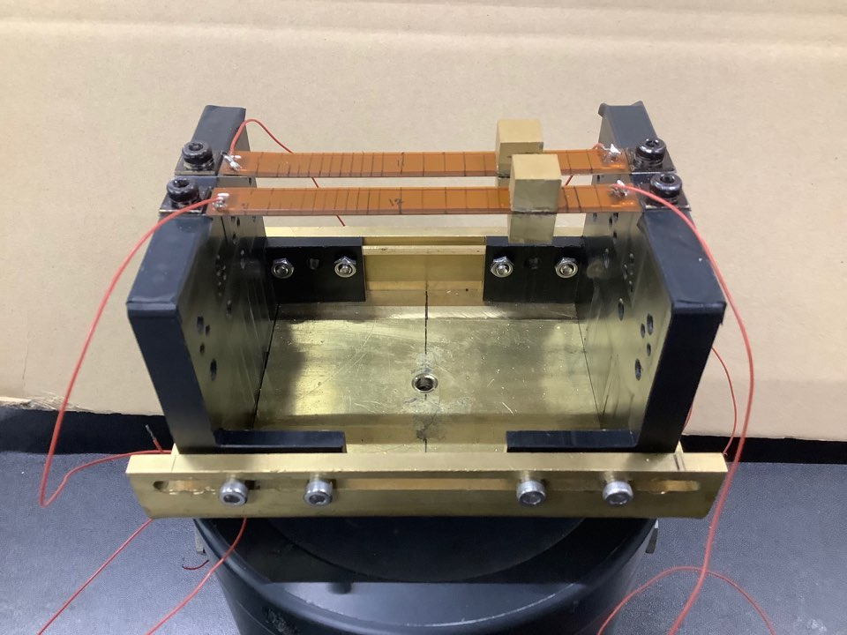
Comsol simulation
Geometric conditions
mass | 14.3 | g
beam length | 100 | mm
beam thickness | 0.6 | mm
beam width | 10 | mm
beam interval | 15 | mm

Slide 2
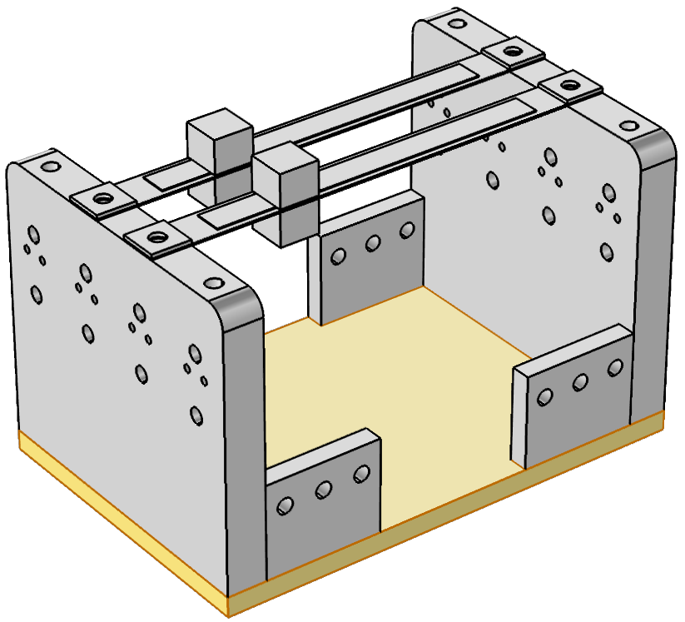
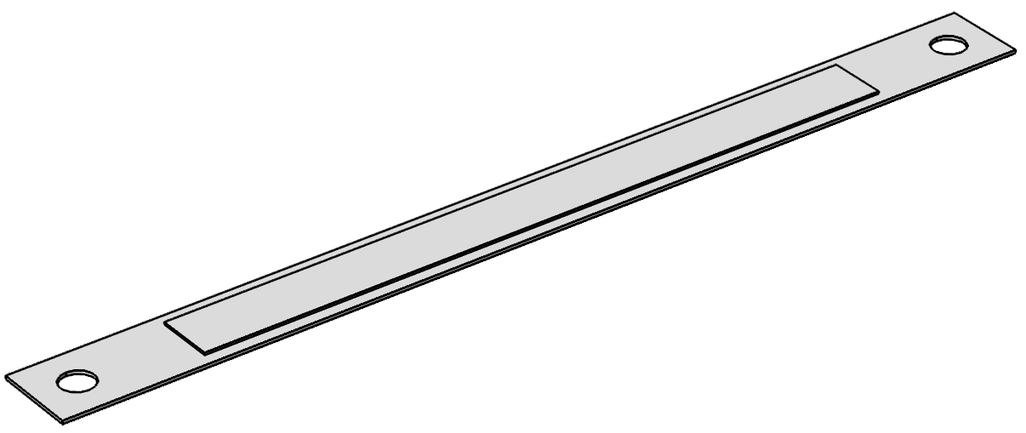
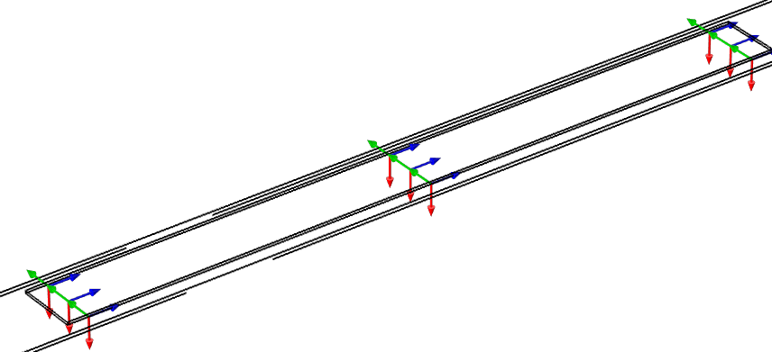
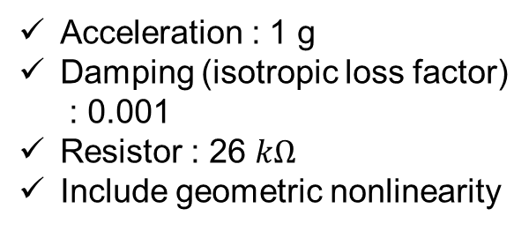
Comsol simulation
Boundary condition
Acceleration : 1 g
Damping (isotropic loss factor)
: 0.001
Resistor : 26 $kΩ$
Include geometric nonlinearity
Fixed constraint
Ground : PZT 밑면
Terminal voltage : 윗면

Slide 3
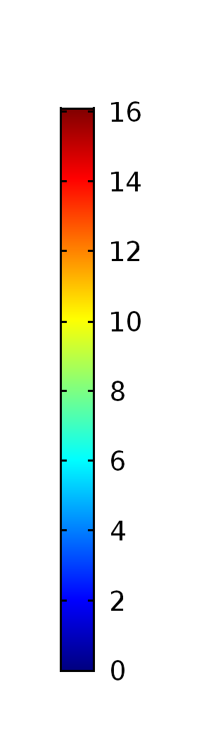
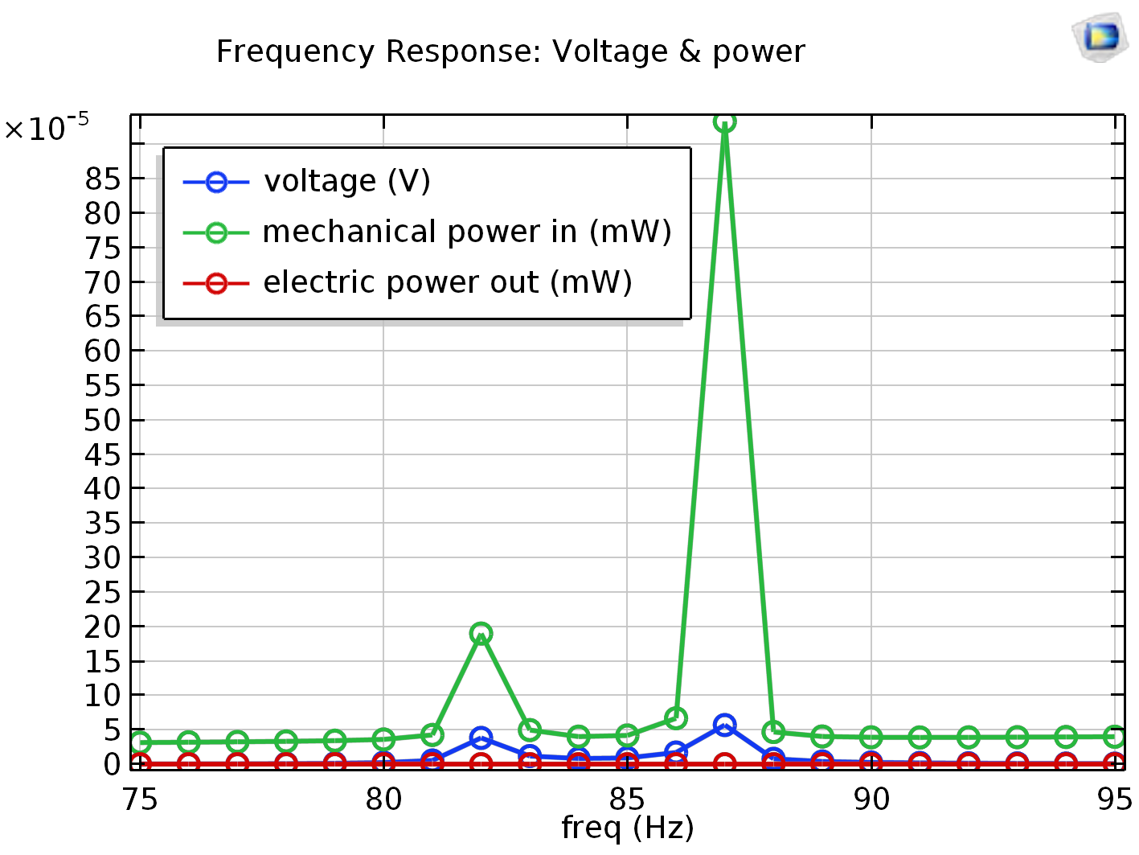
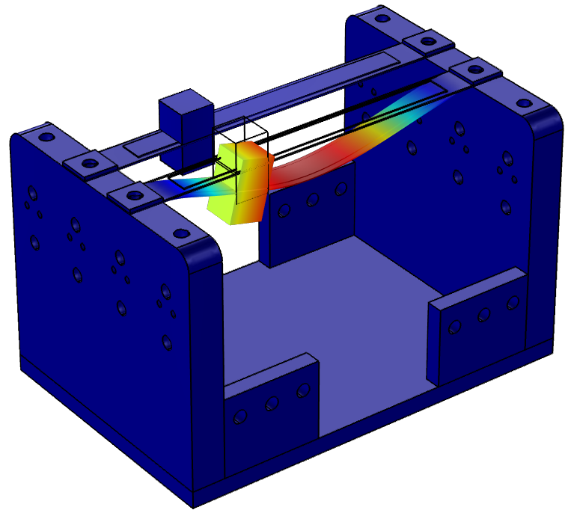
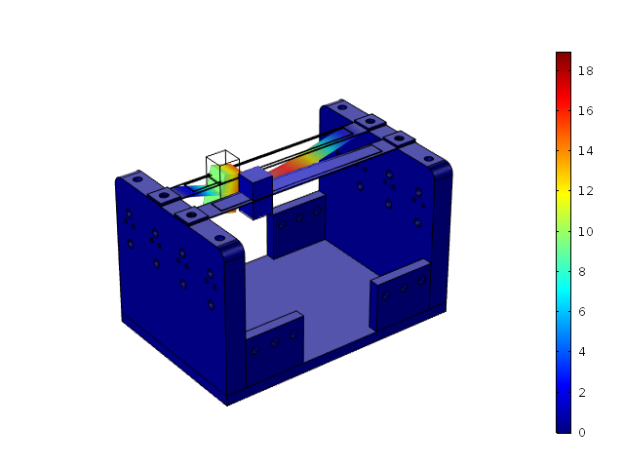
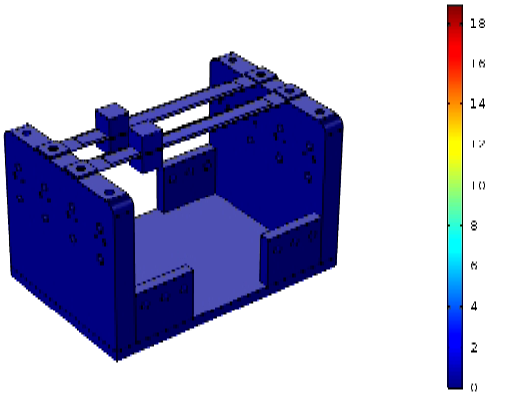
Comsol simulation
(μm)
82 Hz
87 Hz
82 Hz
(μm)
87 Hz

Slide 4
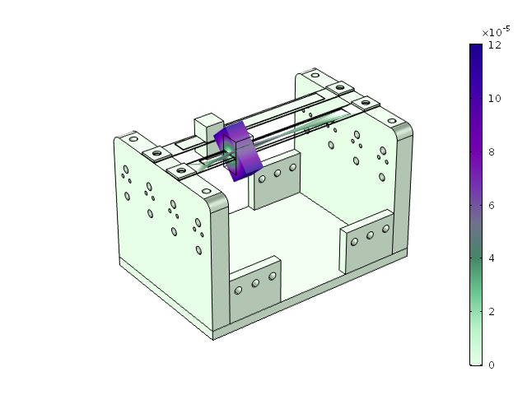
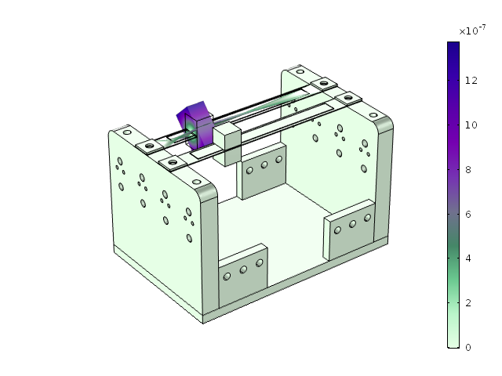
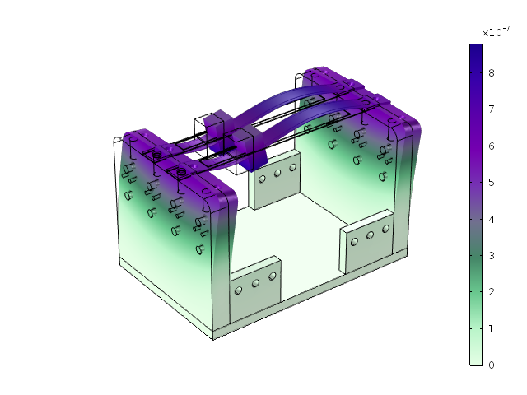
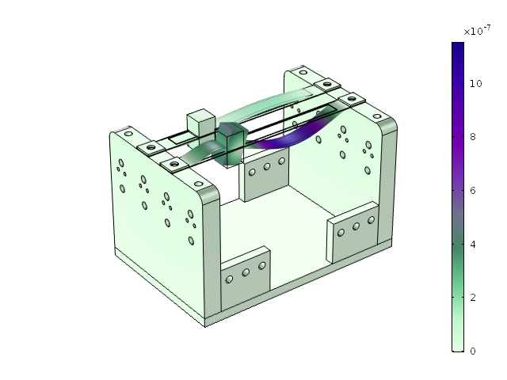
Comsol simulation
253 Hz
260 Hz
360 Hz
447 Hz

