Slide 1
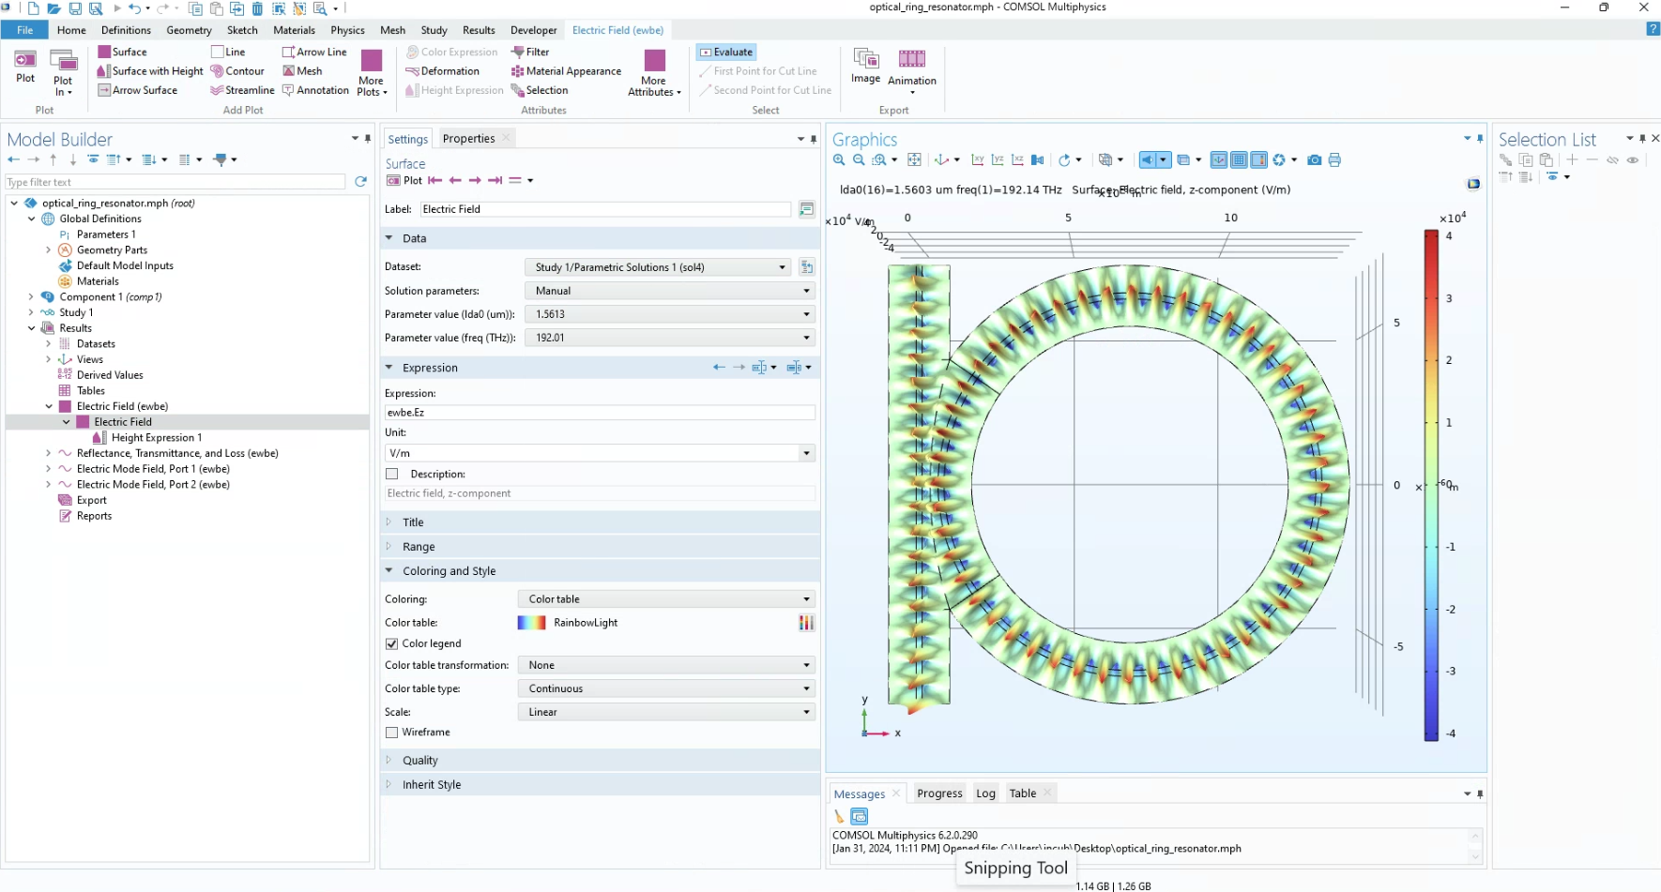


Why are not the both lda0 same?

