Slide 1
Crystallization of Benzoic Acid in a Mixed Suspension, Mixed Product Removal Crystallizer

Slide 2
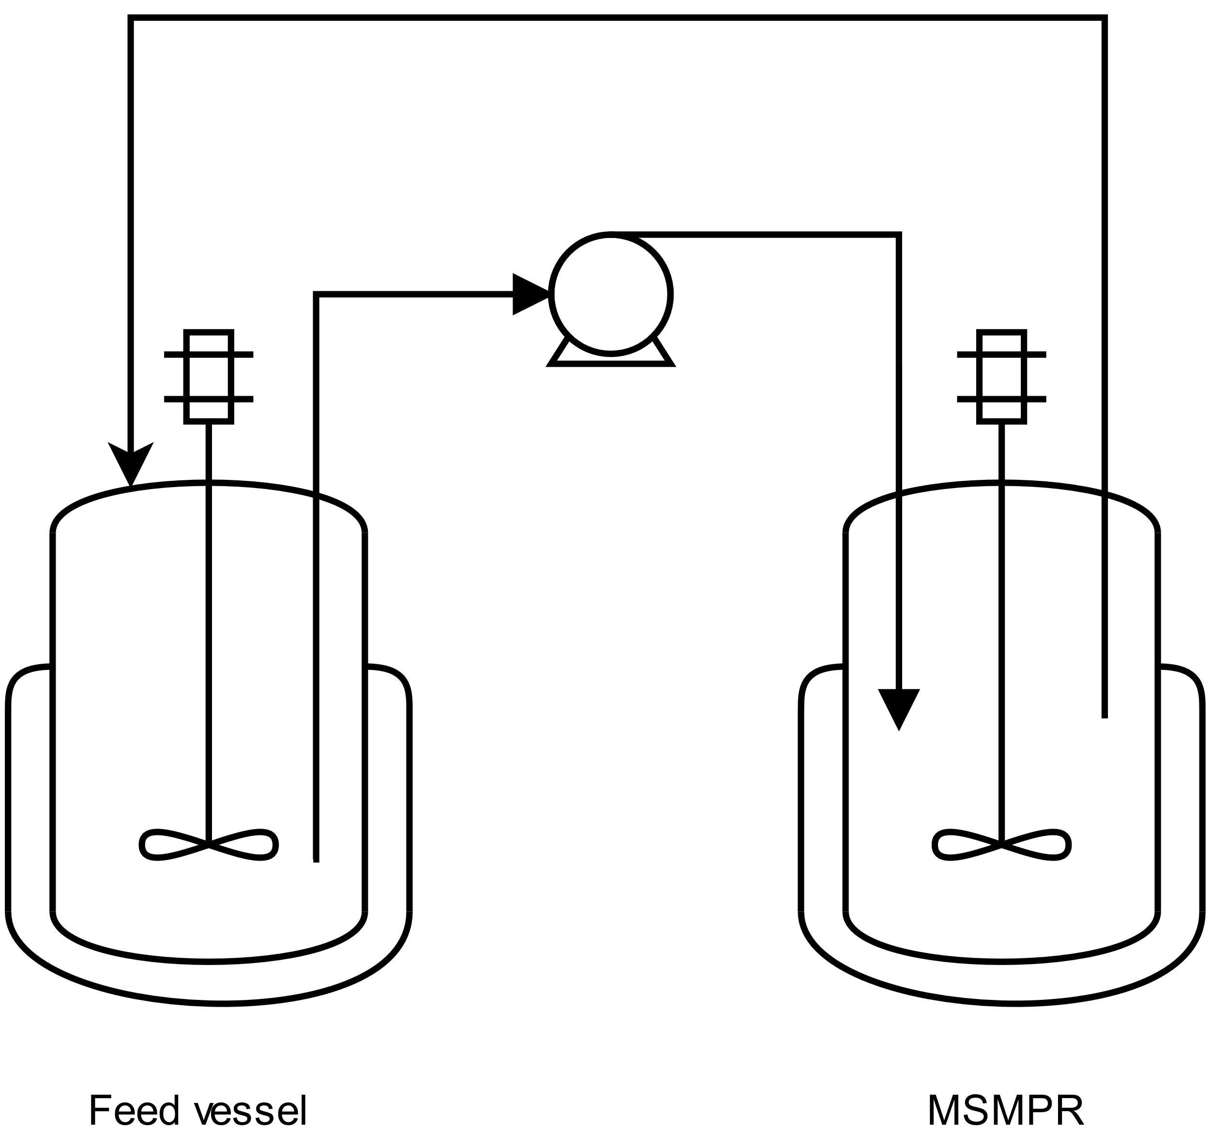



Setup
Suspension feed
Crystal and suspension removal
The model is based on a publication by Morris et al.*
Crystallization of benzoic acid in an experimental MSMPR** crystallizer is modeled using a population balance
0D model assuming perfect mixing in the crystallizer and feed vessel
Crystal dissolution
Pump
Crystal nucleation and growth
$$T_{f}$$
$$T_{c}$$
$$T_{c}<T_{f}$$
Feed Vessel
MSMPR Crystallizer
  * ”Estimation of Nucleation and Growth Kinetics of Benzoic Acid by Population Balance Modeling of a Continuous Cooling Mixed Suspension, Mixed Product Removal Crystallizer", Organic Process Research & Development, 2015
  ** MSMPR =Mixed suspension, mixed product removal

Slide 3
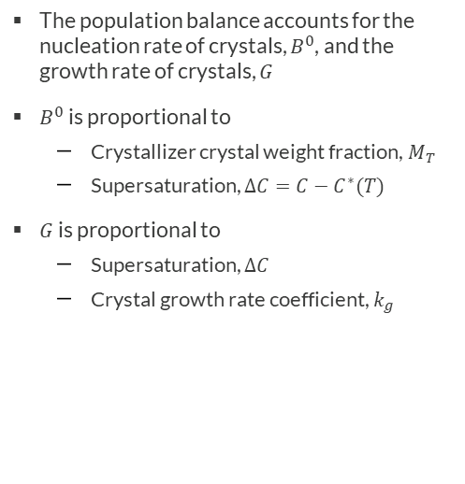
Model definition
Suspension feed
Crystal and suspension removal
The population balance accounts for the nucleation rate of crystals, $B^{0}$, and the growth rate of crystals, $G$
$B^{0}$is proportional to
  Crystallizer crystal weight fraction, $M_{T}$
  Supersaturation, $ΔC=C−C^{∗}(T)$
$G$is proportional to
  Supersaturation, $ΔC$
  Crystal growth rate coefficient, $k_{g}$
Crystal dissolution
Pump
Crystal nucleation and growth
$$T_{f}$$
$$T_{c}$$
$$T_{c}<T_{f}$$
Feed Vessel
MSMPR Crystallizer

Slide 4
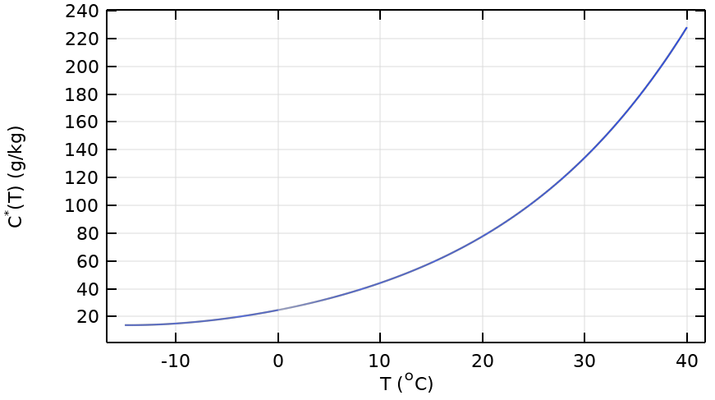









Model Definition
$$C_{0}$$
Steady state crystal population density:
$$n=\frac{B^{0}}{G}\text{exp}\left(−\frac{L}{Gτ}\right)$$
L = Crystal size
τ = Residence time
Nucleation rate:
Crystal growth rate:
$$B^{0}=k_{b}M_{T}^{j}{∆C}^{b}$$
$$G=k_{g}{∆C}^{g}$$
$${C>C}^{∗}$$
Driving Force
Crystal Weight Fraction
System Mass Balance
Mean Crystal Size
Nucleation and crystal growth rate proportional to the supersaturation
A balance on the third moment of the distribution.
Solve for solute mass fraction C that satisfies the system mass balance
From the ratio of the 4th and 3rd moments of the population density.
$$∆C =C−C^{∗}$$
$$M_{T}=6k_{v}ρ_{c}{(Gτ)}^{4}$$
$$C_{0}−C=M_{T}$$
$$L_{4,3}=4Gτ$$

Slide 5
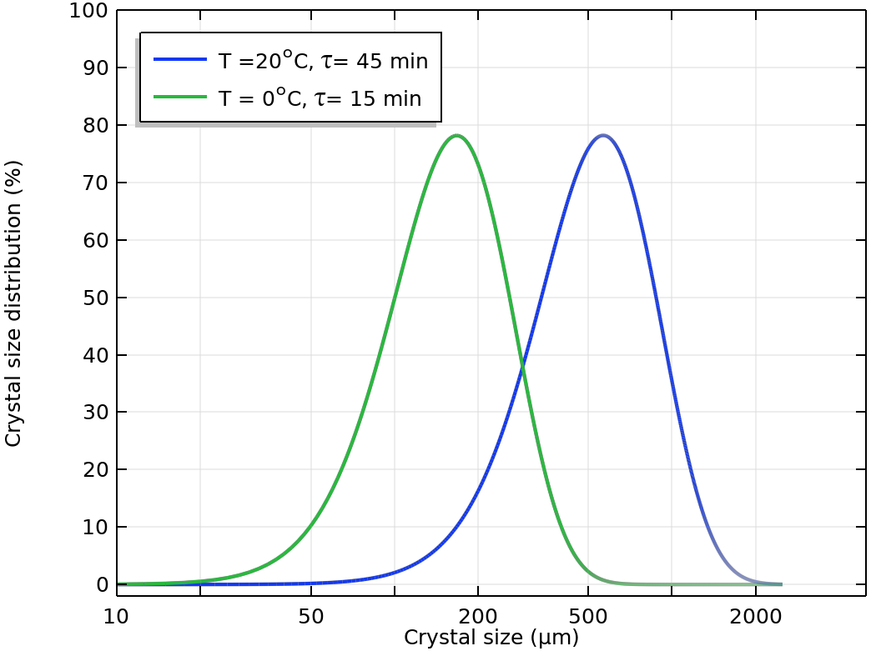
Results
CSDs for the experiment giving the smallest and the largest crystal sizes agrees well with the paper

Slide 6
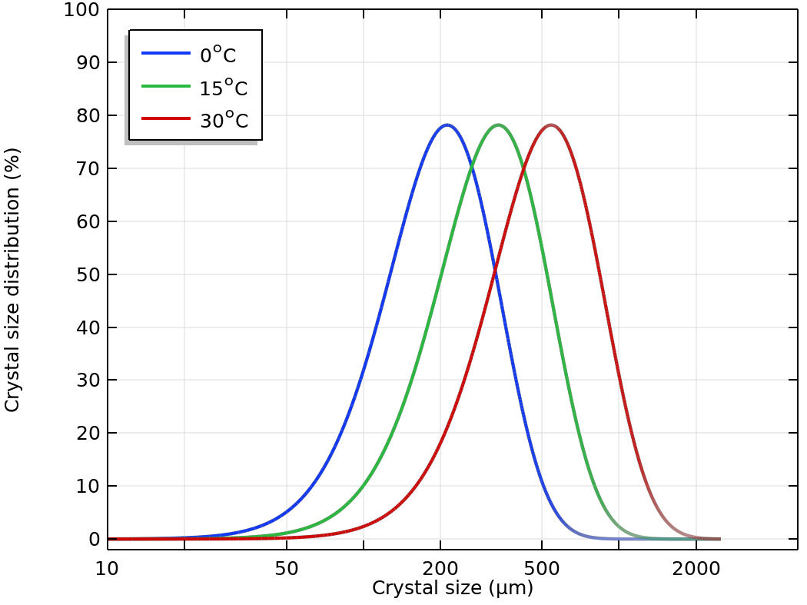
Results
Crystal size distribution for different temperatures
Increasing the temperature increases the rate of crystal growth, resulting in a distribution shifted towards larger sizes

Slide 7
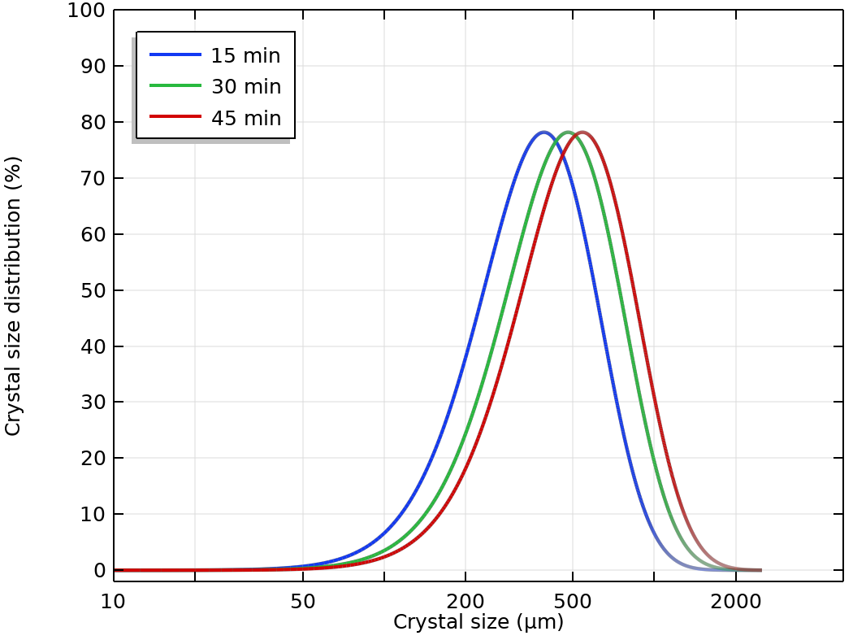
Results
Crystal size distribution for different residence times
Increasing the residence time allows particles to grow for a longer time, reaching larger sizes

Slide 8
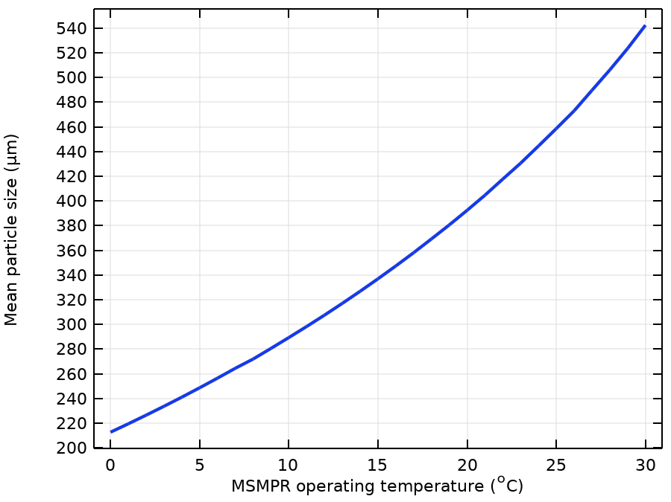
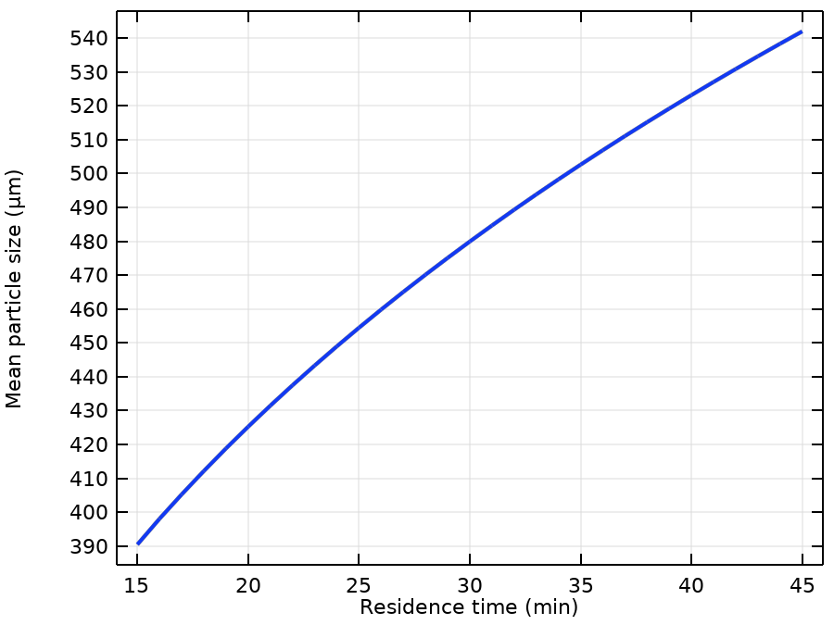
Mean Particle Size for Increasing Temperatures and Residence Times

Slide 9
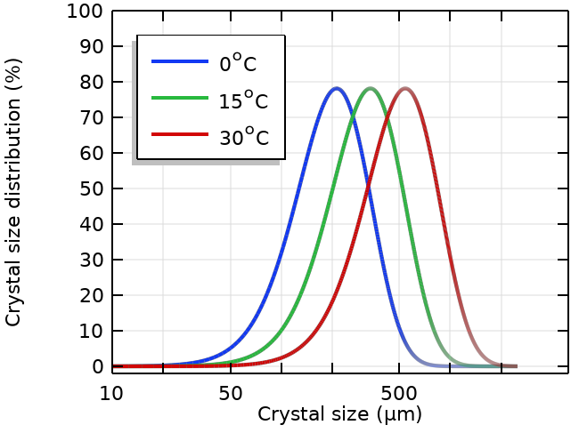
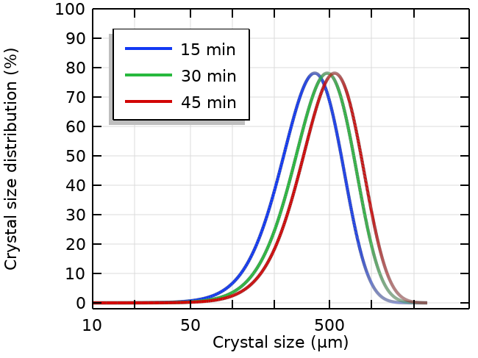
Concluding Remarks
Excellent agreement with scientific literature
Increasing the temperature and residence time shifts the crystal size distribution toward larger crystal sizes
Possible extensions
  Including effects from particle break-up, combination of crystals and rate of stirring
  Using Parameter Estimation to parameterize the population balance model for other chemical species

