Slide 1
Capacitance Matrix of Two Spheres

Slide 2
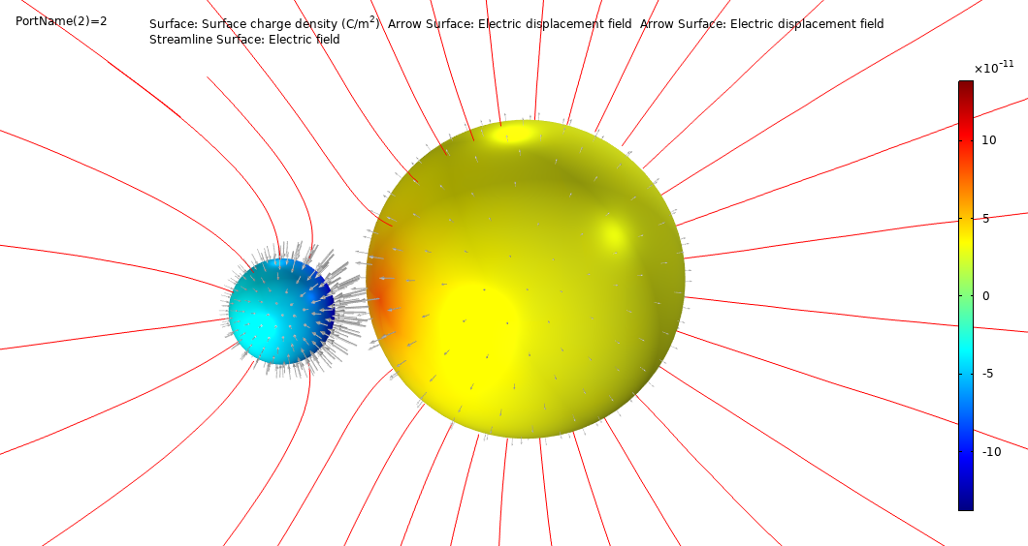
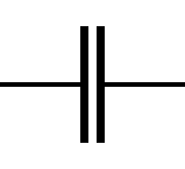
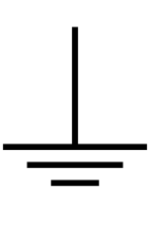



Background
This model describes a benchmark for computing the capacitance matrix for a system of 2 non-concentrical spheres.
Numerical results of COMSOL are compared to an analytical solution (de Queiroz, 2003, Lekner, 2011)
The model discusses also the relation between Maxwell capacitance matrix and mutual capacitance matrix.
Full discussion in blog post.
$$C_{m,12}$$
$$C_{m,11}$$
$$C_{m,22}$$

Slide 3
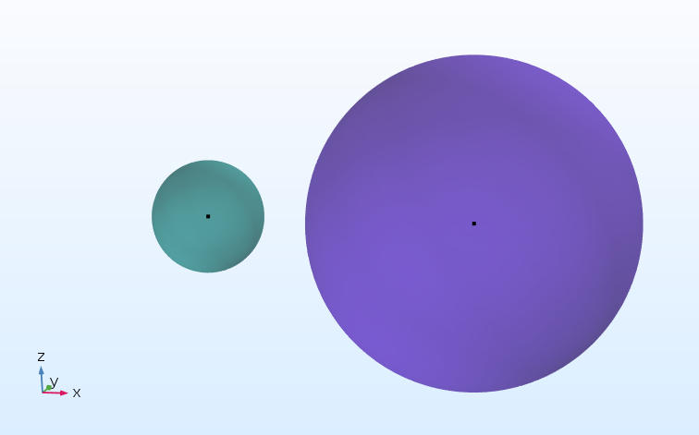




Analytical solution
$$C_{11}=Fab sinh u \sum_{n=0}^{∞}{{\left[a sinh{nu}+b\sinh\left(n+1\right)u\right]}^{−1}}$$
$$C_{22}=Fab sinh u \sum_{n=0}^{∞}{{\left[b sinh{nu}+a\sinh\left(n+1\right)u\right]}^{−1}}$$
$$C_{12}=−F\frac{ab}{c} sinh u \sum_{n=1}^{∞}{{\left[\sinh{nu}\right]}^{−1}}$$
$$\cosh{u}=\frac{c^{2}−a^{2}−b^{2}}{2ab}$$
$$F=4πε_{0}∙1[m]$$
$$b$$
$$a$$
$$c$$

Slide 4
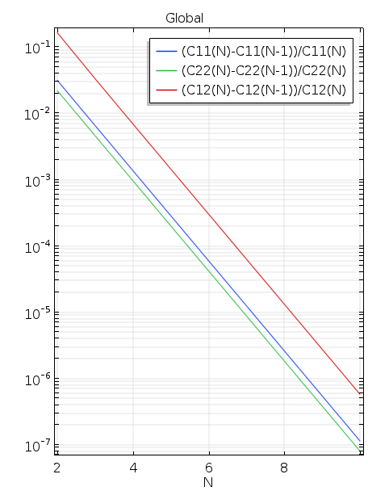
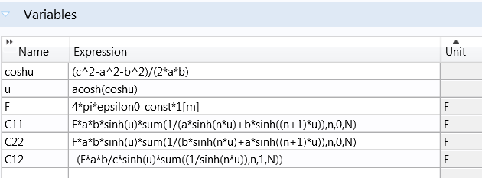
Analytical solution in COMSOL
A parametric sweep over N shows that the series converge rapidly and N=10 is a very reasonable choice for the parameter set a,b, and c chosen in the model.

Slide 5
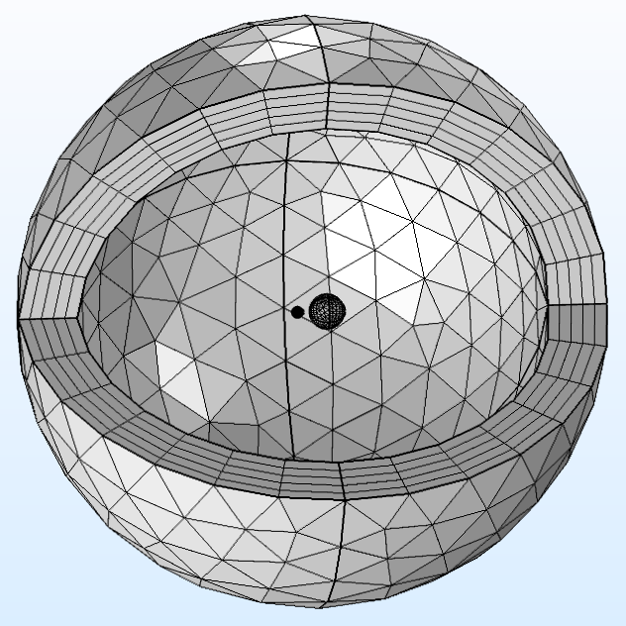
Numerical Settings and Mesh
Outer BNDs set to Ground
Each sphere is set on a terminal with V=1
There are two options to realize a study:
  Use a Parametric Sweep for PortName, the Maxwell Capacitance Matrix will be calculated first.
  Use a Stationary Source Sweep (or Frequency Domain Source Sweep), the inverse Maxwell capacitance matrix will be calculated first.
For both options, the Maxwell- and Mutual Capacitance matrices can be extracted by Data Series Operations.

Slide 6
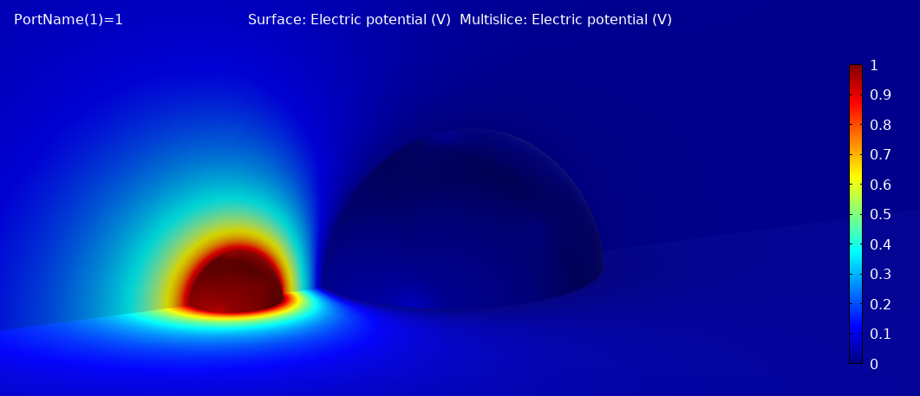
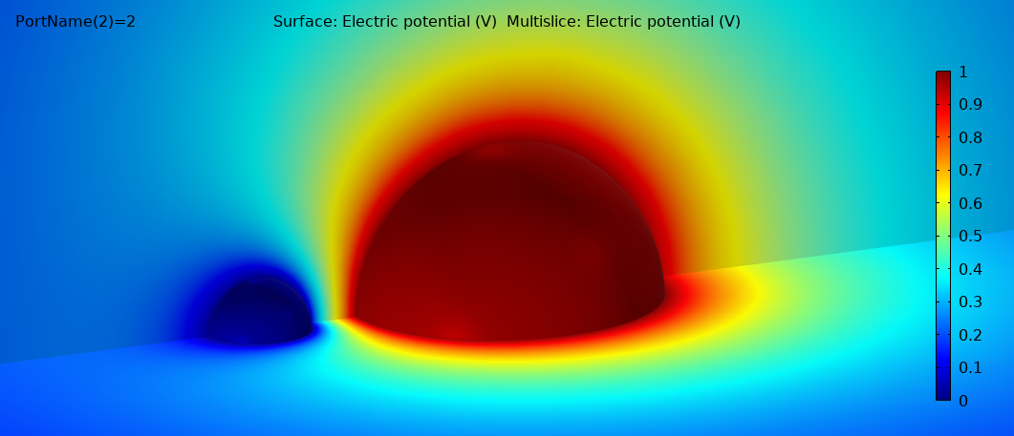
Results Parametric Sweep
In the Parametric Sweep study the chosen terminal to 1 V and all others to GND
One additional conductor or a shell at infinity must additionally be set to GND.

Slide 7
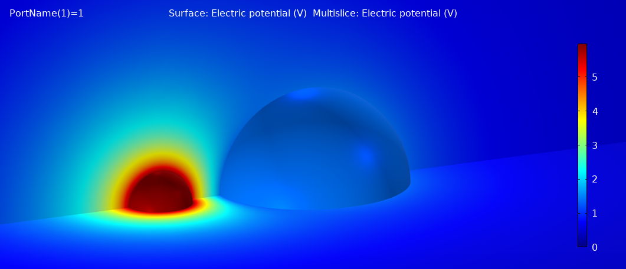
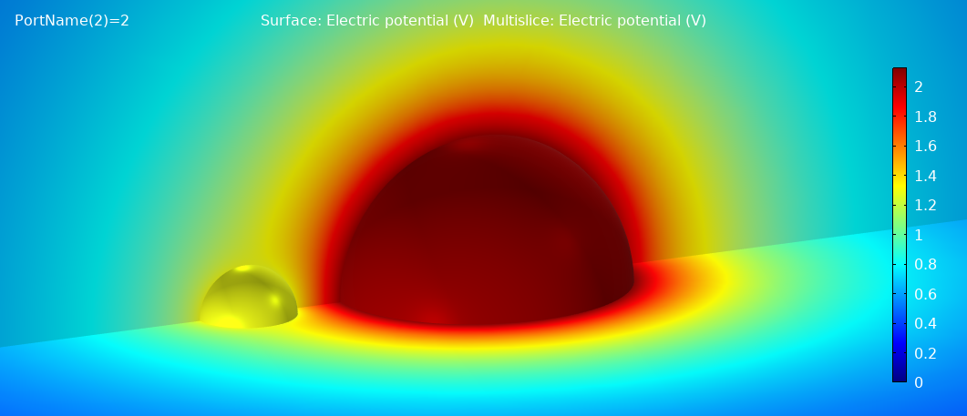
Results Source Sweep
In the Source Sweep study the chosen terminal is set to 1 C. Hence the voltage on the terminal will not be 1 V and GND.
Only the additional conductor or a shell at infinity will remain at GND.

Slide 8
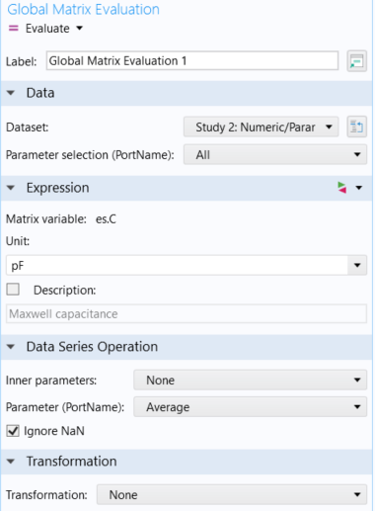

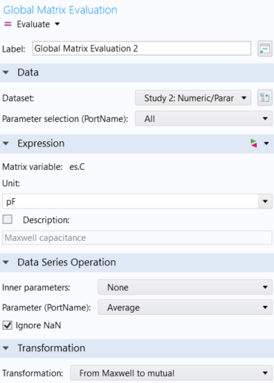

Matrix Extraction for Parameter Sweep
Maxwell Capacitance
Mutual Capacitance

Slide 9
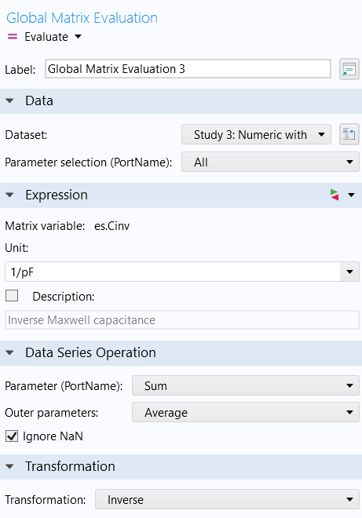

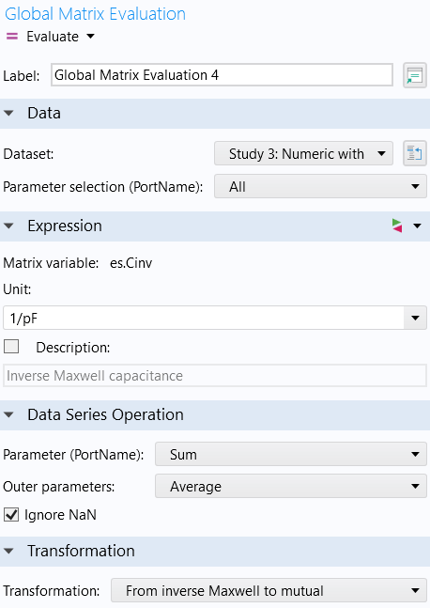

Matrix Extraction for Source Sweep
Maxwell Capacitance
Mutual Capacitance

Slide 10
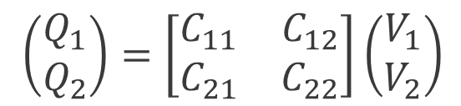



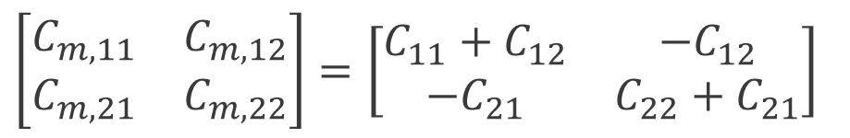
Results
Maxwell capacitance matrix:
Mutual capacitance matrix:
$\left(\begin{matrix}Q_{1} \\ Q_{2}\end{matrix}\right)=\left[\begin{matrix}C_{11} & C_{12} \\ C_{21} & C_{22}\end{matrix}\right]\left(\begin{matrix}V_{1} \\ V_{2}\end{matrix}\right)$
$$\left[\begin{matrix}C_{m,11} & C_{m,12} \\ C_{m,21} & C_{m,22}\end{matrix}\right]=\left[\begin{matrix}C_{11}+C_{12} & {−C}_{12} \\ {−C}_{21} & C_{22}+C_{21}\end{matrix}\right]$$
$$C_{m,12}$$
$$C_{m,11}$$
$$C_{m,22}$$

Slide 11
References
De Queiroz, A. C. M., 2003, Capacitance Calculations, Link
Lekner, J. (2011), Capacitance coefficients of two spheres, Journal of Electrostatics 69, 11-14. Link

