Slide 1
Optimization of a Catalytic Microreactor in 3D

Slide 2
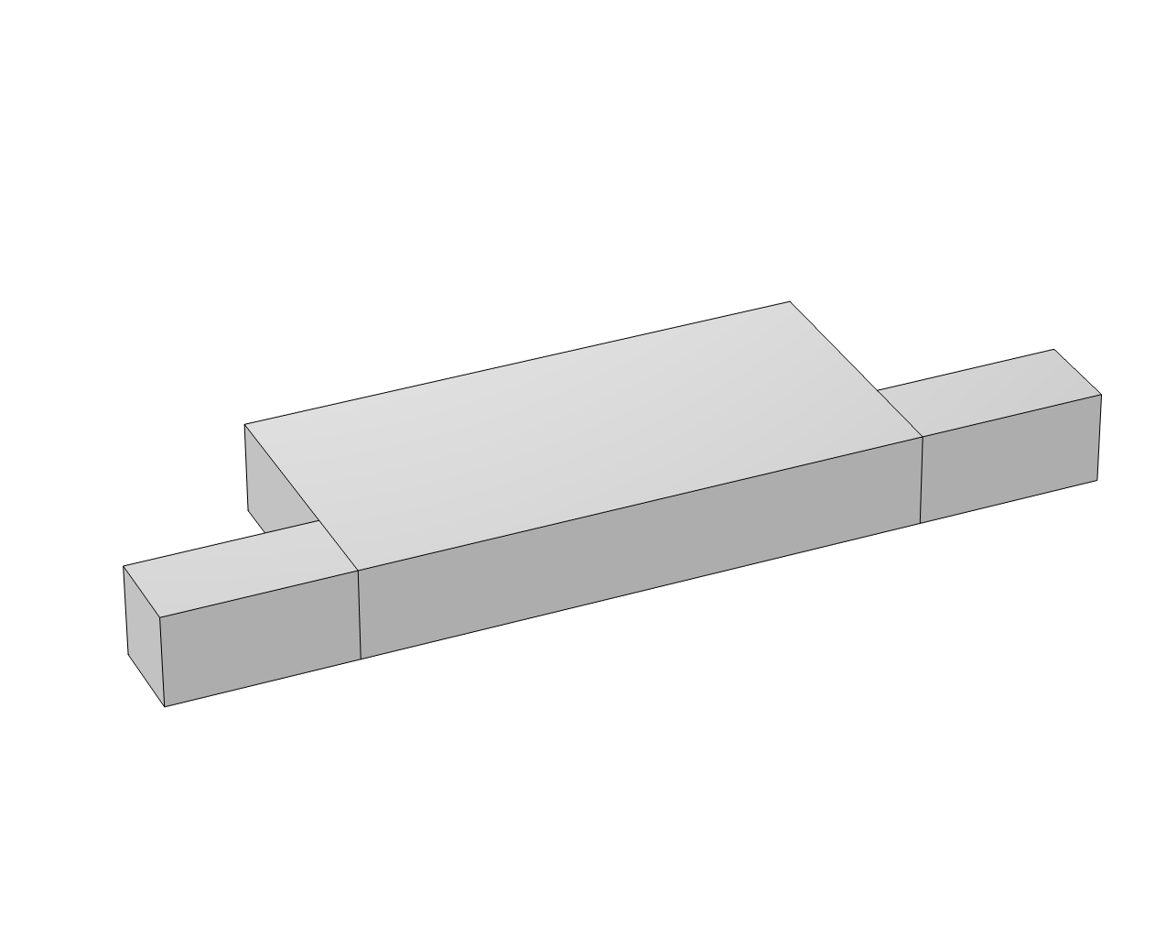
Setup
Reactants pumped through a catalytic fixed bed reactor
  Based on the geometry of Okkels and Bruus*
For a given total pressure loss, find the optimal catalyst distribution that maximizes the reaction rate
Reactor
Outlet
Inlet
Symmetry area
*F. Okkels and H. Bruus, “Scaling Behavior of Optimally Structured Catalytic Microfluidic Reactors,” Phys. Rev. E, vol. 75, pp. 016301 1–4, 2007.
Notes:
The optimal catalyst distribution should maximize the average reaction rate, which is
expressed as the integral of the local reaction rate, r (SI unit: mol/(m3·s)), over the
domain, Ω. Assuming a first-order catalytic reaction with respect to the reactant species, the local
reaction rate is determined by –ra = kaCa(1-theta), theta is the control variable for the optimization. when theta = 1 then there is no catalyst, and the reaction rate is zero.

Slide 3










Model Definition
Topology optimization using a Density model with Darcy interpolation:
Control material volume factor:
$$0≤θ≤1$$
Initial value:
$θ_{0}=1$ (empty reactor, no catalyst)
Penalized material volume factor:
$$θ_{p}=q\frac{1−θ}{q+θ}$$
$$p=∆p$$
$$p=0$$
$$c_{a}=1mol/m^{3}$$
Fluid flow
Reaction rate
Species transport
Optimization
Pressure driven flow described by Navier-Stokes with volume force
First order, dependent on catalyst amount
Transport of diluted species with reaction source
Gradient-based solver is used to maximize the average reaction rate
$$F=\frac{μ}{DaL^{2}}θ_{p}u$$
$${φ=r}_{a}=−k_{a}\left(1−θ\right)c_{a}$$
$$R=−φ$$
$$max\left\{\frac{1}{vol\left(Ω\right)}\int_{Ω}{RⅆΩ}\right\}$$
Notes:
The microreactor is pressure driven and the its purpose is to convert a reactant using a porous catalyst.
The question is how to distribute the catalyst so that reaction rate is at its maximum.
[1] The physics is governed by the Navier-Stokes equation and a convection-diffusion equation.
[2] Theta equal to zero corresponds to solid, while one corresponds to fluid. The no-slip boundary conditions is enforced via a damping term.
[3] This term is automatically defined as the penalized material volume factor for Density Model with Darcy penalization.
[4] In general topology optimization of multiphysics problems involves coming up with interpolation functions that give rise to designs with little or no gray scale. In this case it turns out that a simple linear interpolation works for the reaction rate.
[5] The optimal distribution consists of a small number of channels, and one can see [6] that this causes most of the catalyst to be reacted without the flow being blocked.

Slide 4
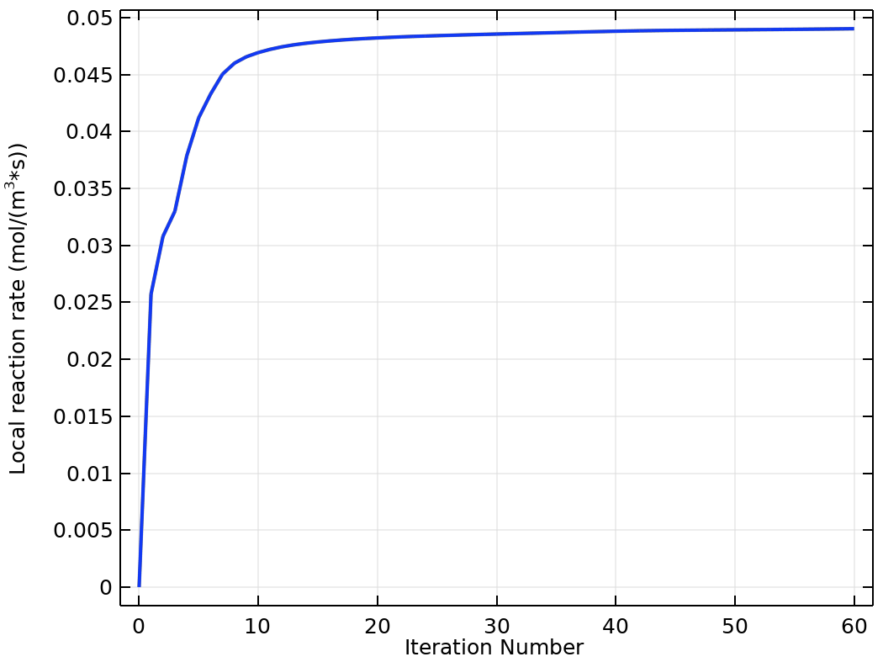
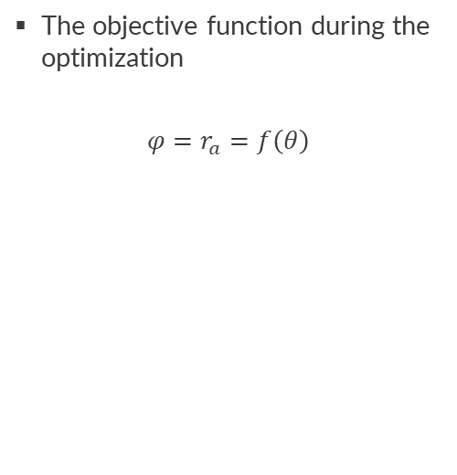
Results
The objective function during the optimization
$$φ=r_{a}=f\left(θ\right)$$

Slide 5
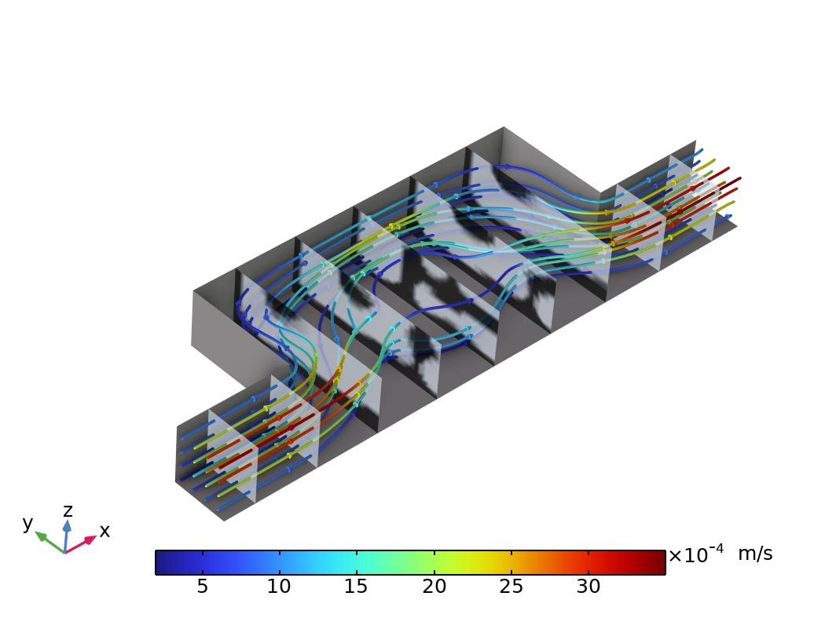
Results
Velocity magnitude illustrated with a slice plot.
The velocity decrease as a function of catalyst amount.

Slide 6
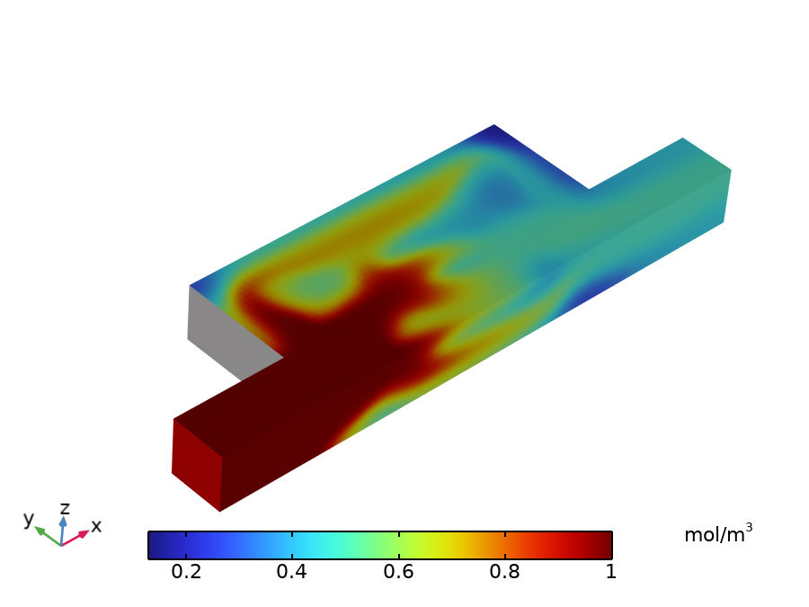
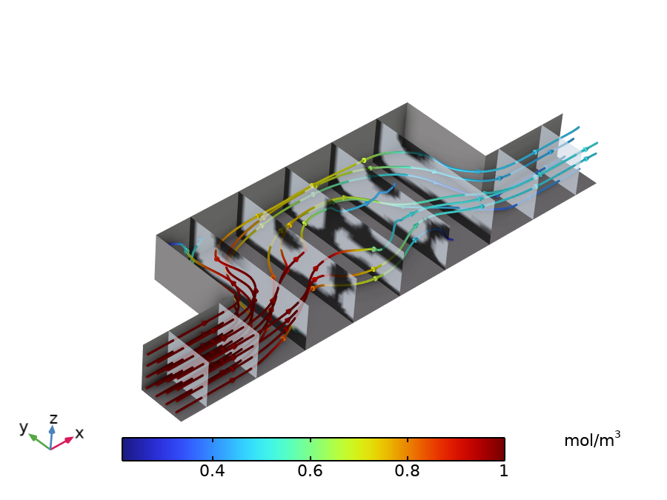
Concentration of reactant in the optimized reactor

Slide 7
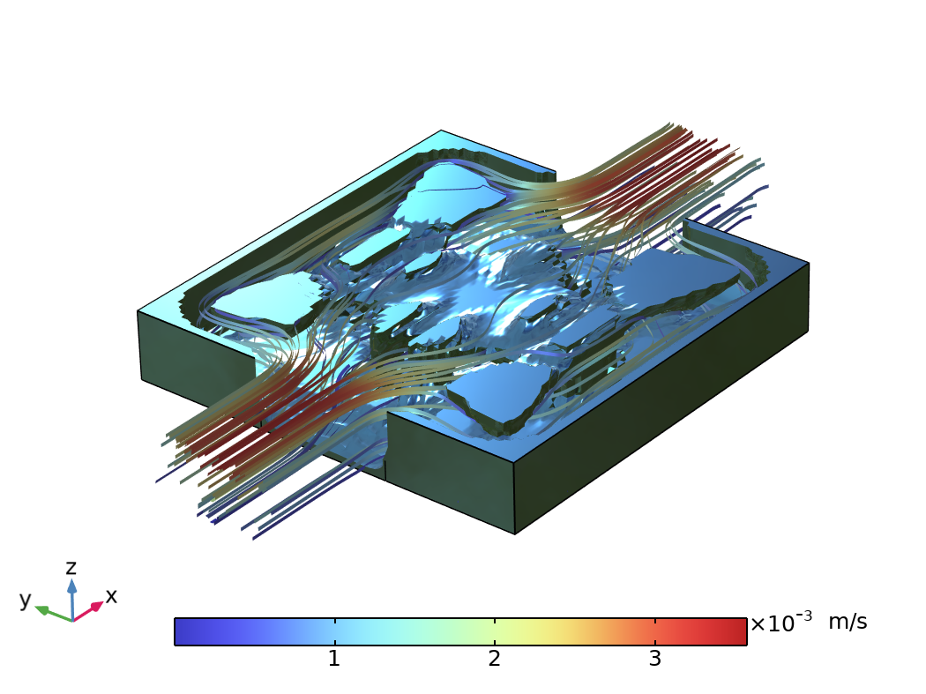
Concluding Remarks
Topology optimization with a Density Model and Darcy penalization was used to optimize the catalyst packing in a reactor.
An optimized packing with sharp transition between solid and void was achieved.
Most of the reactor volume is reached by the flow.
Possible extensions
  Use more complex reaction kinetics
  Optimize not only the packing, but the shape of the reactor too.

