Slide 1
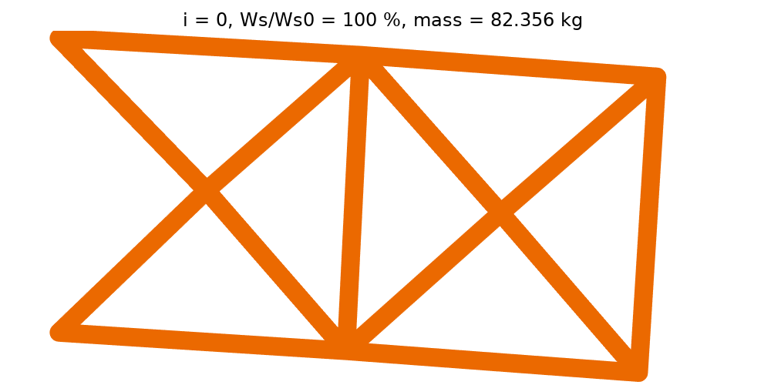
Ten-bar truss optimization

Slide 2
Setup
Control: Truss diameters
  Control Variable Field
Objective: Mass
  Mass Properties
Constraint: Stiffness
  Total elastic strain energy
Optimization Solver: MMA
  Shape Optimization study step

Slide 3
