Slide 1
Maximizing the Eigenfrequency of a Shell

Slide 2
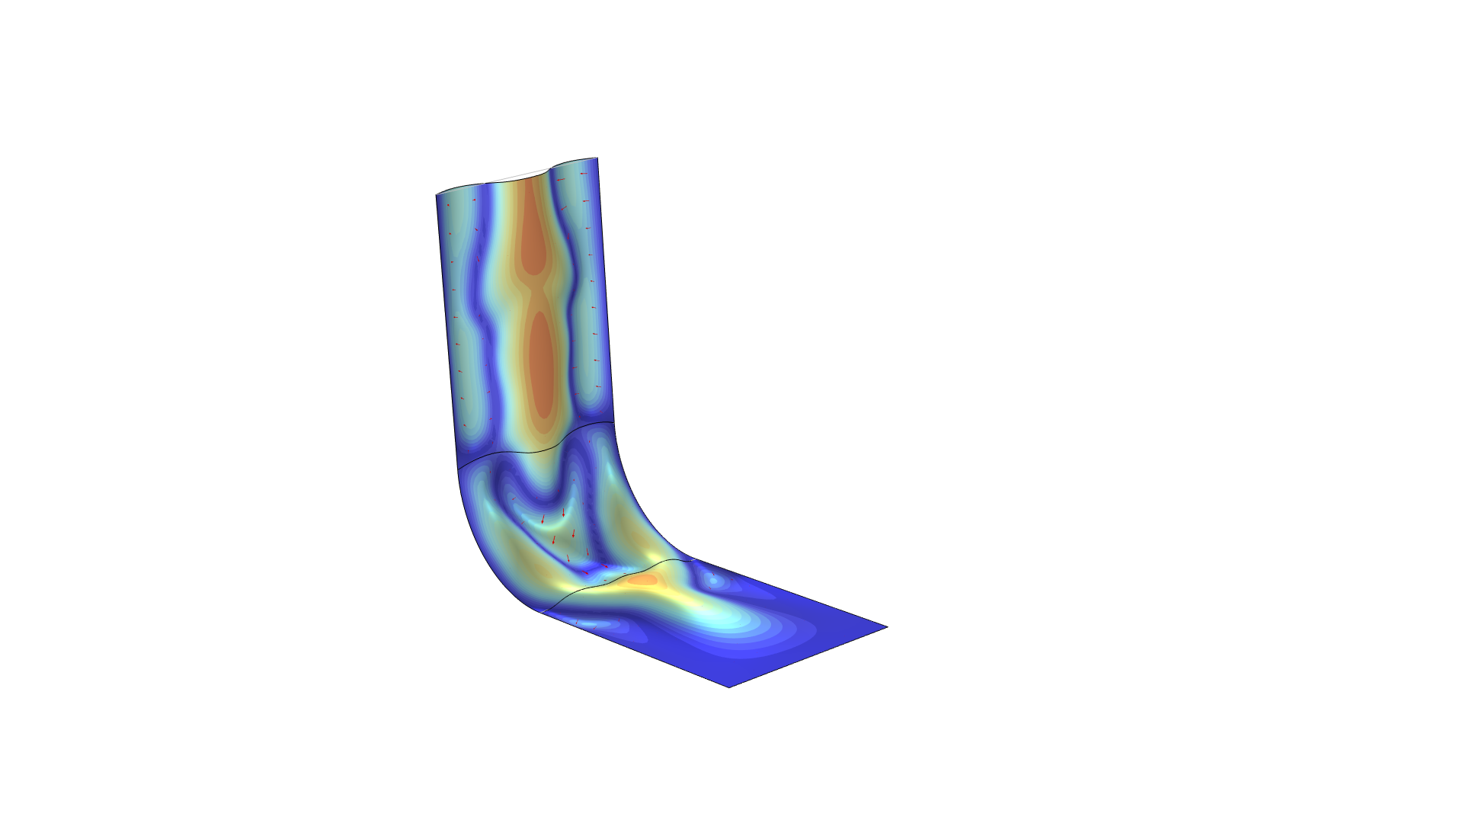
Maximizing the Eigenfrequency of a Shell
Introduction
Gradient based optimization of eigenvalues is supported for the Eigenvalue solver.
The eigenfrequencies of shells can be maximized with gradient based optimization using a combination of
1. Free Shape Shell feature
2. Stationary Then Eigenfrequency study step
The optimization increases the lowest eigenfrequency by more than a factor of 10.
Verification in a new component gives similar eigenfrequencies, but the optimization causes the first eigenfrequencies to become degenerate, so the eigenmodes might be different.
Maximizing the Eigenfrequency of a Shell

Slide 3
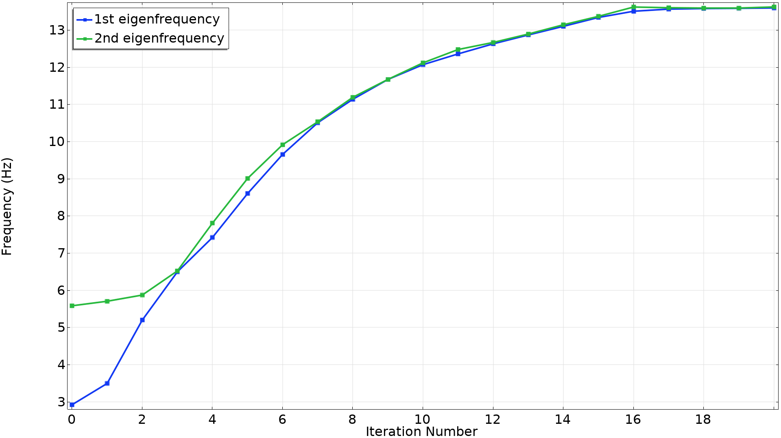
Optimization History
Maximizing the Eigenfrequency of a Shell

