Slide 1
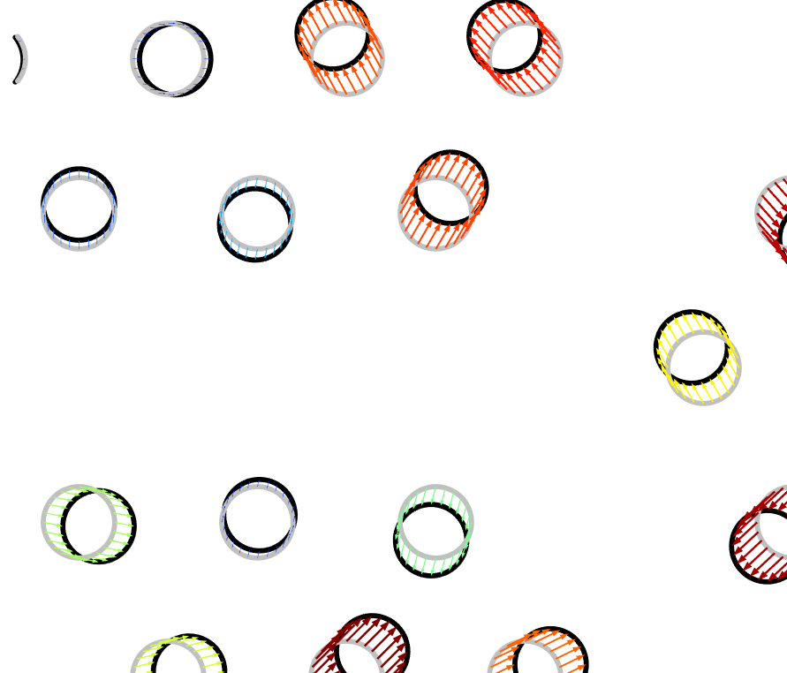
Optimization of a Photonic Crystal for Demultiplexing

Slide 2
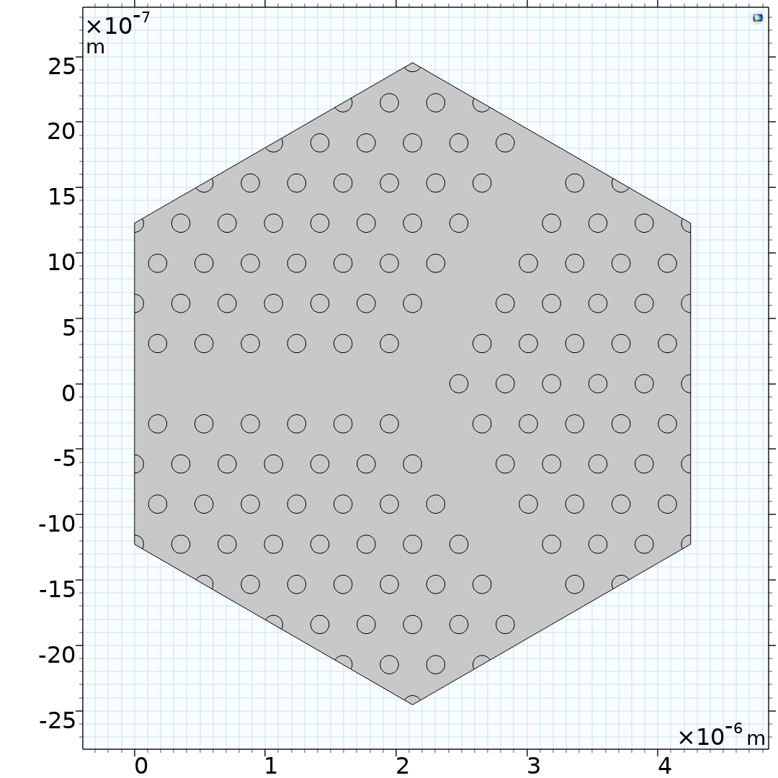
Optimization of a Photonic Crystal for Demultiplexing
Introduction
Electromagnetic waves can propagate in photonic crystals.
This model uses the Transformation feature to design a photonic demultiplexer.
Two frequency bands are considered, each approximated by three frequencies.
The port output power is measured at the output ports.
Optimization
The objective function is to maximize the ratio between the output powers.
The total output power has a lower bound.
Optimization of a Photonic Crystal for Demultiplexing

Slide 3
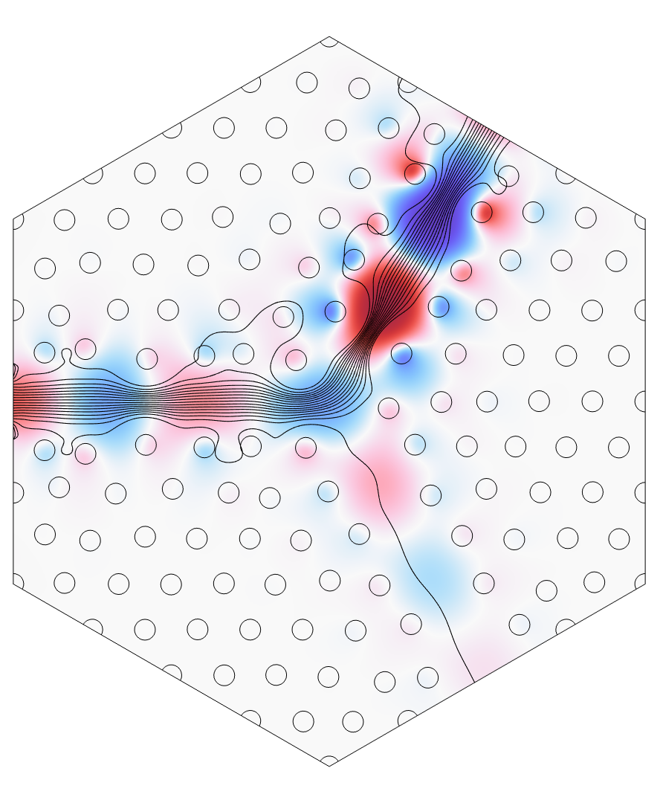
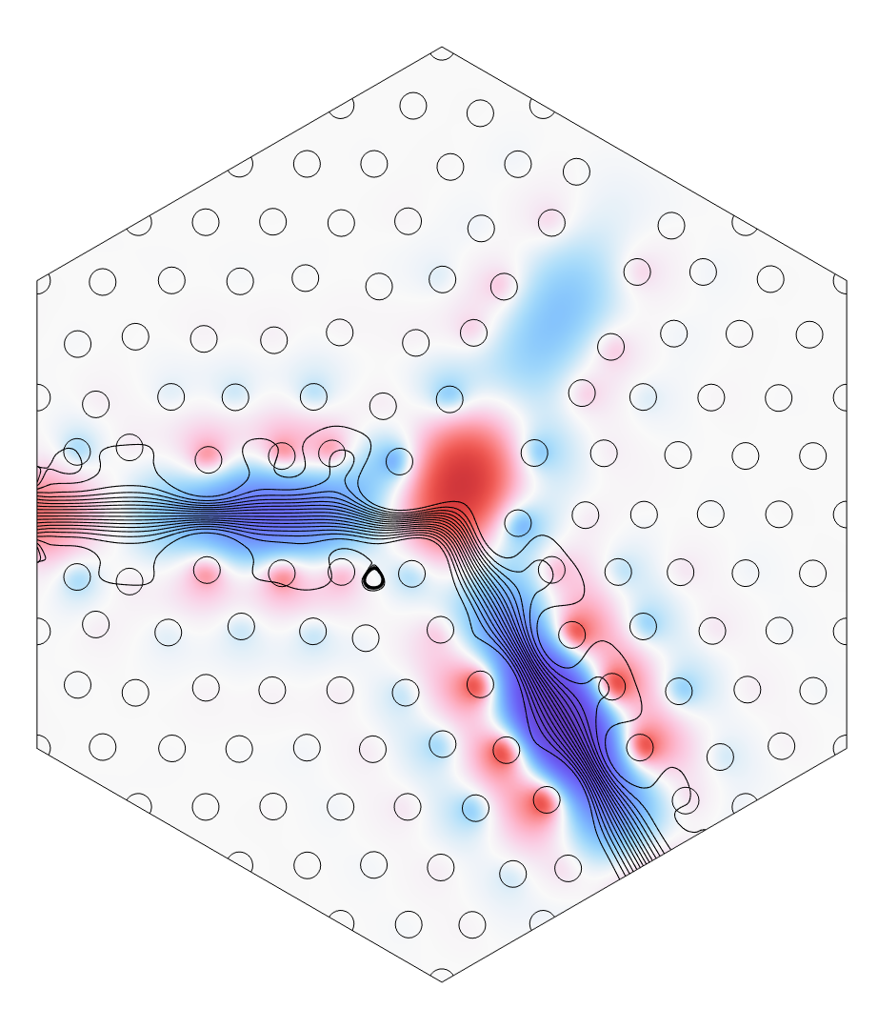
Optimization of a Photonic Crystal for Demultiplexing
λ = 1 µm
λ = 1.1 µm

Slide 4
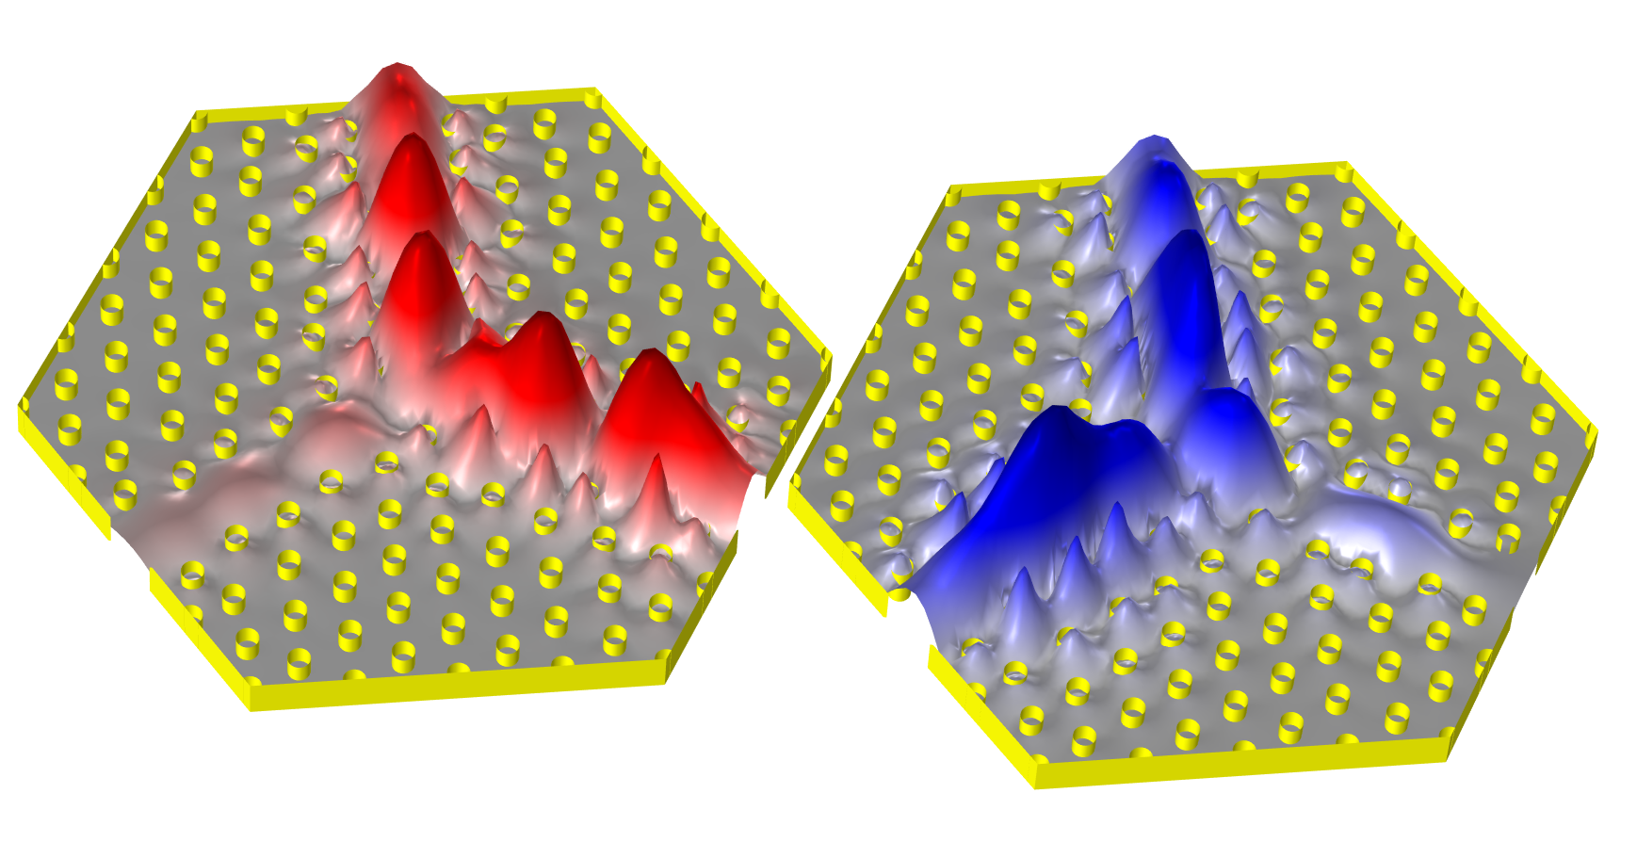
Optimization of a Photonic Crystal for Demultiplexing
λ = 1 µm
λ = 1.1 µm

Slide 5
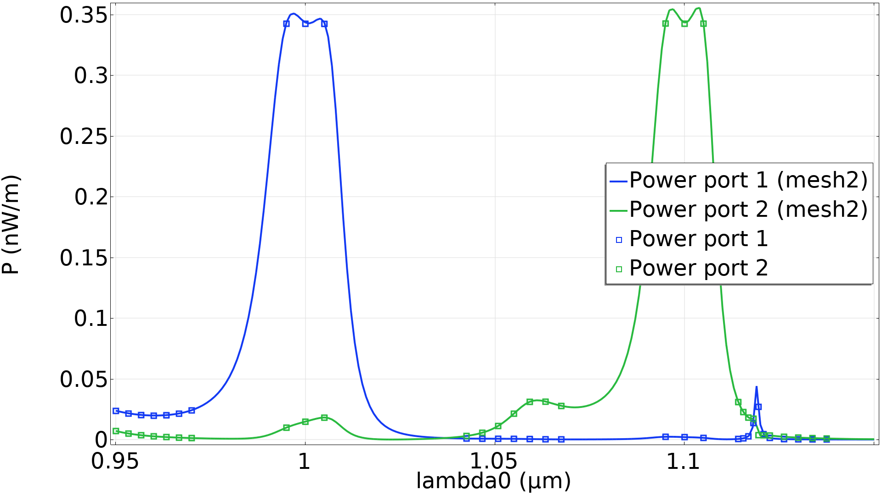
Optimization of a Photonic Crystal for Demultiplexing

Slide 6
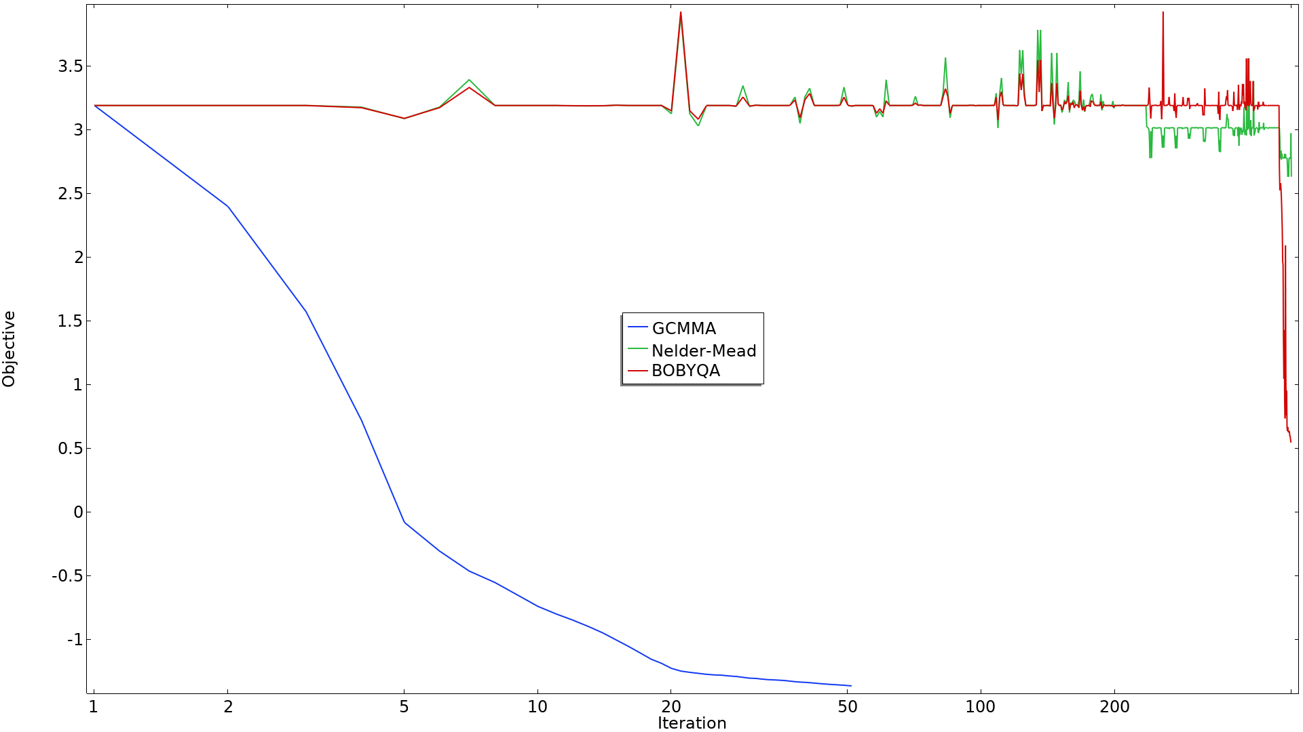
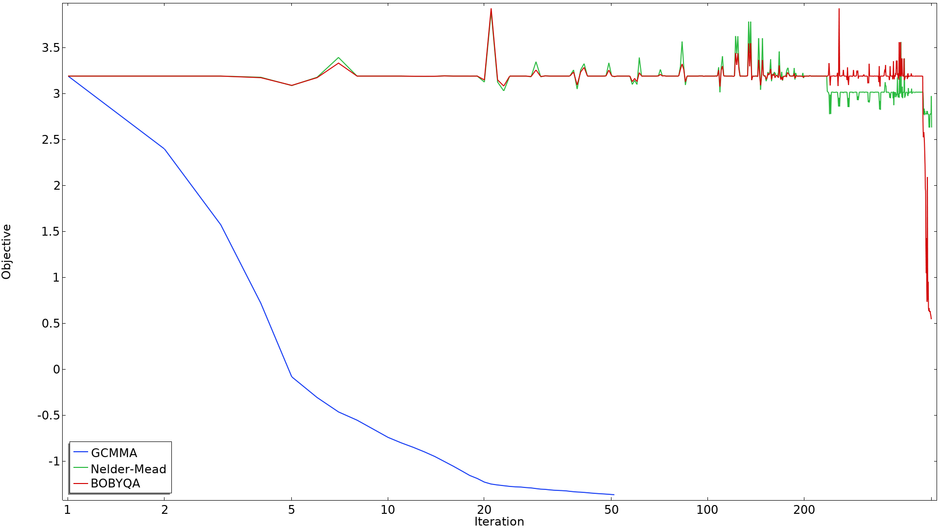
Gradient Based Optimization is Fast for 234 Controls

