Slide 1
Parameter Estimation for Pyrolysis of Wood
Lina Norberg Samuelsson
COMSOL AB

Slide 2
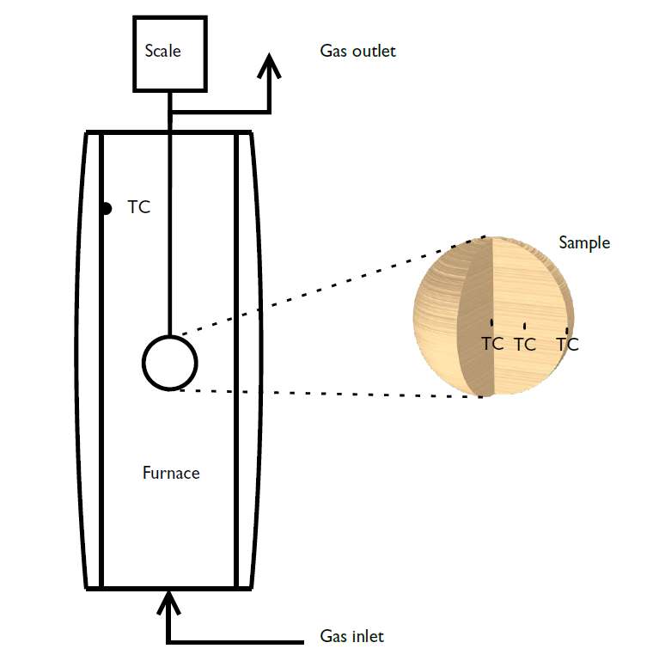
System Setup
A spherical wood sample is inserted into a hot furnace with an inert atmosphere. The sample mass and temperatures are recorded. The sample temperature is measured with thermocouples (TC) at three positions (surface, middle, and center).

Slide 3
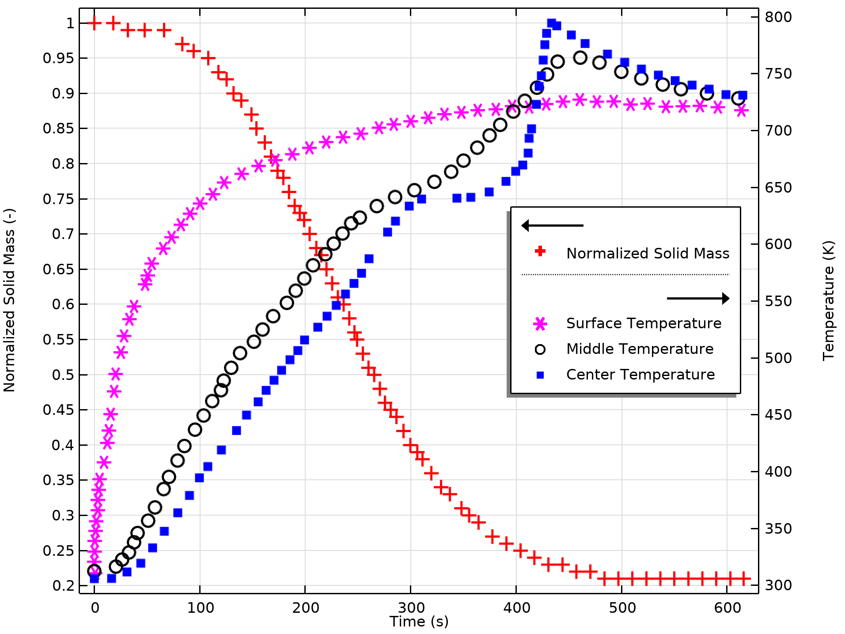
Overview
The model is inspired by the papers by J.C. Park et al (Ref. 1) and X. Shi et al (Ref. 2)
A 2D-axisymmetric geometry is used due to the anisotropic sample
Parameter estimation is used to optimize reaction heats, one arrhenius parameter, and the external heat transfer coefficient against experimental data
Experimental data (Ref. 1).

Slide 4
Model definition
gas
The reaction scheme includs the lumped species tar, gas, intermediate solid, and char
The Transport of Concentrated Species in Porous Media interface describes the mass transfer and fluid phase reactions in the sample
A Domain ODEs and DAEs interface is used to describe the solid phase reactions
The Darcy’s Law interface describes the fluid flow in the sample pores
Heat Transfer in Porpous Media describes heat transfer in the solid and in the fluid within the particle
Boundary conditions define T, p, mass flux and heat flux at the external surface
k_{g}
k_{g2}
k_{t}
k_{c2}
wood
tar
char
k_{is}
k_{c}
intermediate solid
Reaction scheme (Ref. 1).

Slide 5
Parameters to be estimated (control parameters)
gas
Arrhenius frequency factor A_{is} (1/s) for the reaction where wood converts into intermediate solid
Heat of reaction ΔH_{t} (J/kg) for the formation of tar from wood
Heat of reaction ΔH_{c} (J/kg) for the formation of char from intermediate solid
External heat transfer coefficient h_{conv}
ΔH_{t}
wood
tar
char
A_{is}
ΔH_{c}
intermediate solid

Slide 6
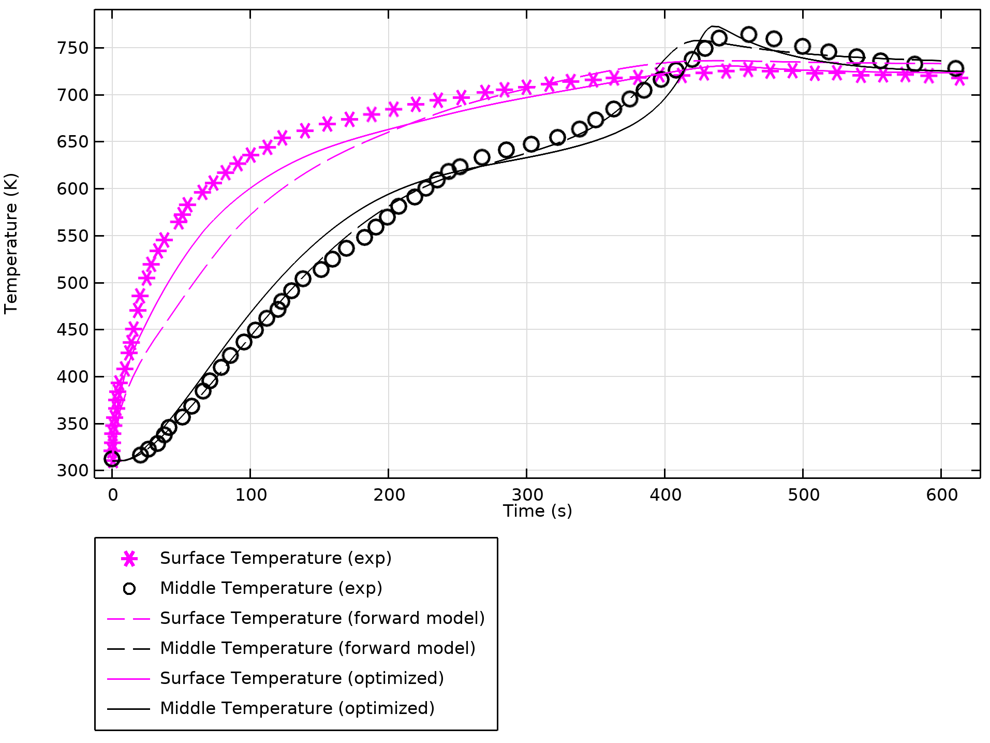
Results
Model prediction of the surface, and middle temperatures, comparing the results from the forward model (solved with initial values for the estimated parameters), and the optimized model.

Slide 7
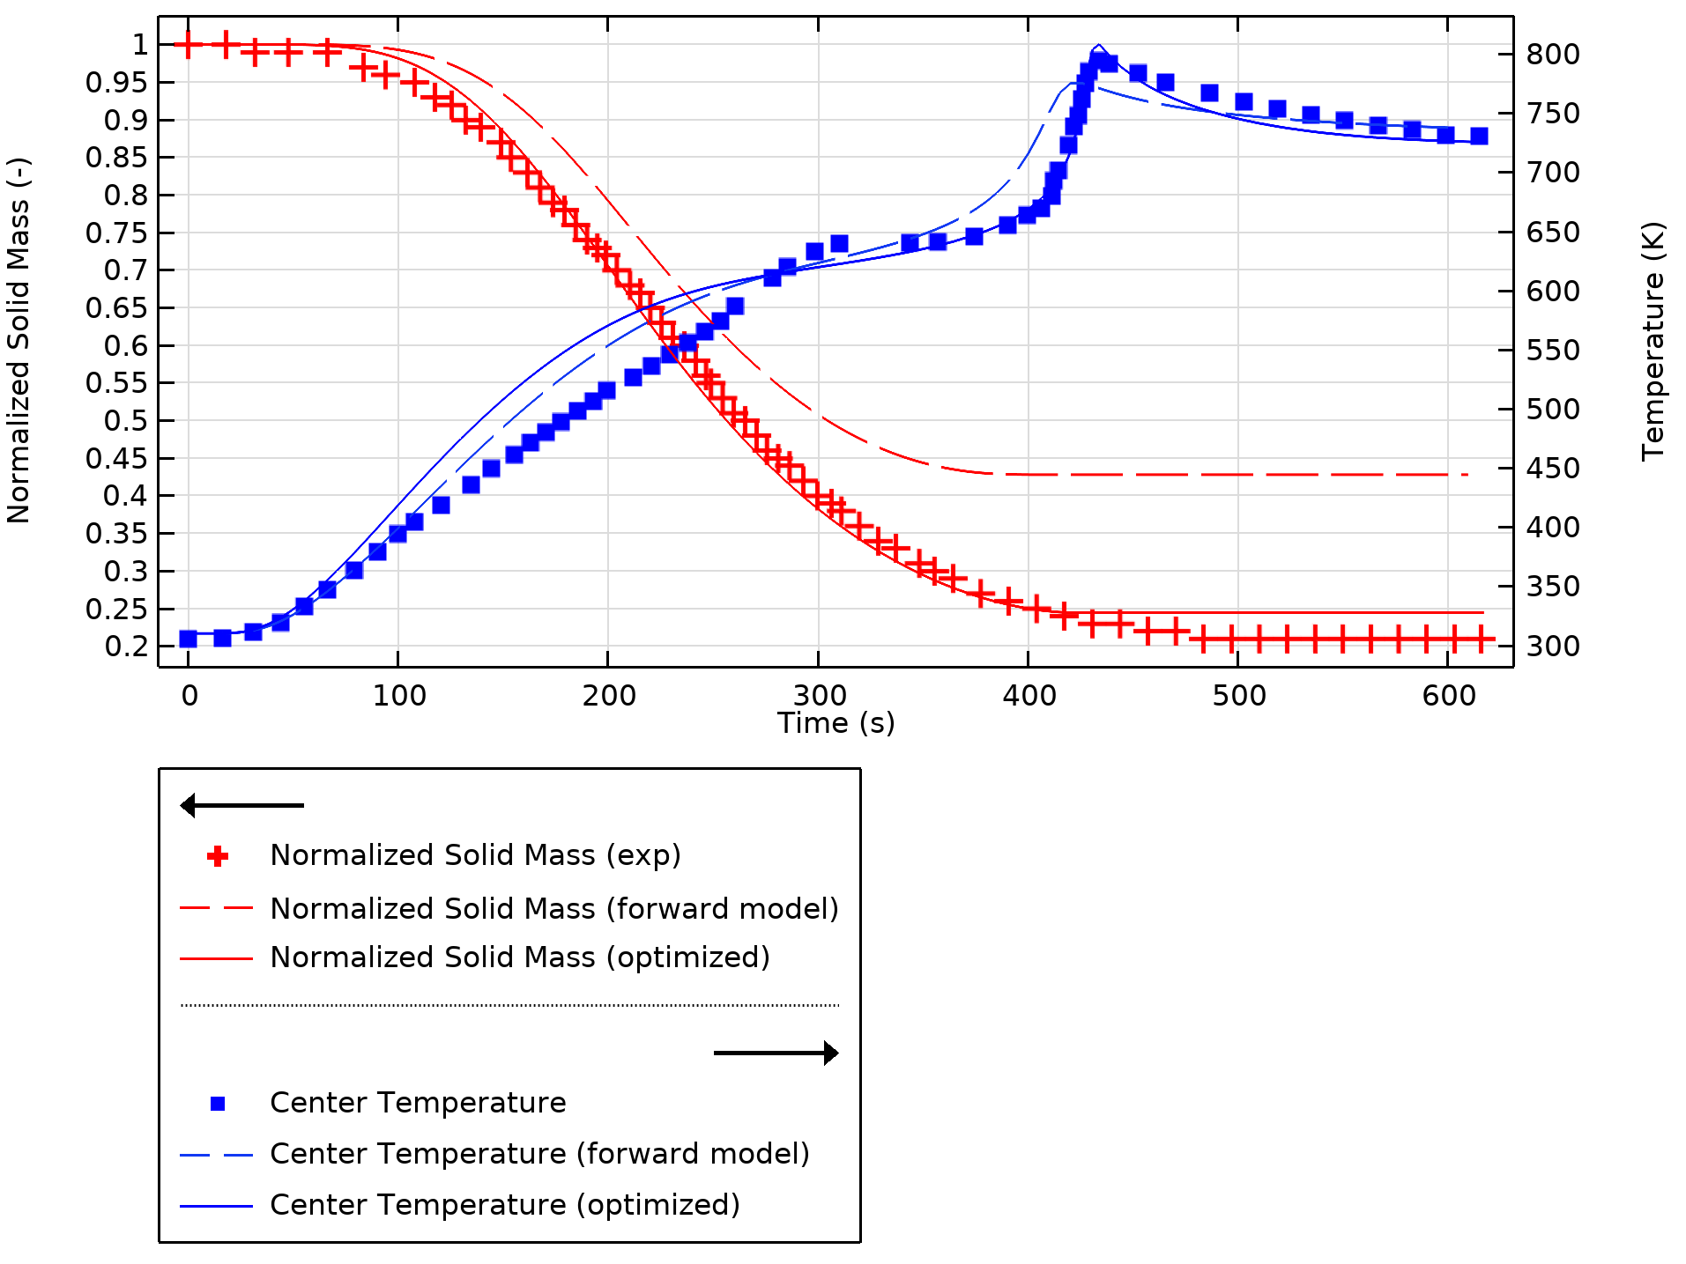
Results
Model prediction of the center temperature and the normalized solid mass, comparing the results from the forward model, and the optimized model.

Slide 8
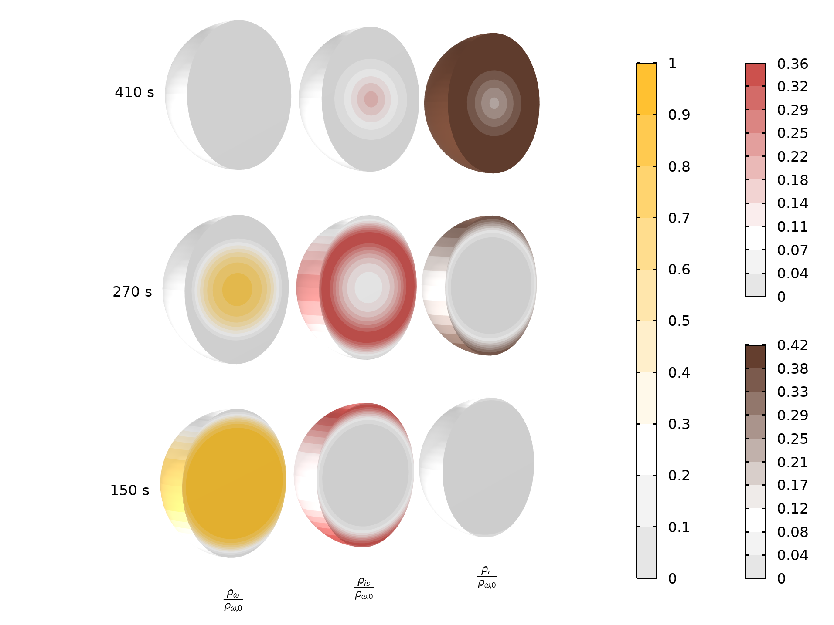
Solid composition over time
As the particle is heated up, the wood is converted into the solid species intermediate solid (is) and char (c), and gas and tar (not shown here).

Slide 9
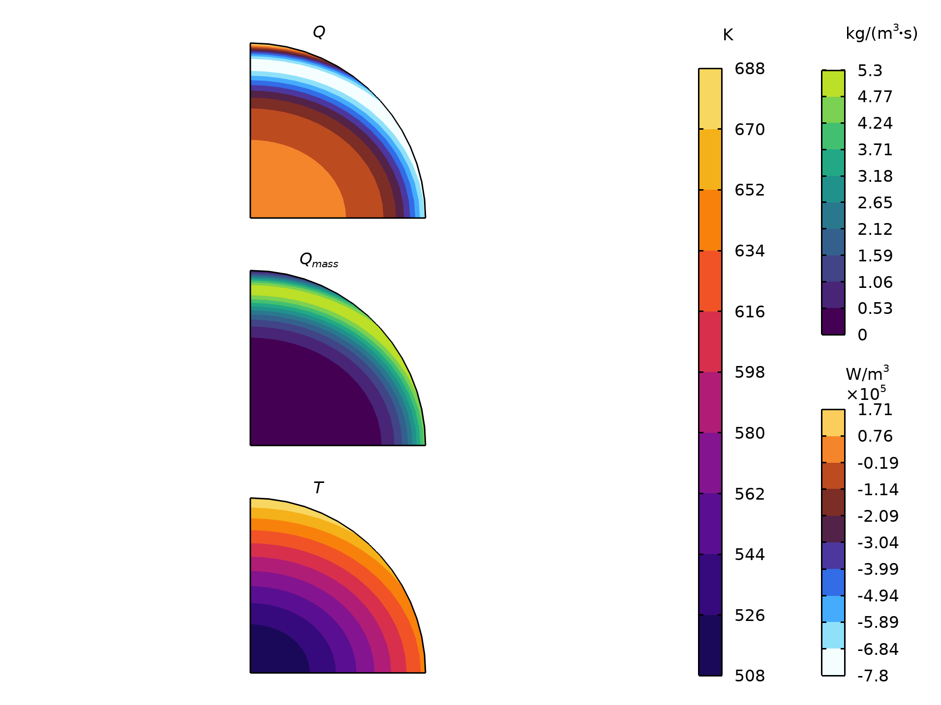
Temperature, mass and heat source at 150 s
Gas and tar formation, associated with a positive mass source, is accompanied by a negative heat source, since these reactions are endothermal.

Slide 10
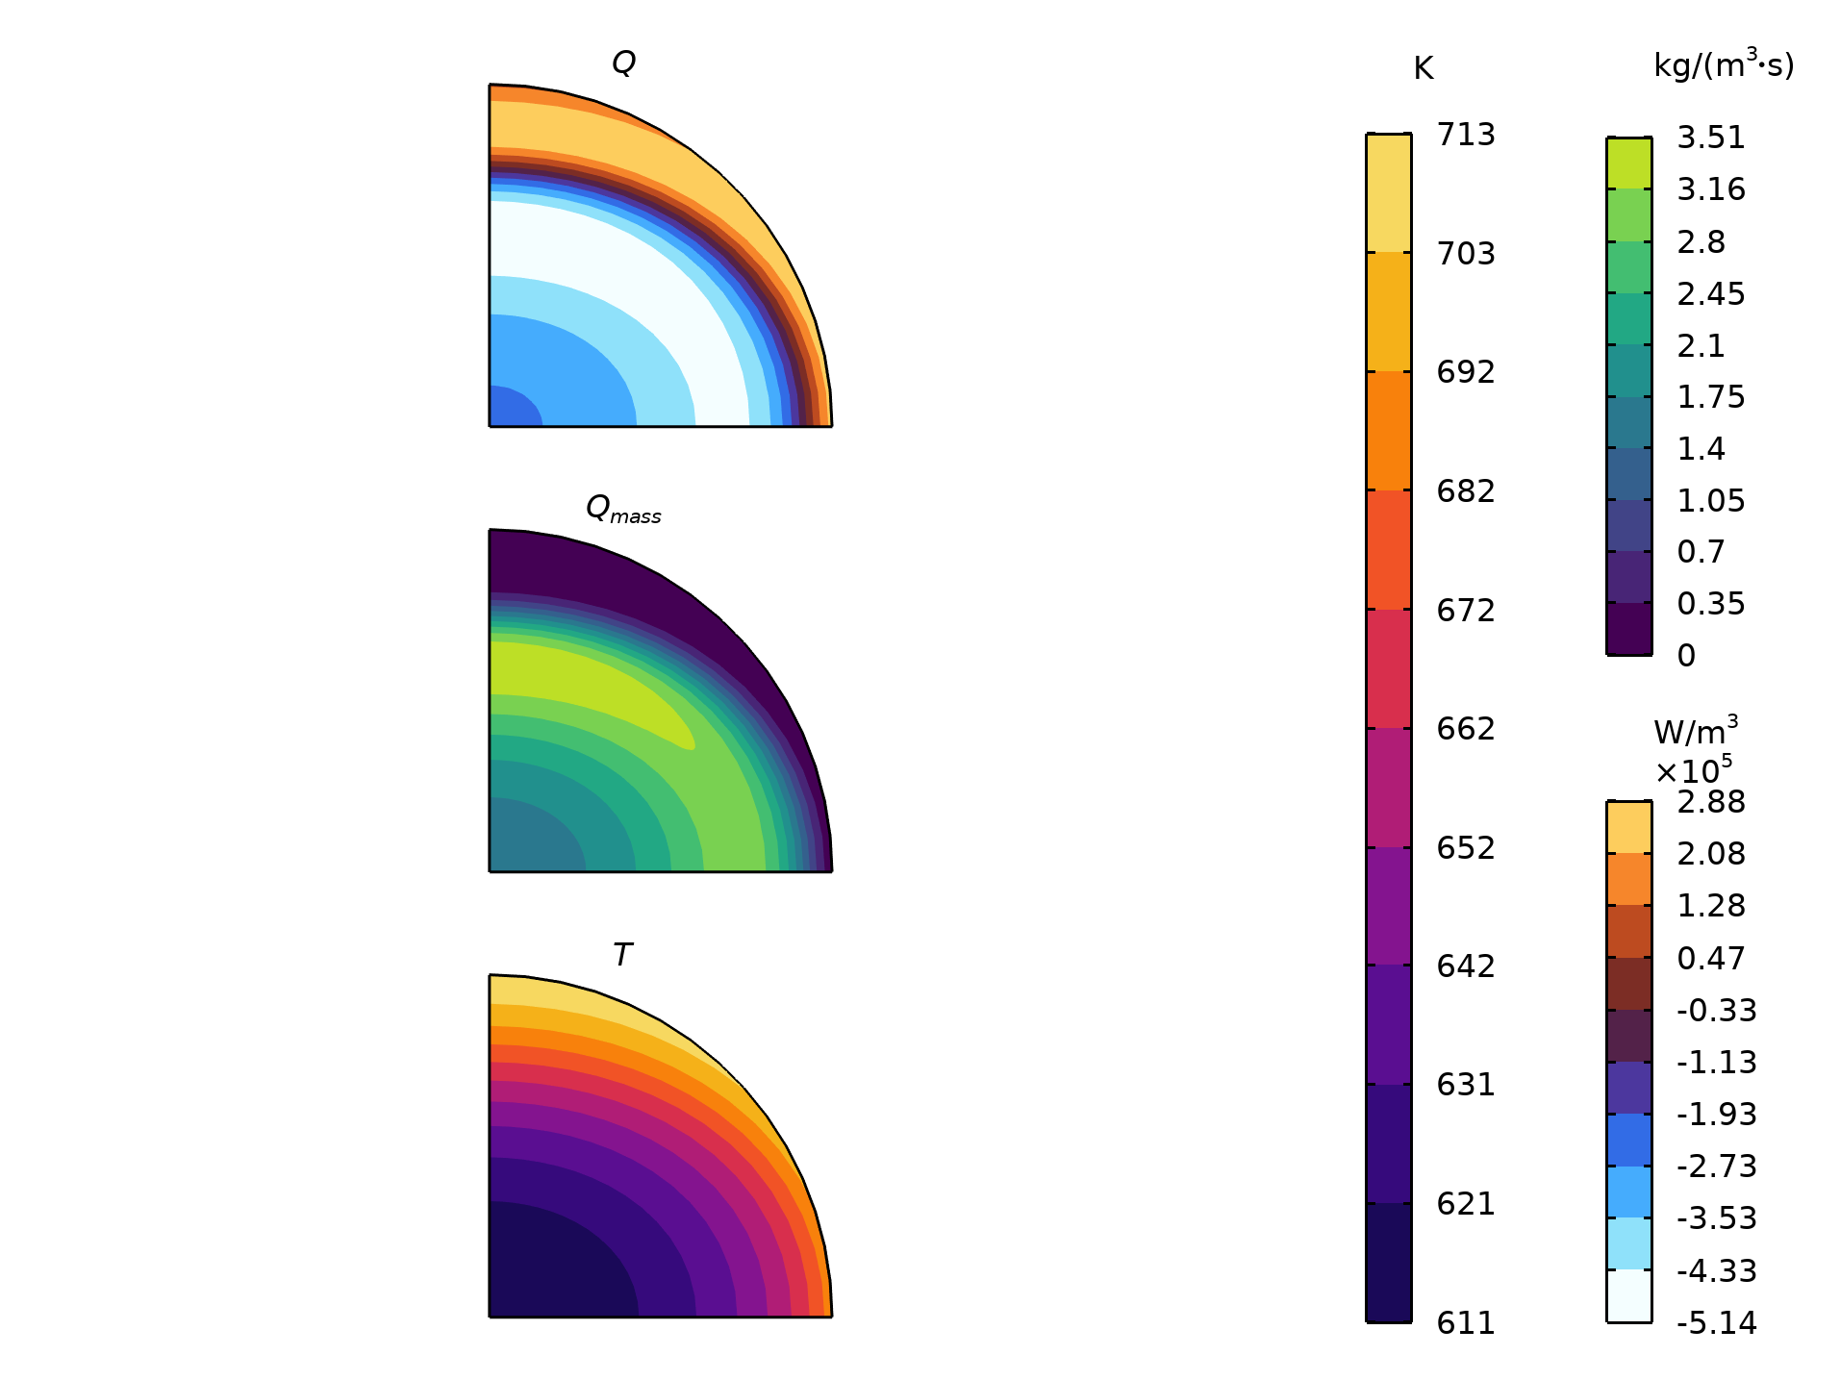
Temperature, mass and heat source at 270 s
Mid-process, the exothermal char forming reactions become present.

Slide 11
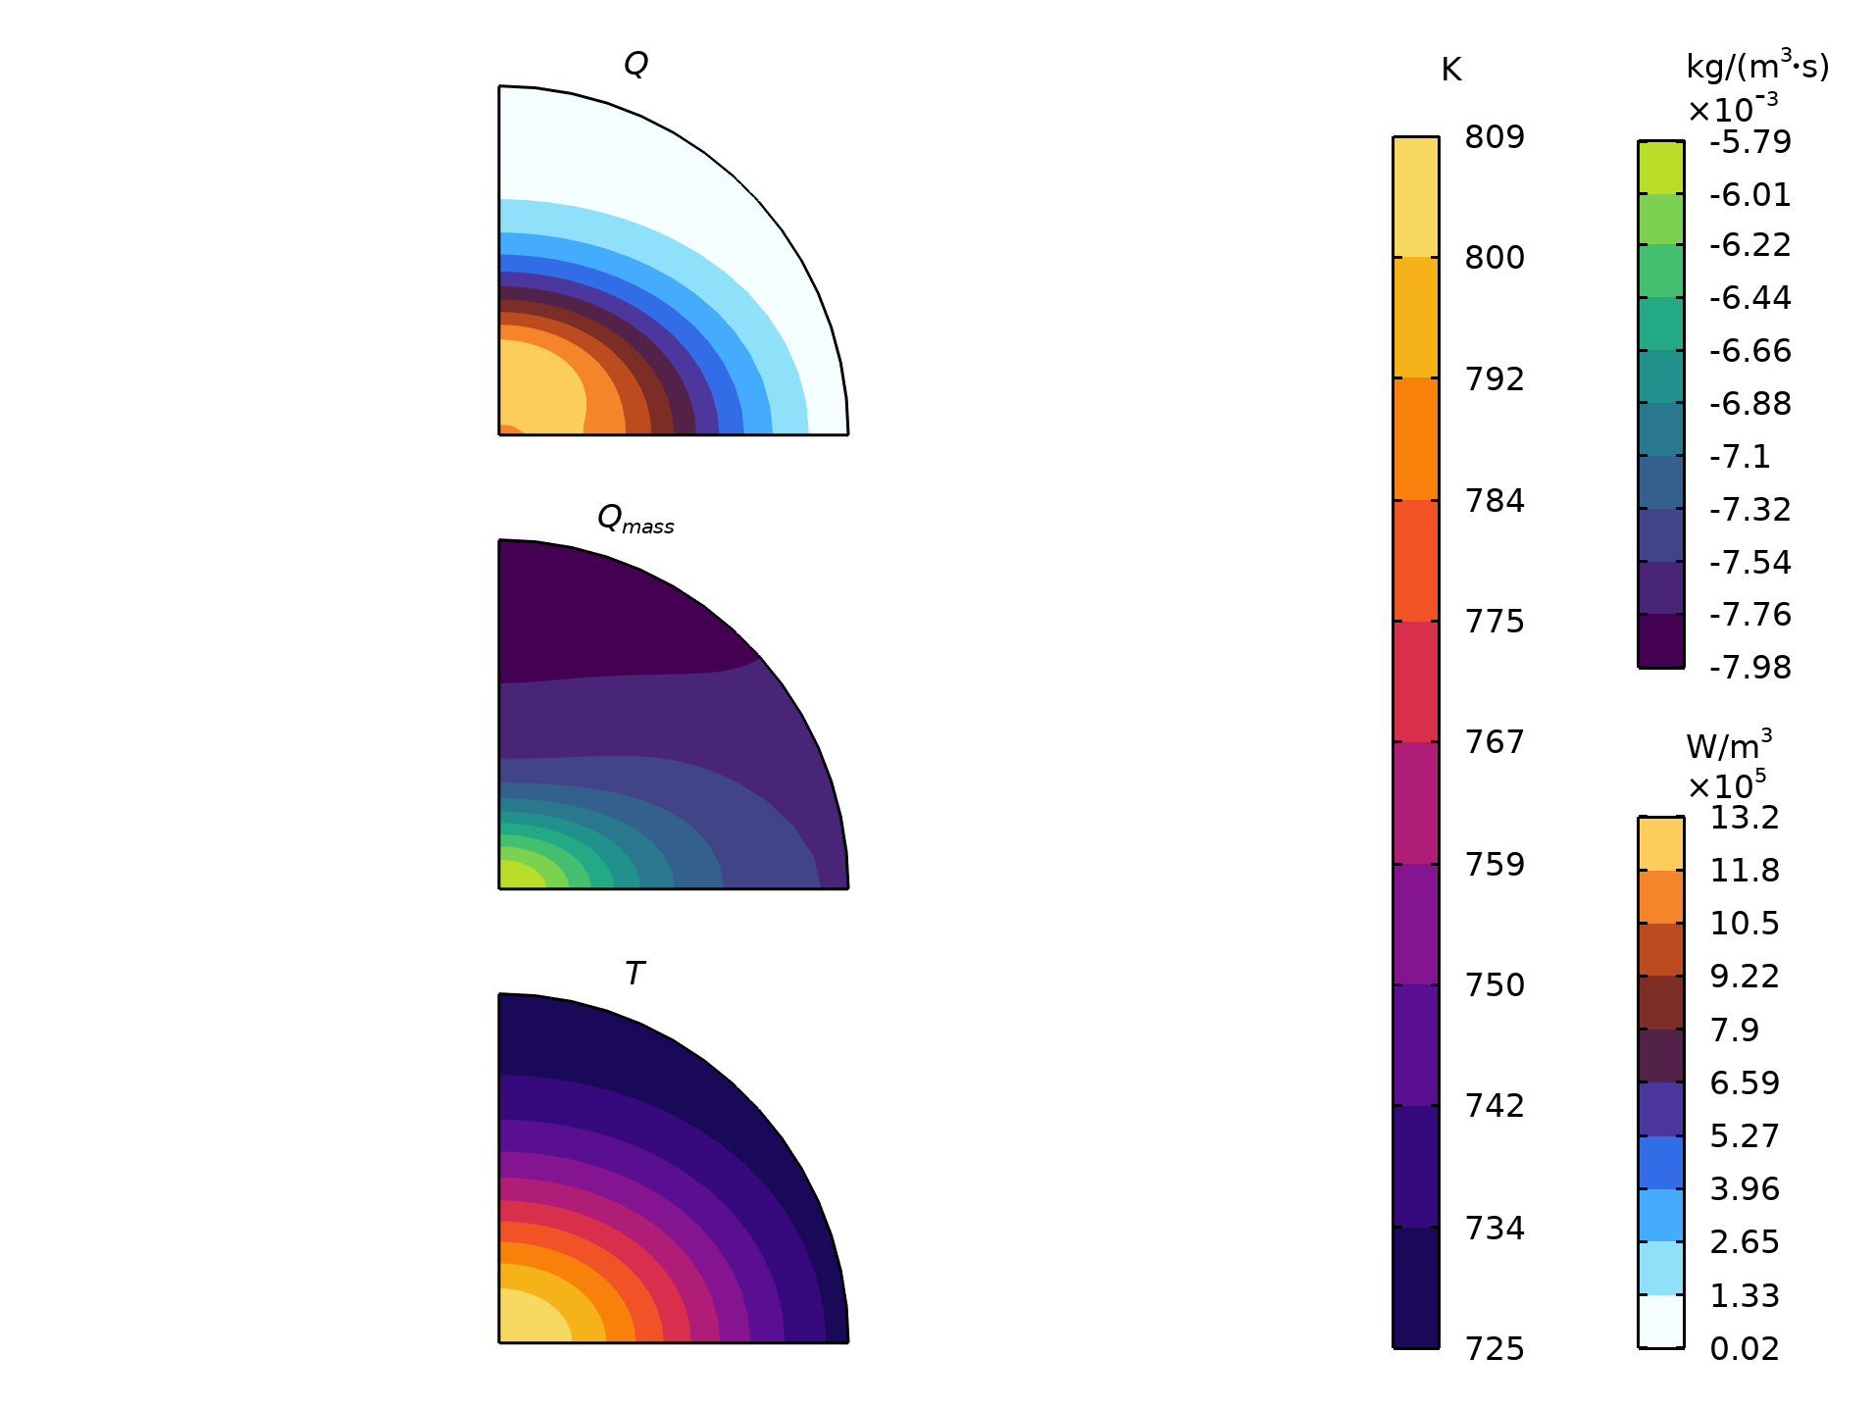
Temperature, mass and heat source at 433 s
Late in the process there are only char forming reactions, and the exothermal nature of these gives rise to a temperature peak at the center of the particle.

Slide 12
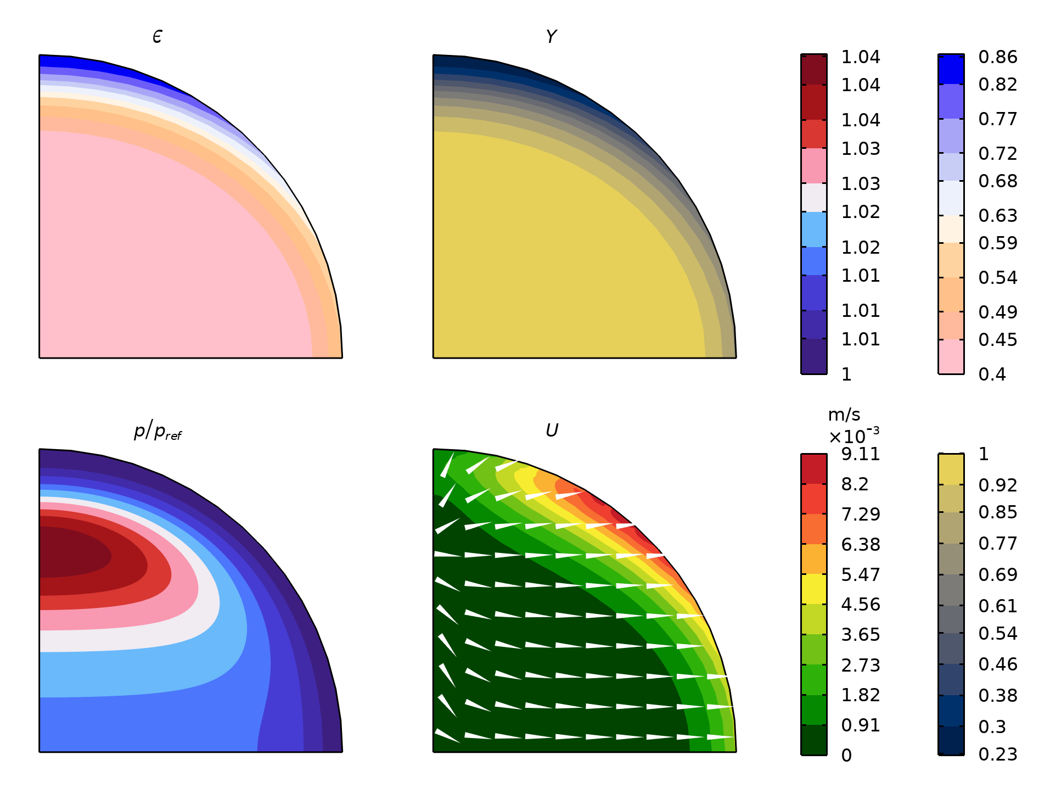
Relative pressure, velocity, porosity, and normalized solid mass
Mid-process, at 270 s, this is the internal status of the particle. The anisotropic permeability is clearly seen, as well as the results of the anisotropic heat conductivity of the solid.

Slide 13
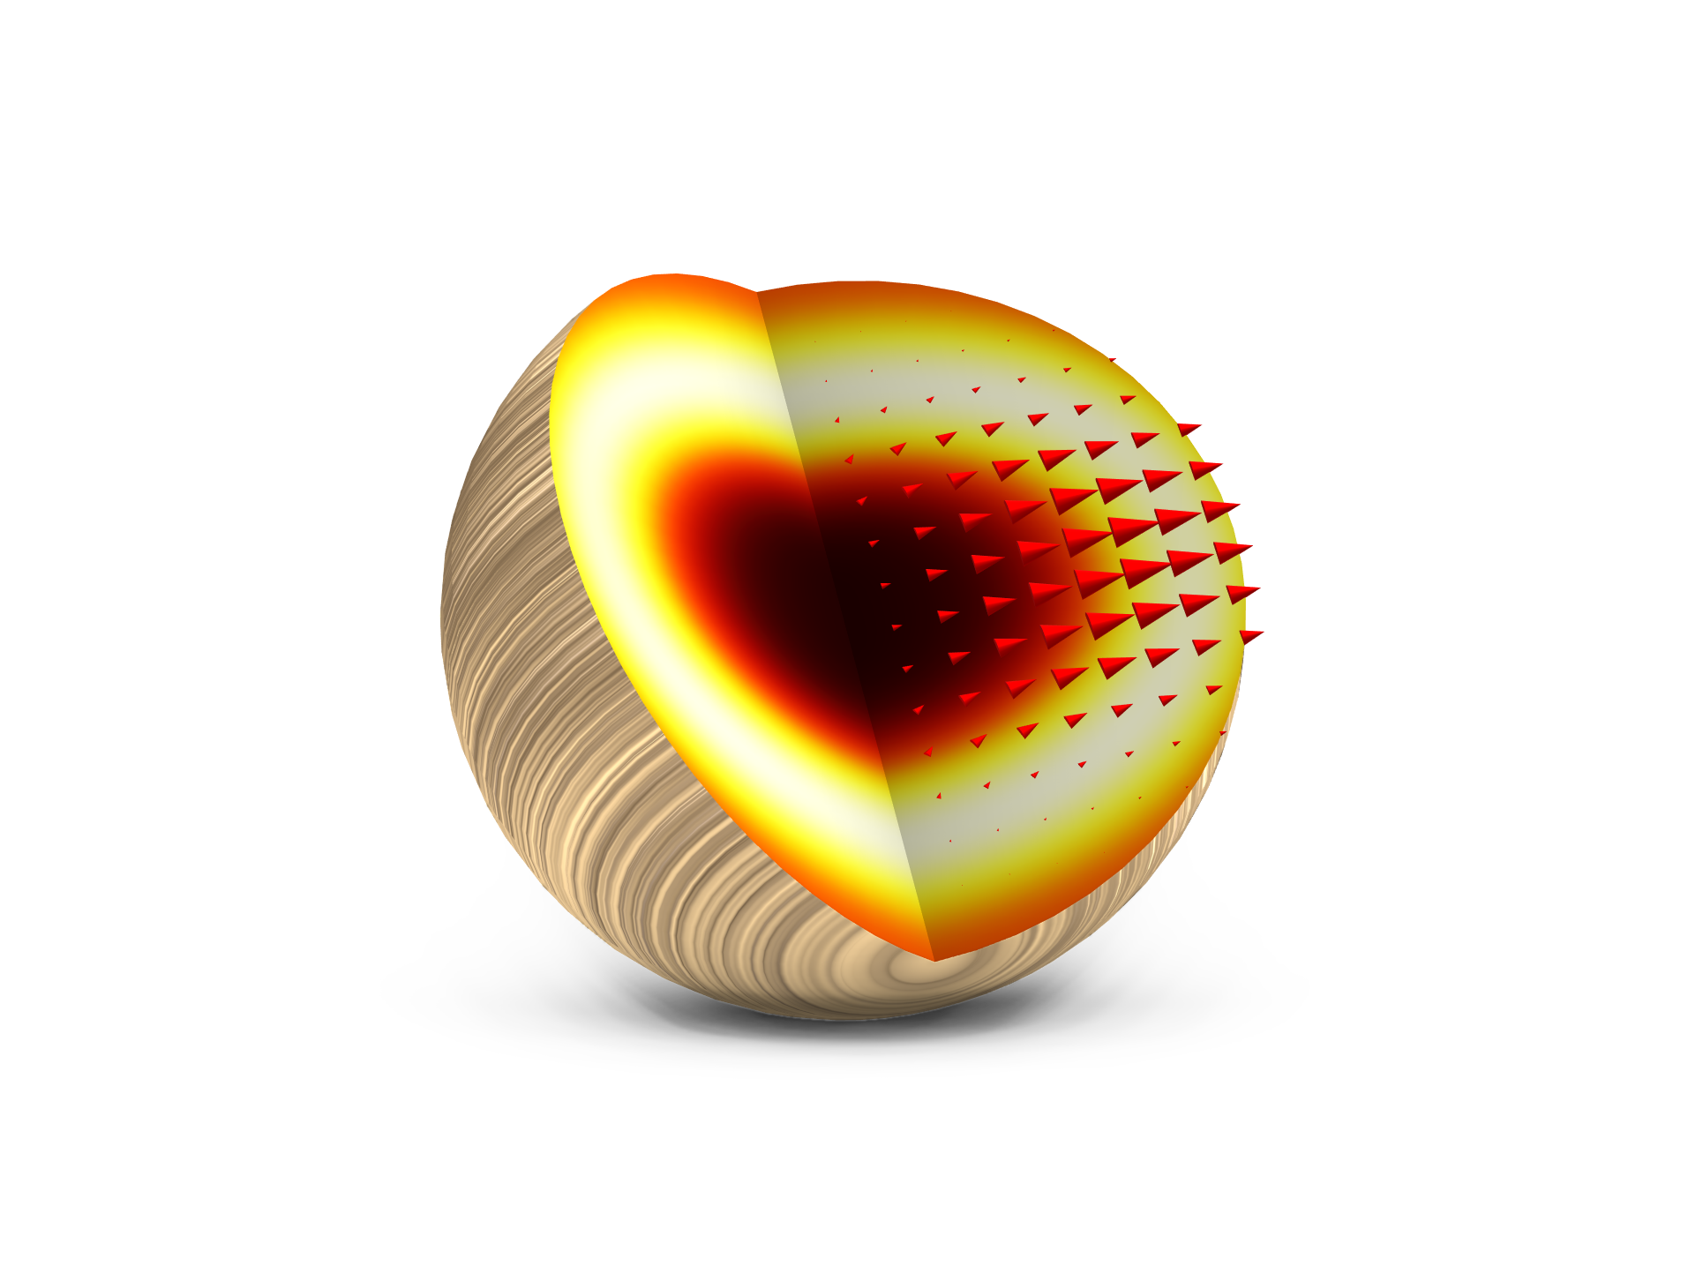
Concluding Remarks
The complex process of wood pyrolysis is well captured by this model
The effect of anisotropic material properties are visible in the results and could easily be investigated further
Parameter estimation was used to calibrate model parameters to experimental data
Possible extensions
  Include more experimental data to the parameter estimation study
  Investigate the effect of process conditions like heating rate and sample size on the product distribution
  Investigate the importance of material properties (wood types) on the product distribution
Total heat source and total mass flux in the particle.

Slide 14
References
W. C. Park, A. Atreya, and H. R. Baum, “Experimental and theoretical investigation of heat and mass transfer processes during wood pyrolysis” Combustion and Flame, vol. 157, pp. 481–494, 2010.
X. Shi, F. Ronsse, and J. G. Pieters, “Finite element modeling of intraparticle heterogeneous tar conversion during pyrolysis of woody biomass particles” Fuel Processing Technology, vol. 148, pp. 302-316, 2016.

