Slide 1
Acoustic-Structure Interaction with Frequency Domain, Modal Solver

Slide 2
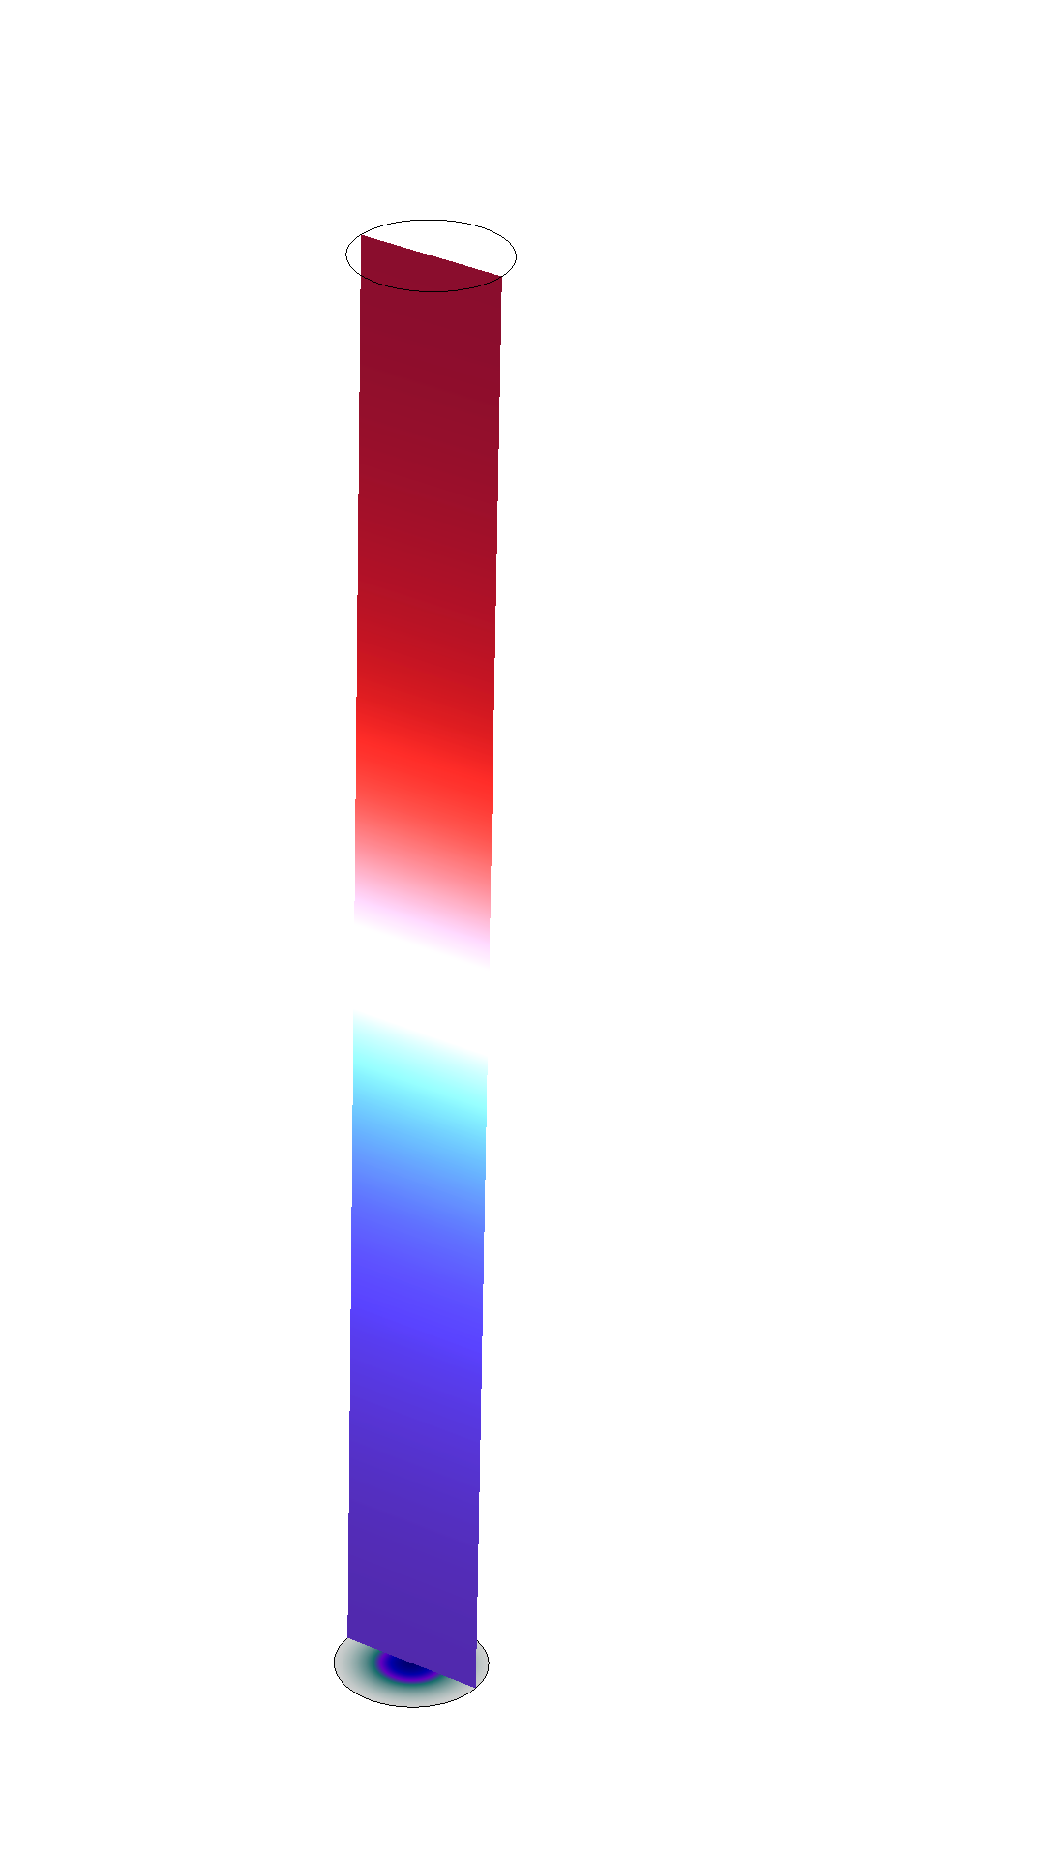
Model Setup
For models with acoustic-structure couplings it is necessary to calculate the left eigenvectors to use the Frequency Domain, Modal solver. This model shows the necessary changes to the default settings of the eigenfrequency solver.
The model is a simple setup of pressure acoustic in a tube coupled to an elastic shell in one end. The system is actuated by a face load on the shell.
Shell displacement and acoustic pressure

Slide 3
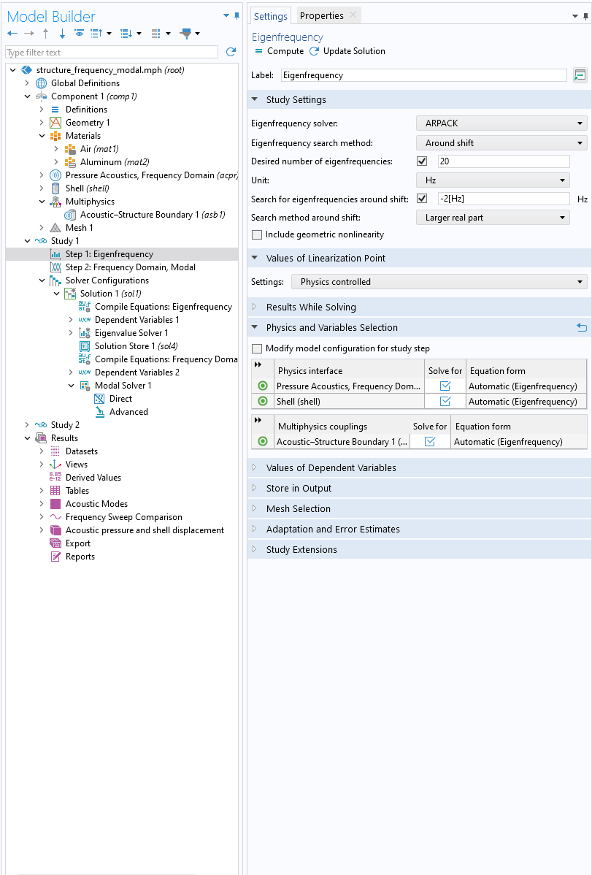
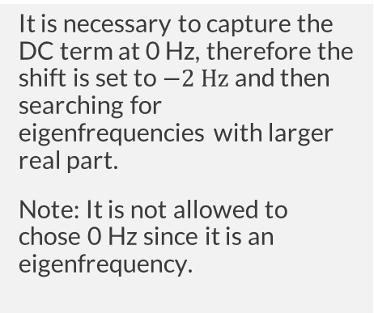
Setup of Eigenfrequency Study Step
Number of eigenfrequencies
Shift and search method
Set the desired number of eigenfrequencies.
It is necessary to capture all eigenfrequencies in the frequency range of the sweep. To ensure accuracy the accuracy eigenfrequencies close to the frequency range should also be found.
It is necessary to capture the DC term at 0 Hz, therefore the shift is set to $−2 Hz$ and then searching for eigenfrequencies with larger real part.
Note: It is not allowed to chose 0 Hz since it is an eigenfrequency.

Slide 4
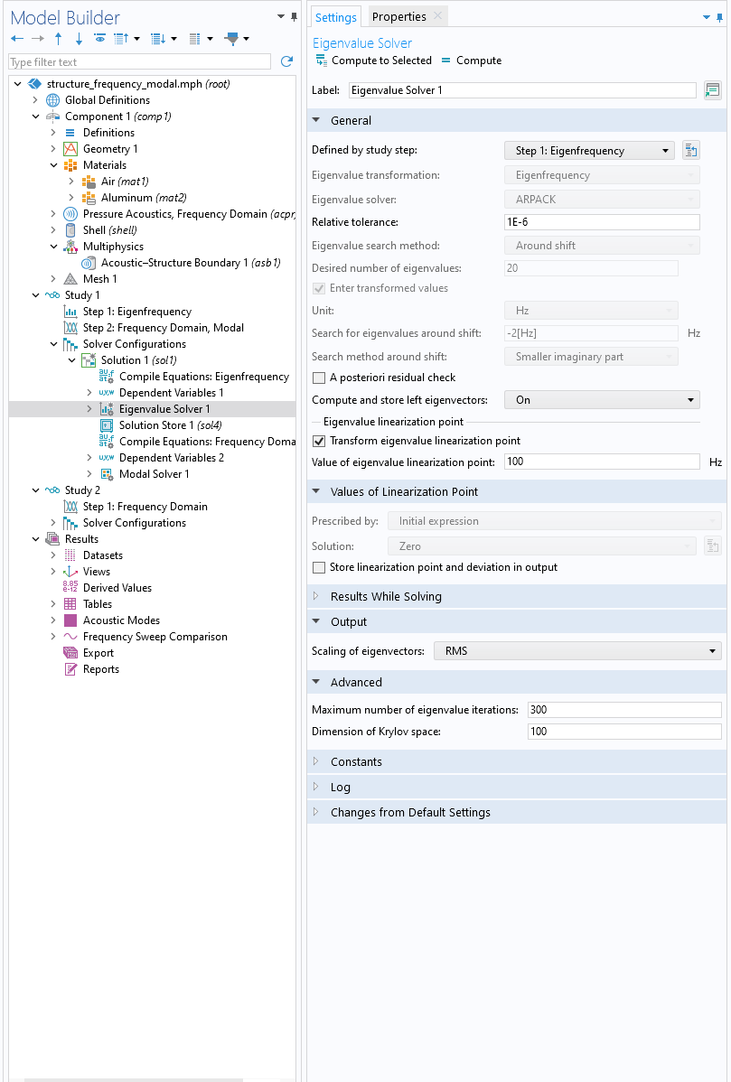
Eigenfrequency Solver
Left Eigenvectors
Krylov Space
Set the Compute and store left eigenvectors to On.
This is needed because the system is nonsymmetric and therefore the left eigenvectors are needed in the Frequency Domain, Modal study step.
Set the Dimension of Krylov space to 100.
This makes the eigenvalue solver more robust.

Slide 5
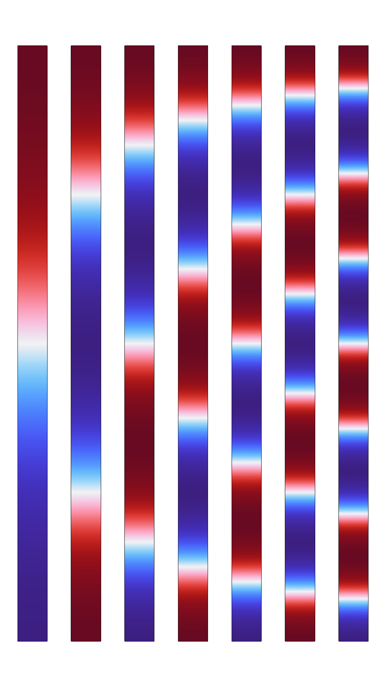
Acoustic Modes
The acoustic modes in the system are the modes of a closed cylinder with the lowest mode corresponding to half a wavelength.
The lowest seven modes of the acoustic pressure in the tube.

Slide 6
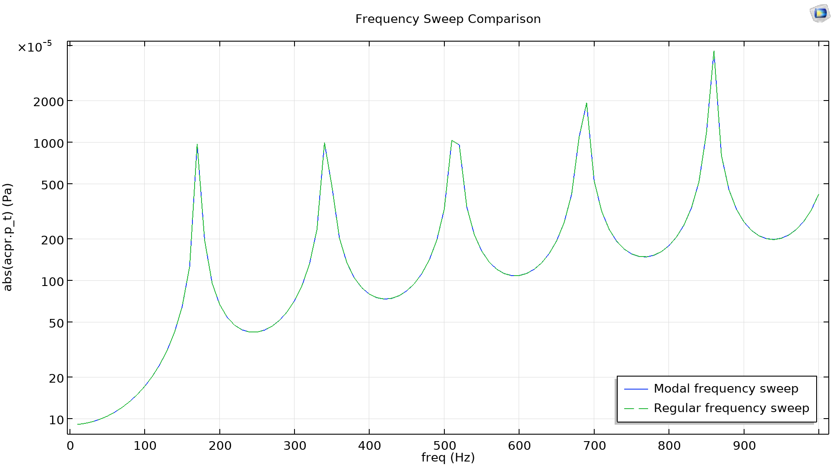
Frequency Sweep
The pressure at the opposite side of the shell is shown for a frequency range from 10 to 1000 Hz.
Comparison of the results from the Frequency Domain, Modal study and Frequency Domain study.
Comparison of frequency sweep with modal and regular solver.

