Slide 1
Reflow Soldering in IC Packaging
Your Name
COMSOL

Slide 2
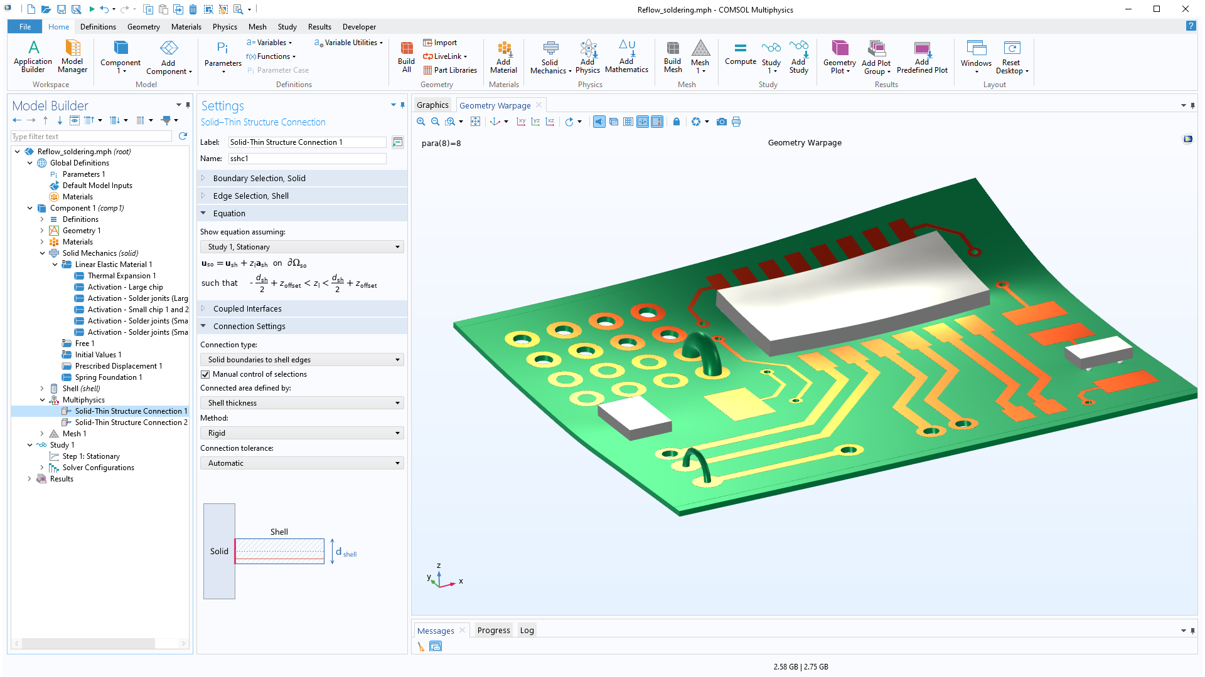
OVERVIEW

Slide 3
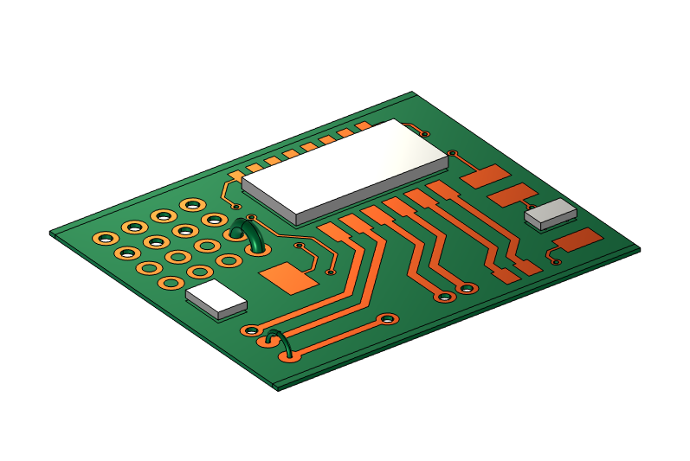
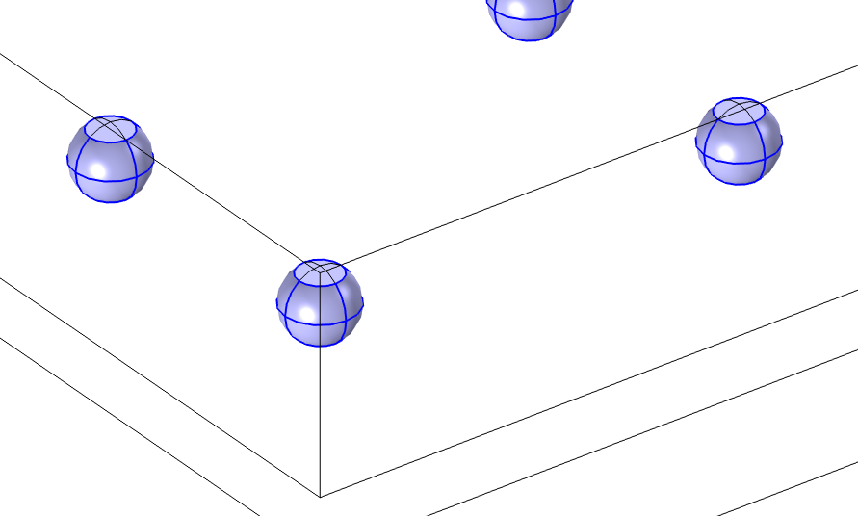
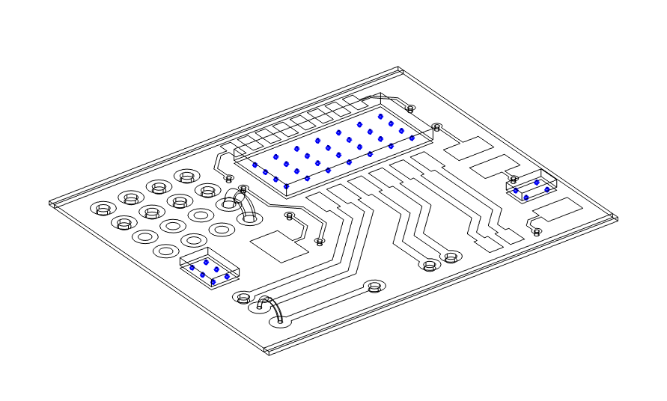
Geometry
PCB
  Substrate + Printed layer
Solder joints
  Radius: 0.25 mm
  Height: 0.4
Components
  One large chip and two small chips
The geometry of PCB is obtained from the model “esd_test_pcb.mph” in our application library

Slide 4
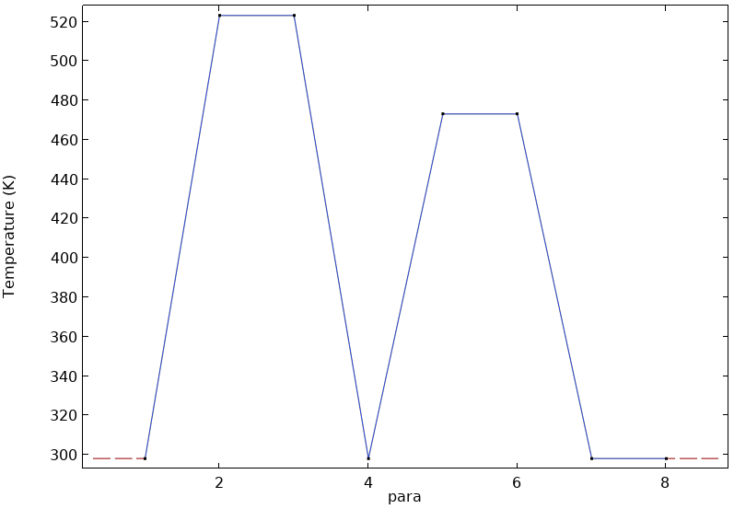
Simulation Process
Initial state
  PCB has already been activated and constrained, T = 25 degC
Soldering for large chip
  Heating state, T = 250 degC
  Large chip and its solder joints are activated
  Cooling state, T = 25 degC
Soldering for small chips
  Heating state, T = 200 degC
  Small chips and their solder joints are activated
  Cooling state, T = 25 degC
Releasing
  Remove the constraint in PCB, T = 25 degC
Activation-1
Activation-2

Slide 5
Materials
Domains | CTE (1/K) | Density (Kg/m³) | Young’s modulus (Gpa) | Poisson’s ratio
Substrate (FR4) | 18e-6 | 1900 | 22 | 0.15
Solder joints for large chip | 24.5e-6 | 7370 | T= 25 degC, 34.3 T= 250 degC, 3.5 Linearly decrease with T | 0.35
Solder joints for small chip | 21e-6 | 9000 | 10 | 0.4
Printed layer (copper) | 17e-6 | 8960 | 110 | 0.35
Chips | 13e-6 | 1900 | 30 | 0.3

Slide 6
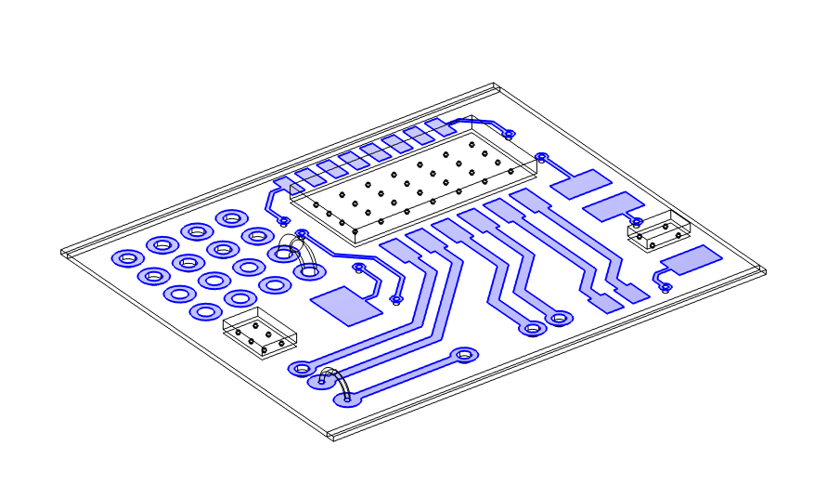
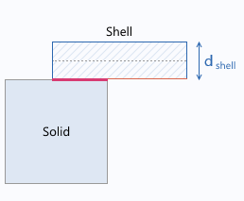
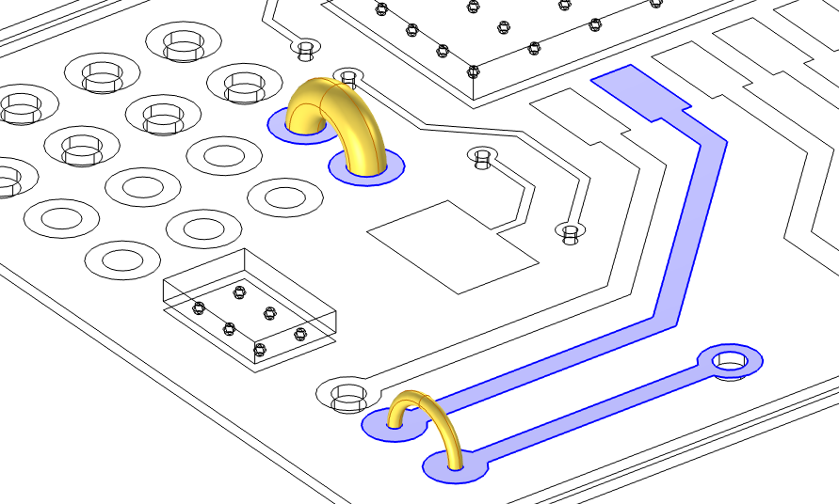
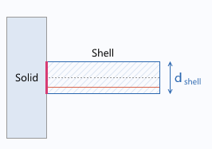
Physics
Solid mechanics
  Thermal expansion
  Activation
Shell
  Thermal expansion
Solid-Thin Structure Connection
  Shared boundaries
  Solid boundaries to shell edges

Slide 7
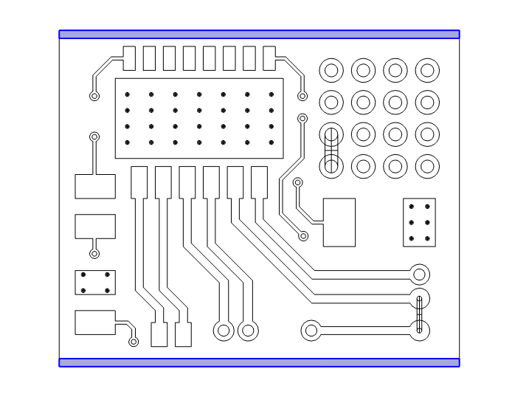
Constraints
The two sides of substrate are fixed during the reflow soldering and released at the final step
A spring foundation with small stiffness is set for numerical stability in the releasing step

Slide 8
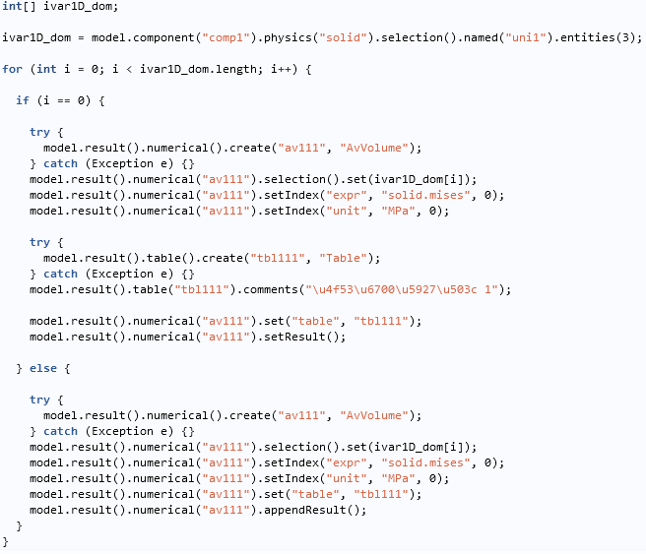
Model Method for Stress Analysis
For large amounts of solder joints, a method is written to efficiently calculate the average von Mises stress in each solder joint.

Slide 9
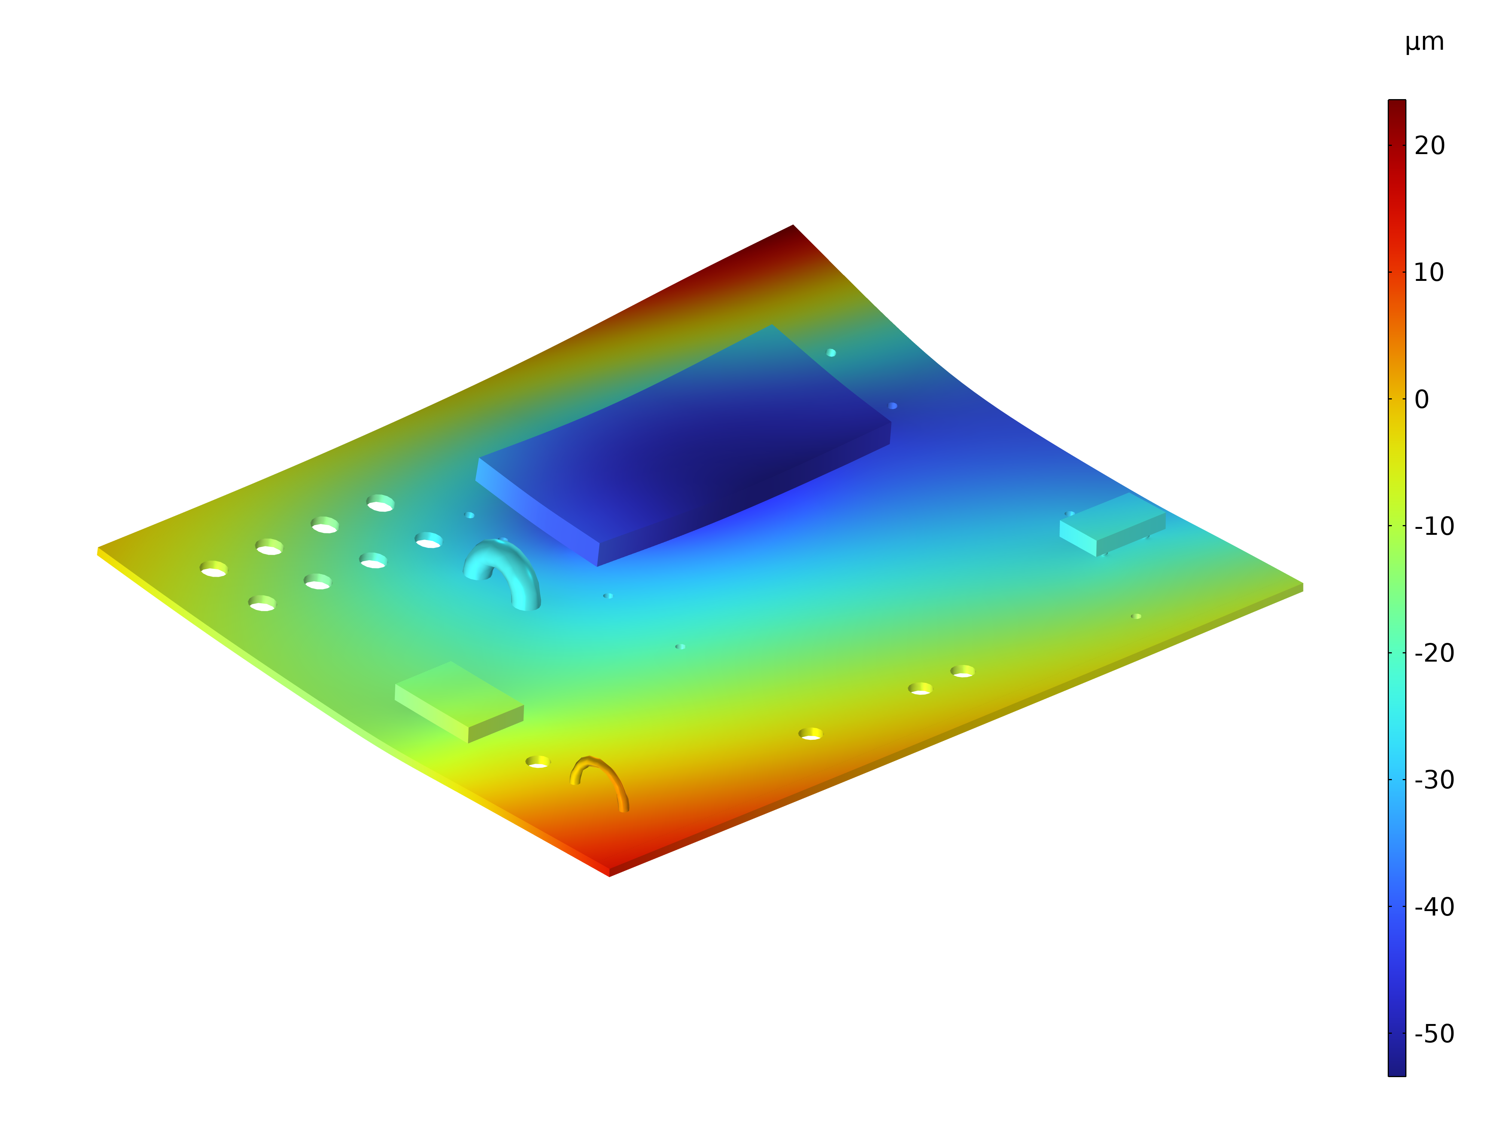
Results
PCB warpage after reflow soldering finished.
Z-displacement of the displacement for the para = 8.

Slide 10
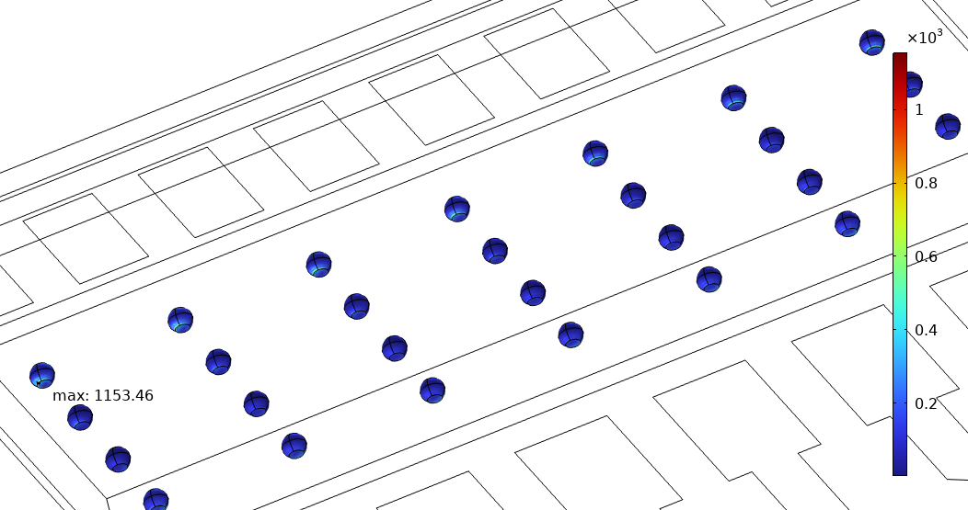
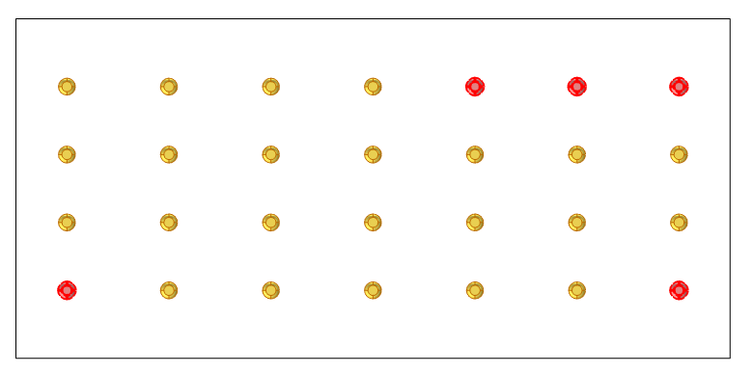
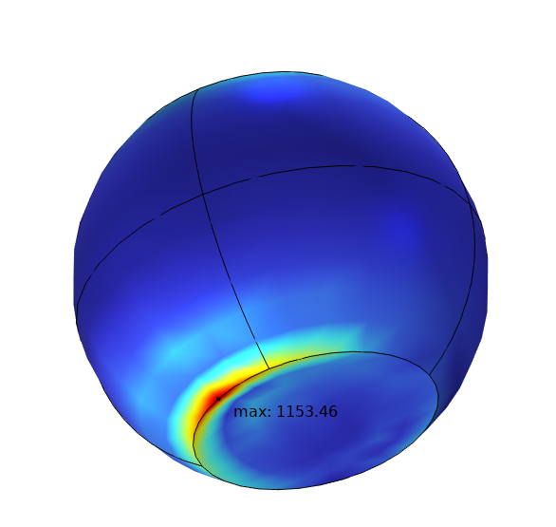
Results
Residual stress in solder joints after reflow soldering finished:
  The corner joints in large chip show higher stress
  Stress concentration is observed at the interface between joints and substrate
No. | 5 | 6 | 7 | 8 | 9 | 10 | 12 | 13 | 14 | 15 | 16 | 17 | 18 | 19 | 20 | 21 | 22 | 23 | 24
Average stress (MPa) | 17.6 | 8.9 | 16.0 | 19.6 | 6.4 | 21.1 | 110.4 | 51.2 | 31.8 | 81.2 | 97.6 | 40.1 | 33.7 | 82.1 | 91.1 | 34.4 | 38.2 | 88.9 | 87.5
No. | 25 | 26 | 27 | 28 | 29 | 30 | 31 | 32 | 33 | 34 | 35 | 36 | 37 | 38 | 39 | 41 | 42 | 43 | 44
Average stress (MPa) | 30.5 | 44.0 | 98.8 | 86.7 | 29.1 | 48.9 | 109.1 | 95.0 | 33.7 | 49.7 | 119.8 | 114.8 | 51.4 | 38.8 | 118.4 | 16.5 | 17.7 | 15.9 | 15.7
MPa
31
35
39
12
36

Slide 11
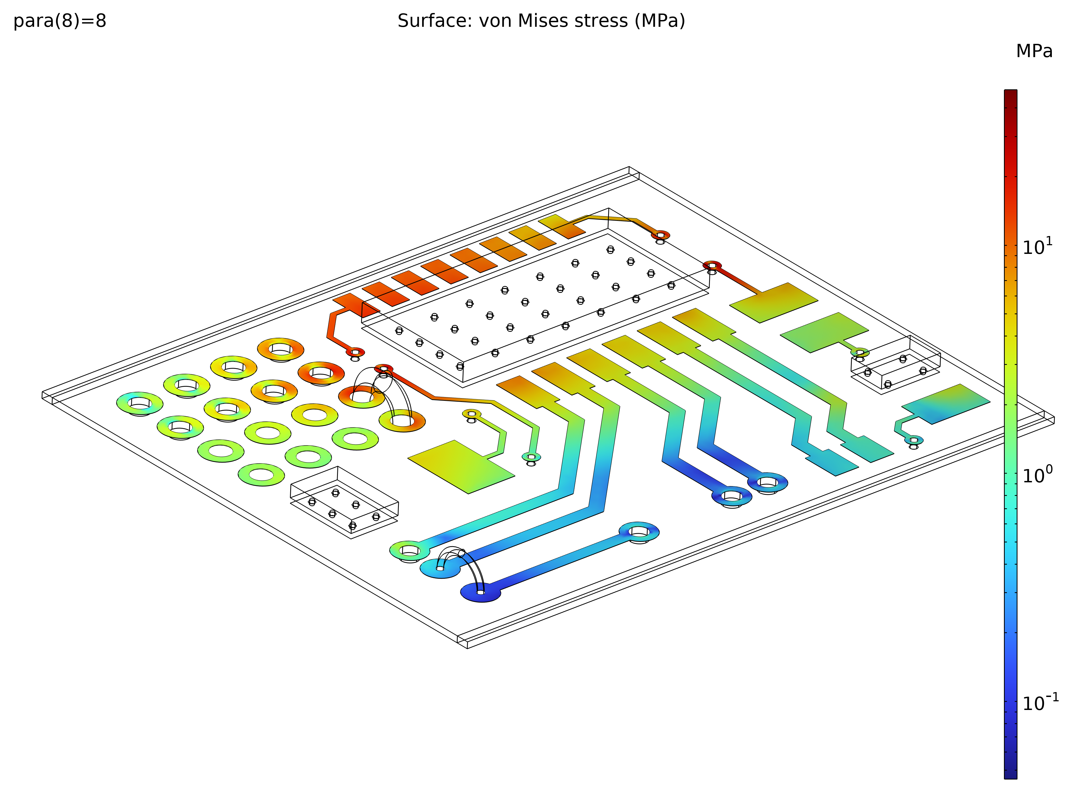
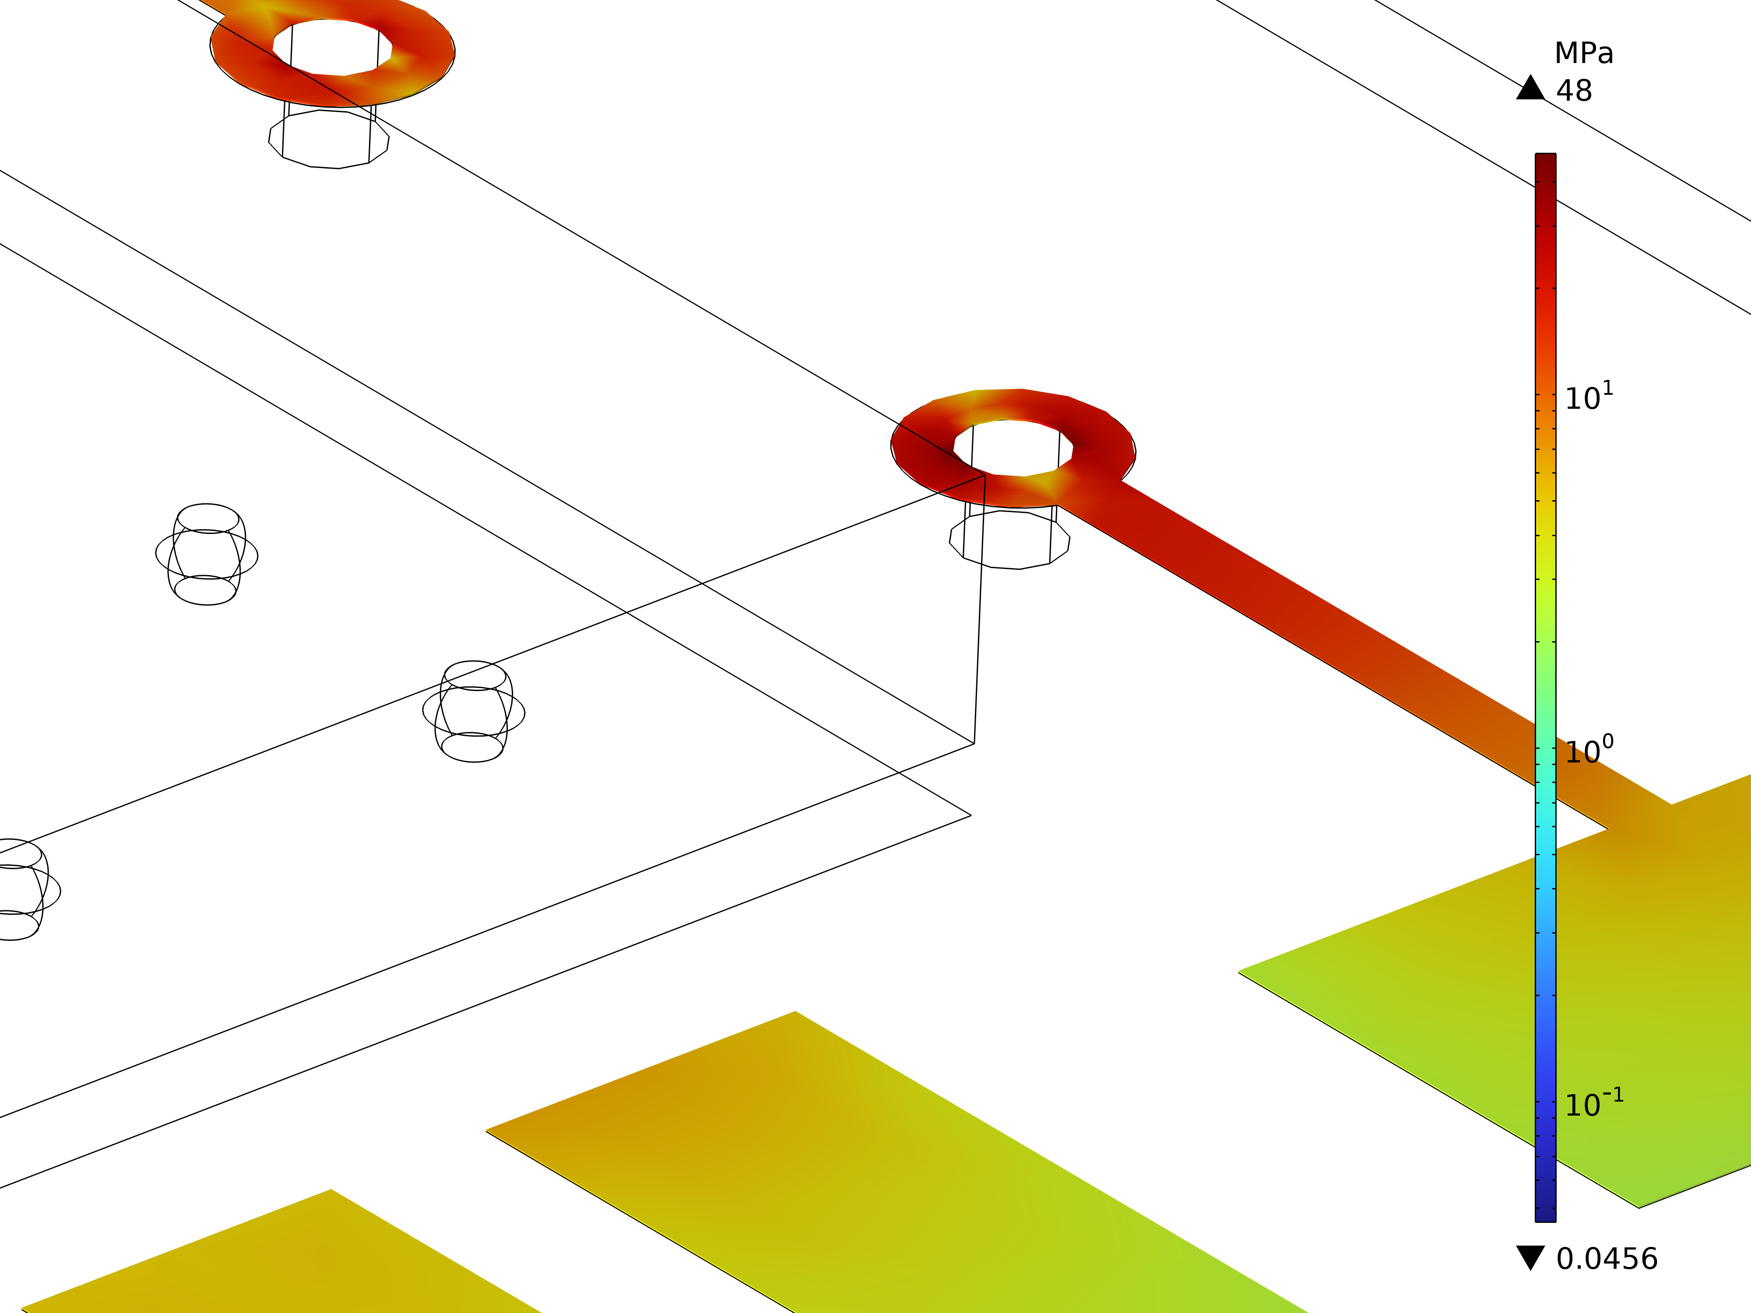
Results
Residual stress in the printed layer after the reflow soldering is finished.
Von Mises stresses in the printed layer for para = 8.

Slide 12
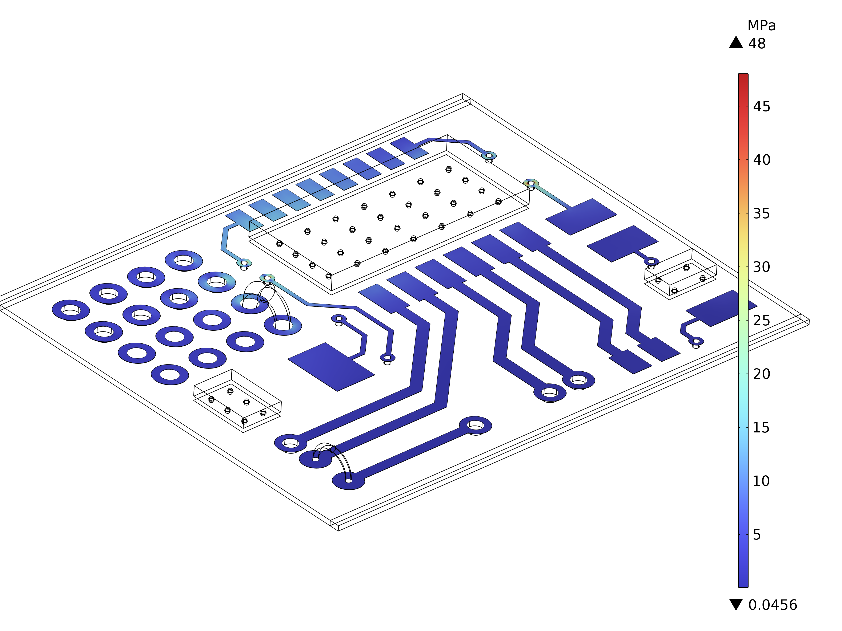
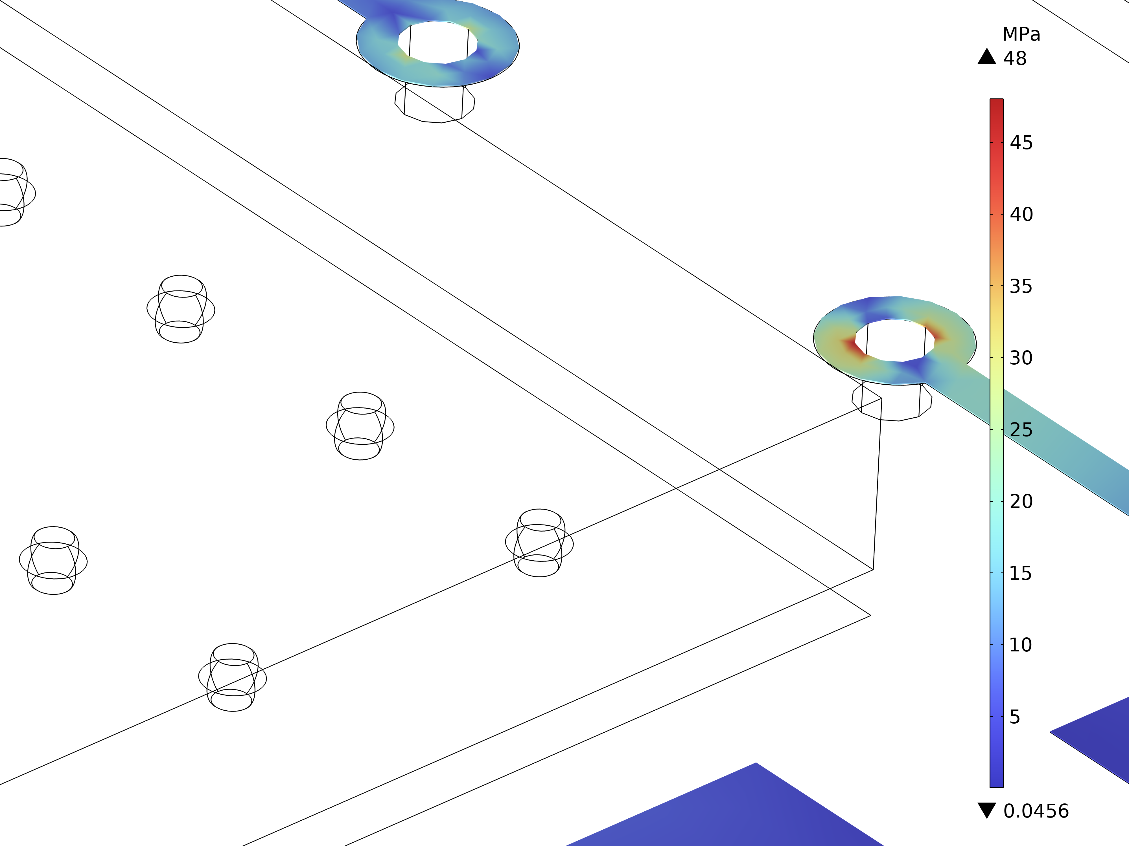
Results
Residual stress in the printed layer after the reflow soldering is finished.
Von Mises stresses in the printed layer for para = 8.

Slide 13
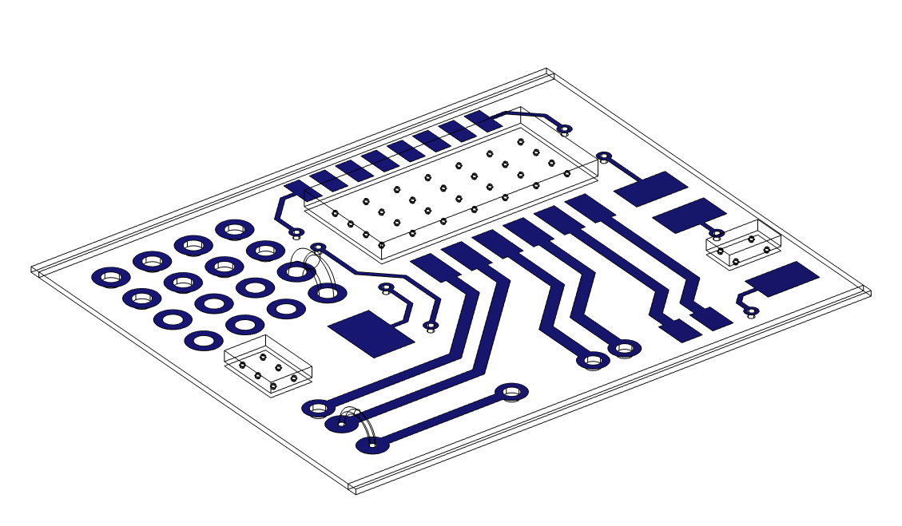
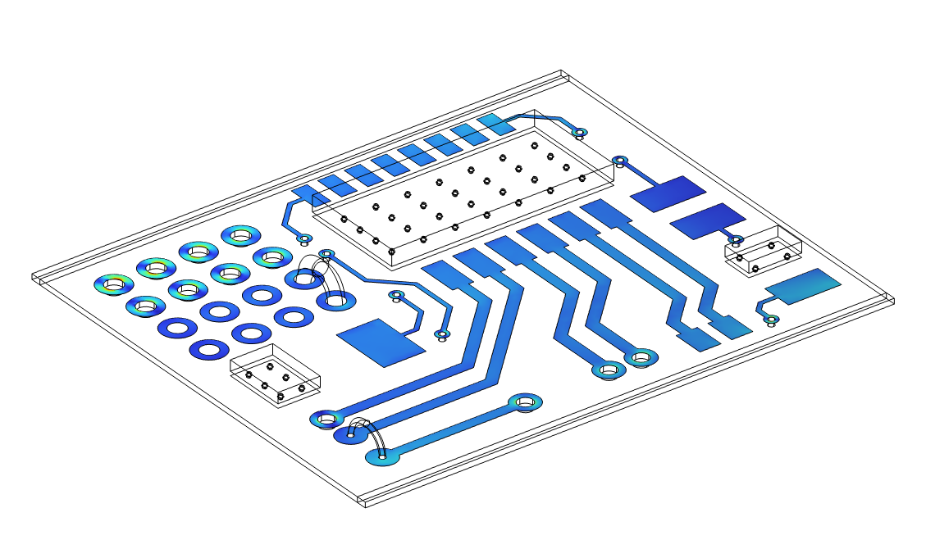

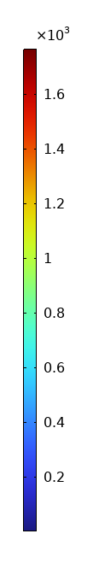
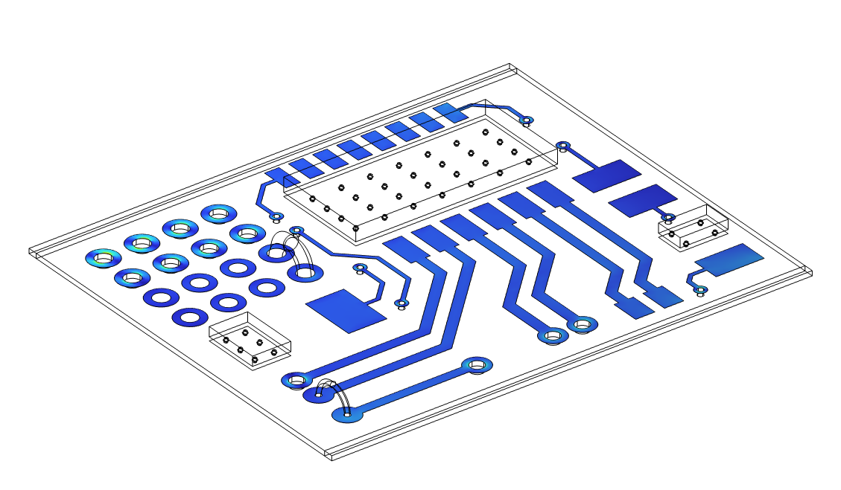


Results
Distribution of von Mises stress in printed layer during reflow soldering process
Initial state
Heating-1
Activation-1
Cooling-1
MPa
Heating-2
Activation-2
Cooling-2
Releasing

Slide 14
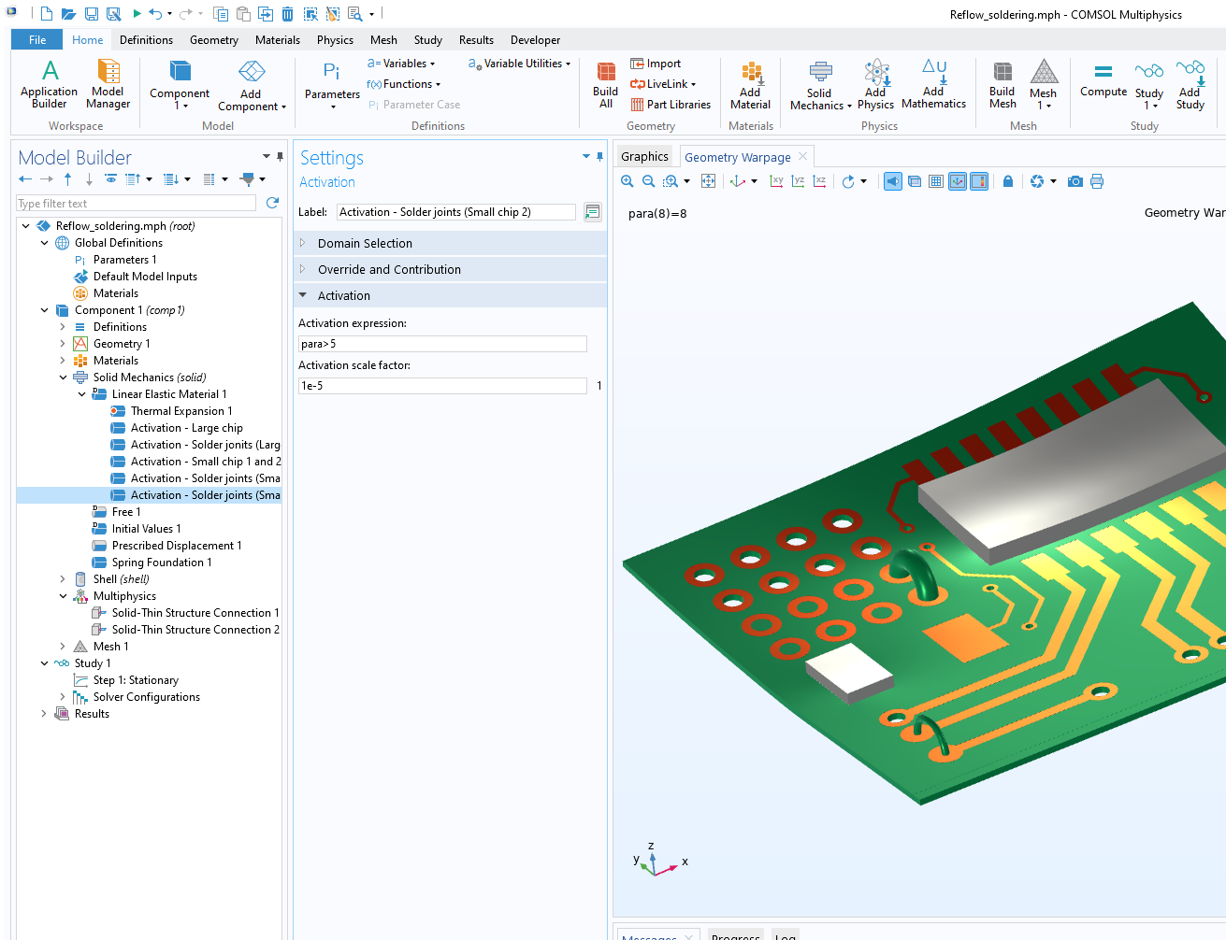
Summary
The process of reflow soldering is implemented using Activation nodes
The temperature change is approximately described by a user-defined function
Further extension
  Heat transfer between structures and surroundings
  More complex constitutive models such as the viscoplasticity for solder materials

