Slide 1
Water Purification Reactor
COMSOL

Slide 2
Introduction
Water purification for turning natural water into drinking water is a process constituted of several steps
At least one step must be a disinfectant step
One way to achieve efficient disinfection in an environmentally friendly way is to use ozone
A typical ozone purification reactor is about 40 m long and resembles a maze with partial walls or baffles that divide the space into room-sized compartments
When water flows through the reactor turbulent flow is created along its winding path around the baffles toward the exit pipe
The turbulence mixes the water with ozone gas that enters through diffusers just long enough to deactivate micropollutants
When the water leaves the reactor, the remaining purification steps filter off or otherwise remove the reacted pollutants

Slide 3
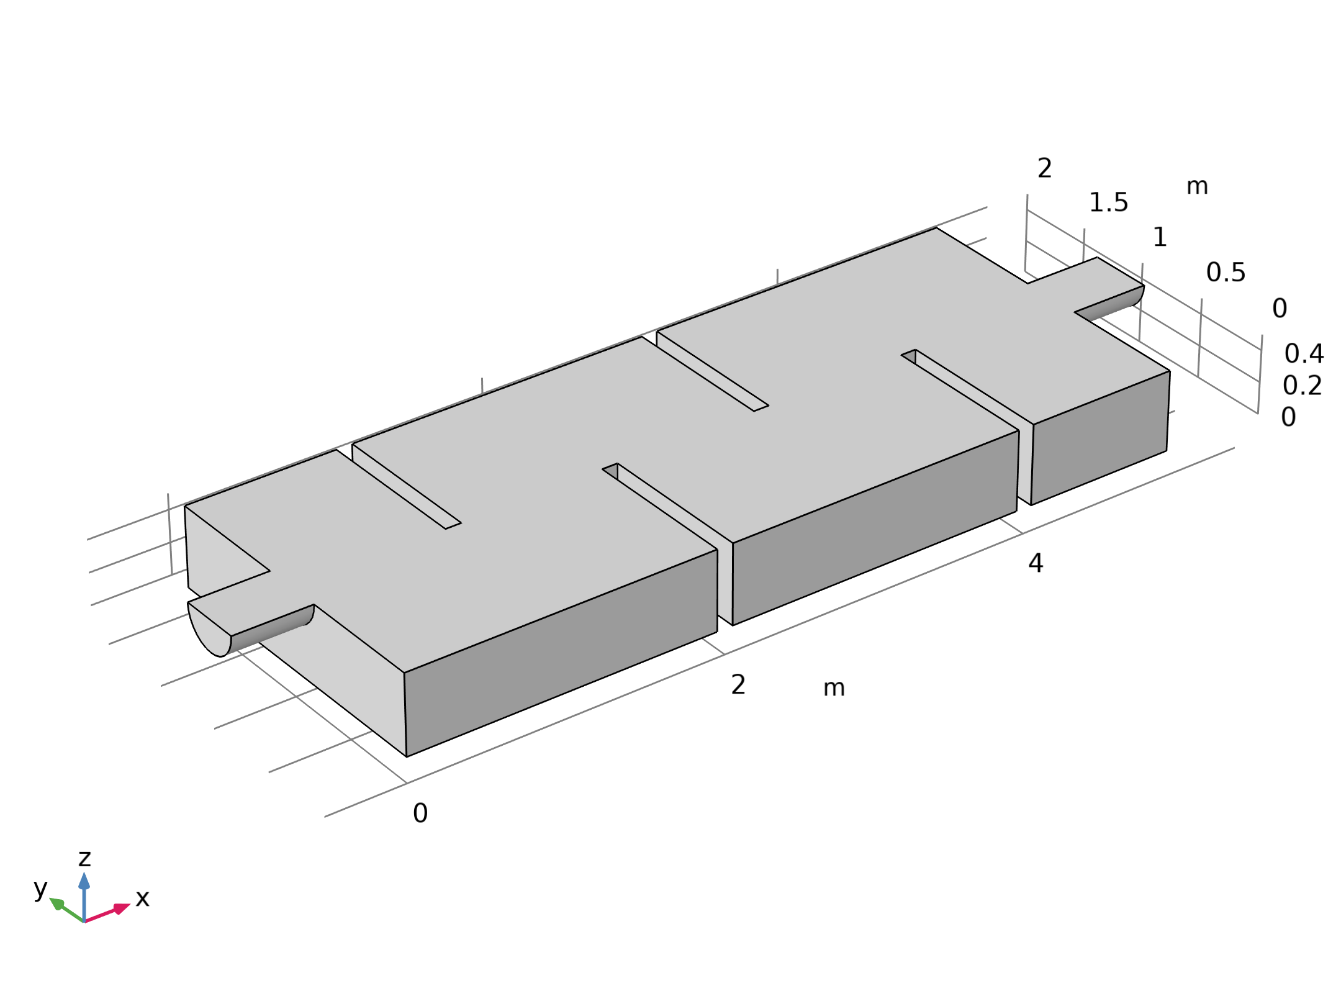
Model Definition
The figure shows the model geometry along with some boundary conditions
The full reactor has a symmetry plane which is utilized to reduce the size of the model
Geometry 1

Slide 4
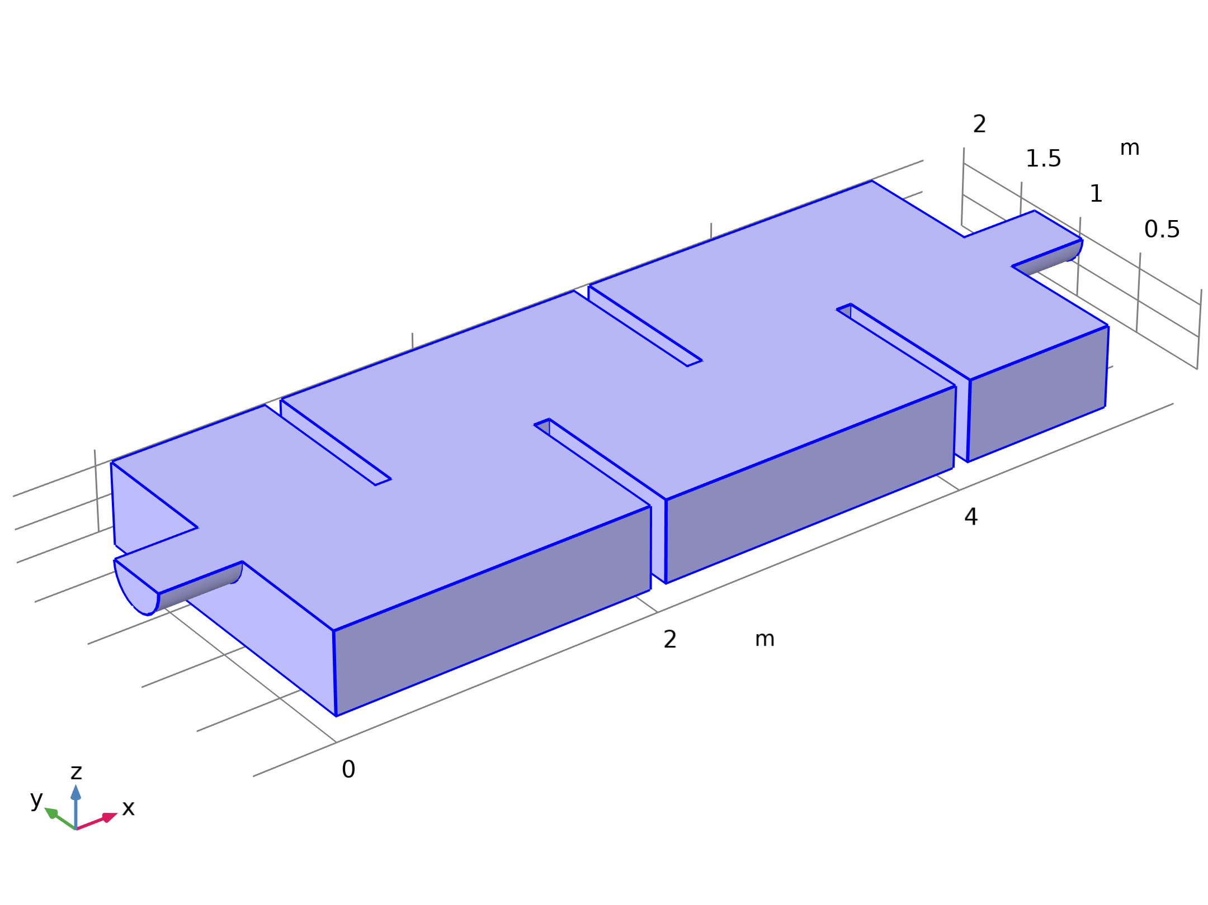



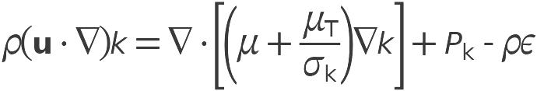
Model Definition
Turbulent Flow, k-ε

Slide 5
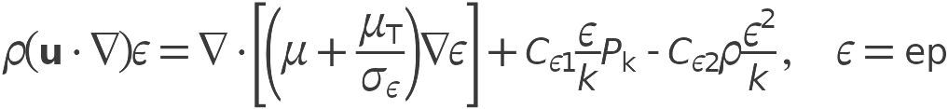


Model Definition
Turbulent Flow, k-ε

Slide 6
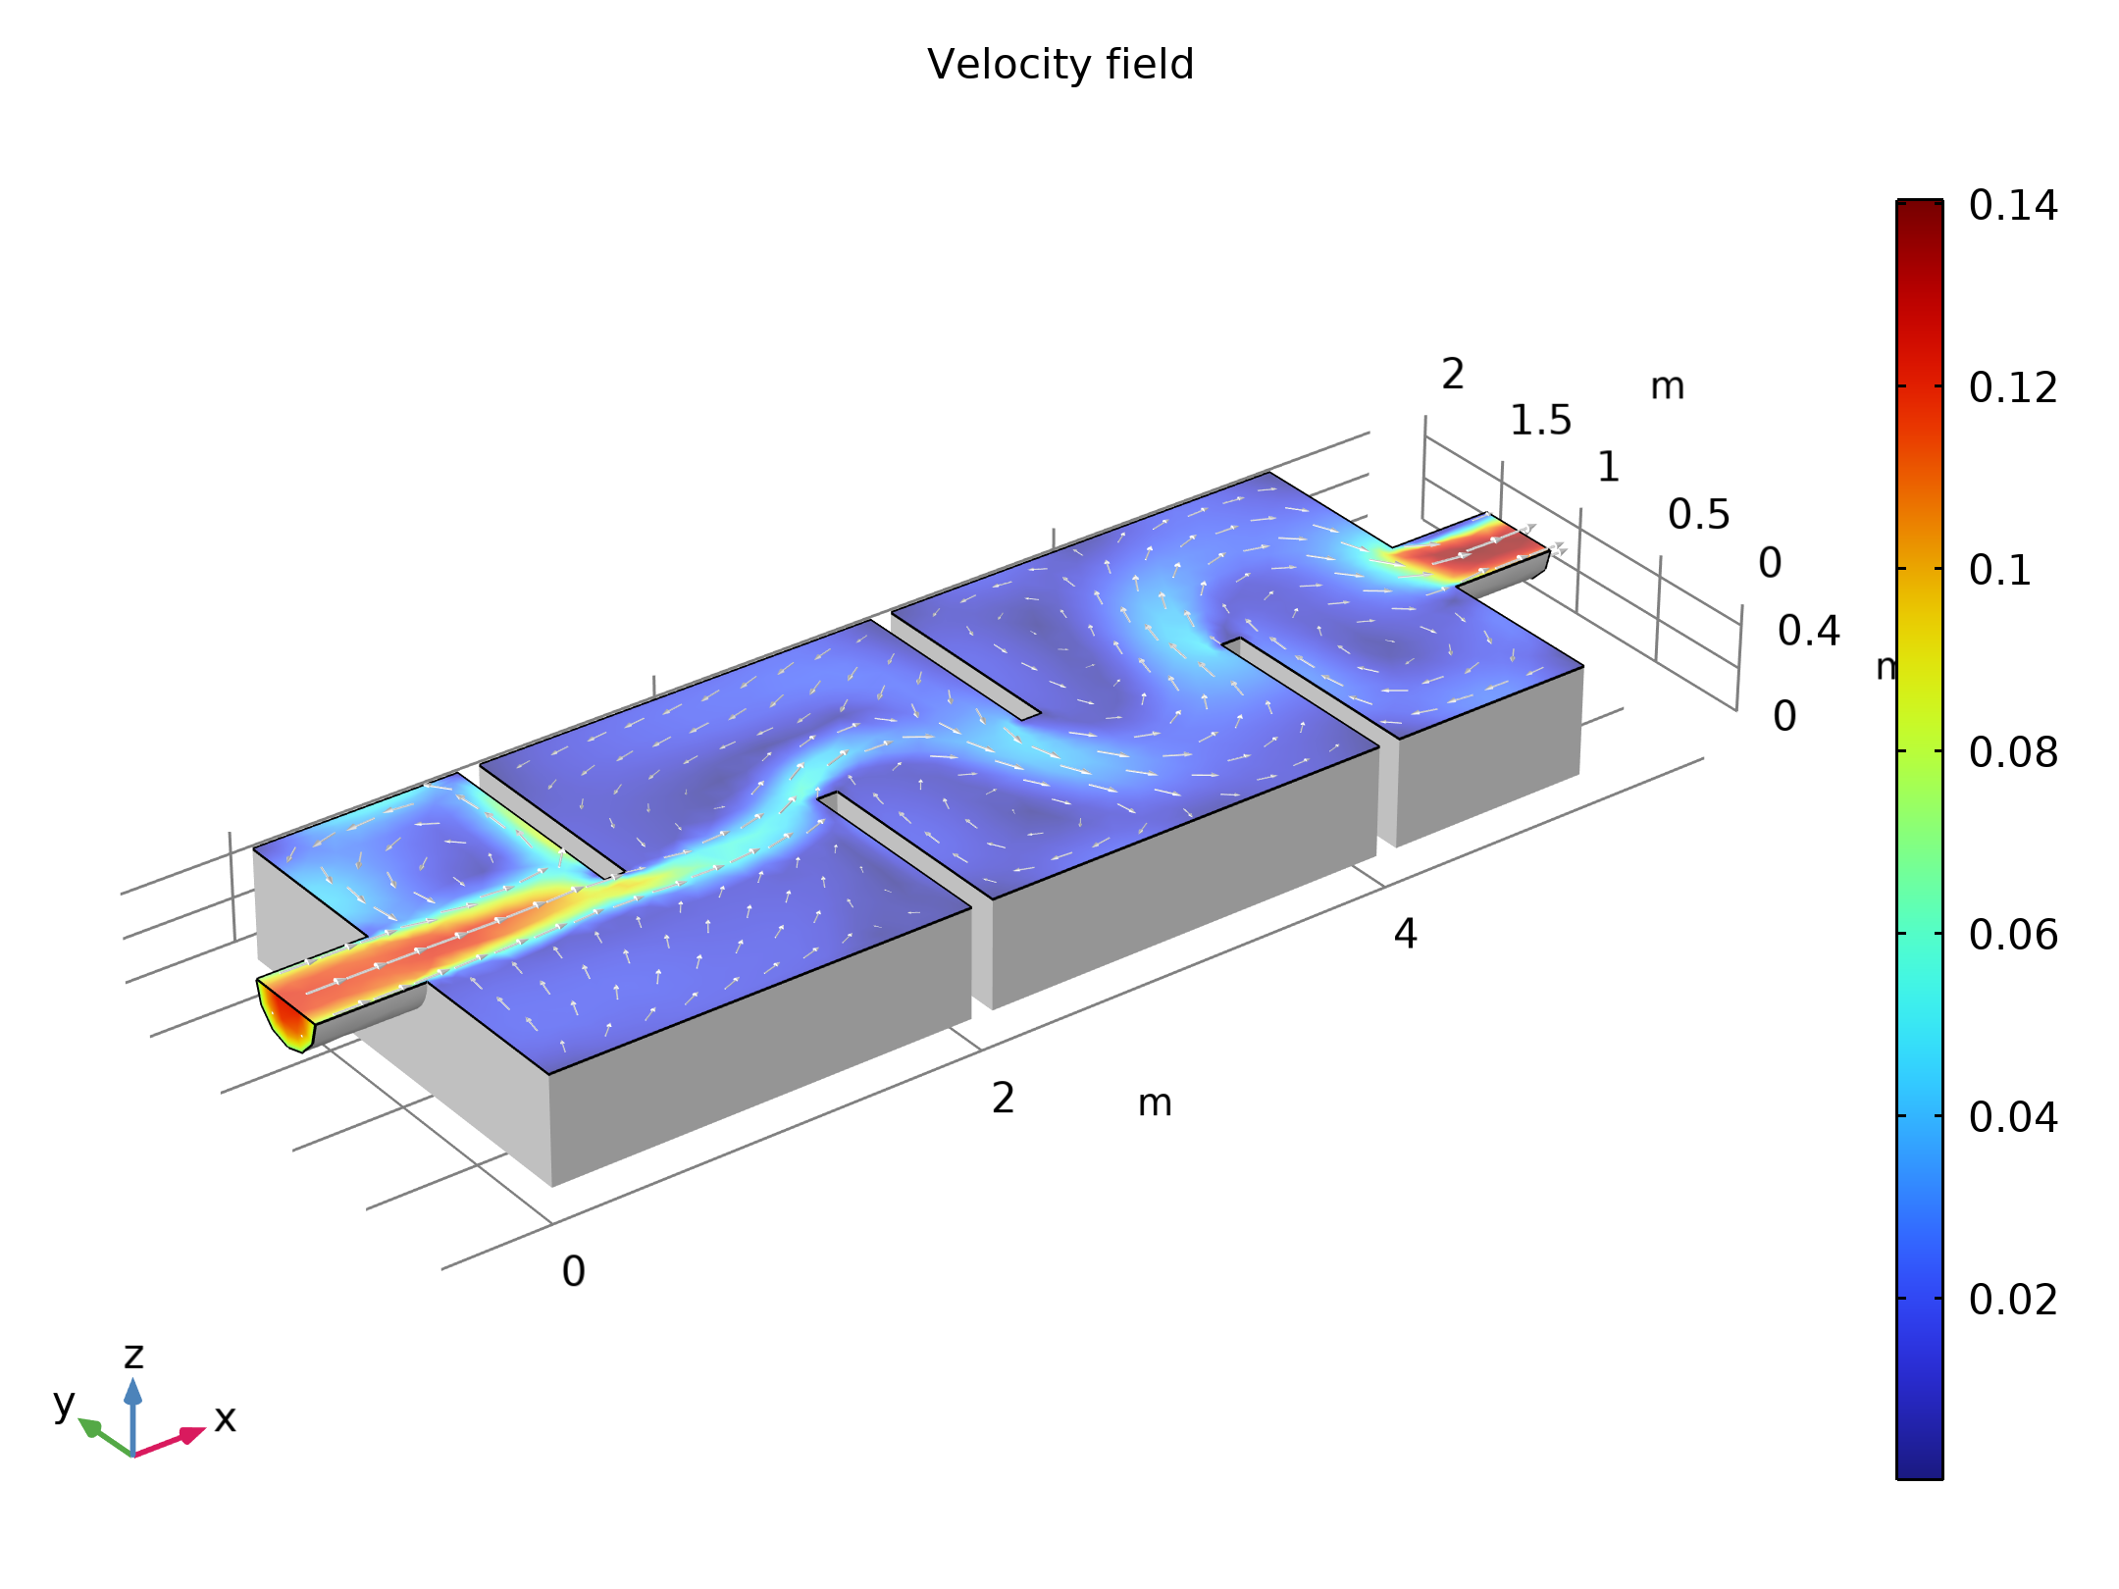
Results
The figure shows the velocity field in the symmetry plane
The jet from the inlet hits the top of the first baffle which splits the jet
One half creates a strong recirculation zone in the first “chamber”
The other half continues down into the reactor and gradually spreads out
The velocity magnitude decreases as more fluid is entrained into the jet
Figure 2 shows the velocity field in the symmetry plane. The jet from the inlet hits the top

Slide 7
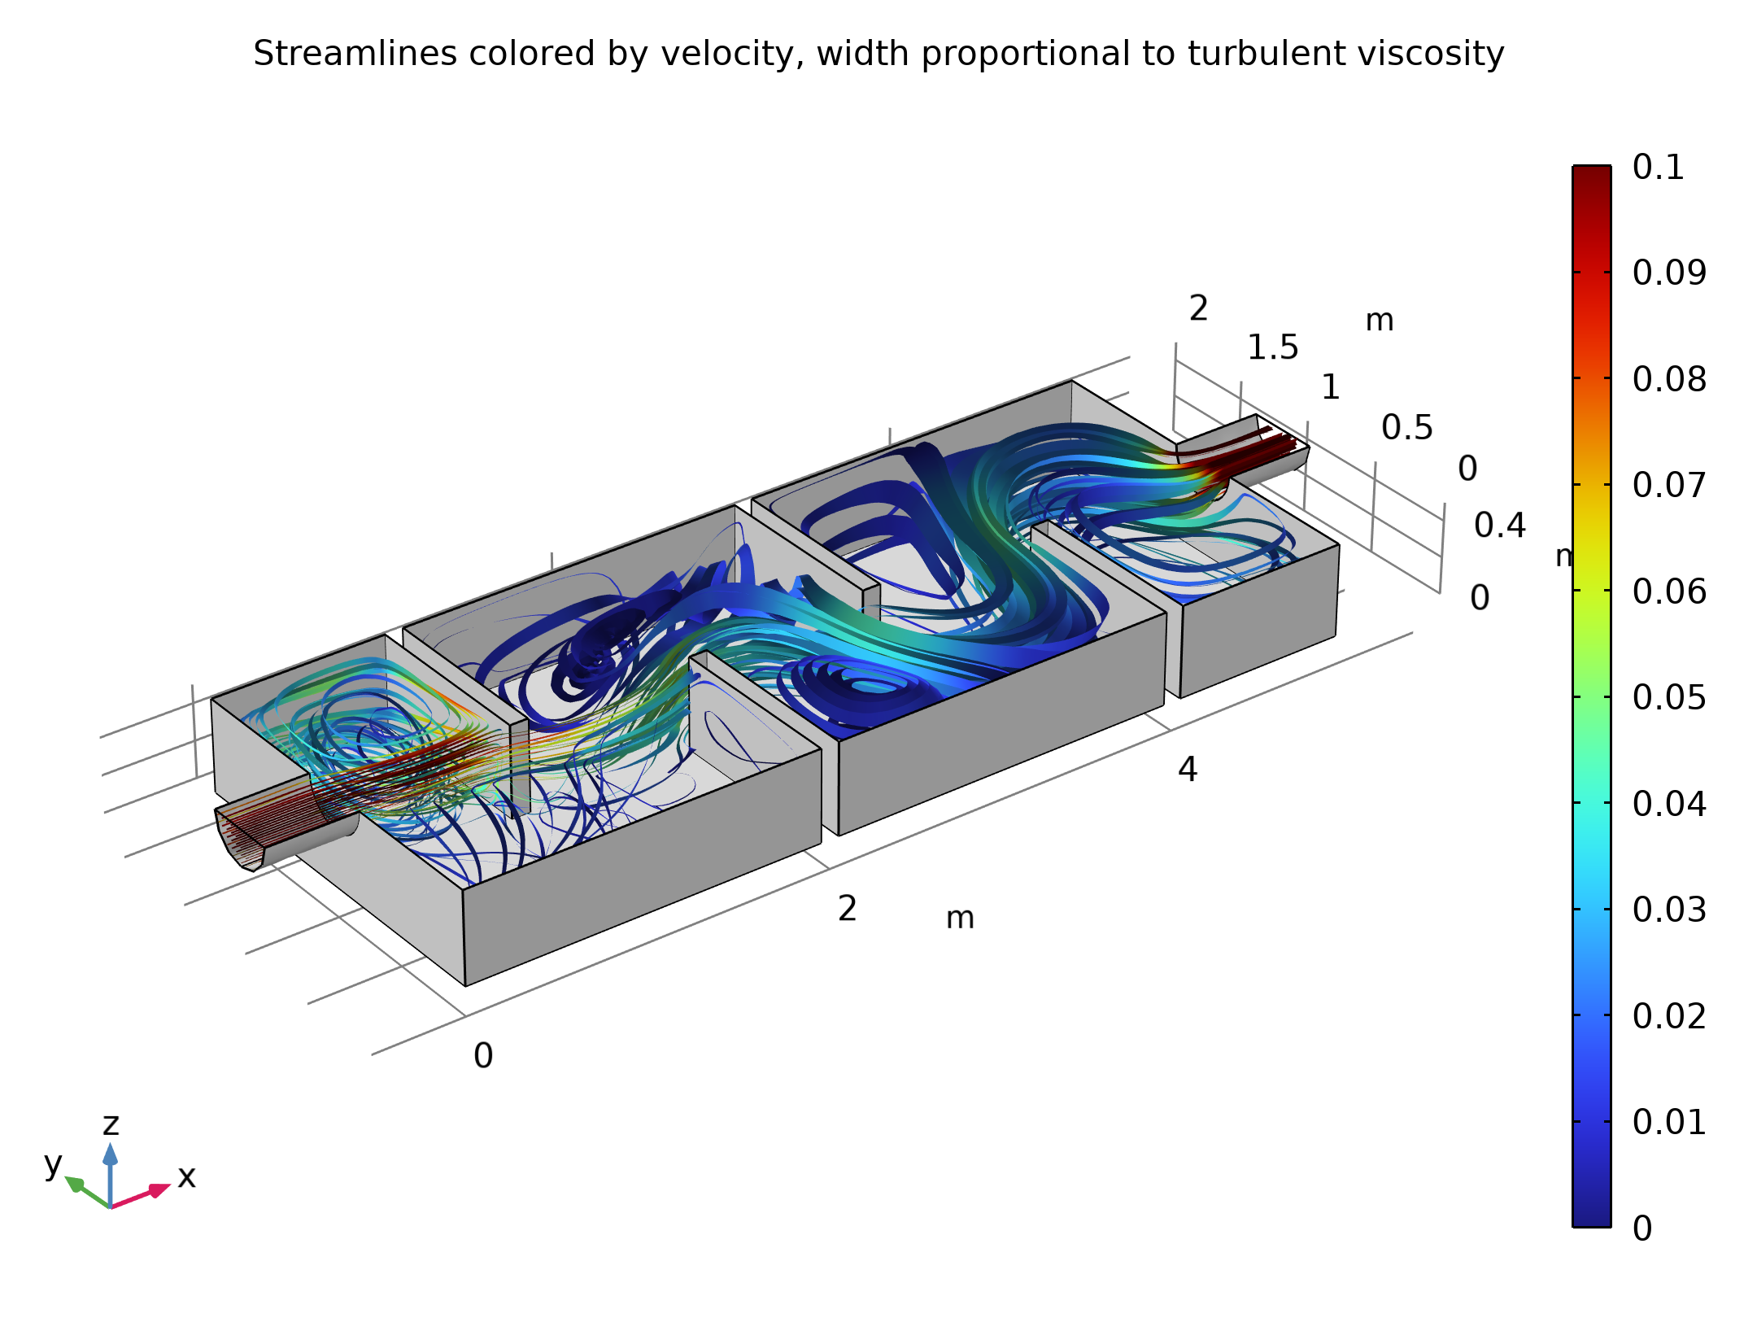
Results
The figure gives a more complete picture of the mixing process in the reactor
The streamlines are colored by the velocity magnitude, and their width are proportional to the turbulent viscosity
Wide lines hence indicate high degree of mixing
Streamlines colored by velocity. The width of the streamlines are proportional to the turbulent viscosity

Slide 8
Results
The turbulence in this example is mainly produced in the shear layers between the central jet and the recirculation zones
The mixing can be seen to be relatively weak in the beginning of the reactor
The plot also shows that it increases further downstream
Streamlines colored by velocity. The width of the streamlines are proportional to the turbulent viscosity

