Slide 1
Electroosmotic Flow in Porous Media
COMSOL

Slide 2
Introduction
This example treats the modeling of electroosmotic flow in porous media
The system consists of a compartment of sintered porous material and two electrodes that generate an electric field
The cell combines pressure-driven and electroosmotic flow

Slide 3
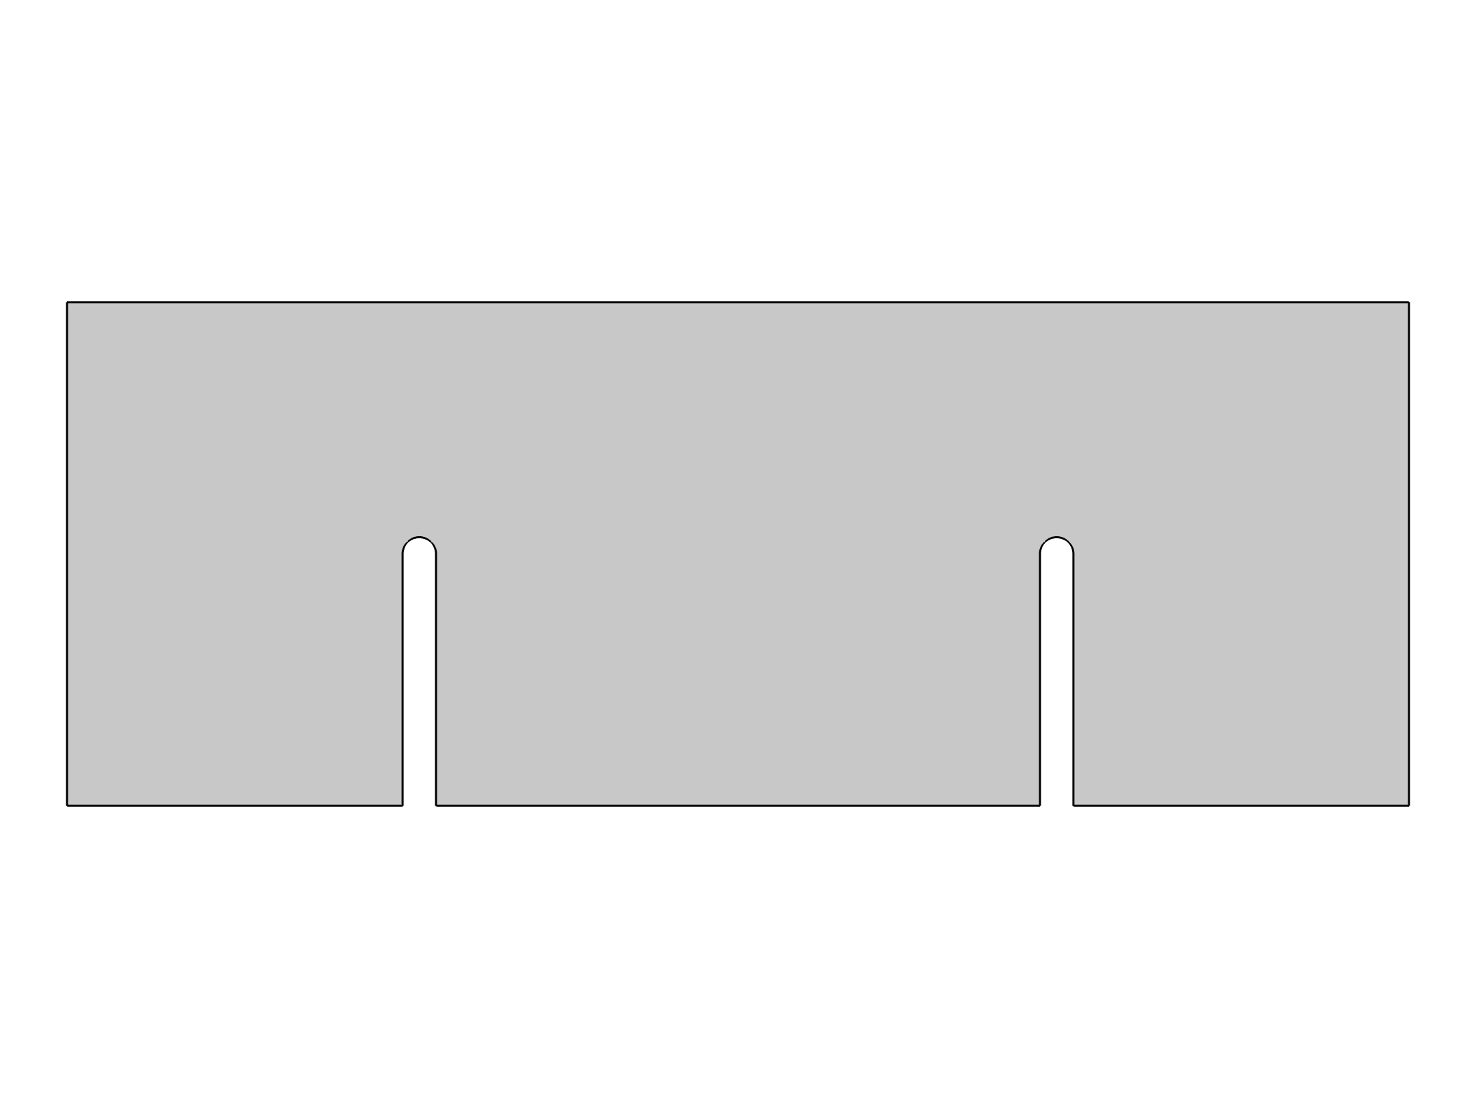
Model Definition
The figure shows the system’s geometry made up of a domain of porous material containing the electrolyte and two electrodes that generate a potential difference
The conductivity is very small, and the model assumes that the effects of electrochemical reactions at the electrode surfaces are negligible
Geometry 1

Slide 4
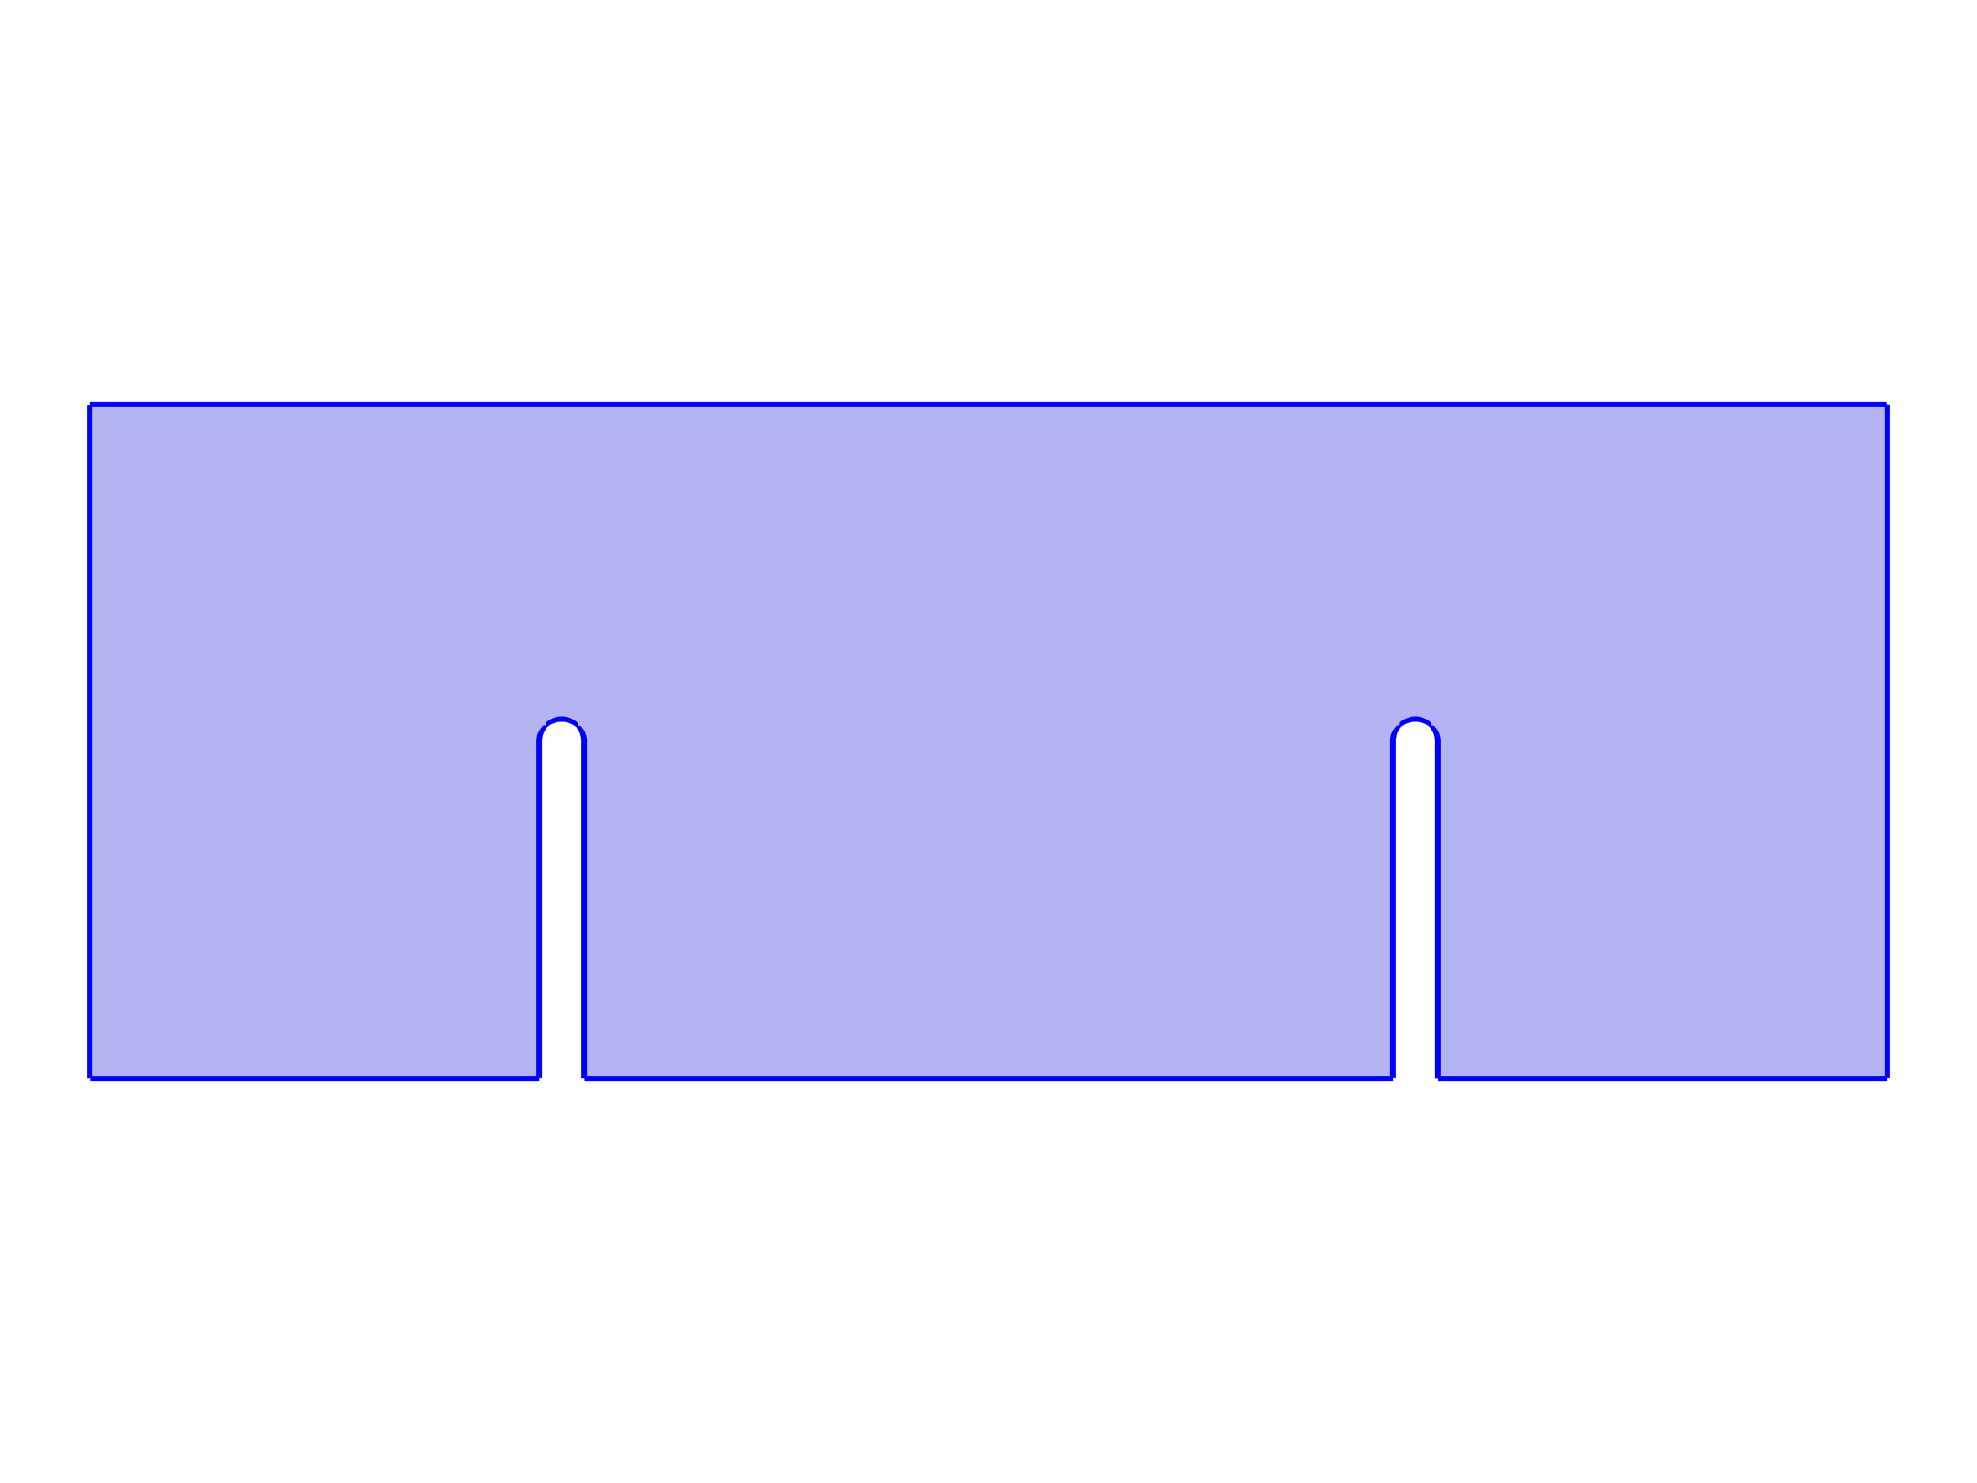



Model Definition
Electric Currents

Slide 5
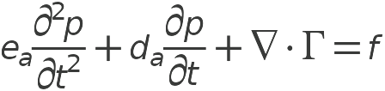

Model Definition
Electroosmotic Pressure

Slide 6


Model Definition
Transport of Diluted Species

Slide 7
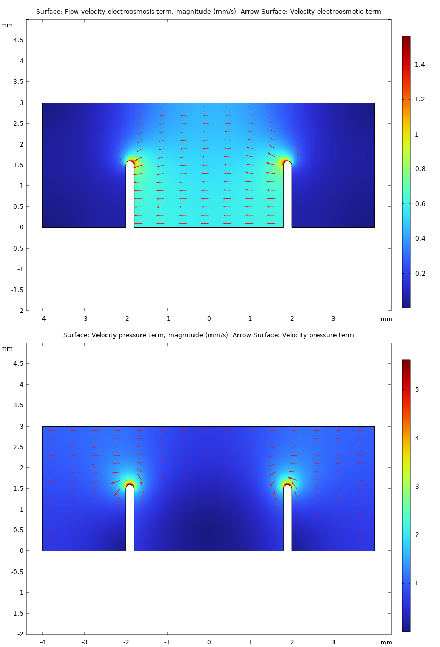
Results
The upper plot in the figure shows the flow distribution in the porous structure when only the electric field acts as a driving force
In the lower plot, it is instead the pressure gradient that drives the flow
In both cases, the velocity is large around the corners of the electrodes, where the field strength is large and the effect of the decrease in the geometry’s cross section is most pronounced
A comparison of the maximum flow-velocity values shows that the pressure gradient is the dominating driving force
Velocity distributions in the cell with an applied electric field (top) and an applied pressure difference (bottom). The unit for the magnitude surface plot is mm/s

Slide 8
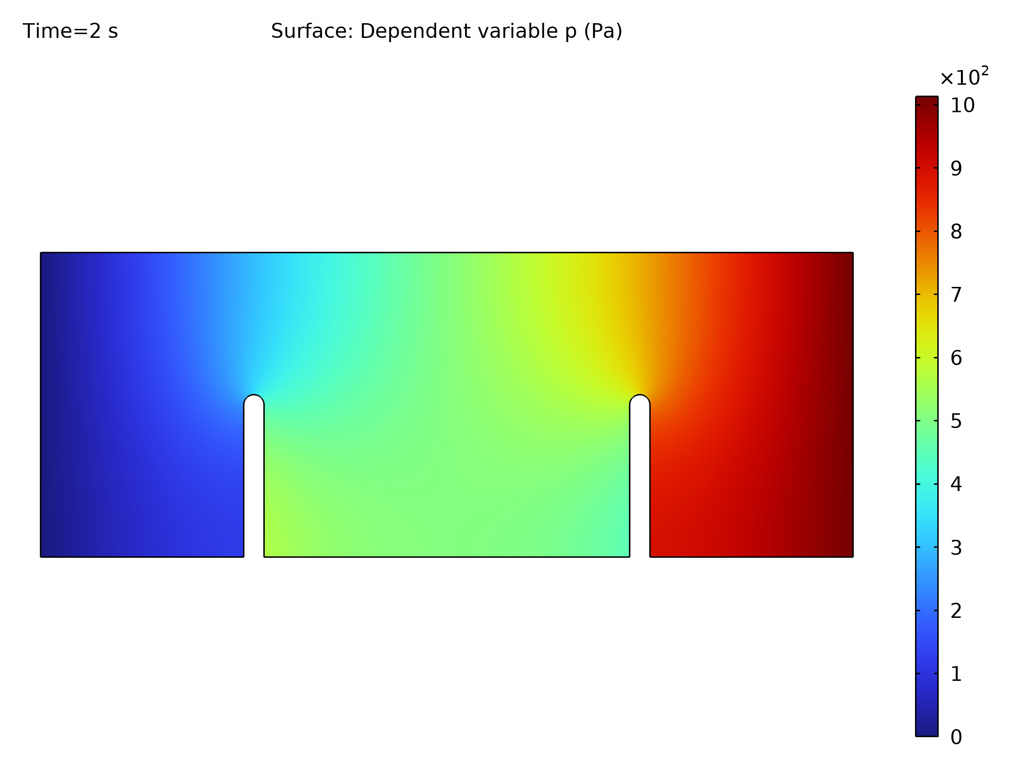
Results
The figure shows the concentration field in the case where both pressure and electroosmotic forces are included
The figure shows that the migration of the charged tracer also influences the transport rate
In this case, the tracer is transported both by the movement of the flow, due to pressure and electroosmotic terms, and the electrophoretic effect on the charged tracer itself
Concentration distribution in the domain at different times after injection. The effects of diffusion, convection, and migration deform the initial bell-shaped pulse

Slide 9
Results
At t = 0, the tracer is introduced as a bell-shaped vertical istribution near the inlet
In the subsequent simulation, this distribution is sheared and transported by diffusion, migration, and convection
Concentration distribution in the domain at different times after injection. The effects of diffusion, convection, and migration deform the initial bell-shaped pulse

Slide 10
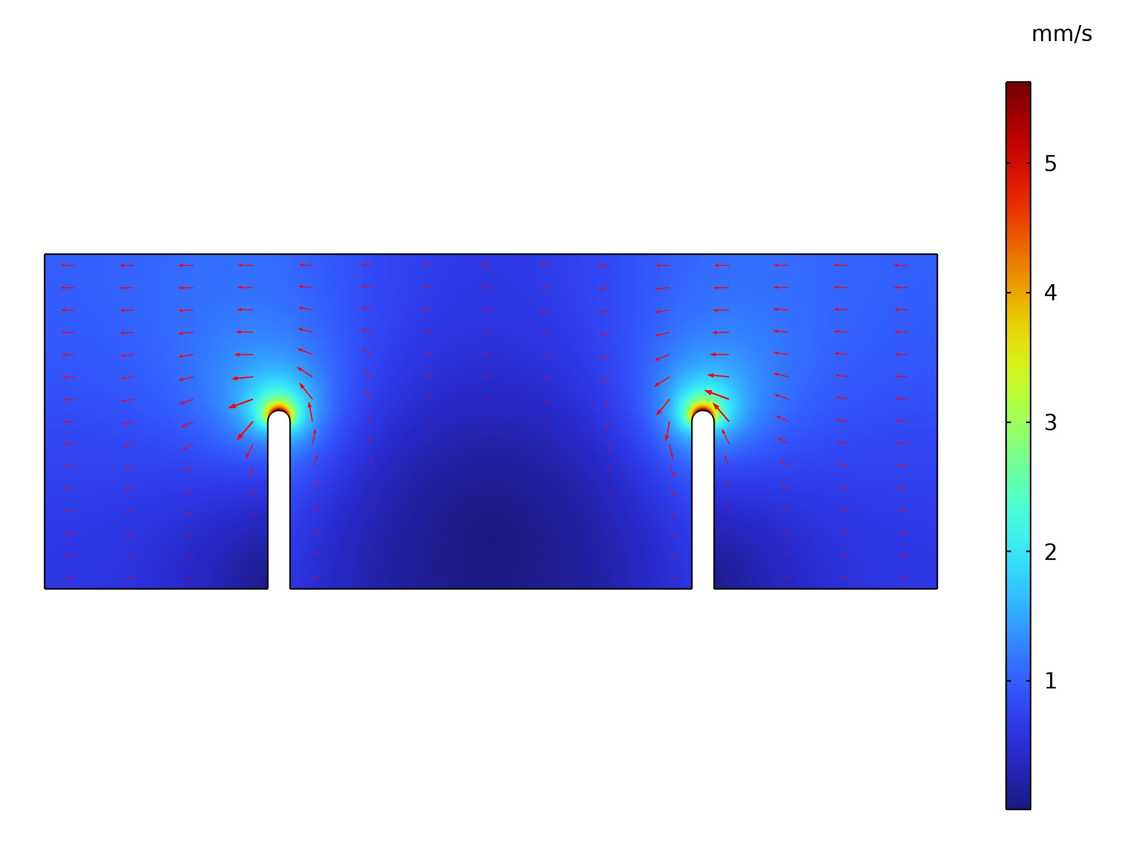
Results
The figure shows the cross sections of the pulse along a line at y = 2.5 mm for the times t =0, 0.5 s, 1.0 s, 1.5 s, and t = 2.0 s
Diffusion, mainly numerical diffusion, smears out the pulse at t = 0 s t = 0.6 s t = 1.2 s t = 1.8 s, while migration and convection mainly translate and shear it, depending on the pressure and the electric field
Cross-section plot of the concentration along a horizontal line at y = 2.5 mm for the times t = 0 (blue solid), 0.5 s, 1.0 s, 1.5 s, and 2.0 s

