Slide 1
Thermal Fatigue of a Surface Mount Resistor
COMSOL

Slide 2
Introduction
A surface mount resistor is subjected to thermal cycling
The difference in the thermal expansion between the materials introduces thermal stresses in the structure
The solder, connecting the resistor to the printed circuit board, is seen as the weakest link in the assembly
Because the operating temperature is high when compared to the melting point of the solder, creep deformation occurs
In order to assure the structural integrity of the component a fatigue analysis is performed where the life prediction from two different fatigue models is compared

Slide 3
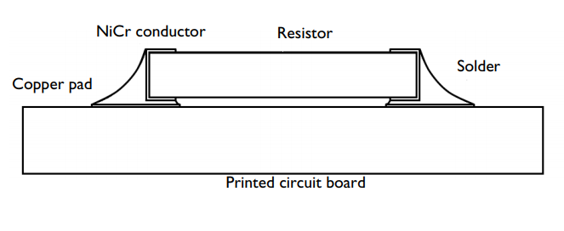
Model Definition
A resistor is fastened on a printed circuit board (PCB) with SnAgCu solder
The solder is connected to the printed circuit board through two copper pads and to the resistor through a NiCr conductor
In reality there are additional thin films around the resistor but they are disregarded in current analysis
A sketch of the surface mount assembly is shown in the figure
The resistor is made out of alumina and has dimensions 3.2 mm x 0.55 mm
Schematic description of the surface mount resistor

Slide 4
Model Definition
It is covered on both edges with a 0.025 mm layer of NiCr conductor
The thin layer continues 0.325 mm along the lower and the upper side of the resistor
The printed circuit board is large in comparison with the resistor and is here modeled 0.8 mm thick
It has two copper pads on the top side that are 0.025 mm thick and 1.05 mm wide
The thickness of the solder fillet between the copper pads and the NiCr conductor is 0.05 mm
Schematic description of the surface mount resistor

Slide 5
Model Definition
The remaining shape of the solder joint varies greatly between each examined solder joint and is here modeled with two representative roundings
Schematic description of the surface mount resistor

Slide 6
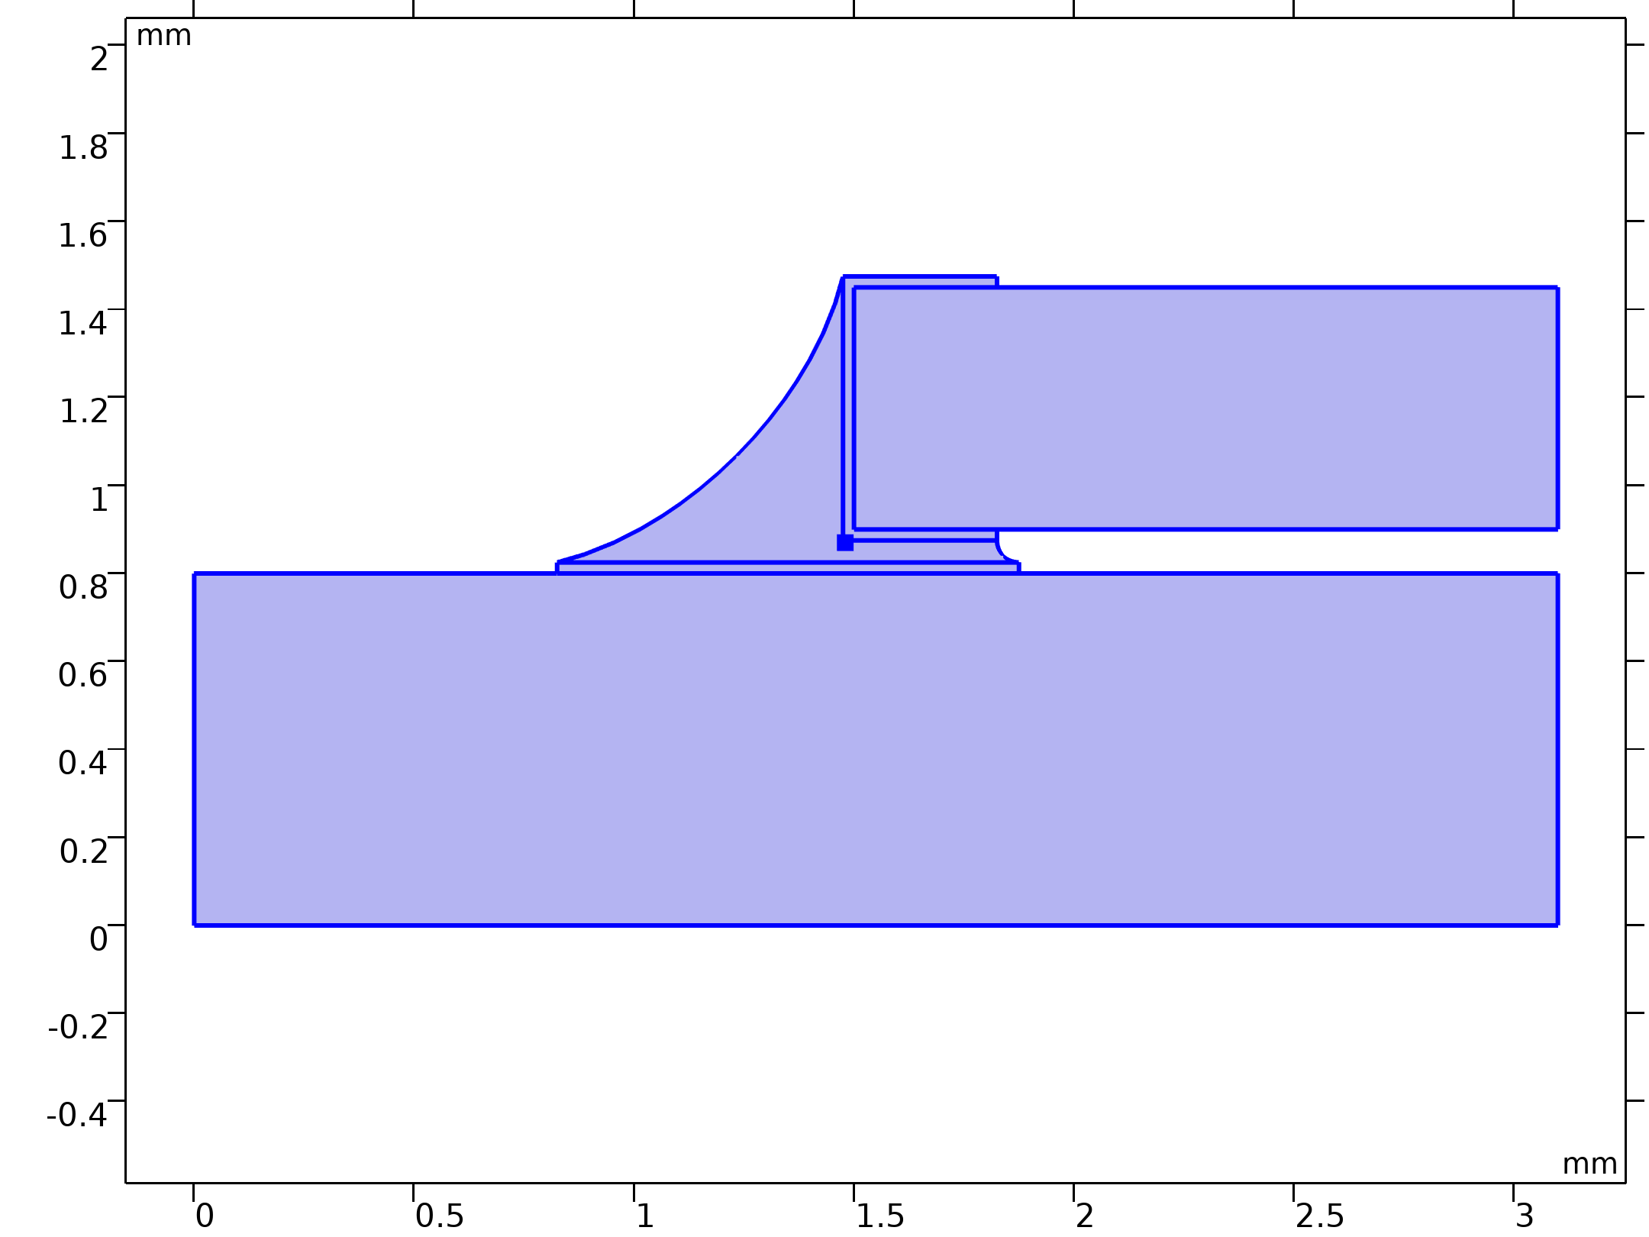

Model Definition
Solid Mechanics

Slide 7
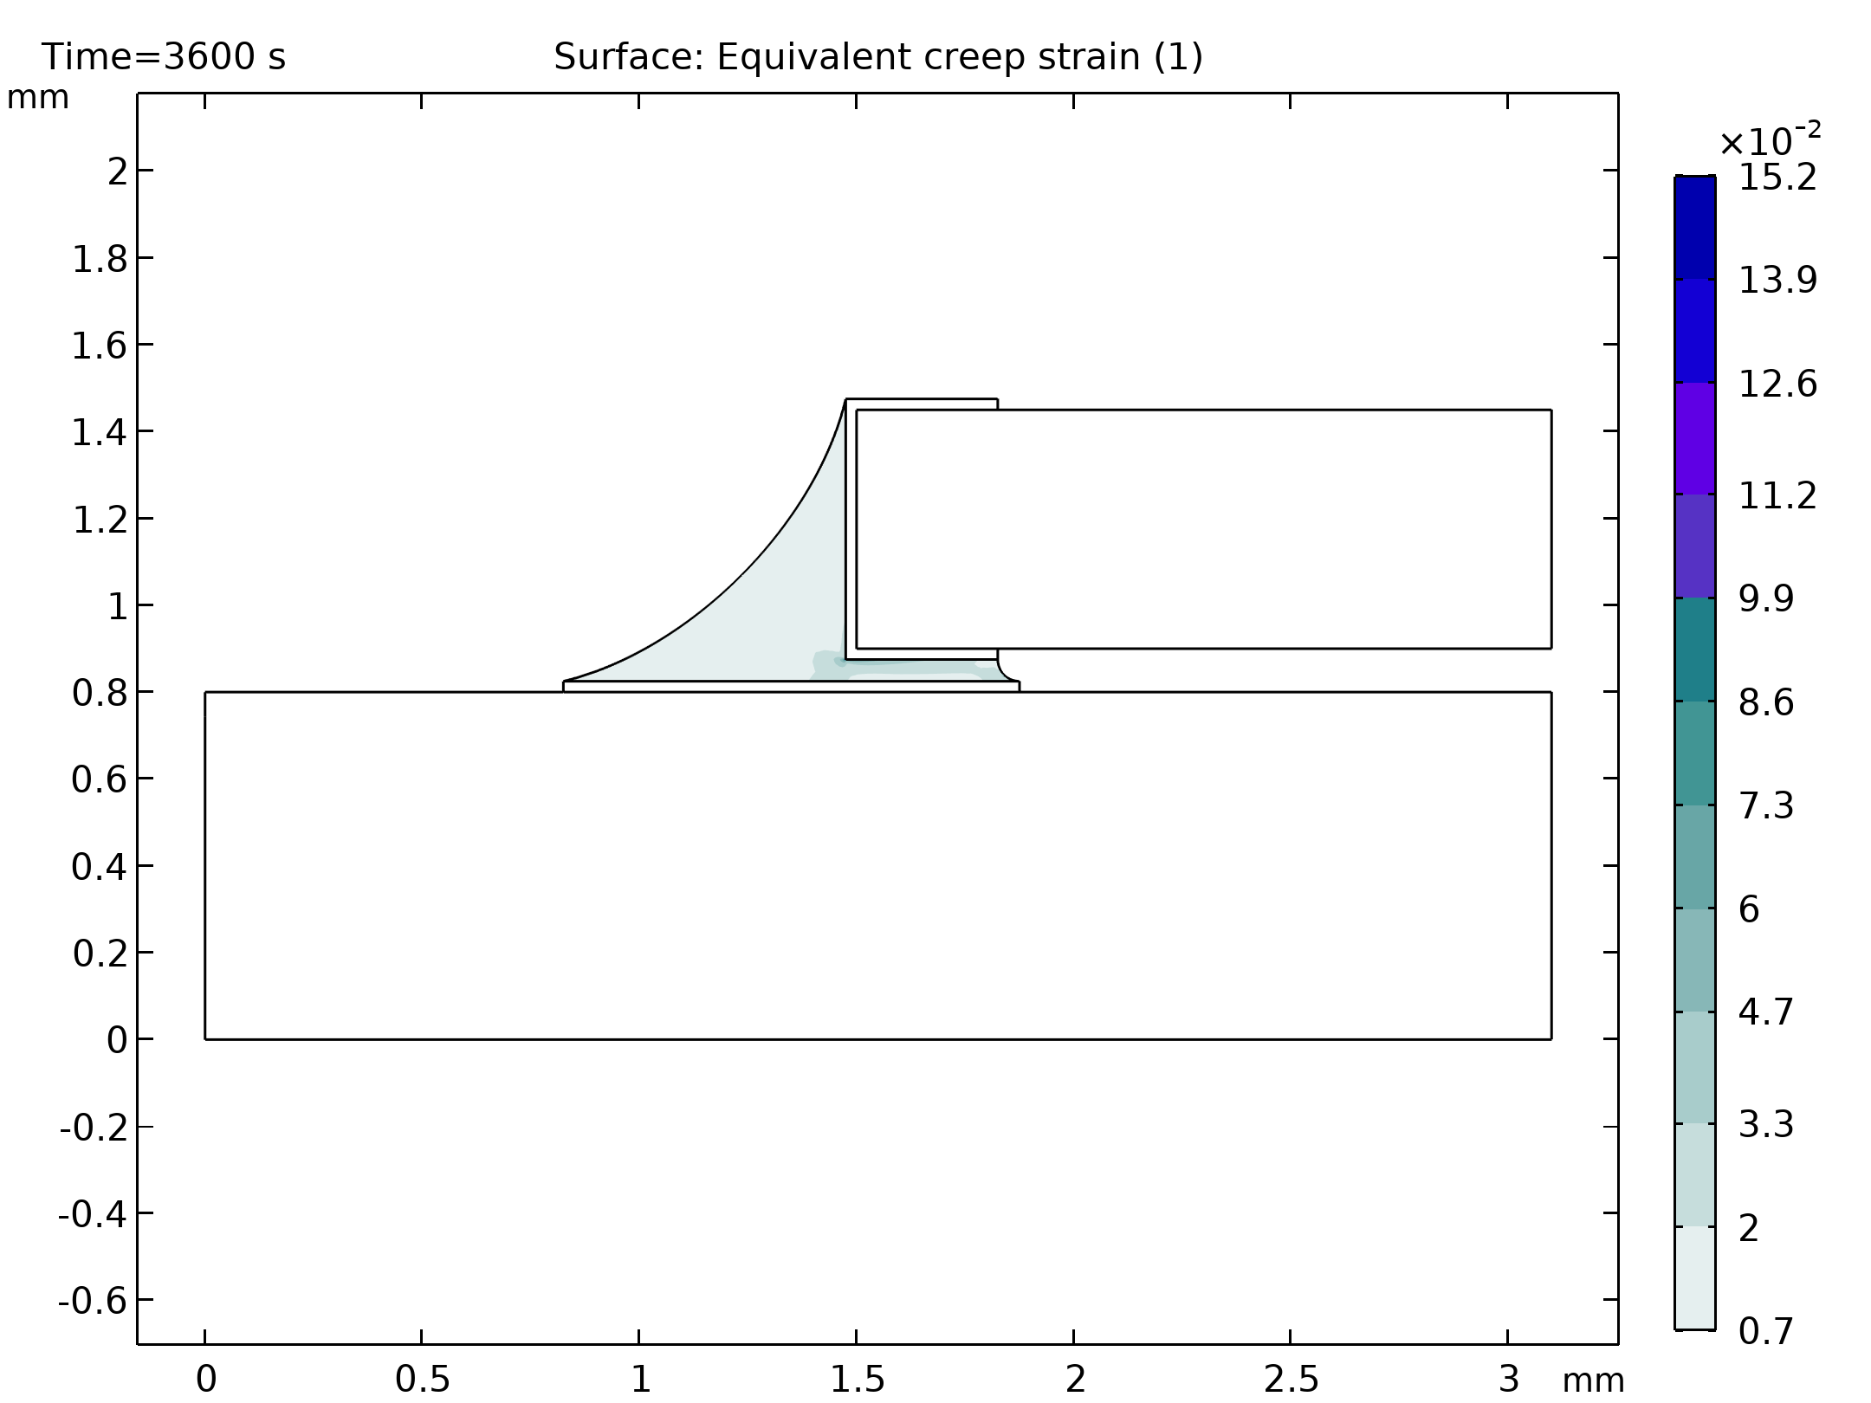
Results
Creep strains in the solder joint

Slide 8
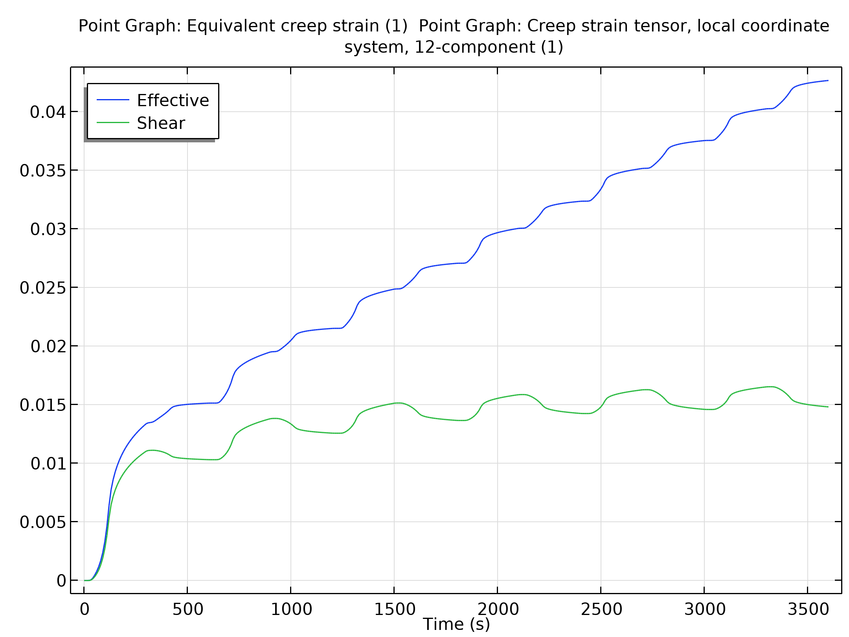
Results
Creep strain development in a critical point below the resistor

Slide 9
Results
The position of this point can be debated
It is however located in the area where the largest strains occurs and is therefore seen as the critical point
In the figure the equivalent creep strain and the shear creep strain component are shown
Creep strain development in a critical point below the resistor

Slide 10
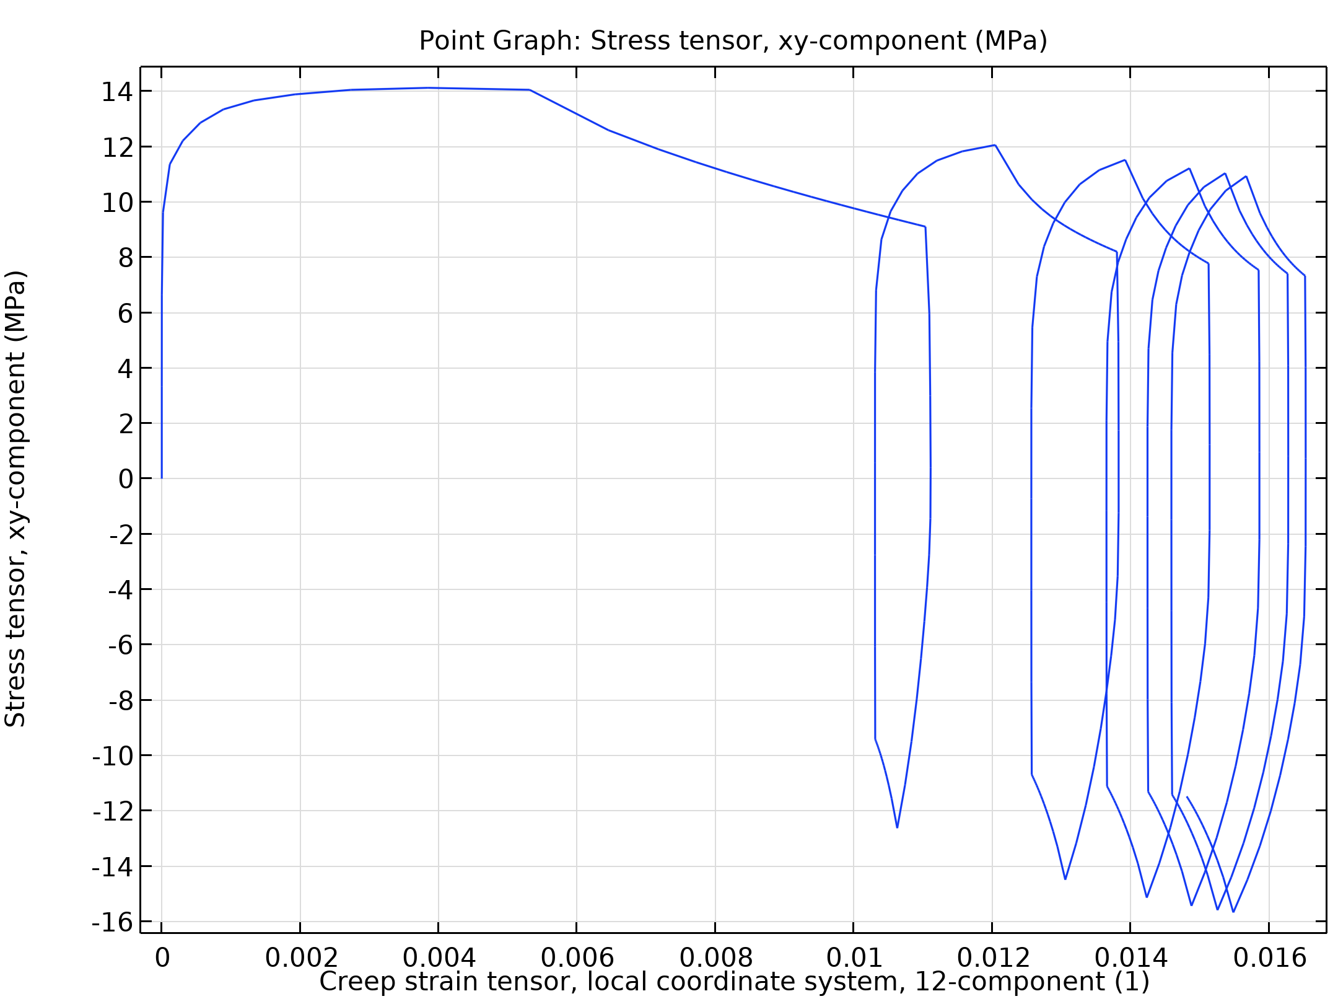
Results
Shear hysteresis evaluated in a critical point just below the resistor

Slide 11
Results
It is clear from the two last figures that the first cycle is not representative for fatigue analysis, since its response differs significantly from the one experienced in the following cycles
Even after six cycles, the stress-strain loop has not stabilized
The temperature cycling can by extended with additional cycles to evaluate whether the state stabilizes further or not
Under some conditions, it may happen that the hysteresis loop is moving in stress-strain space
In this example additional cycles are not simulated since the difference in the creep strain and the dissipated energy between cycle five and six is small
Assuming that the consecutive cycles follow the trend and deform less as, well as dissipate less energy, the fatigue analysis based on the results of the sixth cycle gives a conservative fatigue prediction
The fatigue life based on the Coffin-Manson model is shown in the first graph, and the fatigue life based on the Morrow model is shown in the second graph

Slide 12
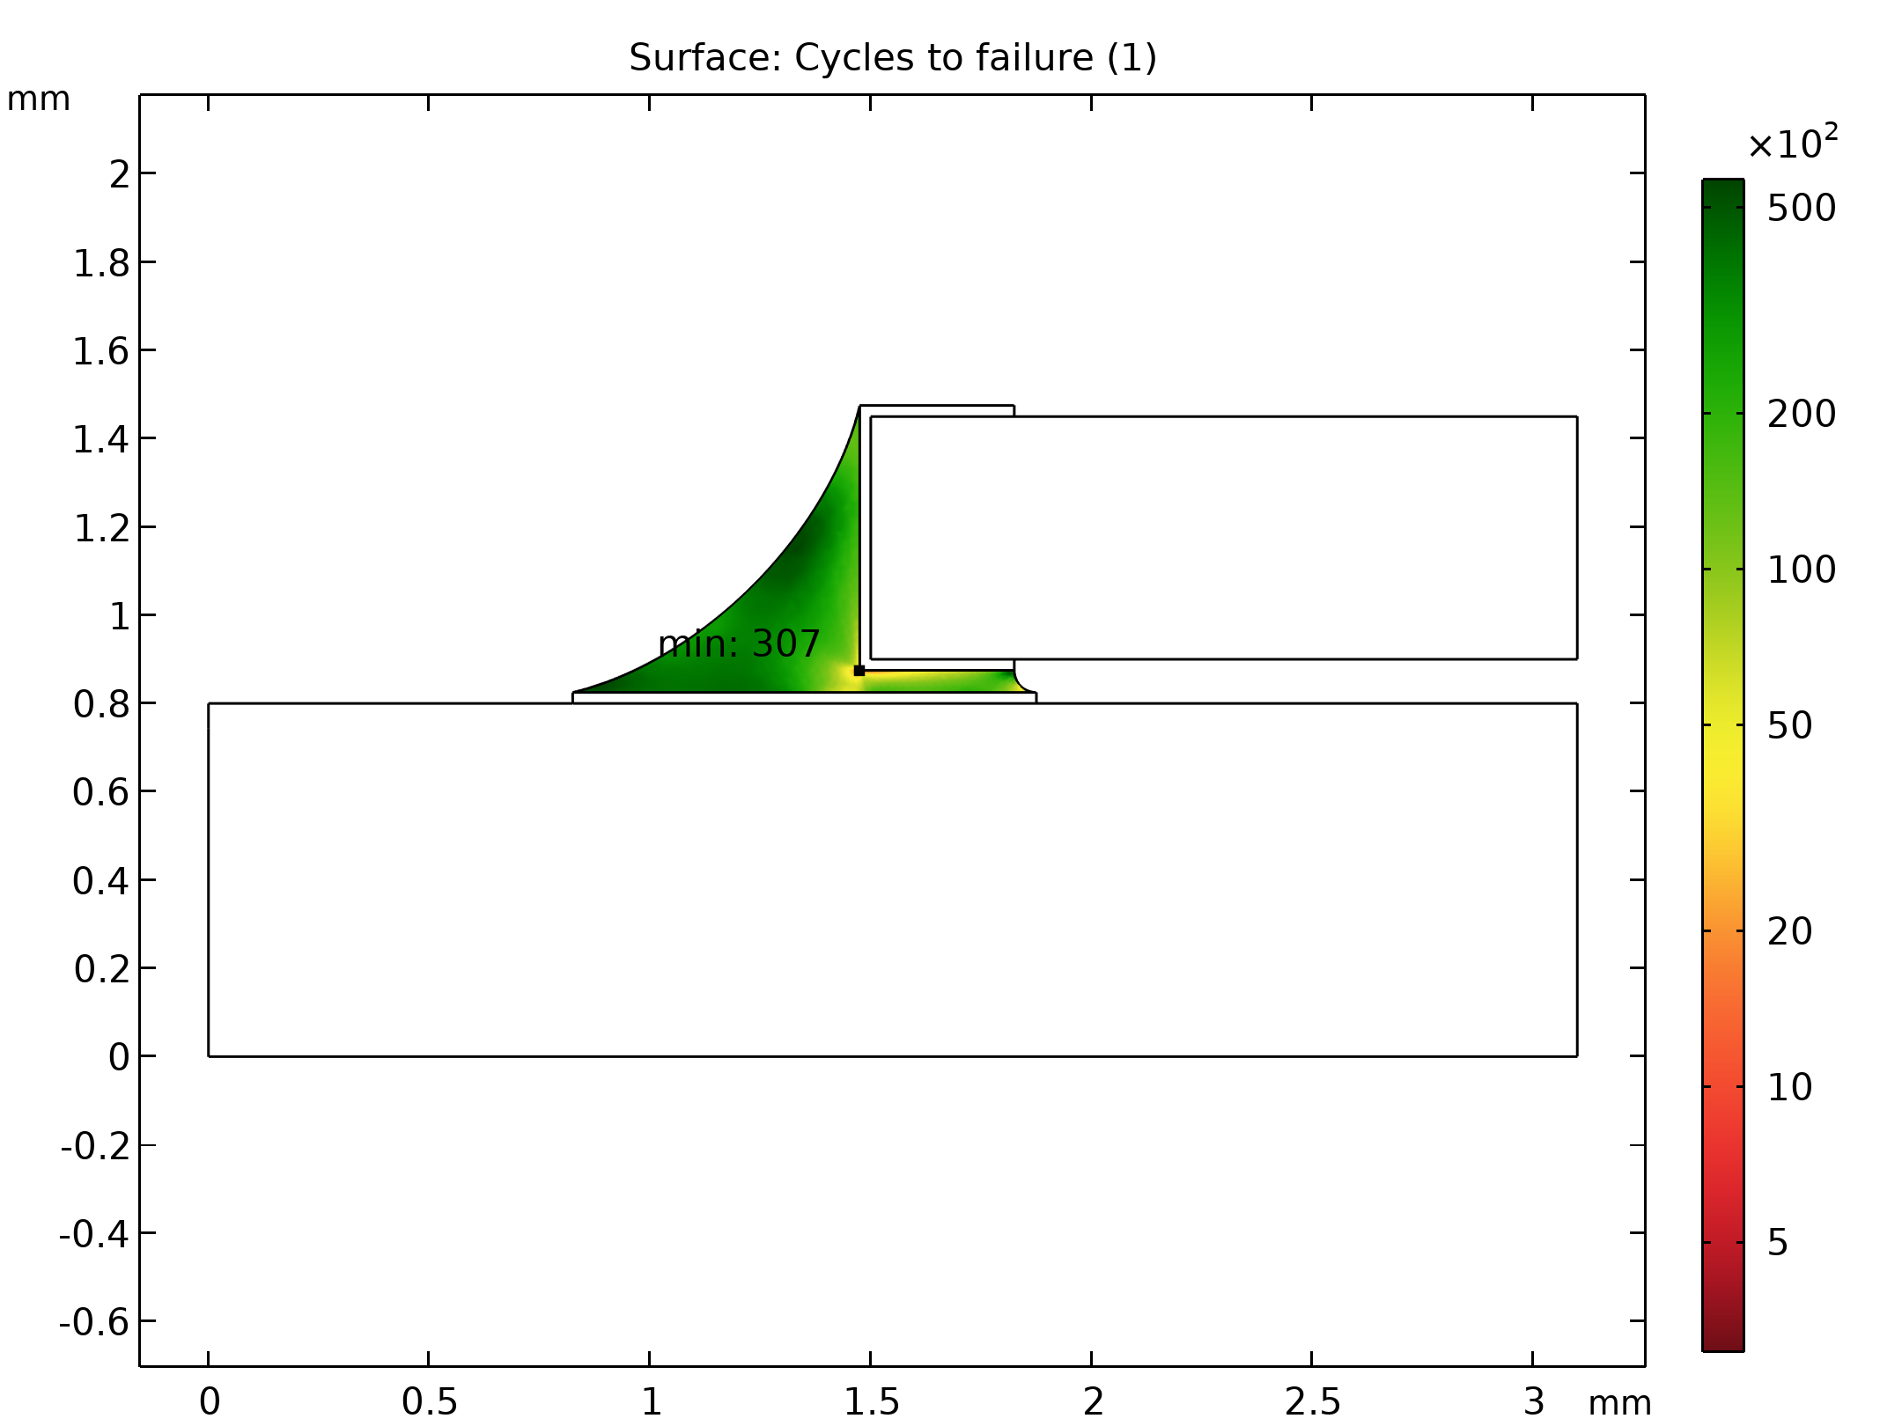
Results
Fatigue life based on the creep strain

Slide 13
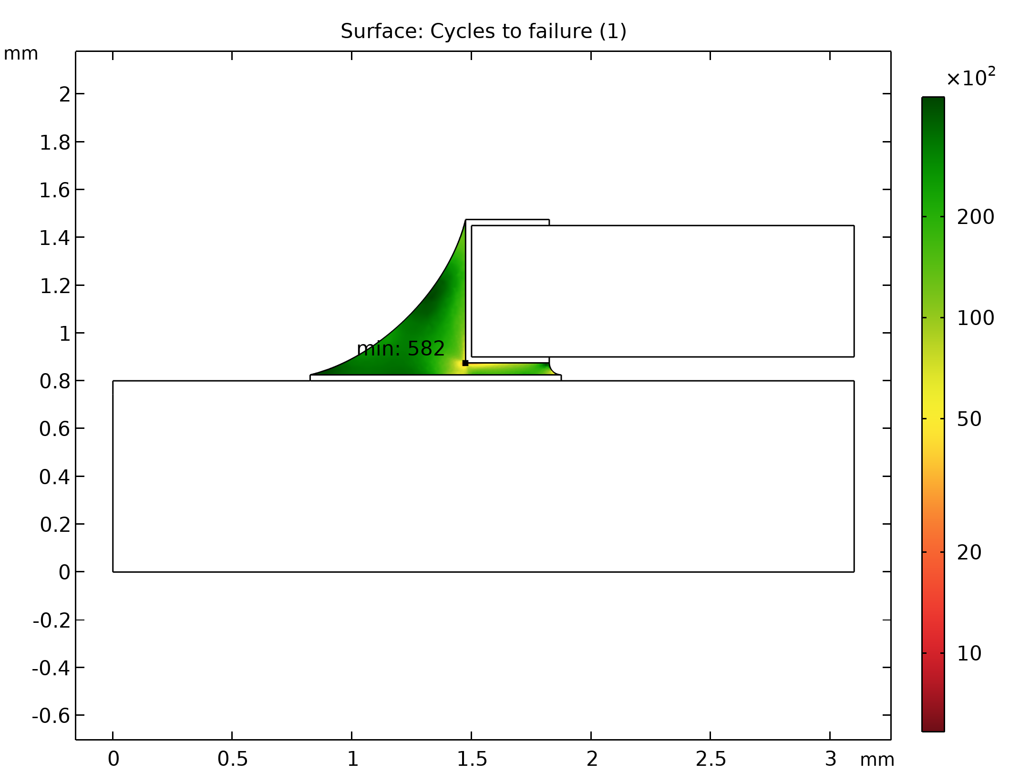
Results
Fatigue life based on the dissipated energy

