Slide 1
Hepatic Tumor Ablation
COMSOL

Slide 2
Background
One method for removing cancerous tumors from healthy tissue is to heat the malignant tissue to a critical temperature that kills the cancer cells
The heating can be accomplished by inserting a four-armed electric probe through which an electric current runs
Electric and bioheat physics are coupled to account for the Joule heating in the tissue
This medical procedure removes the tumorous tissue by heating it above 45°C to 50°C

Slide 3
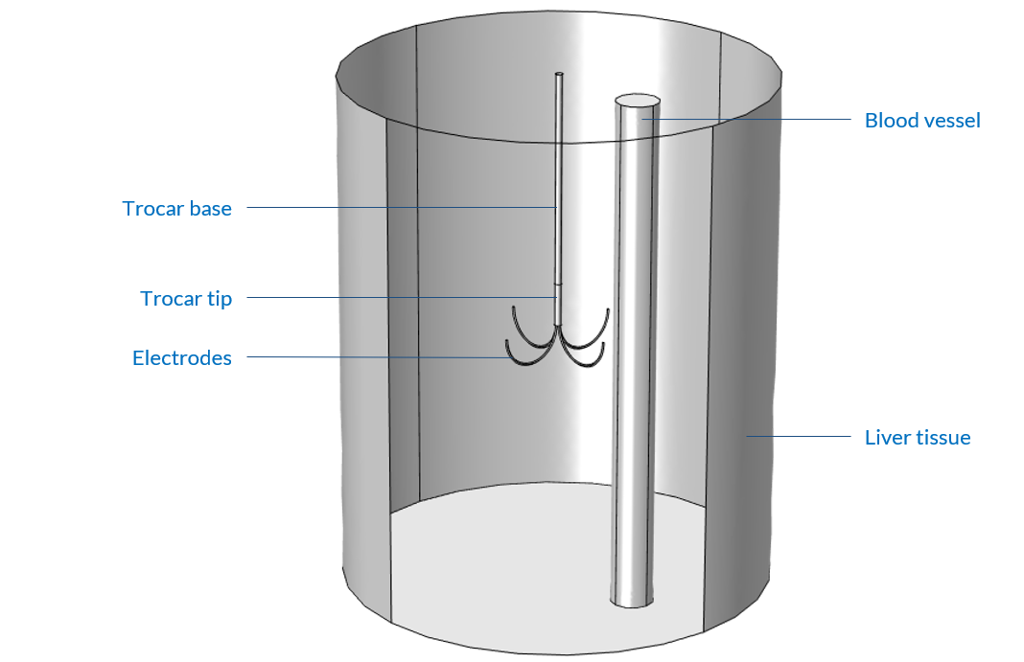
Model Definition
The probe is inserted inside liver tissue
A blood vessel is represented near the probe
The four electrode arms are deployed in an area covering the tumor. The tumor itself is not represented, but is located near the center of the cylindrical liver tissue
DC current is considered through the probe
Model geometry

Slide 4
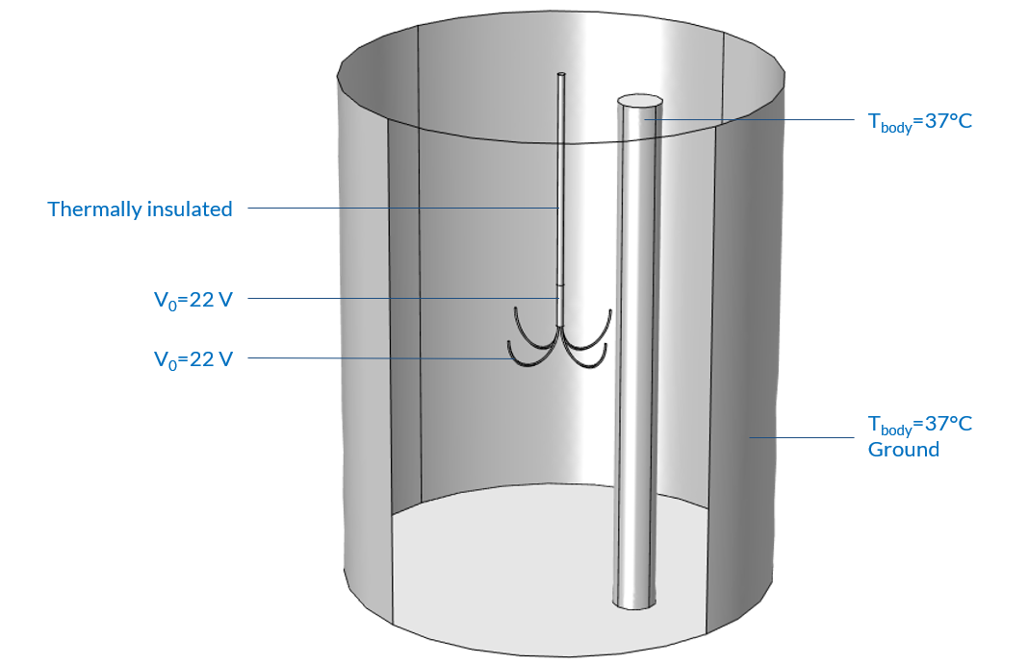
Model Definition
The trocar is thermally insulated except near the electrodes
At the electrode boundaries the potential equals 22 V
The external and the blood vessel boundaries are set at the body temperature of 37°C
A ground condition is applied on the outer boundaries of the liver tissue
Model boundary conditions

Slide 5
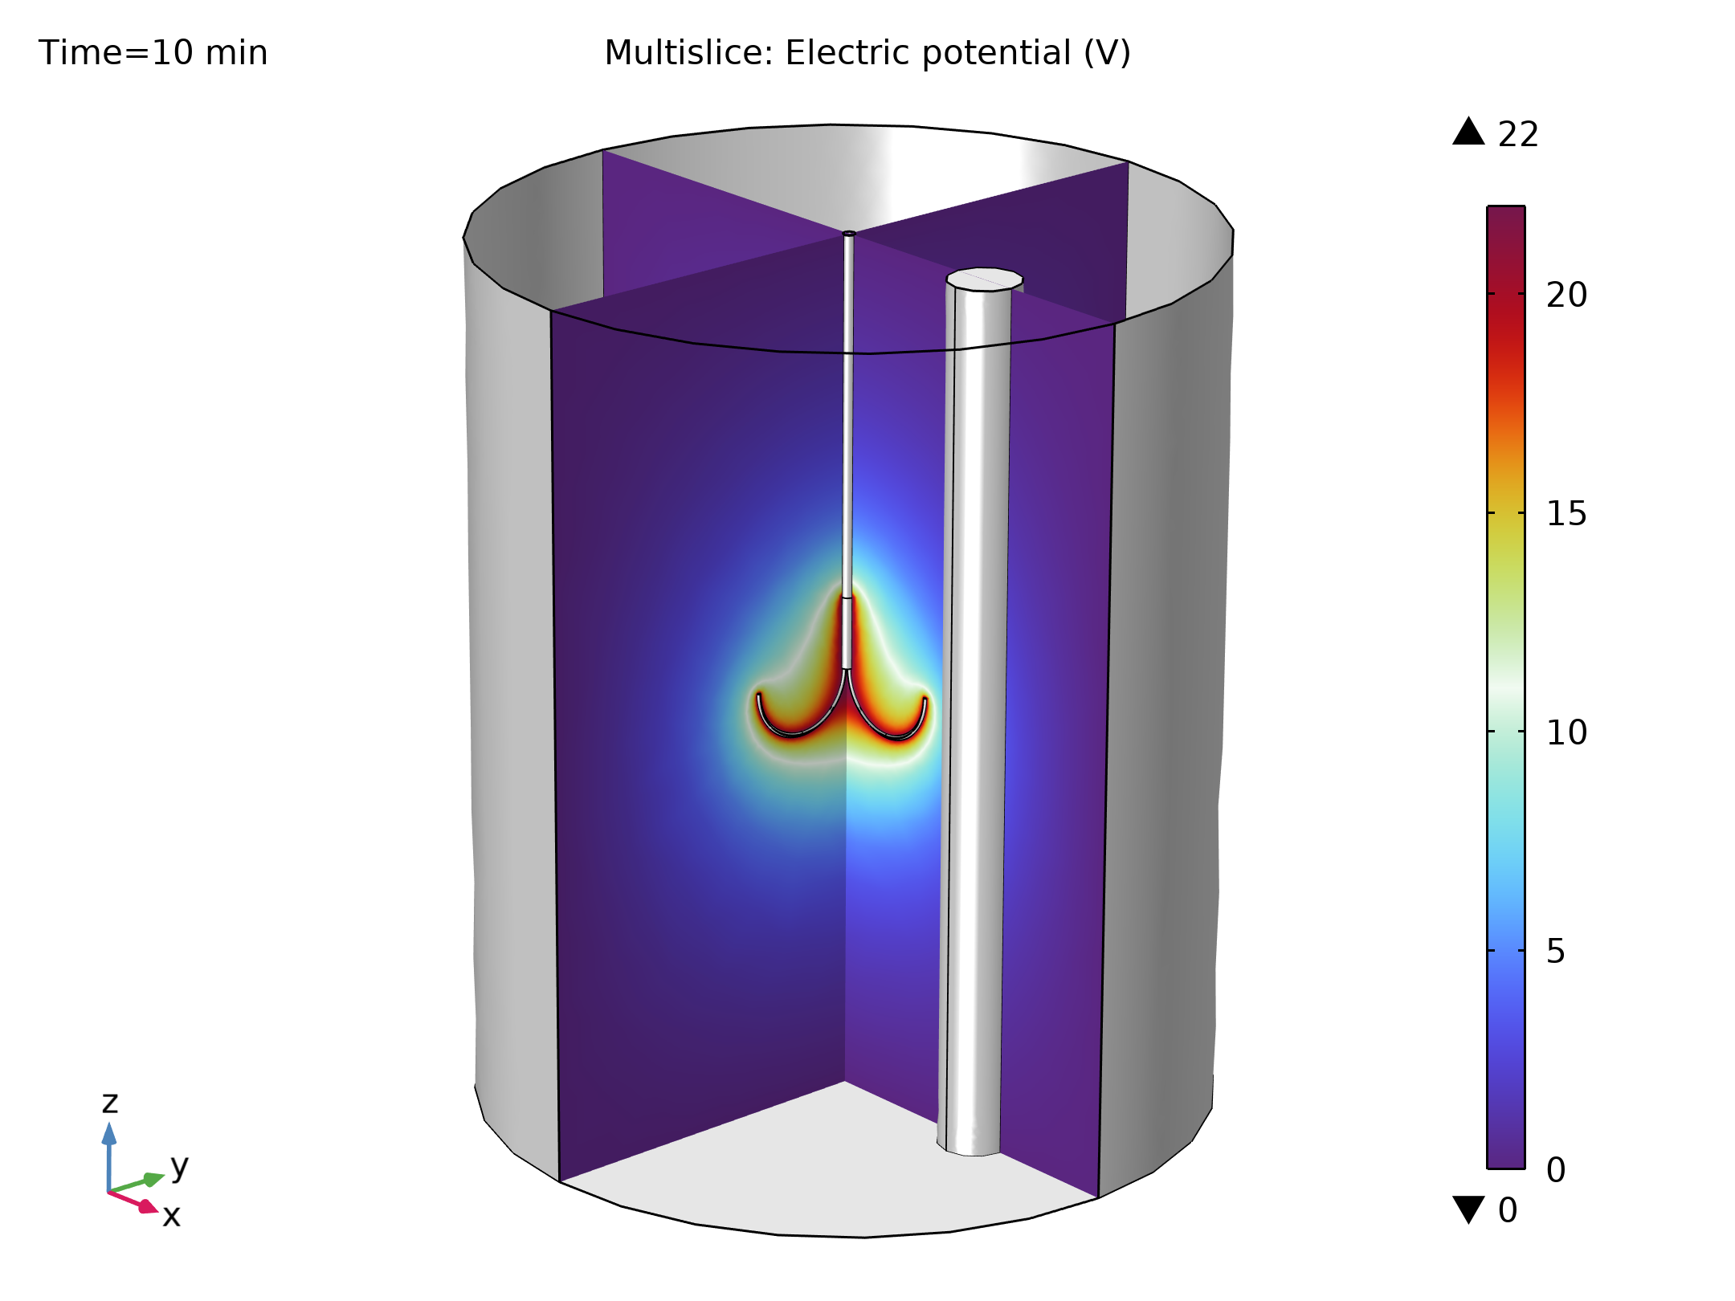
Results
The electric potential is high in the tissue near the electrodes and fades rapidly
The Joule heating in the tissue will therefore be concentrated around the electrodes and the trocar tip
Electric potential field in the liver tissue

Slide 6
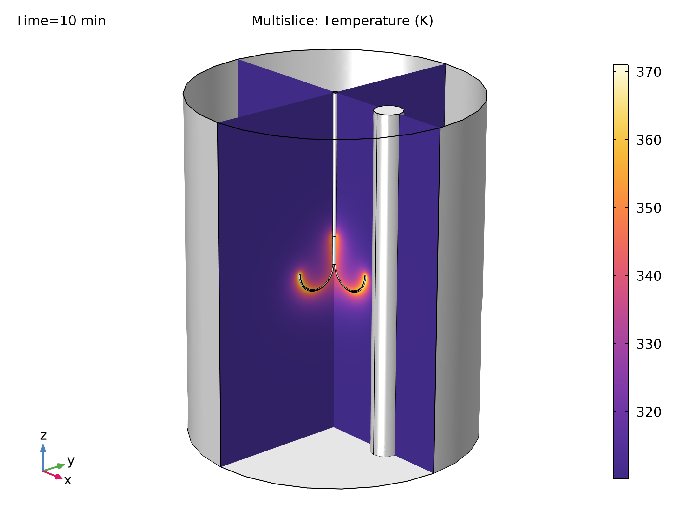
Results
After 10 minutes, the temperature reaches a maximum of 97°C at the tip of the electrodes
The temperature in the liver tissue is high near the probe due to Joule heating
Since the liver tissue has a relatively low thermal conductivity, the temperature remains low in the rest of the tissue
Temperature field in the domain

Slide 7
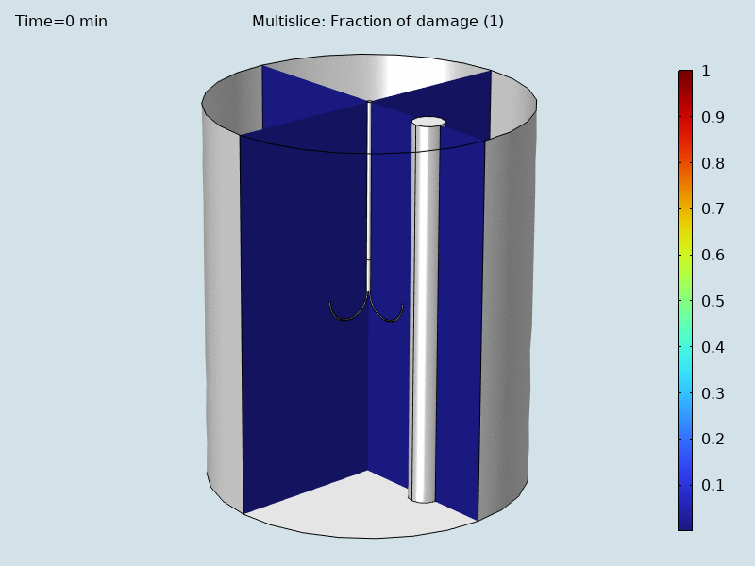
Results
After 10 minutes, the high temperatures close to the probe killed the nearby cells
The farthest cells, which were subjected to temperatures below 40°C, suffered little damage
Evolution of damaged tissue over time

