Slide 1
Buckling of HDPE Liners
COMSOL

Slide 2
Introduction
High Density Polyethilene (HDPE) is used to make liners for damaged pipes.
Sudden collapse of the liner can occurr during idle times, when pressure inside the pipe drops.
This is caused by gas permeating between the liner and the pipe and building up pressure on the outer surface of the component.

Slide 3
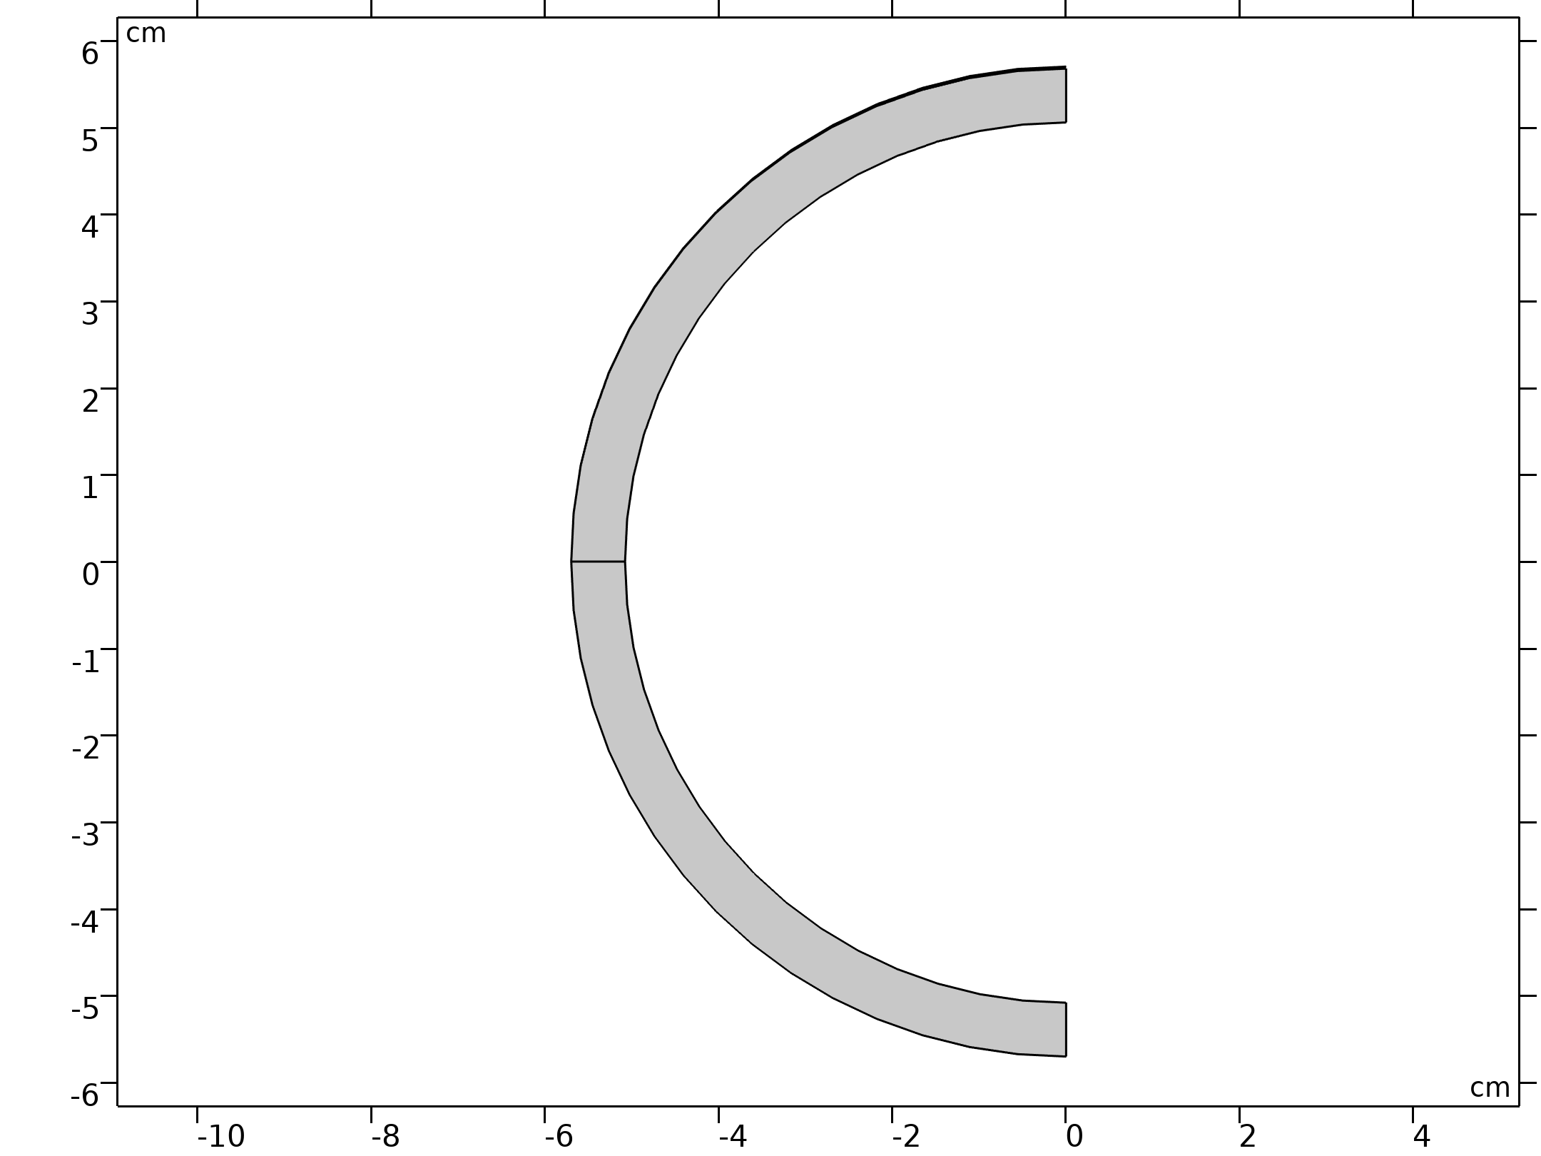
Model Definition
  Under the plain strain assumption, only a section of the 1 m long liner can be modeled.
  The vertical diameter is made 0.2% smaller than the horizontal one, to enforce one-lobe type buckling collapse, as observed experimentally.
  Mirror symmetry along the vertical axis can be exploited to reduce the computational cost.
  The pipe is modeled as a rigid boundary.
Cross-section geometry

Slide 4


Model Definition
The innner surface of the liner is subjected to atmospheric pressure.
The outer surface is subjected to the pressure of the trapped gas:
The gas pressure is increased by imposing a constant inflow mass rate

Slide 5
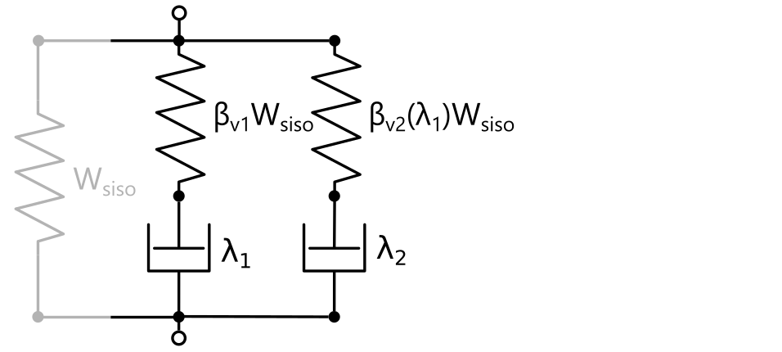
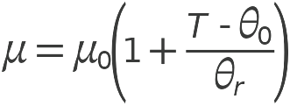

Material Model
The Bergstrom-Bischoff material model features a temperature dempendent stiffness:
The energy factor β_{v2} evolves in time according to:
Rheology of the Bergstrom-Bischoff material model

Slide 6
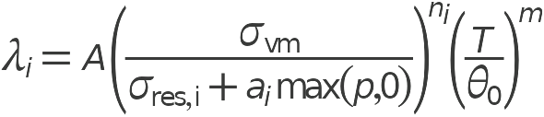
Material Model
The viscoplastic flow is characterized by the following rate multiplier:
μ₀, θ₀, θ_{r}, α, β_{v,f}, A, σ_{res,i}, a_{i}, n_{i}, m are the material properties.
Rheology of the Bergstrom-Bischoff material model

Slide 7
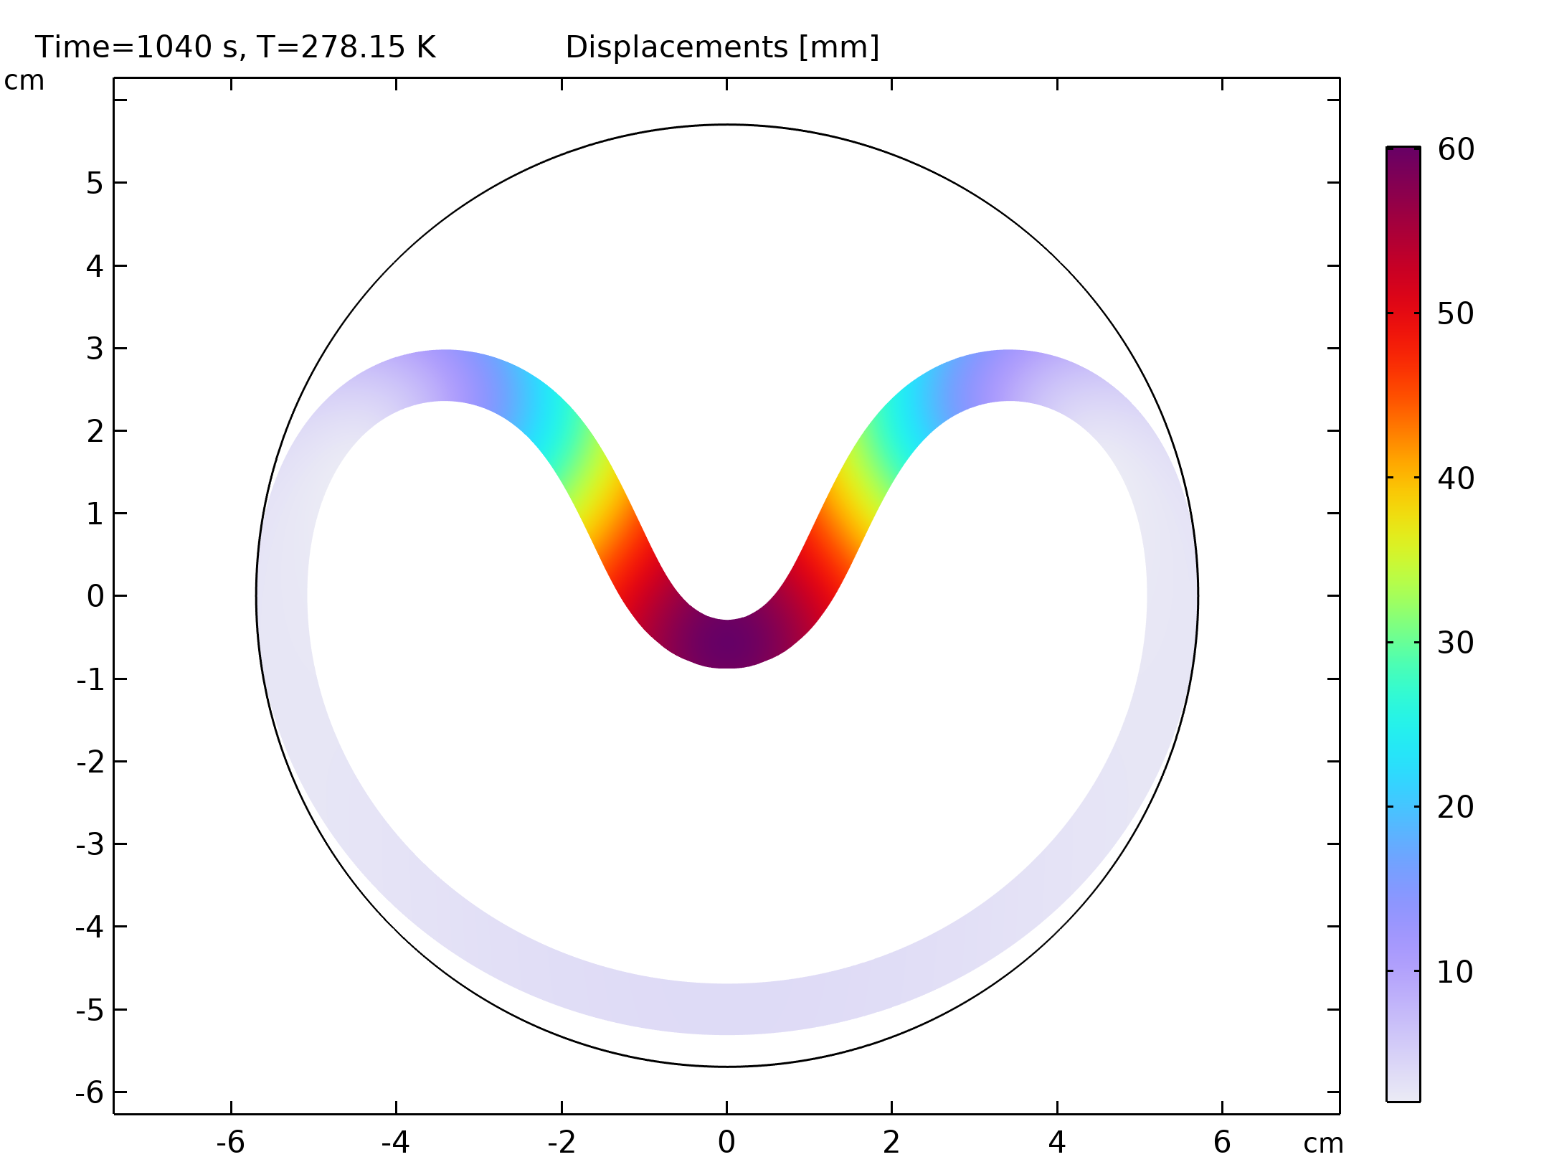
Results
The deformed shape after collapse at 278.15 K.
Displacements [mm]

Slide 8
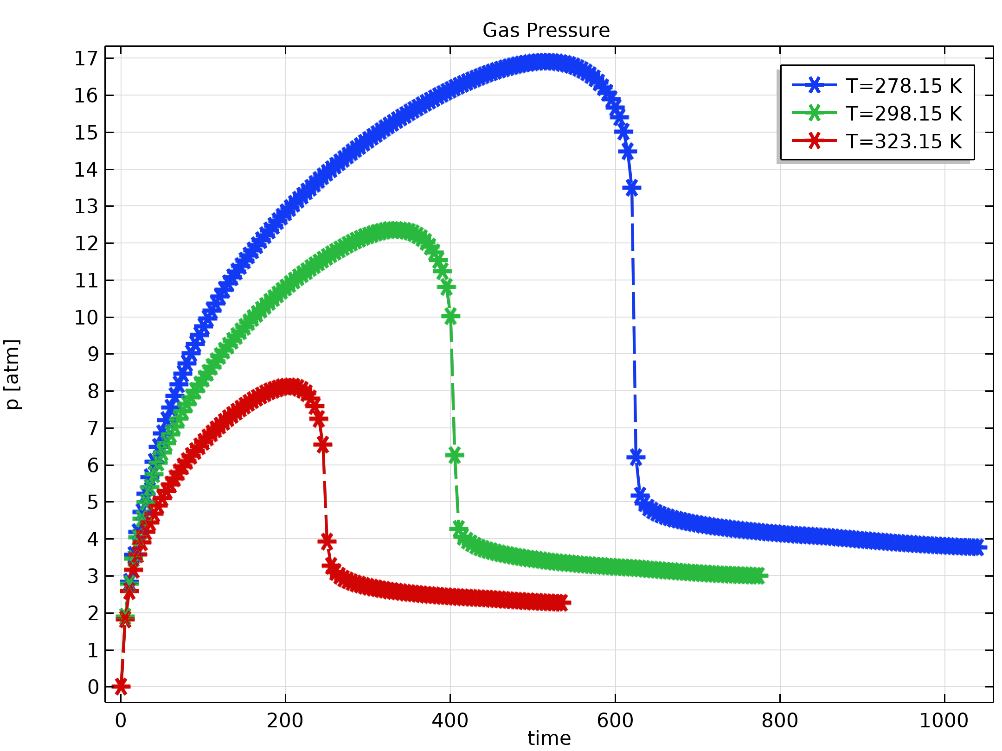
Results
Time evolution of the pressure of the gas trapped between the pipe and the liner.
Gas Pressure

Slide 9

Notes About the COMSOL Implementation
Add an Integration operator to compute the gap volume:
Use the All regions option in the Applicable Pair Region to apply the pressure on the overall external surface of the liner, simulating even permeation of the gas over the whole surface, even if the initial nominal geometry is in contact with the pipe.
Add a Stationary study before the Time Dependent one in order to compute consistent initial conditions. Use the Instantaneous stiffness for the Bergstrom-Boyce material model.

