Slide 1
Effect of Bearing Misalignment on Rotor Vibration
COMSOL

Slide 2
Introduction
In this example, a rotor shaft supported by two hydrodynamic bearings is analyzed The gravity load acts on the rotor
An eccentric disk is also mounted on the rotor between the bearings
One of the bearings is misaligned with the axis of the rotor
The rotor whirls due to the mass imbalance
The built-in multiphysics interface Beam Rotor with Hydrodynamic Bearing is used for the combined simulation of the rotor and bearings
A time dependent analysis is performed for two cases, first without misalignment and then including the misalignment
Results for both cases are compared to understand the effect of the misalignment
The results include stress in the rotor, pressure distribution in the bearings, orbit of the rotor near the disk and the bearings

Slide 3
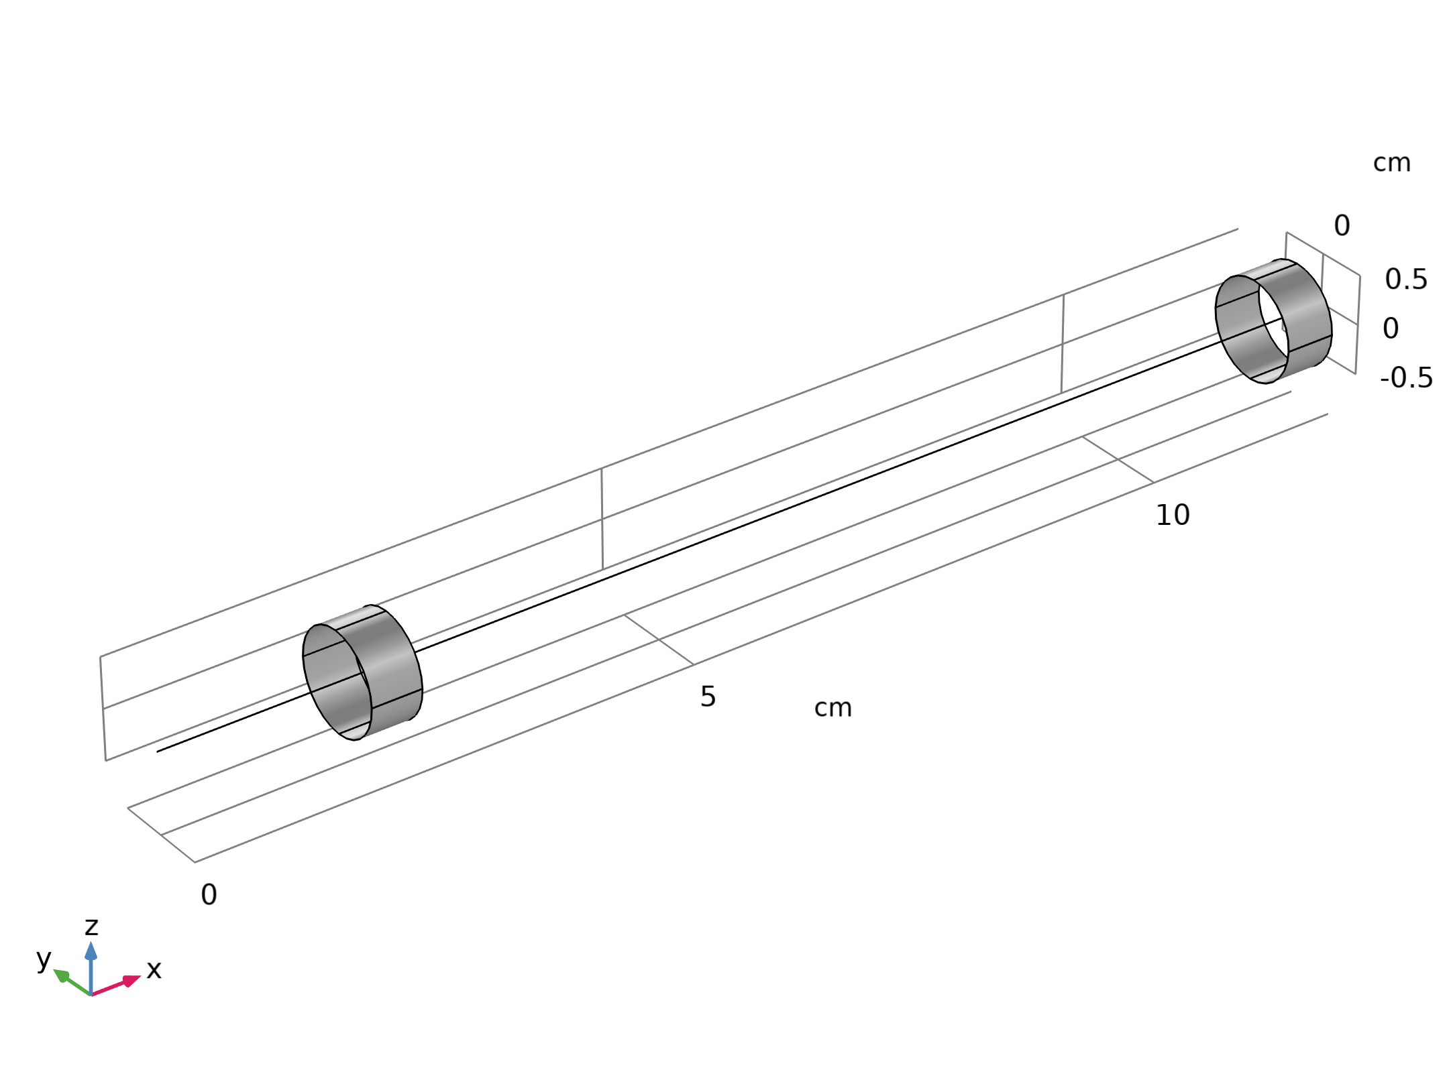
Model Definition
The rotor is driven by a motor and is supported by two hydrodynamic bearings
The distance between the motor and the first bearing is a, the distance between the bearings is L
Thus, the rotor between the motor and first bearing is overhung with overhung of length a
The rotor diameter is d
A disk is mounted on the rotor between the bearings, and it has a certain amount of imbalance
Bearing rotor assembly

Slide 4
Model Definition
The rotor rotates inside the bearings with an angular speed Ω
Bearing rotor assembly

Slide 5
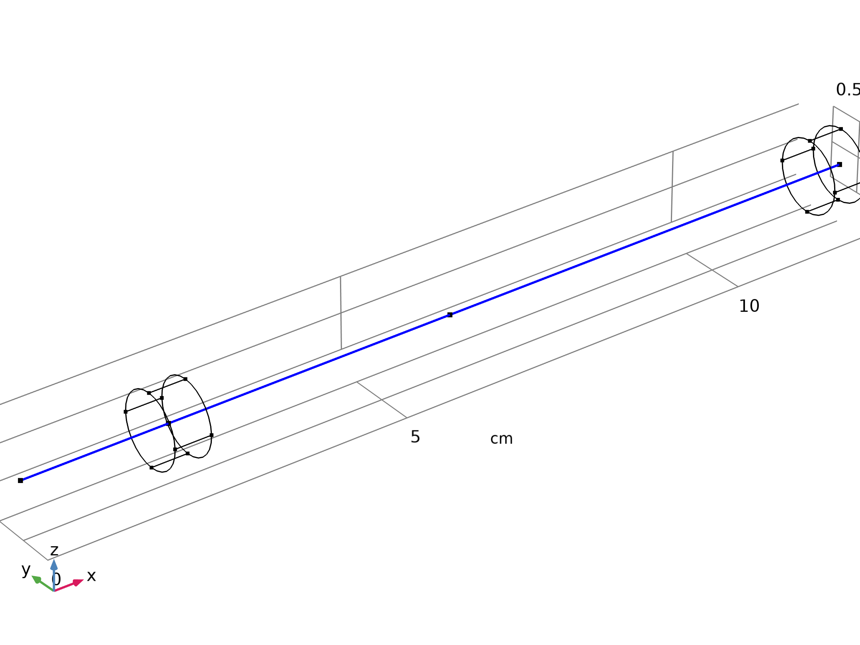

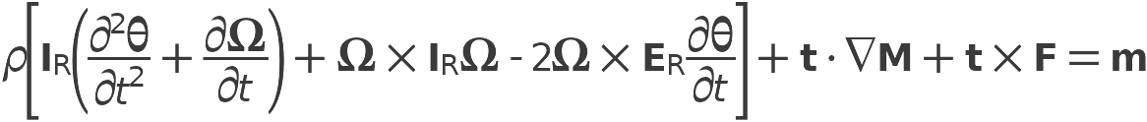
Model Definition
Beam rotor

Slide 6

Model Definition
Beam rotor

Slide 7
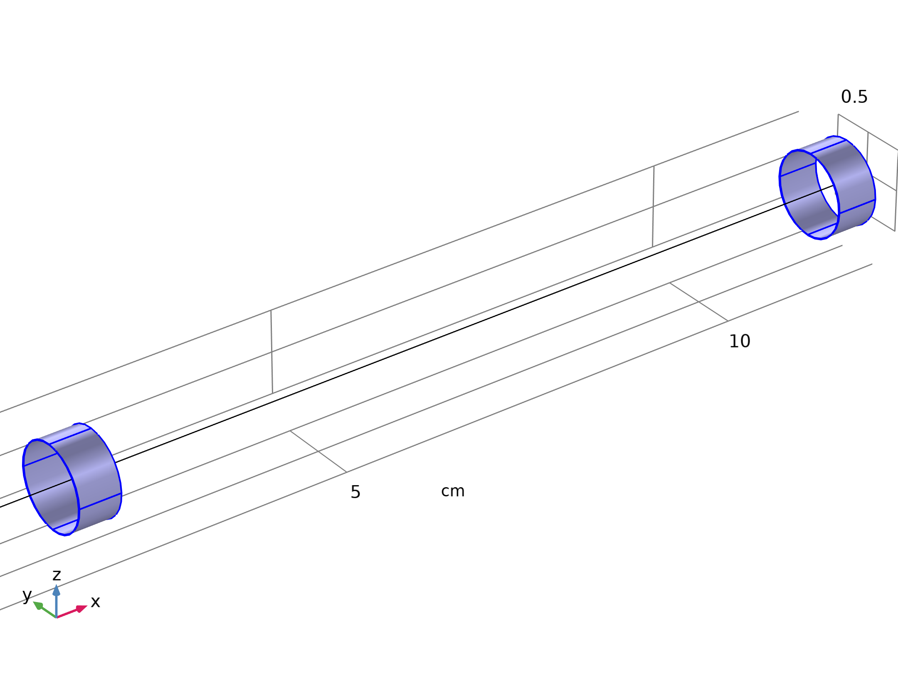


Model Definition
Hydrodynamic bearing

Slide 8
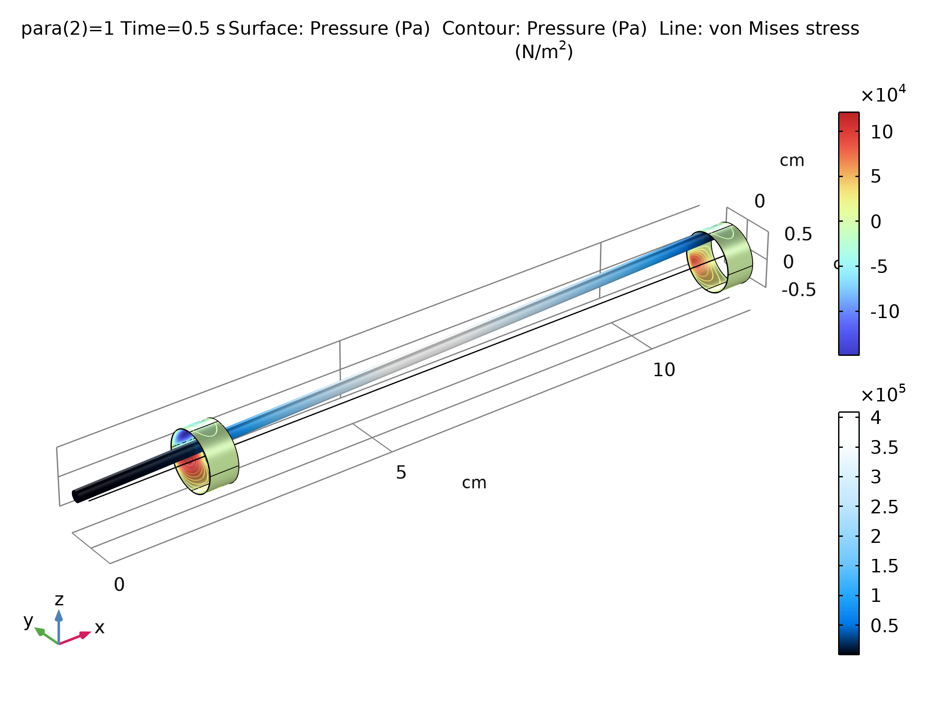
Results
The figure shows the stress profile on the rotor for the misaligned rotor with the maximum bending stress in the middle part
The pressure distribution in the bearings is also shown
Bearing pressure and rotor stress

Slide 9
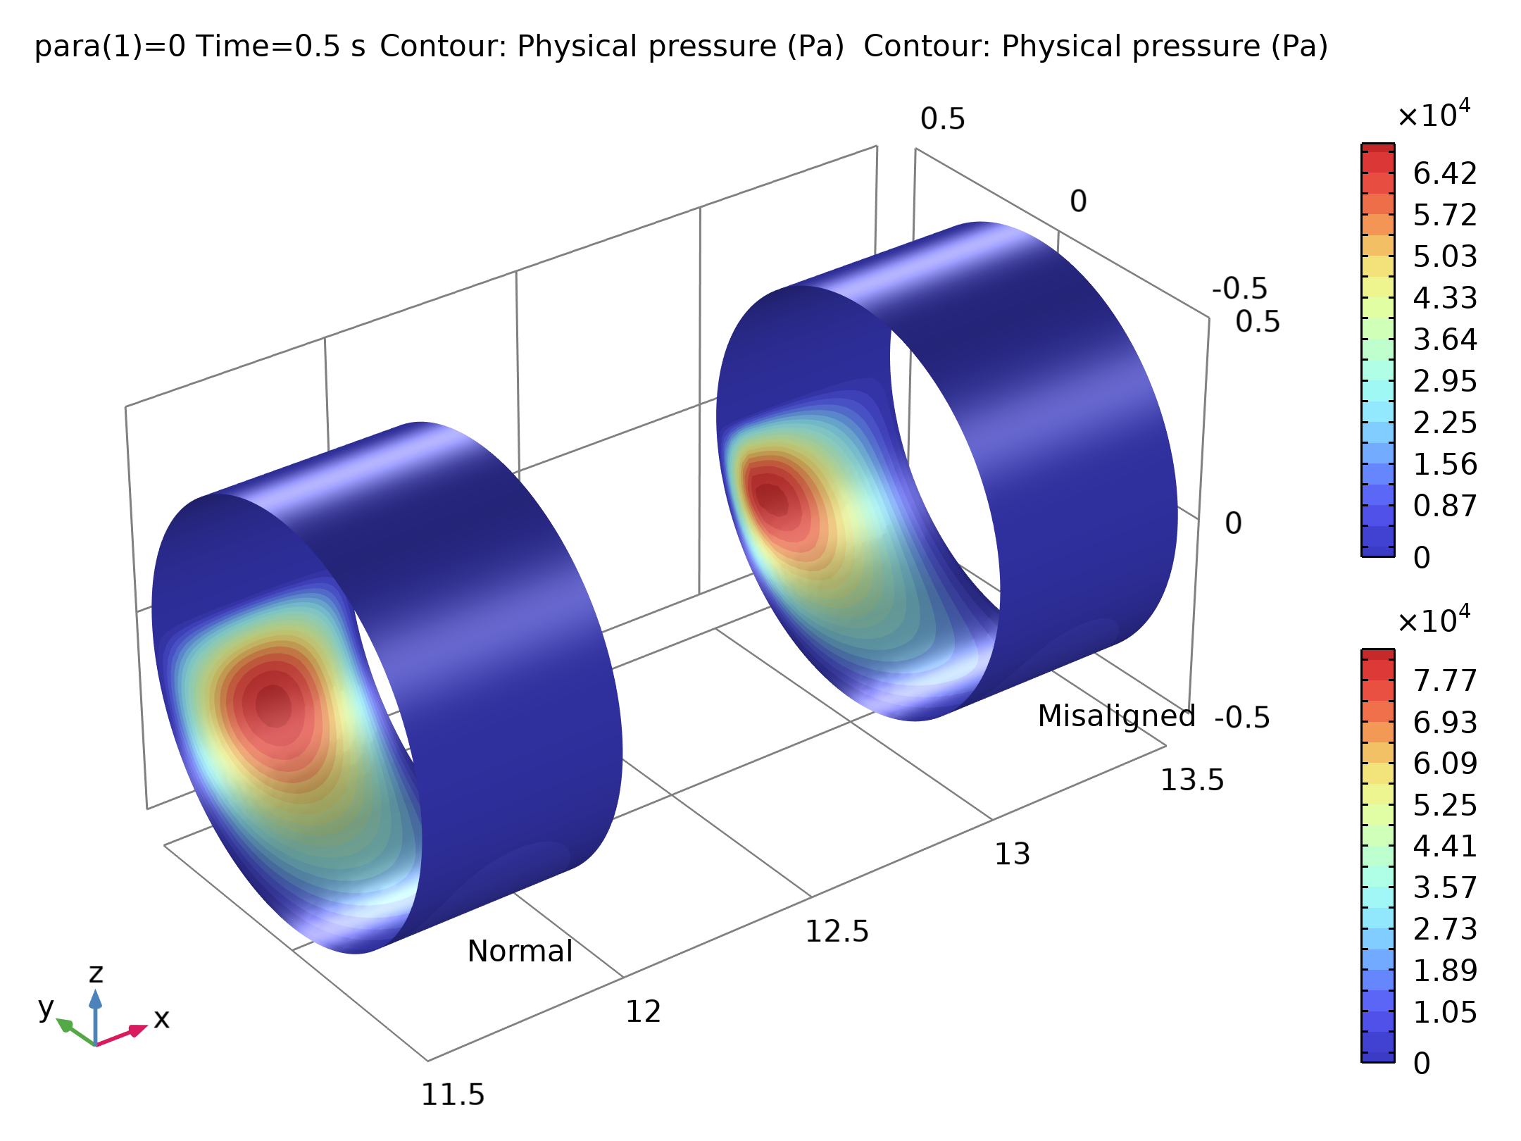
Results
The figure shows a comparison of the pressure in the first bearing for with and without misalignment
In the case of misalignment, the pressure distribution in the bearing becomes skewed
Comparison of bearing pressure with and without misalignment

Slide 10
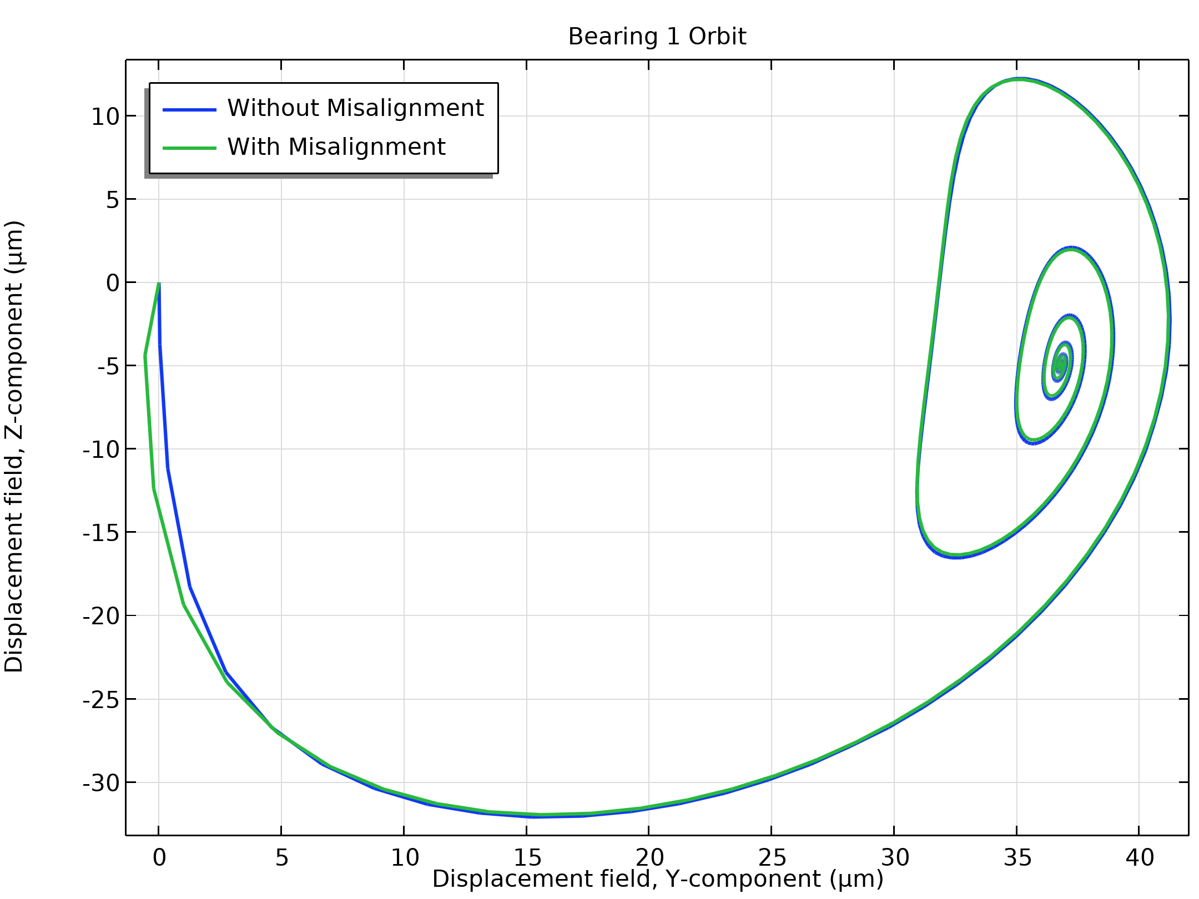
Results
The figure shows the orbit of the journal in the yz-plane in the first bearing
The orbit consists of a transient response followed by steady state whirl
An equilibrium position in the orbit is decided by the gravity load, and the whirl around the equilibrium position is the response to the mass imbalance
The journal orbit in the left bearing is not significantly affected by the misalignment in the right bearing
Journal orbit in left bearing

Slide 11
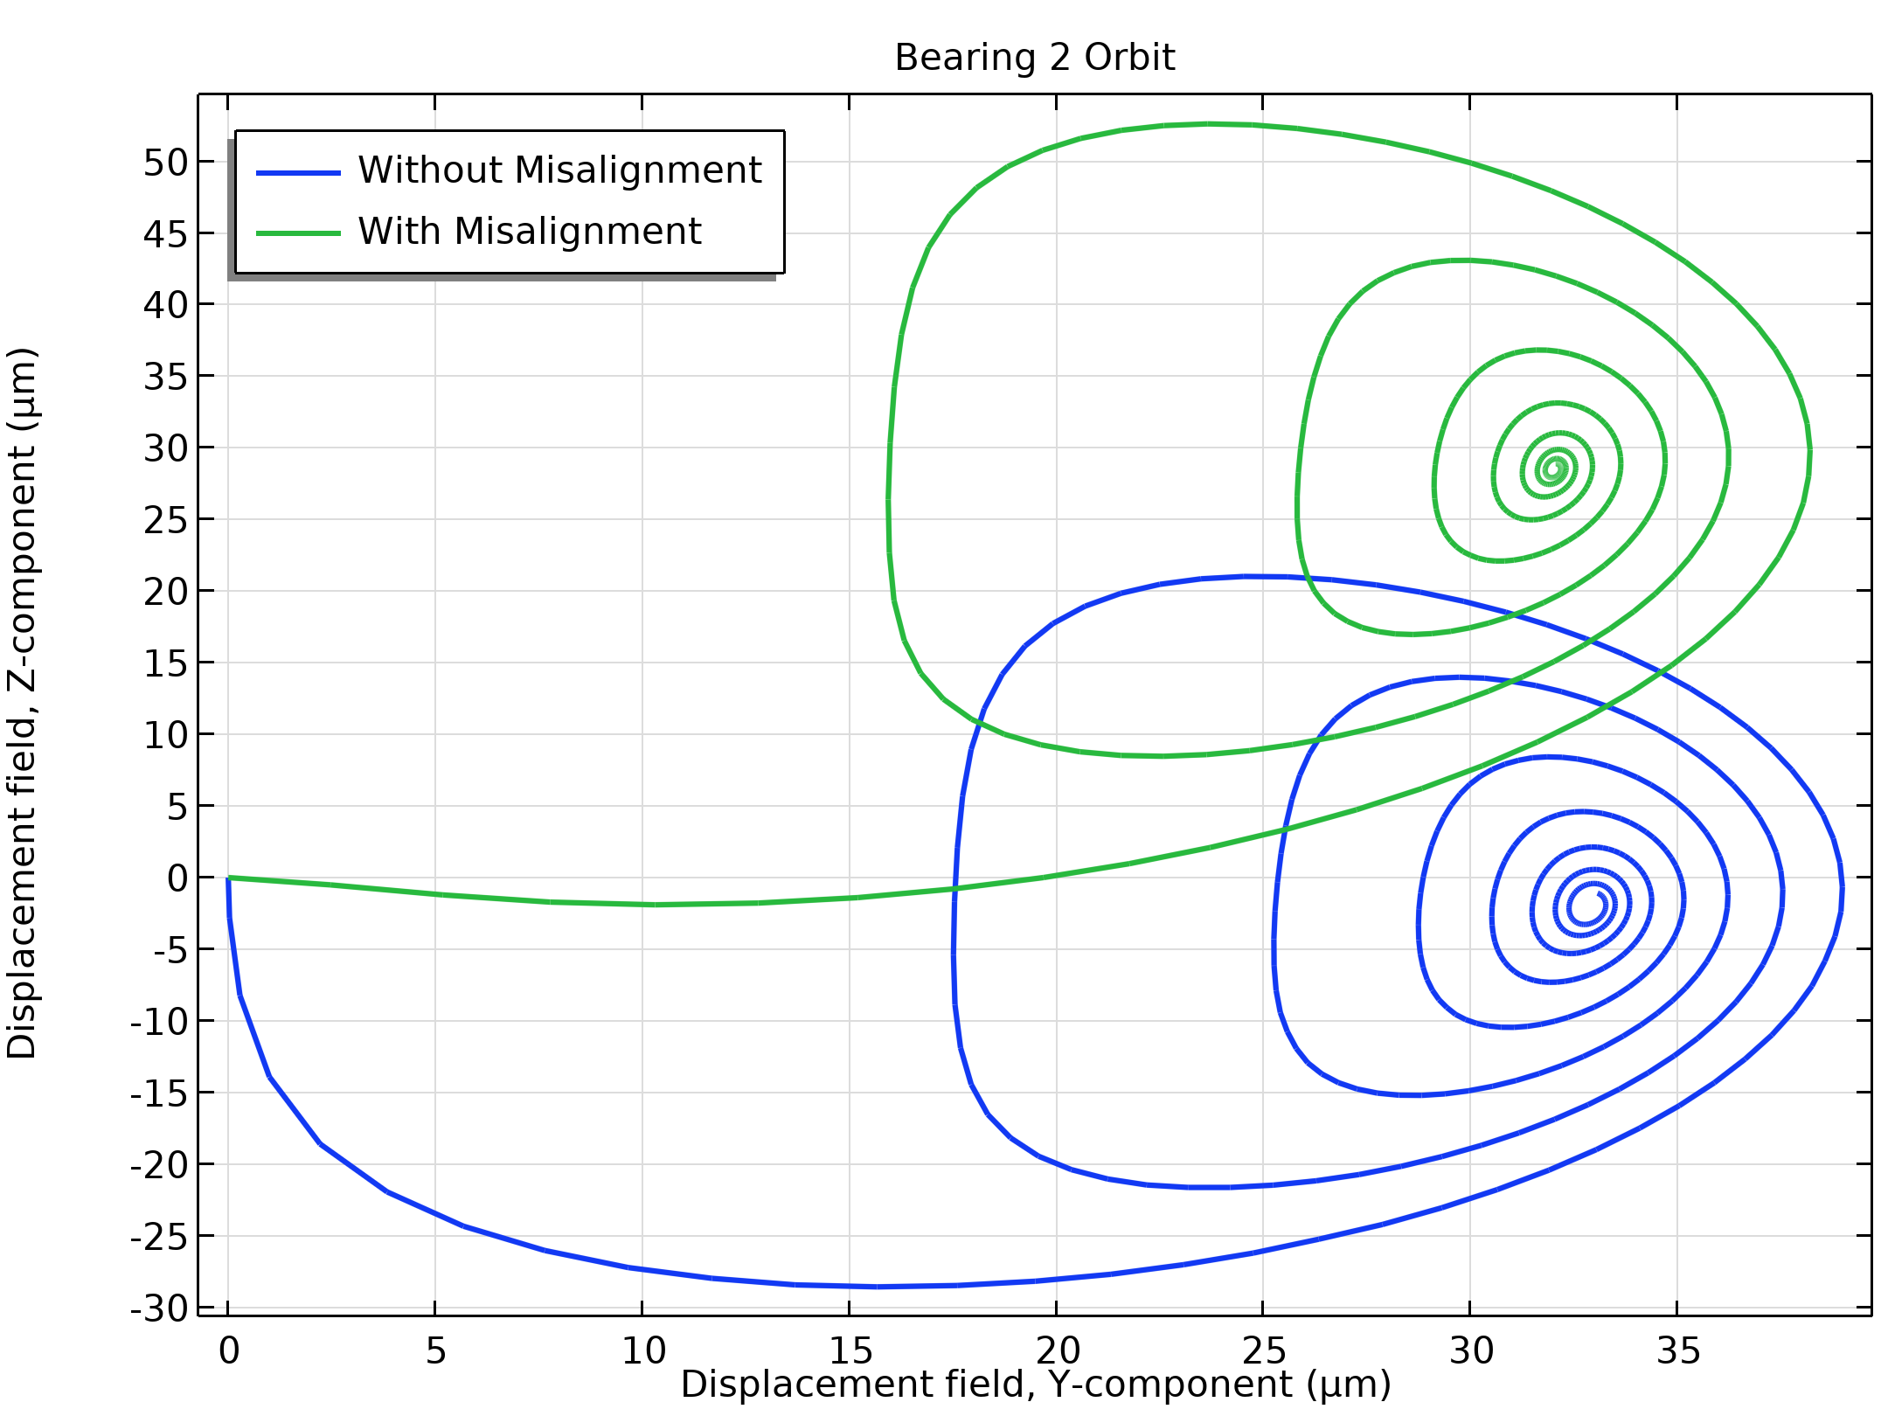
Results
The figure shows an orbit of the journal in the second bearing
The characteristics of the orbit in this bearing are similar to that in the left bearing
The only noticeable difference is that the equilibrium positions of the journal in this bearing depends on the misalignment
Note that the vertical component of the steady state equilibrium position with the misalignment is higher than the one without misalignment due to skewed pressure distribution
Journal orbit in the right bearing

Slide 12
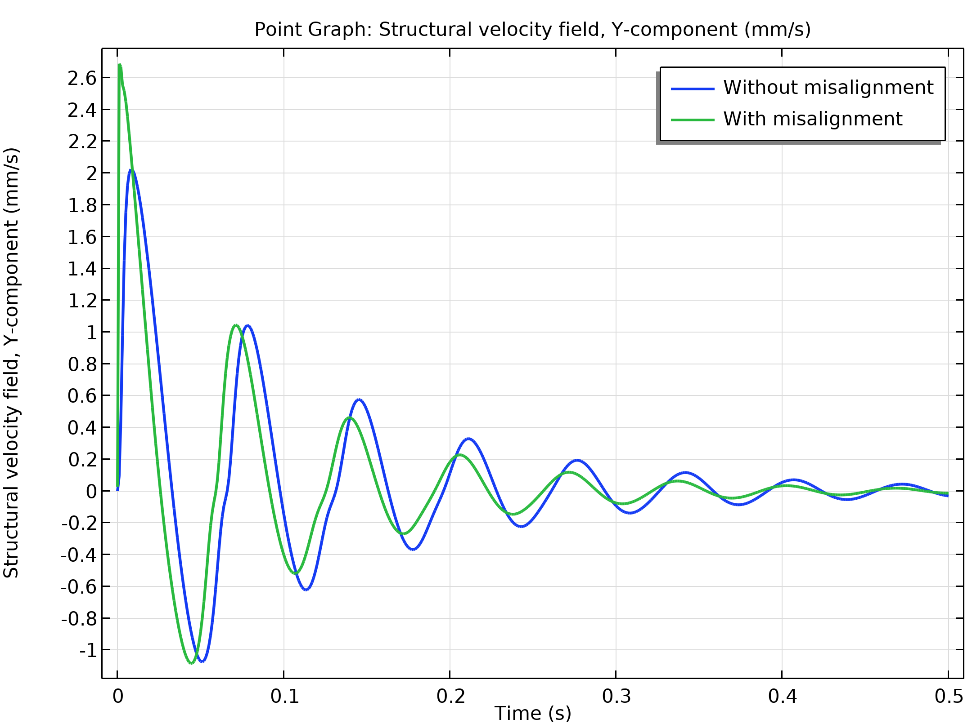
Results
The figure shows a comparison of the velocity of the journal in the right bearing
The oscillation in the velocity has a leading phase for the misaligned bearing as compared to the same for the normal bearing
Thus, the journal reaches the equilibrium position much quicker when the bearing is misaligned
Horizontal velocity of the journal in the right bearing

Slide 13
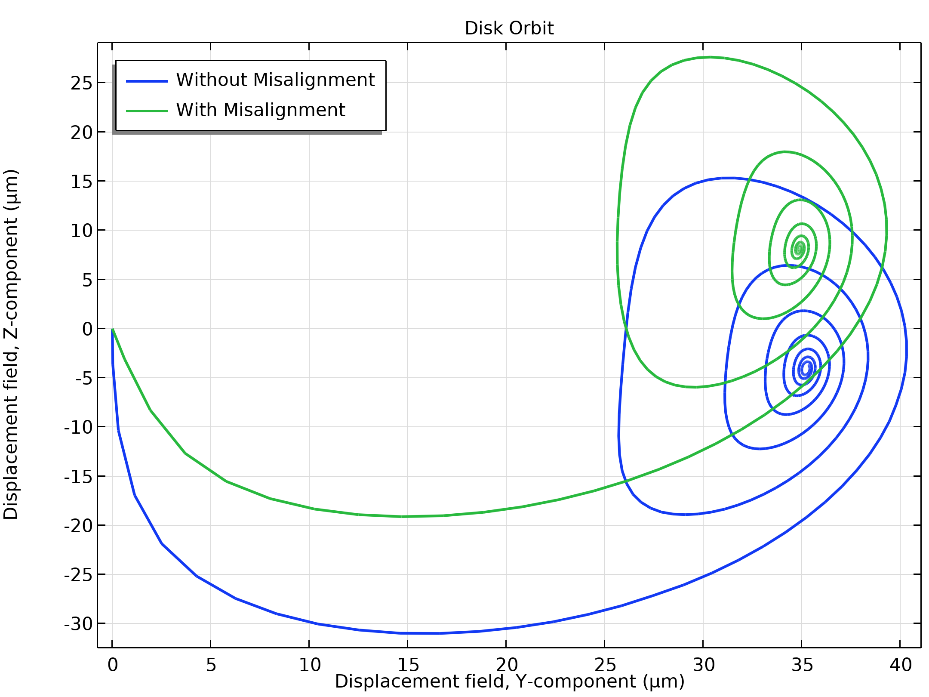
Results
The figure shows the orbit of the rotor at the disk
The equilibrium position of the orbit at this location is also affected by the misalignment in the right bearing
In steady state, the rotor is slightly inclined from its initial axis due to misalignment
Rotor orbit at disk

