Slide 1
Aquifer Characterization
COMSOL

Slide 2
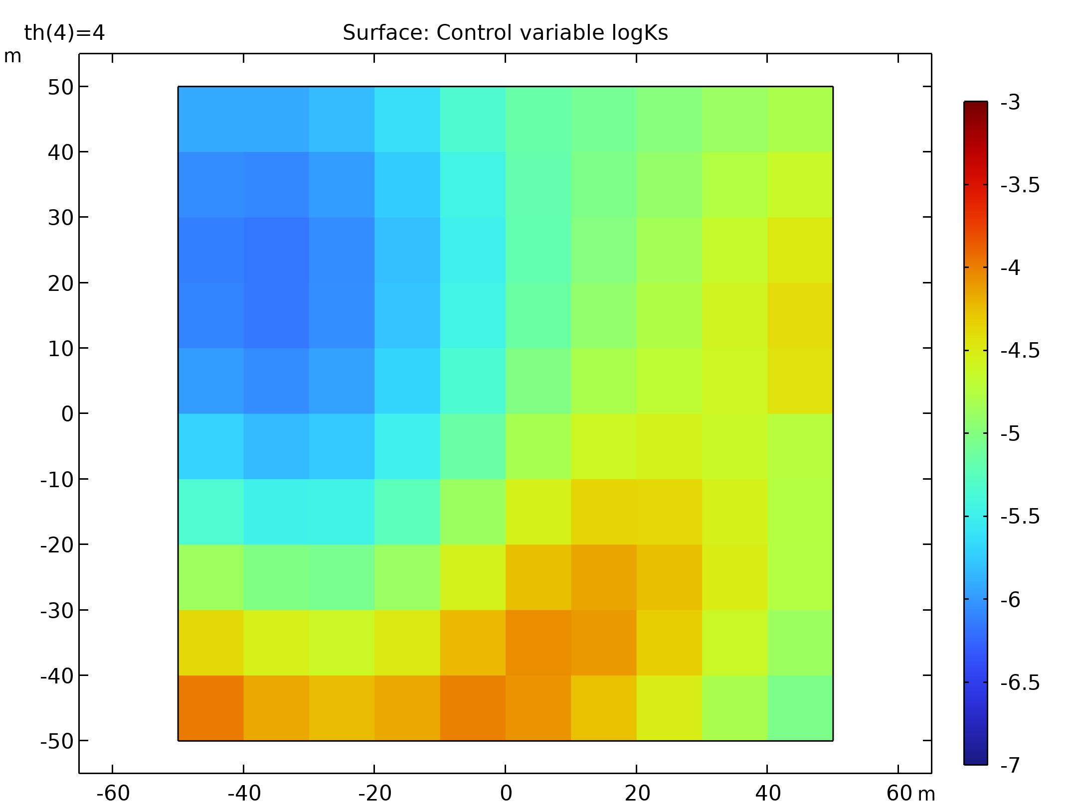
Introduction
This is an example of how to use the Optimization interface to solve an inverse-modeling problem
Inverse modeling is the practice of using (measurement) data as input to estimate the unknown parameters of the function which would describe the data
A forward model using the Darcy's Law interface is set up to generate the data which is then used for the inverse modeling. The efficiency and accuracy of the inverse method as well as the optimization solver's performance can be evaluated using the forward model.
Surface: Control variable logKs

Slide 3
Introduction
The techniques used here are generally applicable for solving underdetermined optimization problems with COMSOL Multiphysics
Surface: Control variable logKs

Slide 4
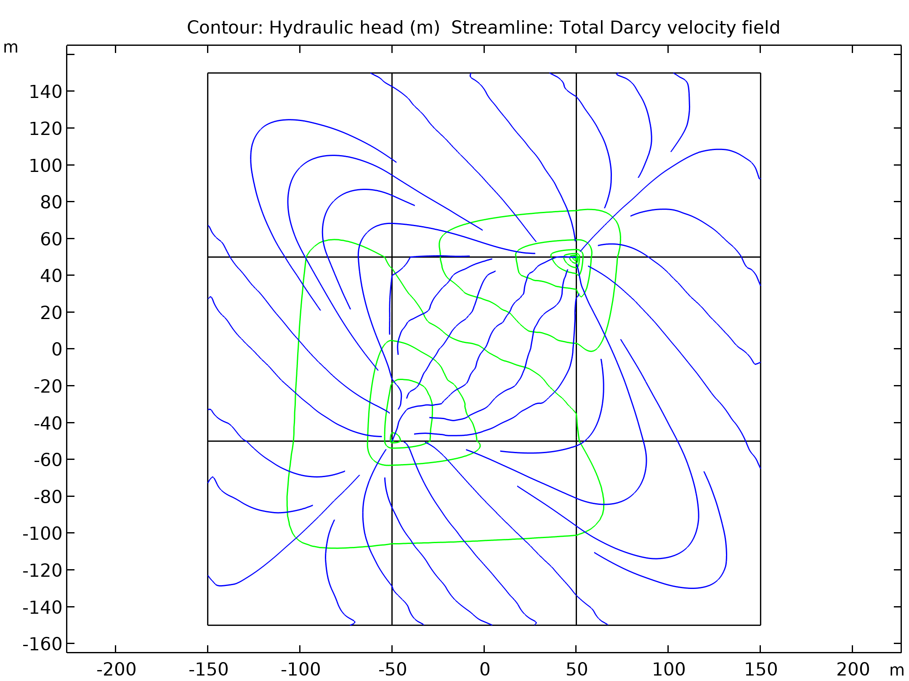
Model Description
The flow in an aquifer with spacially variable hydraulic conductivity is simulated
In the forward model the aquifer is surrounded by a quasi-infinite domain with constant hydraulic conductivity, which is represented by infinite elements. The flow is modeled using Darcy's Law interface
The inverse problem is to estimate the hydraulic-conductivity field on a discretized quadratic grid in the aquifer using experimental (that is, forward-model) data in the form of hydraulic-head measurements from four dipole-pump tests
Contour: Hydraulic head (m) Streamline: Total Darcy velocity field

Slide 5
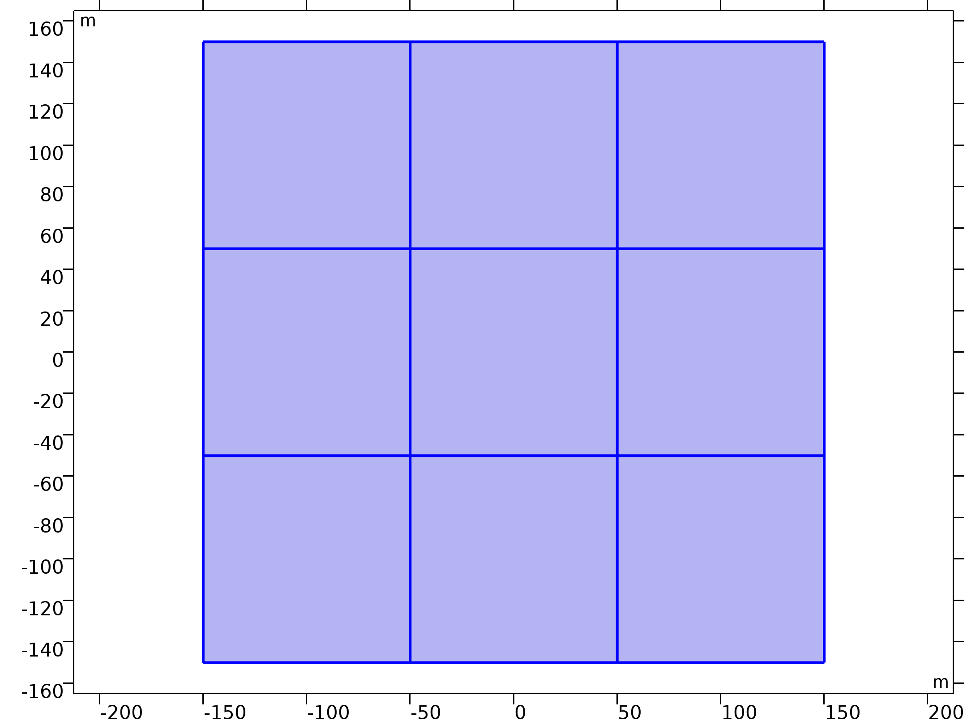


Equations - Fluid Flow
Darcy's Law
Darcy's Law

Slide 6
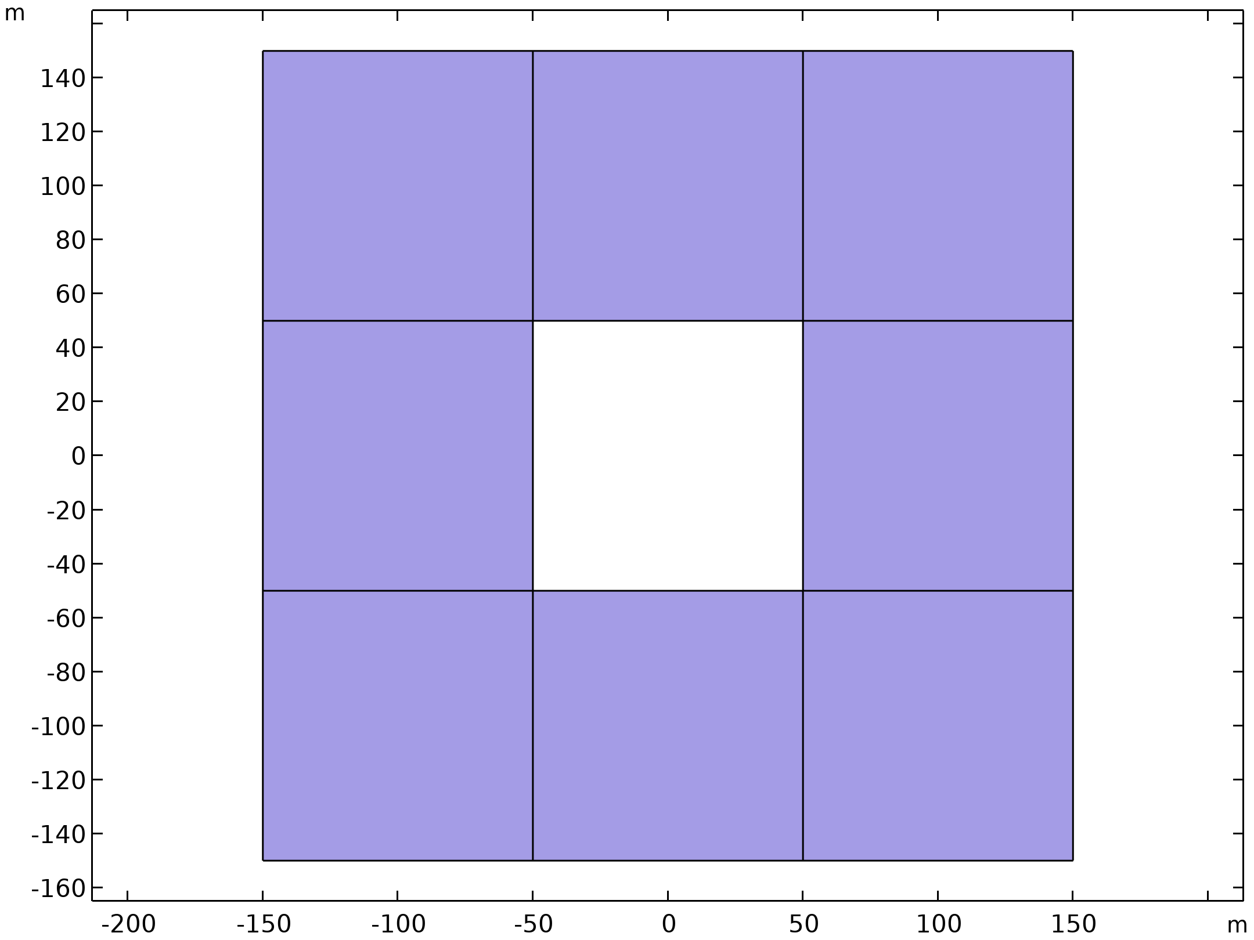
Equations - Fluid Flow
The Aquifer is surrounded by Infinite Elements

Slide 7
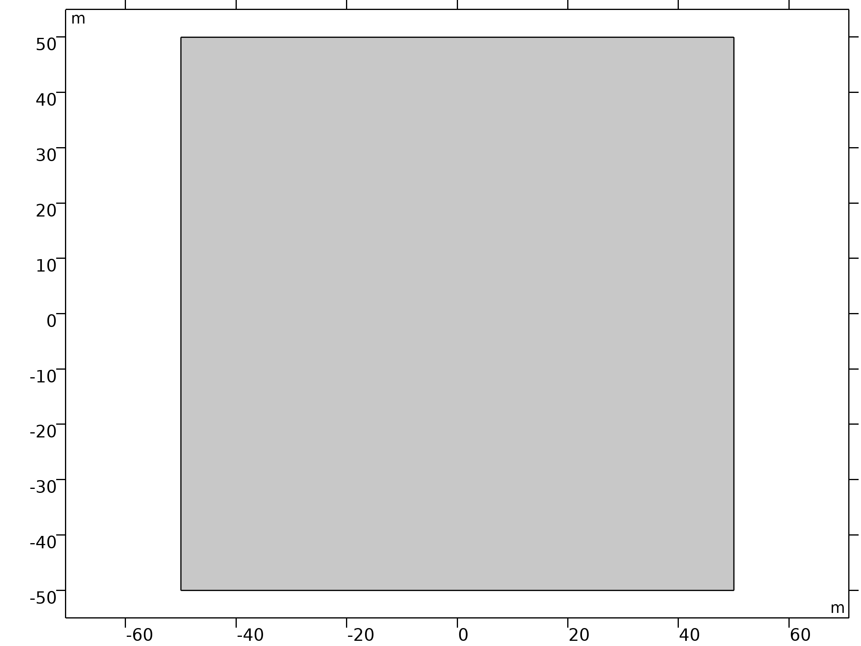
Optimization
If the number of unknown parameters, n, is larger than the number of measurement values, m, the inverse problem is called underdetermined
The objective function L for an underdetermined inverse problem can be written as the sum of a fitness term and a penalty term
The fitness term measures how well the model fits with the observations
The penalty term is relevant for problems where the number of parameters, n, exceeds the number of measurement values, m. It serves to discriminate between solutions with comparable fitness values.
General Optimization

Slide 8

Objective Function
y denotes an m-dimensional row vector of measurement values,
s is an n-dimensional row vector of parameter values,
h: R^{n} --> R^{m} is the forward model, which maps from parameter values to expected measurements,
and R is the m-by-m covariance matrix of measurement errors. For equally distributed errors, it resembles σ_{R}² I with I being the identity matrix

Slide 9


Penalty Term for Underdetermined Inverse Problems
Q is the spatial covariance matrix,
E denotes the expectation value
X is an n-dimensional row vector whose elements all equal 1, and
β refers to the scalar constant mean of the parameter field.

Slide 10
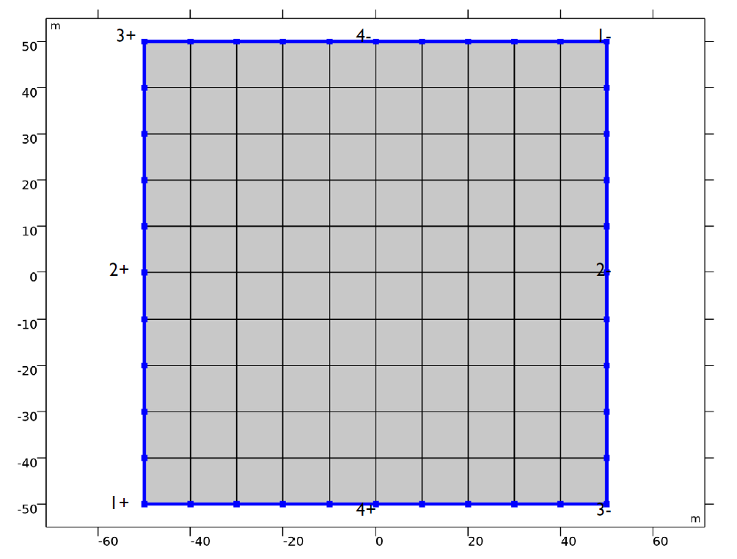
Model Setup
In the Figure, the eight points on the rim of the area being characterized are numbered pairwise as 1±, 2±, 3±, 4±, with plus and minus signs denoting injection wells and pumping wells, respectively.
Discretization of the hydraulic-conductivity parameter field.

Slide 11
Model Data
A text file with reference synthetically generated field data, containing the logarithmic values of the regularized hydraulic-conductivity parameter field is used to generate fictitious hydraulic-head measurements.
This allows to evaluate the optimization solver’s performance and accuracy, and to test and calibrate the inverse model.
Different penalty terms in the objective function can be investigated and the solution’s dependence on the number of used observations can be analyzed.

Slide 12
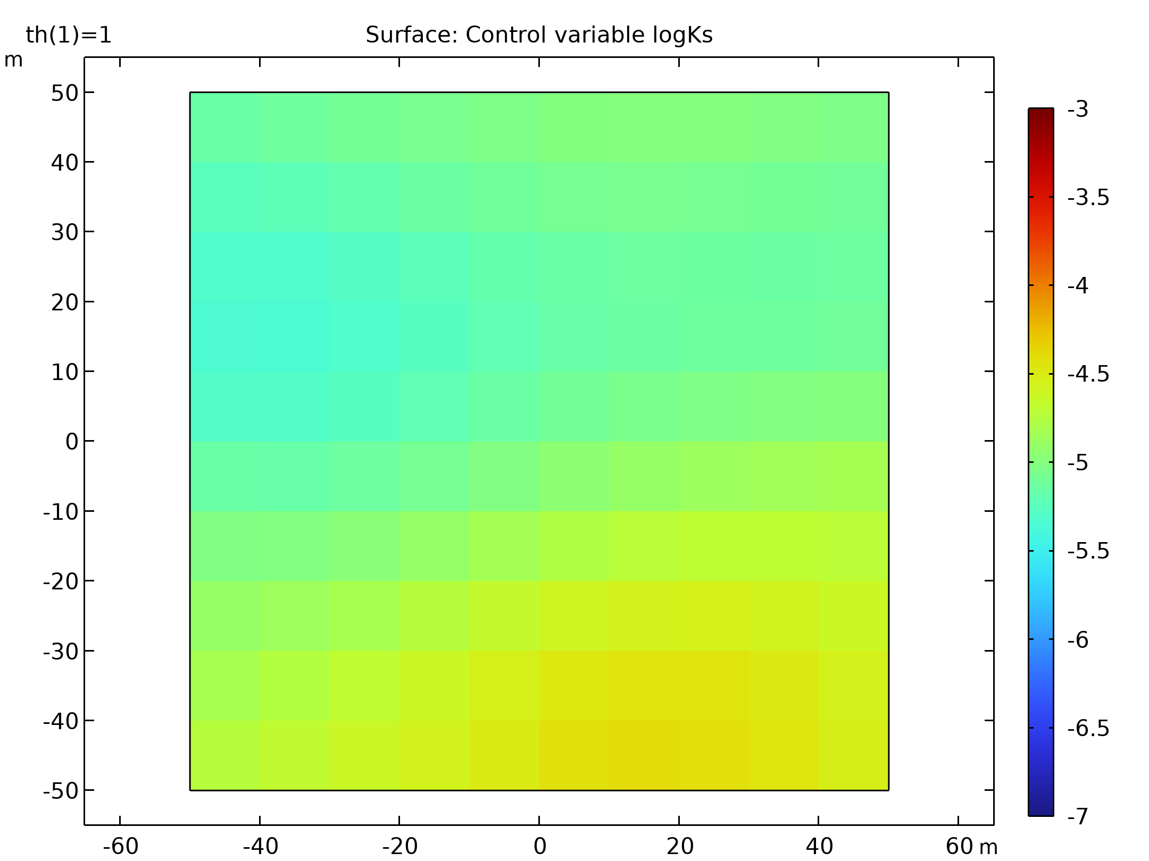
Results
Inverse-modeling results for the hydraulic conductivity field with 6 hydraulic-head observations taken into account
Hydraulic conductivity field

Slide 13
Results
Inverse-modeling results for the hydraulic conductivity field with 24 hydraulic-head observations taken into account
Hydraulic conductivity field

