Slide 1
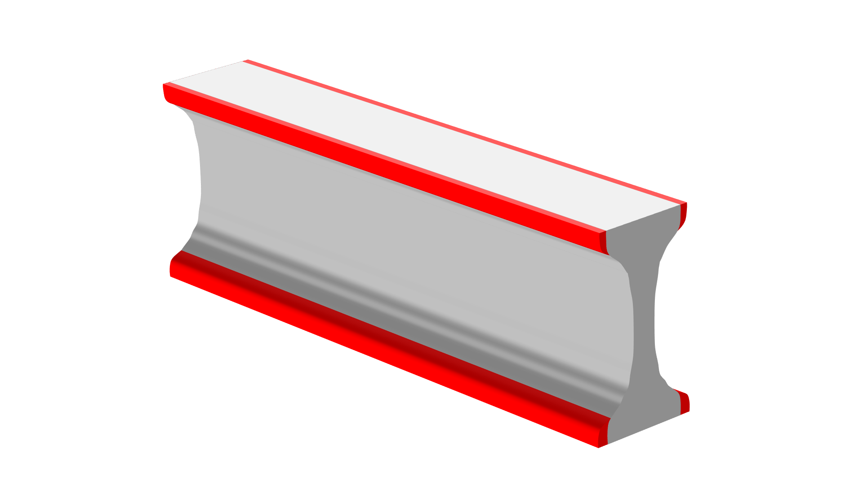
Shape and Topology Optimization of an Extruded Beam

Slide 2
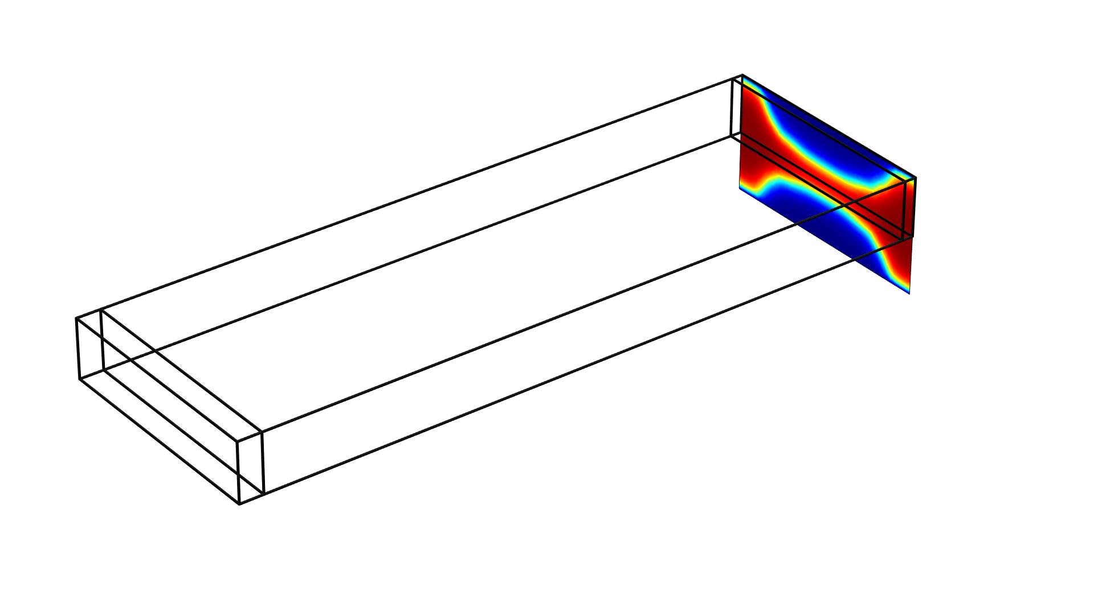
Shape and Topology Optimization of an Extruded Beam
Topology Optimization
The objective is to minimize the compliance subject to a 50 % volume constraint
A general extrusion operator is used to couple the boundary Density Model to the domains.
An Prescribed Void Boundary feature is used to avoid internal cavities.
The resulting design is transferred to a new component for further analysis via a Filter dataset.
Shape and Topology Optimization of an Extruded Beam

Slide 3
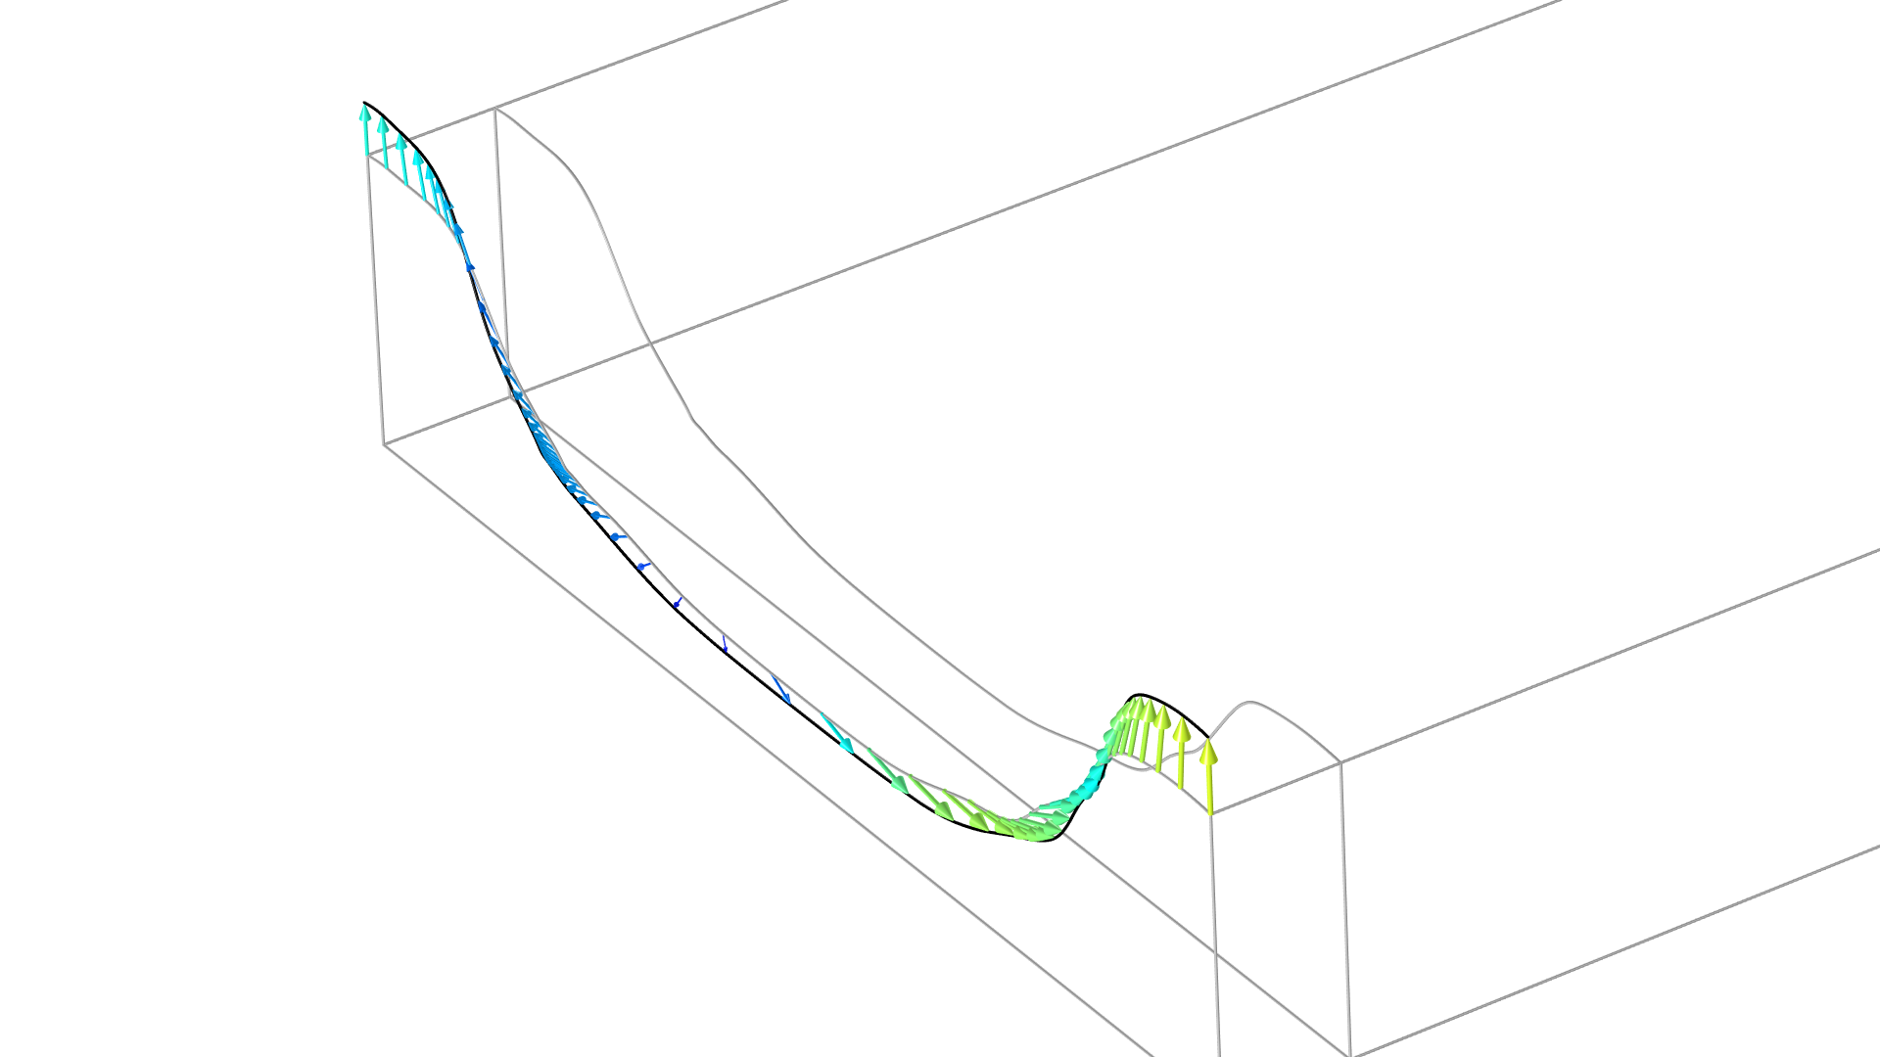
Shape and Topology Optimization of an Extruded Beam
Shape Optimization
Equation based modelling is used to regularize the shape deformation similarly to the functionality of the Free Shape Boundary feature.
A General eEtrusion operator is used transfer the edge displacements to the moving boundaries.
The same objective and constraint is used, but the shape optimization causes the design to go a bit beyond the original design domain.
Shape and Topology Optimization of an Extruded Beam

