Slide 1
Lithium Plating

Slide 2
Background
Deposition of metallic lithium on the negative electrode in preference to lithium intercalation is known to be a capacity loss and safety concern for lithium-ion batteries.
Harsh charge conditions such as high currents (fast charging) and/or low temperatures can lead to lithium plating.
Probing the potential of the negative electrode during charge can be used as an indicator for the plating susceptibility.
This tutorial investigates lithium plating by using the Lithium-Ion Battery interface to predict when and where to expect plating in a cell.
The resulting capacity loss is predicted for different temperatures and charging rates.

Slide 3


Model Definition
The main reaction in the porous matrix, lithium interaction, is as follows:
This reaction can be accompanied with the lithium plating side reaction to form metallic lithium on the electrode surface:
The model uses a 1D geometry, including a negative electrode (graphite), a positive electrode (NMC811), and a separator in between to represent the battery cell
The model is based on Newman’s framework 1, solving for:
  Charge conservation in the electrolyte and solid electrodes
  Species conservation in the electrolyte and active material
$$C_{6}+Li^{+}+e^{−} LiC_{6}$$
$$Li^{+}+e^{−} Li (s)$$

Slide 4
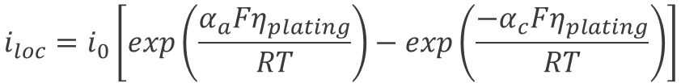
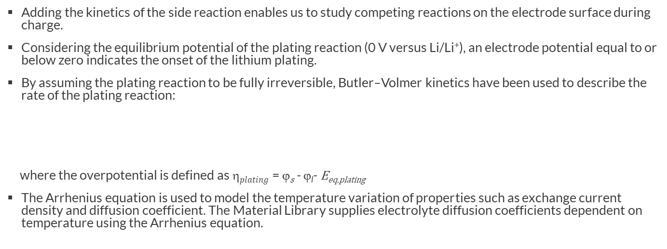
Lithium Plating Kinetics
Adding the kinetics of the side reaction enables us to study competing reactions on the electrode surface during charge.
Considering the equilibrium potential of the plating reaction (0 V versus Li/Li⁺), an electrode potential equal to or below zero indicates the onset of the lithium plating.
By assuming the plating reaction to be fully irreversible, Butler–Volmer kinetics have been used to describe the rate of the plating reaction:
where the overpotential is defined as η$plating$= ϕ_{s} - ϕ_{l}- E_{eq,plating}
The Arrhenius equation is used to model the temperature variation of properties such as exchange current density and diffusion coefficient. The Material Library supplies electrolyte diffusion coefficients dependent on temperature using the Arrhenius equation.
$$i_{loc}=i_{0}\left[exp\left(\frac{α_{a}Fη_{plating}}{RT}\right)−exp\left(\frac{{−α}_{c}Fη_{plating}}{RT}\right)\right]$$

Slide 5
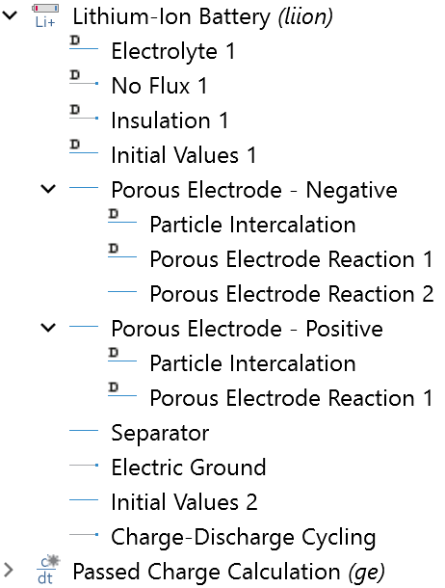
Implementation
The Lithium-Ion Battery interface is used to model the battery performance.
A reaction has been added under the Porous Electrode node to define the plating reaction on the negative electrode.
The Charge-Discharge Cycling node has been used to define a constant current–constant voltage (CCCV) charge protocol.
The dissolving-depositing species section of the Porous Electrode node has been used to account for the deposition of lithium metal on the negative electrode.
A global equation has been used to calculate the passed charge and state of charge (SOC) during charge.

Slide 6
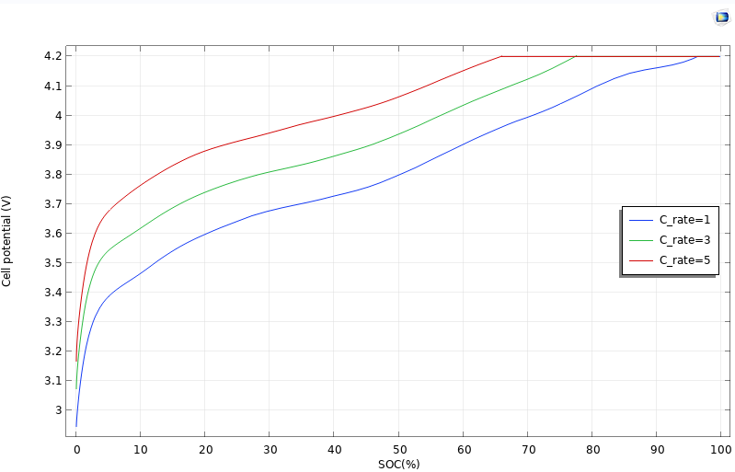
Results
A parametric sweep study has been used to investigate the effect of different charging rates and cell temperatures on the plating likelihood and resulting capacity loss.
For the temperature study, the charging rate has been fixed at 1C rate and for the rate study, the cell temperature has been set to 298 K.
Cell potential versus state of charge (SOC) at different charge rates

Slide 7
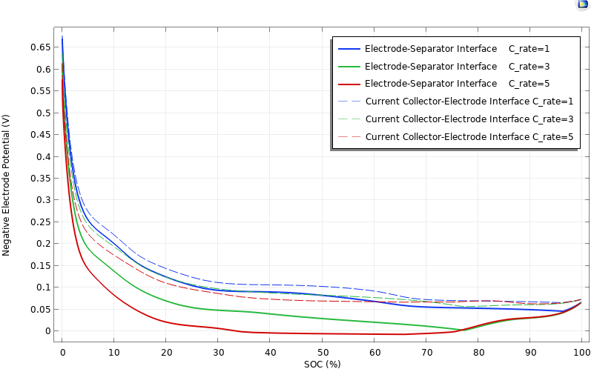
Results
The negative electrode potential, which indicates plating susceptibility, has been plotted at both the electrode–separator interface and current collector–electrode interface to illustrate the likelihood of plating at different locations in the electrode.
Charging at high rates results in more plating, in particular at the electrode–separator interface.
Negative electrode potential (plating susceptibility)

Slide 8
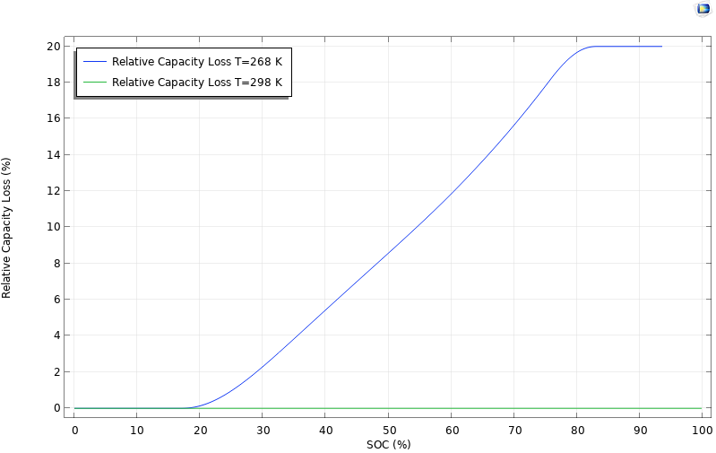
Results
The relative capacity loss versus SOC has been plotted at different cell temperatures and charging rates to illustrate plating-induced capacity loss.
We get significantly more plating when charging at low temperatures.
Relative capacity loss versus state of charge (SOC) at different cell temperatures

Slide 9
Reference
M. Doyle, J. Newman, A.S. Gozdz, C.N. Schmutz, and J.M. Tarascon, “Comparison of Modeling Predictions with Experimental Data from Plastic Lithium Ion Cells,” J. Electrochem. Soc., vol. 143, no. 6, pp. 1890–1903, 1996.

