Slide 1
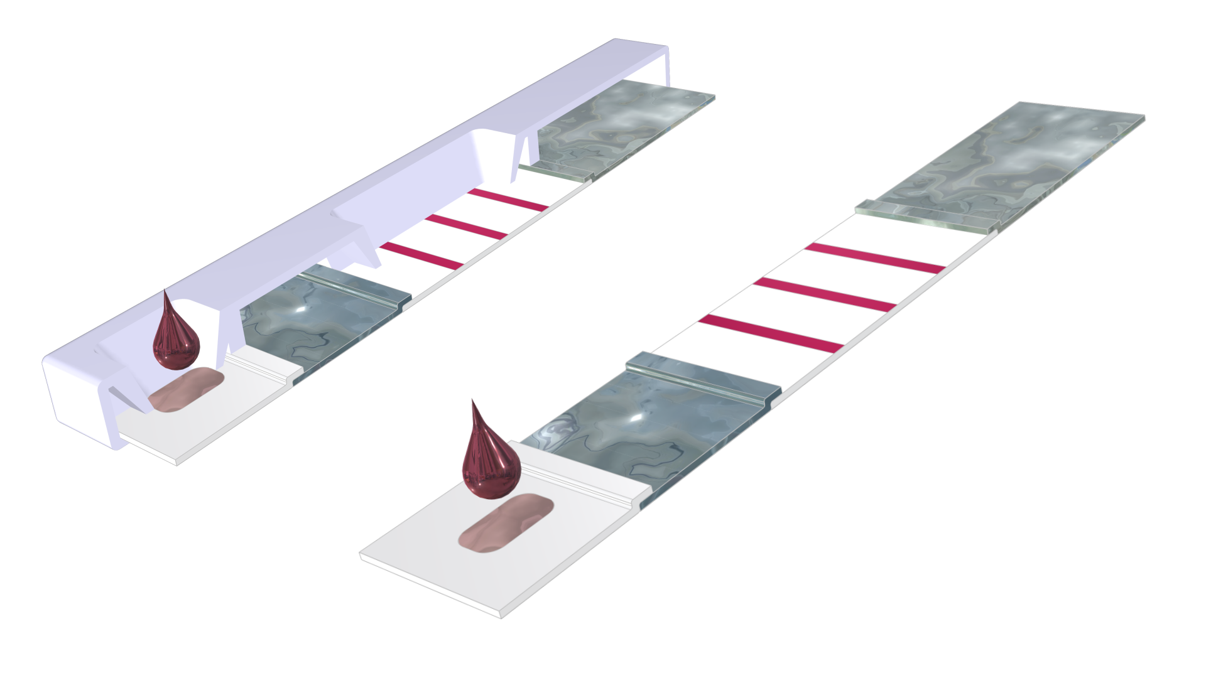
Rapid Detection Test for Coronavirus

Slide 2
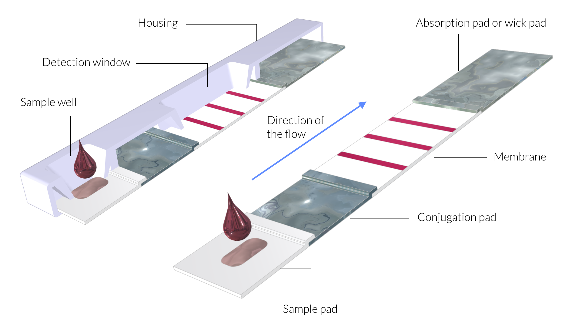
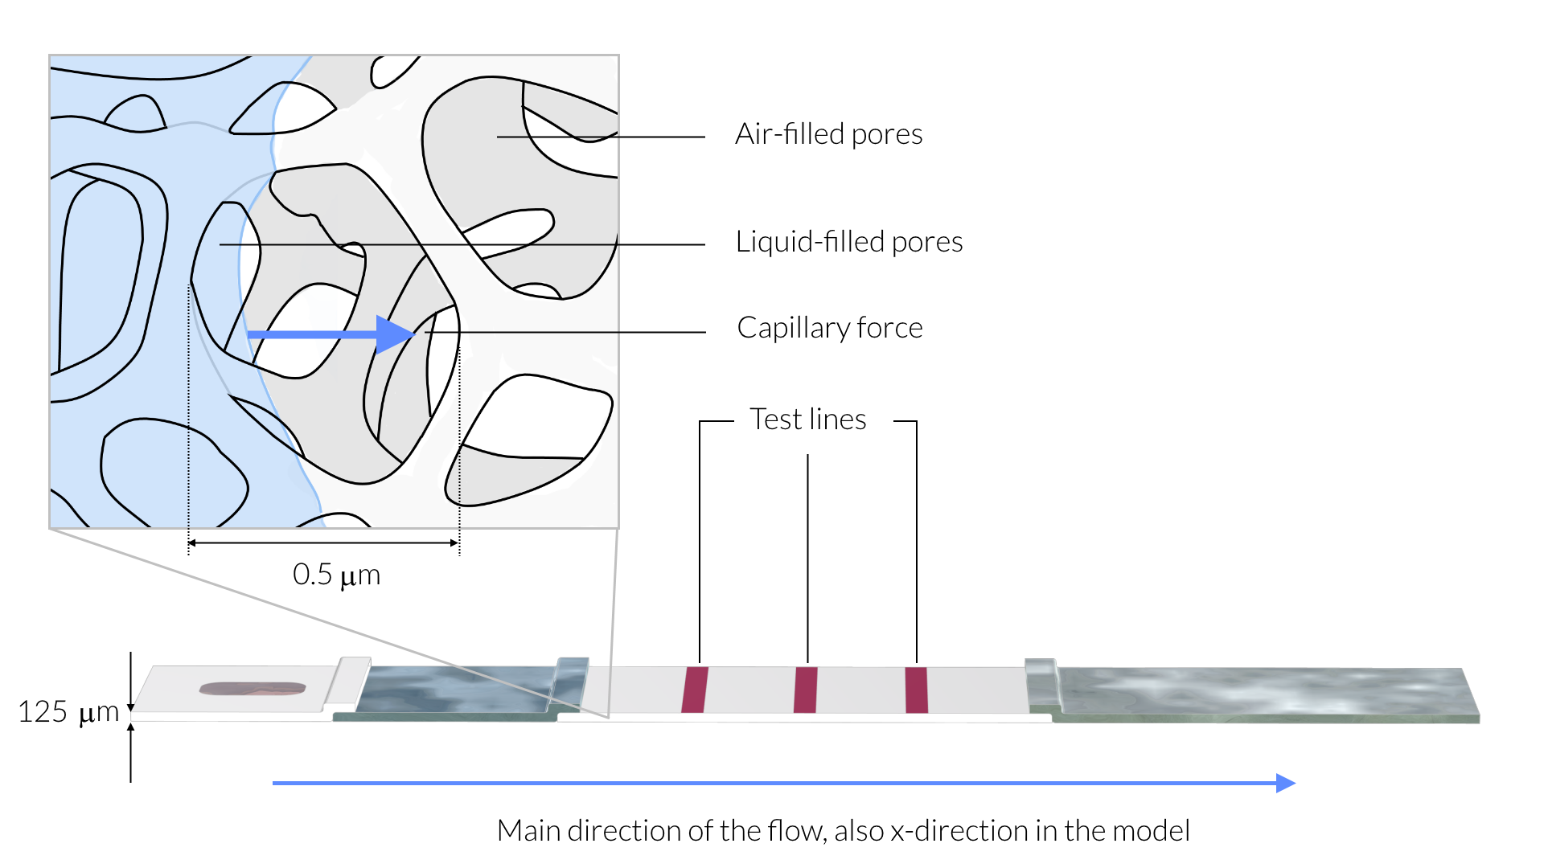
The Rapid Detection Test Device
Rapid detection test based on lateral flow assay (LFA)
The test strip assembly consist of porous sample and conjugate pads, a porous membrane, and a porous absorption pad
The sample is applied in the sample well and flows from the sample pad to the absorption pad
The flow is driven by capillary forces in the porous materials

Slide 3
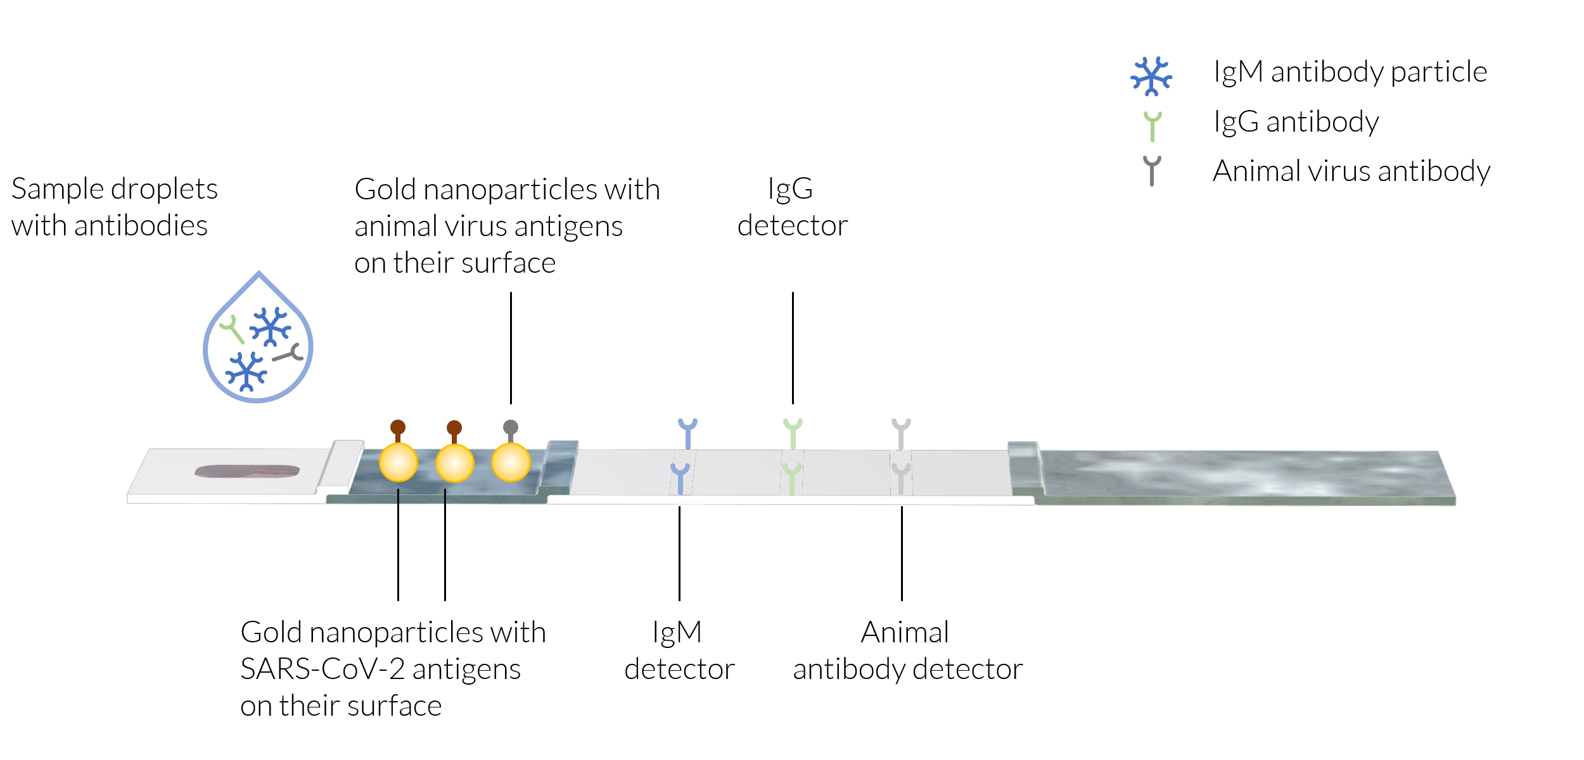
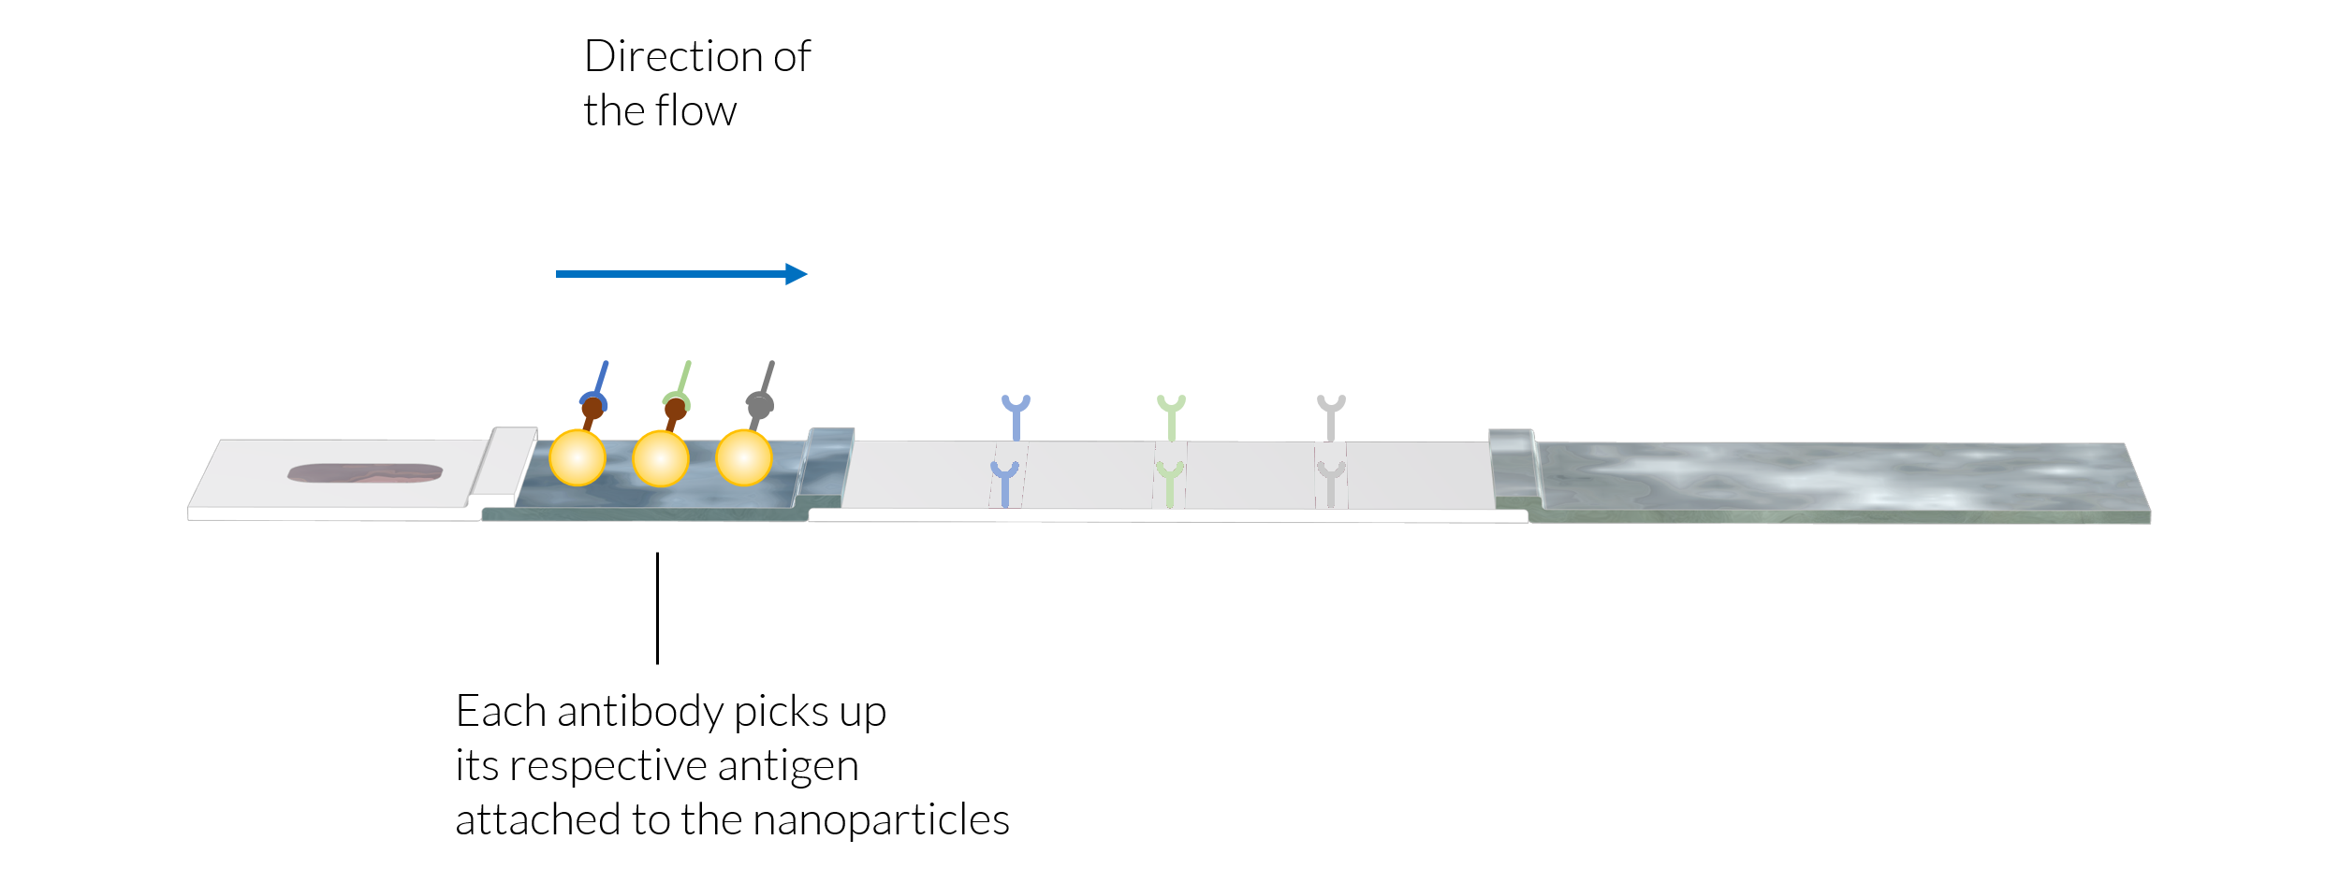
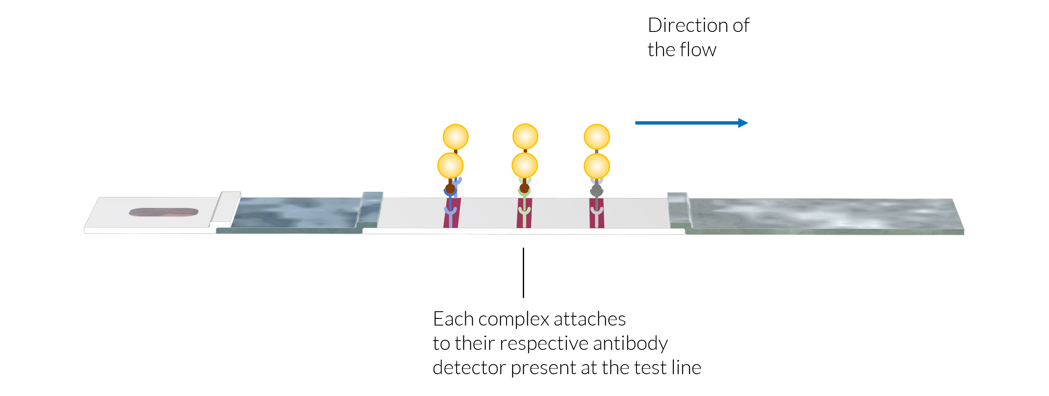
The Principle for Detection
1
The sample:
  May contain coronavirus antibodies (IgM, IgG)
  Contains an animal virus antibody added as reference during sample preparation
The conjugate pad:
  Human antibodies pick up gold nanoparticles by attaching to coronavirus antigens at the surface of the nanoparticles forming a complex
  The animal antibodies pick up nanoparticles with animal antigens on their surface
  The antibody-antigen-particle complexes are dissolved in the sample and carried with the flow
The membrane:
  Each antibody is immobilized by attaching to their antibody detector at the respective test line
  The accumulation of gold nanoparticles gives each test line its color
  If the animal detector test line is not colored, then the test is discarded, since the sample has not flown properly through the test strip
2
3

Slide 4
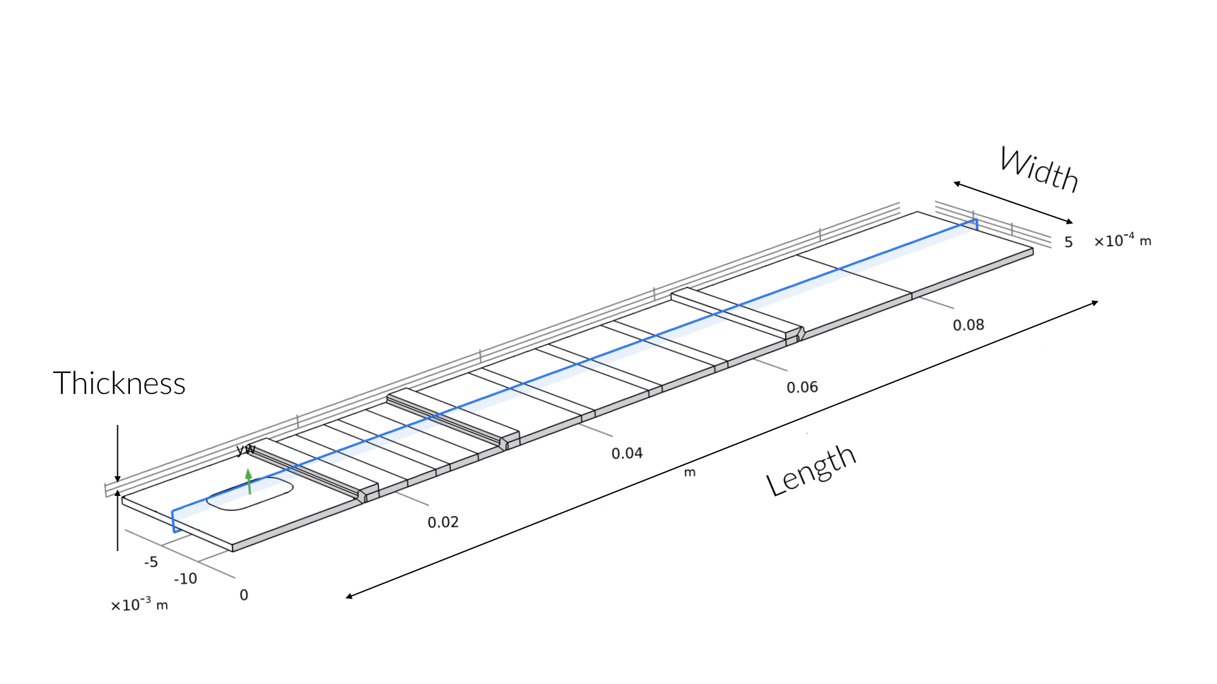
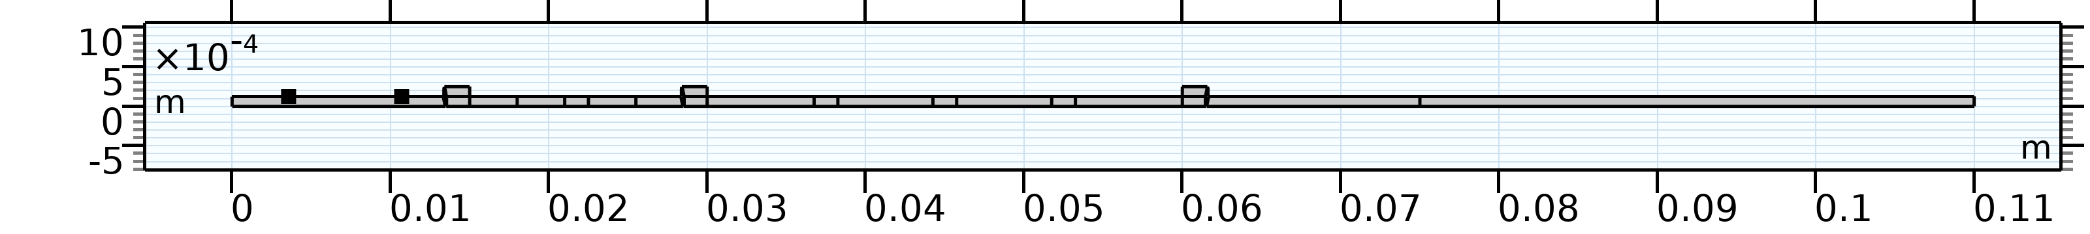
Models
3D model for investigation possible symmetries in the flow
2D models for the transport and chemical phenomena in the LFA:
  Homogeneous model
  Heterogeneous model
The 2D model domain is formed using a vertical cross section in the middle of the 3D test strip
The blue shaded plane shows where the cross section in the 3D model is taken for the 2D model.
The modeled 2D domain.

Slide 5
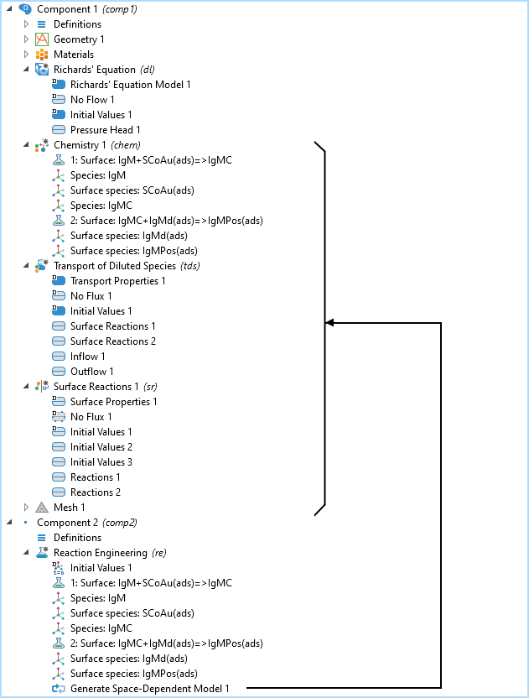
Model Definition
Richards’ equation for fluid flow
Transport of diluted species for the transport and the reactions of the involved species
Surface reactions for the adsorbed species, which are not carried by the flow (denoted “ads” in the figure)
Implementation notes:
  The reactions are typed-in the reaction engineering interface
  The species and material balances for each species are automatically created from the chemical reactions
  The generate space-dependent node generates all transport interfaces except the Richards’ equation
Automatic generation of the transport and reaction interfaces for the space dependent model
The model tree for the heterogeneous 2D model. The chemistry, transport of diluted species,
and the surface reaction interfaces are created using the reaction engineering interface’s
“generate space-dependent model” node.

Slide 6
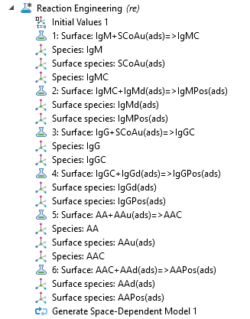
The Chemical Reactions
The reactions are entered in the reaction engineering interface
Coronavirus antibodies: IgM and IgG
Animal virus antibody: AA
Coronavirus antigen (spike protein, S) attached to gold nanoparticle: SCoAu
Animal antigen attached to nanoparticle: AAu
Antibody-antigen-nanoparticle complex: IgMC, IgGC, AAC
Antibody detectors: IgMd, IgGd, AAd
Complexes attached to detectors at the test lines (positive): IgMPos, IgGPos, AAPos
Reactions 1, 3, 5 occur in the conjugate pad
Reactions 2, 4, 6 occur at the respective test line
Reactions 1, 2, and 3 occur in the conjugate pad. Reactions 4, 5, and 6 occur in the respective test line, if the test is positive.

Slide 7
The 2D Models
Reactions at
the surface
Heterogenous model:
  The reactions occur at the surface of the test strip
Homogeneous model:
  The reactions occur across the whole thickness of the membrane at the location of the test lines and in the conjugation pad
Reactions
distributed
across the
thickness
Heterogeneous model, top, and homogeneous model, bottom.
The reactions are distributed along the whole thickness of the membrane at the test line for the homogeneous model.

Slide 8
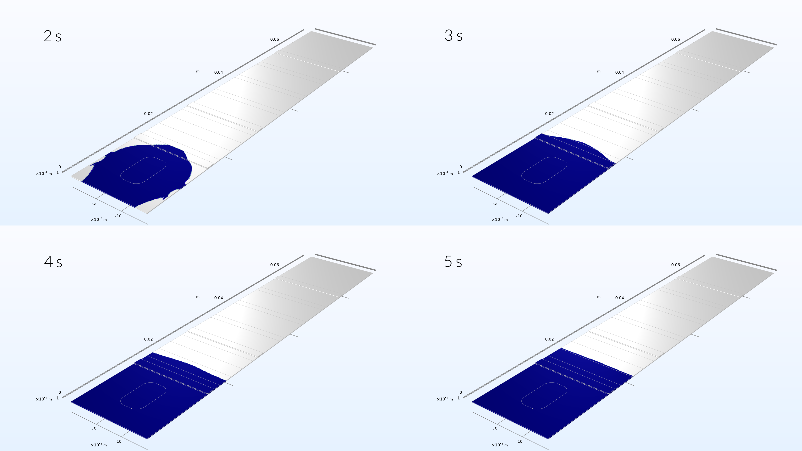
3D Model
The saturation becomes uniform across the width of the test strip already after 5 s, i.e. when the liquid sample has reached the conjugate pad
This implies that the distribution of the sample is completely uniform across the width of the test strip when the sample reaches the test lines

Slide 9
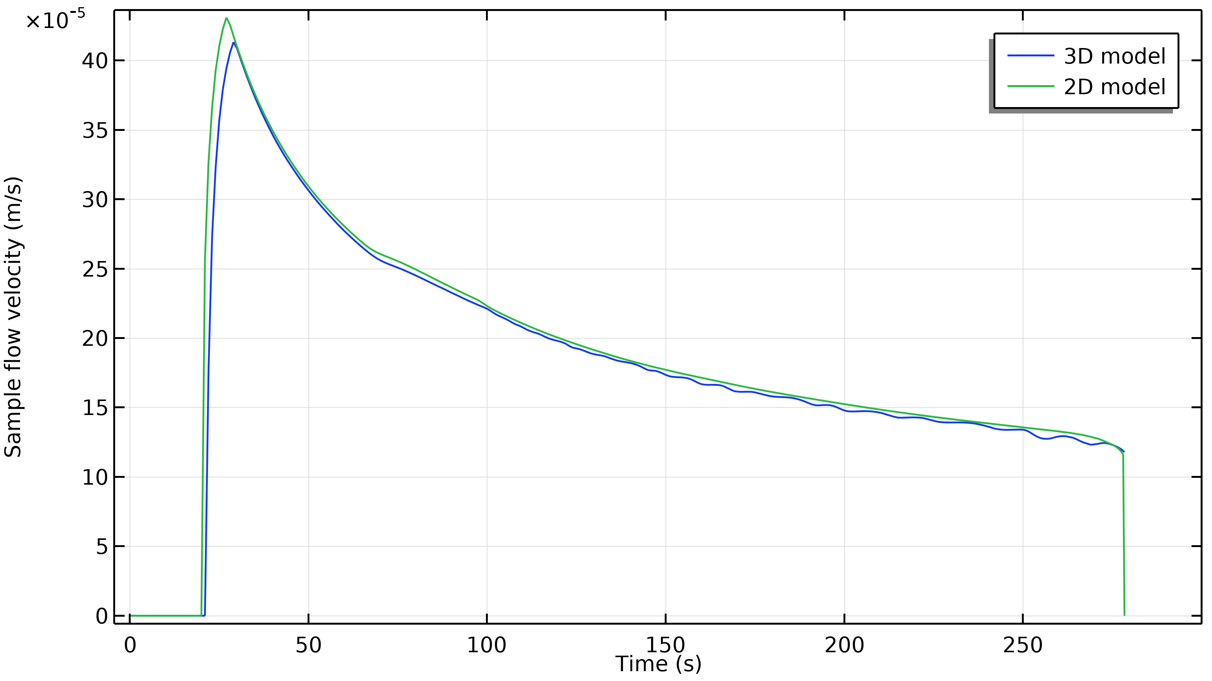
3D and 2D Comparison
The velocity in the x-direction at the position of the first test line in the 3D and 2D models are in good agreement
The slight delay in the 3D model at the beginning may be due to the fact that some of the sample has to flow also along the width of the test strip the first few seconds
We can use the 2D models to make a fairly accurate model of the chemistry, since the sample is uniformly distributed already in the conjugate pad
Comparison of the sample flow velocity in the 3D and 2D model at the position of the first test line.

Slide 10
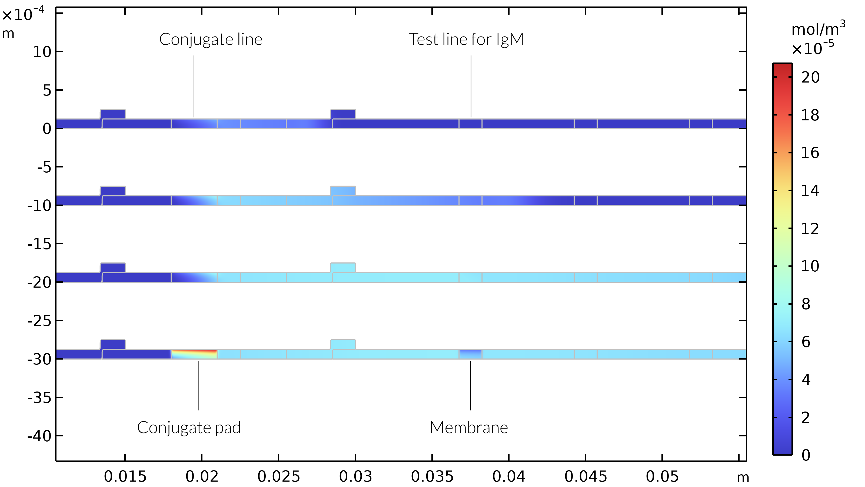
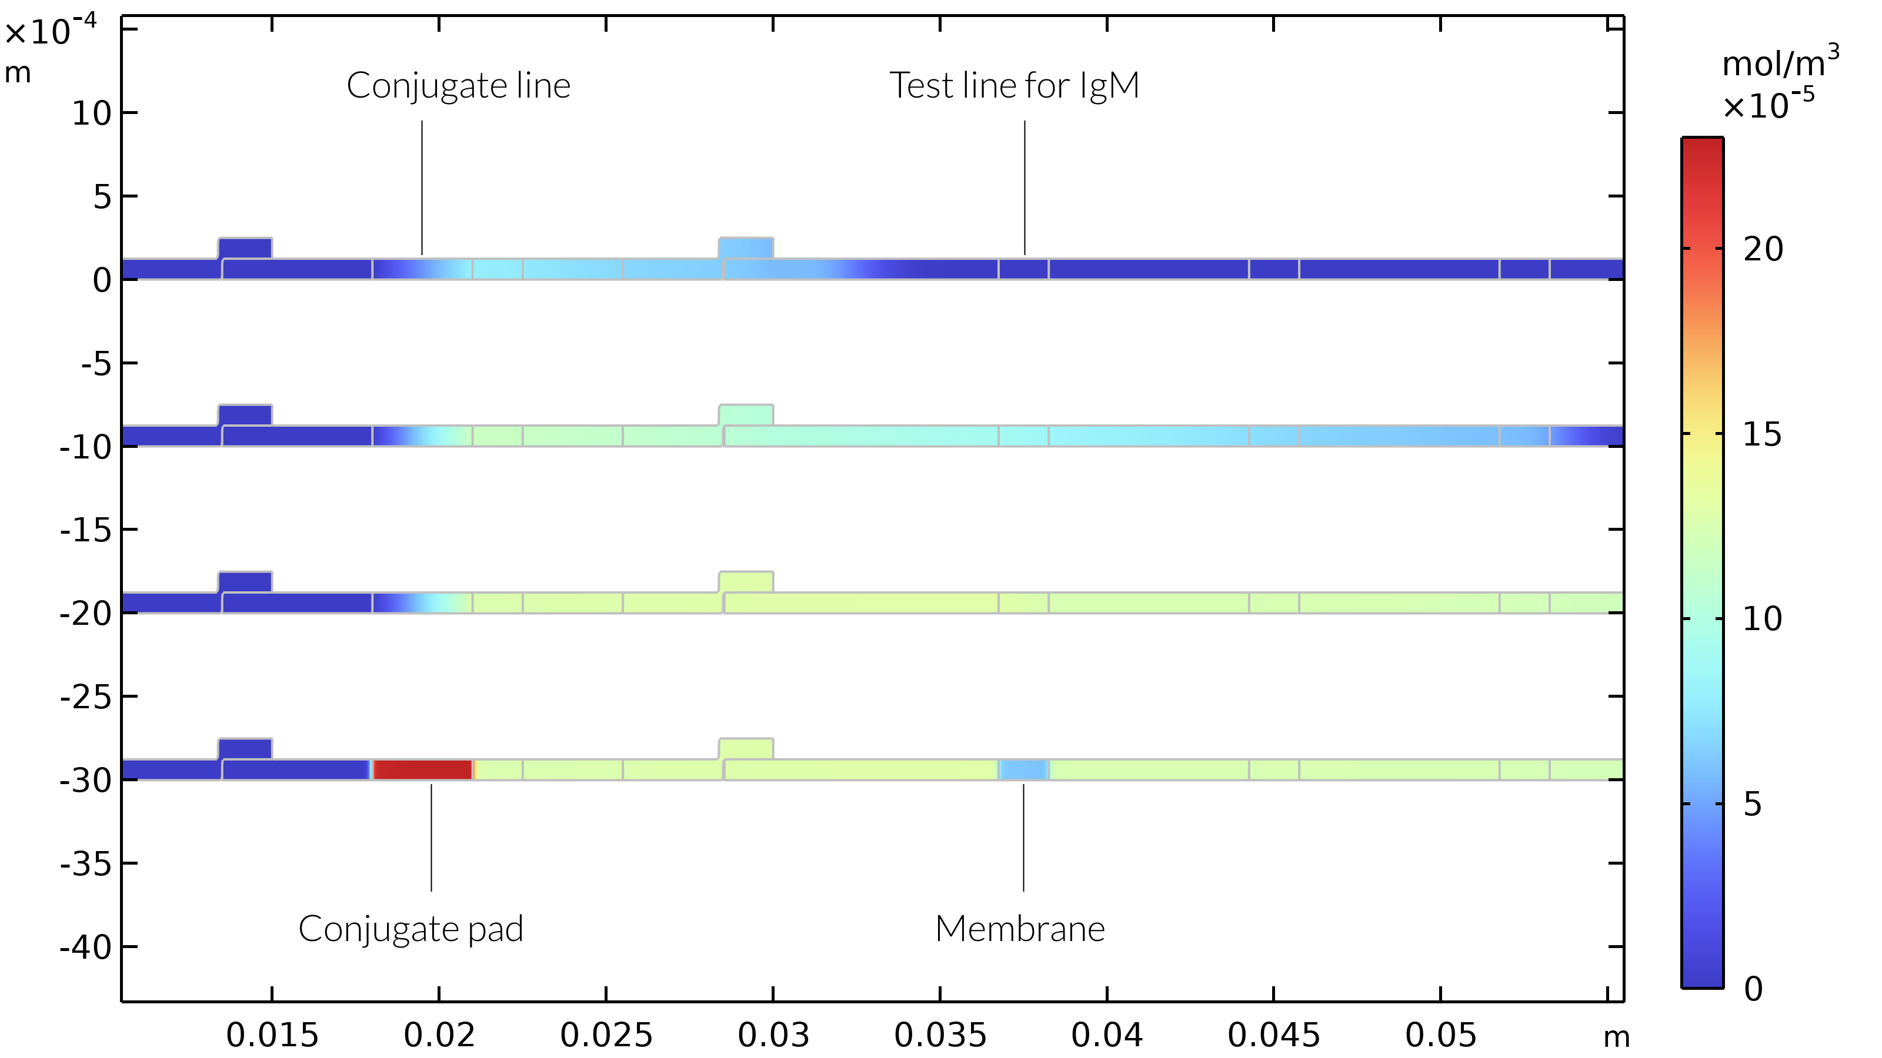
IgMC Concentration
The heterogeneous and homogeneous models are in decent agreement
This agreement is due to the fact that the conjugate and test line reactions are both limited by adsorption kinetics
If the transport of species to the surface in the heterogeneous model was limiting, we would see a larger discrepancy between the two models
Heterogeneous model at 21 s, 65 s, 260 s, and 410 s.
Homogeneous model at 21 s, 65 s, 260 s, and 410 s.

Slide 11
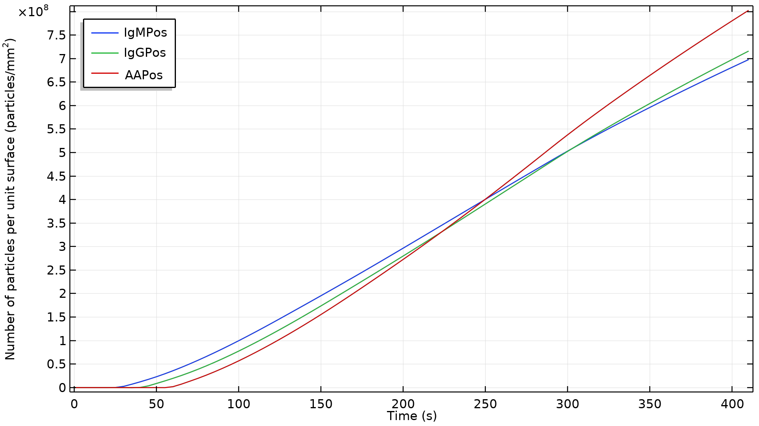
Detection
The revelation of the IgM test line as a function of time is almost linear
If the process was limited by mass transport, we would see a decrease in the slope at around 275 s, when the flow stops:
  This can be confirmed if we increase the adsorption rate constants (this was tested)
The slight delay between the detection of the three antibodies reflects the difference in arrival of the liquid sample to the test lines
IgM and IgG compete in picking up nanoparticles with coronavirus antigens, which gives a slight decay in rate compared to the animal reference antibody
Nanoparticle concentration for the respective antibody detection test line. The test line starts to be visible at around 1·10⁸ particles/mm².

