Slide 1
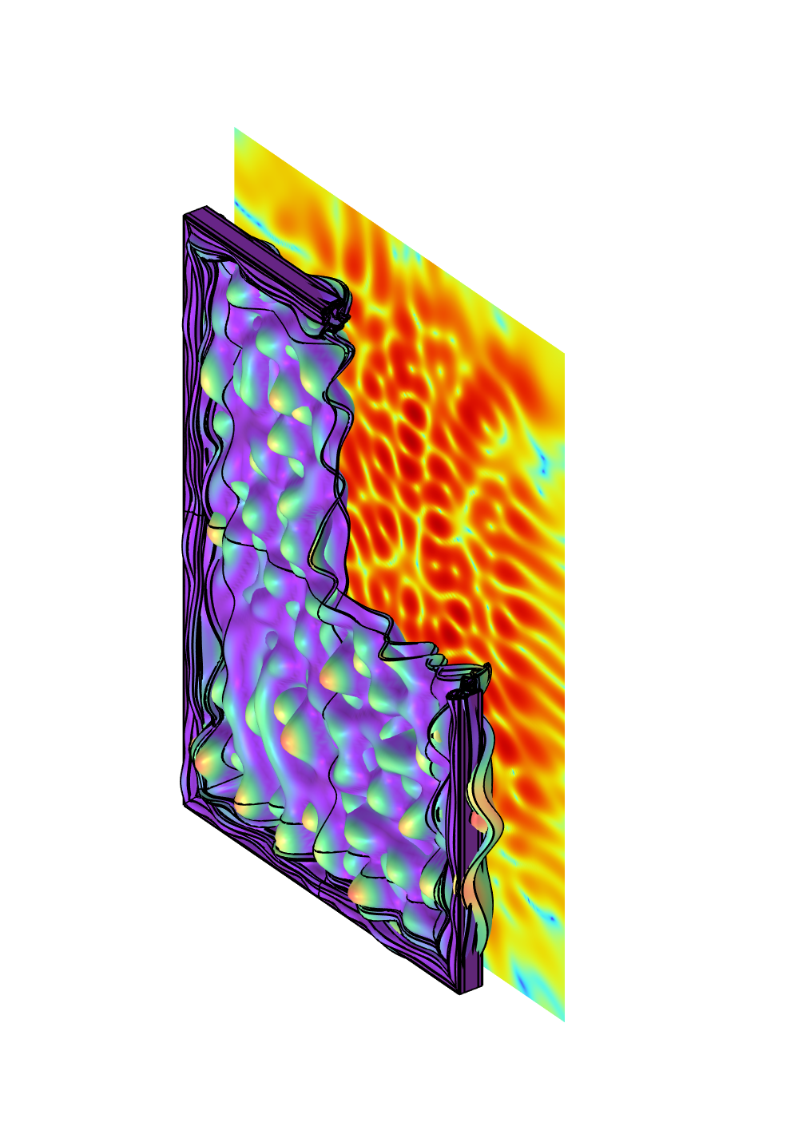
Sound Transmission Loss
Through a Window

Slide 2
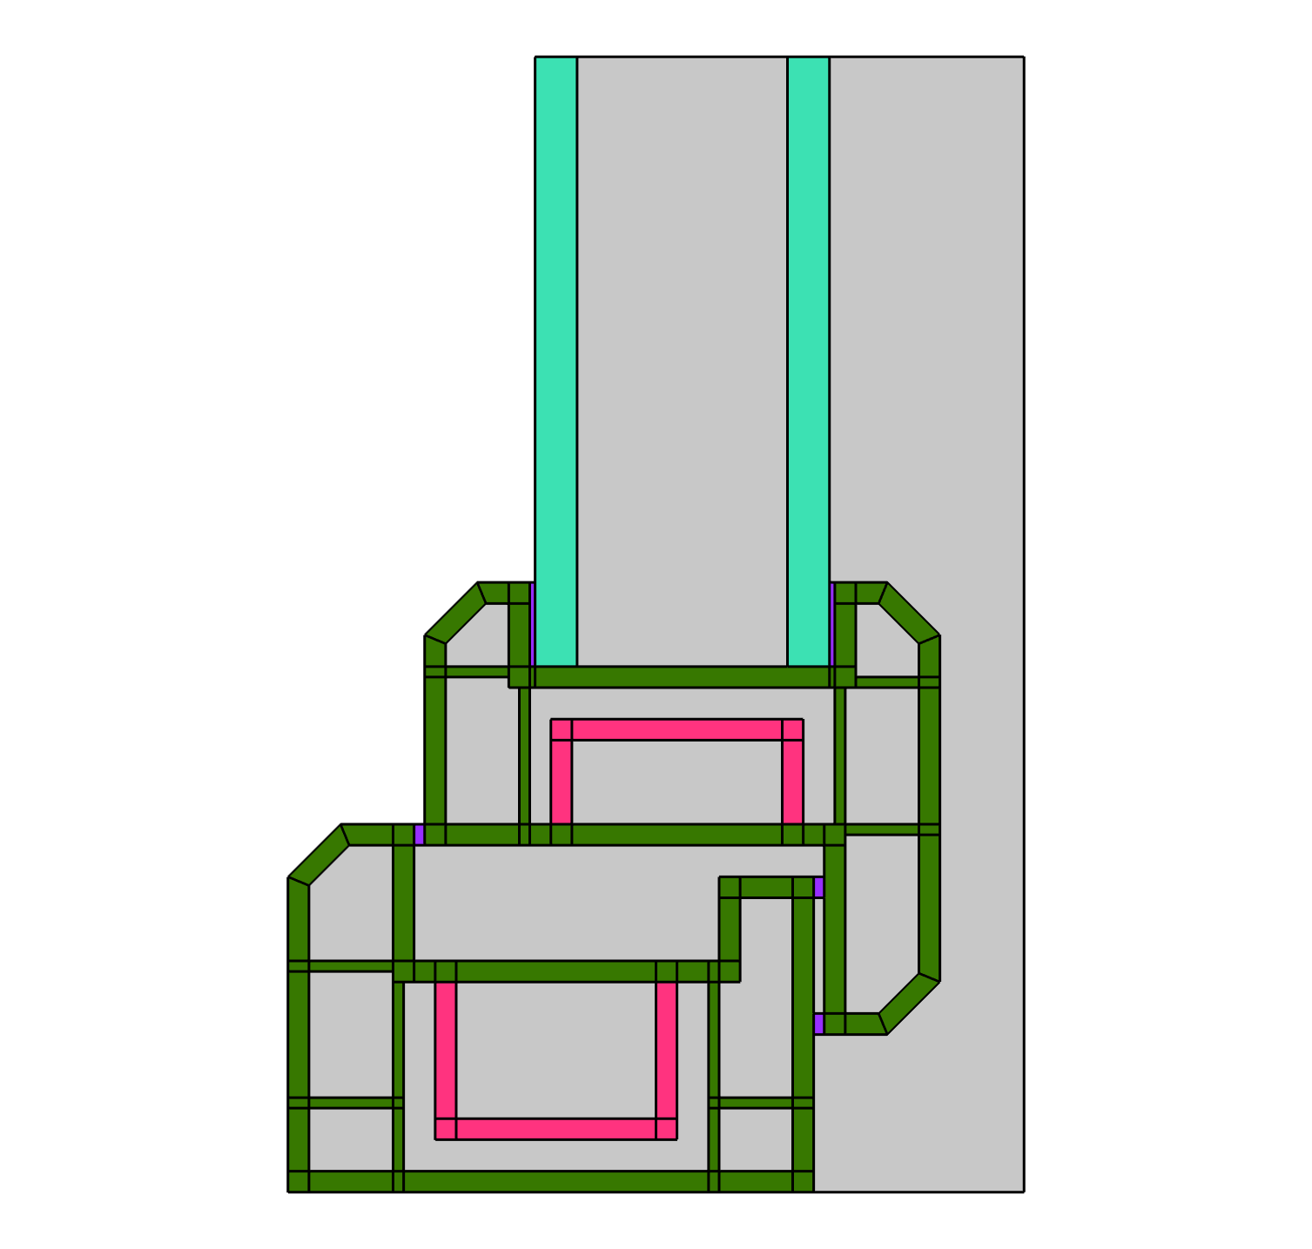
Model Geometry
Double-glazed window.
Materials (glass, uPVC, aluminum, foam) with damping for internal energy dissipation.
Geometry sequence for the window section from file: sound_transmission_loss_window_geometry_section_62.mph.
Geometry of the window section.

Slide 3
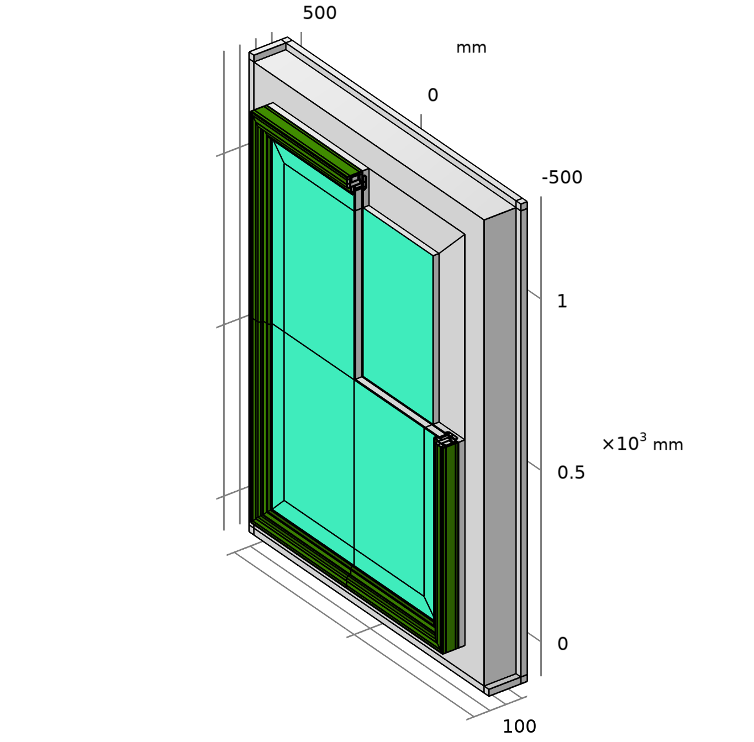
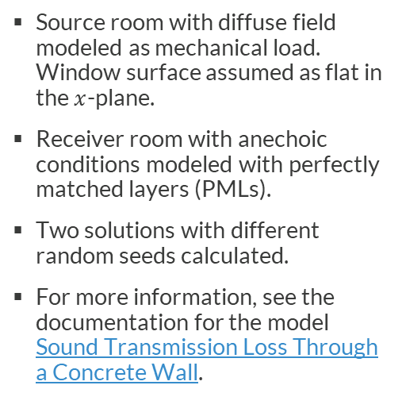
Model Setup
Source room with diffuse field modeled as mechanical load. Window surface assumed as flat in the $x$-plane.
Receiver room with anechoic conditions modeled with perfectly matched layers (PMLs).
Two solutions with different random seeds calculated.
For more information, see the documentation for the model Sound Transmission Loss Through a Concrete Wall.
Model geometry with receiver air domain and PML.

Slide 4
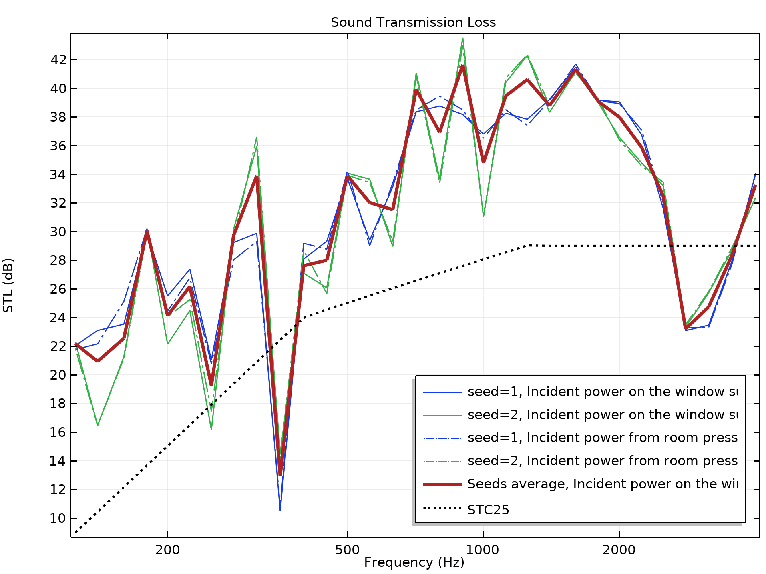
Results
The variability between seeds is larger at low frequencies, where the wavelength is comparable to the size of the window.
The STL is reduced at resonance and coincidence frequencies.
The window modeled can be rated with a sound transmission class of 25 dB.

Slide 5
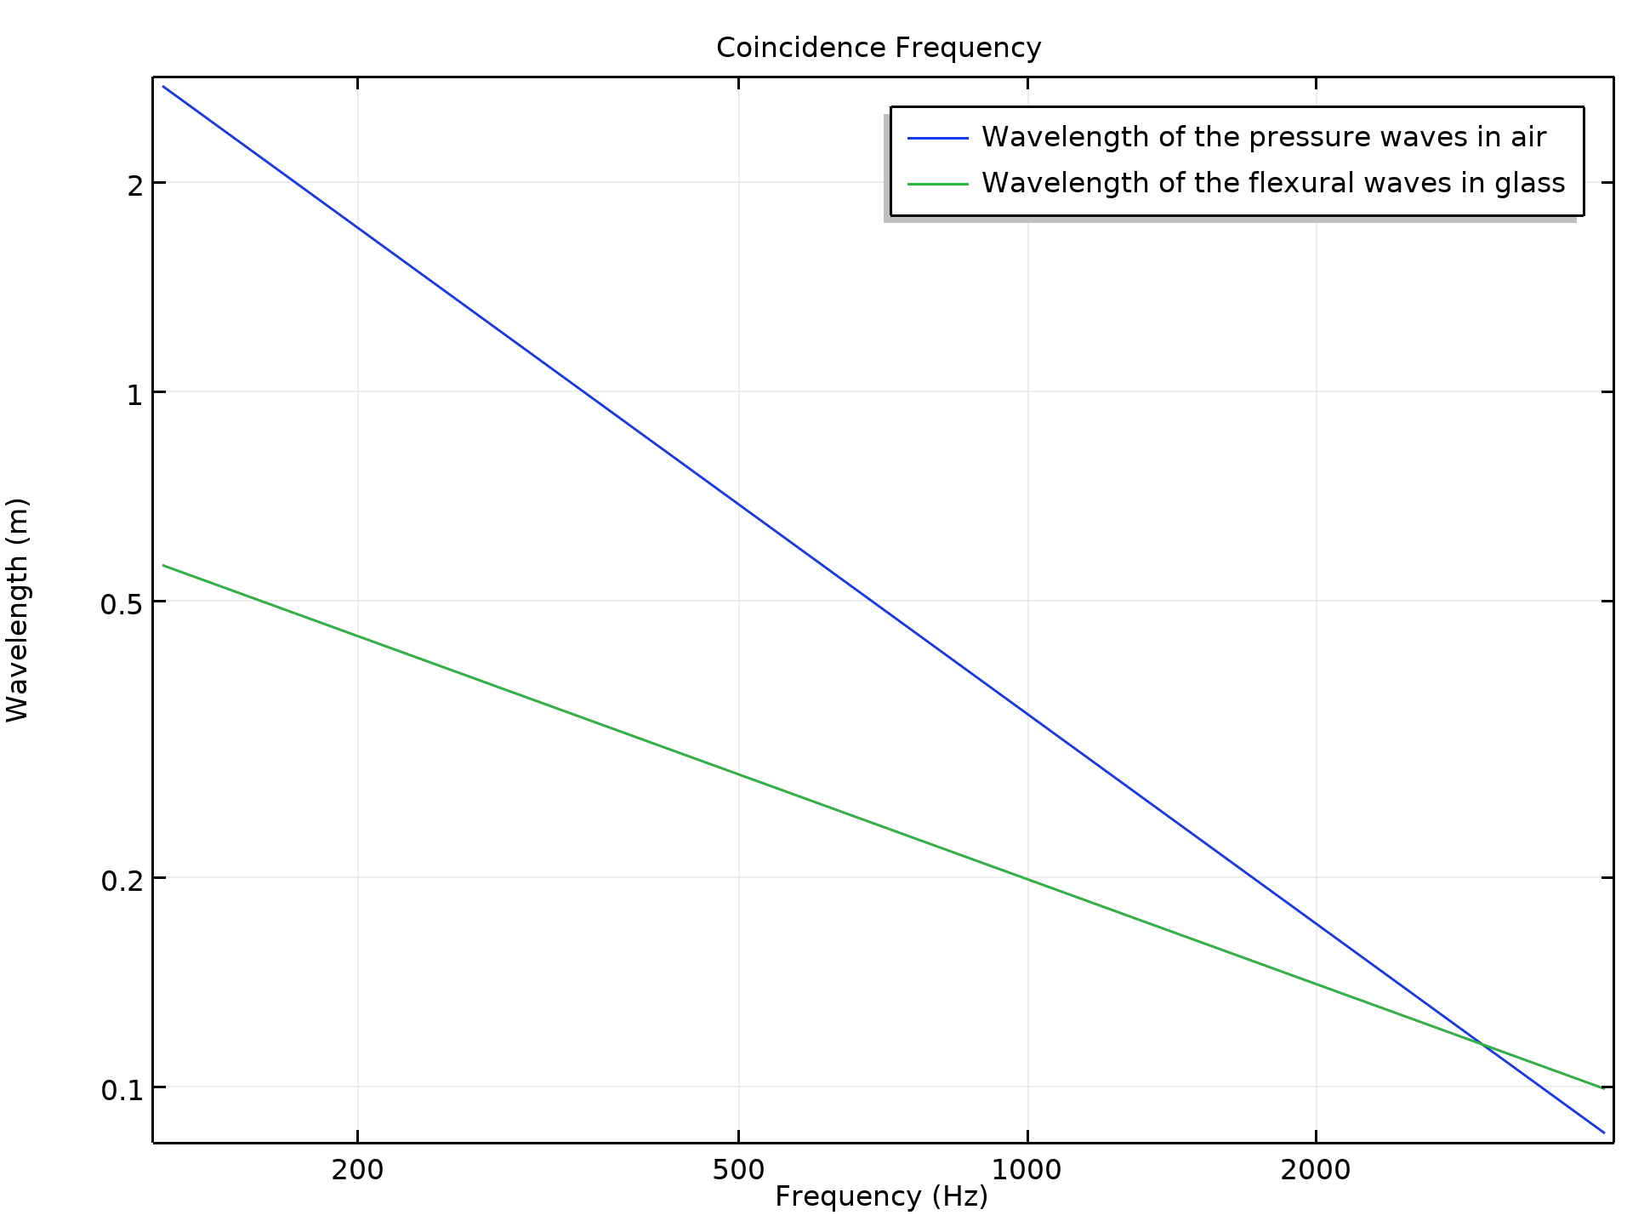
Results

Slide 6
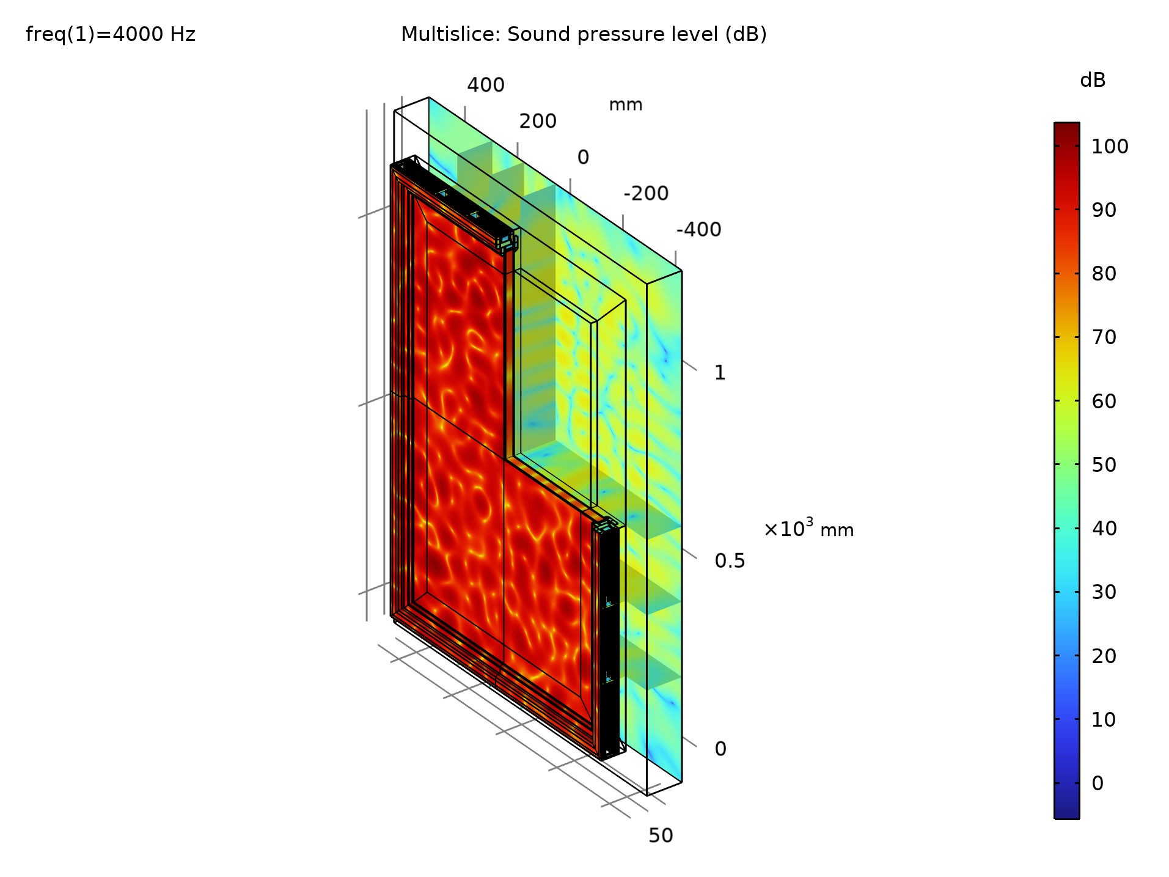
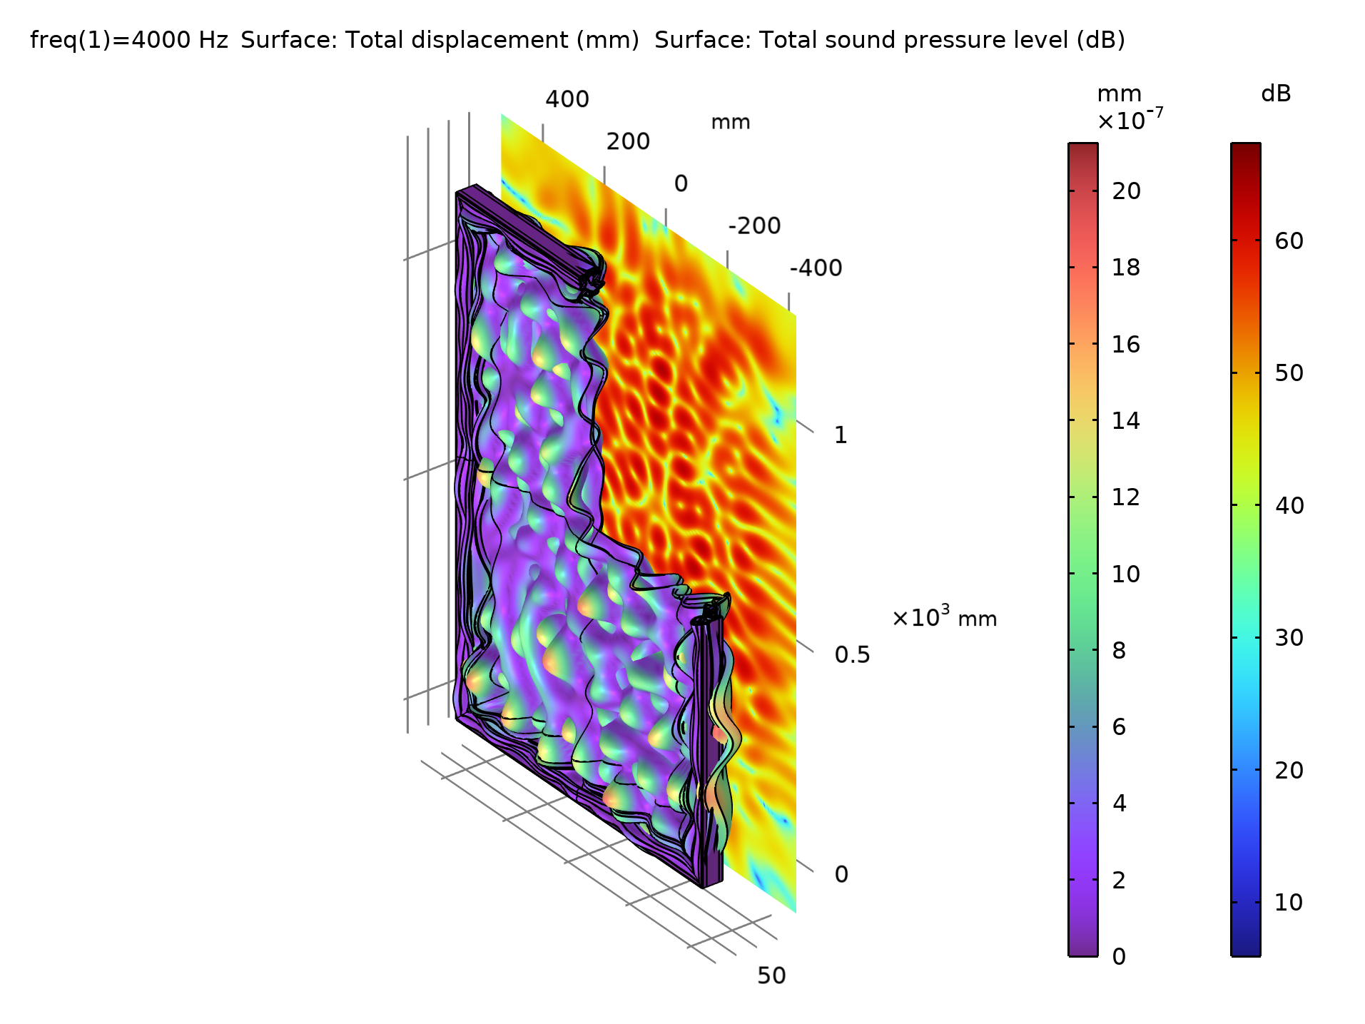
Results

