Slide 1
Stress Analysis of an IGBT Module under Highly Accelerated Stress Test Conditions
COMSOL

Slide 2
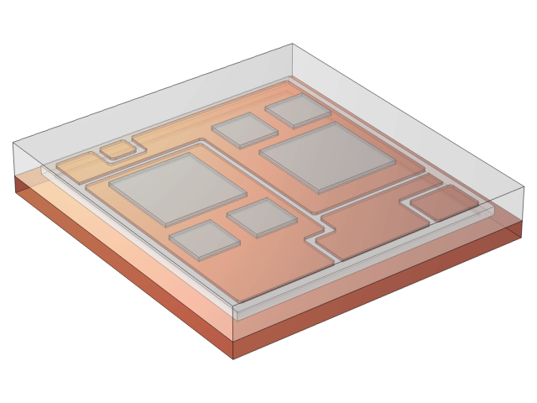
Introduction
Highly accelerated stress test (HAST)
  High temperature, high humidity
  Measure the stress reliability of the plastic-encapsulated IGBT module under non working condition
    Thermal stress
    Hygroscopic stress
HAST testing conditions
  Test temperature 135℃
  Test humidity 85% RH
  Standing time 96h
Reference standards: JESD22-A110

Slide 3
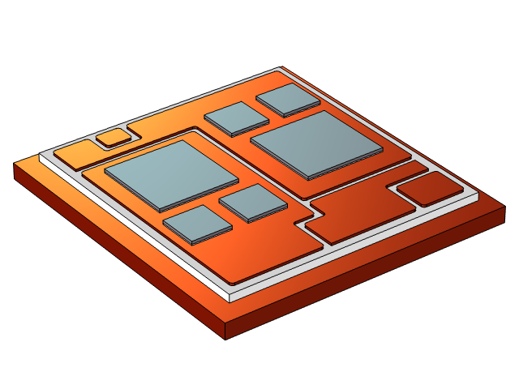
IGBT Module
Composition of IGBT module:
  Epoxy molding compound (EMC)
  Silicon chips
  Solder
  Ceramic substrate
  Copper substrate

Slide 4
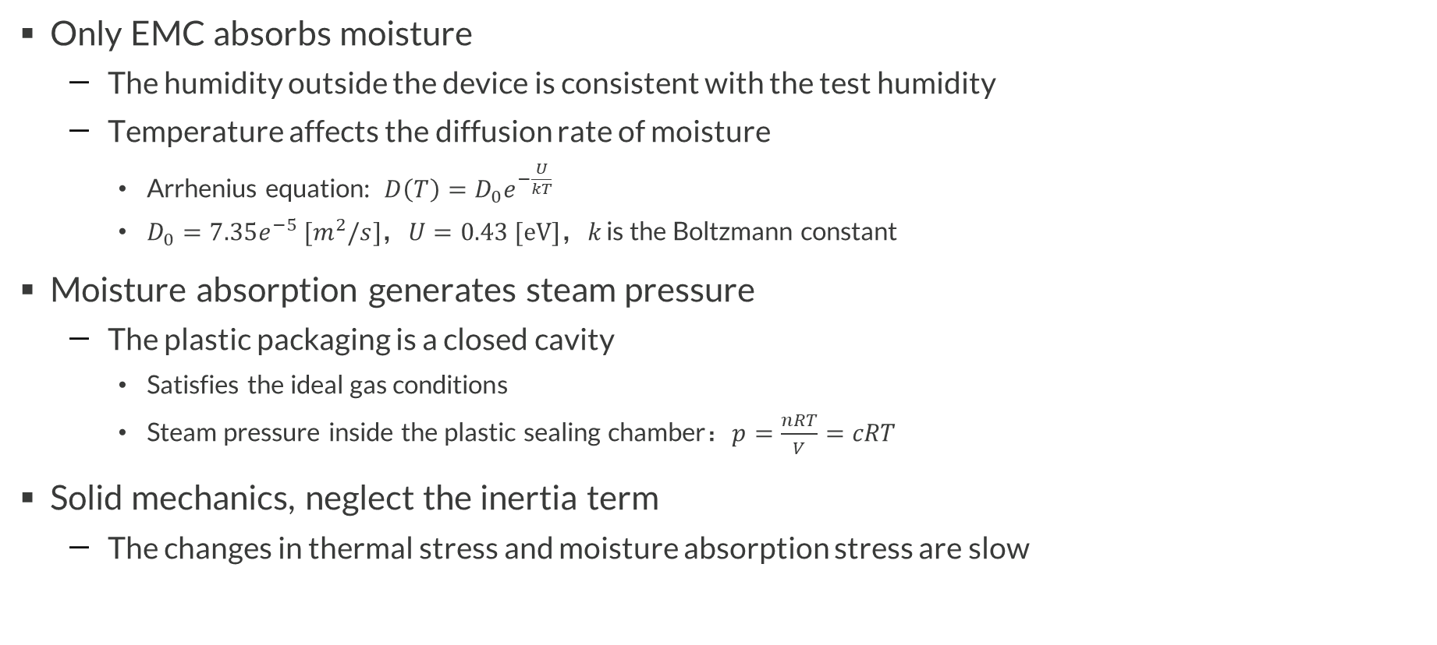
Model Assumptions
Only EMC absorbs moisture
  The humidity outside the device is consistent with the test humidity
  Temperature affects the diffusion rate of moisture
    Arrhenius equation: $D\left(T\right)=D_{0}e^{−\frac{U}{kT}}$
    $D_{0}=7.35e^{−5} [m^{2}/s]$，$U=0.43 [eV]$，$k$ is the Boltzmann constant
Moisture absorption generates steam pressure
  The plastic packaging is a closed cavity
    Satisfies the ideal gas conditions
    Steam pressure inside the plastic sealing chamber：$p=\frac{nRT}{V}=cRT$
Solid mechanics, neglect the inertia term
  The changes in thermal stress and moisture absorption stress are slow

Slide 5
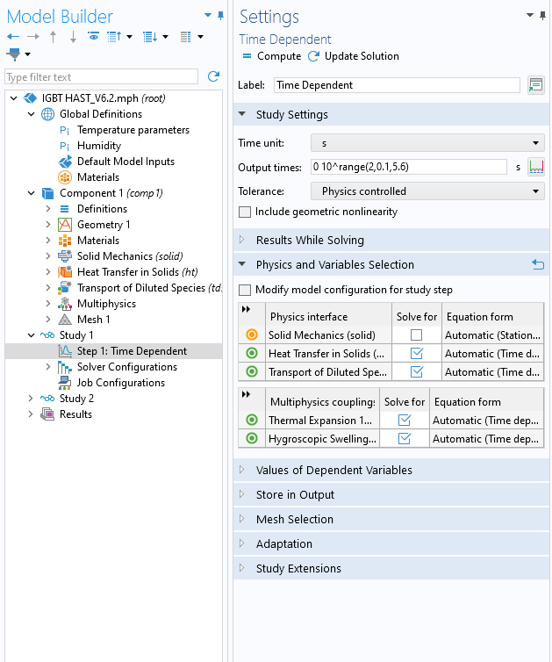
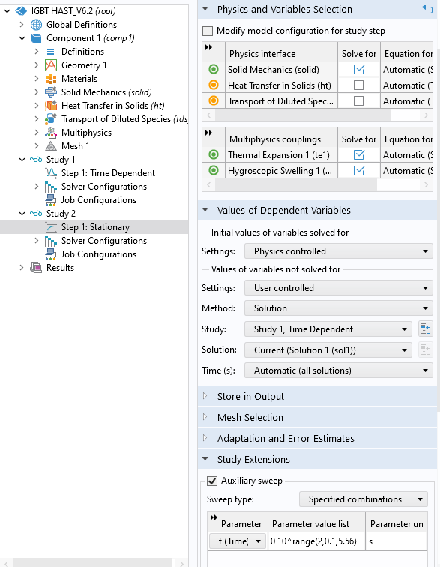
Study
Stepwise Calculation
Stationary study improves computational efficiency
Time dependent
Stationary
Transmission of temperature and humidity
Neglect the inertia term
Moisture absorption stress and thermal stress

Slide 6
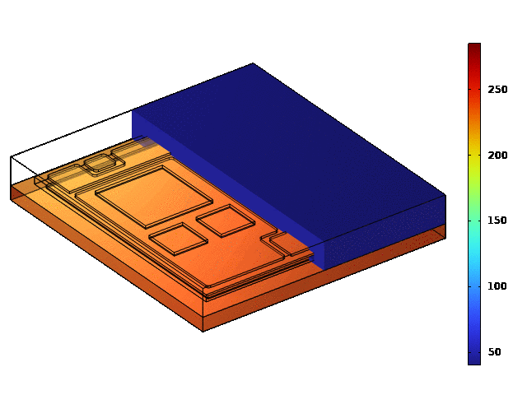
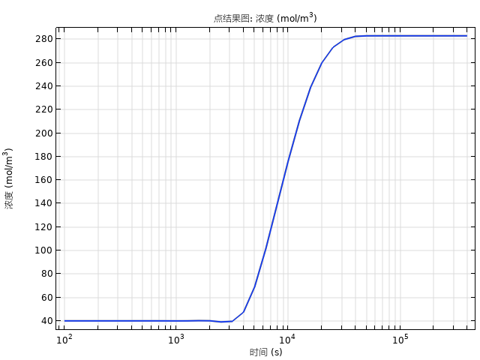
Result: Humidity
Reaches test humidity after approximately 8.78h

Slide 7
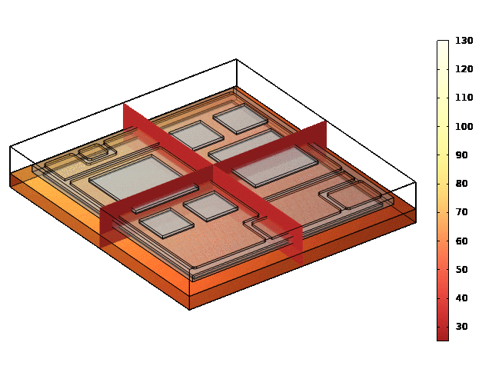
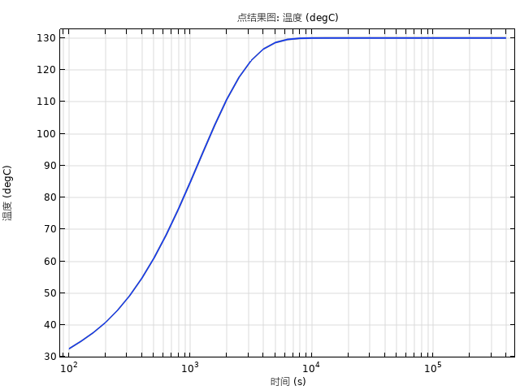
Result: Temperature
Reaches test temperature after approximately 2.21h

Slide 8
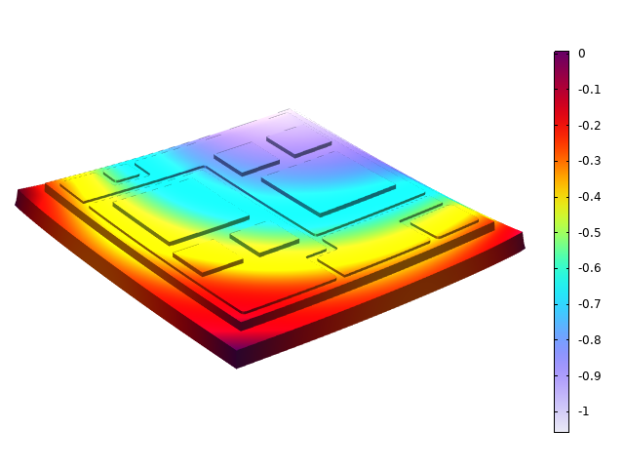
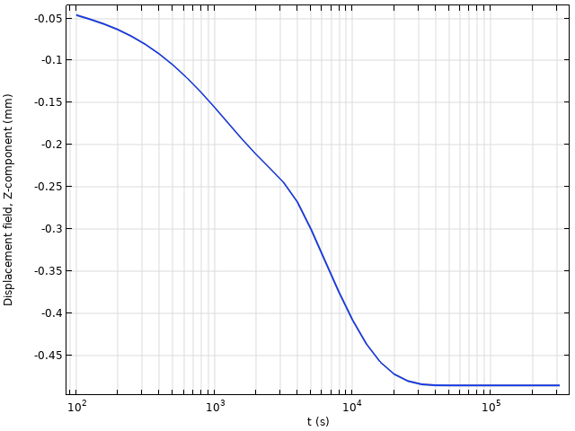
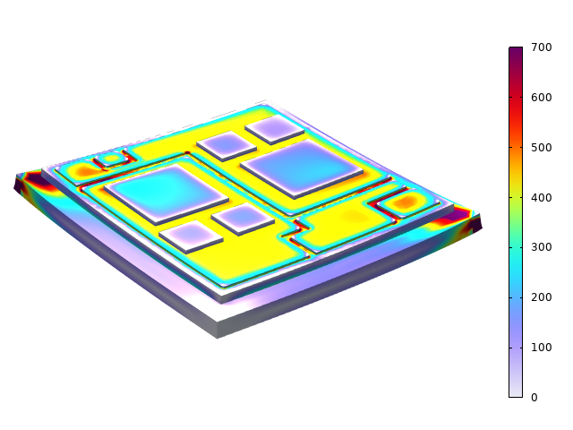
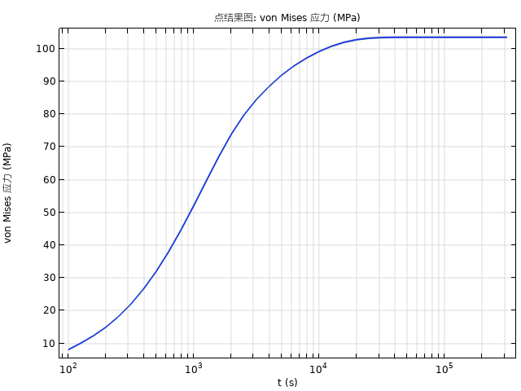
Result: Displacement & Stress
Displacement in z-direction
Displacement curve
Von mises stress
Stress curve
Warpage and stress caused by temperature and humidity
  Reaches maximum after 8.78h
  Temperature and concentration both reach saturation values
Exceeding the permitted warpage or stress is considered failure

Slide 9
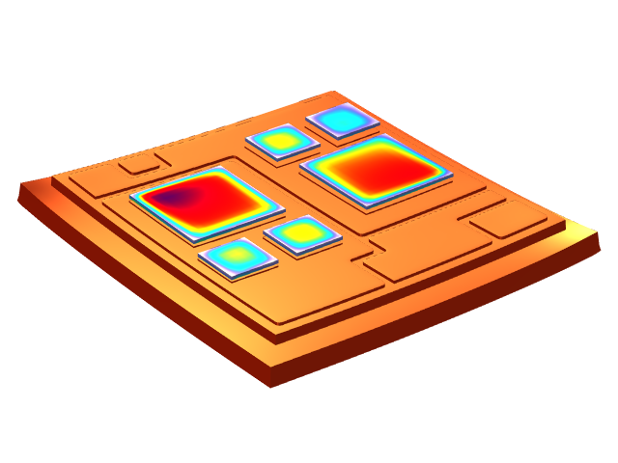
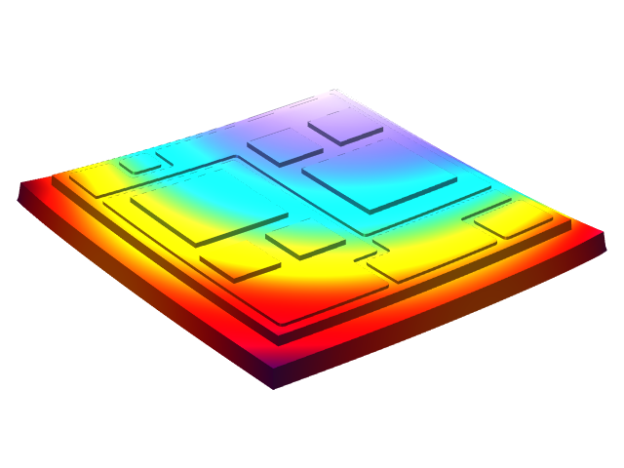
Discuss: Stress Singularity
Point constraints and edge constraints lead to stress singularity
  If possible, avoid point and edge constraints
Evaluate stress singularity
  Ignore the singularity
    According to Saint-Venant’s Principle, regions far from singularities are not affected by singularity
    Eg: If only focus on the stress of the chips, singularity can be ignored
  Avoide the singularity
    Use displacement standard, displacement will not have singularity
    Introduce local plasticity to alleviate stress singularity
    Preserve the rounded corners of the focus position
Stress of the chip
Displacement

