Slide 1
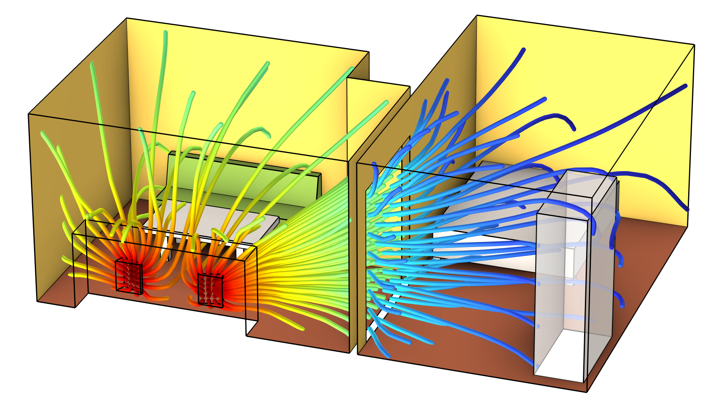
Apartment Acoustics Analyzed Using the Acoustic Diffusion Equation

Slide 2
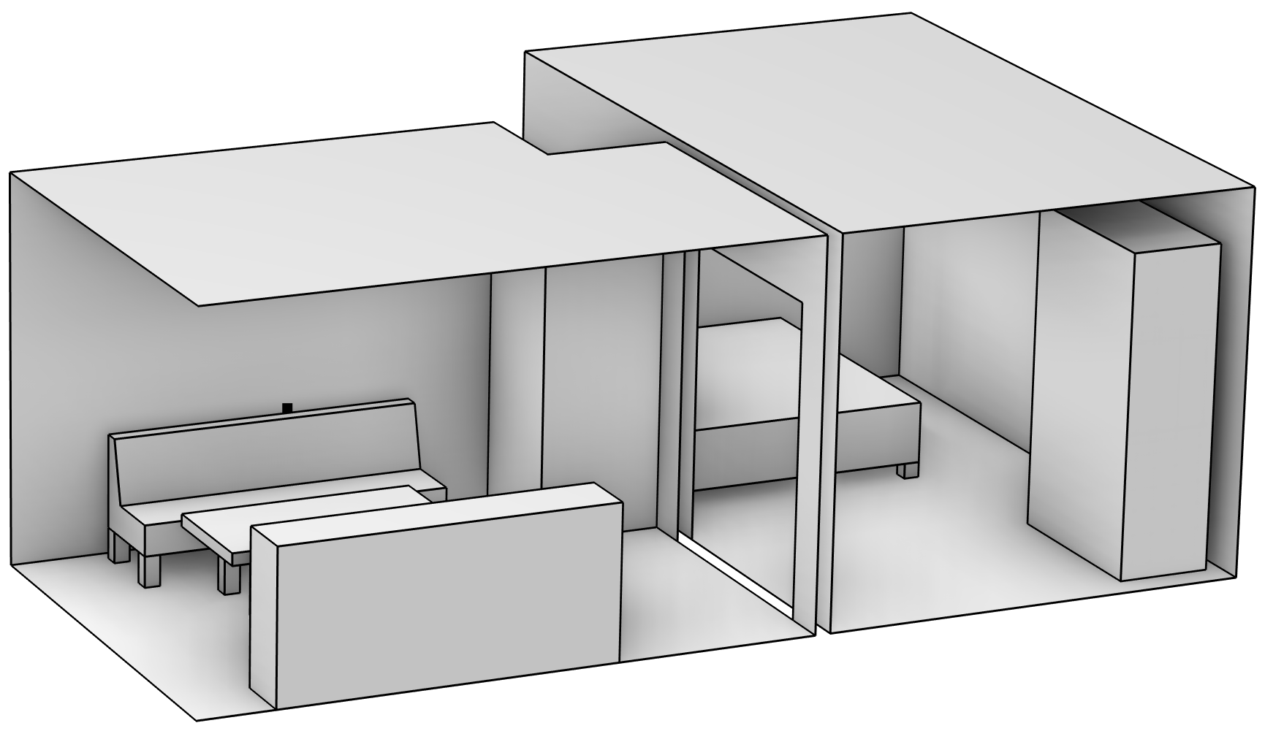
Model Setup
Calculation of sound pressure level distribution from a TV in a two-room apartment.
Acoustic Diffusion Equation physics interface with manual expression for direct sound.
Rooms connected by a Mapped Room Coupling with transmission loss of 10 dB.
Geometry of the model with a living room and a bedroom separated by a closed door.

Slide 3
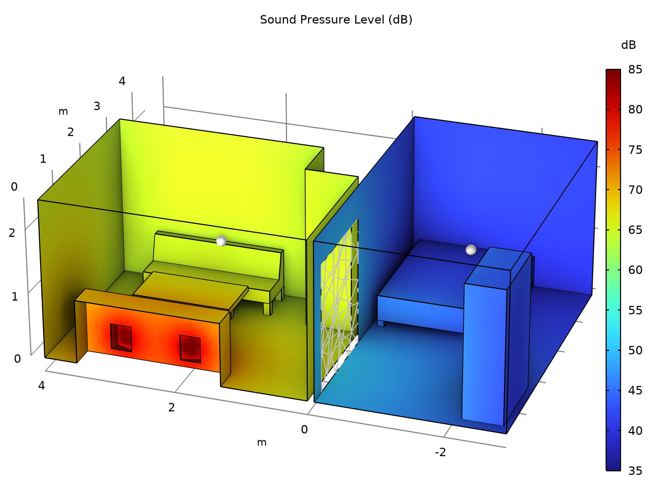
Results: Sound Pressure Level

Slide 4
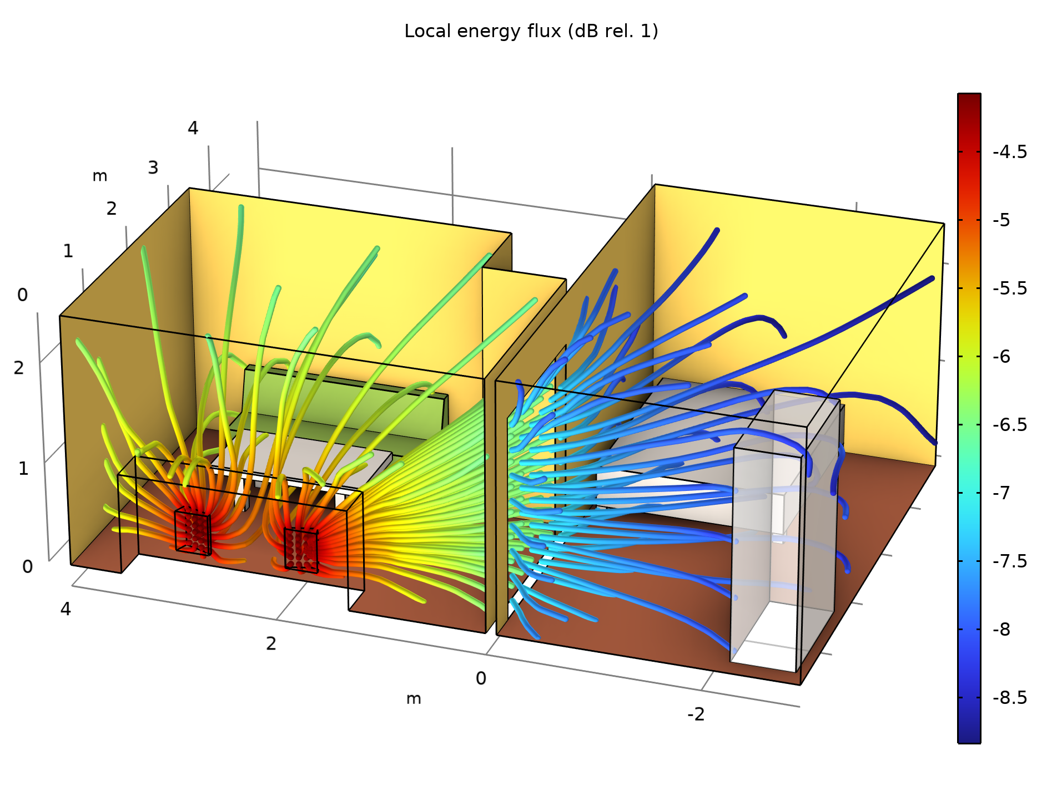
Results: Energy Flux

Slide 5
comsol.com/contact

