Slide 1
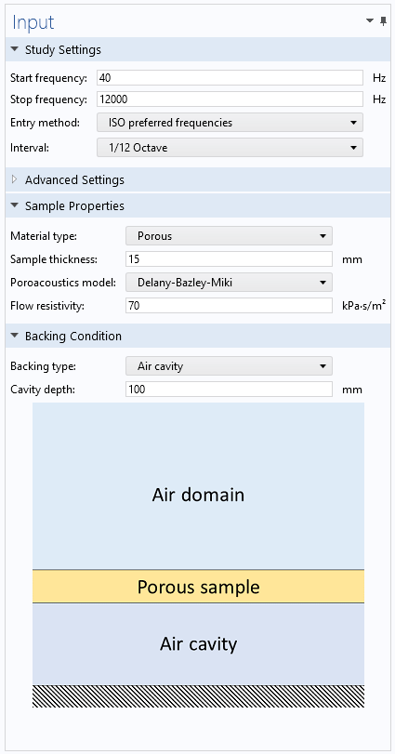
Acoustic Treatment
Boundary Calculator

Slide 2
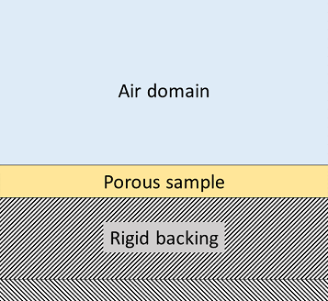
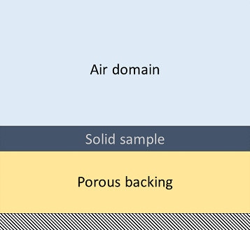
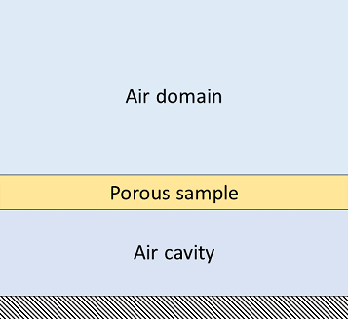
Model Setup
Choice between porous or solid sample with rigid, porous, or air cavity backing conditions.
Calculation of angle- and frequency-dependent sound absorption and surface impedance.
Pre-processing of the results for conversion to time domain.

Slide 3
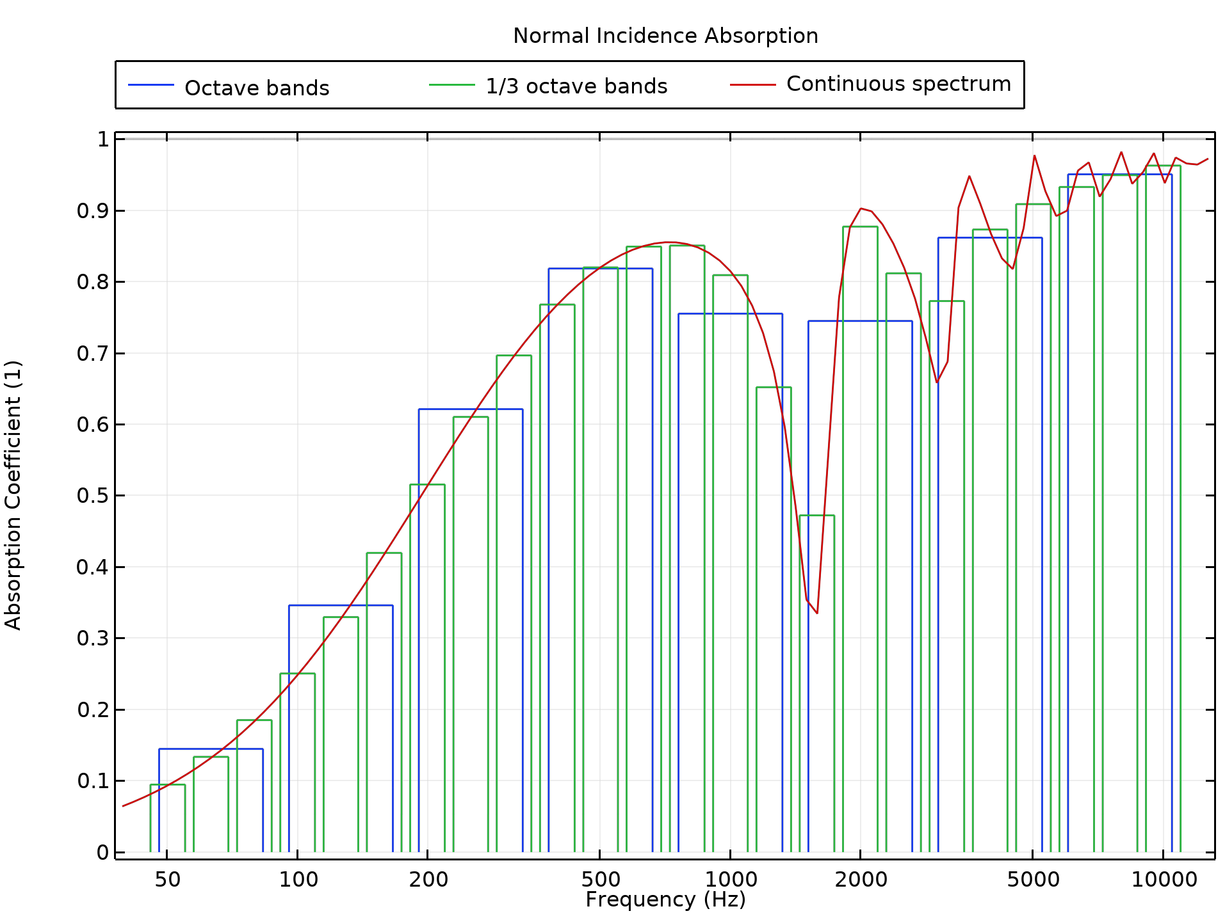
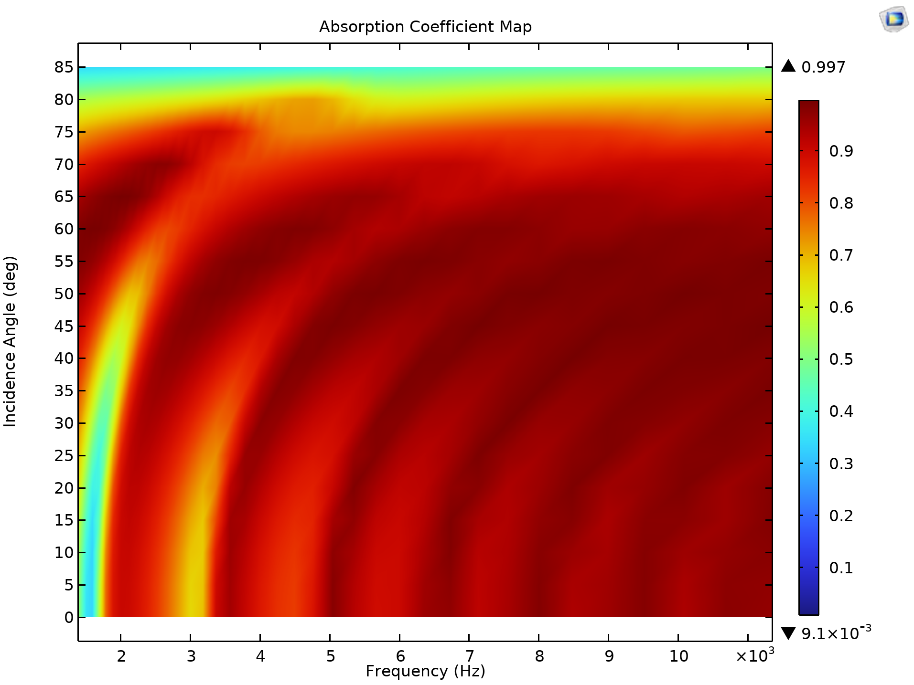
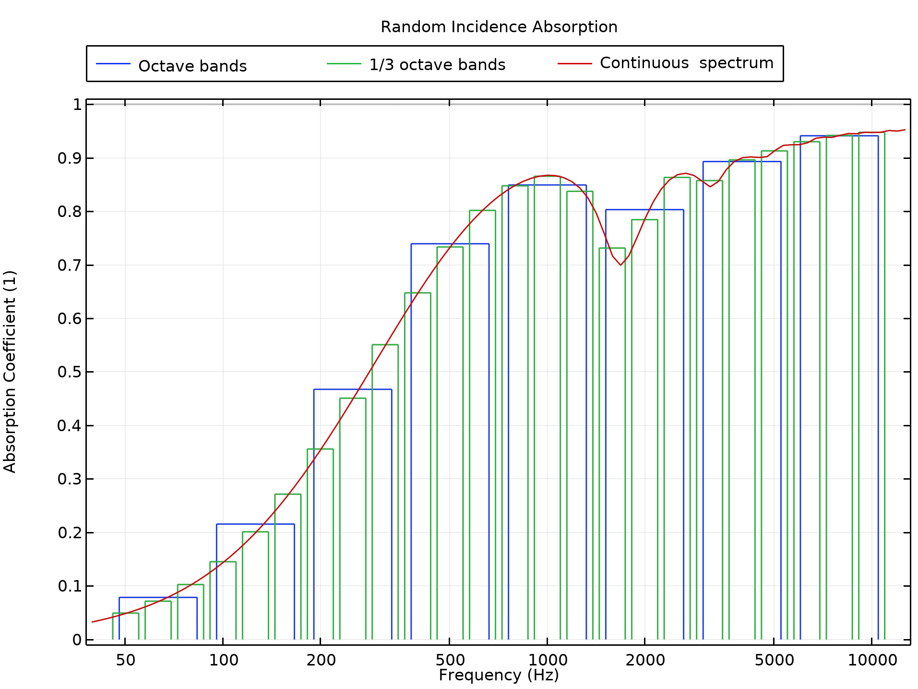
Results: Absorption Coefficient

Slide 4
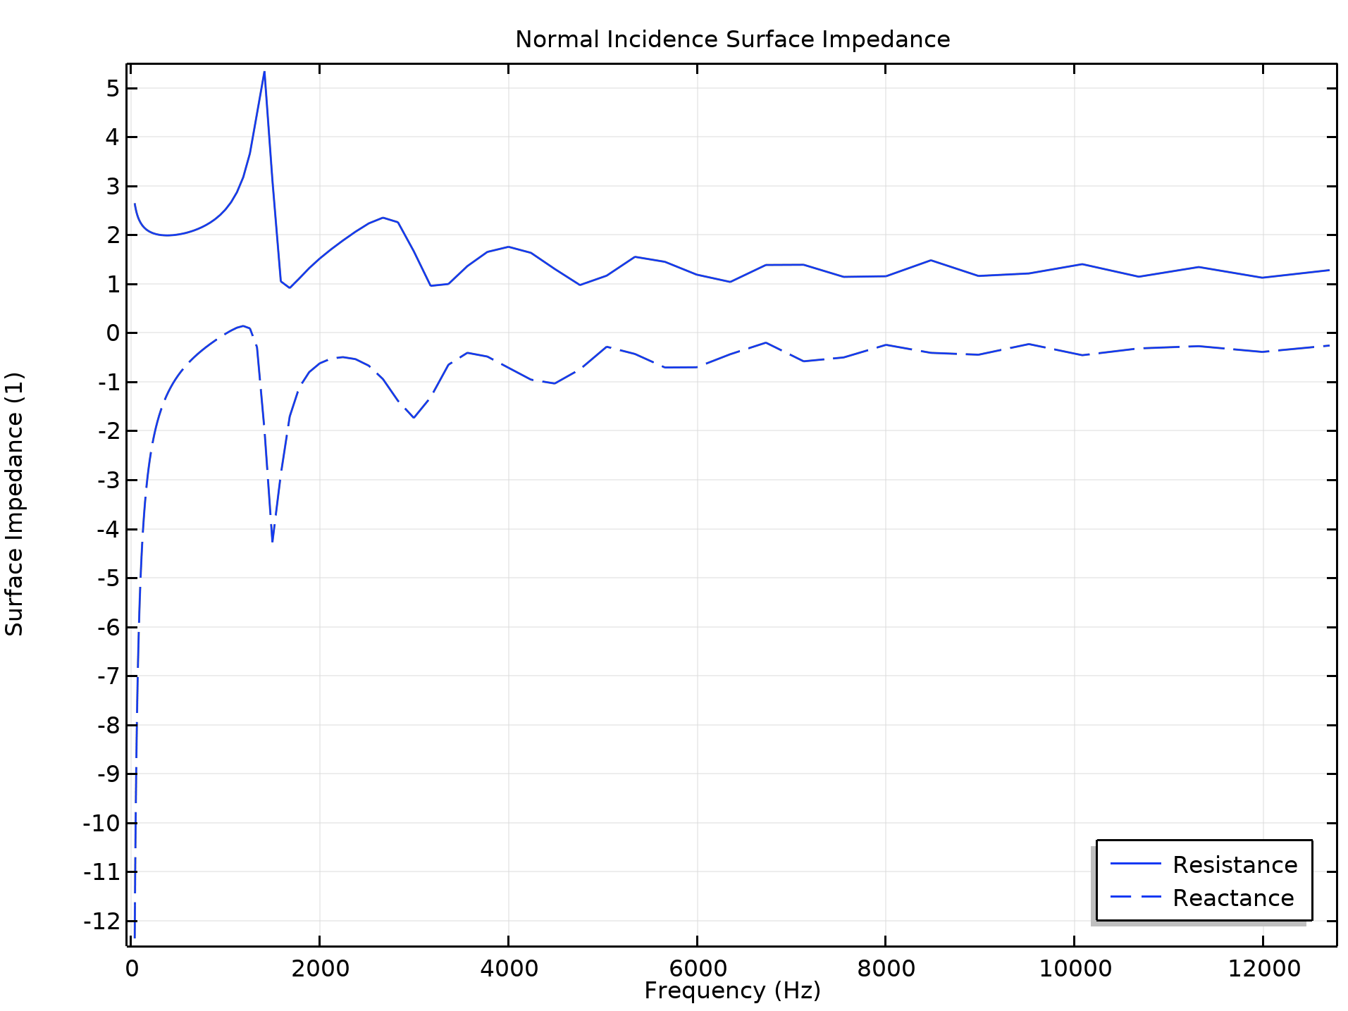
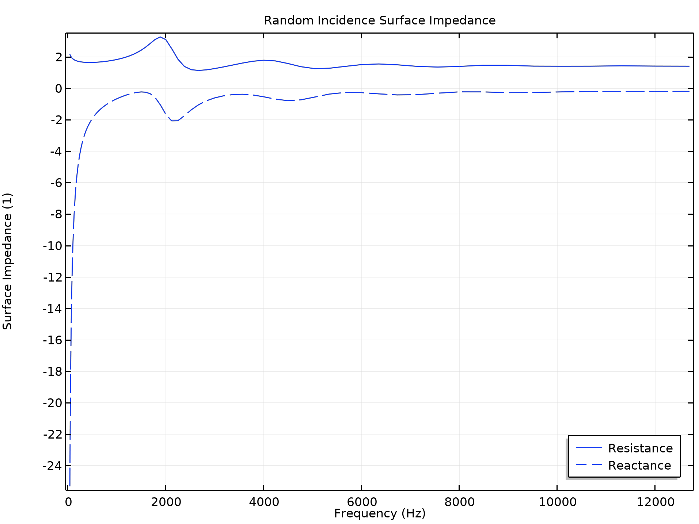
Results: Surface Impedance

Slide 5
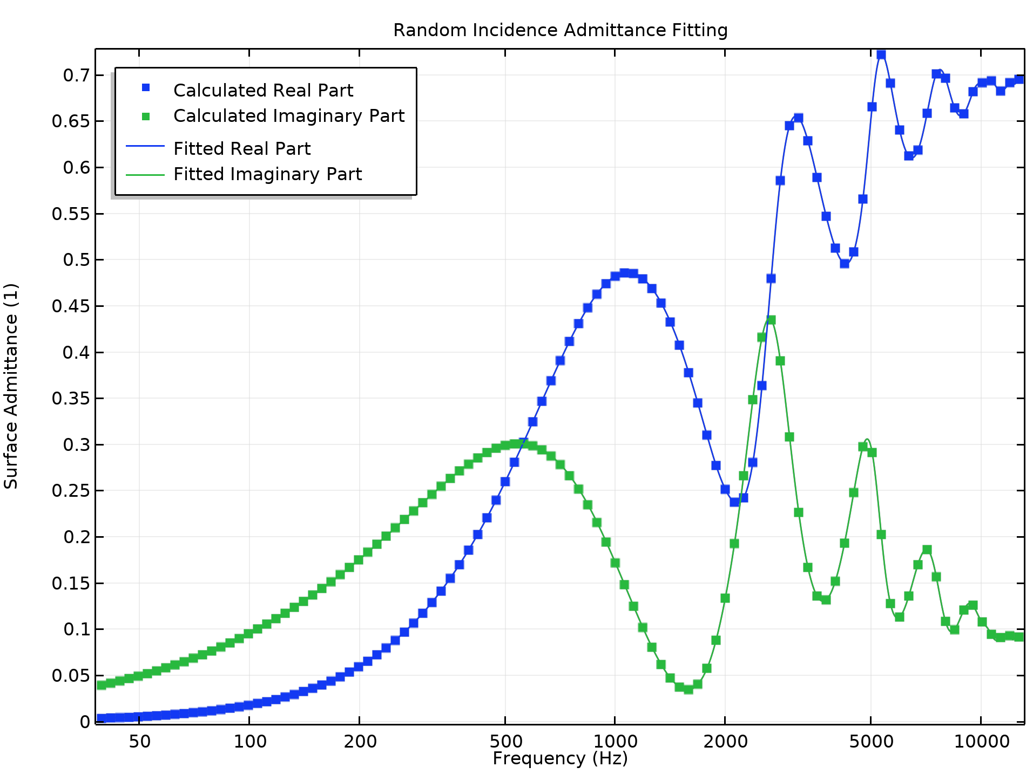
Conversion to Time Domain
The app shows the Partial Fraction Fit of the simulated surface admittance in order to verify the agreement between calculated and fitted data.
To implement impedance boundary conditions in the time domain, see the Wave-Based Time-Domain Room Acoustics with Frequency-Dependent Impedance model in the Application Library.

