Slide 1
Performing Convolution for Room Acoustics in COMSOL Multiphysics®

Slide 2

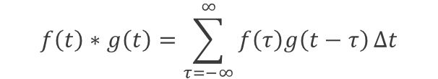
Definition
  The examples model implement the following three convolution methods:
Convolution integral
$$f\left(t\right)∗g\left(t\right)=\int_{−∞}^{∞}{f\left(τ\right)g\left(t−τ\right)dτ}$$
Discrete convolution
$$f\left(t\right)∗g\left(t\right)=\sum_{τ=−∞}^{∞}{f\left(τ\right)g\left(t−τ\right)}∆t$$
Convolution theorem
$$f\left(t\right)∗g\left(t\right)=ℱ^{−1}\left[ℱ\left[f\left(t\right)\right]×ℱ\left[g\left(t\right)\right]\right]$$

Slide 3
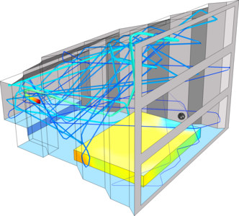
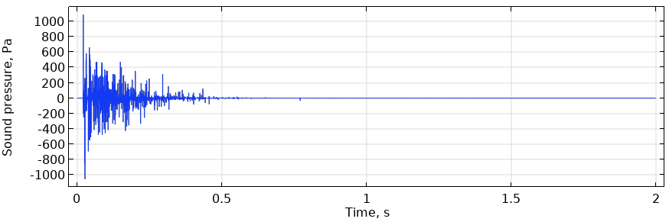
Examples
Using convolution to process an impulse response (IR) obtained from the Small Concert Hall Acoustics tutorial for the following two scenarios:
  Example 1: Low-pass filtering of the room IR
    File: performing_convolution_methods_62.mph
  Example 2: Auralization of trumpet sounds in the concert hall
    File: performing_convolution_auralization_62.mph
Room IR
Analyzed small concert hall model.

Slide 4
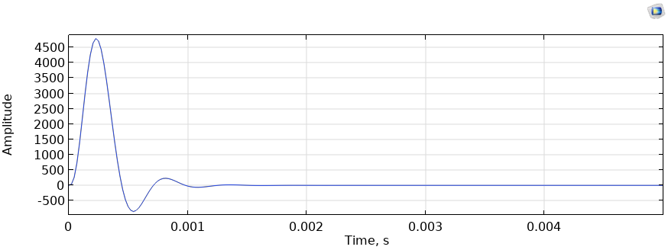
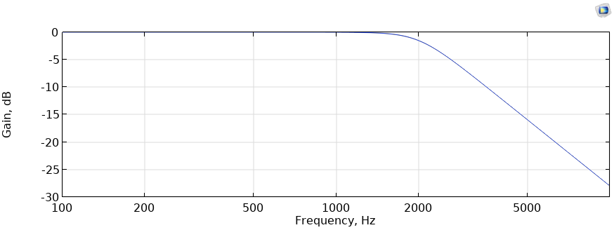
Example 1: Low-Pass Filtering of the Room IR
  Convolution with 4th-order Butterworth low-pass filter, with a cutoff frequency of 2 kHz
Waveform of the IR of the low-pass filter
Gain characteristics of the low-pass filter

Slide 5
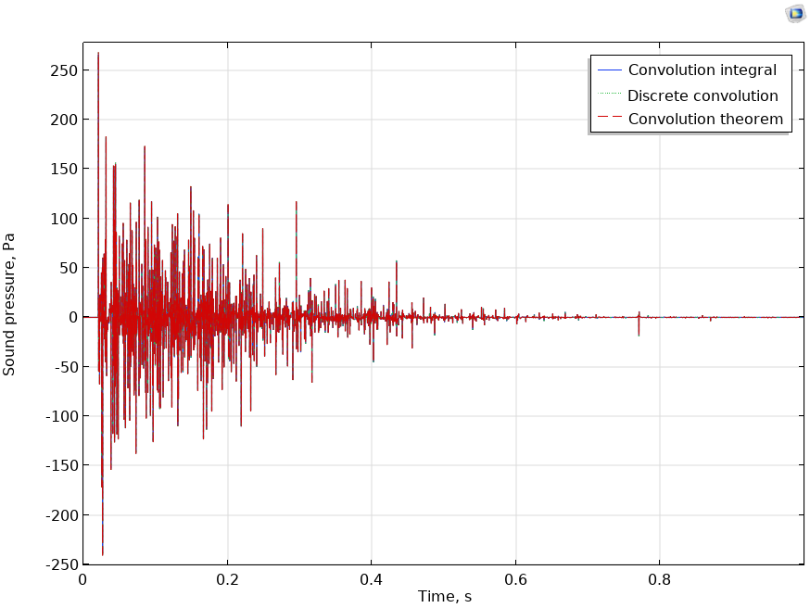
Result: Filtered Room IR
  The results of the three methods are in good agreement.

Slide 6
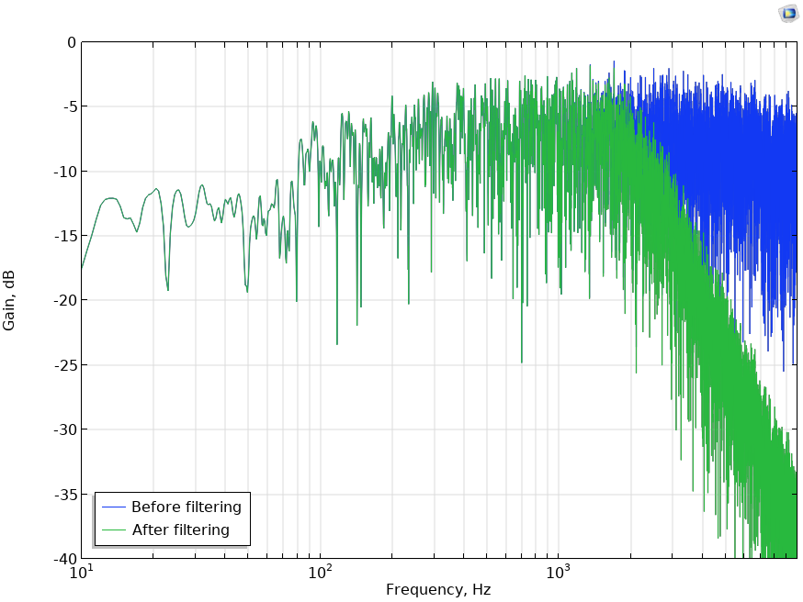
Result: Spectra of the Room IR Before and After Filtering
  By performing convolution with the low-pass filter, the spectrum of the filtered room IR decreases above 2 kHz, as compared with the original

Slide 7
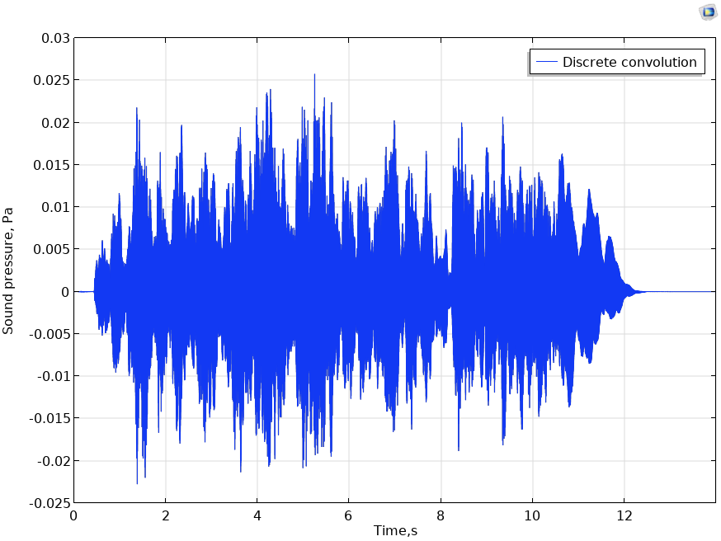

Example 2: Auralization of Trumpet Sounds in the Concert Hall
  You can experience the effect of the concert hall acoustic on a trumpet sound by the convolution of the room IR and the anechoic sound.
  anechoic
  convolution
The anechoic sound is provided by The Open AIR Library (https://www.openair.hosted.york.ac.uk/) under CC BY 4.0 (https://creativecommons.org/licenses/by/4.0/).

