Slide 1
Semitransparent Surface Feature

Slide 2





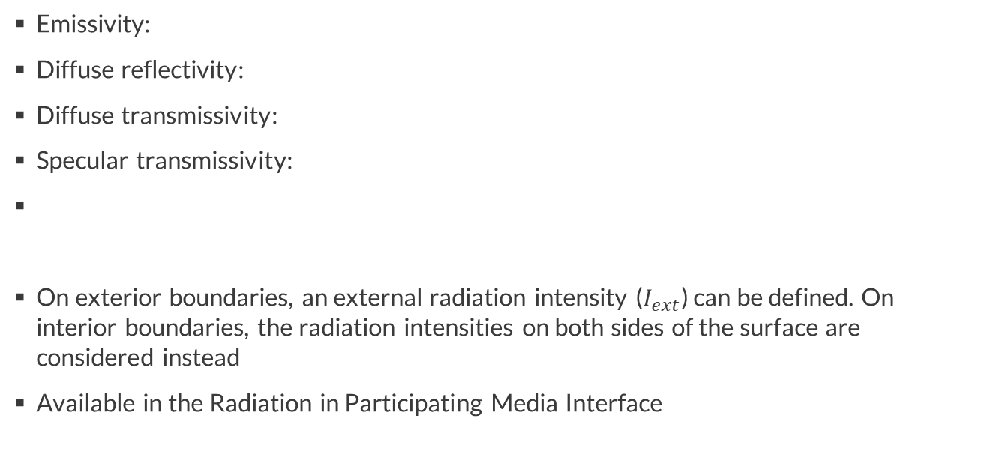





Semitransparent Surface
$$I$$
$$ρ_{d}G$$
Emissivity:
Diffuse reflectivity:
Diffuse transmissivity:
Specular transmissivity:
On exterior boundaries, an external radiation intensity ($I_{ext}$) can be defined. On interior boundaries, the radiation intensities on both sides of the surface are considered instead
Available in the Radiation in Participating Media Interface
$$ε$$
$$εI_{b}(T)$$
$$ρ_{d}$$
$$τ_{d}$$
$$τ_{s}$$
$$τ_{d}G$$
$$ε+ρ_{d}+τ_{s}+τ_{d}=1$$
$$τ_{s}I$$

Slide 3
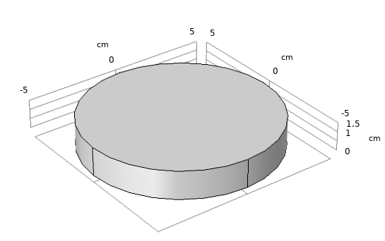

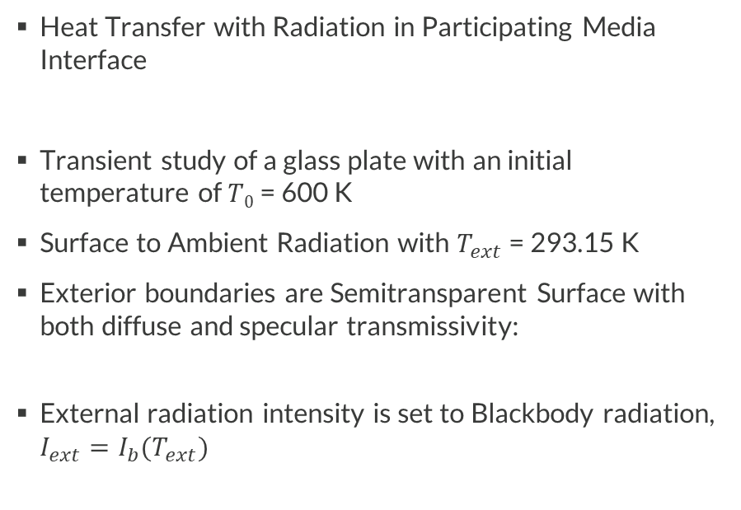
Problem definition
Heat Transfer with Radiation in Participating Media Interface
Transient study of a glass plate with an initial temperature of $T0$ = 600 K
Surface to Ambient Radiation with $T_{ext}$ = 293.15 K
Exterior boundaries are Semitransparent Surface with both diffuse and specular transmissivity:
External radiation intensity is set to Blackbody radiation, $I_{ext}=I_{b}(T_{ext})$
$$ε=0.6, τ_{s}=0.2, τ_{d}=0.2$$
Model geometry

Slide 4
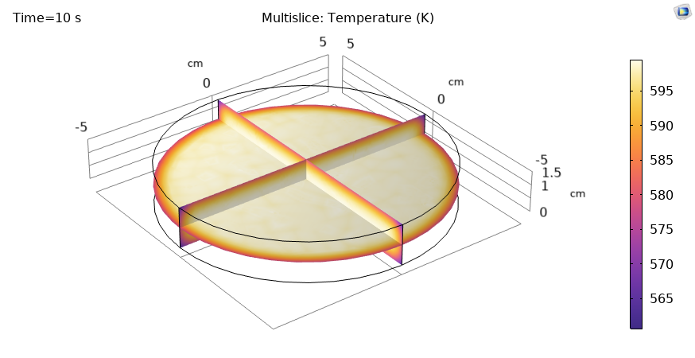
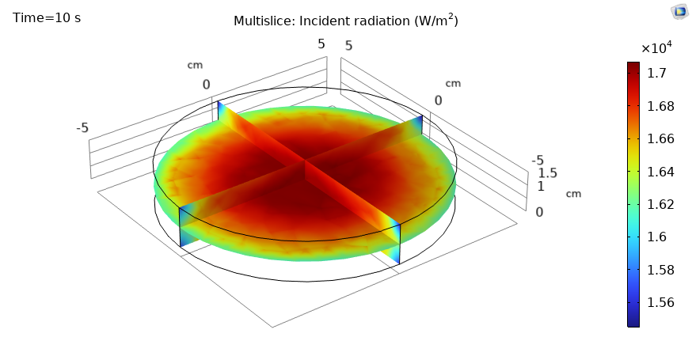
Results
The results after 10 s of radiative cooling are shown on the two figures on the right
This model shows how to use the Semitransparent Surface feature in Radiation in Participating Media
This feature can be especially useful to model incident radiation coming from a transparent media on a participating media

