Slide 1
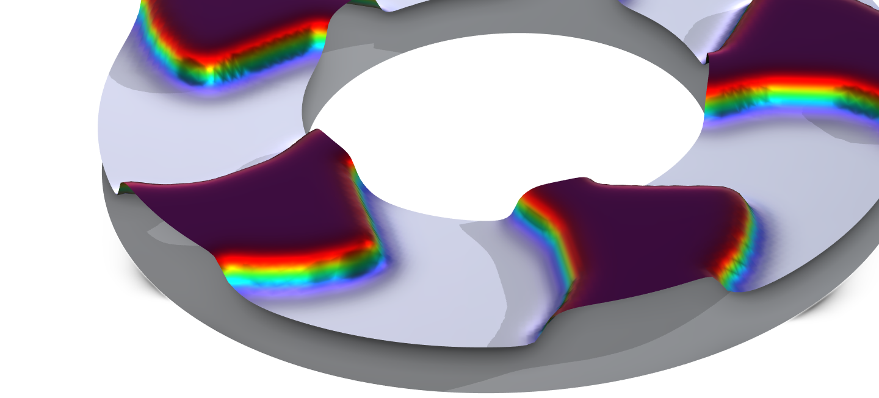
Topology Optimization of a Step Thrust Bearing

Slide 2
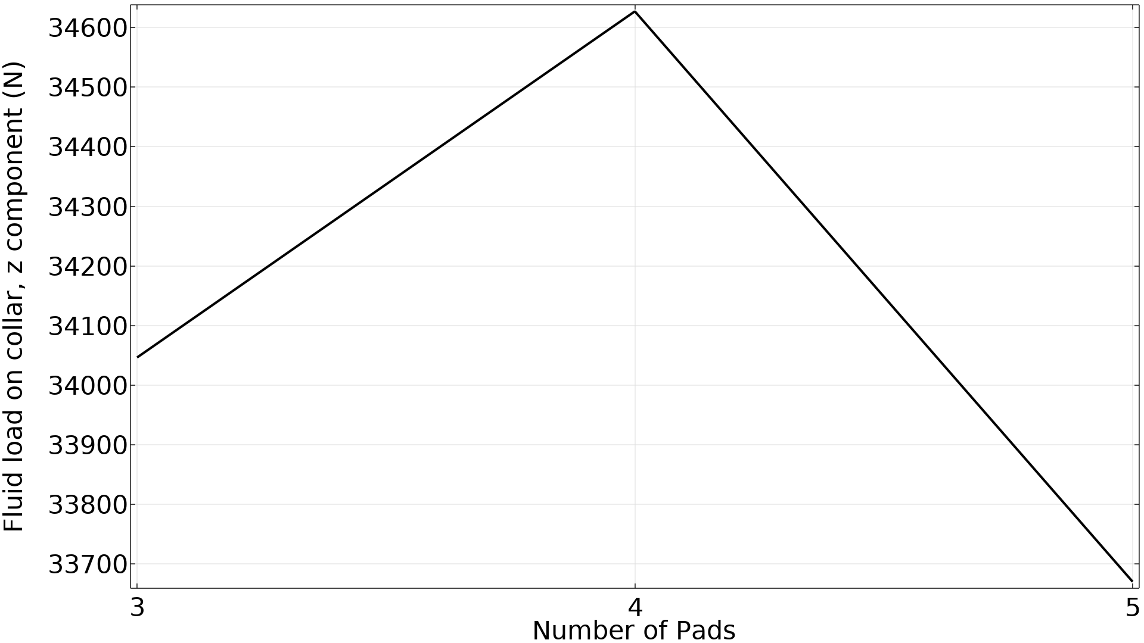
Topology Optimization of a Step Thrust Bearing
Results
Problem is self-penalizing, so no need for regularization or constraints.
Uniform initial guess leads to optimal number of grooves, but local minima can be identified using non-uniform initial guesses.
Topology Optimization of a Step Thrust Bearing
Topology Optimization of a Step Thrust Bearing

Slide 3
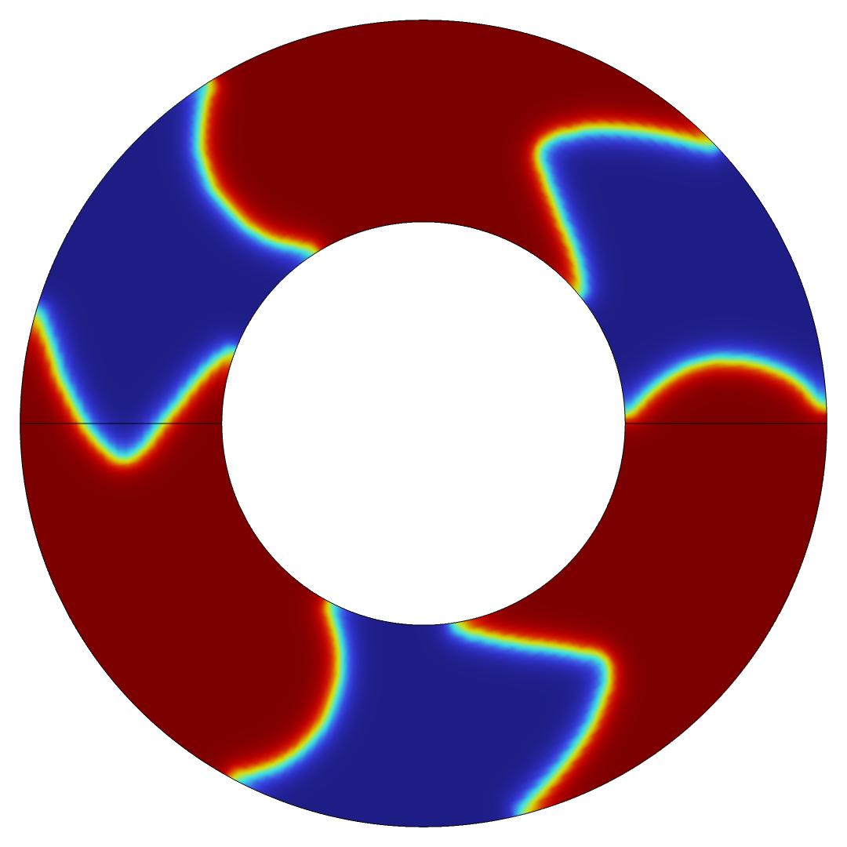
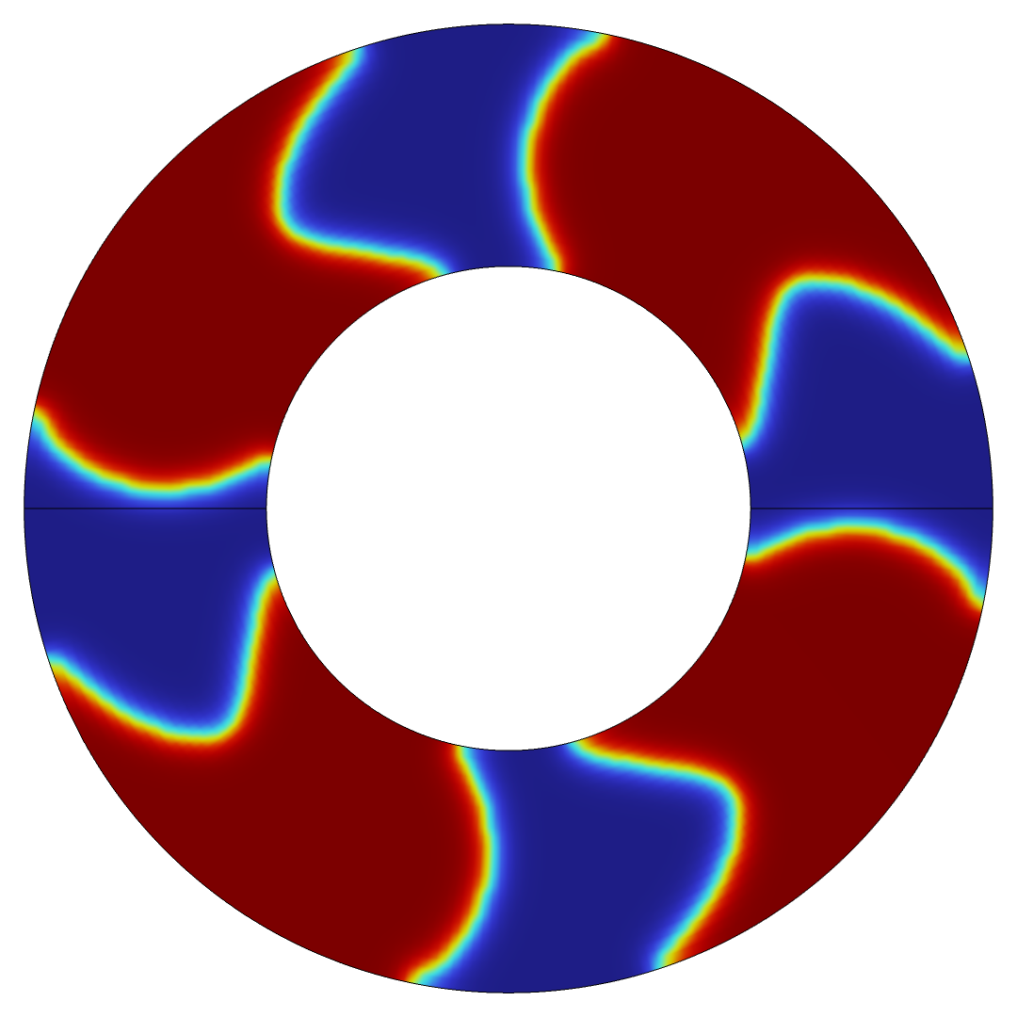
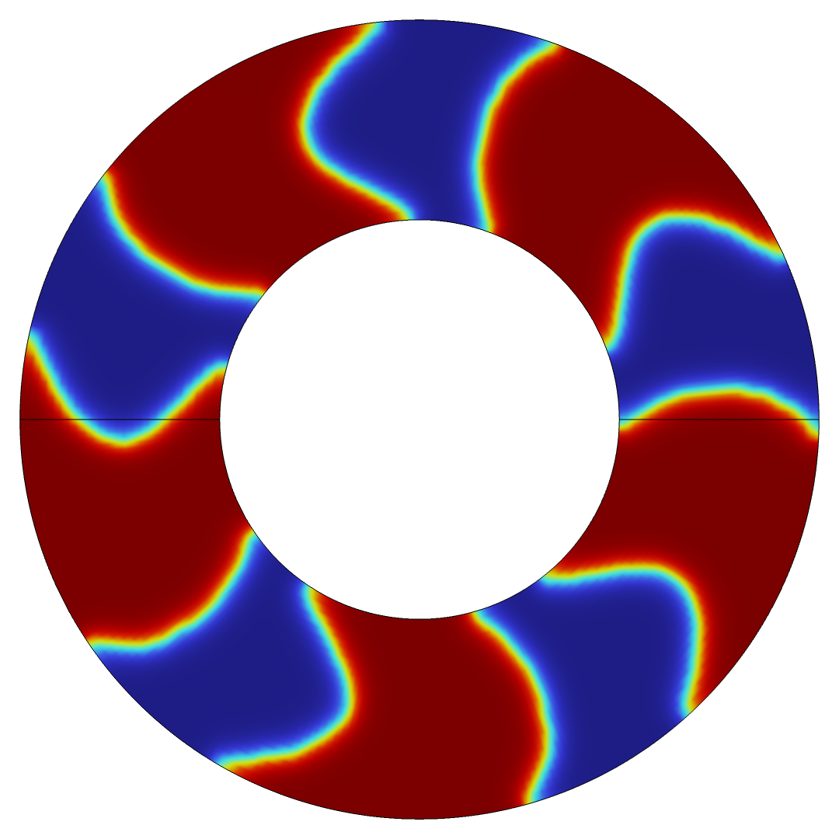
Topology Optimization of a Step Thrust Bearing
Topology Optimization of a Step Thrust Bearing

