Slide 1
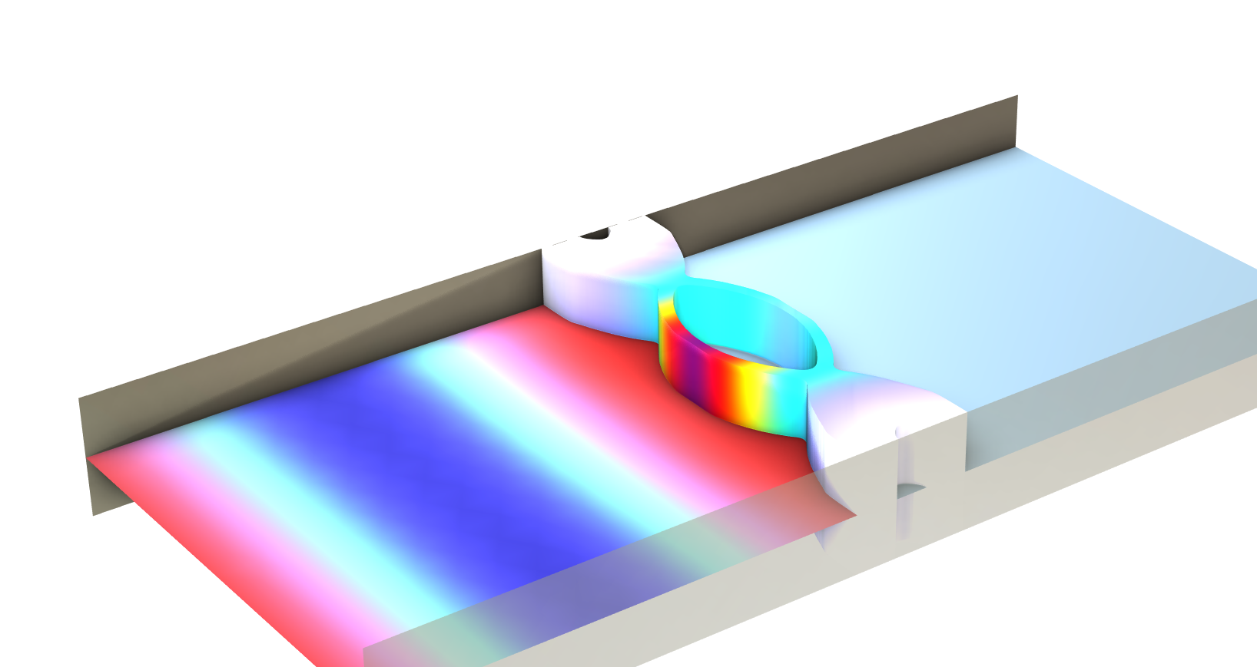
Topology Optimization of a
Sound Partition considering
Acoustic-Structure Interaction

Slide 2
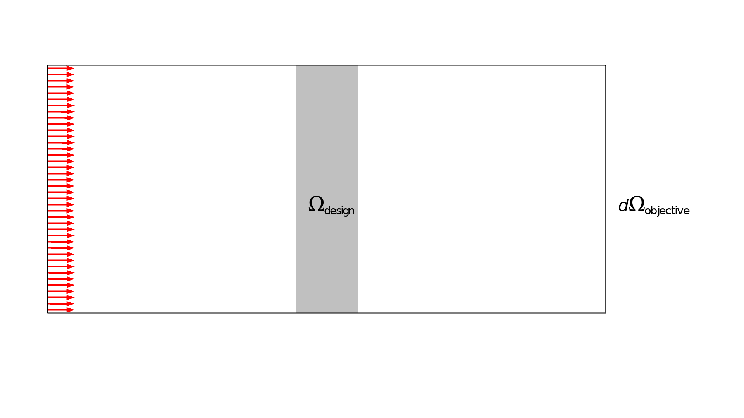

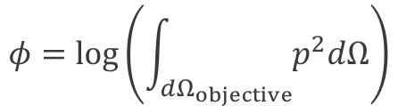
Setup
The implementation uses the following functionality
Solid Mechanics interface
for modelling design domain
Pressure Acoustics interface
outside design domain for saving computational resources
Density Model feature
for regularization with
Helmholtz filter and SIMP penalization
Topology Optimization study step
$$φ=log\left(\int_{dΩ_{objective}}{p^{2}dΩ}\right)$$
Topology Optimization of a Sound Partition considering Acoustic-Structure Interaction

Slide 3
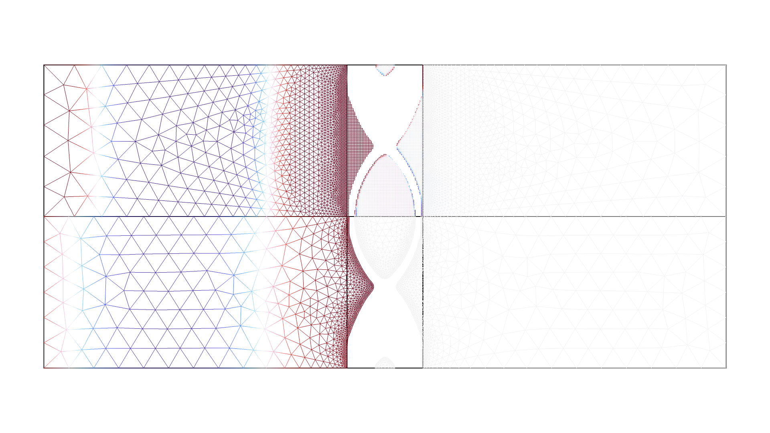
Results - Pressure
Topology Optimization of a Sound Partition considering Acoustic-Structure Interaction

Slide 4
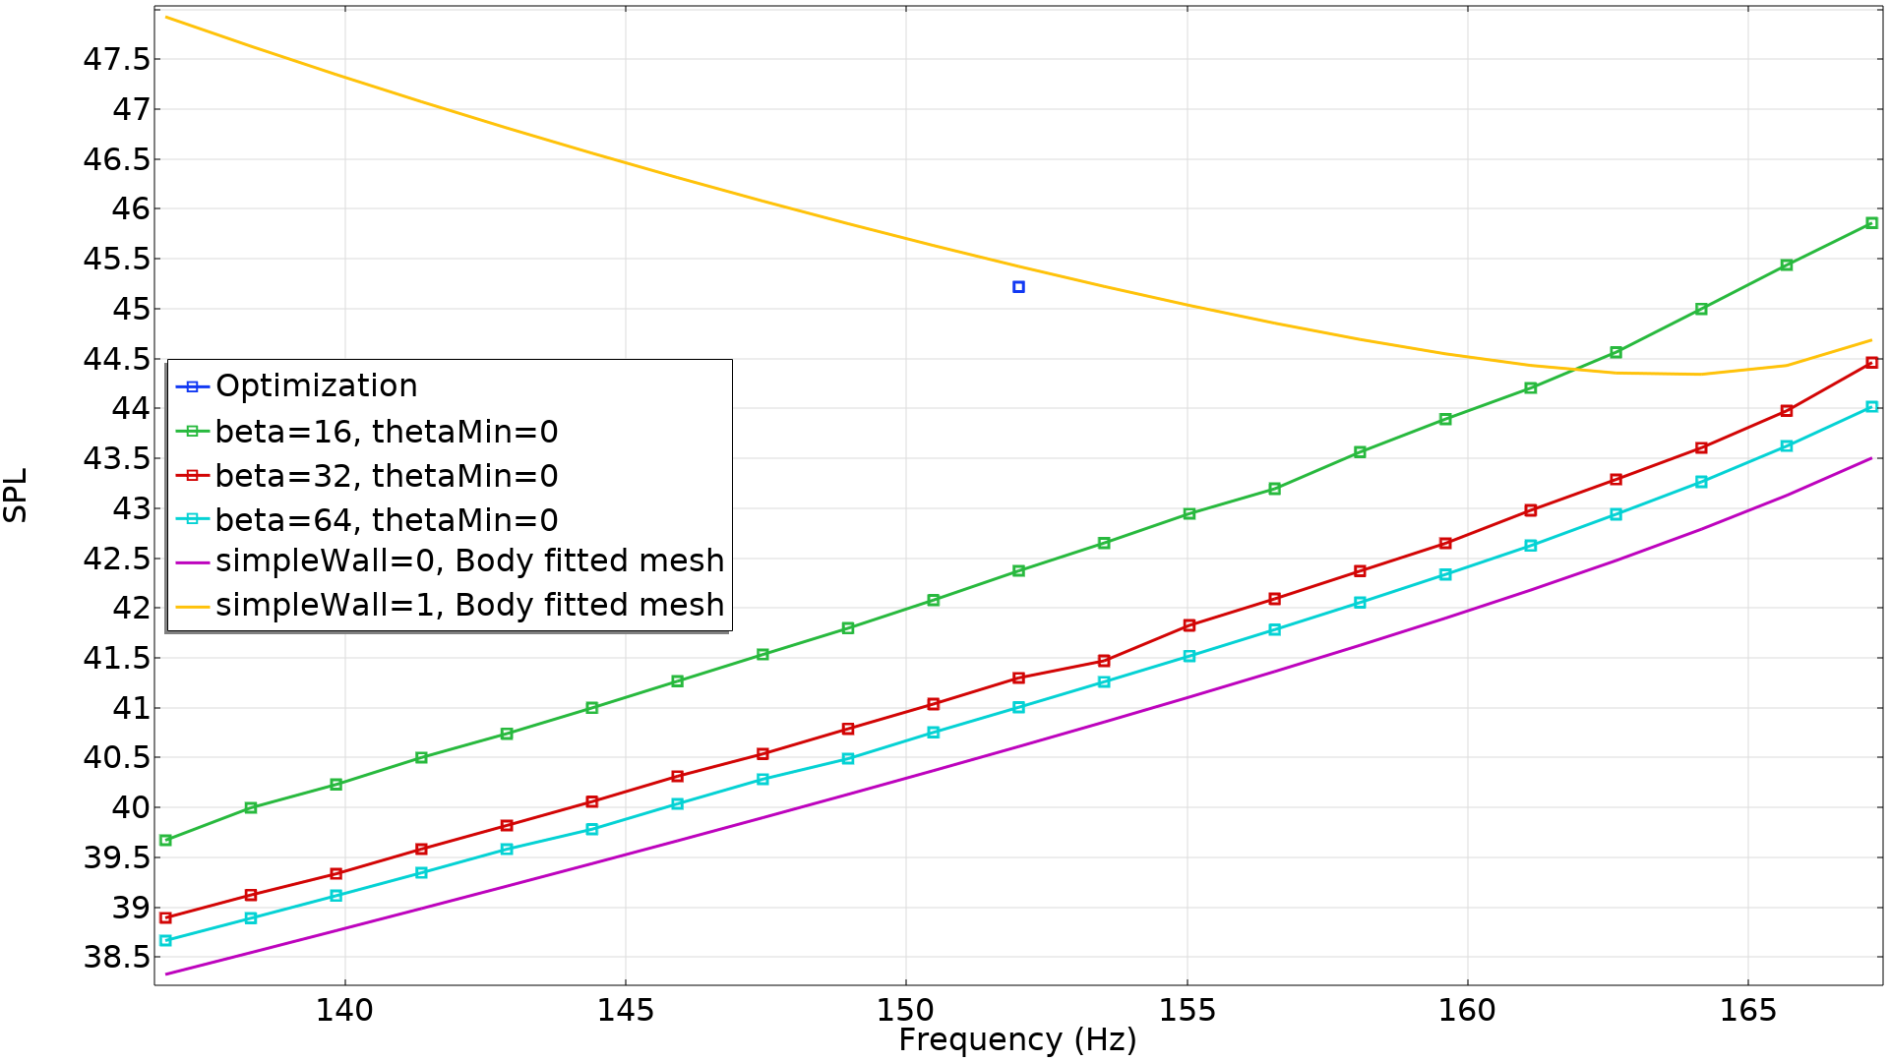
Results - Objective
The optimization results agrees with the body fitted mesh in the limit of beta going to infinity
The optimized topology is significantly better for all considered frequencies
Topology Optimization of a Sound Partition considering Acoustic-Structure Interaction

Slide 5
References
[1 ] Kook, Junghwan and Chang, Jin Hyun, A high-level programming language implementation of topology optimization applied to the acoustic-structure interaction problem, SMO 64(6), 4387--4408 (2021)
Topology Optimization of a Sound Partition considering Acoustic-Structure Interaction

