Slide 1
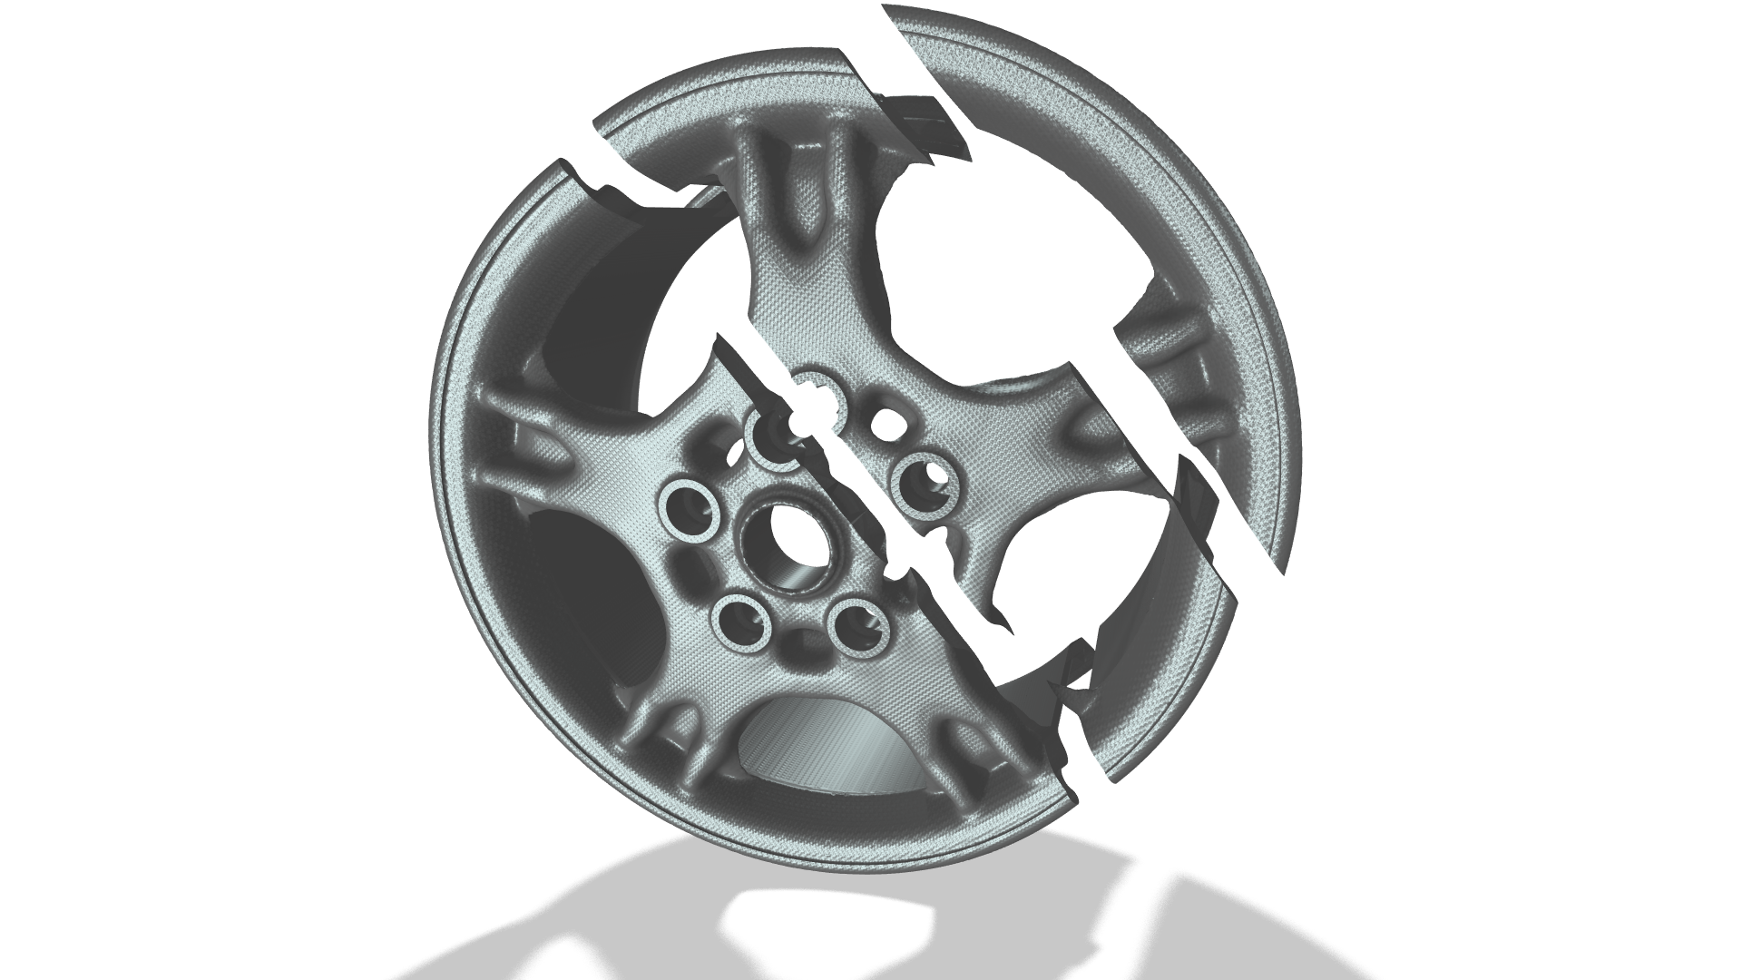
Wheel Rim — Topology Optimization with Milling Constraints

Slide 2
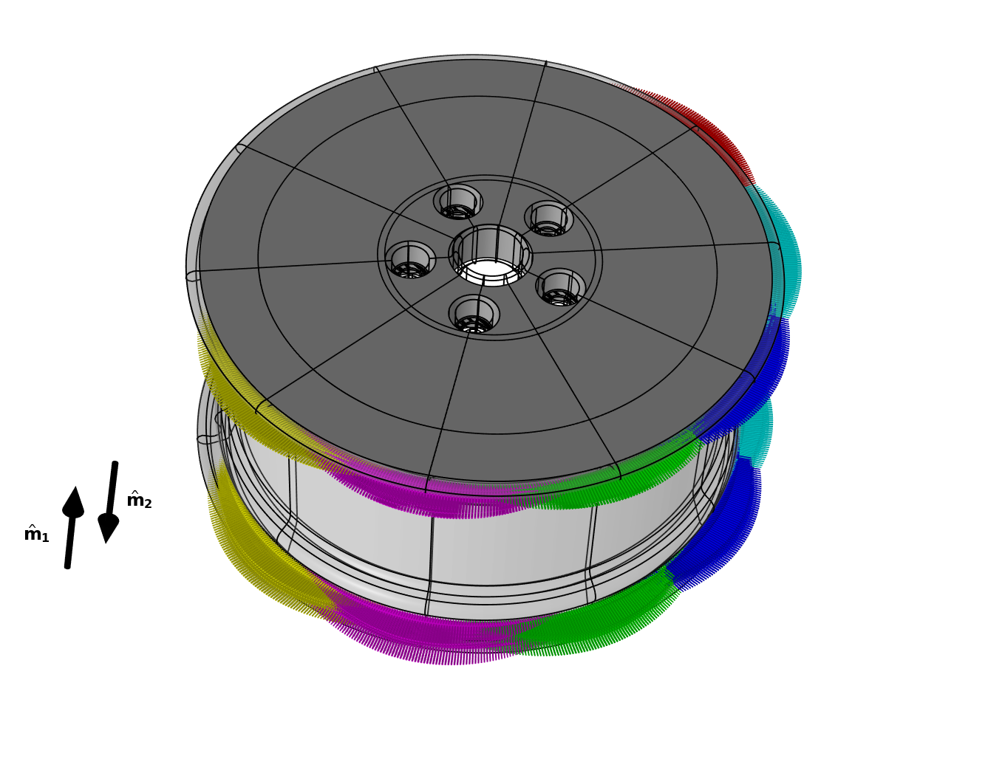
Topology Optimization
Controls
Use Density Model feature with constraints in axis directions
Enforce symmetry and copy density model variables using Sector Symmetry feature
Solid Mechanics
Avoid constraining one of the bolts to encourage material usage between wheel center and bolts
Consider 12 load cases in a minimax formulation for the stiffness
30 % volume fraction constraint
The entire wheel is modeled, because the topology optimization can change the local stiffness characteristics. This prevents the use of a sub-modeling approach. The transparent domains are excluded from the design domain. Only 6 load cases are shown, but an equivalent set of axial load cases are also considered.
Wheel Rim — Topology Optimization with Milling Constraints

Slide 3
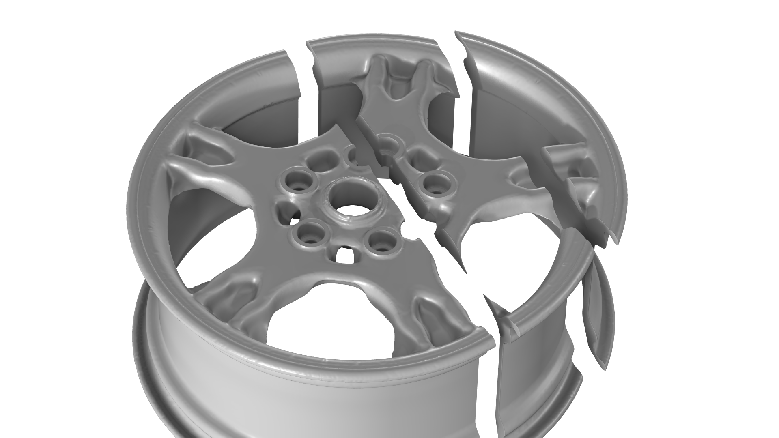
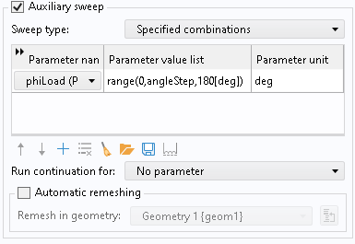
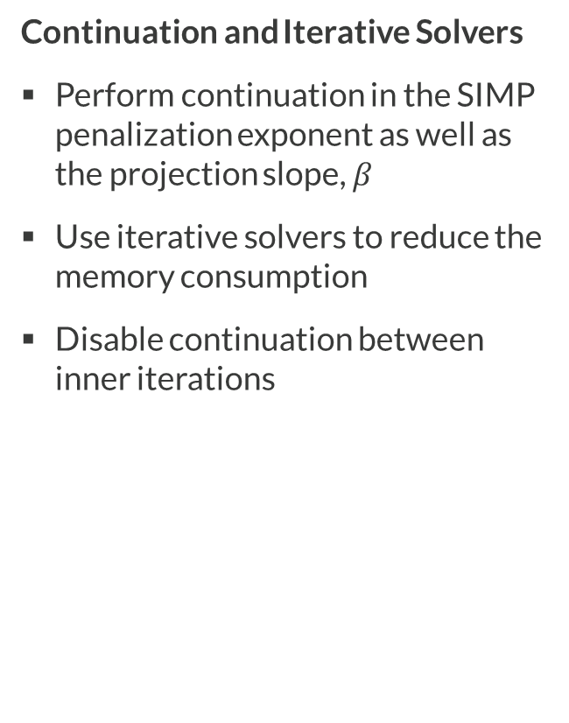
Solver Setup
Continuation and Iterative Solvers
Perform continuation in the SIMP penalization exponent as well as the projection slope, $β$
Use iterative solvers to reduce the memory consumption
Disable continuation between inner iterations
The topology optimization increases produces a shell-like filter radius at the points of large stress, which improves the fatigue properties of the wheel rim. Several load cases are considered in every iteration using a minimax strategy.
Wheel Rim — Topology Optimization with Milling Constraints

Slide 4
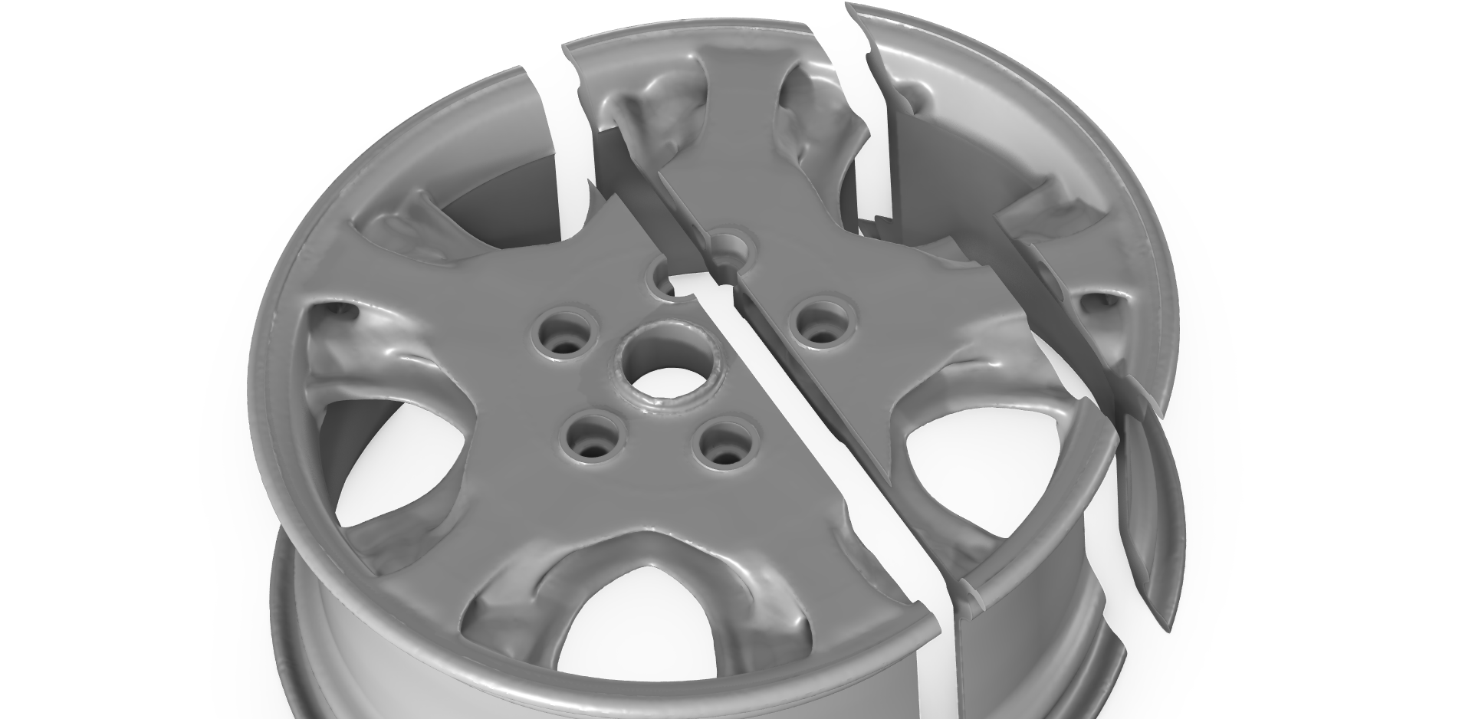
Reference Design
Disabled Milling Constraints
One can disable the milling constraints to illustrate their effect
The result is a design with a different topology
The result cannot be manufactured with milling
Wheel Rim — Topology Optimization with Milling Constraints

