Slide 1
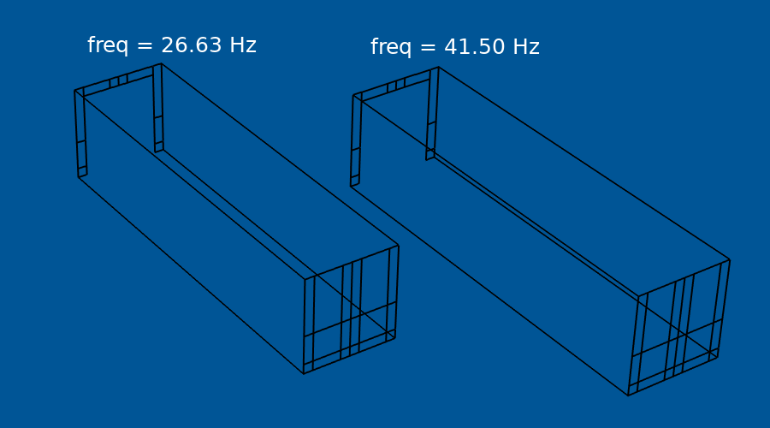
Maximizing the Eigenfrequency of a Beam

Slide 2
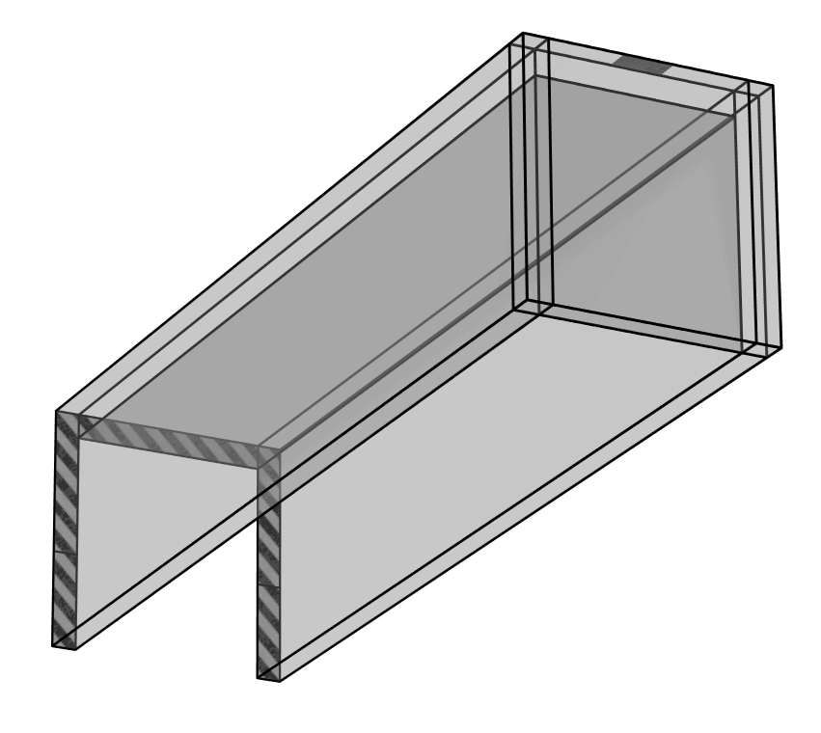
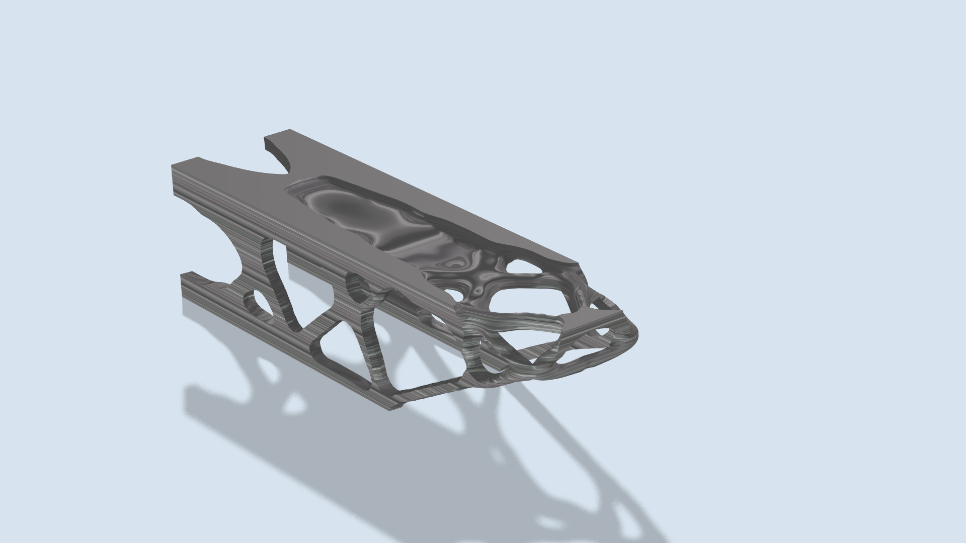
Topology Optimization
Setup
Results
The beam fixed as one end and subjected to a 15 % mass load at the tip together with a volume fraction of 40 % for the optimization
The initial design is better (than the shell example), so the lowest eigenfrequency is only doubled

Slide 3
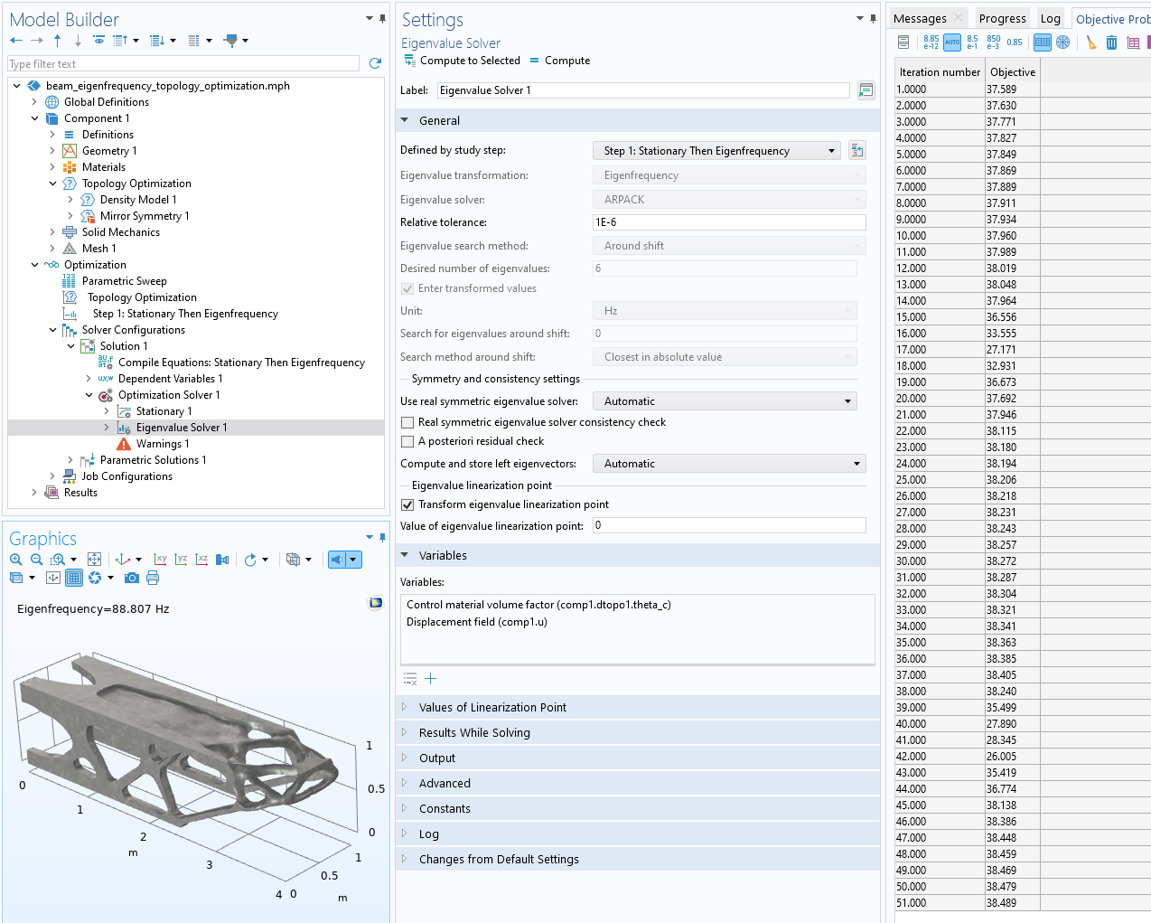
Maximizing the Eigenfrequency of a Beam
Gradient based optimization of eigenvalues is supported for the Eigenvalue solver.
The eigenfrequencies of structural components can be maximized with gradient based optimization using a combination of
1. Density Model feature
2. Stationary Then Eigenfrequency study step
The optimization causes identical values for the two lowest eigenfrequencies.
Maximizing the Eigenfrequency of a Beam

Slide 4
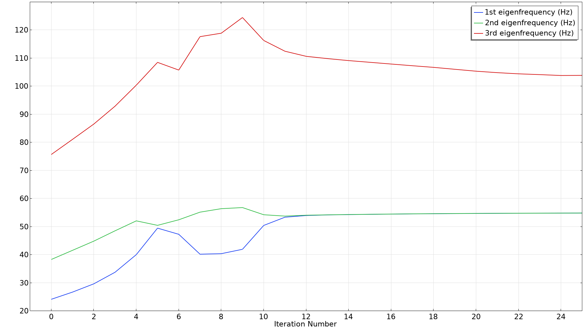
Optimization History
Maximizing the Eigenfrequency of a Beam

