Slide 1
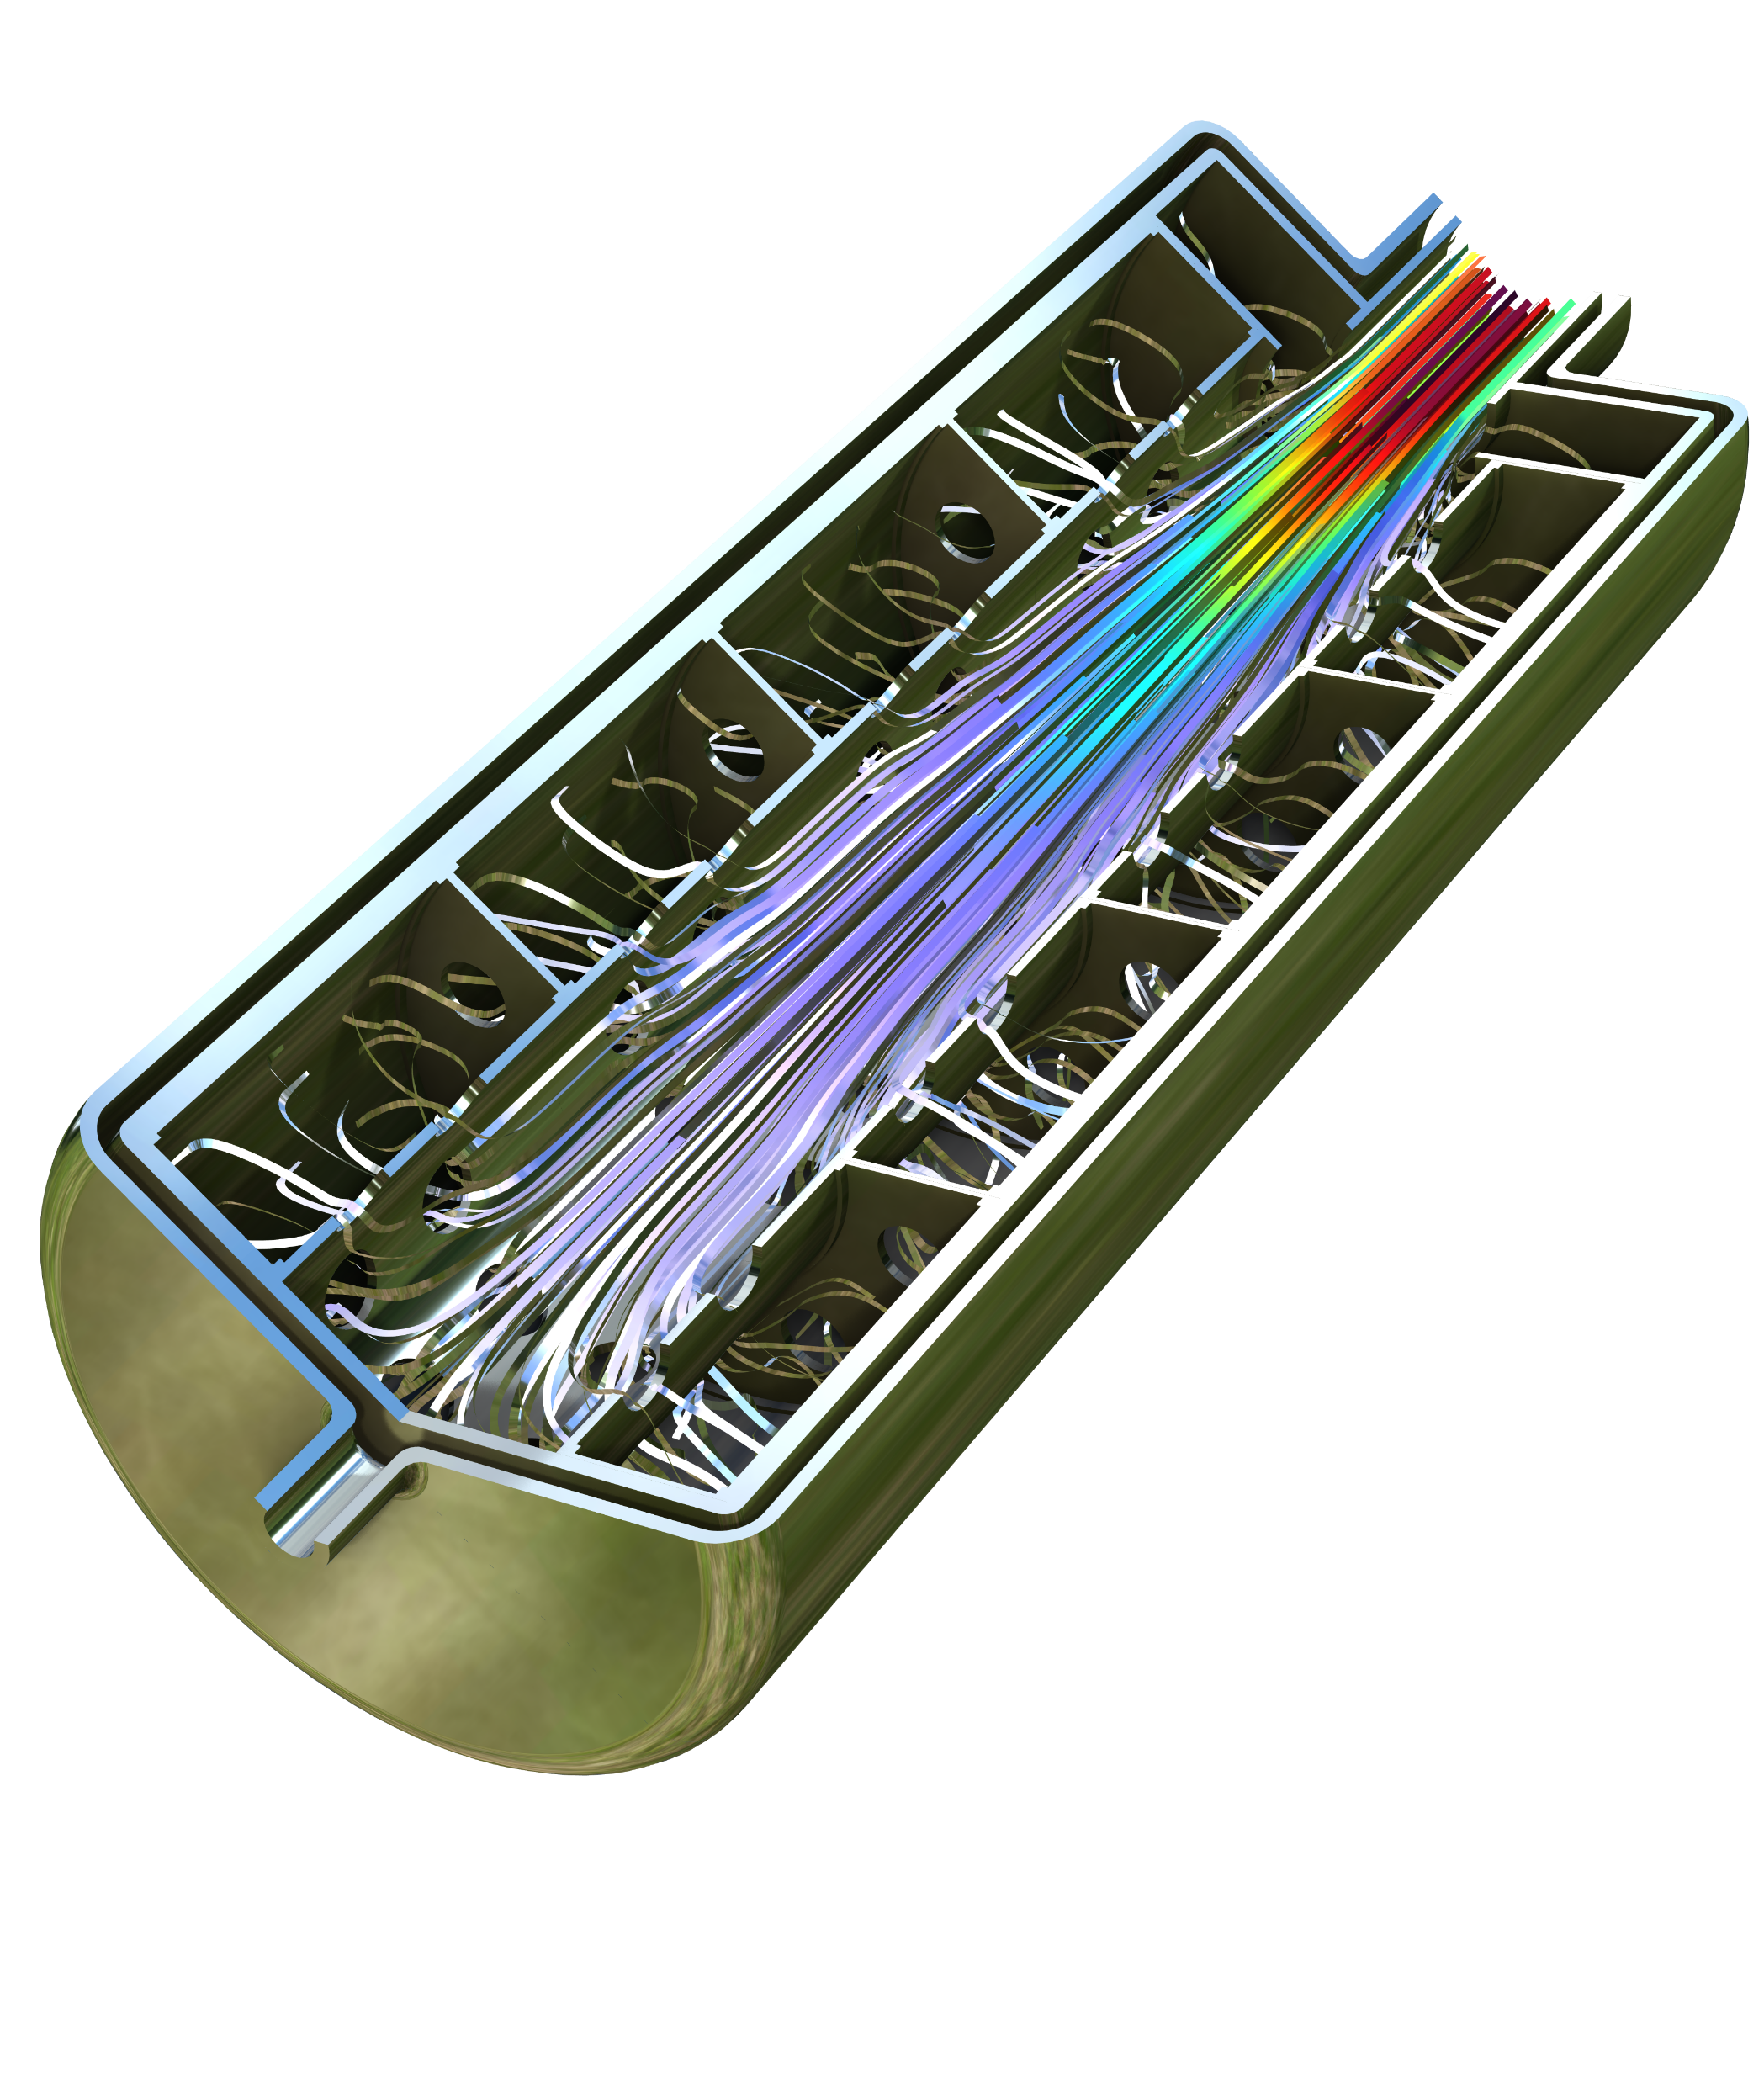
Modeling the Charging Process in a Metal Hydride Hydrogen Tank

Slide 2
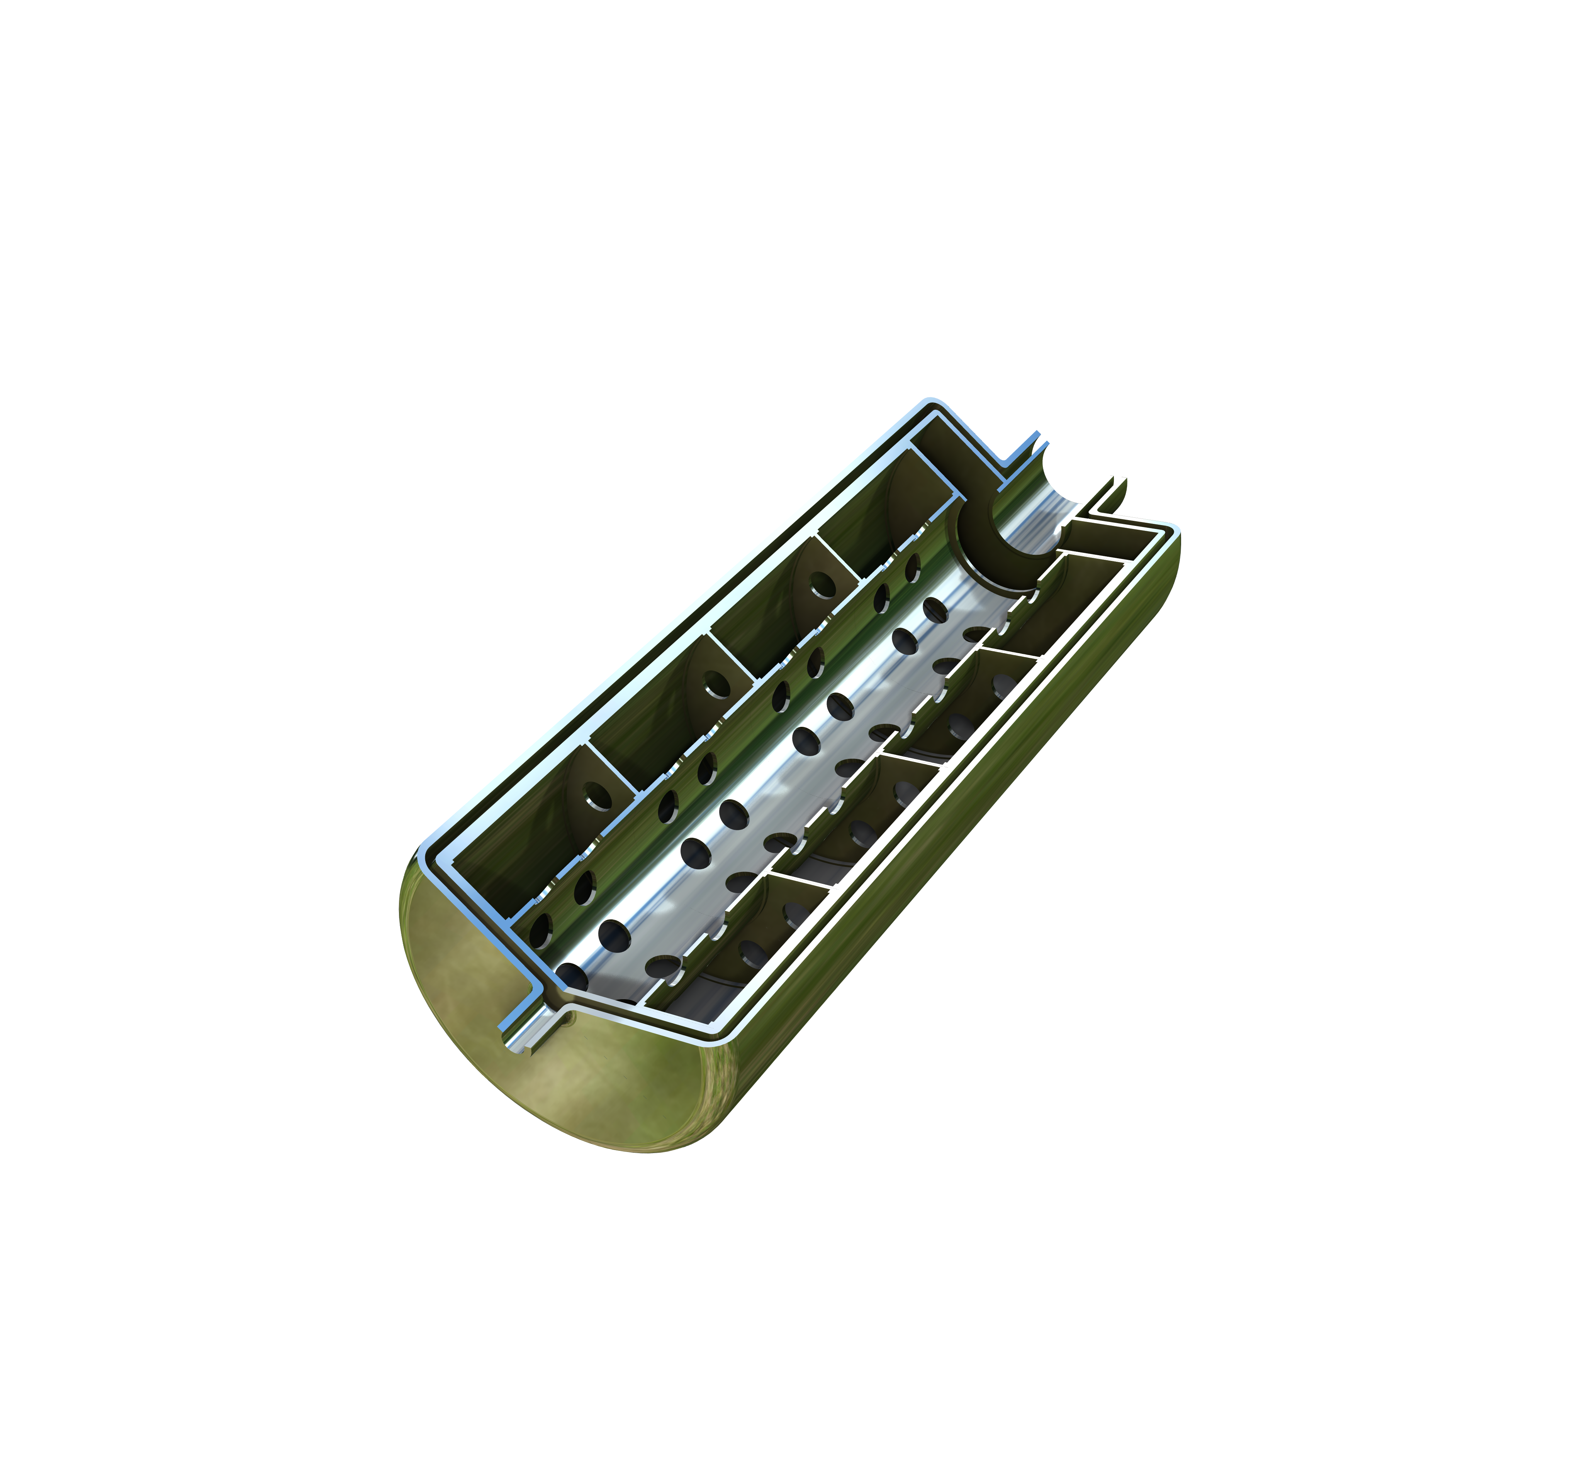
Background
Metal hydride tanks offer safe hydrogen storage (low reactivity) and a relatively high hydrogen density.
The operation principle is simple: charge a porous metal hydride (metal foam) by adsorption at high pressure and discharge it by applying a low pressure, which causes desorption.
This model treats the adsorption process. Models like this one can be used to design and optimize operating conditions (gas composition, pressure, and temperature) based on design parameters such as metal composition, porosity, and geometric dimensions.
The metal hydride tank treated in this model is equipped with a cooling/heating jacket and a central gas distribution/collection perforated pipe.

Slide 3
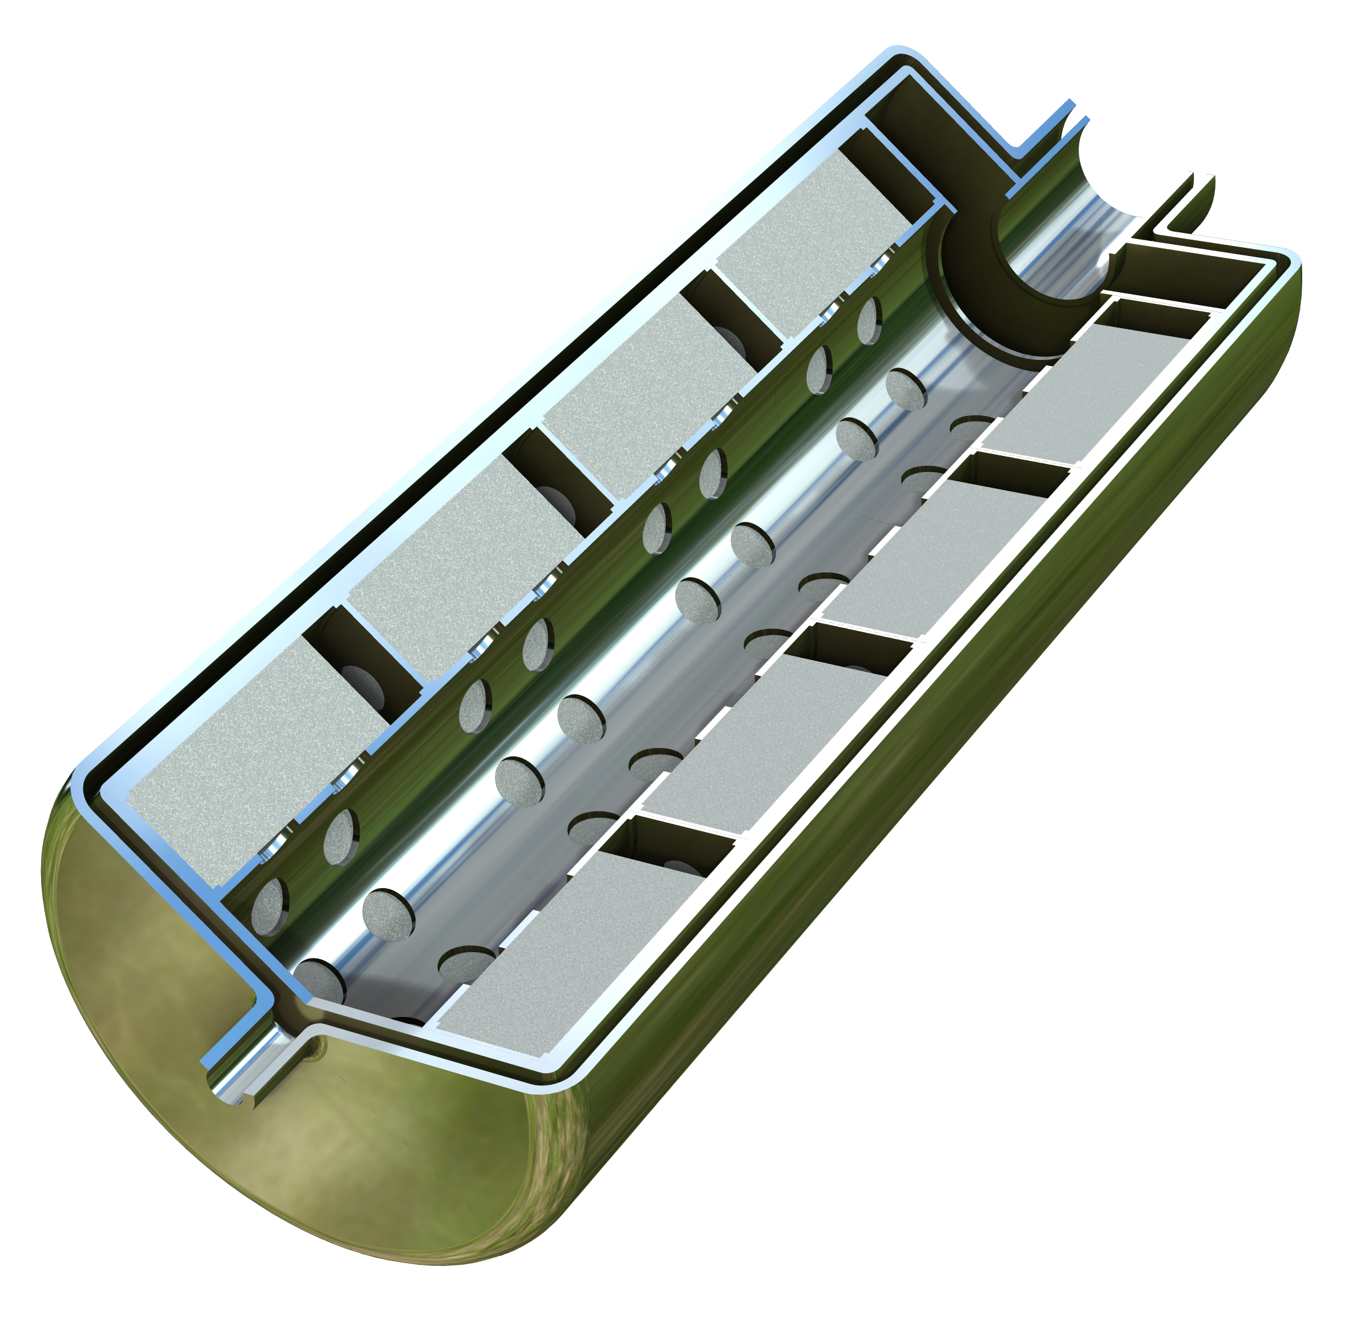
Model Definition
Cooling
jacket
Annular inlet
of coolant
Inlet of a hydrogen and nitrogen mixture (0.05 mole fraction of N₂) through a central pipe into a perforated distribution pipe
Adsorption of H₂ in the porous hydride bed
The adsorption process is exothermic and requires cooling, which is provided by a cooling jacket equipped with an annular inlet and a pipe outlet
Note:
  The inlet becomes an outlet, the distribution pipe becomes a collection pipe, and the cooling jacket becomes a heating jacket during the discharge process (desorption is endothermic)
  Only 1/8 of the tank geometry (one sector) is modeled, since we have sector symmetry
Coolant outlet
Gas inlet
Porous hydride bed
Perforated gas
distribution pipe

Slide 4
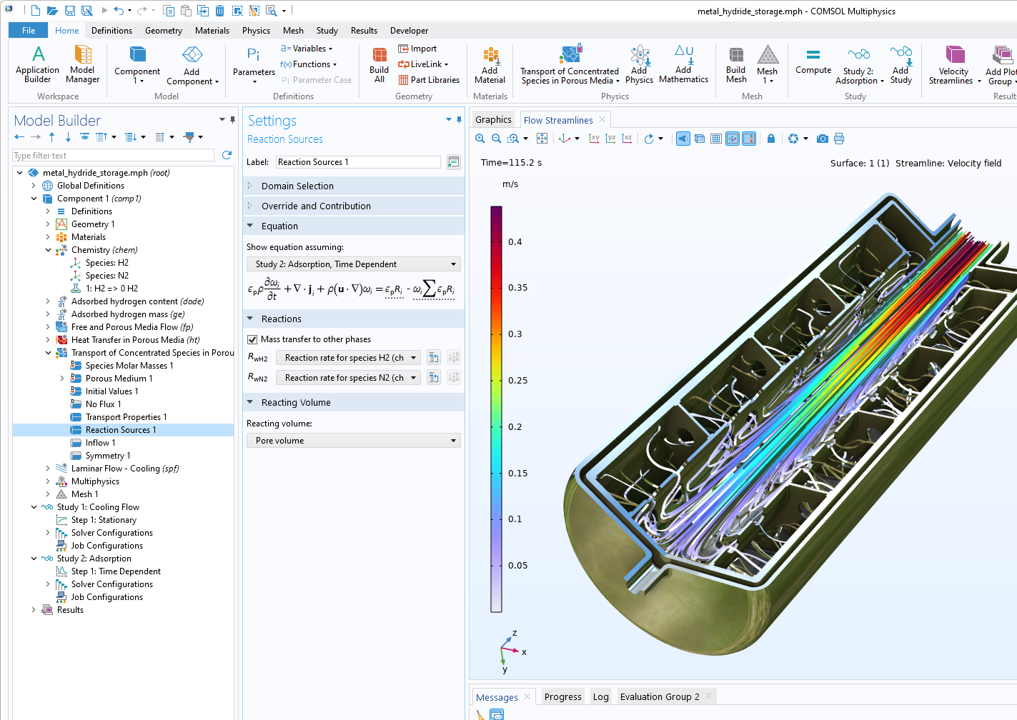
Implementation in COMSOL Multiphysics®
Chemistry interface to define kinetics and thermodynamics
Free and Porous Media Flow to describe the coupled flow in the open channels and in the porous hydride beds
Transport of Concentrated Species in Porous Media to describe the transport of H₂ and N₂ as well as the adsorption of H₂
Heat Transfer in Porous Media to describe the exothermic adsorption (heat source) and the cooling of the tank
Adsorbed hydrogen content equation to integrate the local adsorbed H₂ over time
Adsorbed hydrogen mass equation to integrate the total H₂ mass in the hydride bed as well as over time

Slide 5
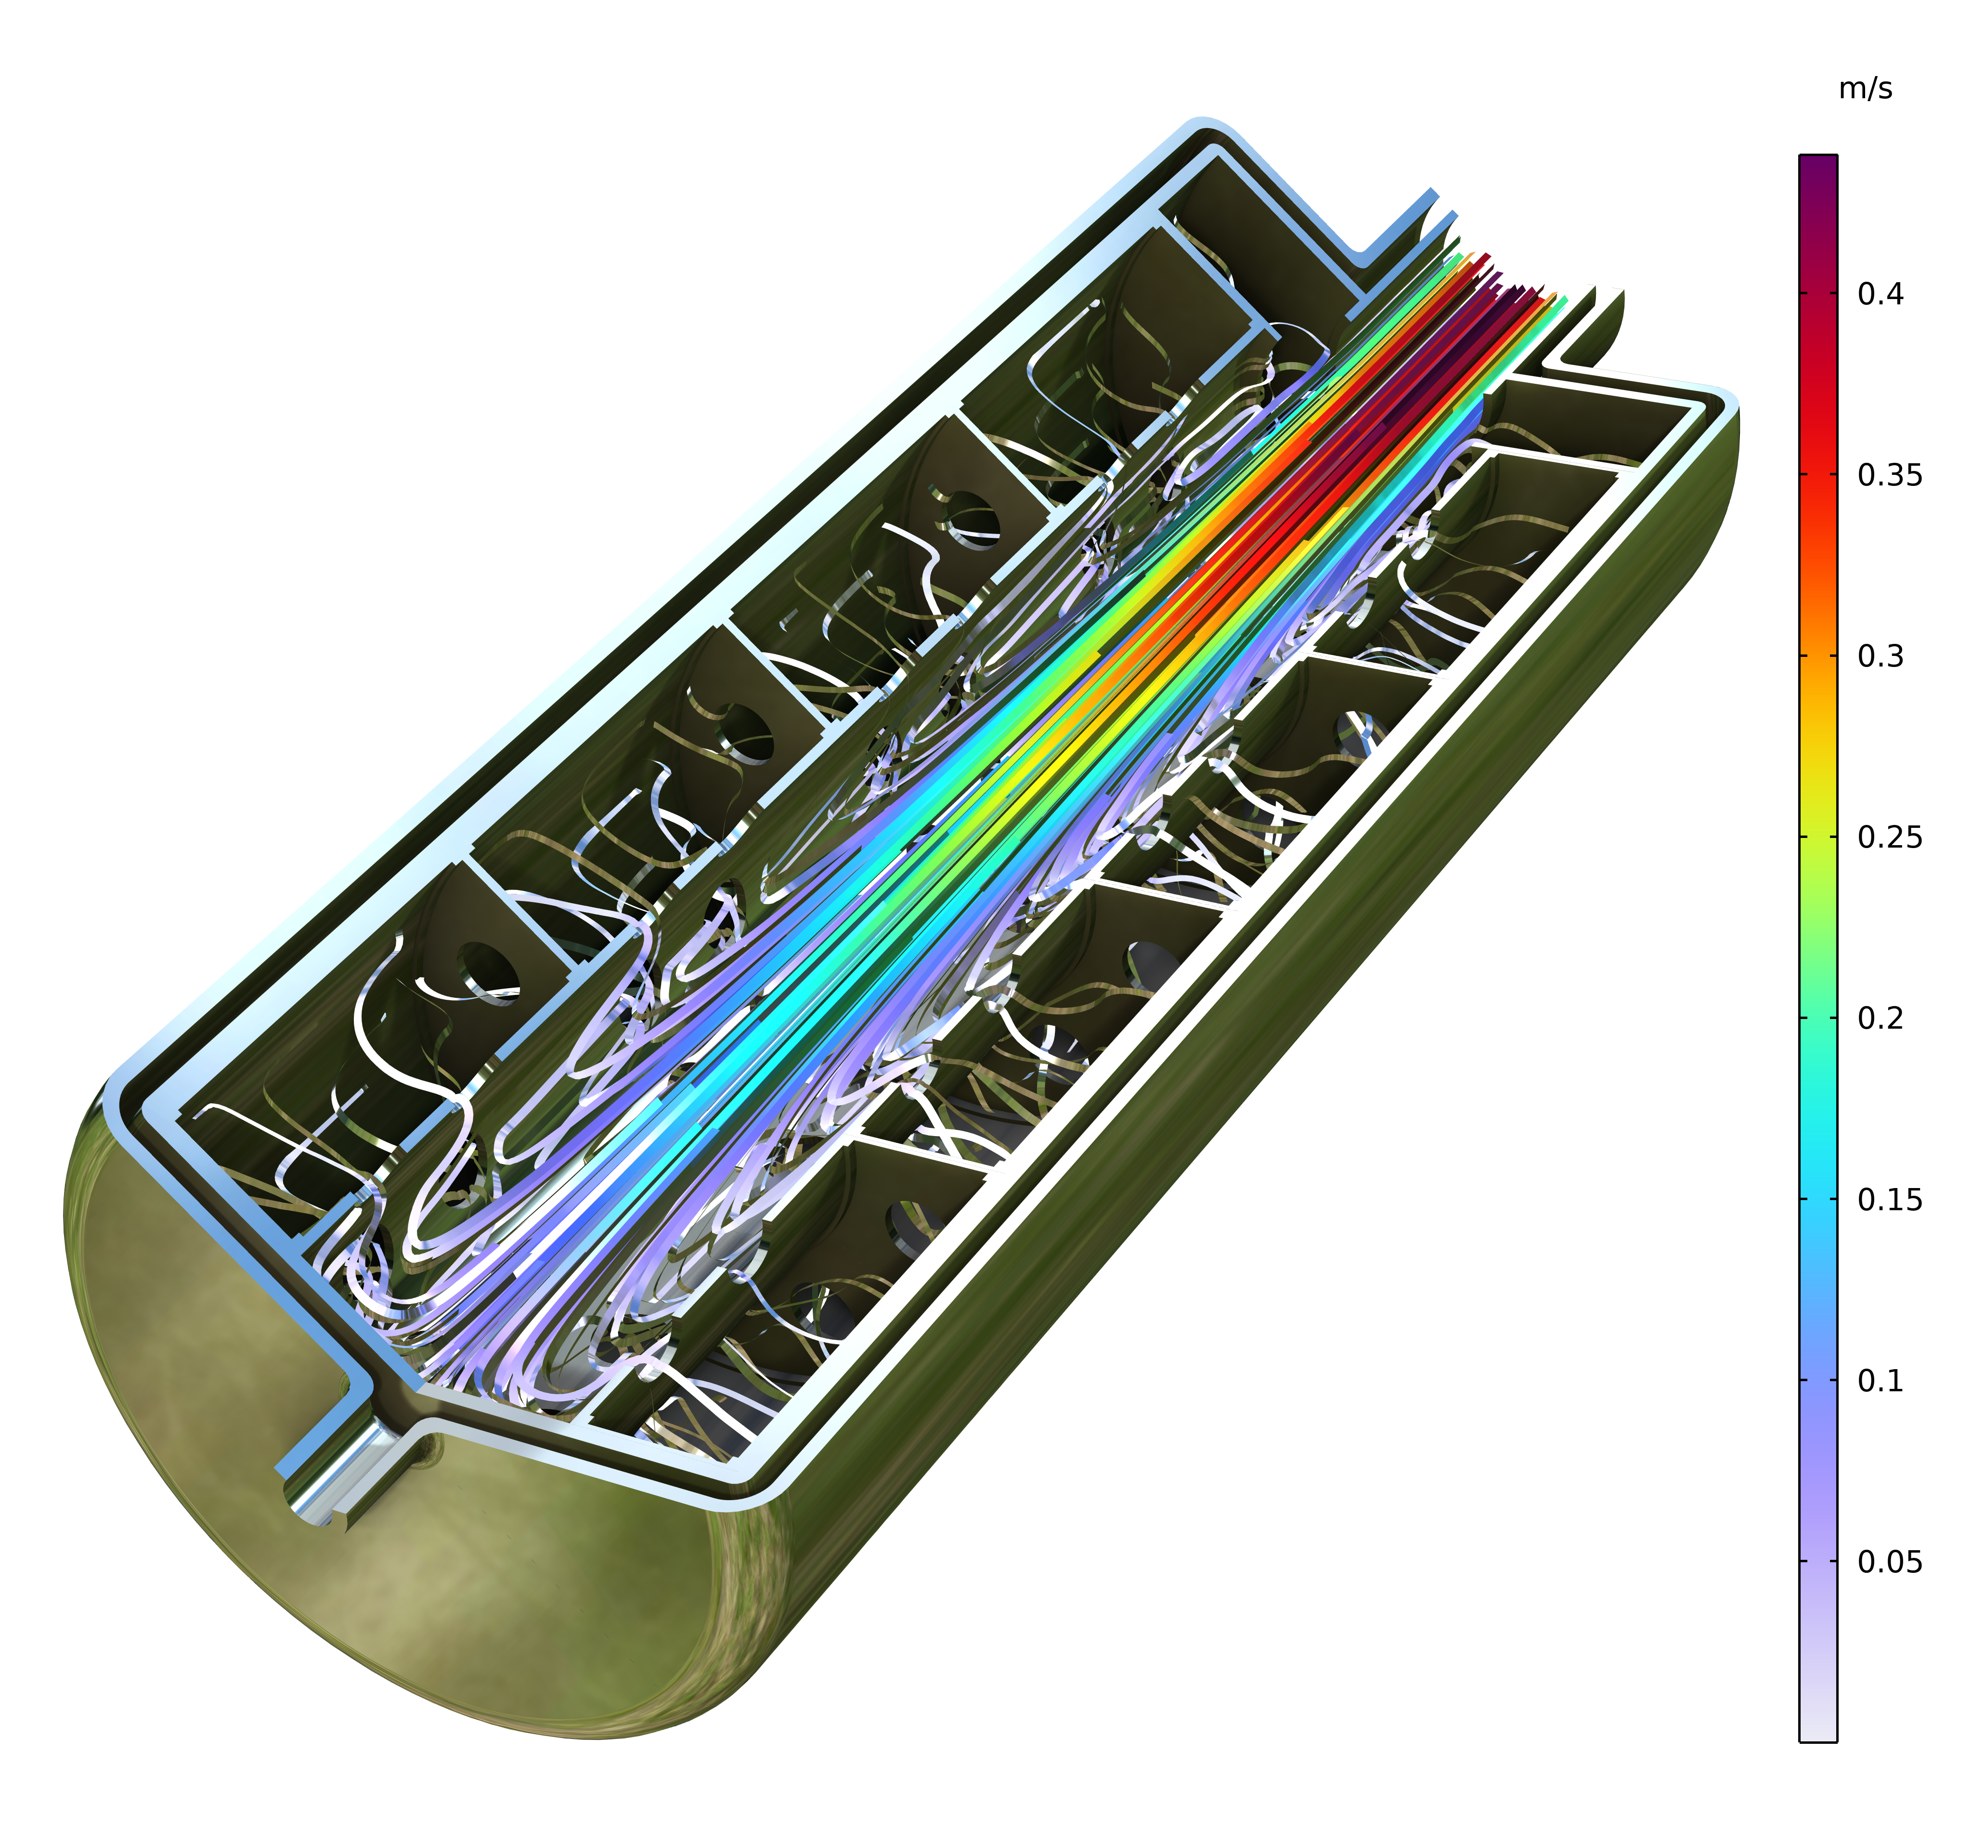
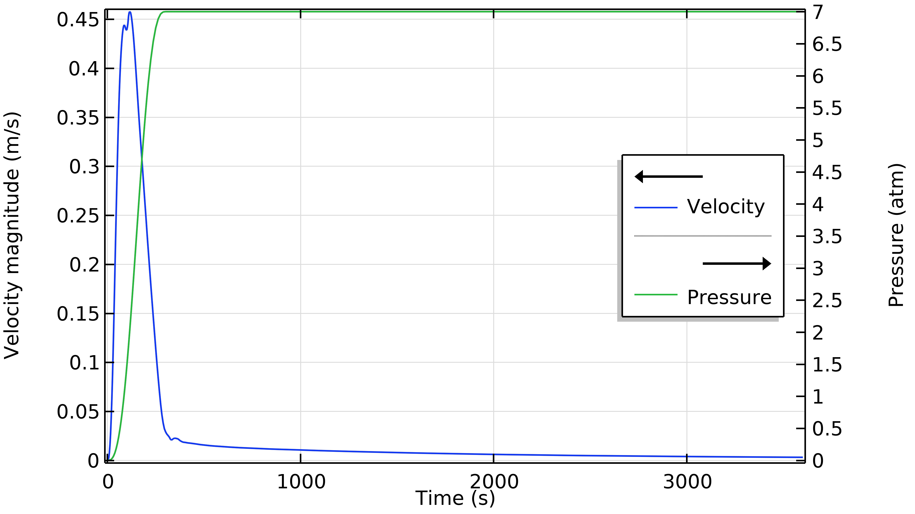
RESULTS
Flow Field
The pressure at the inlet is applied over 5 minutes, where it reaches its operational pressure
The inlet velocity increases to a maximum of 0.45 m/s at the center of the inlet after 115 seconds and thereafter it decreases to values of the order of magnitude of cm/s and mm/s
Velocity and pressure at the center of the inlet (left) and velocity field after 115 s (top).

Slide 6
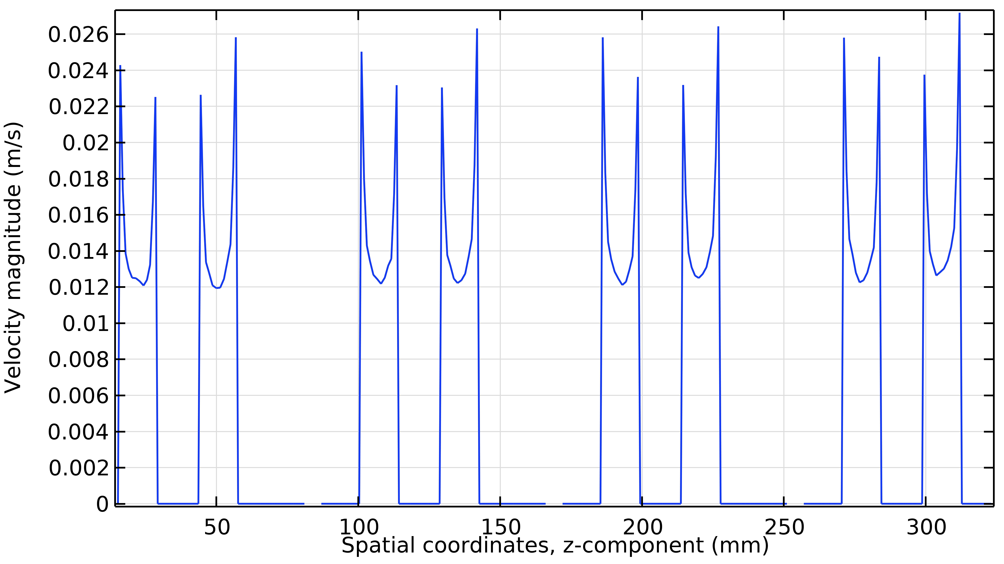
RESULTS
Flow Distribution
Although the flow in the central channel is nonuniform, the flow into the hydride bed is almost uniform. This is due to the high pressure loss in the porous domains compared to the open domains, which tends to even out the flow. There is only a small difference between the charging velocity at the bottom of the tanks and the top (closer to the inlet).
z
Flow velocity after 115 s of charging (top) along a line (light blue dotted line, left) through the gas distribution orifices from the bottom to the top (inlet) of the tank.

Slide 7
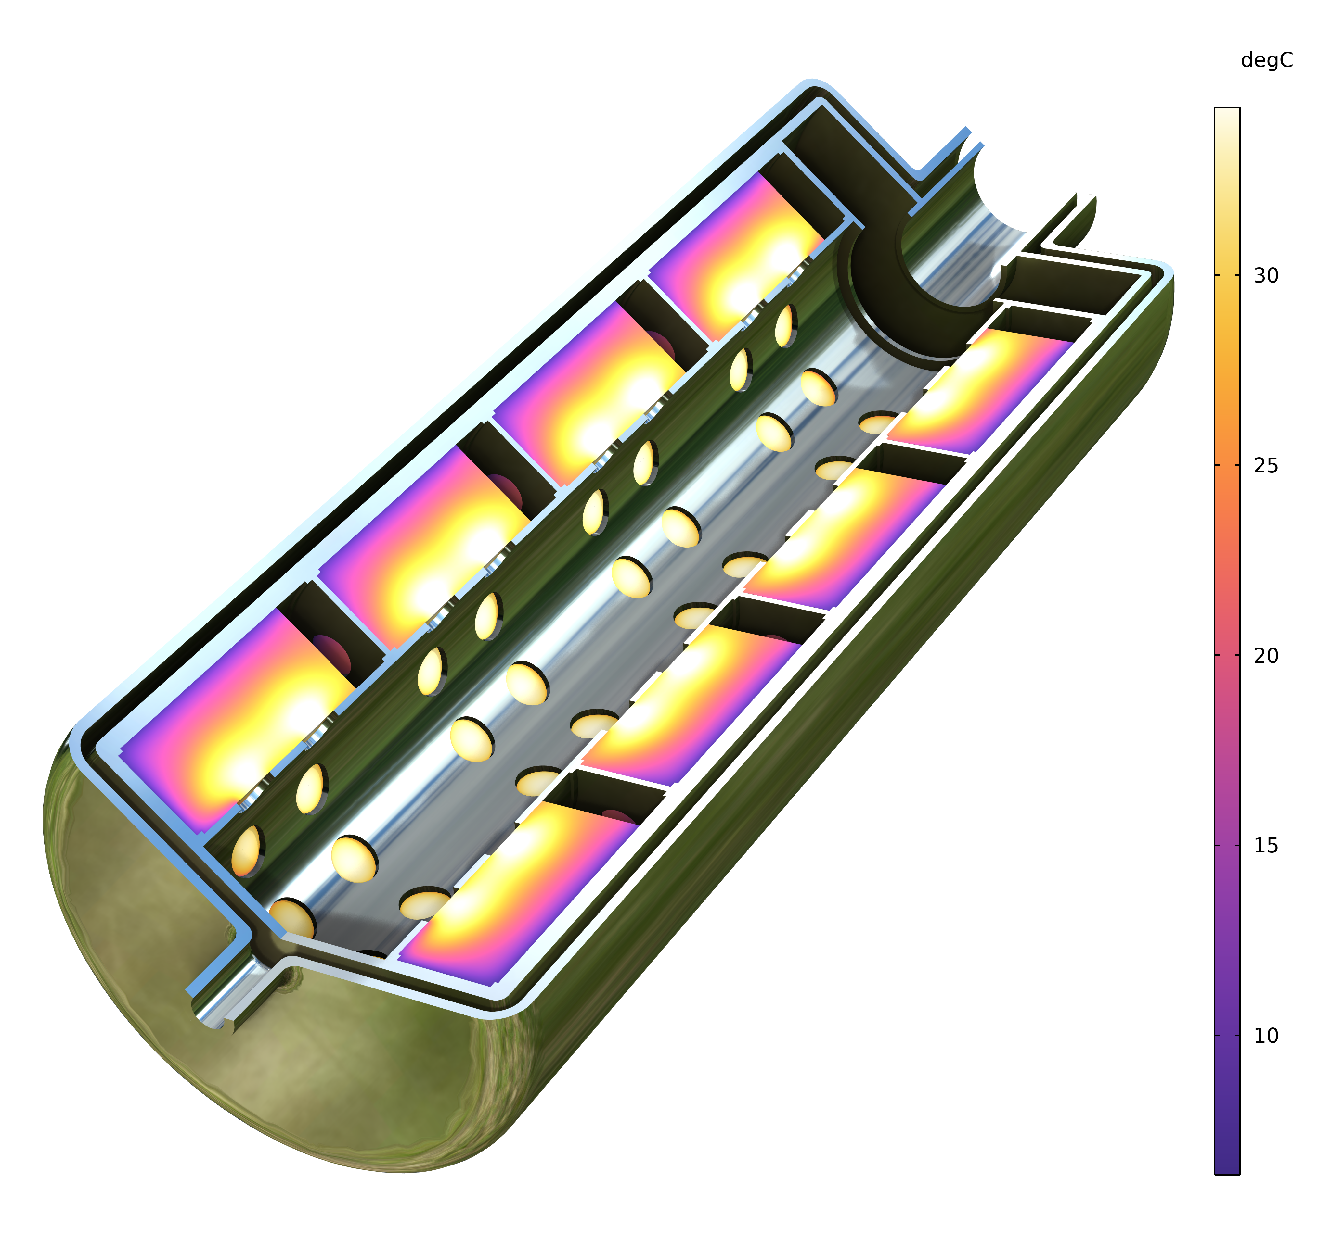
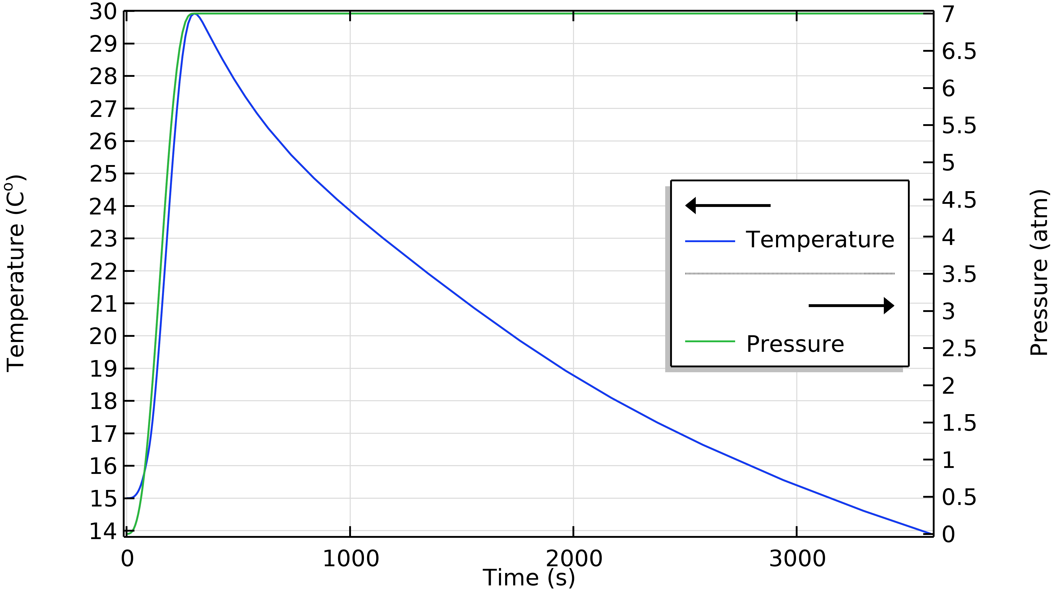
RESULTS
Temperature
The temperature is closely coupled to the pressure during the initial pressure-increasing phase. As the pressure reaches the constant value of 7 atm, the temperature starts decaying during the charging process, as the cooling starts taking effect.
Temperature at the position of an inlet orifice in the hydride bed and pressure (left) and temperature in the bed after 300 s (top).

Slide 8
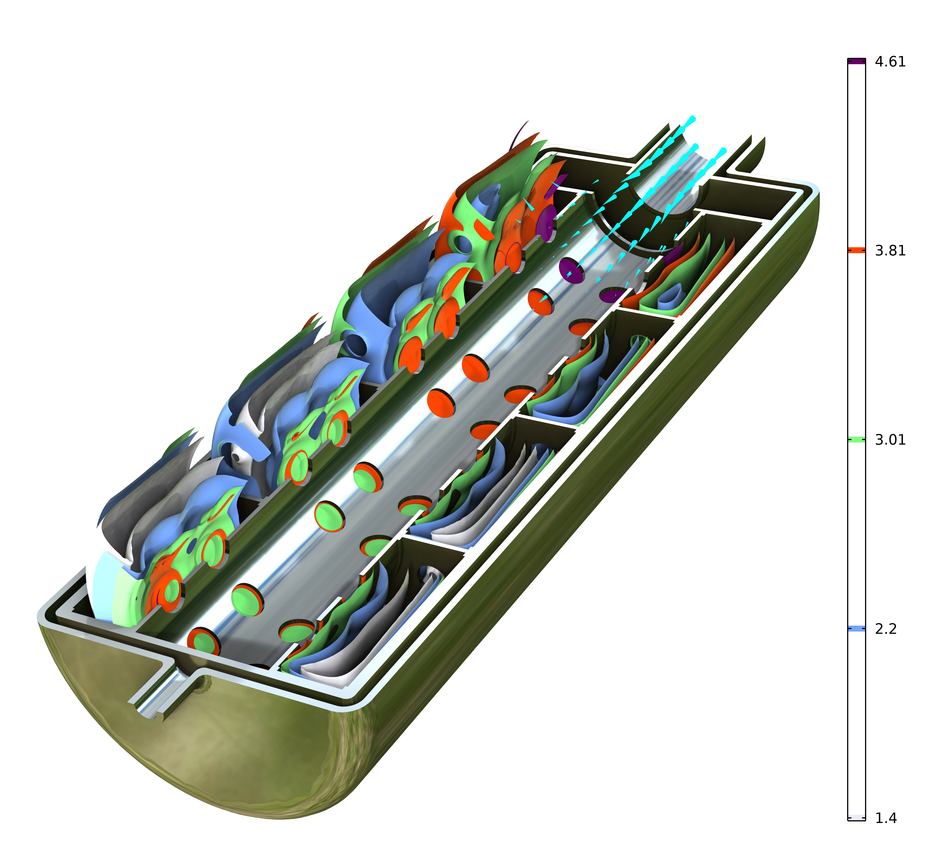
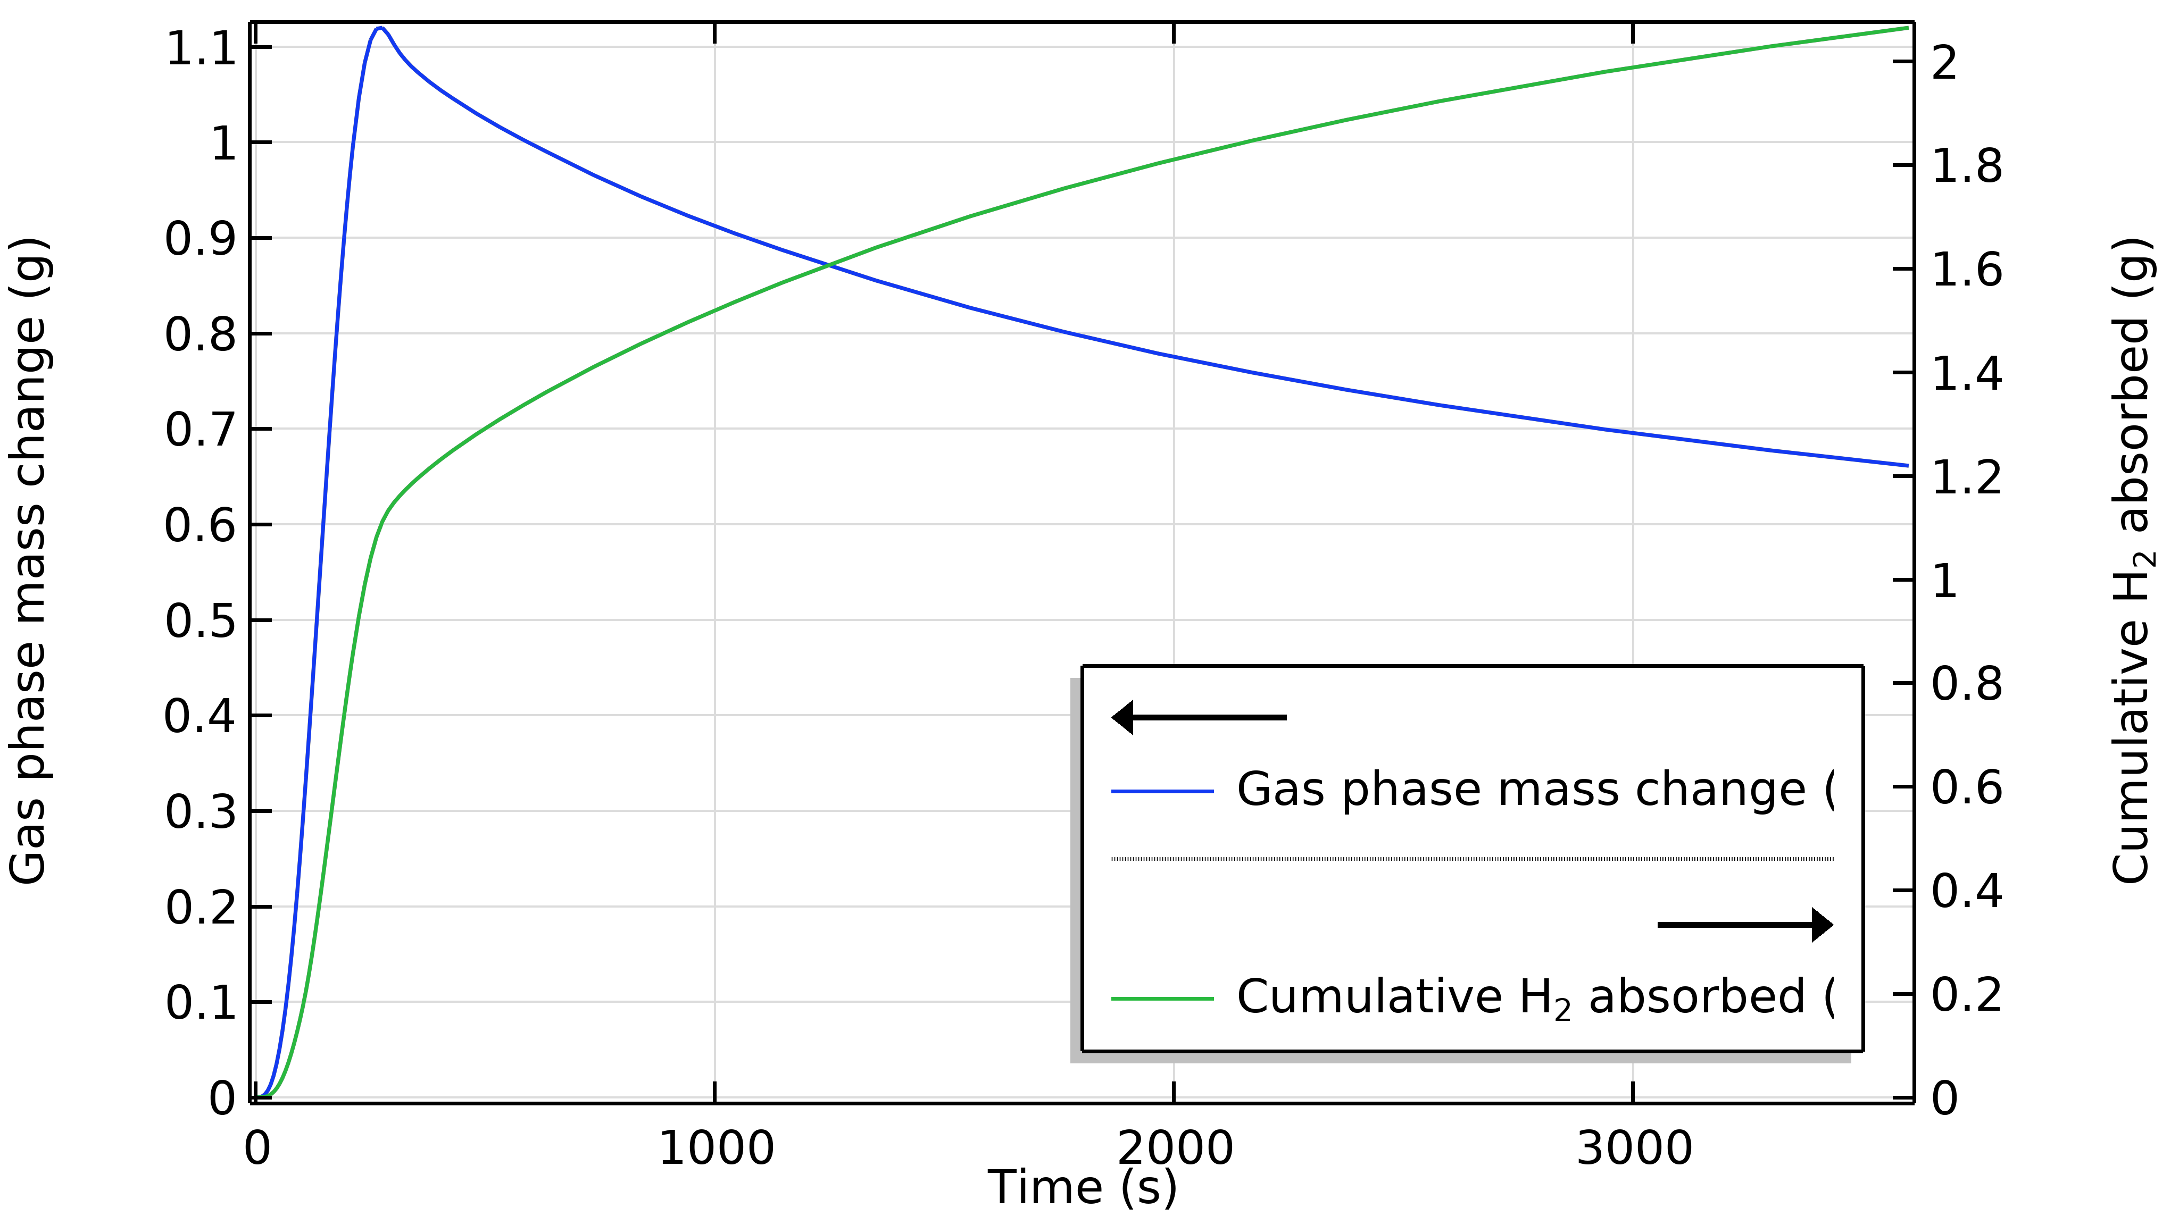
RESULTS
Stored Hydrogen
The charging process is not completed after 1 hour at 7 atm; see the green curve below. The contour plot shows the hydrogen content in mole H₂ per mole metal. The maximum value is 3 mole H₂ per mole metal hydride (6 mole atomic hydrogen per mole metal). This means that there is still plenty of saturated metal hydride after 1 hour of charging at 7 atm.
Adsorbed and gas phase hydrogen in g (left) and hydrogen content (max. possible = 6) after 3600 s of charging at 7 atm (top).

Slide 9
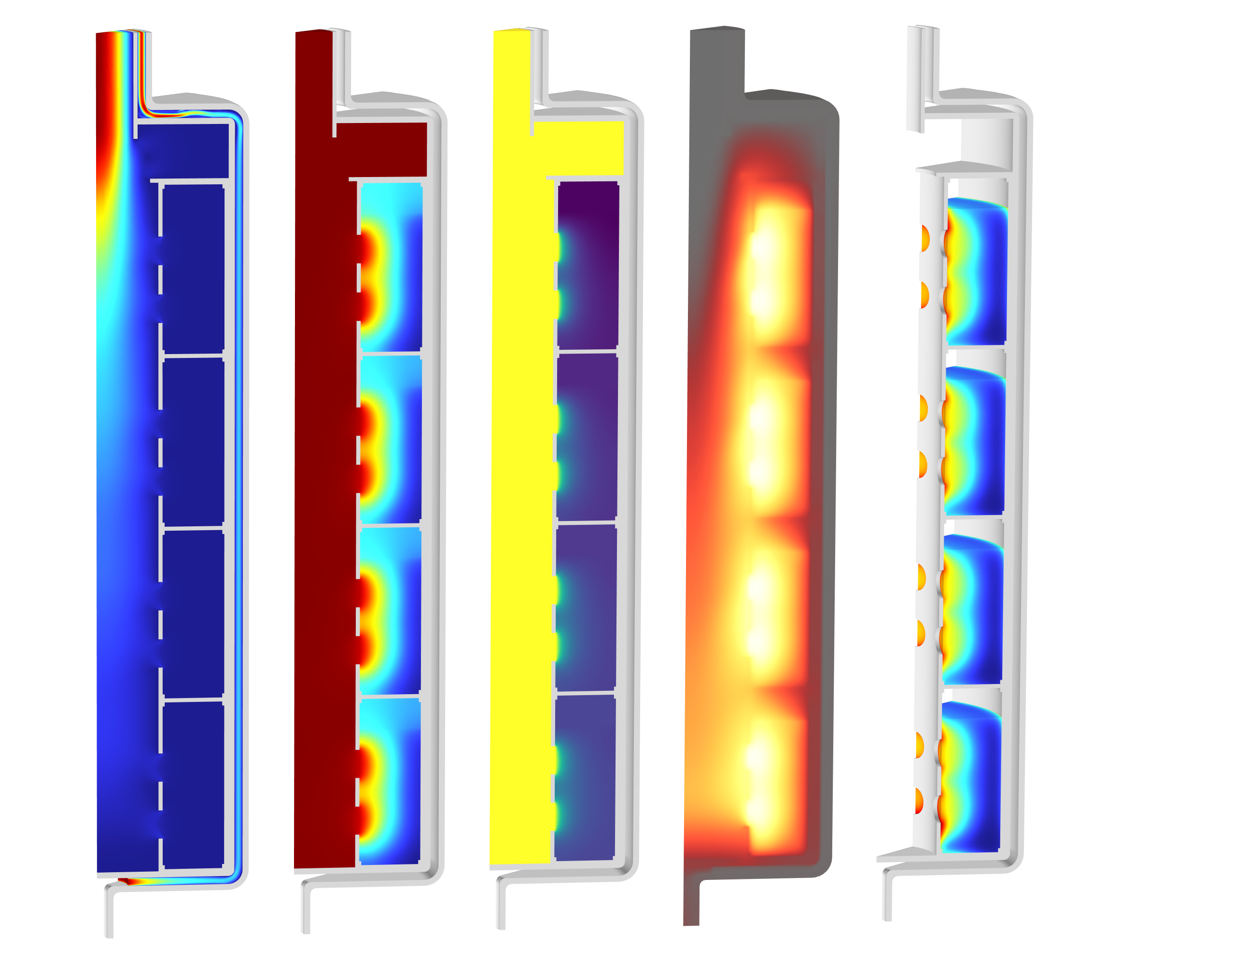
MODEL SUMMARY
Hydrogen Adsorption in a Metal Hydride Tank
The model is easy to set up and solve using COMSOL Multiphysics and the Chemical Reaction Engineering Module. The solution to the model equations gives the flow field, pressure, temperature, and hydrogen content in the bed during the charging process.

