Slide 1
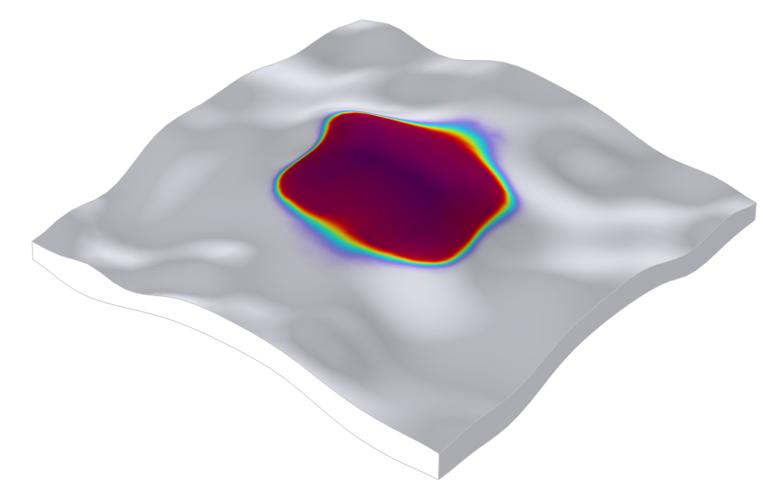
Modeling H₂ Storage in a Geological Formation

Slide 2
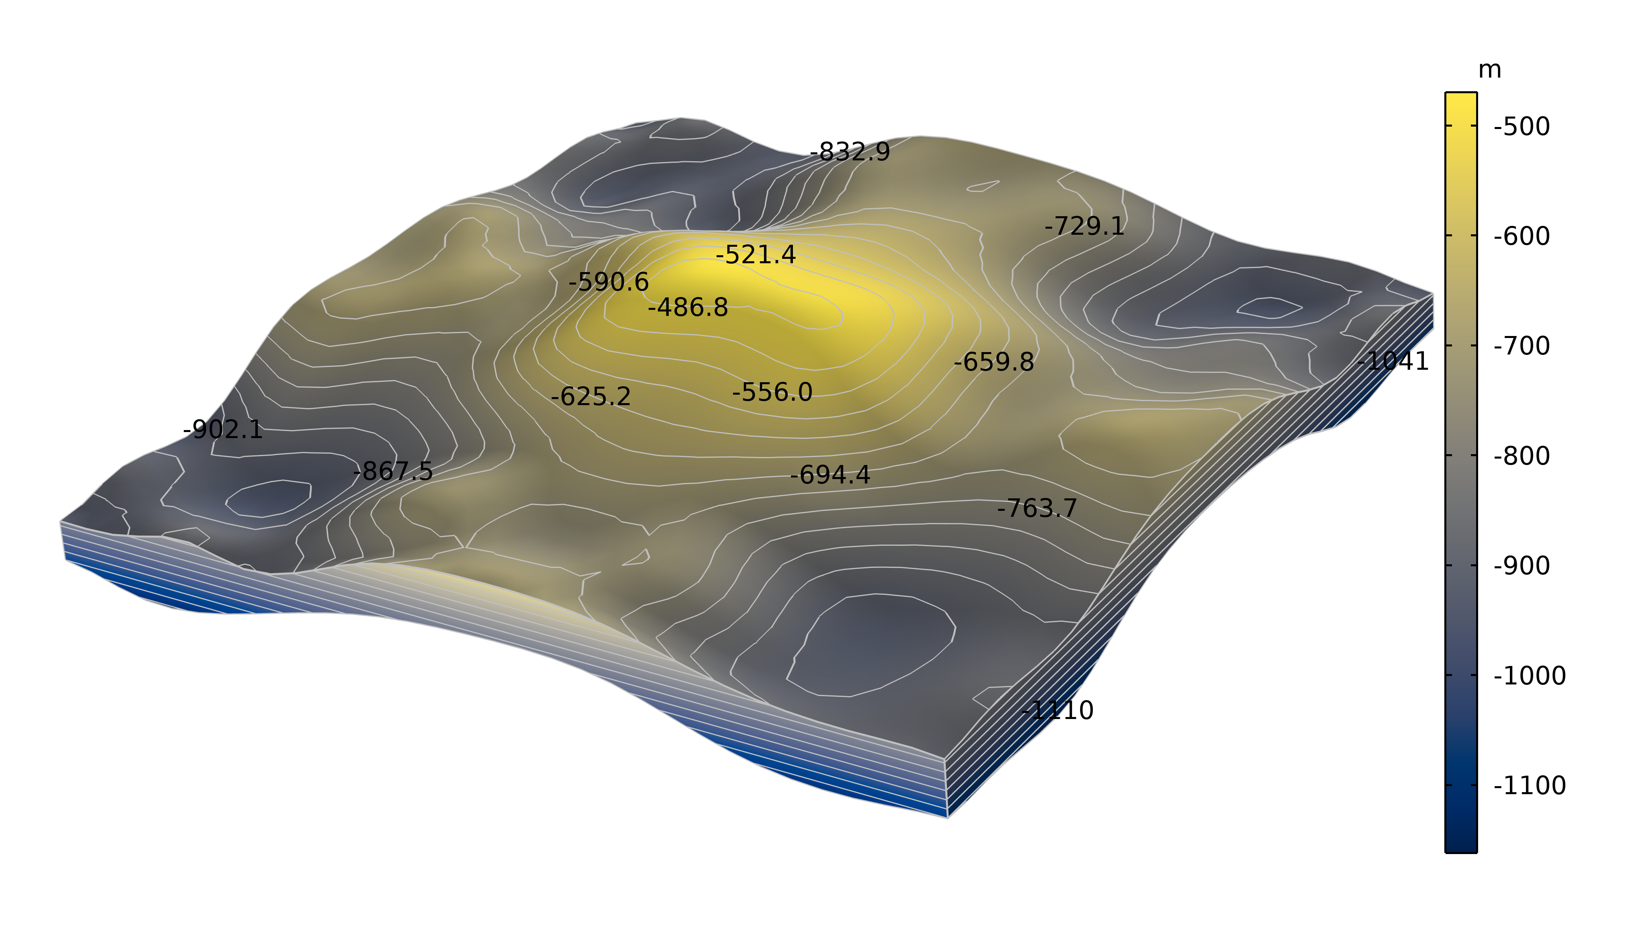
Background
Hydrogen technology is a green alternative for reducing the carbon footprint of the energy, transportation, oil and gas, and manufacturing sectors.
Green hydrogen can be used to remedy the intermittence in electricity production from solar and wind farms.
Hydrogen can be stored in reservoirs, aquifers, salt caves, and other geological formations.
This model shows how to define a model of a hydrogen storage cycle in a geological formation. Models such as this one can be used to prospect suitable sites for hydrogen storage.
The topography of the top of the geological formation, with a dome-shaped structure, which suggests that it could be suitable for H₂ storage.

Slide 3
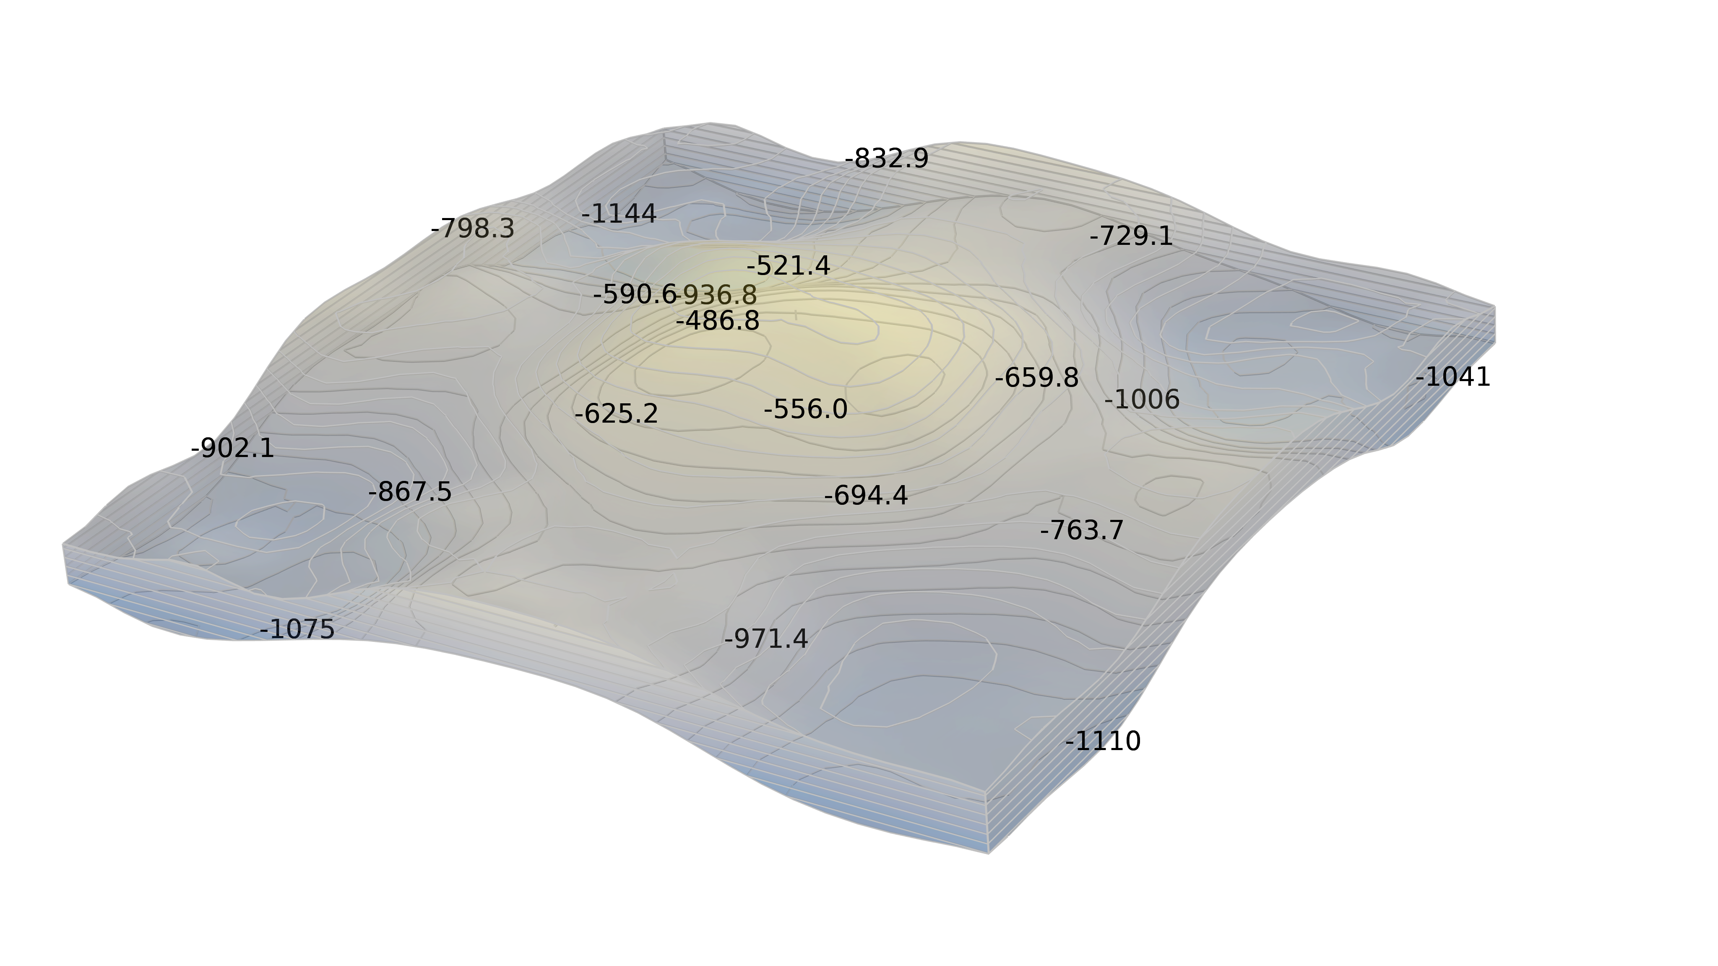
Model Definition
Position of the well
The domain is selected large enough for the lateral boundaries to give a small impact on the process over the storage–discharge cycle
A well is situated at the highest point of the dome-shaped geological formation
The model describes two-phase flow in porous media and the porosity is constant in the formation
The well is used for injection at 1kg/s of hydrogen during 2 years, followed by extraction over 5 months
In reality, the injection over two years would likely be followed by a cyclic phase with injection and extraction over days and weeks, once the storage is relatively well filled

Slide 4
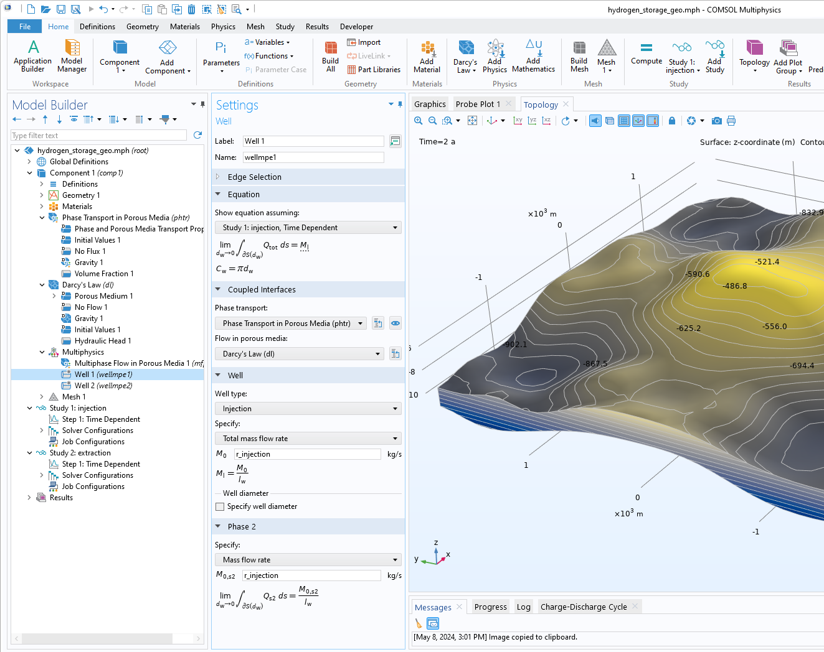
Implementation in COMSOL Multiphysics®
Phase Transport in Porous Media to describe two-phase flow
Darcy’s Law to describe the total flow of both phases
Multiphase Flow in Porous Media to describe the coupling of phase transport and the total flow
Well 1 and Well 2 features to describe the injection and extraction processes, respectively, despite the fact that they have the same geometrical position
Injection study to describe injection by activating the feature Well 1
Extraction study to describe extraction by activating the feature Well 2

Slide 5
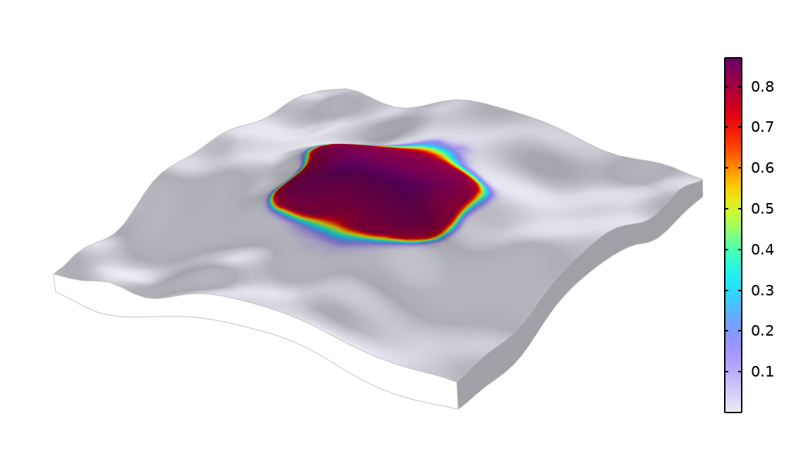
RESULTS
H₂ Content
After Injection
Over a period of two years and with the mass rate of 1 kg/s, the dome of the formation is able to store a large amount of hydrogen with small losses to the surrounding media.
Hydrogen volume fraction in the pores of the structure after 2 years of injection at a mass rate of 1 kg/s.

Slide 6
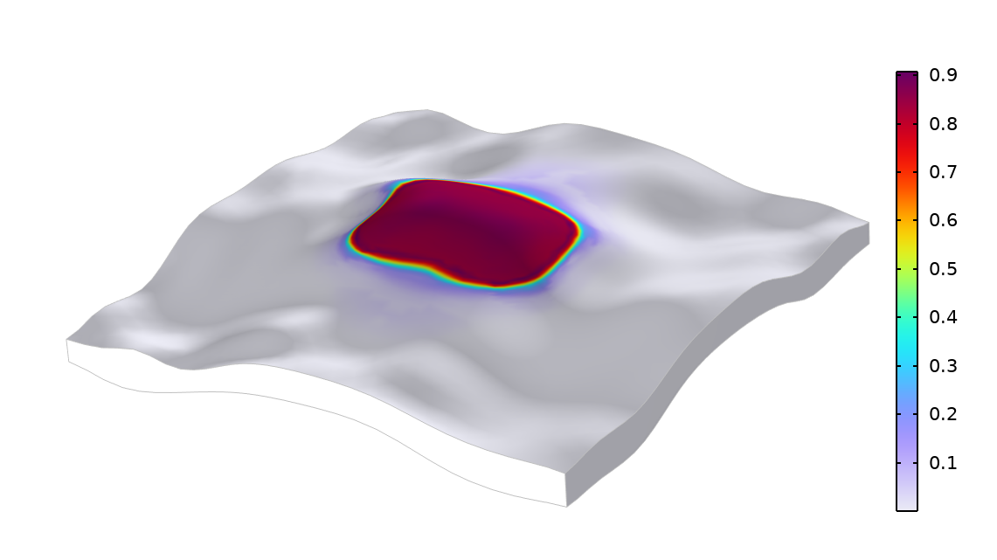
RESULTS
H₂ Content
After Extraction
The modeled extraction phase occurs at a faster mass flow rate than the injection phase. After extraction during 5 months, a considerable amount of H₂ remains in the structure.
Hydrogen volume fraction in the pores of the structure after about 5 months of extraction at a mass rate of about 2 kg/s.

Slide 7
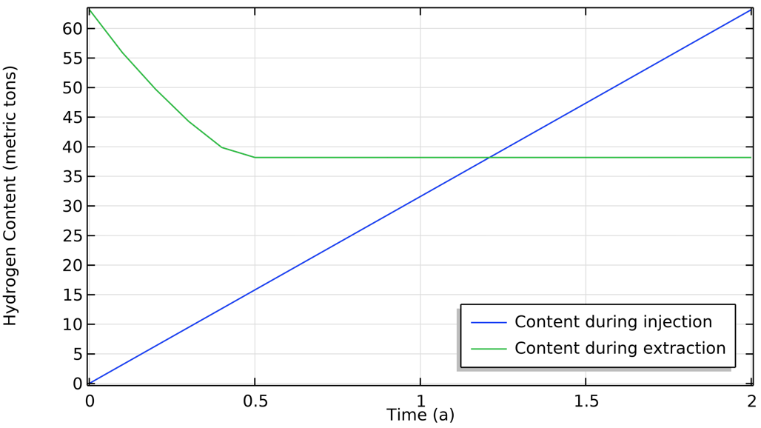
RESULTS
H₂ Content
During Cycling
The model shows that the extraction phase using the applied conditions is somewhat faster than the injection phase.
However, in a real process, cycling after the initial injection would probably be even faster, within days and weeks with injection–extraction cycles following the weather conditions and hydrogen production.
Hydrogen volume fraction in the pores of the structure after 2 years of injection at a mass rate of 1 kg/s.

Slide 8
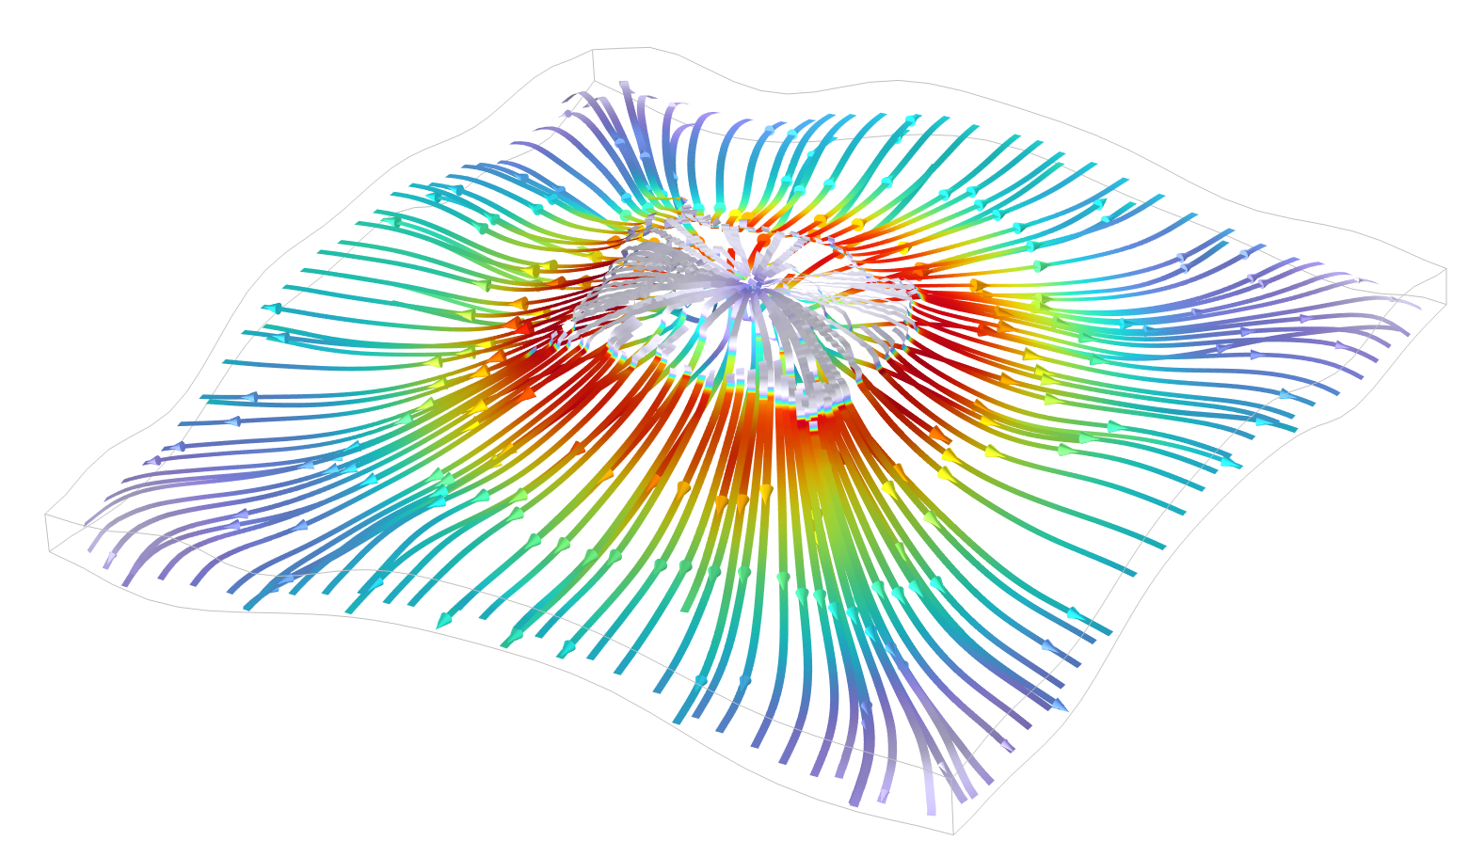
MODEL SUMMARY
Hydrogen Storage in a Geological Formation
The model is easy to set up and solve using COMSOL Multiphysics and the Subsurface Flow Module. The studies that can be concatenated allow for defining arbitrary injection–extraction cycles. The model shows when leakage occurs and if there is mass loss of H₂ during storage.

