Slide 1
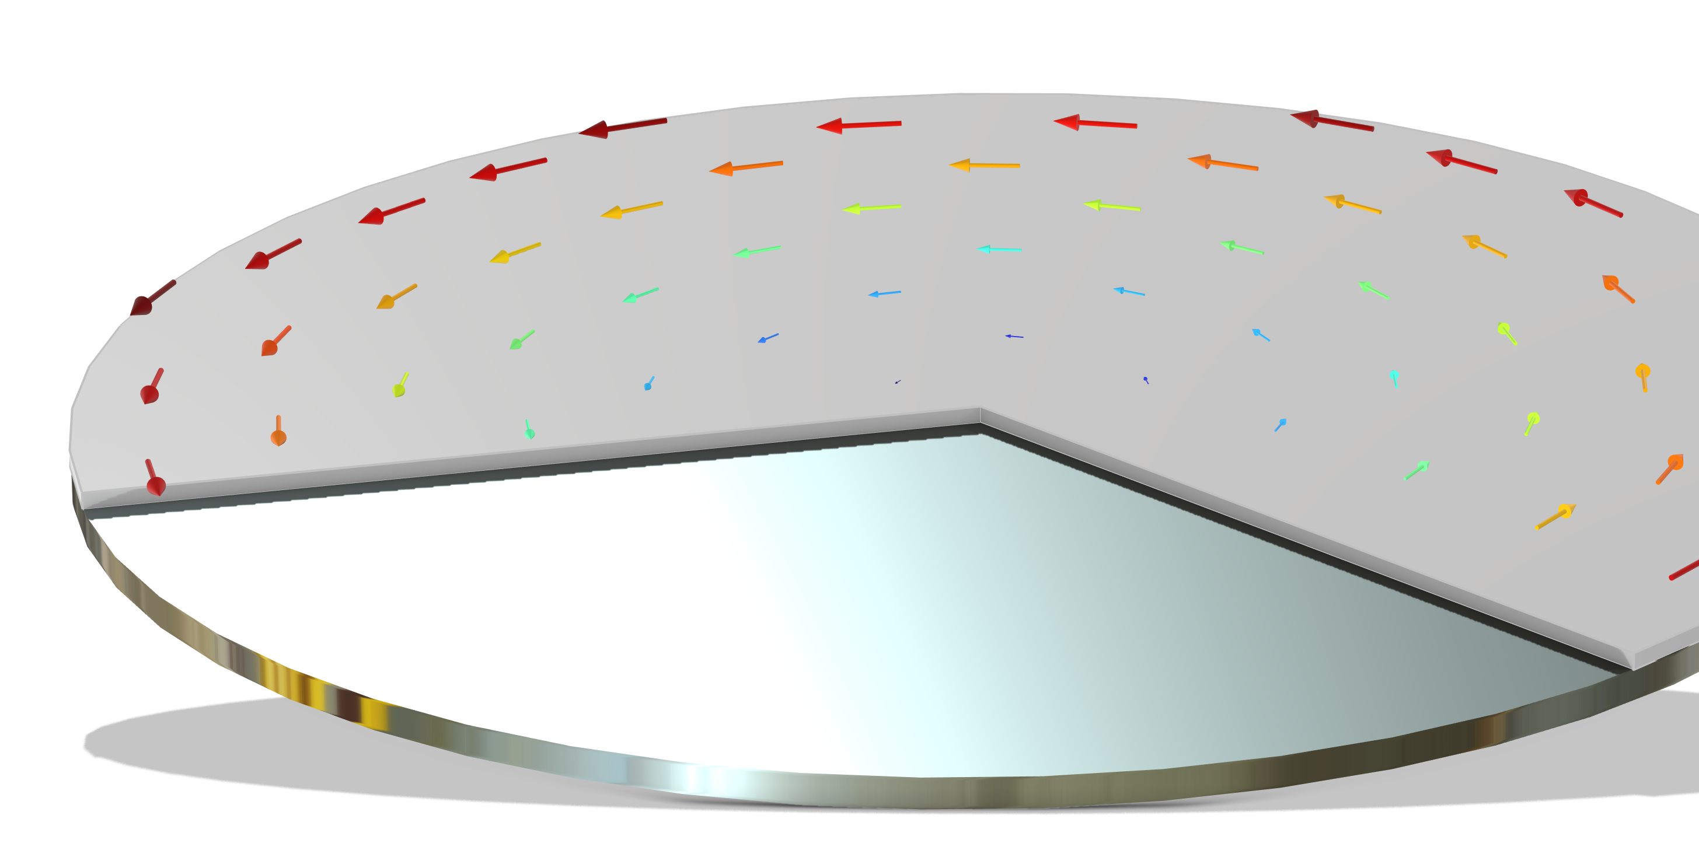
Photoresist Spin Coating

Slide 2
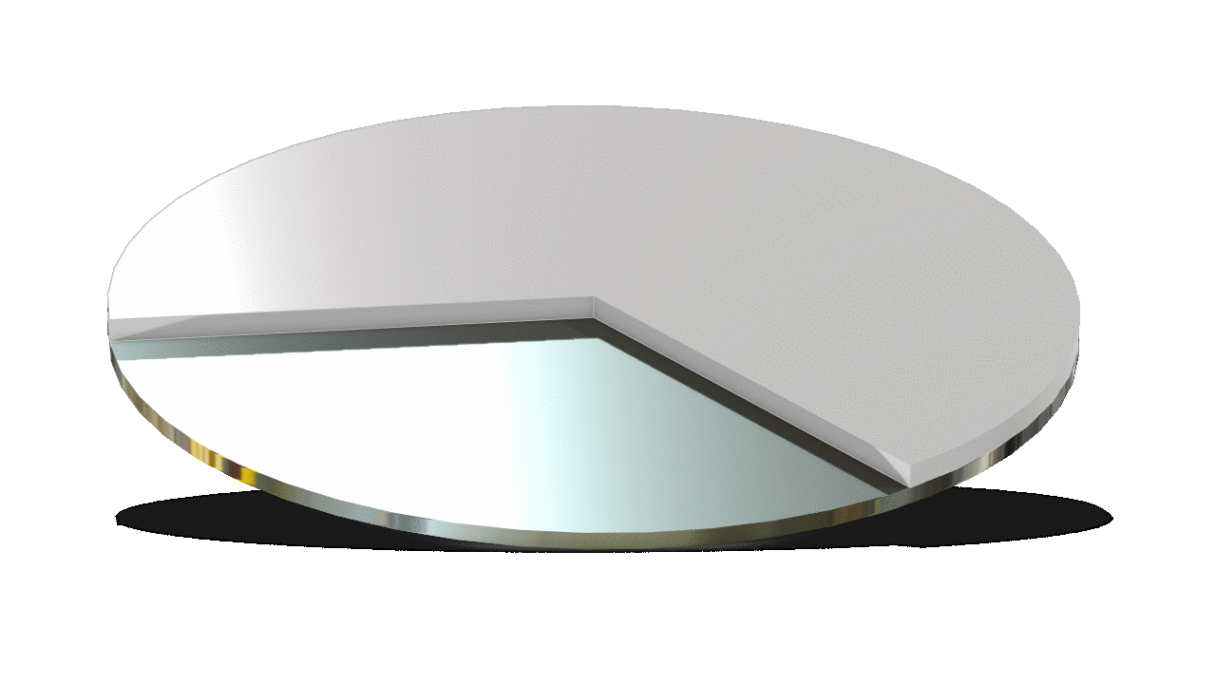
Overview
A simulation model for photoresist spin coating on 8-inch wafer surface has been established
The thickness begins with 10um, changed with rotating speed
The thickness changes of photoresists with different rotating speeds and viscosity were investigated
The thinning process of the photoresist on the wafer surface.

Slide 3
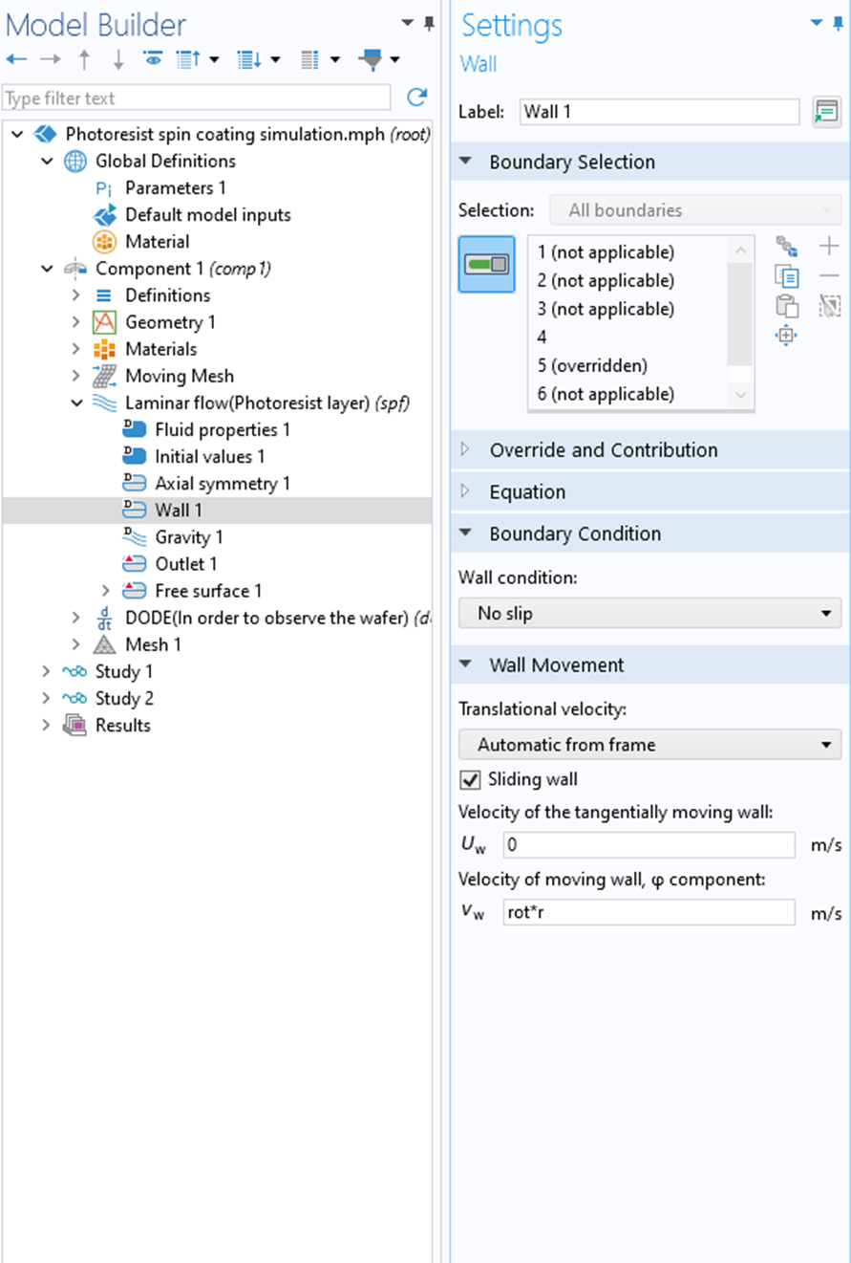
Model Setup
2D axisymmetric
Two-phase flow, moving mesh
  laminar flow
    Turn on Swirl flow and set the rotating speed of the wafer
  Moving mesh
    Free surface, surface tension 0.07 N/m, contact angle 90 degrees
Wafer diameter is 8 inches, initial thickness of photoresist is 10um
Parametric scanning
  Rotate Speed: 1000/2000/4000/6000/8000 [rpm]
  Photoresist dynamic viscosity: 2/6/11/29 [mPa · s]

Slide 4
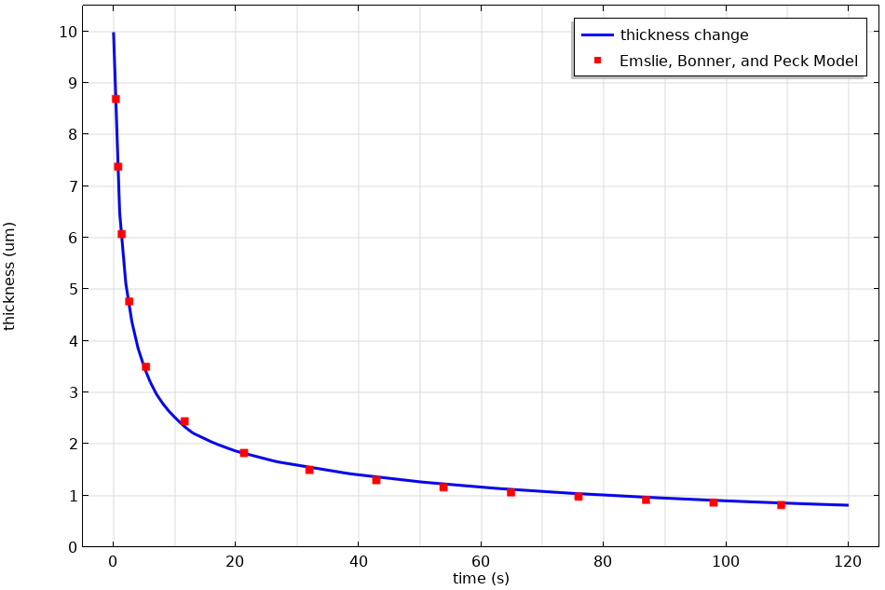
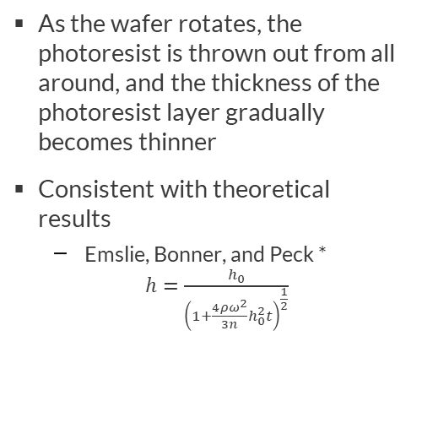
Gradual Thinning of Photoresist Thickness
As the wafer rotates, the photoresist is thrown out from all around, and the thickness of the photoresist layer gradually becomes thinner
Consistent with theoretical results
  Emslie, Bonner, and Peck * $h=\frac{h_{0}}{{\left(1+\frac{4ρω^{2}}{3n}h_{0}^{2}t\right)}^{\frac{1}{2}}}$
* A. G. Emslie, F. T. Bonner, and L. G. Peck, J. Appl. Phys. 29, 858 (1958).

Slide 5
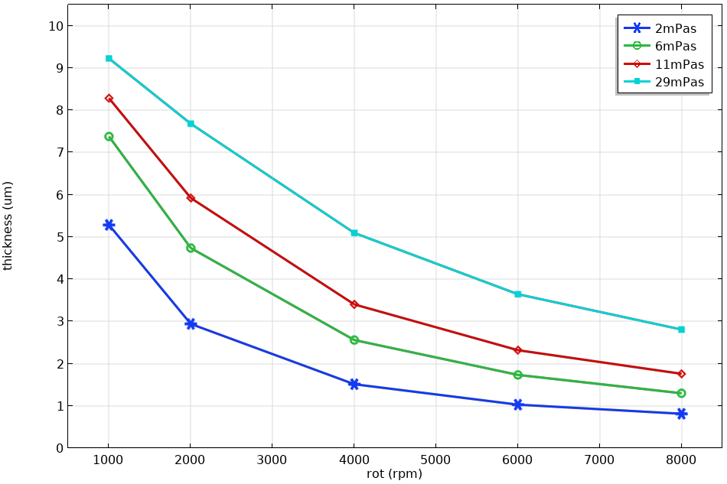
Variation of Adhesive Layer Thickness With Viscosity and Rotational Speed
The smaller the viscosity, the faster the rotating speed, and the thinner the photoresist layer
Average thickness of photoresist layer after 120s at different viscosity and speeds.

Slide 6
Summary
Simulated photoresist spin coating process by laminar flow and moving mesh in COMSOL
Photoresist layer gradually becomes thinner as the wafer rotates，consistent with theoretical result
The smaller the viscosity, the faster the rotational speed, and the thinner the photoresist layer
Photoresist is treated as a Newtonian fluid without considering shear thinning/thickening effects and the influence of temperature.
  If there is a non Newtonian effect, a non-Newtonian constitutive should be used.
The evaporation of photoresist solvent has not been considered.
  If necessary, an evaporation flux should be added to the free surface.

