Slide 1
Modeling curing in automotive rubber
COMSOL

Slide 2
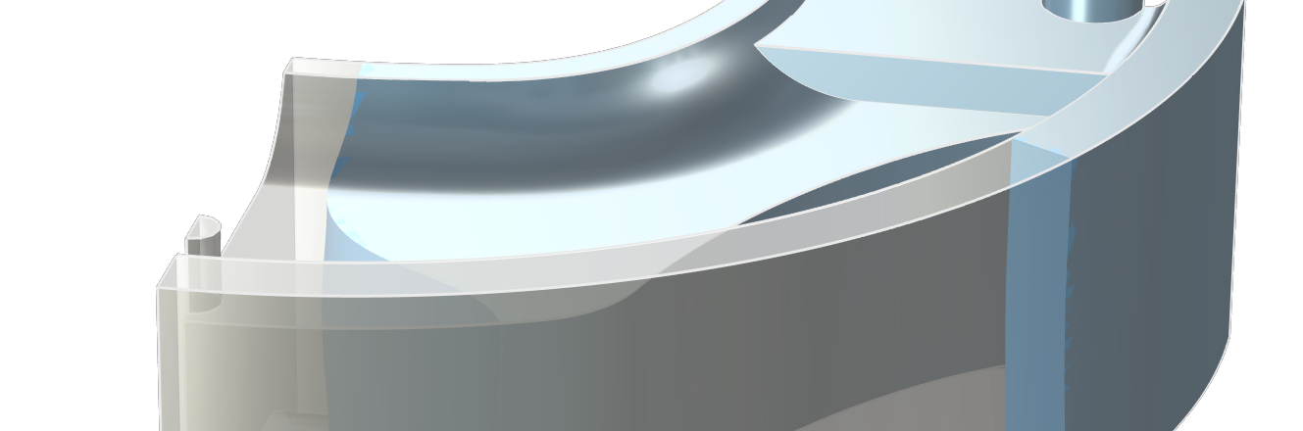
Background
Modeling curing is important in a wide variety of applications such as for devices utilizing polymer materials, rubber materials, plastics and concrete.
Curing is usually an exothermic reaction.
In the current example, curing of butyl rubber is studied in a 3D mold for an automotive vibration damper.
The model uses the geometry from the «Rubber injection molding»-model in the Polymer Flow Module.

Slide 3
Included Phenomena and Physics Interfaces
Heat transfer is an important part of curing since the heat source of the curing reaction influences the energy balance, and thus the rate of curing.
The Curing reaction interface is added for modeling curing of polymers during heat treatment.
The Kamal-Sourour kinetic model is used for the curing simulations.
The Curing Reaction Heating multiphysics coupling is used to add the source term to account for reaction heating in the heat equation.

Slide 4
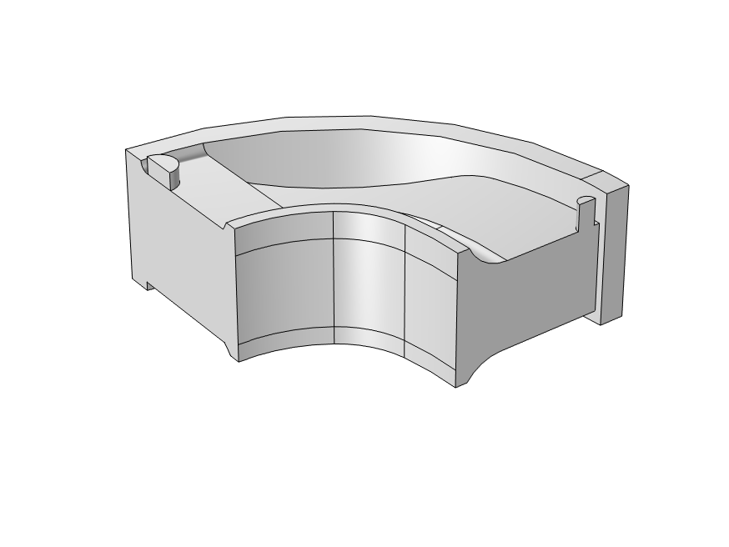
Model Definition
3D model with quarter symmetry filled with uncured butyl rubber.
Initial temperature: 122 degC
Natural convection towards external heated surface at 162 degC
Symmetry boundaries

Slide 5
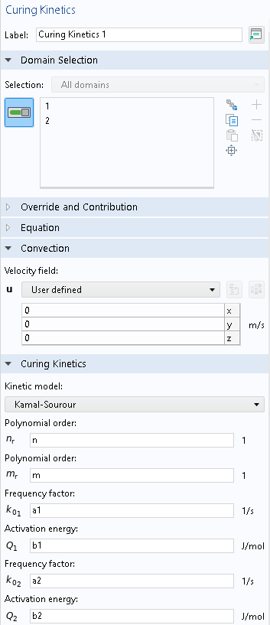
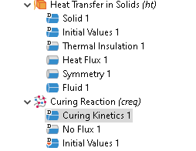
Curing Reaction
The Curing Kinetics node defines the equation to analyze the evolution of the conversion degree during curing reactions.
The Kamal-Sourour kinetic model can be selected from the list of available models.

Slide 6
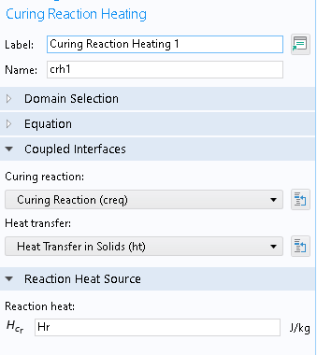
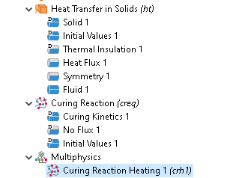
Curing Reaction Heating
Heat is generated during the curing reaction. Add a Curing Reaction Heating multiphysics coupling to account for reaction heating.

Slide 7
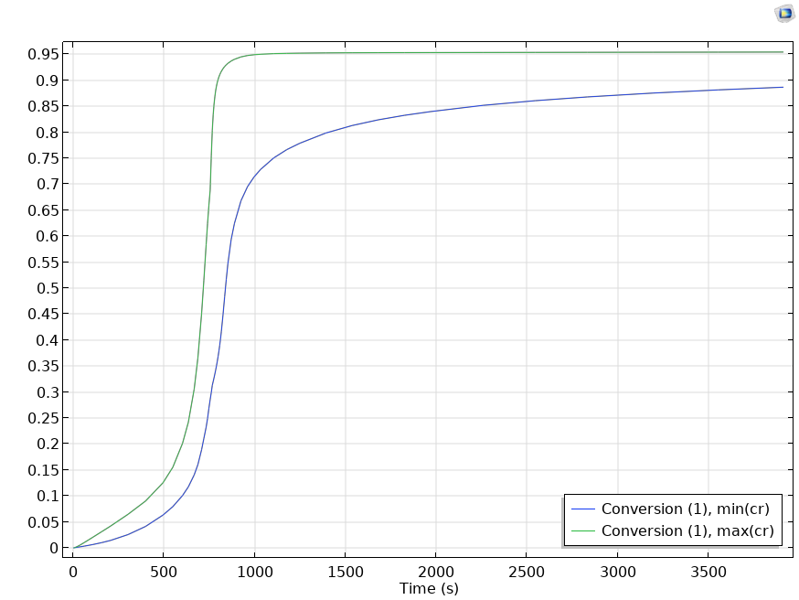
Results
Time dependent maximum and minimum conversion in the domain (Probe plots)

Slide 8
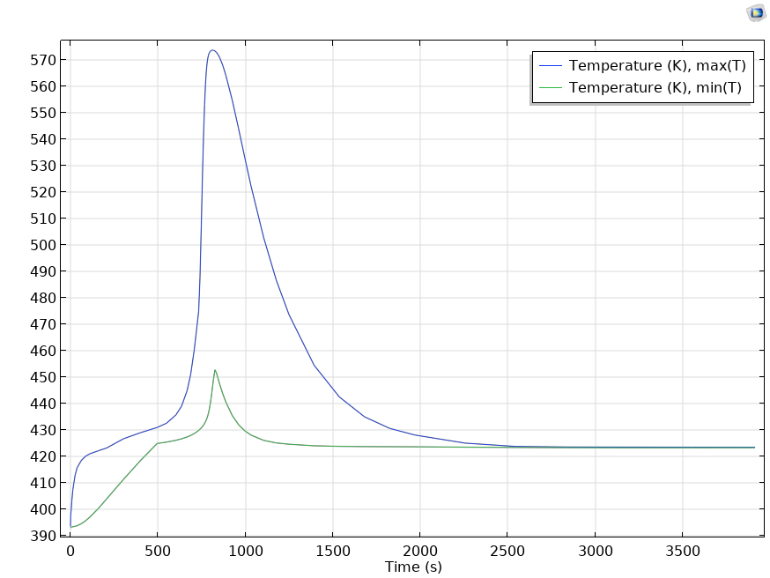
Results
Time dependent maximum and minimum temperature in the domain (Probe plots)

Slide 9
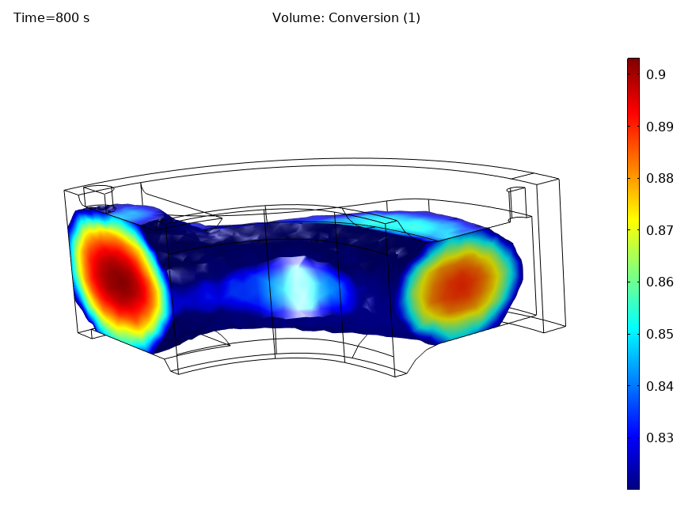
Results
Amount of material cured. Irreversible transformation indicator above 82% at 800s

Slide 10
Concluding Remarks
The model shows how to use the Curing Reaction interface with the Kamal-Sourour kinetic equation for curing of thermoset polymers
The curing reaction acts as a significant heat source, and it is important to control the parameters of this process for optimal device performance.

Slide 11
References
A three dimensional simulation of a rubber curing process considering variable order of reaction, M. Erfaninan et. al, Applied Mathematical Modelling Volume 40, Issues 19–20, October 2016, Pages 8592-8604

