Slide 1
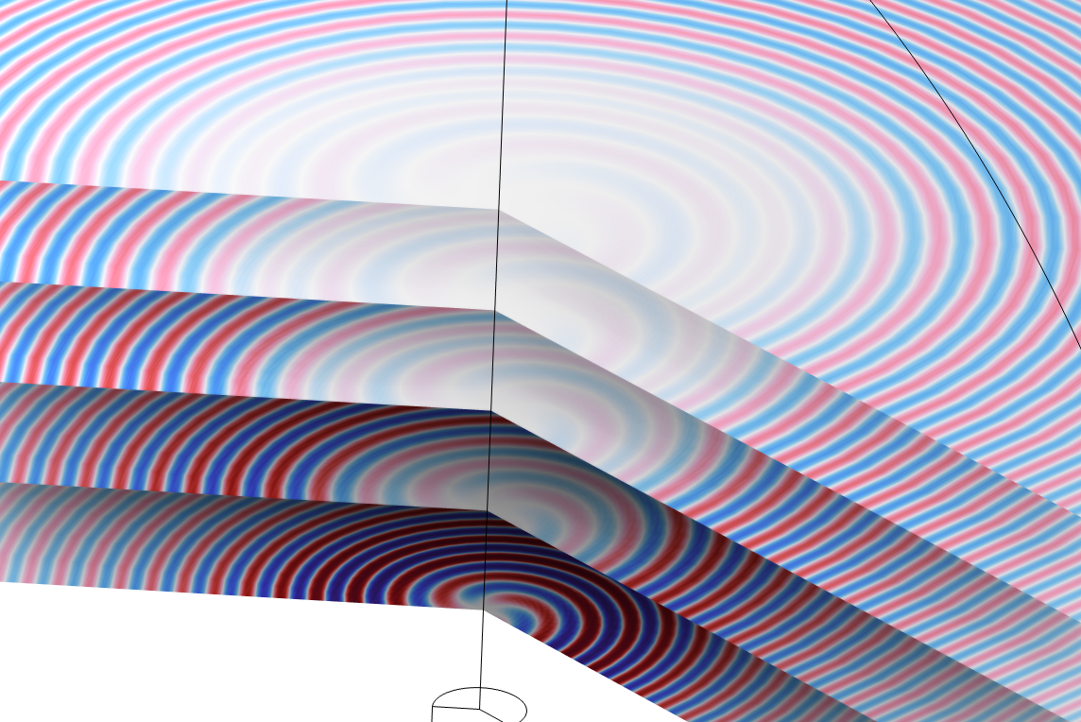
Sound Radiation from
Circular Duct with Flow

Slide 2
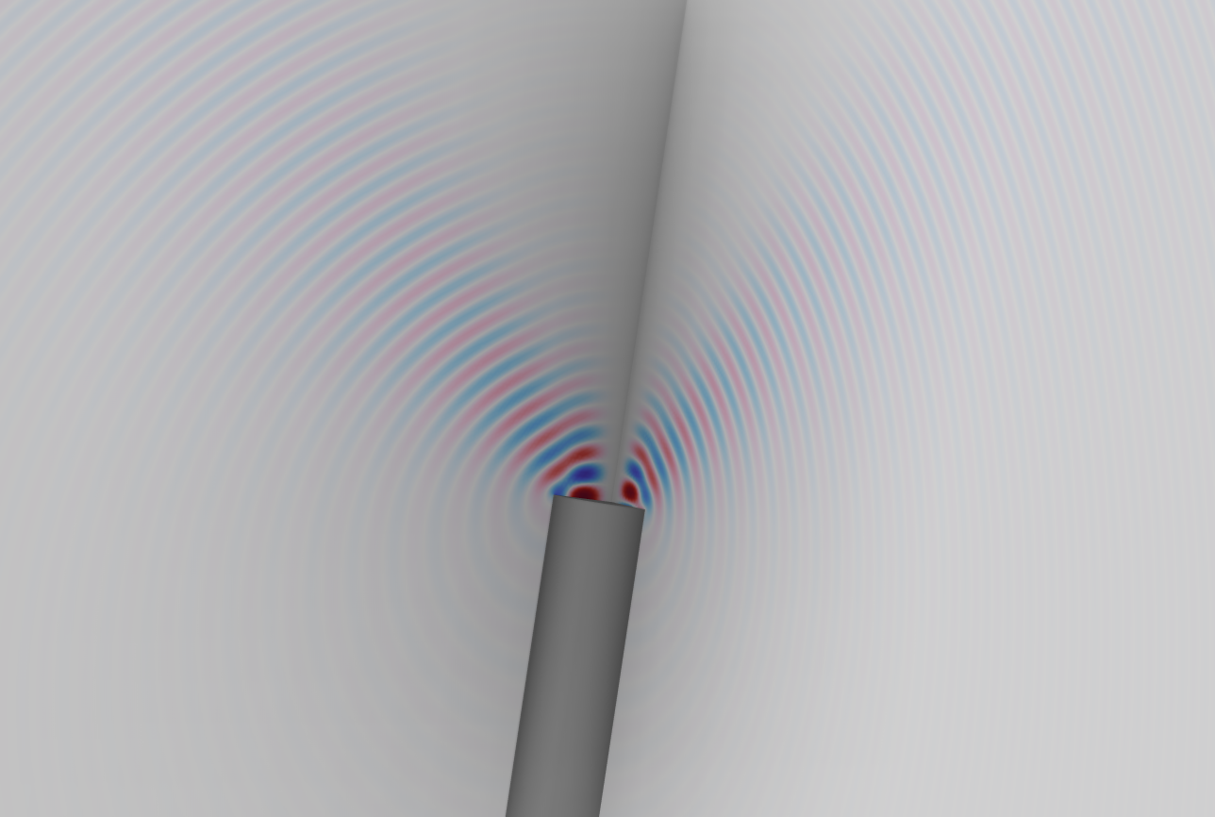
Introduction
Uniform background flow: u₀
Model of the sound radiation from a circular duct with flow. The convected acoustic problem is described using the linearized potential flow (LPF) equations. The acoustic inlet is treated including higher order modes by combining the Port boundary condition and a Boundary Mode analysis.
Reference paper:
C. Ford, A. Pereira, and C. Bailly, "Radiation of higher order modes from circular ducts with flow," Acta Acoustica, Vol. 7 (2023).¹
Incident and outgoing modes at the duct inlet.
¹Article available at:
https://acta-acustica.edpsciences.org/articles/aacus/full_html/2023/01/aacus220052/aacus220052.html. Copyright The Aurhor(s), published by EDP Sciences, 2023. This Article is published under the Creative Commons Attribution 4.0 International license: https://creativecommons.org/licenses/by/4.0/. The model Sound Radiation from a Circular Duct with Flow reproduces the pressure radiation pattern from Figure 8 (b), by using the duct radius, Mach number, and flow velocity parameters from Table 1.
Schematic setup of the problem.

Slide 3
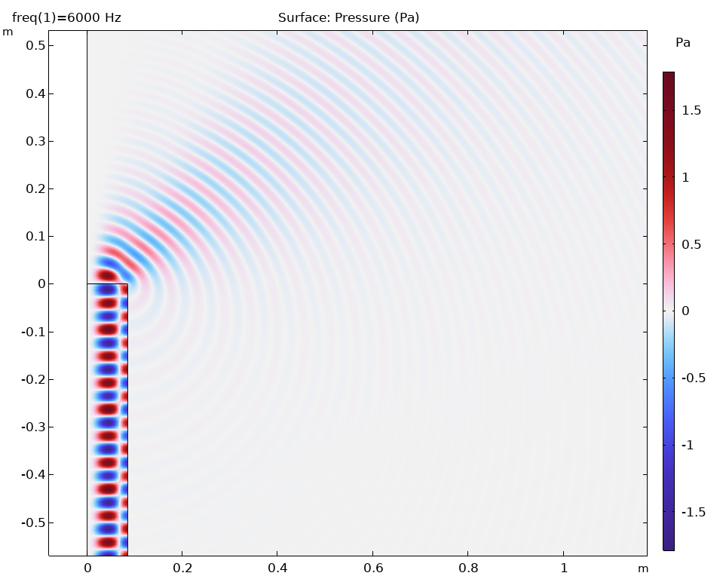
Results: Case 1
Mach number M = 0.3
Source mode (m,n) = (3,1)
File:
radiation_circular_duct_flow_62
_M030_mn31.mph
Radiated acoustic field in the 0 azimuthal angle plane.

Slide 4
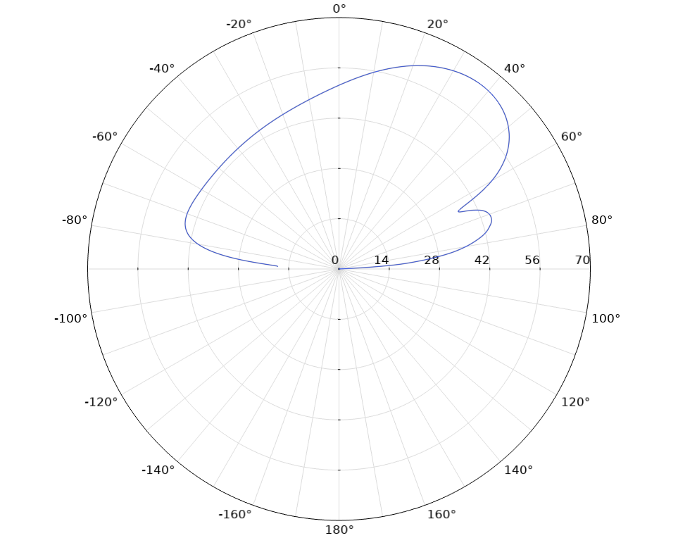
Results: Case 1
Mach number M = 0.3
Source mode (m,n) = (3,1)
Reproduces the results from figure 9b in the reference paper.
File:
radiation_circular_duct_flow_62
_M030_mn31.mph
Radiation pattern from the duct.

Slide 5
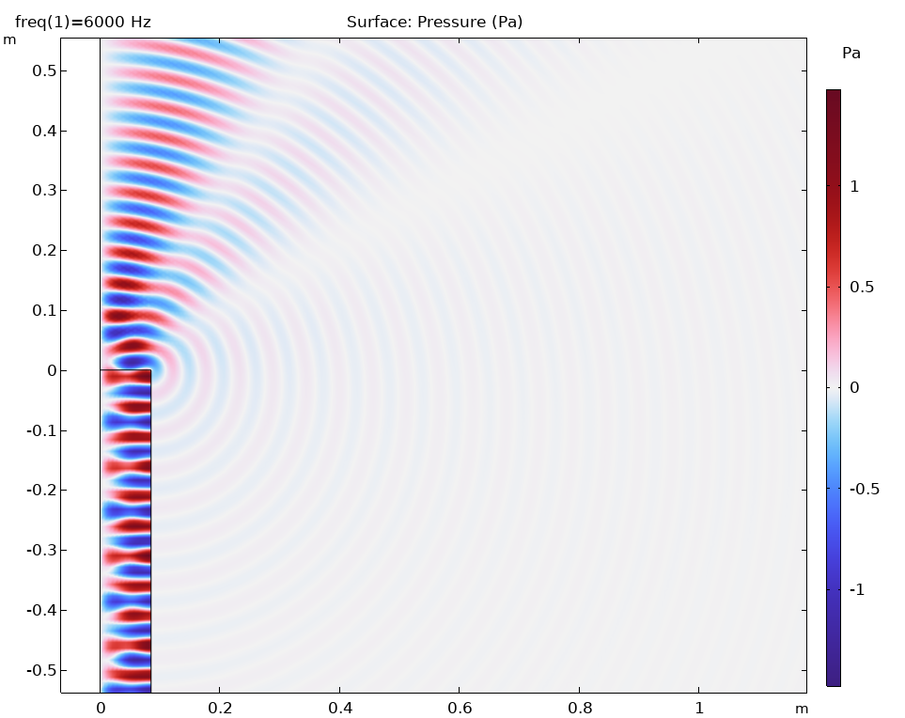
Results: Case 2
Mach number M = 0.12
Source mode (m,n) = (1,0)
File:
radiation_circular_duct_flow_62
_M012_mn10.mph
Radiated acoustic field in the 0 azimuthal angle plane.

Slide 6
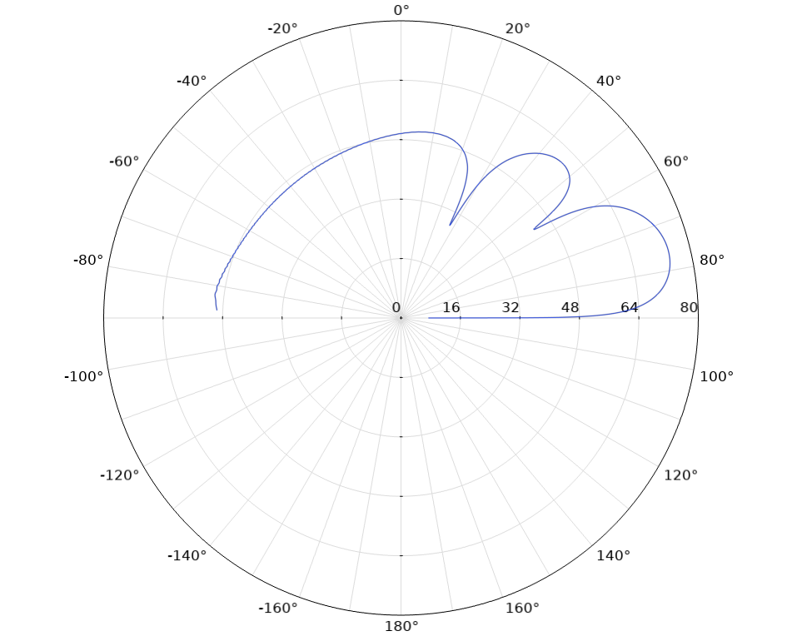
Results: Case 2
Mach number M = 0.12
Source mode (m,n) = (1,0)
Reproduces the results from figure 8b in the reference paper.
File:
radiation_circular_duct_flow_62
_M012_mn10.mph
Radiation pattern from the duct.

