Slide 1
Lithium Plating and Stripping

Slide 2
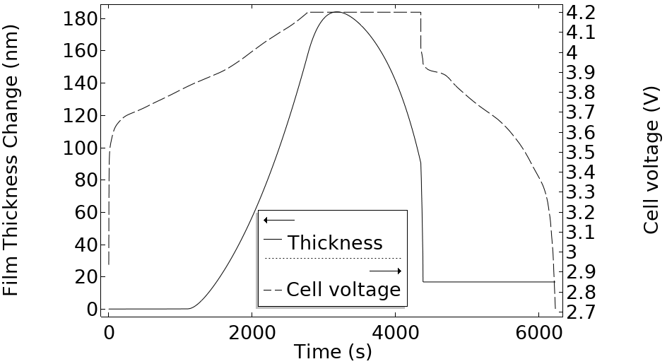
Introduction
Deposition of metallic lithium on the negative electrode in preference to lithium intercalation is known to be a capacity loss and safety concern for lithium-ion batteries
Harsh charge conditions such as high currents (fast charging) and/or low temperatures can lead to lithium plating
This example investigates lithium plating and stripping by using the lithium-ion battery interface to model when and where to expect plating and dead lithium formation in a cell
The impact of temperature and current is demonstrated over a full charge-discharge cycle
Plated lithium film thickness during charge-discharge cycle at – 5 °C

Slide 3
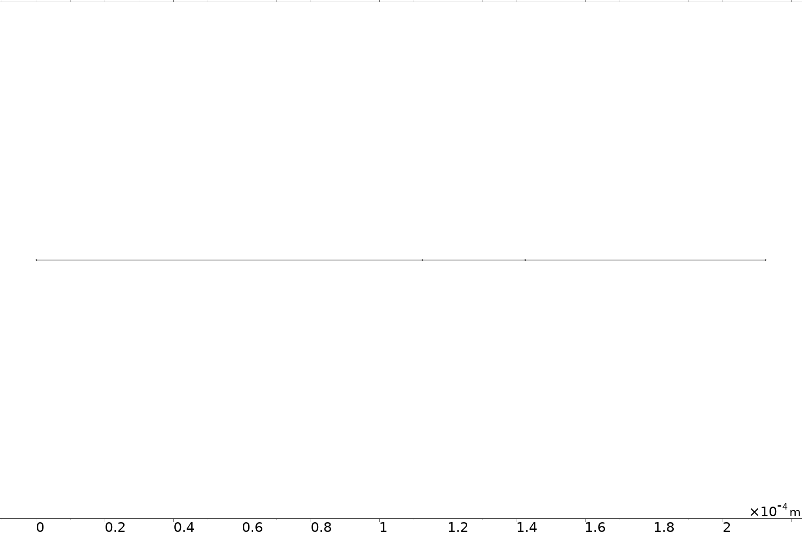
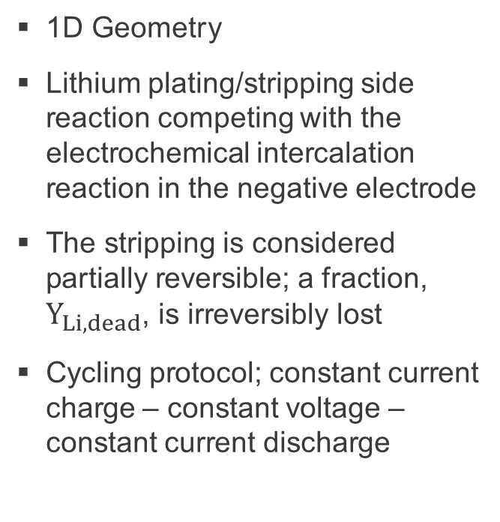


Setup
1D Geometry
Lithium plating/stripping side reaction competing with the electrochemical intercalation reaction in the negative electrode
The stripping is considered partially reversible; a fraction, $Y_{Li, dead}$, is irreversibly lost
Cycling protocol; constant current charge – constant voltage – constant current discharge
Negative porous electrode
(graphite)
Separator
Positive porous electrode
(NMC 811)
$$C_{6}+Li^{+}+e^{−}↔ LiC_{6}$$
(intercalation)
(lithium plating)
(stripping)
$$Li^{+}+e^{−}→ Li\left(s\right)$$
$$\left(1+Y_{Li, dead}\right)Li \left(s\right)→Li^{+}+e^{−}+Y_{Li, dead}$$
$${Ni}_{0.8}{Mn}_{0.1}{Co}_{0.1}O_{2}+Li^{+}+e^{−}↔ Li{Ni}_{0.8}{Mn}_{0.1}{Co}_{0.1}O_{2}$$
(intercalation)

Slide 4
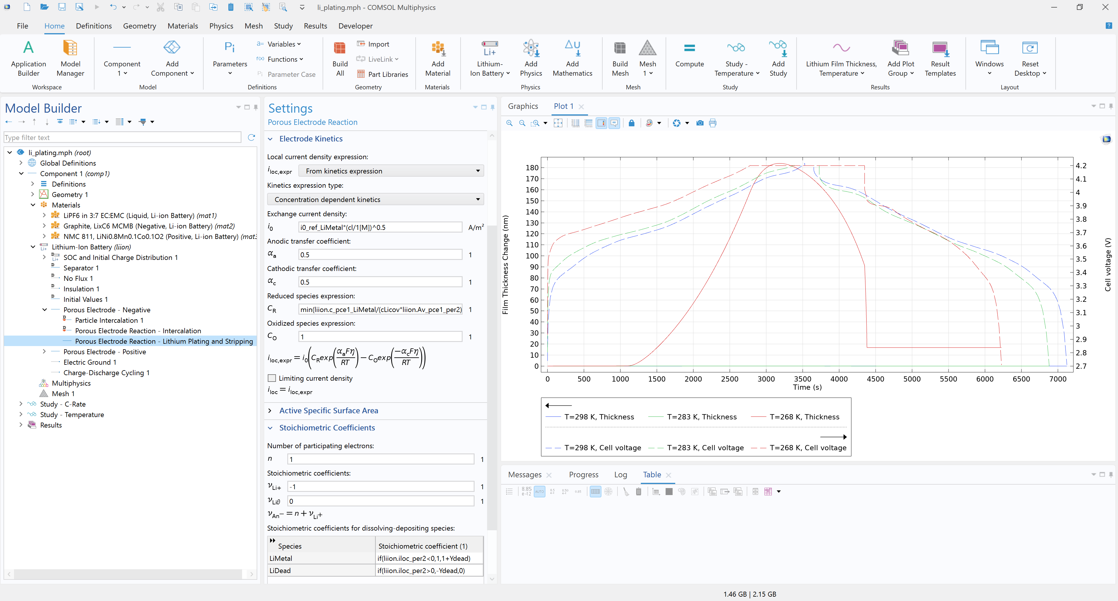
Lithium-Ion Battery Interface
Lithium plating/stripping reaction: Add a Porous Electrode Reaction sub-feature in the Porous Electrode - Negative feature to set electrode kinetics, enable dissolving-depositing species, and adjust stoichiometric coefficients

Slide 5
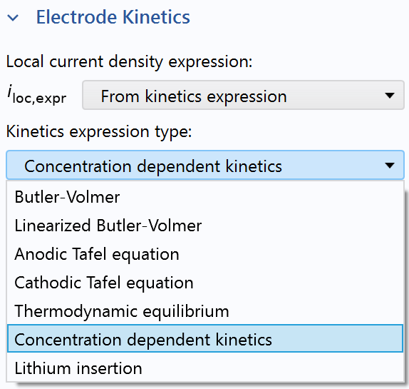
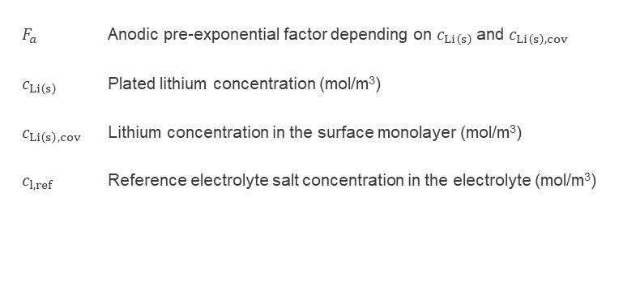
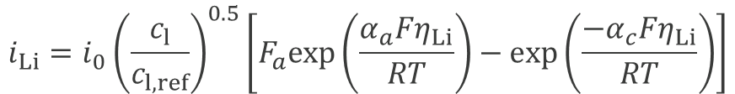
Lithium Plating/Stripping Reaction Kinetics
Concentration dependent Butler-Volmer expression describes the local current density of the side reaction
$$i_{Li}=i_{0}{\left(\frac{c_{l}}{c_{l,ref}}\right)}^{0.5}\left[F_{a}exp\left(\frac{α_{a}Fη_{Li}}{RT}\right)−exp\left(\frac{{−α}_{c}Fη_{Li}}{RT}\right)\right]$$
${F_{a}}_{ }$ Anodic pre-exponential factor depending on ${c_{Li\left(s\right)}}_{ }$and $c_{Li\left(s\right),cov}$
${c_{Li\left(s\right)}}_{ }$ Plated lithium concentration (mol/m³)
${c_{Li\left(s\right),cov}}_{ }$ Lithium concentration in the surface monolayer (mol/m³)
${c_{l,ref}}_{ }$ Reference electrolyte salt concentration in the electrolyte (mol/m³)

Slide 6
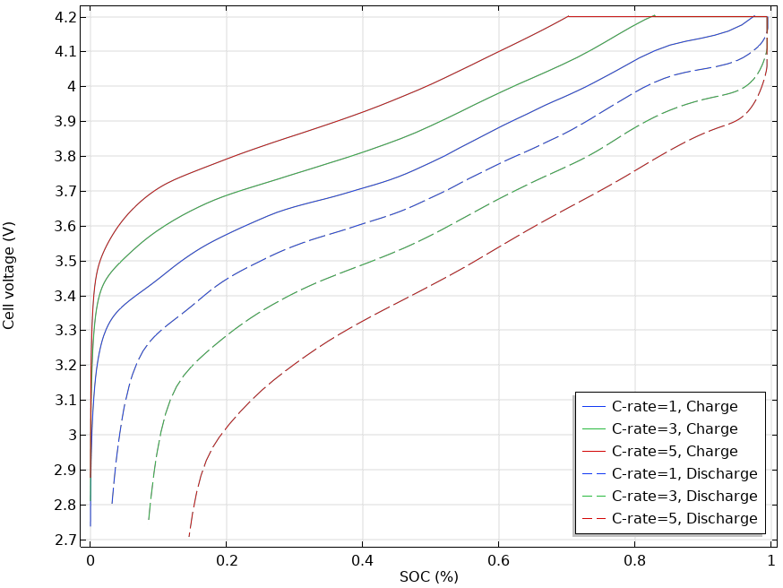
Results
Parametric sweep to investigate plating likelihood and capacity loss:
  Impact of C-rate in the charge-discharge cycle at 298 K

Slide 7
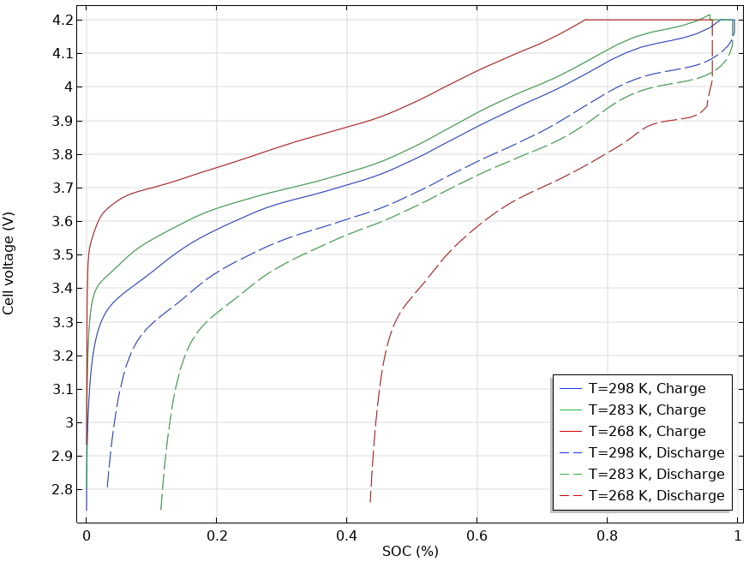
Results
Parametric sweep to investigate plating likelihood and capacity loss:
  Temperature influence for a 1C charge-discharge cycle

Slide 8
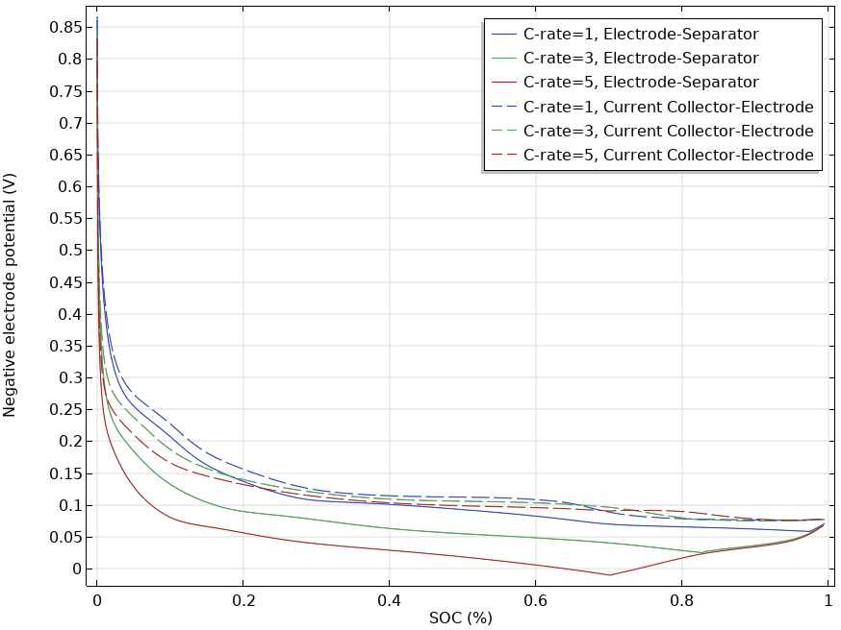
Probing the Potential
The negative electrode during charge can act as an indicator for the plating susceptibility at different locations in the electrode

Slide 9
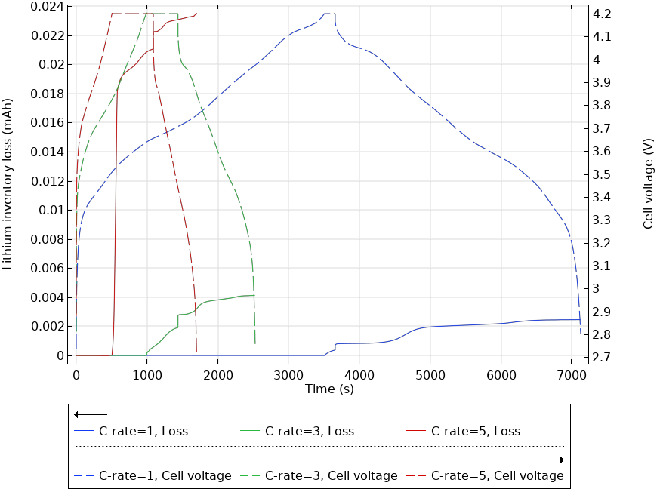
Capacity Loss
More capacity (lithium inventory) is lost for higher C-rate cycling protocols

Slide 10
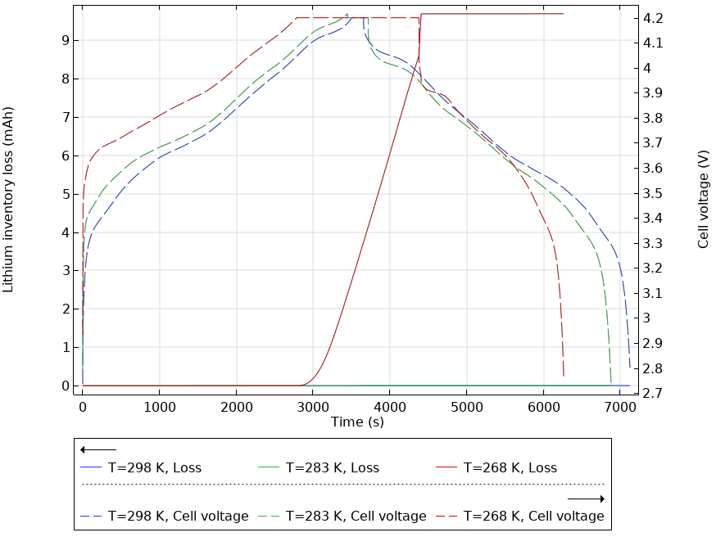
Capacity Loss
Substantial loss at the lowest temperature

Slide 11
Further Reading
S. E. J. O’Kane, I. D. Campbell, M. W. J. Marzook, G. J. Offer, and M. Marinescu, “Physical Origin of the Differential Voltage Minimum Associated with Lithium Plating in Li-Ion Batteries,” J. Elec. Soc., vol. 167, pp. 090540, 2020.
X. -G. Yang, S. Ge, T. Liu, Y. Leng, and C. -Y. Wang, “A look into the voltage plateau signal for detection and quantification of lithium plating in lithium-ion cells,” J. Power Sources, vol. 395, pp. 251–261, 2018.
S. E. J. O’Kane, W. Ai, G. Madabattula, D. Alonso-Alvarez, R. Timms, V. Sulzer, J. S. Edge, B. Wu, G. J. Offer, and M. Marinescu, “Lithium-ion battery degradation: how to model it,” Phys. Chem. Chem. Phys., vol. 24, pp. 7909–7922, 2022.

