Slide 1
Simple Thermoacoustic Engine
Converting thermal energy into acoustic energy

Slide 2
Background and Motivation
Thermoacoustic devices have long been known and have received an increasing amount of interest in the recent years due to their relevance in regards to sustainable energy solutions, from acoustically driven heat-pumps to thermoacoustic refrigerators.
Here we model a simple thermoacoustic engine converting thermal energy into acoustic energy.
Examples of thermoacoustic devices:
  A thermoacoustic engine – is able to turn heat into sound or mechanical work by exploiting that gases and liquids compress/expand as an acoustic wave propagates
  A thermoacoustic refrigerator – is cooling by using a acoustic field. It uses the same effect as the thermoacoustic engine but in “reverse”. Here it is possible by applying a sustained acoustic field to cool down a component to a temperature lower than the connected heat sink.
  Rijke’s tube – a well known high school/university science experiment which with simple means demonstrates the thermoacoustic effect by turning heat into a sustained sound.

Slide 3
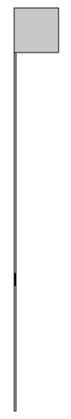
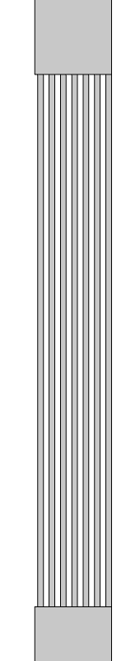




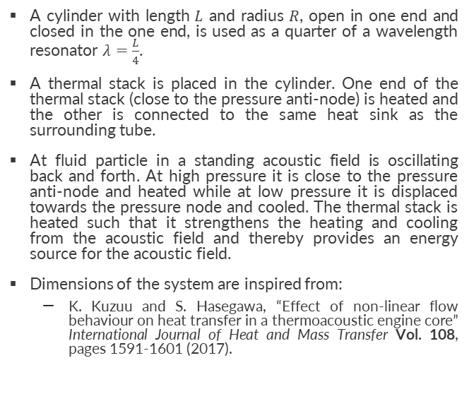
Physical Principle and Setup
Symmetry axis
Buffer zone
A cylinder with length $L$ and radius $R$, open in one end and closed in the one end, is used as a quarter of a wavelength resonator $λ=\frac{L}{4}$.
A thermal stack is placed in the cylinder. One end of the thermal stack (close to the pressure anti-node) is heated and the other is connected to the same heat sink as the surrounding tube.
At fluid particle in a standing acoustic field is oscillating back and forth. At high pressure it is close to the pressure anti-node and heated while at low pressure it is displaced towards the pressure node and cooled. The thermal stack is heated such that it strengthens the heating and cooling from the acoustic field and thereby provides an energy source for the acoustic field.
Dimensions of the system are inspired from:
  K. Kuzuu and S. Hasegawa, “Effect of non-linear flow behaviour on heat transfer in a thermoacoustic engine core” International Journal of Heat and Mass Transfer Vol. 108, pages 1591-1601 (2017).
$$R=2.025 cm$$
$$L=4 m$$
$$L_{stack}=14 cm$$
$$L=1.4 m$$

Slide 4

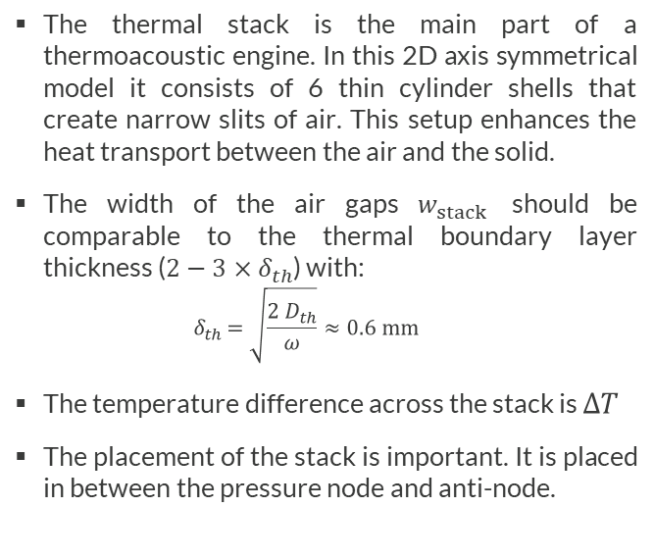





System – The thermal stack
Symmetry axis
$$T=T_{ref }$$
$$T=T_{ref }$$
The thermal stack is the main part of a thermoacoustic engine. In this 2D axis symmetrical model it consists of 6 thin cylinder shells that create narrow slits of air. This setup enhances the heat transport between the air and the solid.
The width of the air gaps $w_{stack}$ should be comparable to the thermal boundary layer thickness ($2−3×δ_{th}$) with:
  $${ δ}_{th }=\sqrt{\frac{2 D_{th}}{ω}}≈0.6 mm$$
The temperature difference across the stack is $ΔT$
The placement of the stack is important. It is placed in between the pressure node and anti-node.
$$L_{stack}=14 cm$$
$$w_{stack}=1.5 mm$$
$$T=T_{ref }+ΔT$$
$$R=2.25 cm$$

Slide 5
Simulation Approaches
Heat Transfer in Fluids and Thermoviscous Acoustics interfaces
  The first method is based on perturbation theory and assumes that the temperature variations due to the acoustic field is small compared to the stationary temperature gradients. This assumes small fluid displacement compared to the length scales of the stationary temperature field.
  The Heat Transfer in Fluids interface is used to model the stationary temperature field.
  The Thermoviscous Acoustics, Transient interface is used to model the oscillating acoustic fields.
Nonisothermal Flow multiphysics interface
  The second approach uses the Nonisothermal Flow multiphysics coupling to couple the fluid flow and temperature thermal equations. It does not assume that the acoustics fields or fluid displacement are small.
  When solving, it is important to control the time-stepping to ensure that the oscillating field is well resolved in time.
  This approach can be necessary when the fluid displacement is larger or comparable to the size of the thermal stack.
  The approach is a factor of 8-10 times slower than the perturbation/acoustic approach.

Slide 6
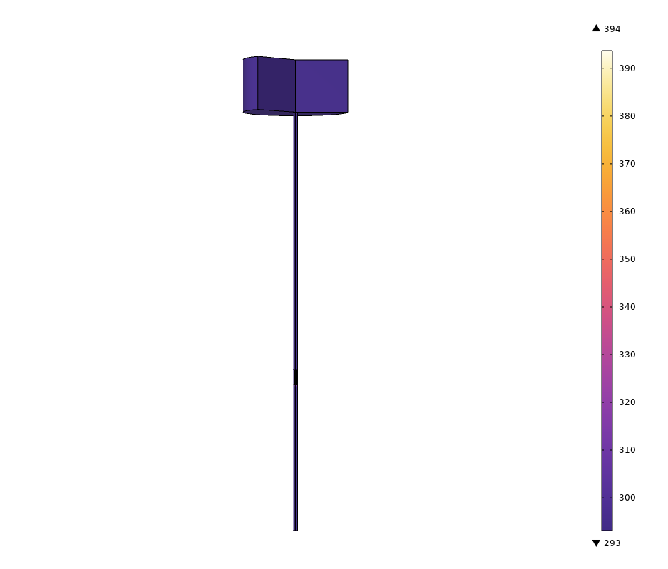
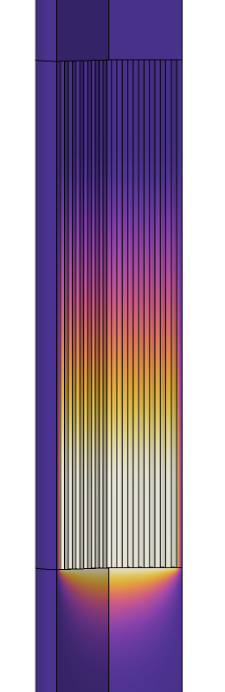

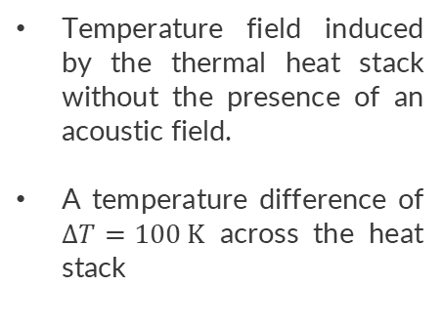
Stationary Temperature Field
Temperature field induced by the thermal heat stack without the presence of an acoustic field.
A temperature difference of $ΔT=100 K$ across the heat stack
$$ΔT$$
Thermal
stack
Stationary temperature field T₀

Slide 7
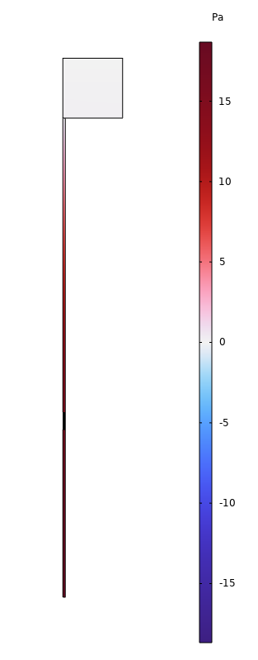
Acoustic Fields
Pressure field p₁
Actuated by a pulse at the outlet of the buffer zone.
Actuates the quarter wavelength resonance wave in the thin tube.
Depending on the temperature gradient in the thermal stack the amplitude of the acoustic field decreases or increases.
With no thermal gradient the acoustic field would slowly decrease due to the thermoviscous loses in the tube.

Slide 8
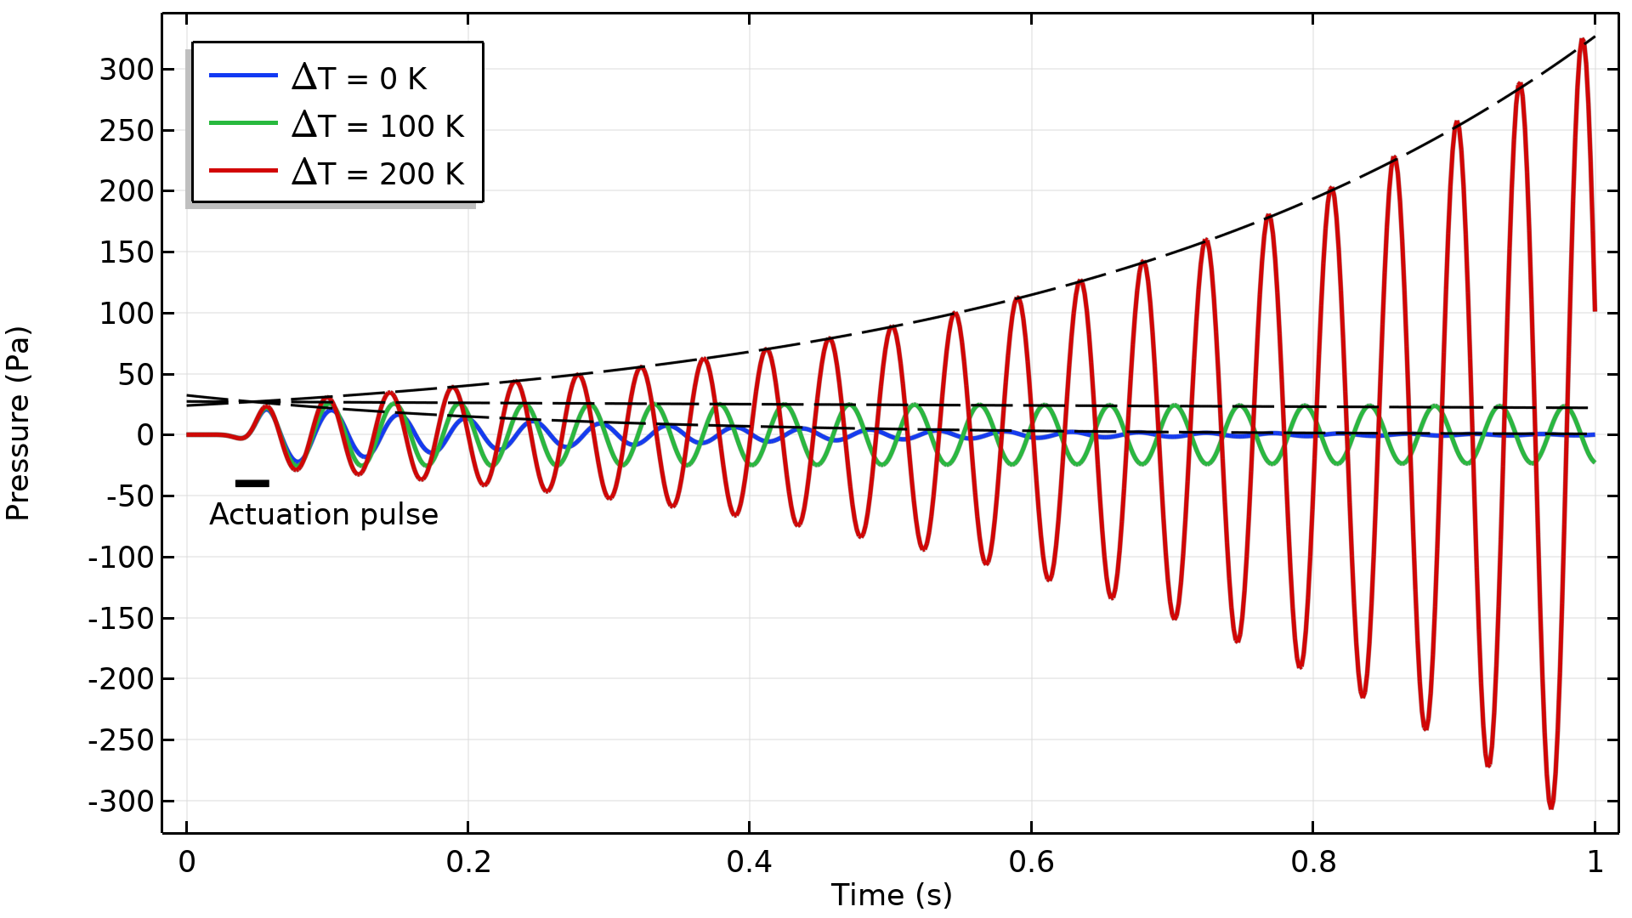
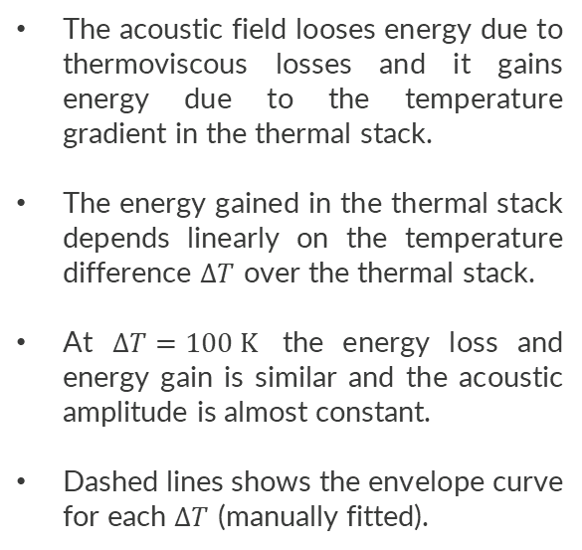
Acoustic Fields
The acoustic field looses energy due to thermoviscous losses and it gains energy due to the temperature gradient in the thermal stack.
The energy gained in the thermal stack depends linearly on the temperature difference $ΔT$ over the thermal stack.
At $ΔT=100 K$ the energy loss and energy gain is similar and the acoustic amplitude is almost constant.
Dashed lines shows the envelope curve for each $ΔT$ (manually fitted).
Pressure field p₁, as a function of time for different stack temperatures

Slide 9
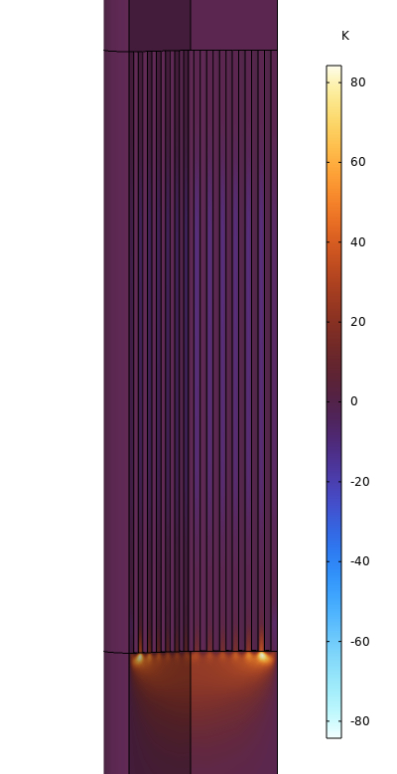
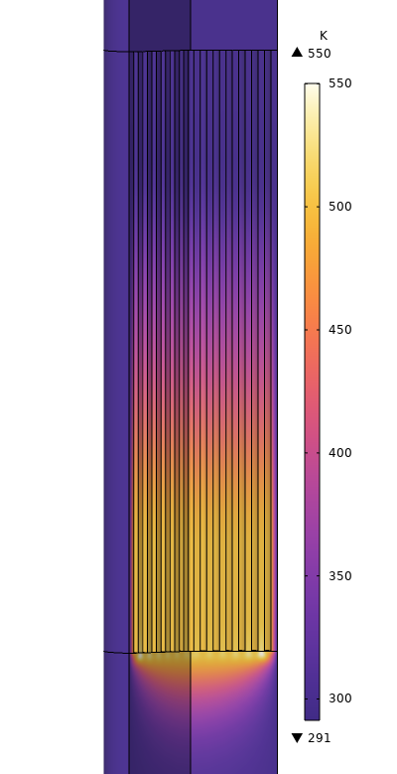
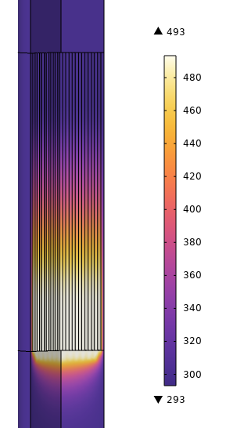
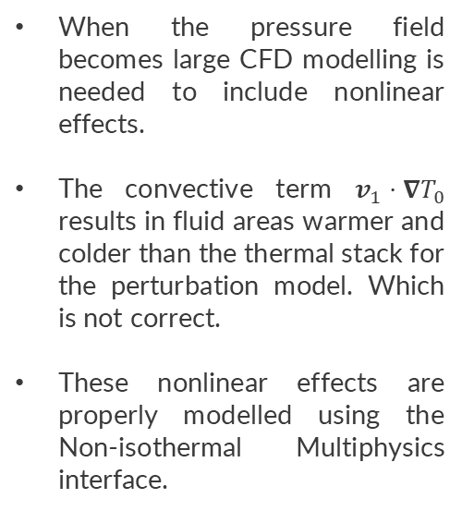
Nonlinear Effects – CFD Modelling
Acoustic
temperature
(Perturbation)
Total
temperature
(Perturbation)
Total
temperature
(CFD)
When the pressure field becomes large CFD modelling is needed to include nonlinear effects.
The convective term $v_{1}⋅∇T_{0}$ results in fluid areas warmer and colder than the thermal stack for the perturbation model. Which is not correct.
These nonlinear effects are properly modelled using the Non-isothermal Multiphysics interface.

Slide 10
Concluding Remarks
A thermoacoustic engine can extract energy from a temperature gradient and transform it into acoustic energy.
The sustained or increasing sound pressure can be used to drive a mechanical engine. A thermoacoustic engine is an enticing method to convert thermal energy to acoustic energy.
The temperature in the heat stack changes the fluid parameters including the viscosity and heat conductivity and therefore the losses in the system is not the exact same for different temperatures in the thermal stack.
The inclusion of nonlinear effects are necessary at high acoustic pressures. Although it does take significantly longer to run (a factor of 8-10)
Note that energy is constantly provided to sustain the temperature gradient in the thermal stack so this is not an infinity machine.

