Slide 1
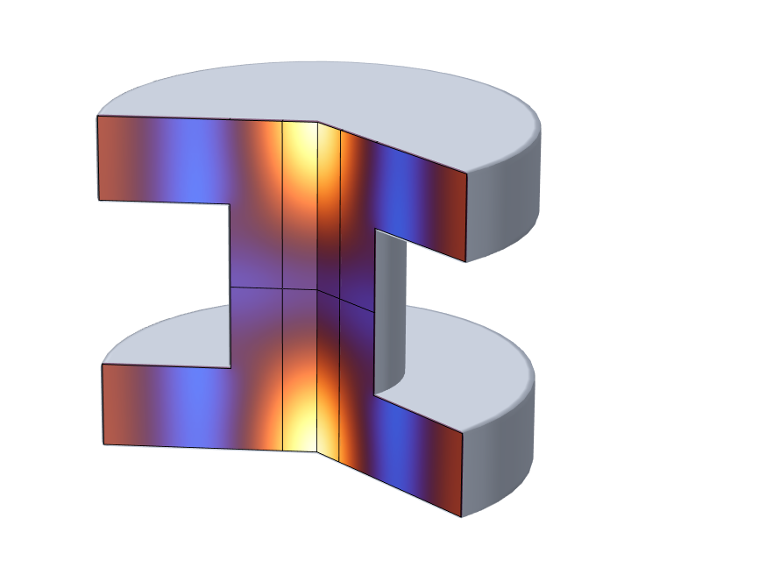
Photoacoustic Resonator
Simple Illustration of Photoacoustic/Optoacoustic Effects

Slide 2


Background and Motivation
This tutorial shows how to model photoacoustic/optoacoustic effects in COMSOL Multiphysics
A pulsating laser heats air inside a resonance chamber thus creating an acoustic pressure wave
The model is set up using two approaches:
  Detailed approach with Thermoviscous Acoustics
  Using Pressure Acoustics and the Thermoviscous Boundary Layer Impedance boundary condition
The model is based on the geometry described in:
  L. Duggen, R. Frese, and M. Willatzen, “FEM analysis of cylindrical resonant photoacoustic cell”, J. of Phys.: Conference Series 214 (2010)
Laser heat source:
$$Q0\left(t\right)=Q0\text{∙}exp(iωt)$$
$$2R_{buf}$$

Slide 3
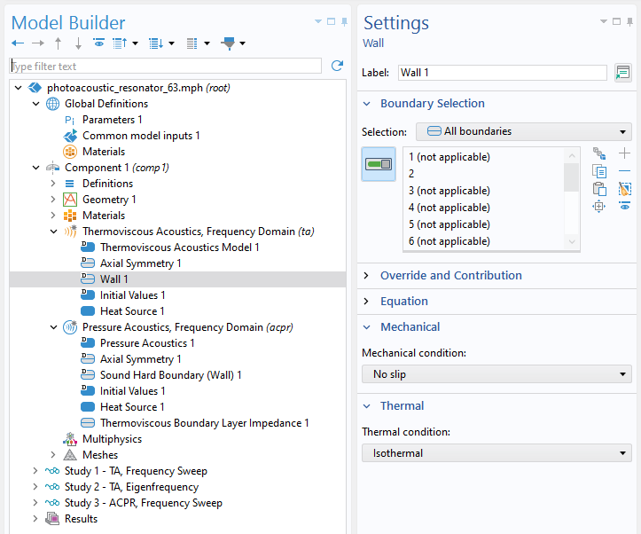



Boundary Conditions
The thermoviscous boundary layer
(δ ~0.05 mm) is small compared to the geometrical dimensions (L_{geom} = 5 cm):
In this case, using Slip and Adiabatic wall conditions is a good approximation
However, the models shows how to mesh the boundary layer and model it using Thermoviscous Acoustics
Using Pressure Acoustics, the boundary layer can in this situation be mimicked using the Thermoviscous Boundary Layer Impedance boundary condition
$$δ_{v}=\sqrt{\frac{2μ}{ρω}}$$
$$δ_{v}=\sqrt{\frac{2k}{ρωC_{p}}}$$
$$L_{geom}\sim δ_{v/th}$$

Slide 4
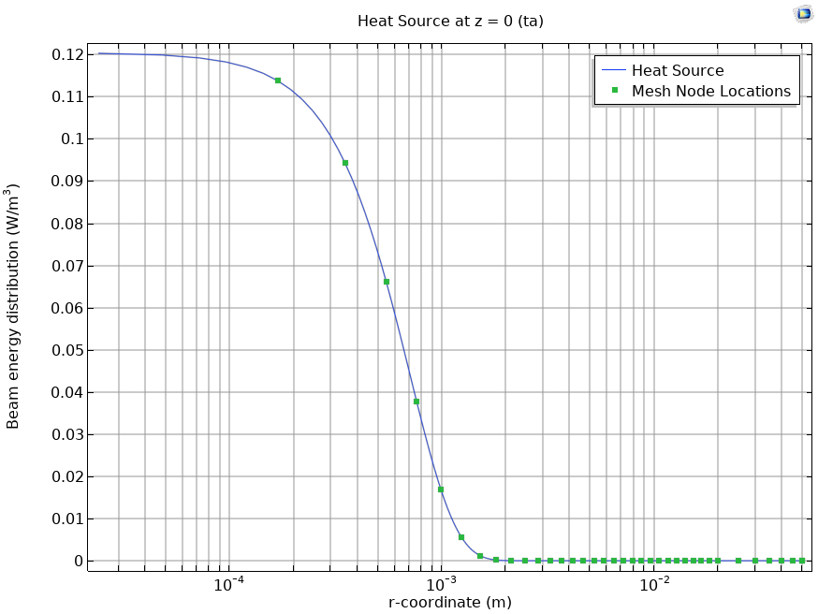
Mesh
The mesh has to resolve the waves, the geometry, and gradients in the model.
In this model, resolving the heat source is the most important factor.
Heat source and mesh nodes as a function of r at z=0

Slide 5
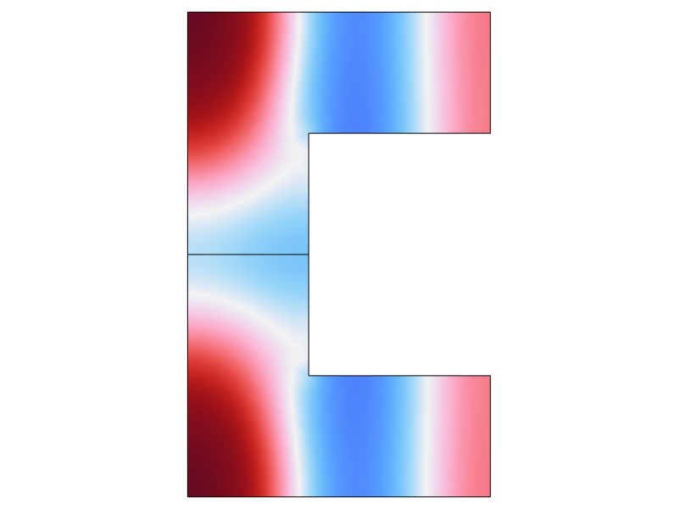
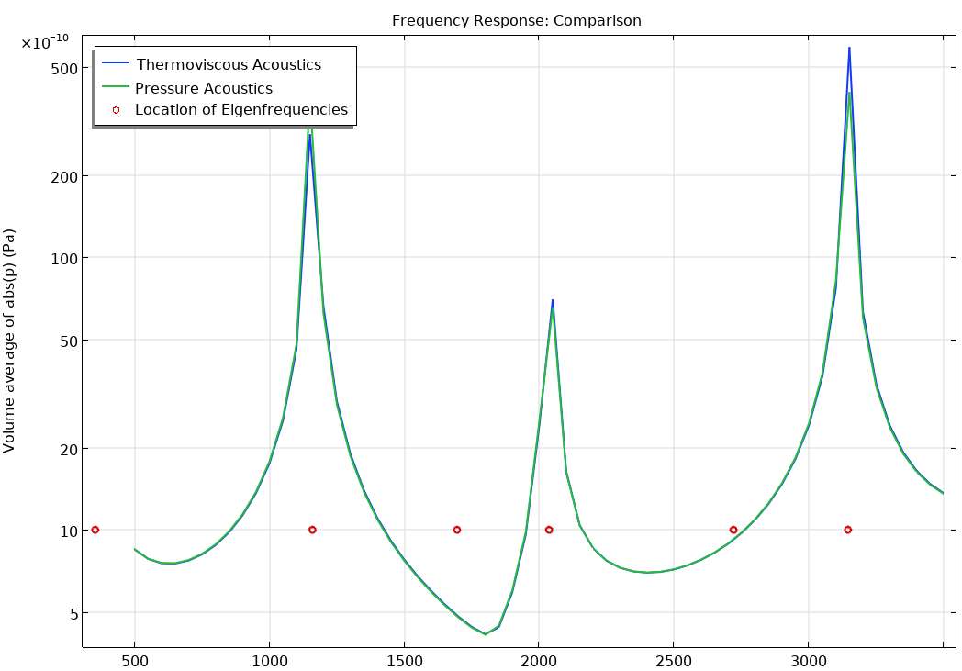
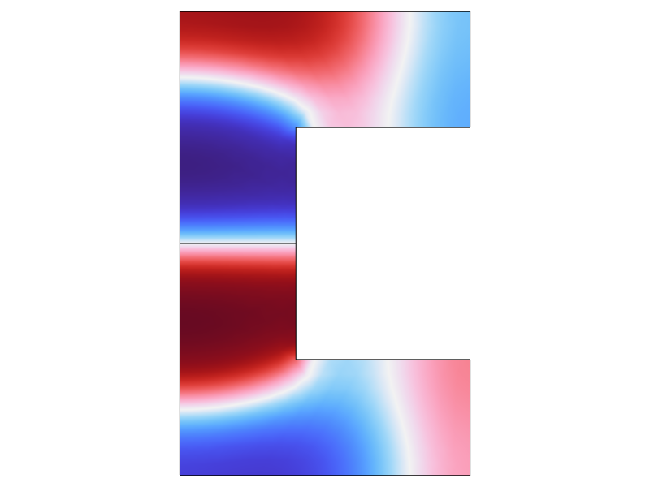
Results
symmetric mode
is excited
non-symmetric mode
not excited

Slide 6
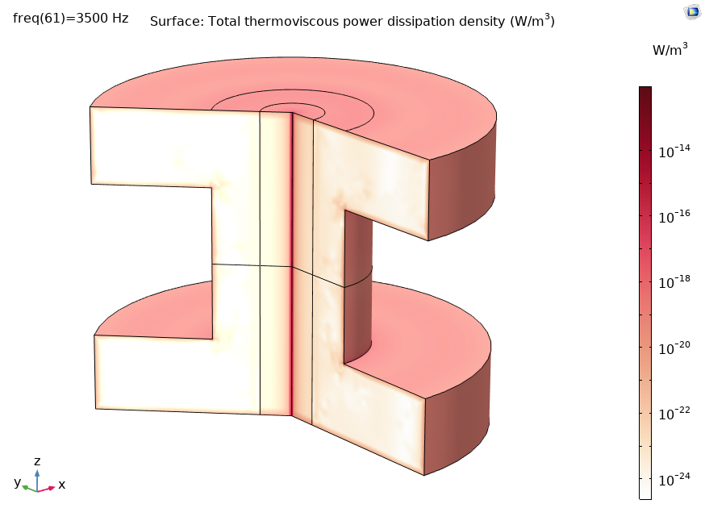
Results
To study the total thermoviscous power dissipation density in this model, you need to use Thermoviscous Acoustics.
Total thermoviscous power dissipation density, calculated with the Thermovoscous Acoustics, Frequency Domain interface.

