Slide 1
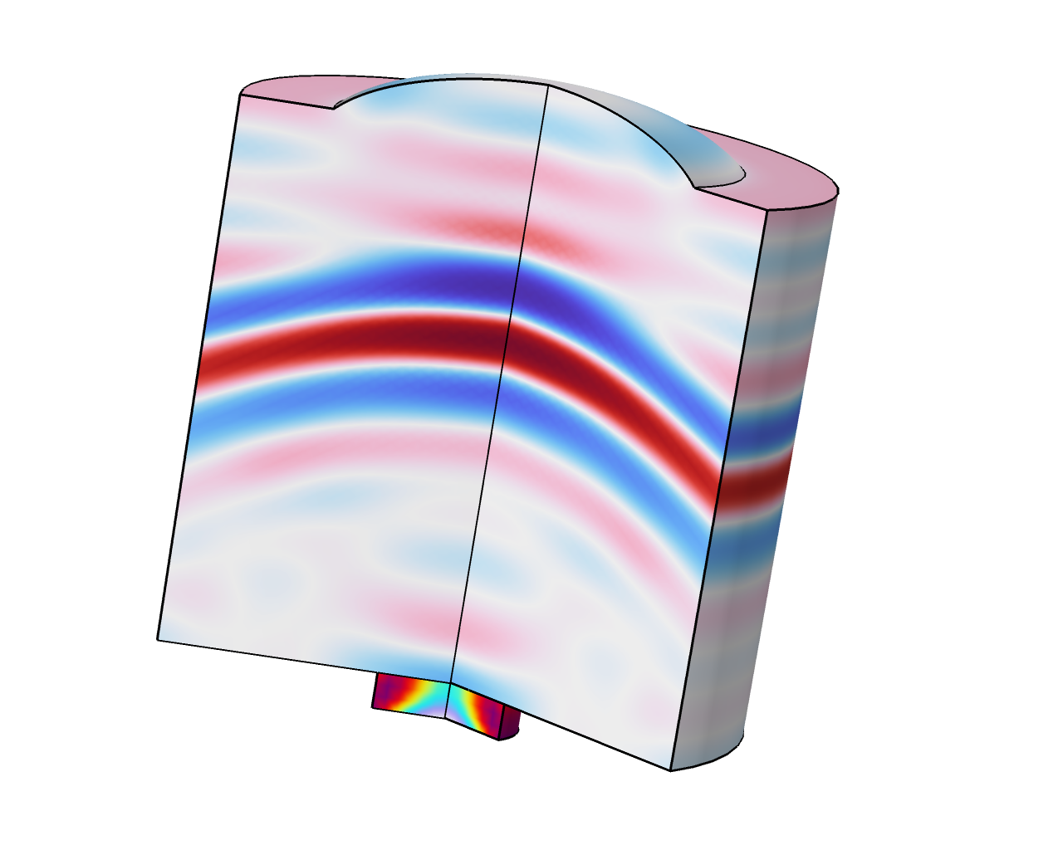
Modeling Piezoelectric Devices as Both Transmitters and Receivers

Slide 2
Application Background
Piezoelectric devices are widely used as sources to generate sound waves or receivers to detect acoustic signals
The same transducer can be used as a transmitter to send a source signal and receiver to detect echoes
Use cases:
  Ultrasound imaging
  Nondestructive testing
This model shows how to model a piezoelectric device that acts as a transmitter and receiver at the same time using COMSOL Multiphysics®
Transient analysis when time of flight is an output of interest

Slide 3
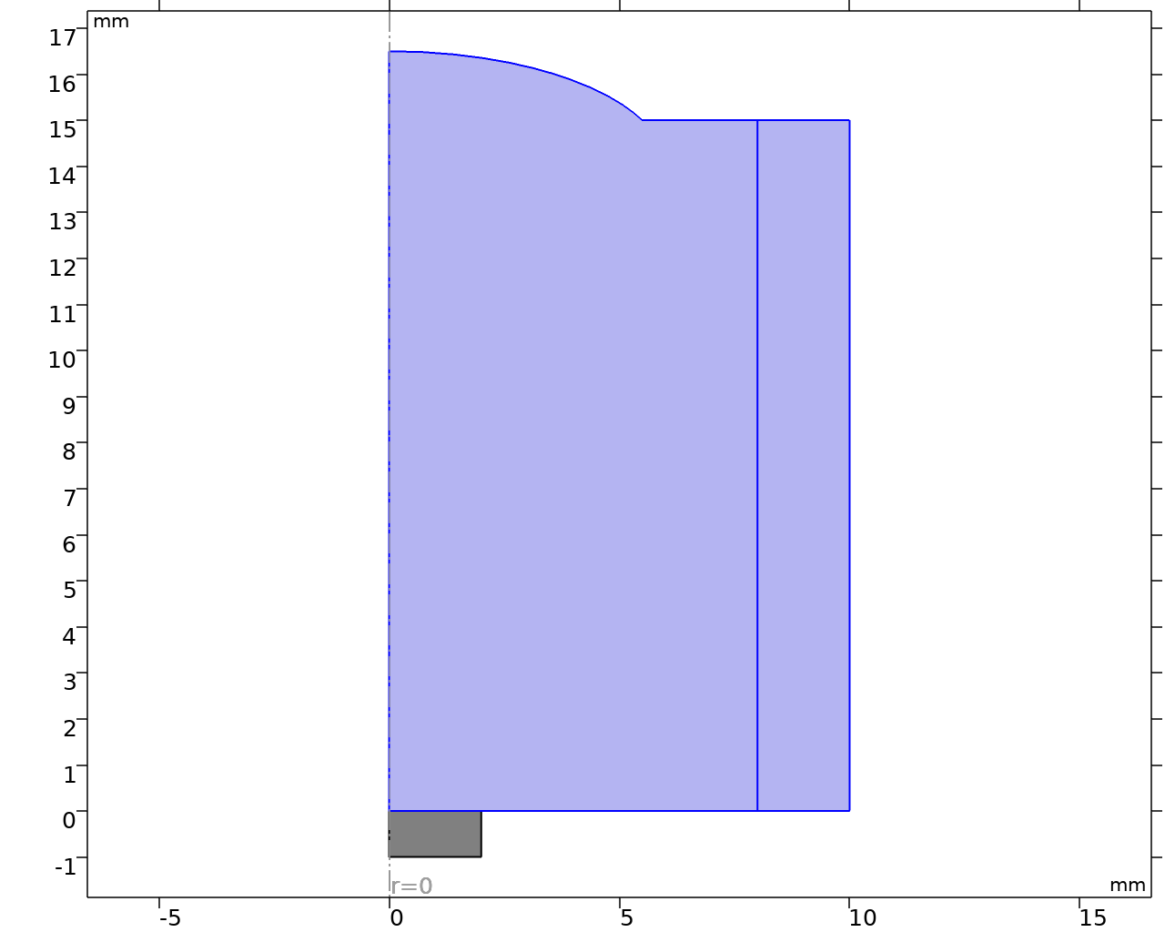
Model Setup
rigid walls
2D axisymmetric configuration
Transducer is a lead zirconate titanate (PZT-5H) disc with dimensions:
  Radius = 2 mm
  Thickness = 1 mm
The piezo device sits in an infinitely large baffle and radiates a sound pulse to the water domain that fills the space in between the sound baffle and rigid walls on the top
The water domain extends to infinity in the radial direction
A perfectly matched layer (PML) is used to truncate the domain
PML
water
PZT-5H
sound baffle

Slide 4
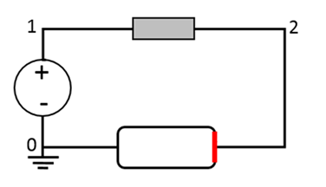
Model Setup Using the Terminal Feature
Piezoelectric Effect and Pair Acoustic-Structure Boundary couple
  Pressure Acoustics, Transient (water domain)
  Solid Mechanics (piezo domain)
  Electrostatics (piezo domain)
Electrical Circuit
  Simple circuit that excites the transducer and receives detected signals
  Gaussian modulated sine wave with a central frequency f = 0.5 MHz
resistor
1000 Ω
voltage
source
PZT
terminal 1
Very simple circuit that can be extended to include more elements for real devices.

Slide 5
Model Setup Using the Terminal Feature
Connecting the transducer to the electrical circuit:
  Add a Terminal node to the Electrostatics interface and set the Terminal type to Circuit
  On the boundary selection, add the boundary where the electrode is connected to the electrical circuit
  Add a Ground node to the Electrostatics interface and apply it to the other electrode of the piezo device
  Add an External I-Terminal node to the Electrical Circuit interface and set the Electrical potential of the external terminal to Terminal voltage (es/term1)

Slide 6
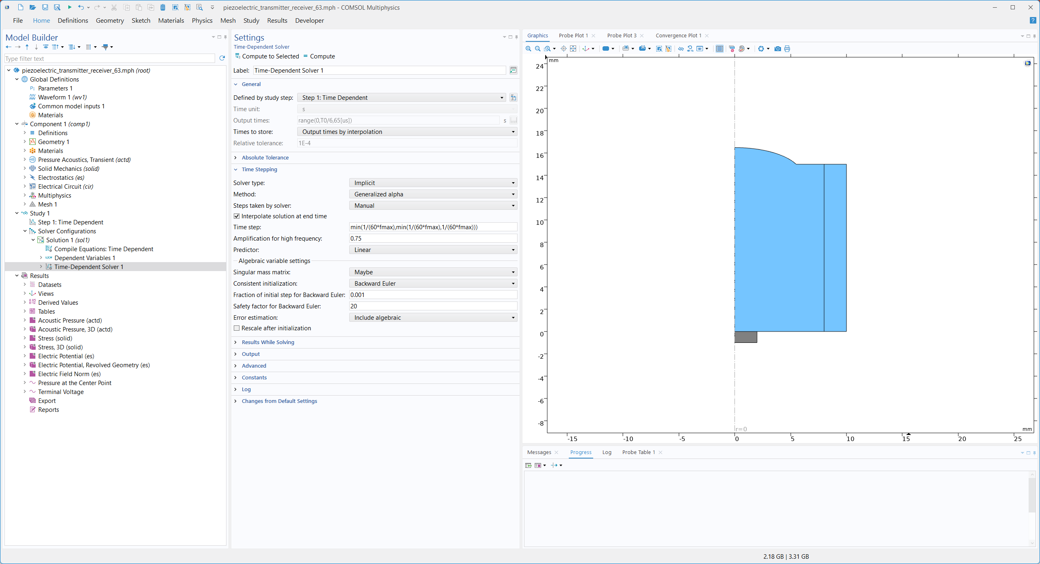
Transient Solver Setup
Change Method to Generalized alpha
Change Steps taken by solver to Manual

Slide 7
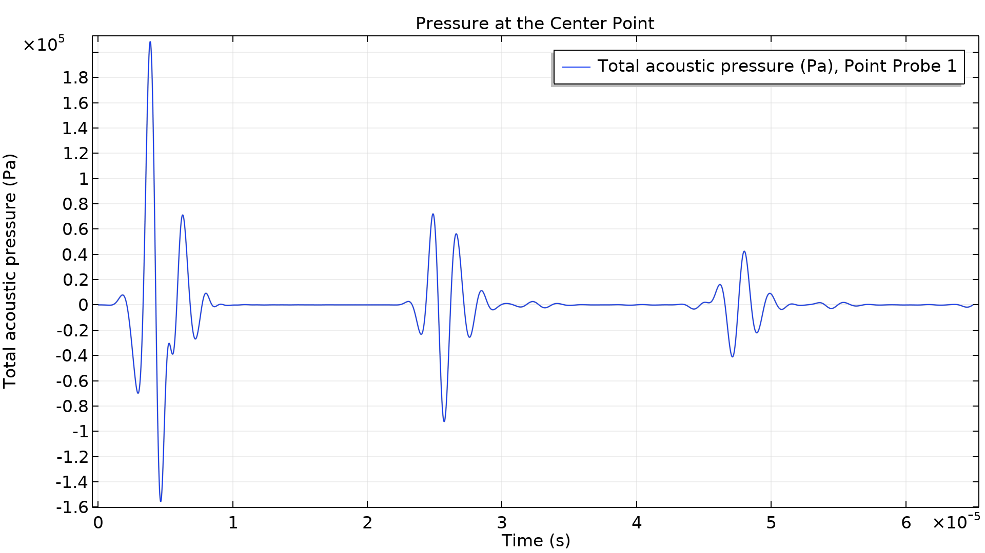
first echo
second echo
RESULTS
Acoustic Pressure
Pulse and two echoes
A plot of the acoustic pressure at the center point of the top surface of the transducer

Slide 8
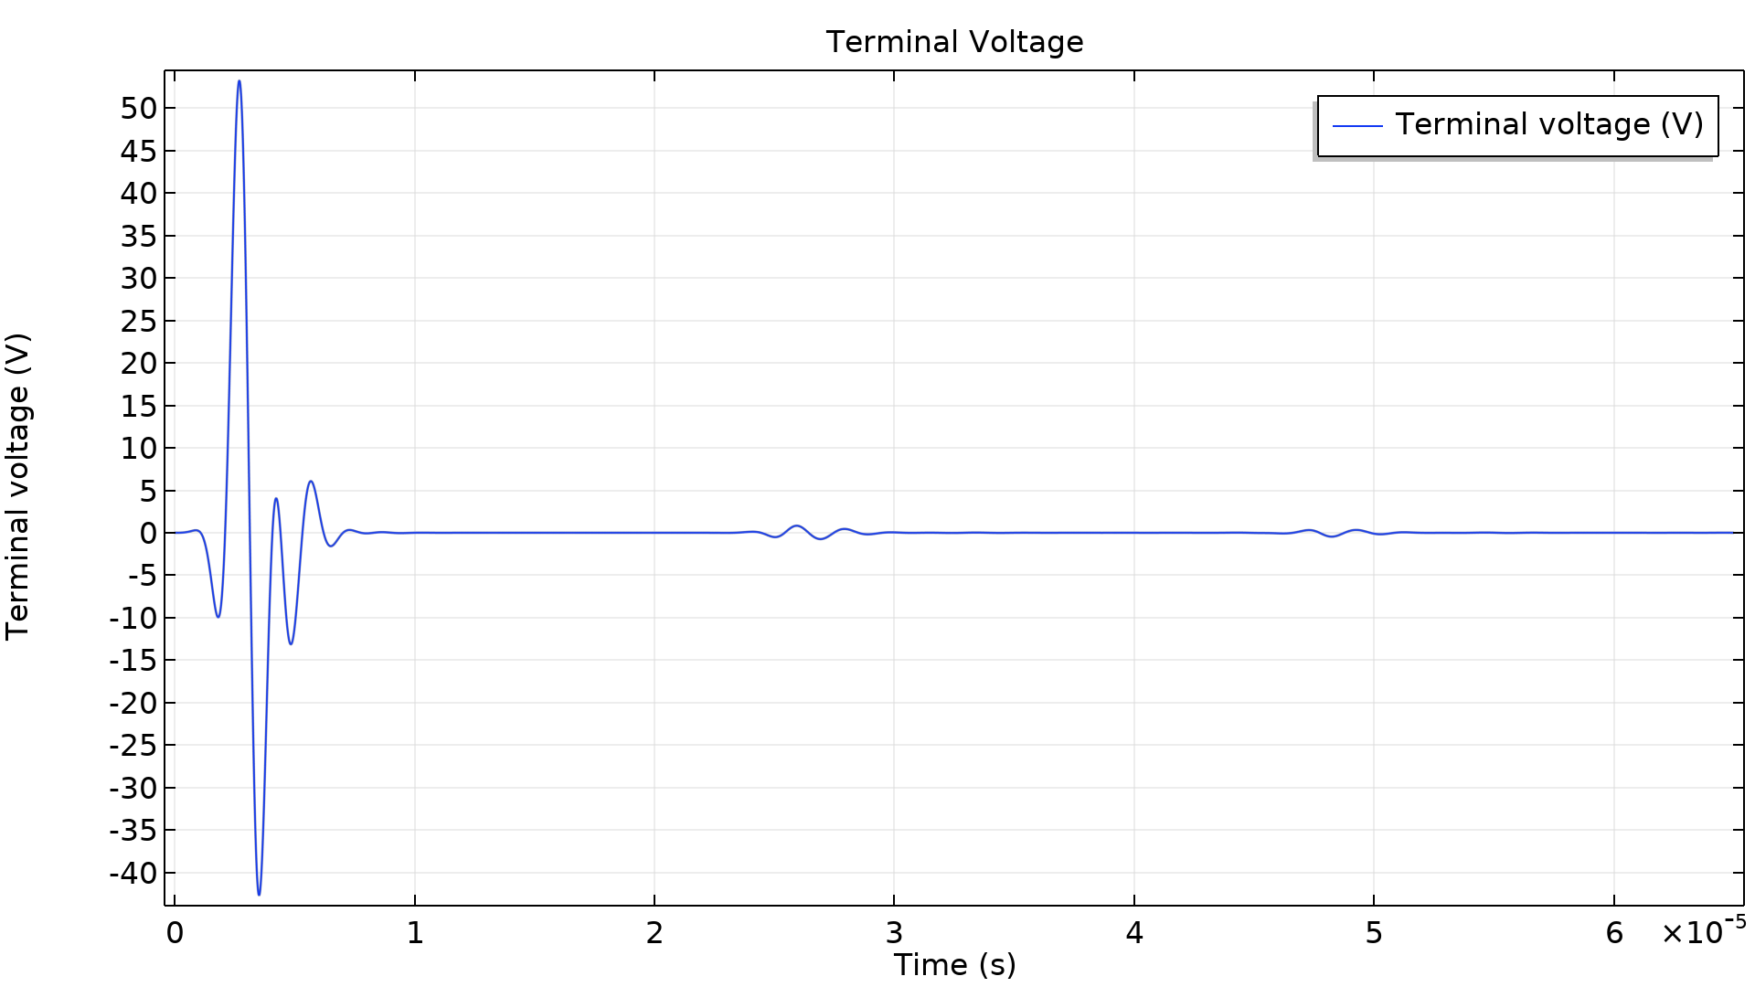
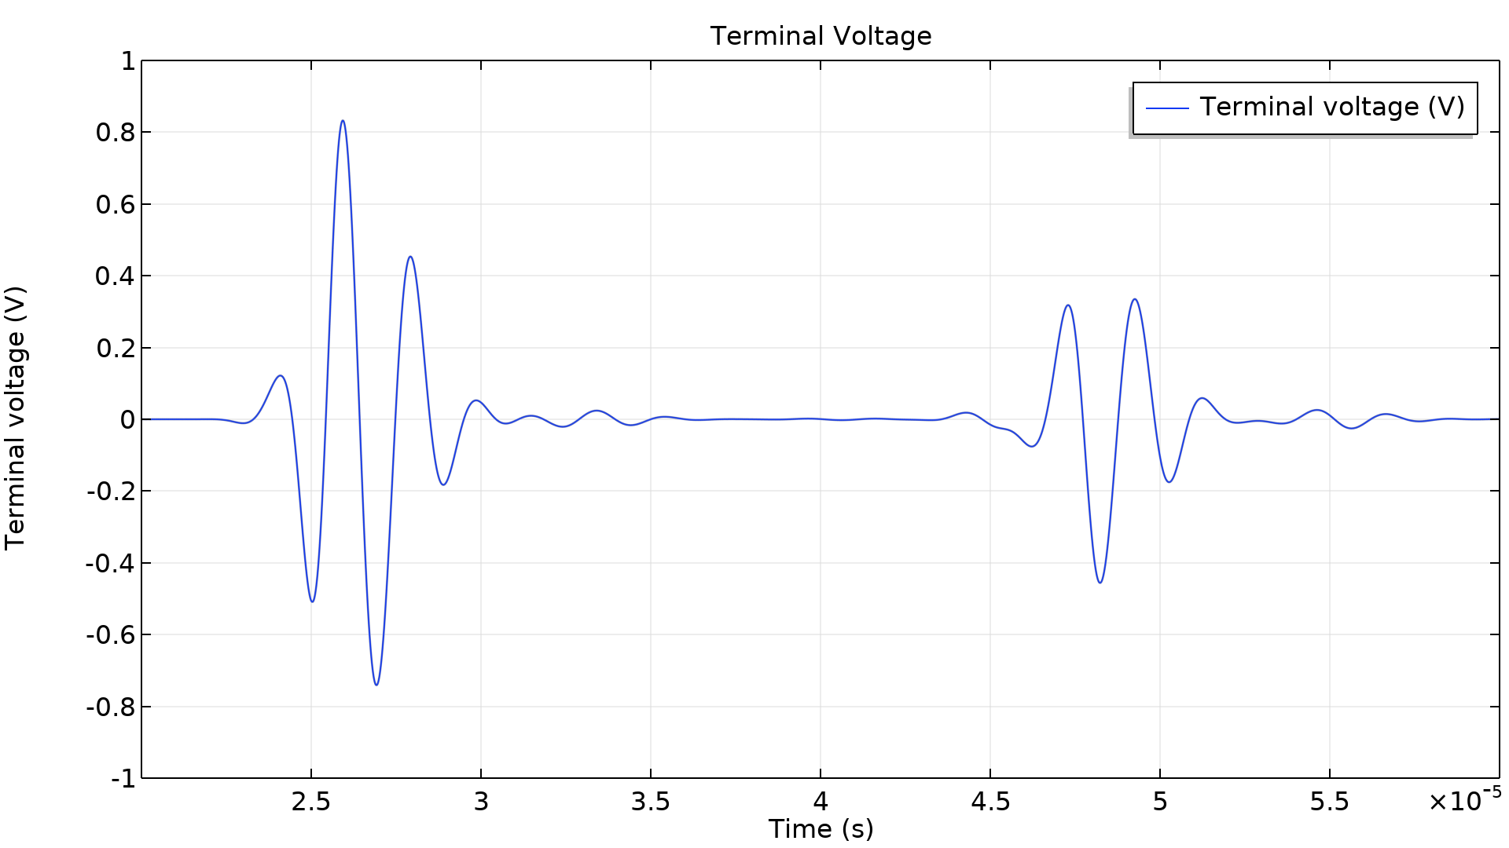
Results: Signals at the Terminal
Transmitted and received signals
Zoomed-in received signals

Slide 9
comsol.com

