Slide 1
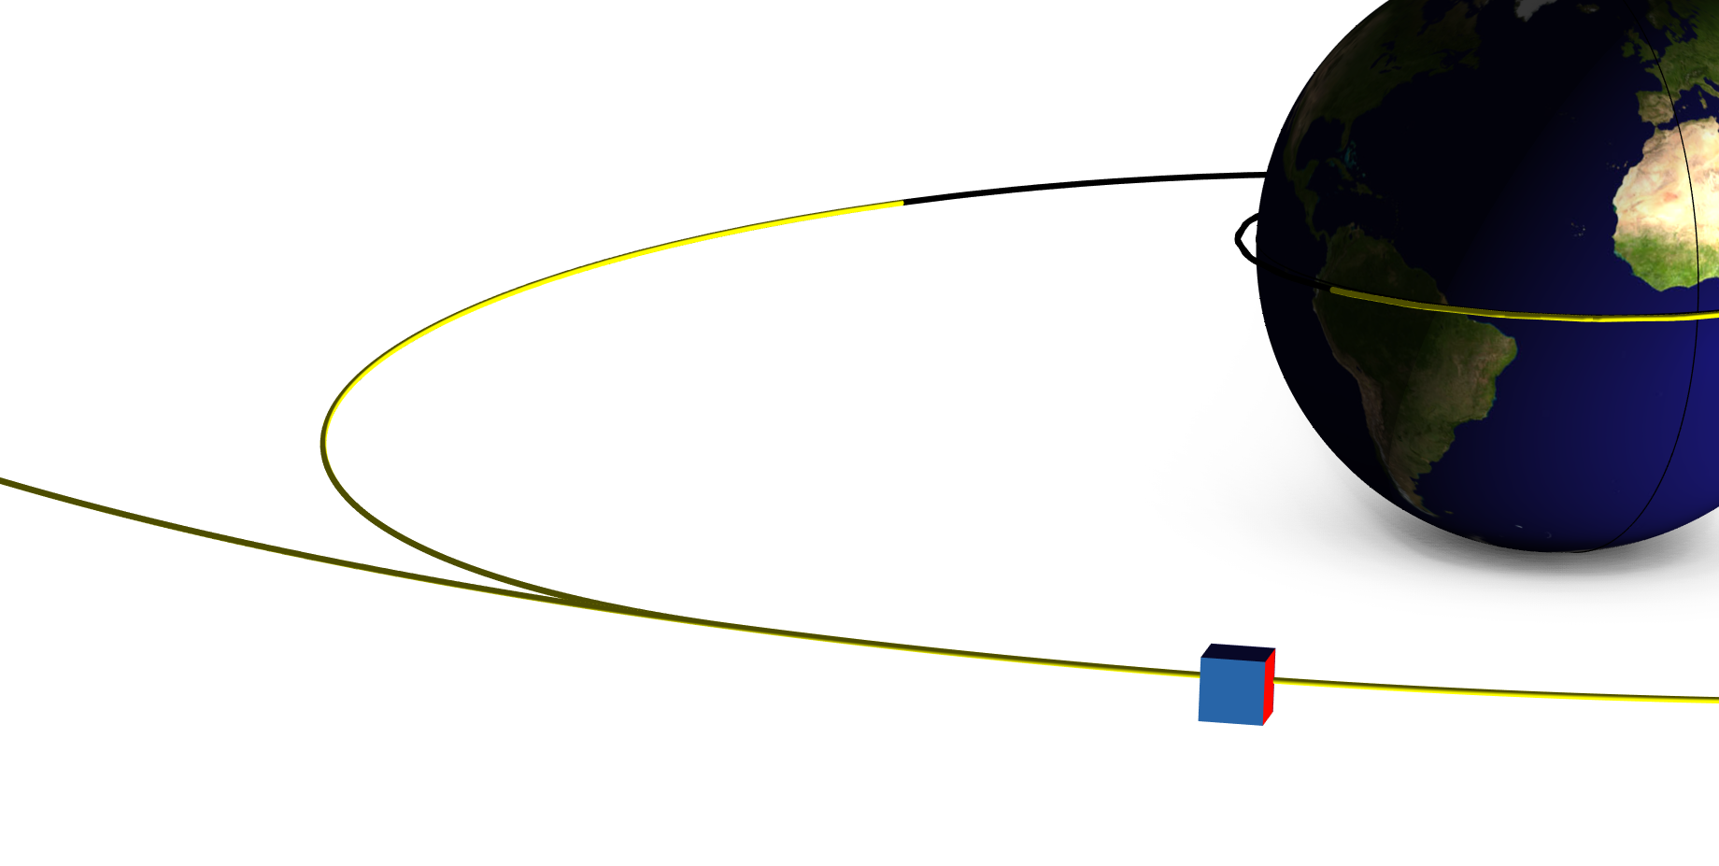
Transfer Orbit

Slide 2
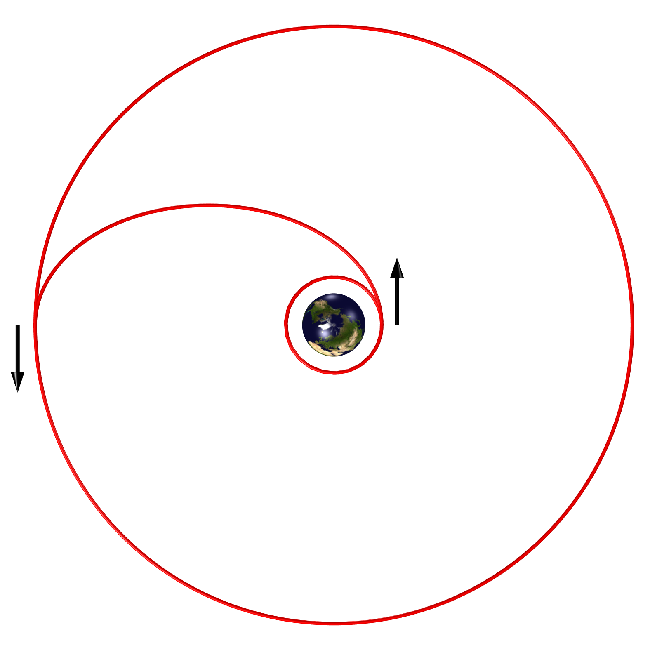
Background
In order to send satellites in medium or high orbit trajectory with the lowest fuel consumption, specific orbital maneuvers are used.
This model describe a Hohmann transfer from low Earth orbit to a geostationary one.
During the entire maneuver, the direct solar, albedo, and Earth radiative thermal loads are analyzed.
Hohmann transfer trajectory in red line - Spacecraft acceleration represented by the black arrows

Slide 3
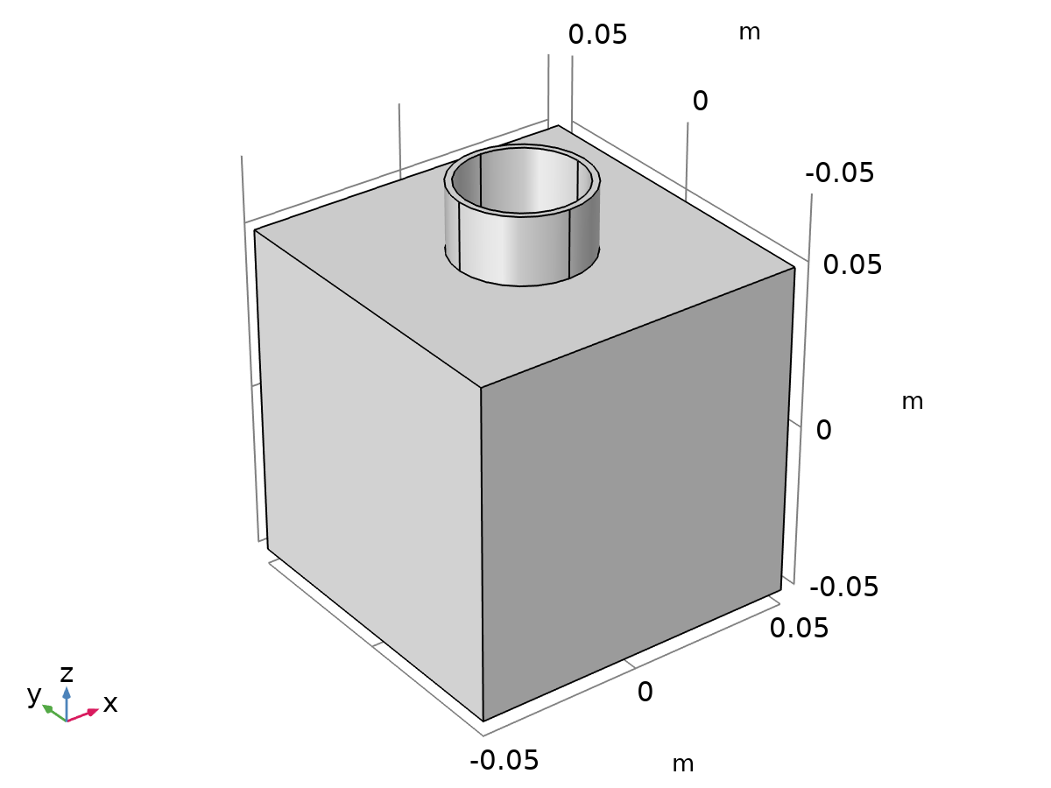
Model Definition
The User defined orbit type option is used to define the spacecraft trajectory.
The satellite characteristic length is 10 cm.
The satellite is oriented towards the Earth.
Satellite geometry

Slide 4
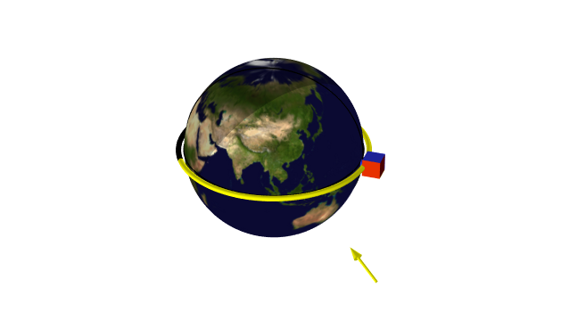
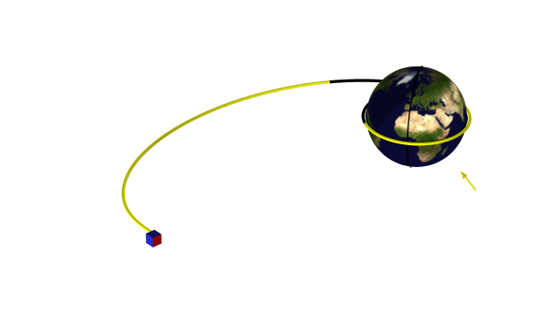
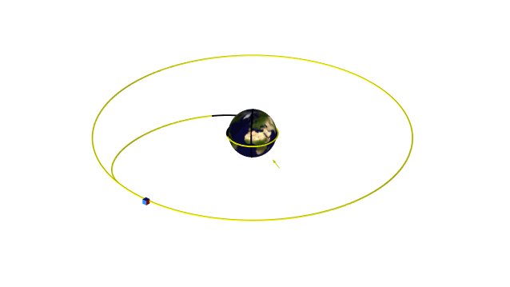
Model Definition
Trajectory steps
Low Earth orbit
Transfer orbit
Geostationary orbit
Circular orbit at 400 km of altitude
Instantaneous acceleration at 11107 s transforms the circular trajectory into an elliptical one
Ellipse eccentricity is 0.723
Instantaneous acceleration at 30156 s transforms the elliptical trajectory into a circular one
Circular orbit at 35786 km of altitude

Slide 5
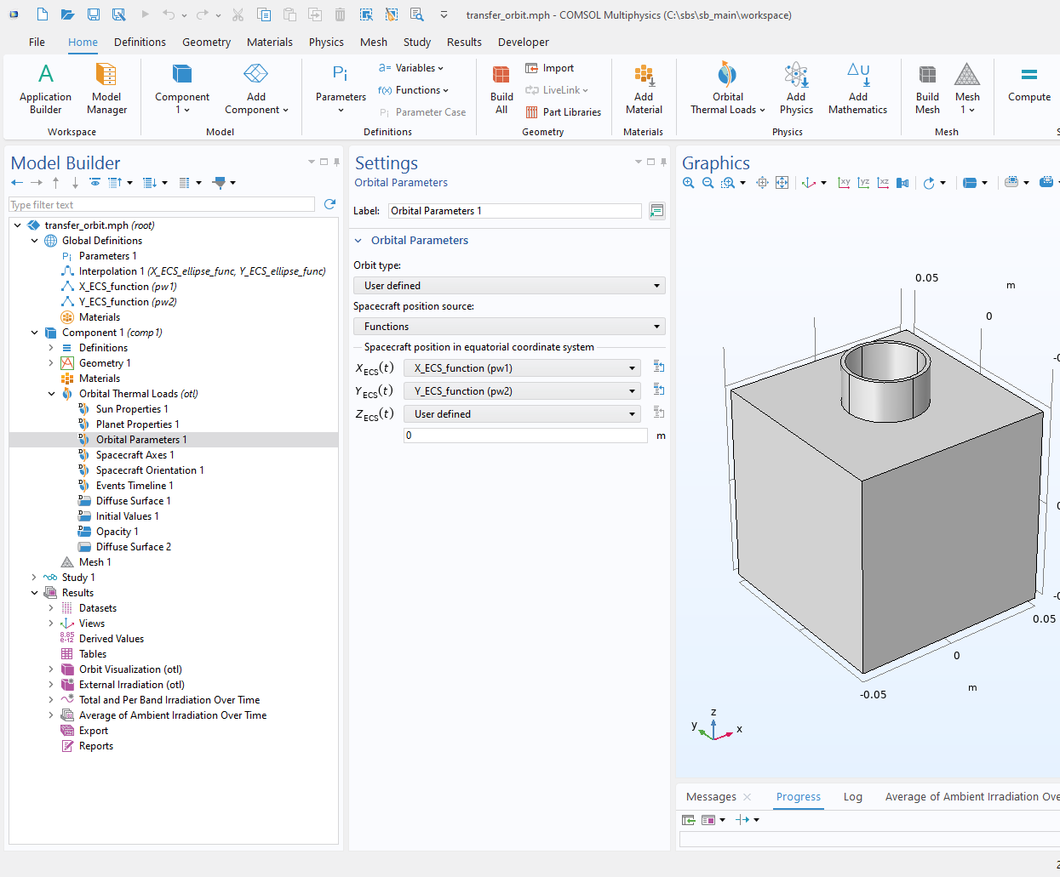
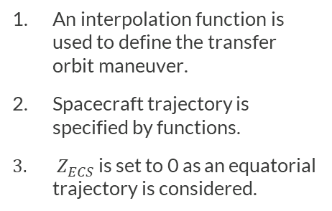
Model Definition
User defined orbit
1
2
3
An interpolation function is used to define the transfer orbit maneuver.
Spacecraft trajectory is specified by functions.
$Z_{ECS}$ is set to 0 as an equatorial trajectory is considered.

Slide 6
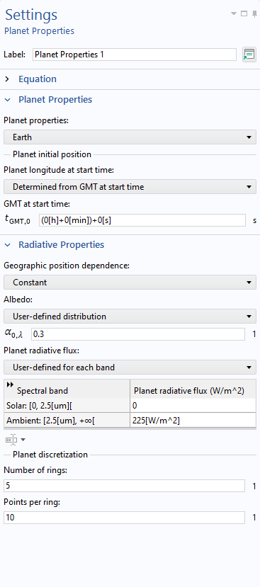
Planet and sun parameters
The sun at the winter solstice is considered.
The Earth albedo is defined by a 0.3 constant distribution.
The planet radiative flux is set to 225 W/m² for the ambient spectral band.

Slide 7
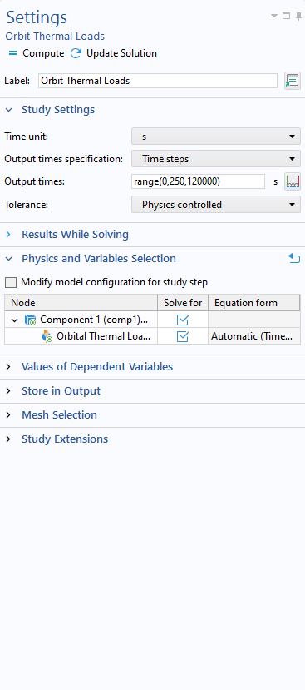
Study parameters
The Orbital Thermal Loads study is used to compute the external irradiation.
Time steps option is selected because the model is based on a User defined orbit type.

Slide 8
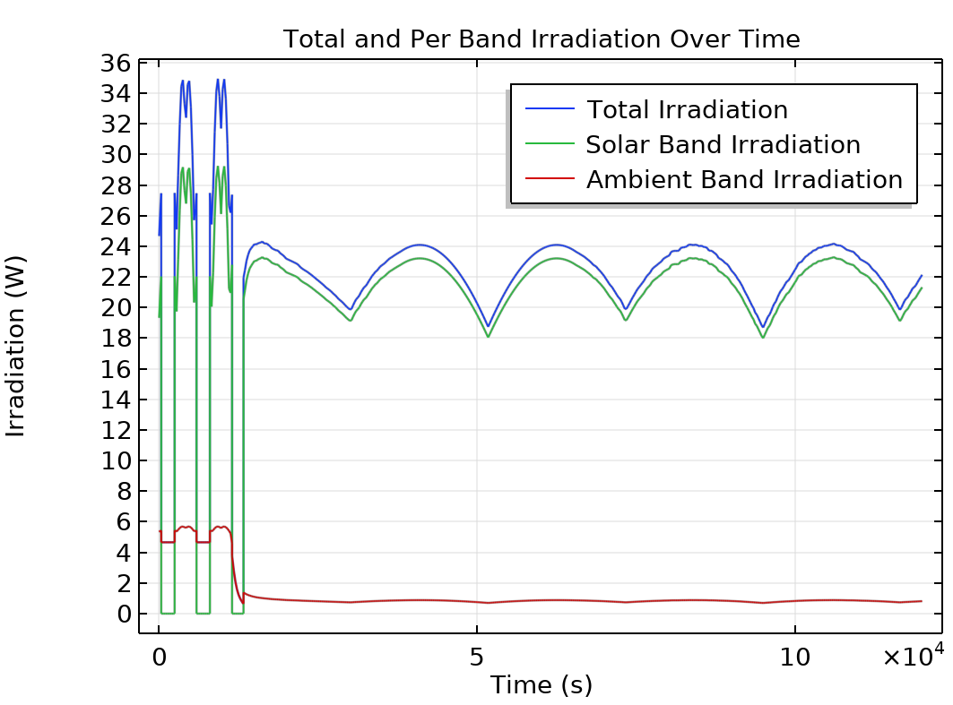
Results
Irradiation per band
During the first and second trajectory steps, discontinuous drops in irradiation can be observed due to eclipse events.
The external irradiation in the ambient spectral band decreases as the satellite moves away from the Earth during the second step.
The external irradiation in the solar spectral band slightly decreases as the satellite moves away from the Earth, due to the lower contribution of albedo.

