Slide 1
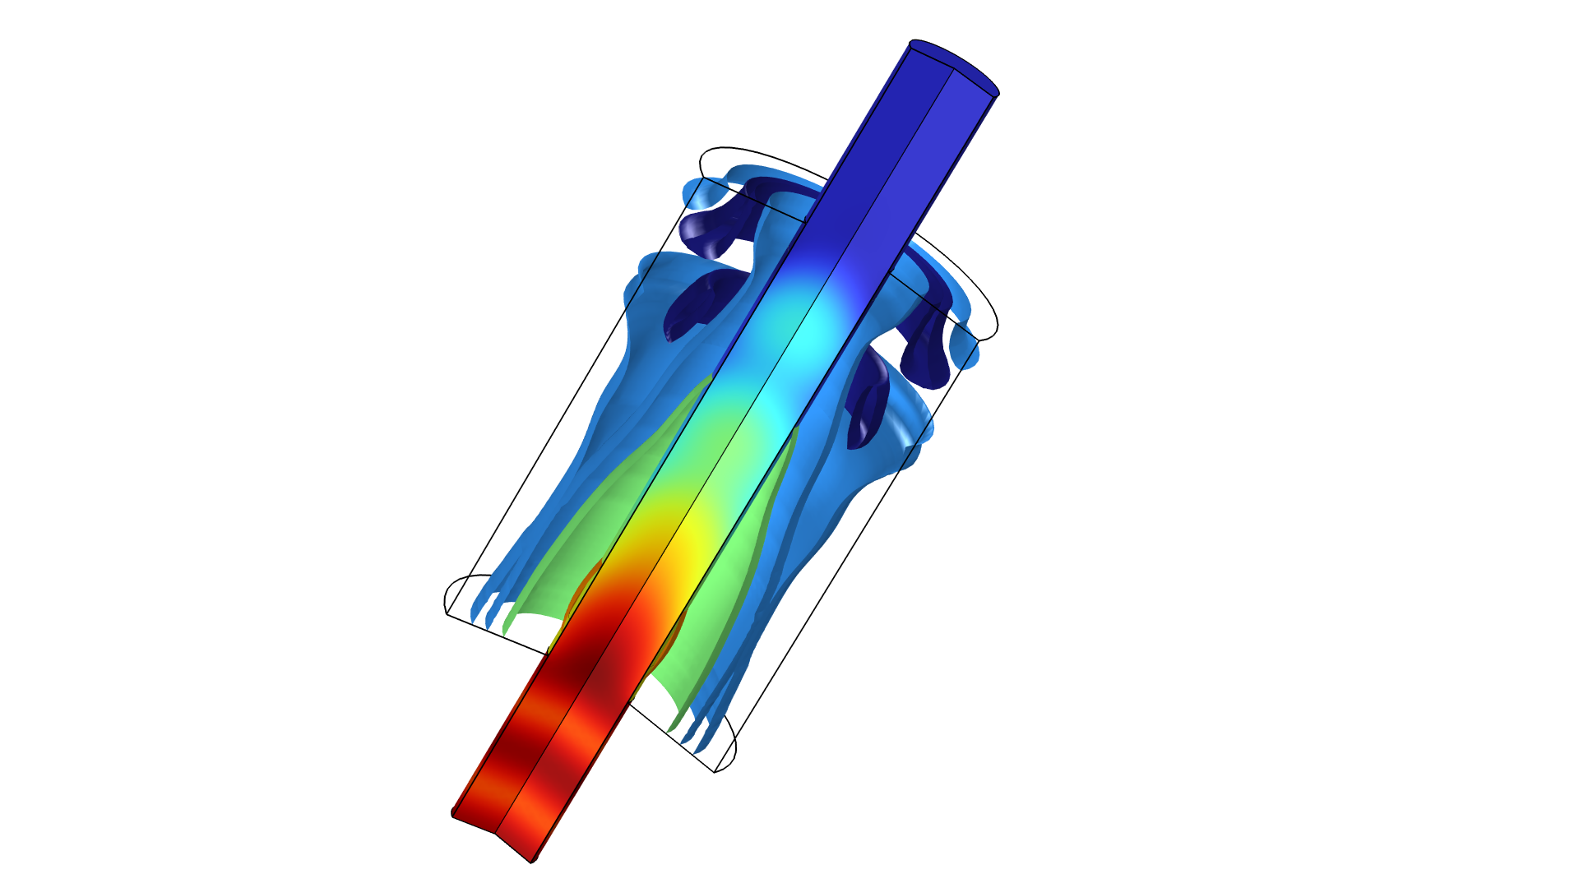
Acoustic Muffler with Thermoviscous Acoustic Impedance Lumping

Slide 2
Background and Motivation
This is a true multiscale and multiphysics model of a simple muffler system
  A detailed thermoviscous acoustic sub-model is used to determine the transfer impedance of the holes in an internal perforated plate (by looking at one hole in detail)
  This model uses the Thermoviscous Acoustics, Frequency Domain interface for modeling acoustics with thermal and viscous losses
  The results are compared to the Perforated Plate option available for the Interior Impedance boundary condition in the Pressure Acoustics, Frequency Domain interface
  The results are also compared to a user-defined impedance model by Kirby and Cummings and experimental data
The geometry of the muffler and the holes in the perforate are the same as the geometry used in the paper by Selamet et al., JSV, 262, p. 509 (2003)
For further details see also the Transfer Impedance of a Perforate model located in the Application Library of the Acoustics Module

Slide 3
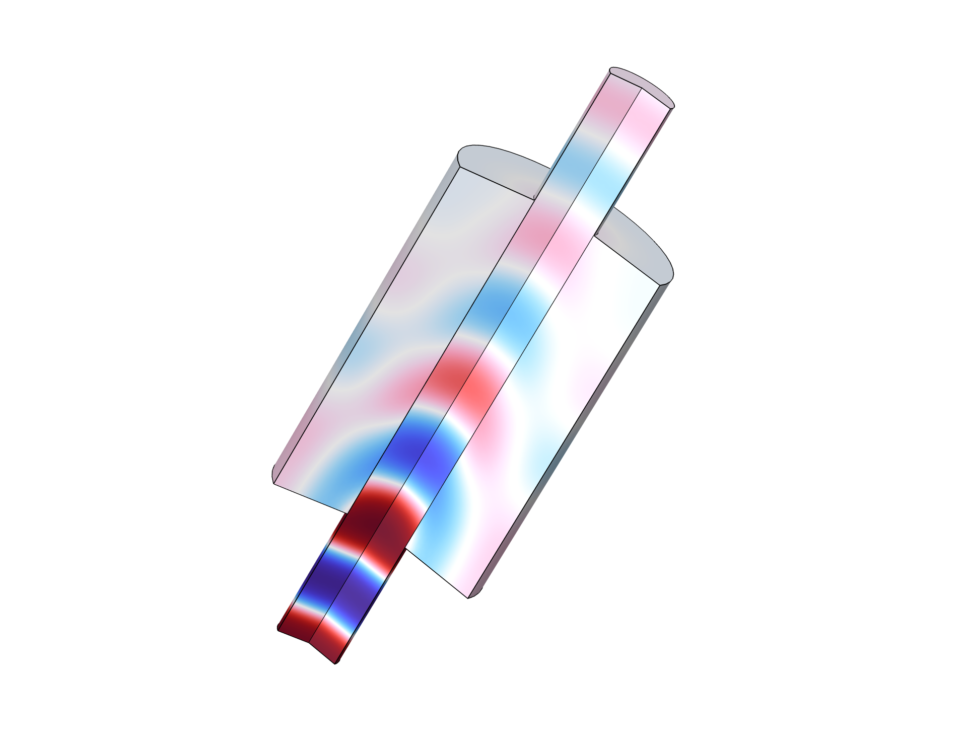

Geometry and Problem Sketch
Outlet
Porous filling
Full Muffler
Internal Perforated Plate
Silencer length:
L_{m} = 257 mm
Hole diameter:
d = 2.49 mm
Plate thickness:
t_{w} = 0.9 mm
Inlet

Slide 4
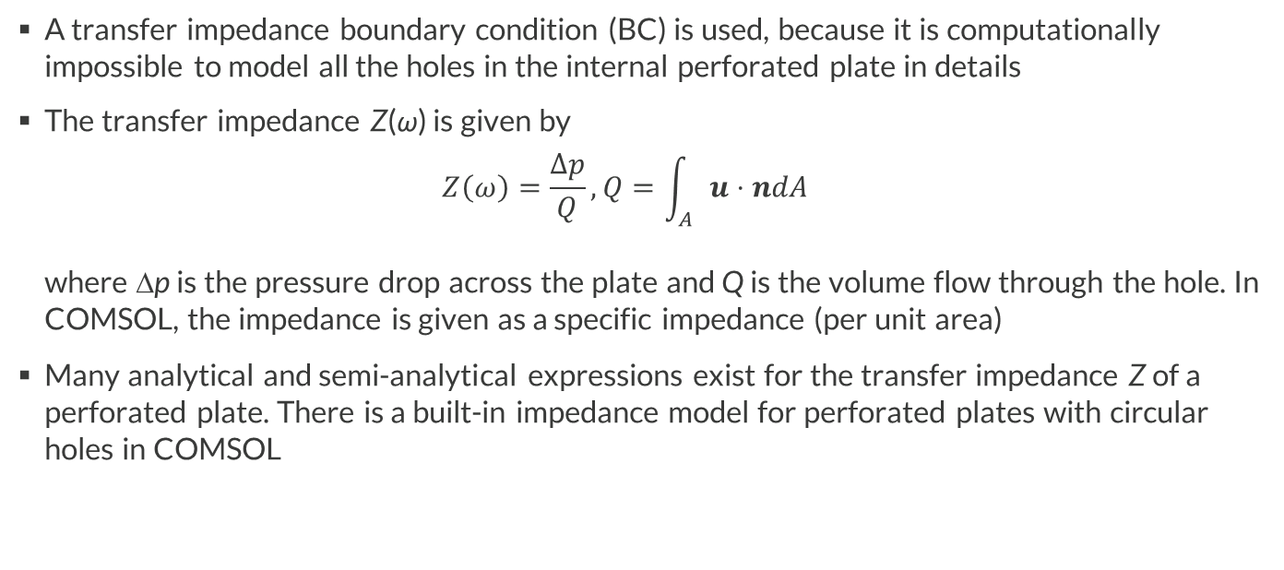
Transfer Impedance Models
A transfer impedance boundary condition (BC) is used, because it is computationally impossible to model all the holes in the internal perforated plate in details
The transfer impedance Z(ω) is given by
$Z\left(ω\right)=\frac{Δp}{Q}, Q=\int_{A}{u⋅ndA}$
where Δp is the pressure drop across the plate and Q is the volume flow through the hole. In COMSOL, the impedance is given as a specific impedance (per unit area)
Many analytical and semi-analytical expressions exist for the transfer impedance Z of a perforated plate. There is a built-in impedance model for perforated plates with circular holes in COMSOL

Slide 5
Transfer Impedance Models
The aim of the present model is to determine the impedance Z(ω) using a detailed thermoviscous acoustic model of a single hole. This will give a precise value of Z including thermal and viscous losses as well as all hole-hole interactions. Moreover, there are no free parameters here. The so-called end correction is included explicitly when solving this detailed thermoviscous model
The effect of having a porous backing on one side of the perforated plates is however not included. This may effect the end-correction as well as the hole-hole interaction on one side. For comparison, the simple semi-analytical Kirby-Cummings impedance model, that takes a porous backing into account, is implemented
The results are also compared to the built-in Perforated Plate option available for the Interior Impedance boundary condition

Slide 6

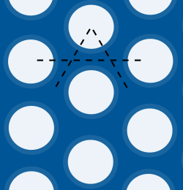


Model of the Hole in the Perforated Plate
use
symmetry
$$Δp$$
Side View
Front View
$$Q$$
Front view

Slide 7
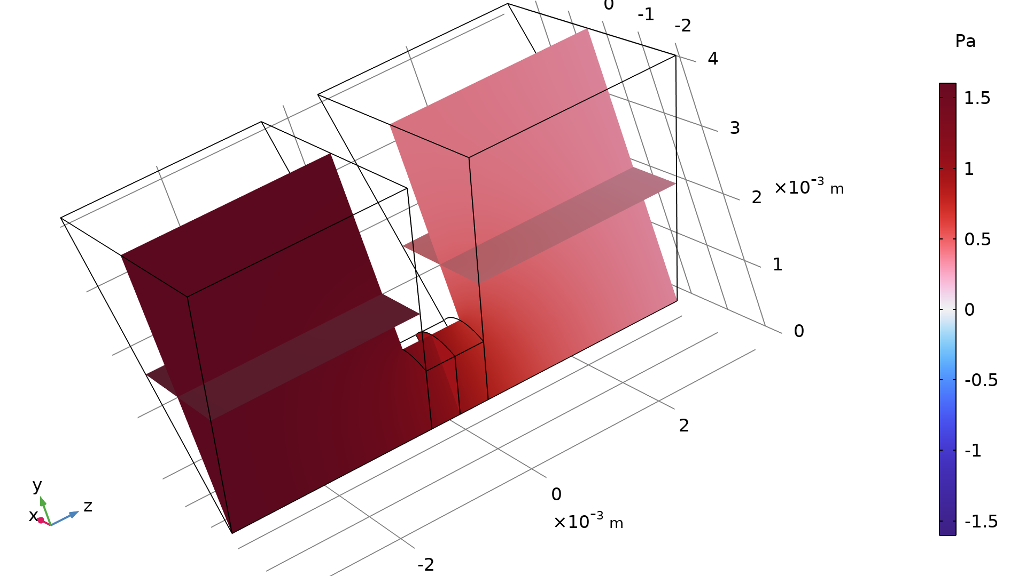
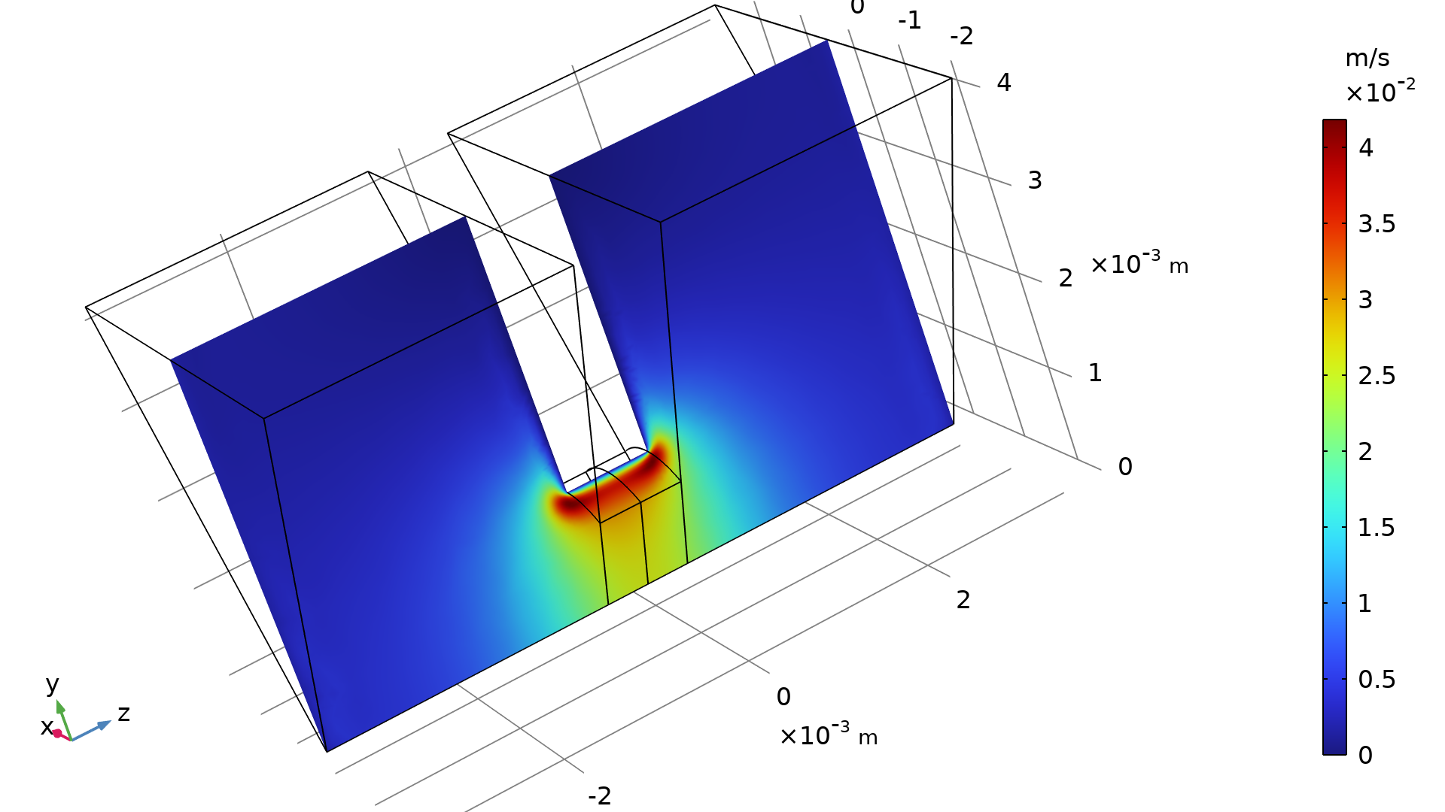
Results: Thermoviscous Acoustic Sub-Model
Acoustic boundary
layer due to no-slip
“End correction region”
automatically computed
Acoustic pressure distribution (Pa) at 3500 Hz
Instantaneous acoustic particle velocity (m/s) at 600 Hz

Slide 8
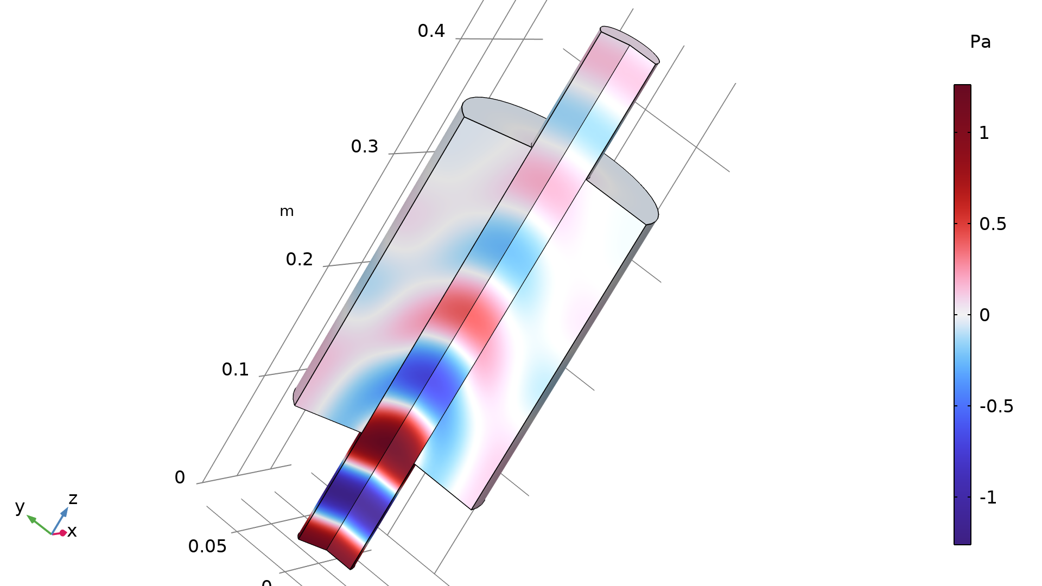
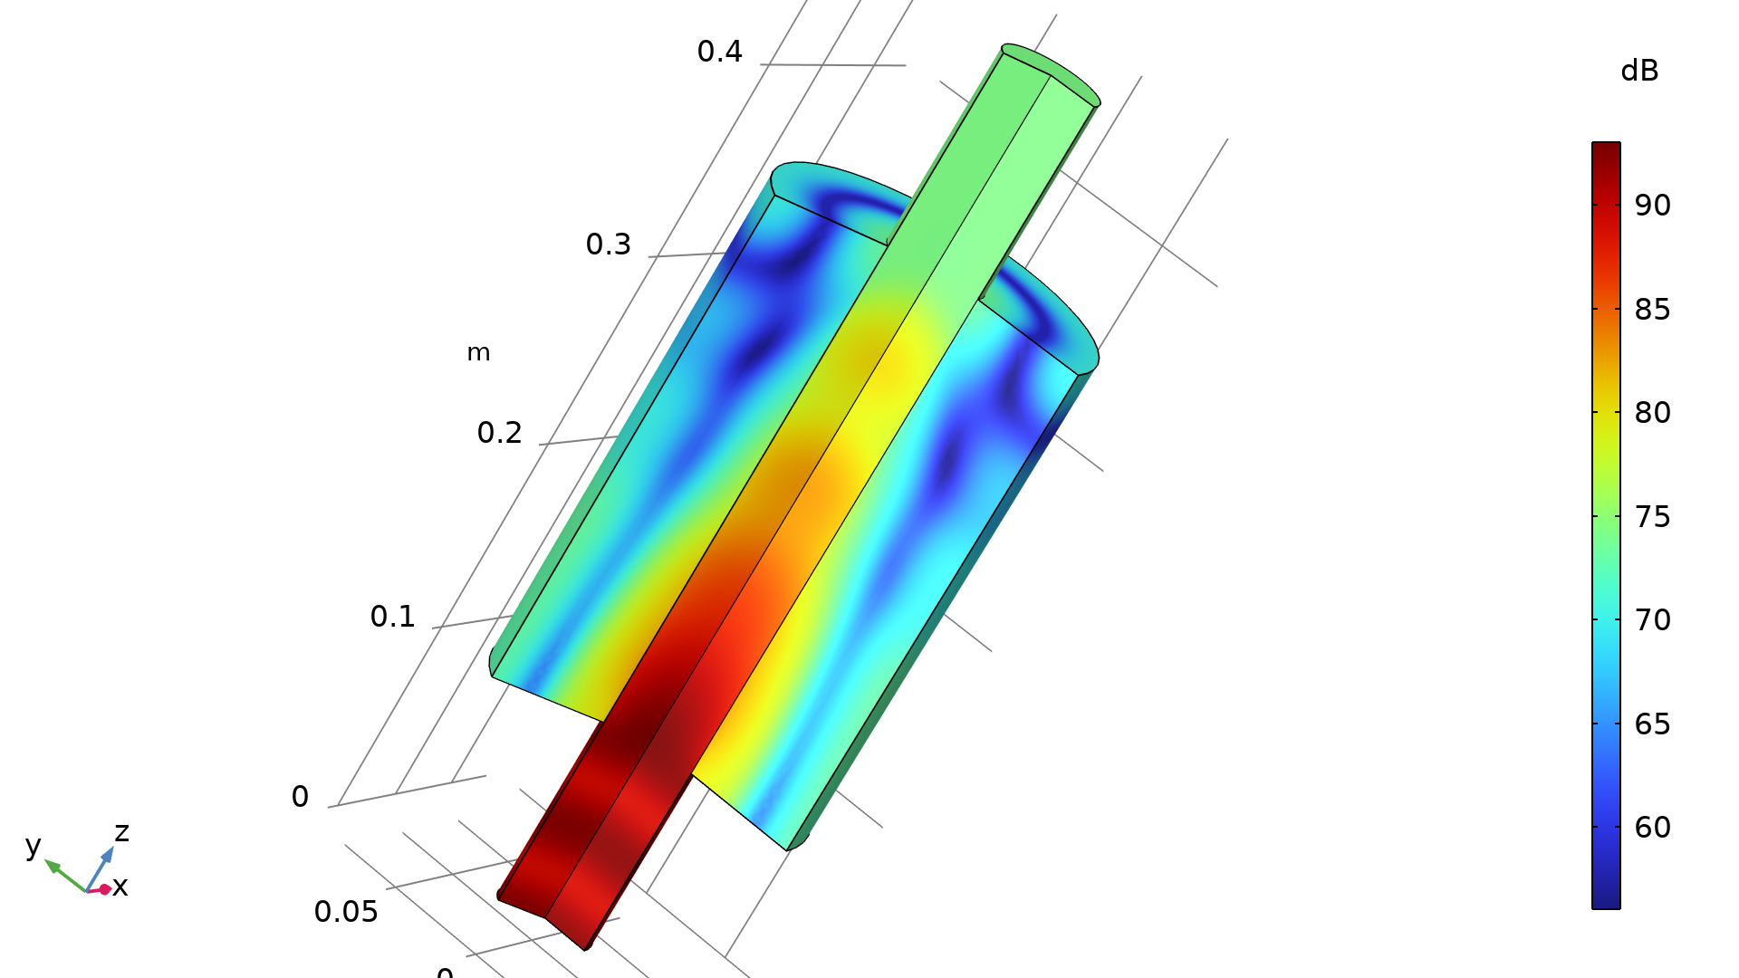
Results: Muffler Model
Acoustic pressure distribution (Pa) at 3500 Hz
Sound pressure level (dB) at 3500 Hz

Slide 9
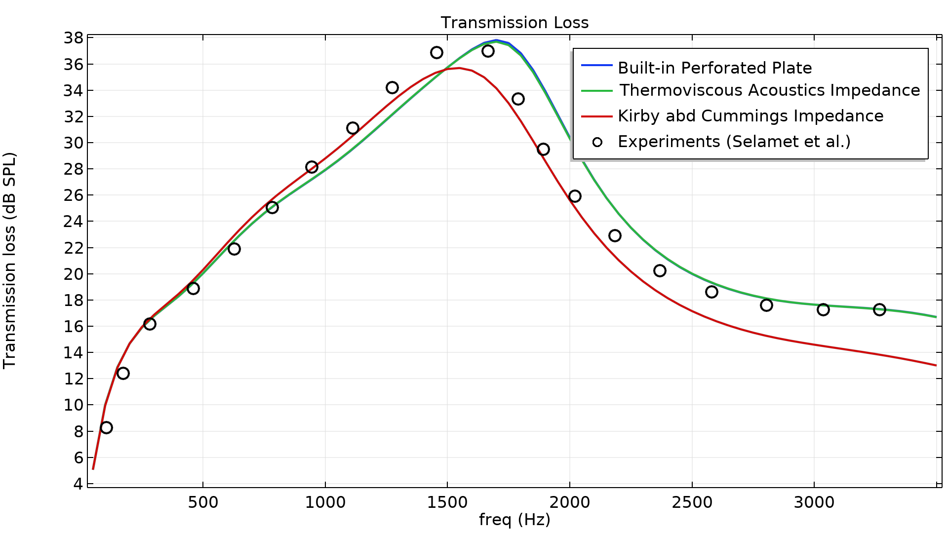
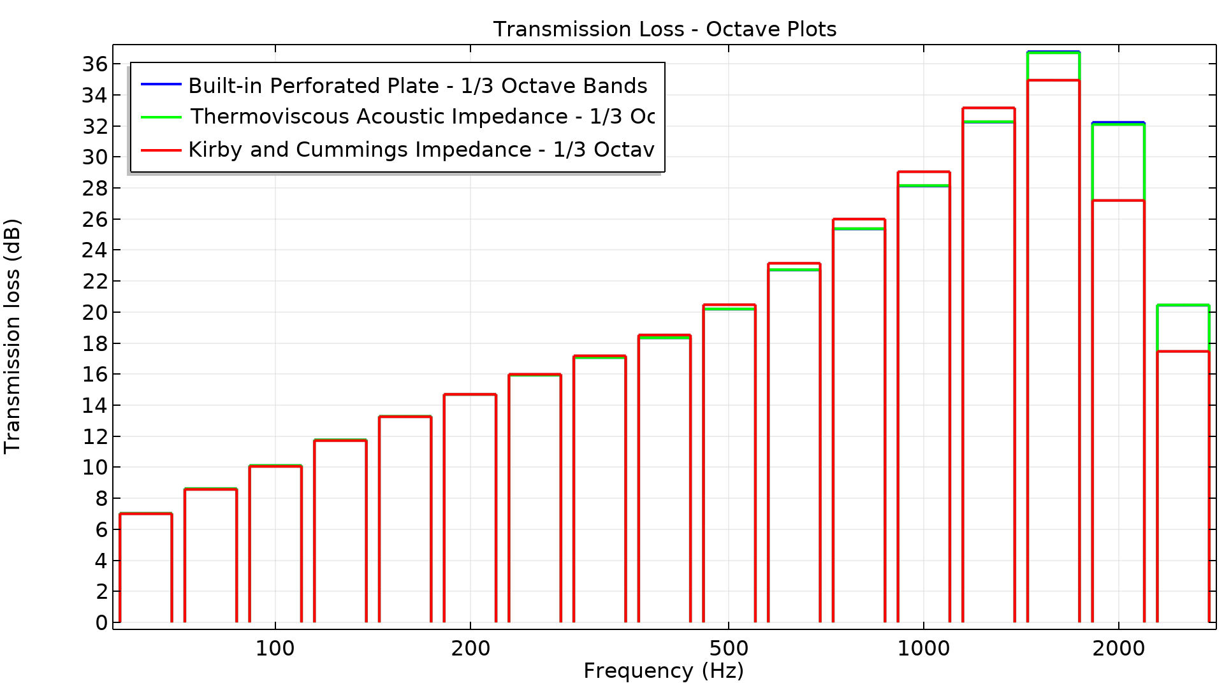
Results: Transmission Loss (Continuous and Octave Plots)

Slide 10
comsol.com

