Slide 1
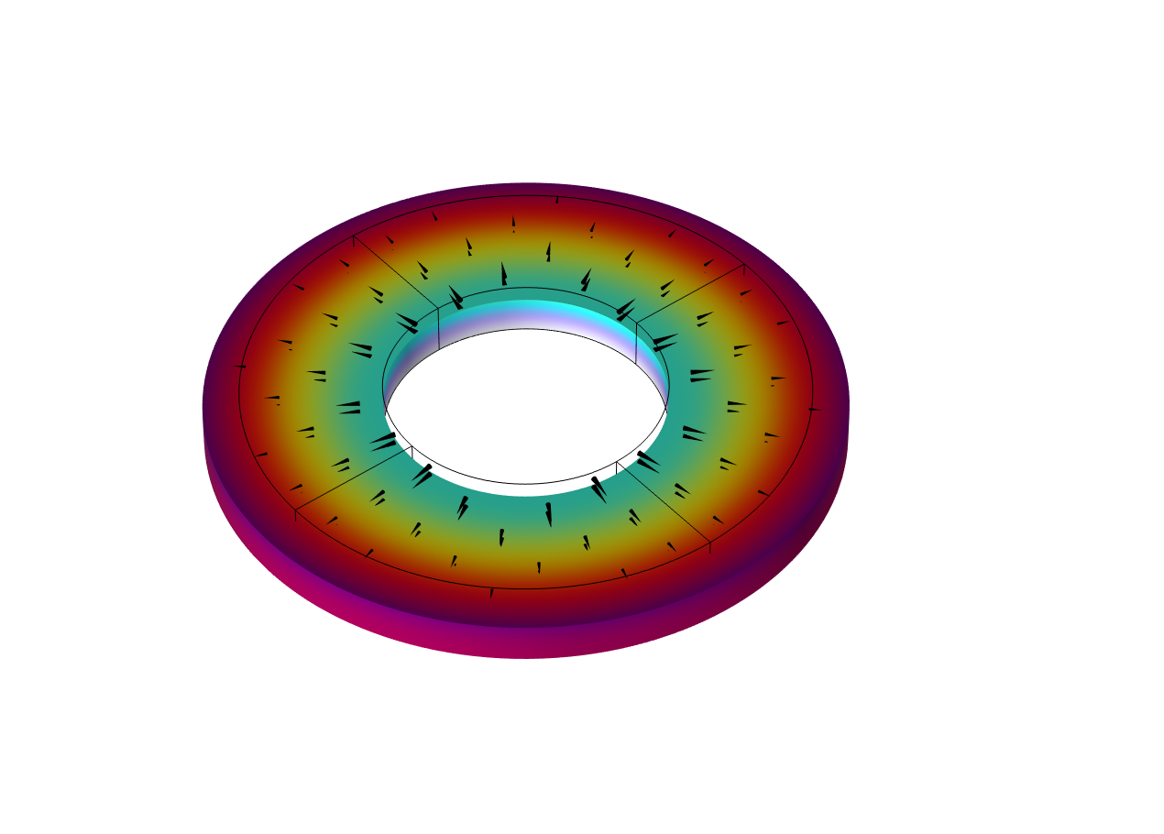
Radially Polarized
Piezoelectric Transducer

Slide 2
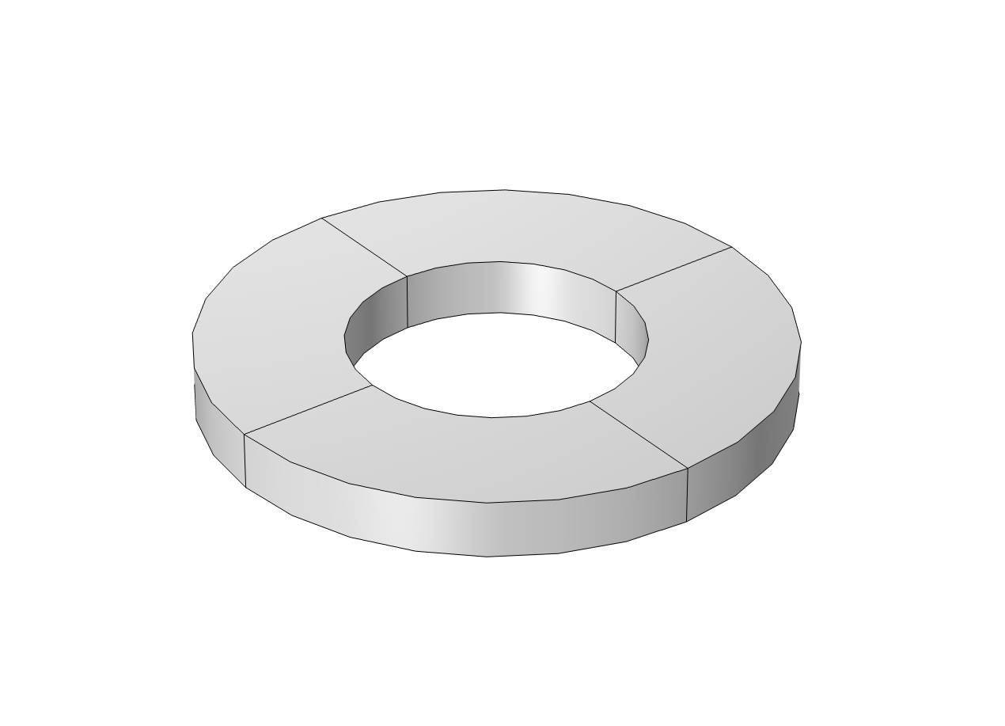
Introduction
Set up a coordinate system for a radially polarized piezoelectric transducer
Visualize stress and strain in the local cylindrical coordinate system
V
Polarization direction

Slide 3
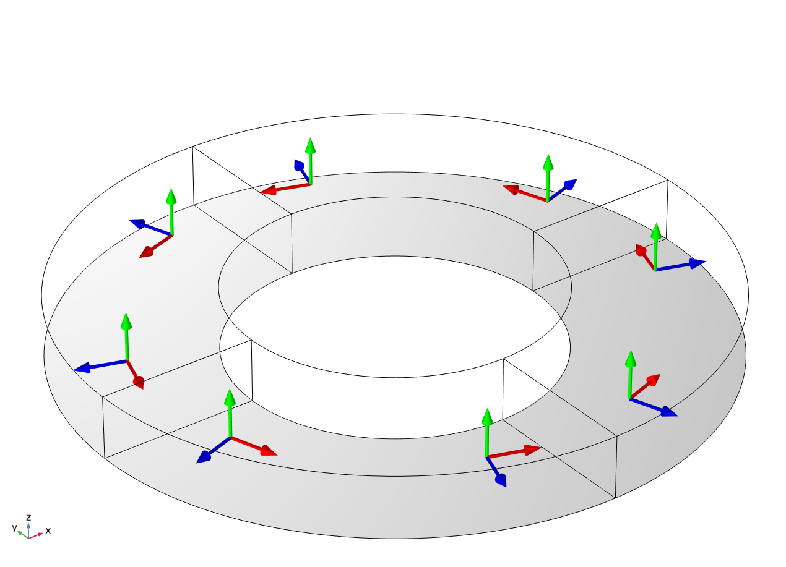
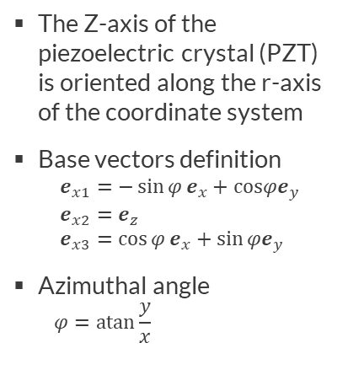
Cylindrical Coordinate System
The Z-axis of the piezoelectric crystal (PZT) is oriented along the r-axis of the coordinate system
Base vectors definition
  $$e_{x1}=−\sin{φ}e_{x}+cosφe_{y} \\ e_{x2}=e_{z} \\ e_{x3}=\cos{φ}e_{x}+\sin{φe_{y}}$$
Azimuthal angle
  $$φ=\operatorname{atan}{\frac{y}{x}}$$
Created Cylindrical System: Desired Polarization
Built-in Cylindrical System: Undesired Polarization
x1 (phi): azimuthal
x2 (z): axial
x3 (r): radial
x1 (r): radial
x2 (phi): azimuthal
x3 (z): axial

Slide 4

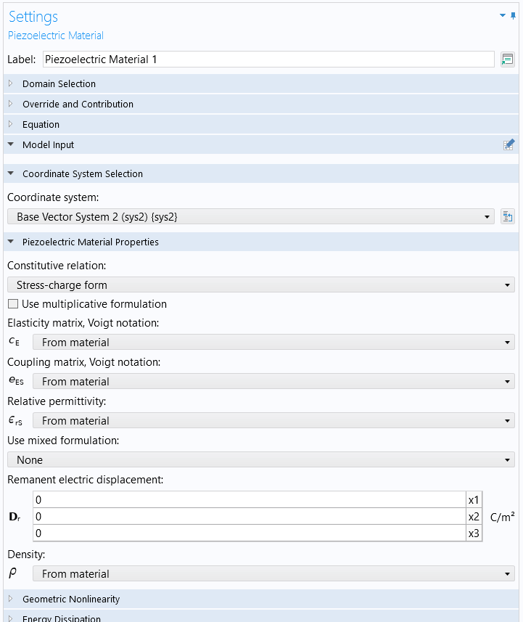
Cylindrical Coordinate System
Definition
Use as a local coordinate system
Define as Base Vector System
Select for desired polarization

Slide 5
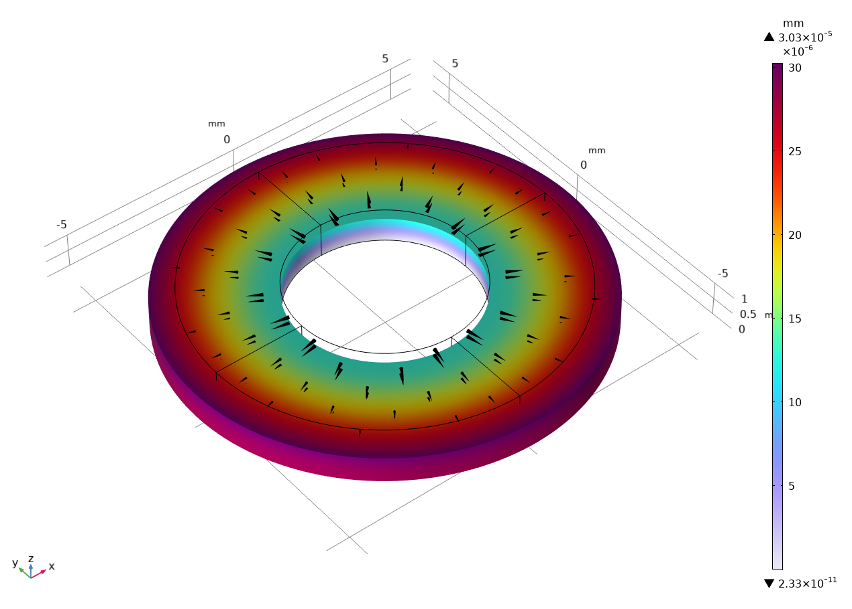
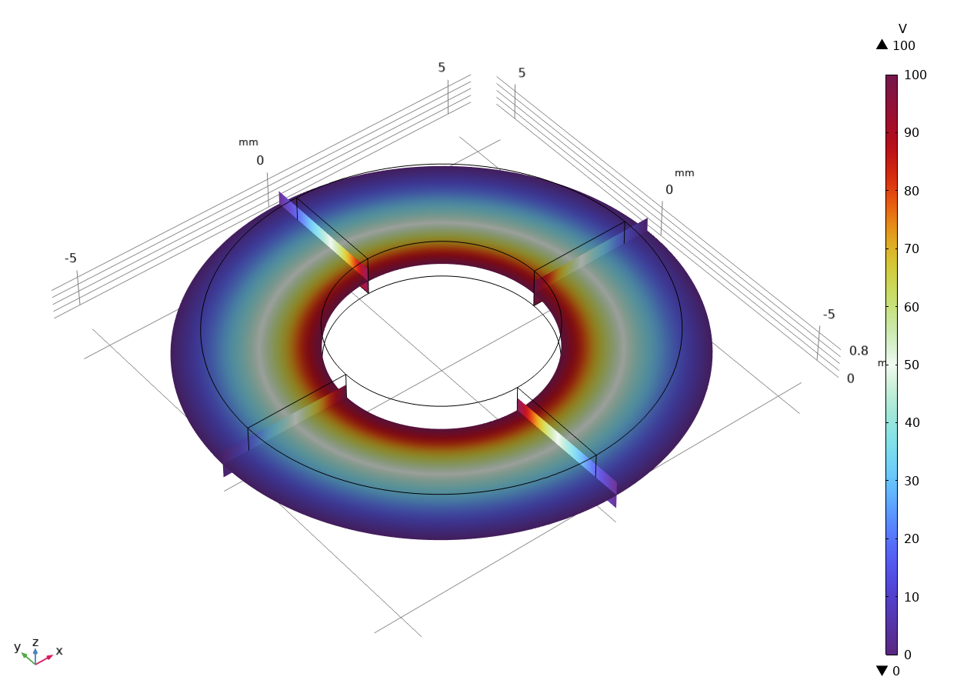
Displacement and Electric Potential
Displacement
Electric Potential
Arrows indicate the electric field direction
Applied voltage results in a radial deformation

Slide 6
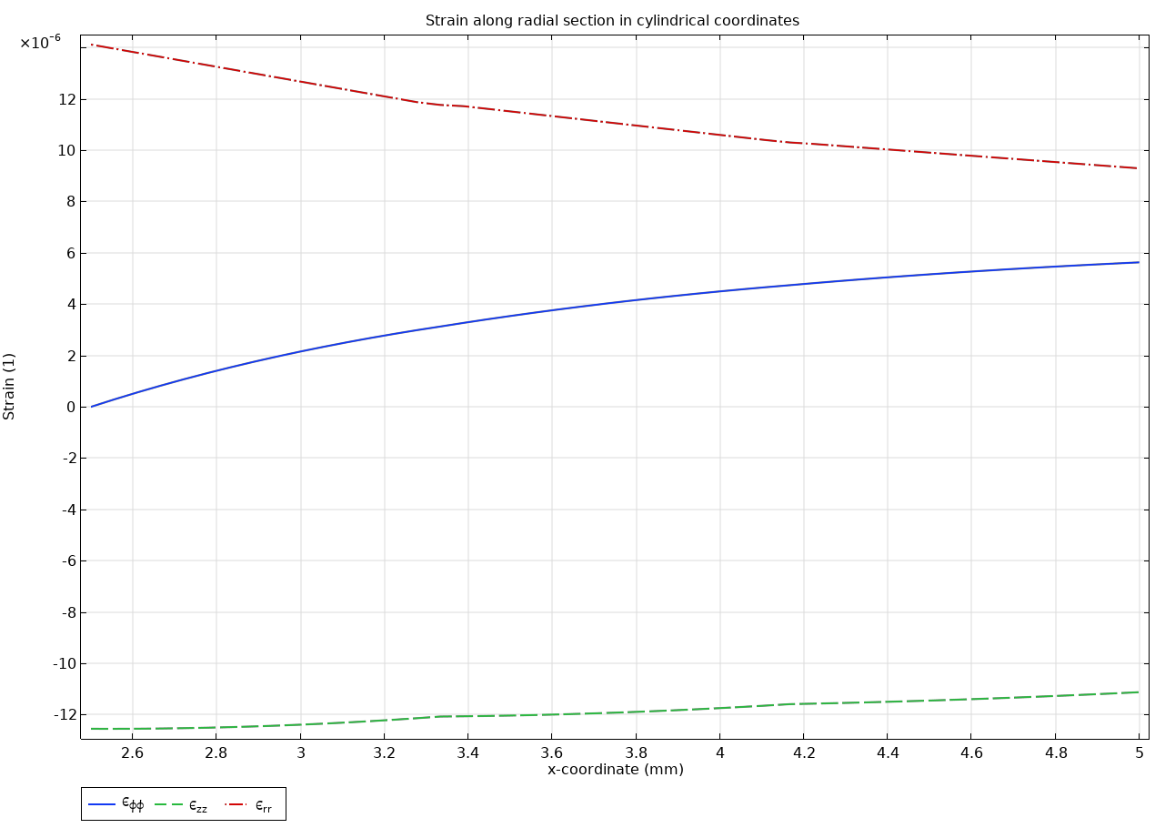
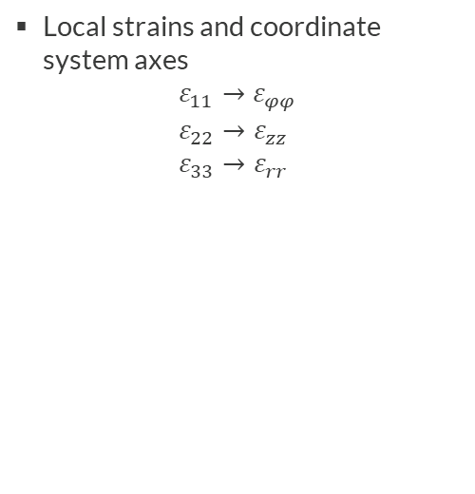
Strain in Local Coordinates
Local strains and coordinate system axes
$$ε_{11}→ε_{φφ} \\ ε_{22}→ε_{zz} \\ ε_{33}→ε_{rr}$$
Normal strains in the phi-, z-, and r-directions

Slide 7
comsol.com

