Slide 1
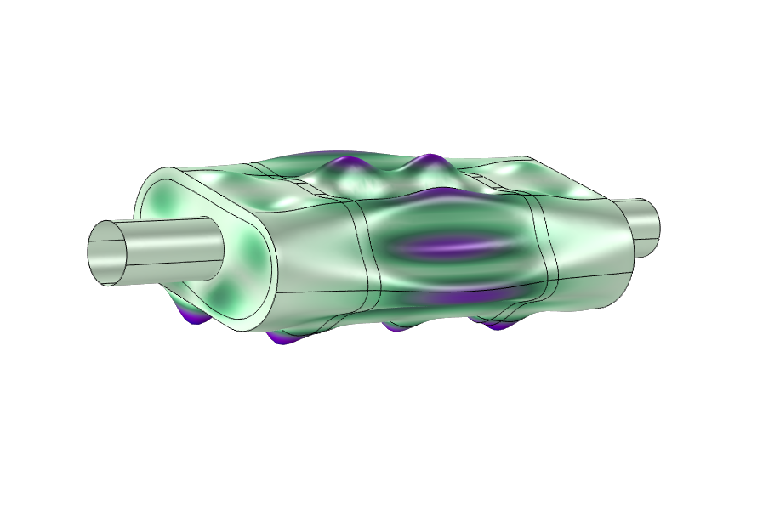
Absorptive Muffler with Shells

Slide 2
Background and Motivation
This model describes the pressure wave propagation in a muffler for an internal combustion engine. The purpose of the model is to show how to analyze both inductive and resistive damping in pressure acoustics as well as coupling the fluid to the surrounding elastic shell structure of the muffler. Finally, the eigenmodes of a pure structural problem is analyzed and the modes compared to peaks in the transmission loss.
The model is an extension of the Absorptive Muffler model located in the Application Library, with acoustic-structure interactions (ASI) included.
In real muffler systems, the main effect of acoustic-structure interaction is probably due to elastic vibrations sources that stem from vibrations in the full exhaust system. In this model, the vibrations are induced by the pressure waves in the air (inside the muffler).
Adding structural sources can also be done by specifying a deformation or a velocity on edges or points in the structure.

Slide 3
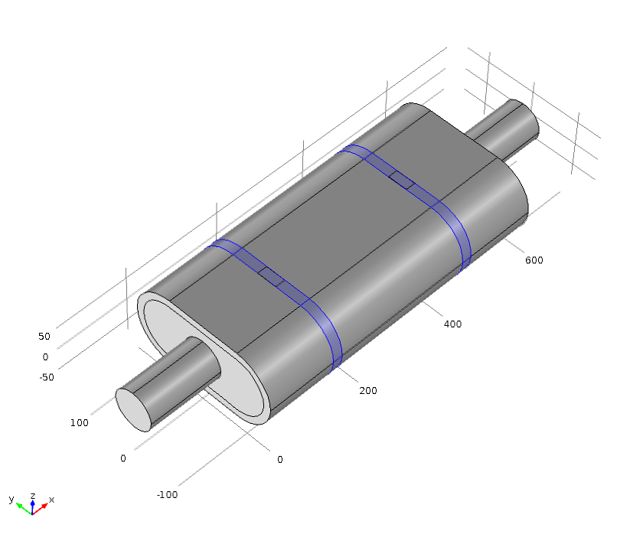
Geometry and Operating Conditions
Outlet:
Port condition
Muffler made of
1 mm steel plates
Fixed constraint
Fixing straps made
of 3 mm steel
Inlet:
Port condition
Fixed constraint (edge)

Slide 4
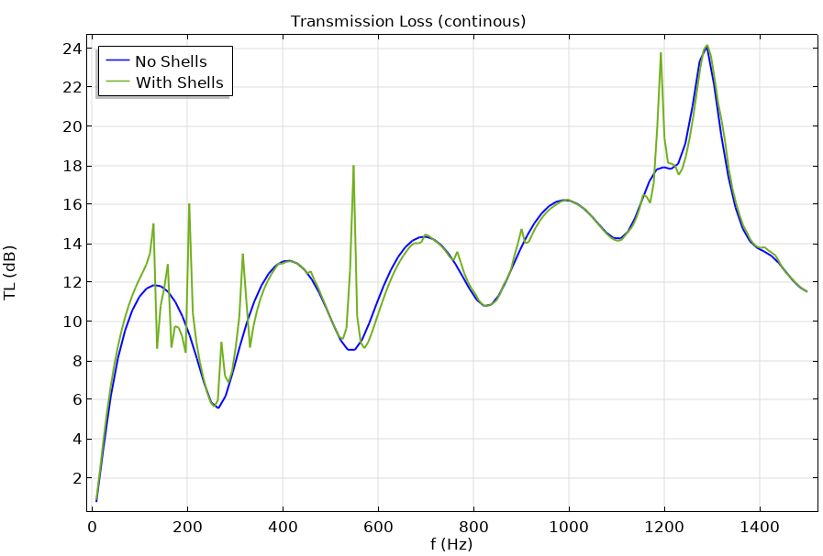
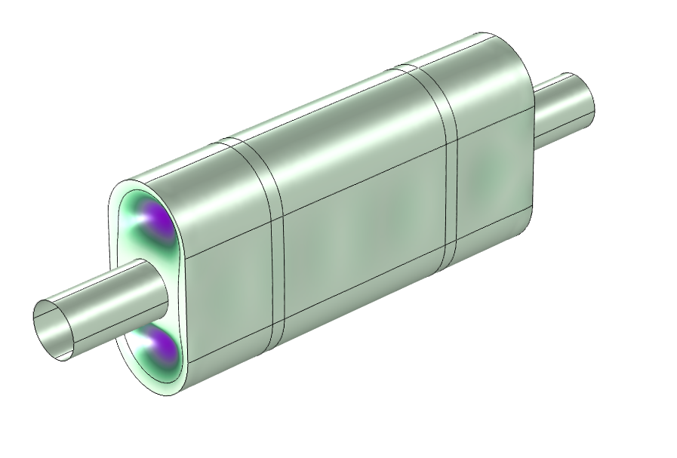
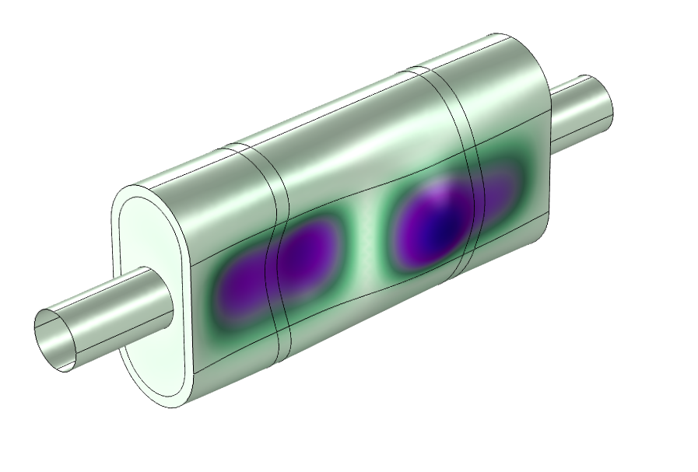
Results: Transmission loss

Slide 5
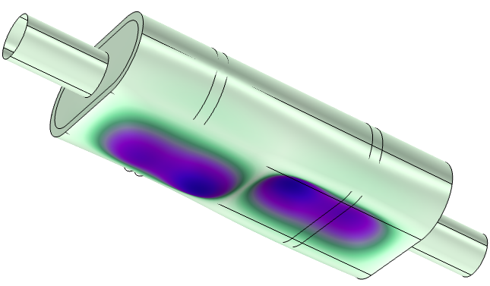
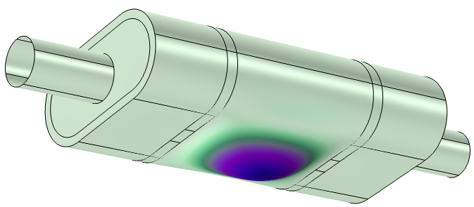
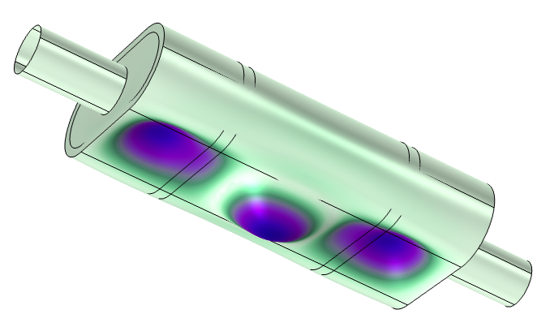
Results: Eigenmodes
Mode at f = 165 Hz
Mode at f = 206 Hz
Mode at f = 225 Hz

Slide 6
Concluding Remarks
The interaction is strong in the low frequency range where the eigenmodes are symmetric and easily excited by the acoustic field. The field will not excite all existing eigenmodes.
There is probably a stronger effect on the transmission loss if there are structural vibration sources; these can result in a transmission loss that is negative. Strong acoustic sources may appear at the muffler walls. These are not accounted for in the input power which is pure acoustic.
Even though the effect of the pressure-solid interaction is not large, undesired eigenmodes of the muffler structure may exist in places where large transmission loss is desired/needed.

