Slide 1
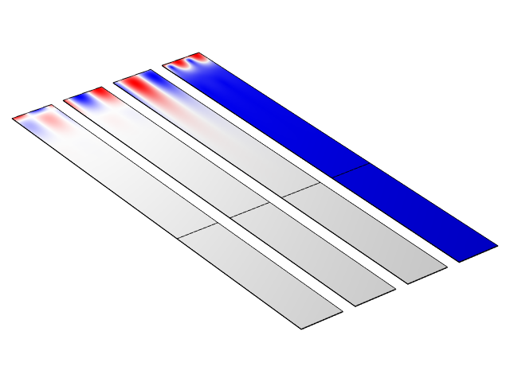
Euler Angles Rotation in SAW Modeling

Slide 2
Problem Definition
In the SAW (surface acoustic waves) industry different crystal cuts of piezoelectric materials are used, e.g.:
  128ᵒ YX LiNbO3, AT&ST quartz, 42ᵒ YX LiTaO3 and so on
  Direct data isn’t available for all cuts
The standard approach is to use the so-called Euler angle rotation
  COMSOL supports it via the Rotated System functionality
  Detailed info about its usage: Part 1 & Part 2
  When performing such a rotation, one should keep in mind that it’s inherently 3D, therefore some extra manipulations might be needed for different orientations of piezo crystals in geometry
Here, some special 2D & 3D cases conversion from the default “Lithium Niobate” material to “128 YX cut LiNbO3” are demonstrated on simple piezoelectric unit cell
  The default “Lithium Niobate material is taken from the dedicated Piezoelectric Material Library
  The Z-X-Z Euler angle set for “128 YX cut LiNbO3” is (alphaL128=0[deg], betaL128=-38[deg], gammaL128=0[deg])
  Verification is performed for a simple unit cell model aiming to obtain SAW eigenfrequencies and a typical SAW velocity

Slide 3
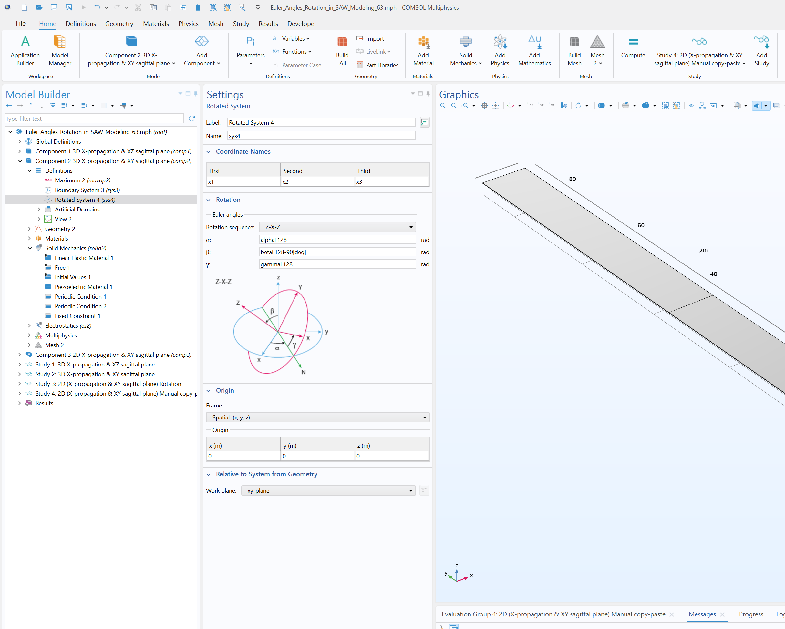
3D Case
In 3D one should take care of the expected SAW direction and its sagittal plane orientation
For 128 YX cut LiNbO3, application of the standard Euler angles leads to the following orientation: XZ sagittal plane, wave propagation in X, aperture of possible IDTs in Y
  See Component 1, Study 1
To obtain XY sagittal plane and wave propagation in X & aperture of possible IDTs will be in Z Euler angles should be modified as (0, -38[deg]-90[deg], 0)
  See Component 2, Study 2

Slide 4
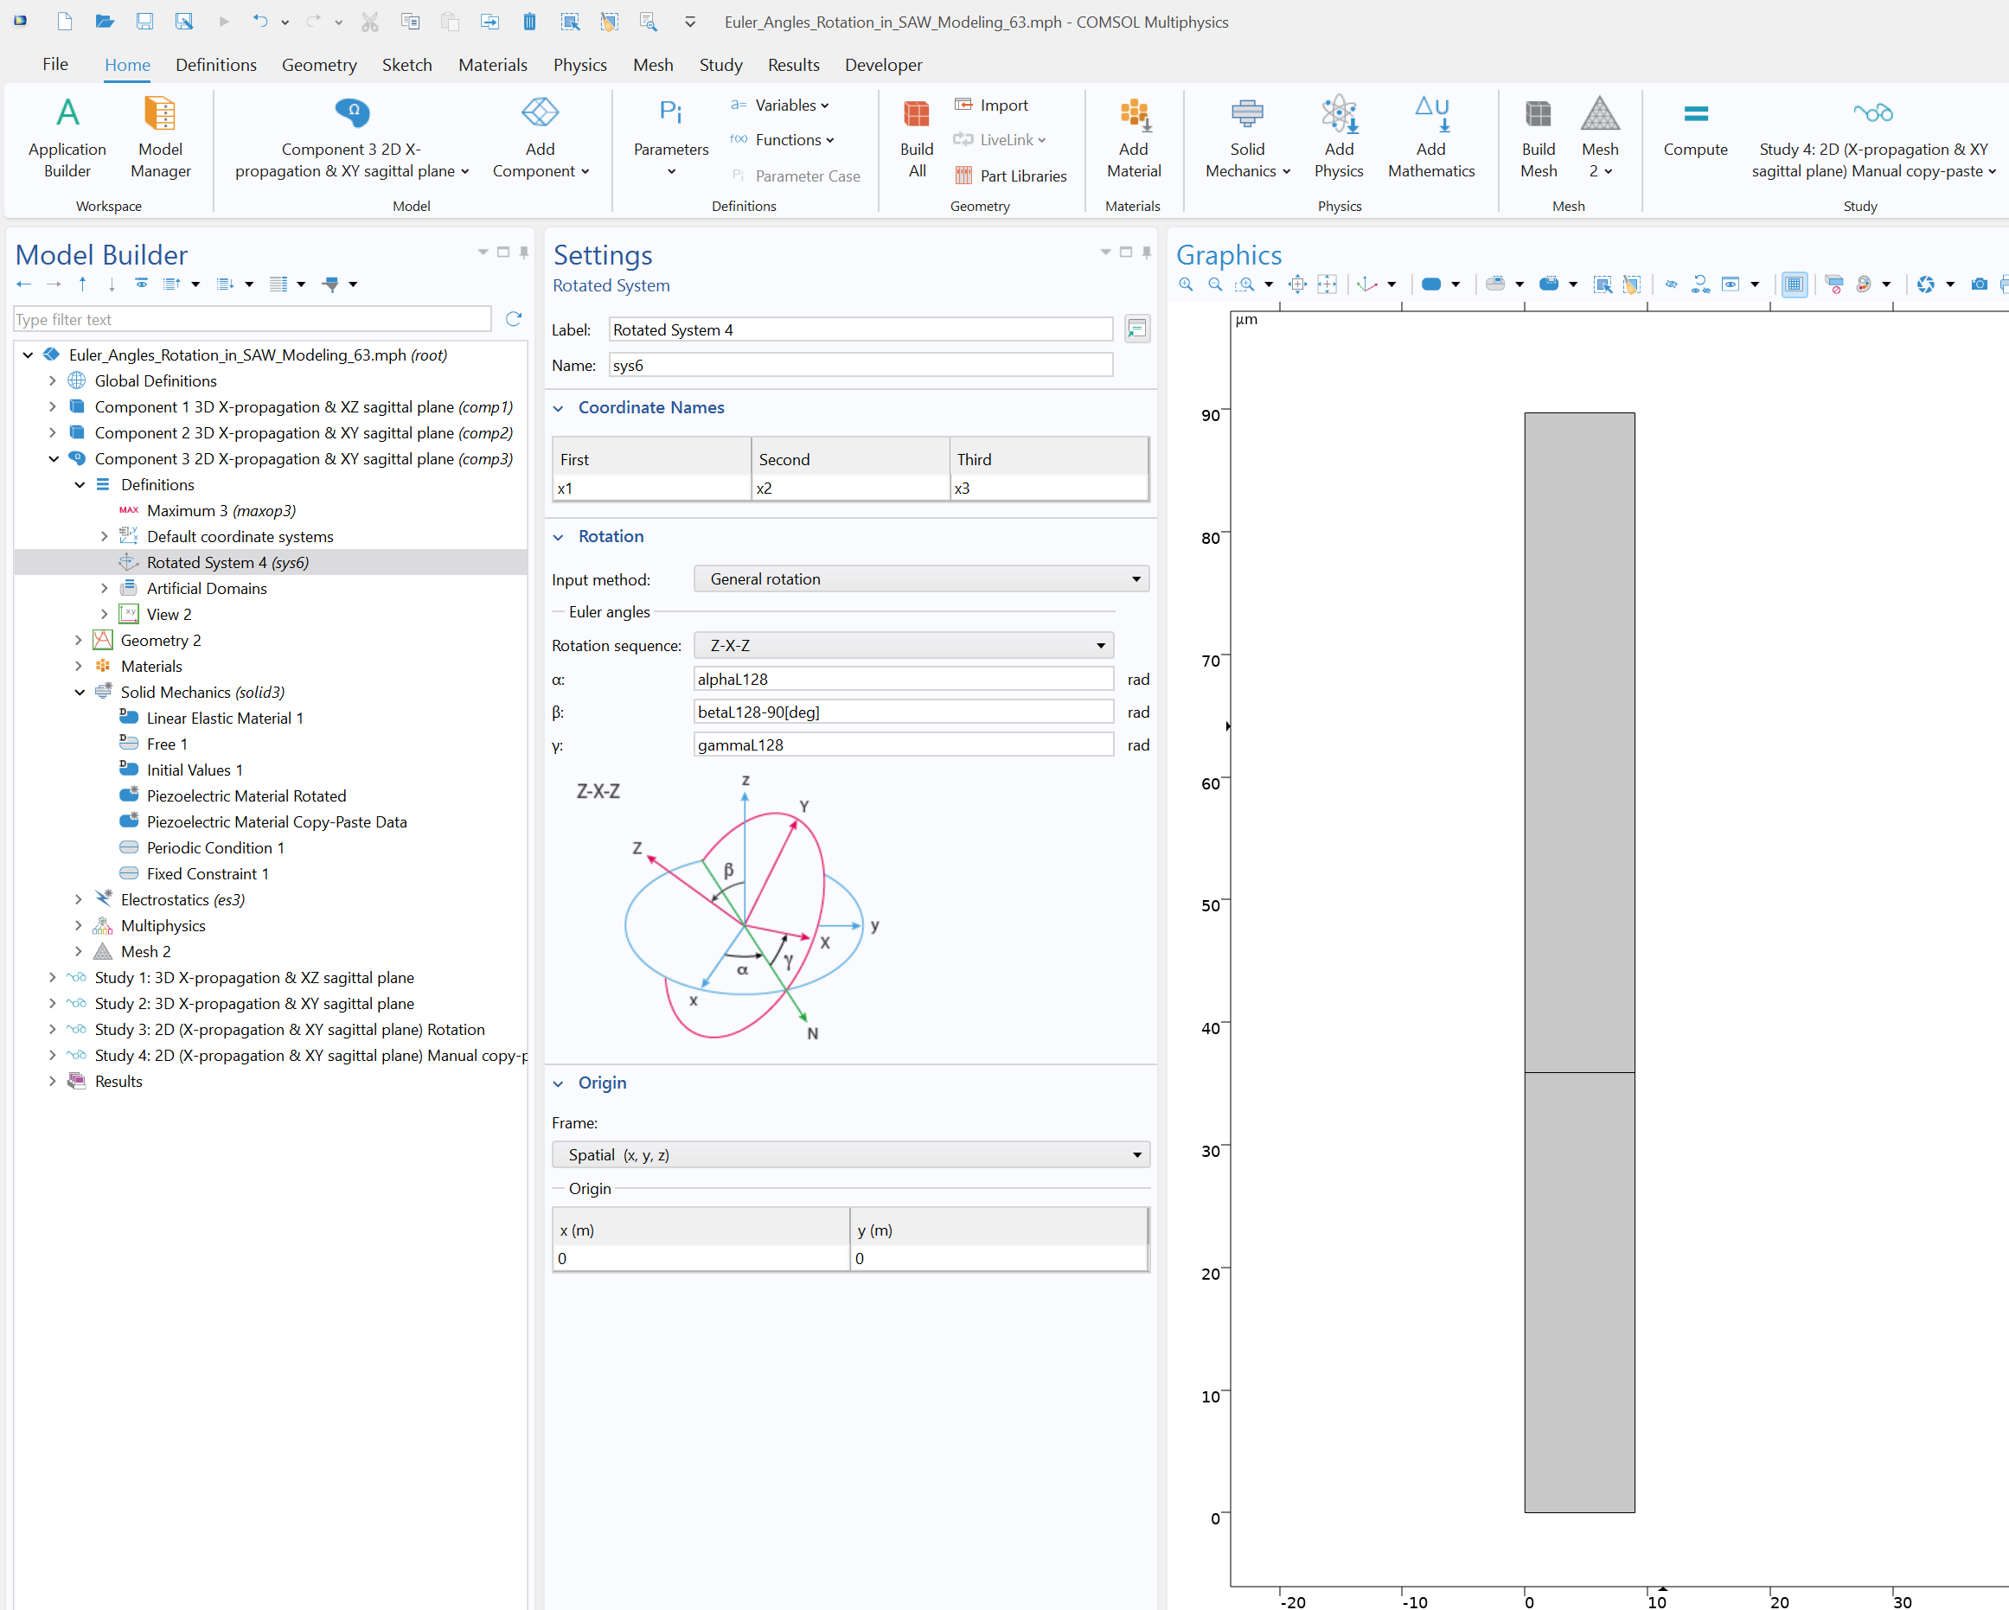
2D Case
For SAW, the typical 2D layout corresponds to the X-propagation and XY sagittal plane
From COMSOL 5.5, this can be achieved directly by the Rotated System with the following set of angles (0[deg], -38[deg]-90[deg], 0[deg])
  See Component 3, Study 3
Alternatively, one can use direct «copy-paste» of the material date from the pure 3D rotation for the XZ sagittal plane
  See Component 3, Study 4
  Make sure to copy with the full precision

Slide 5
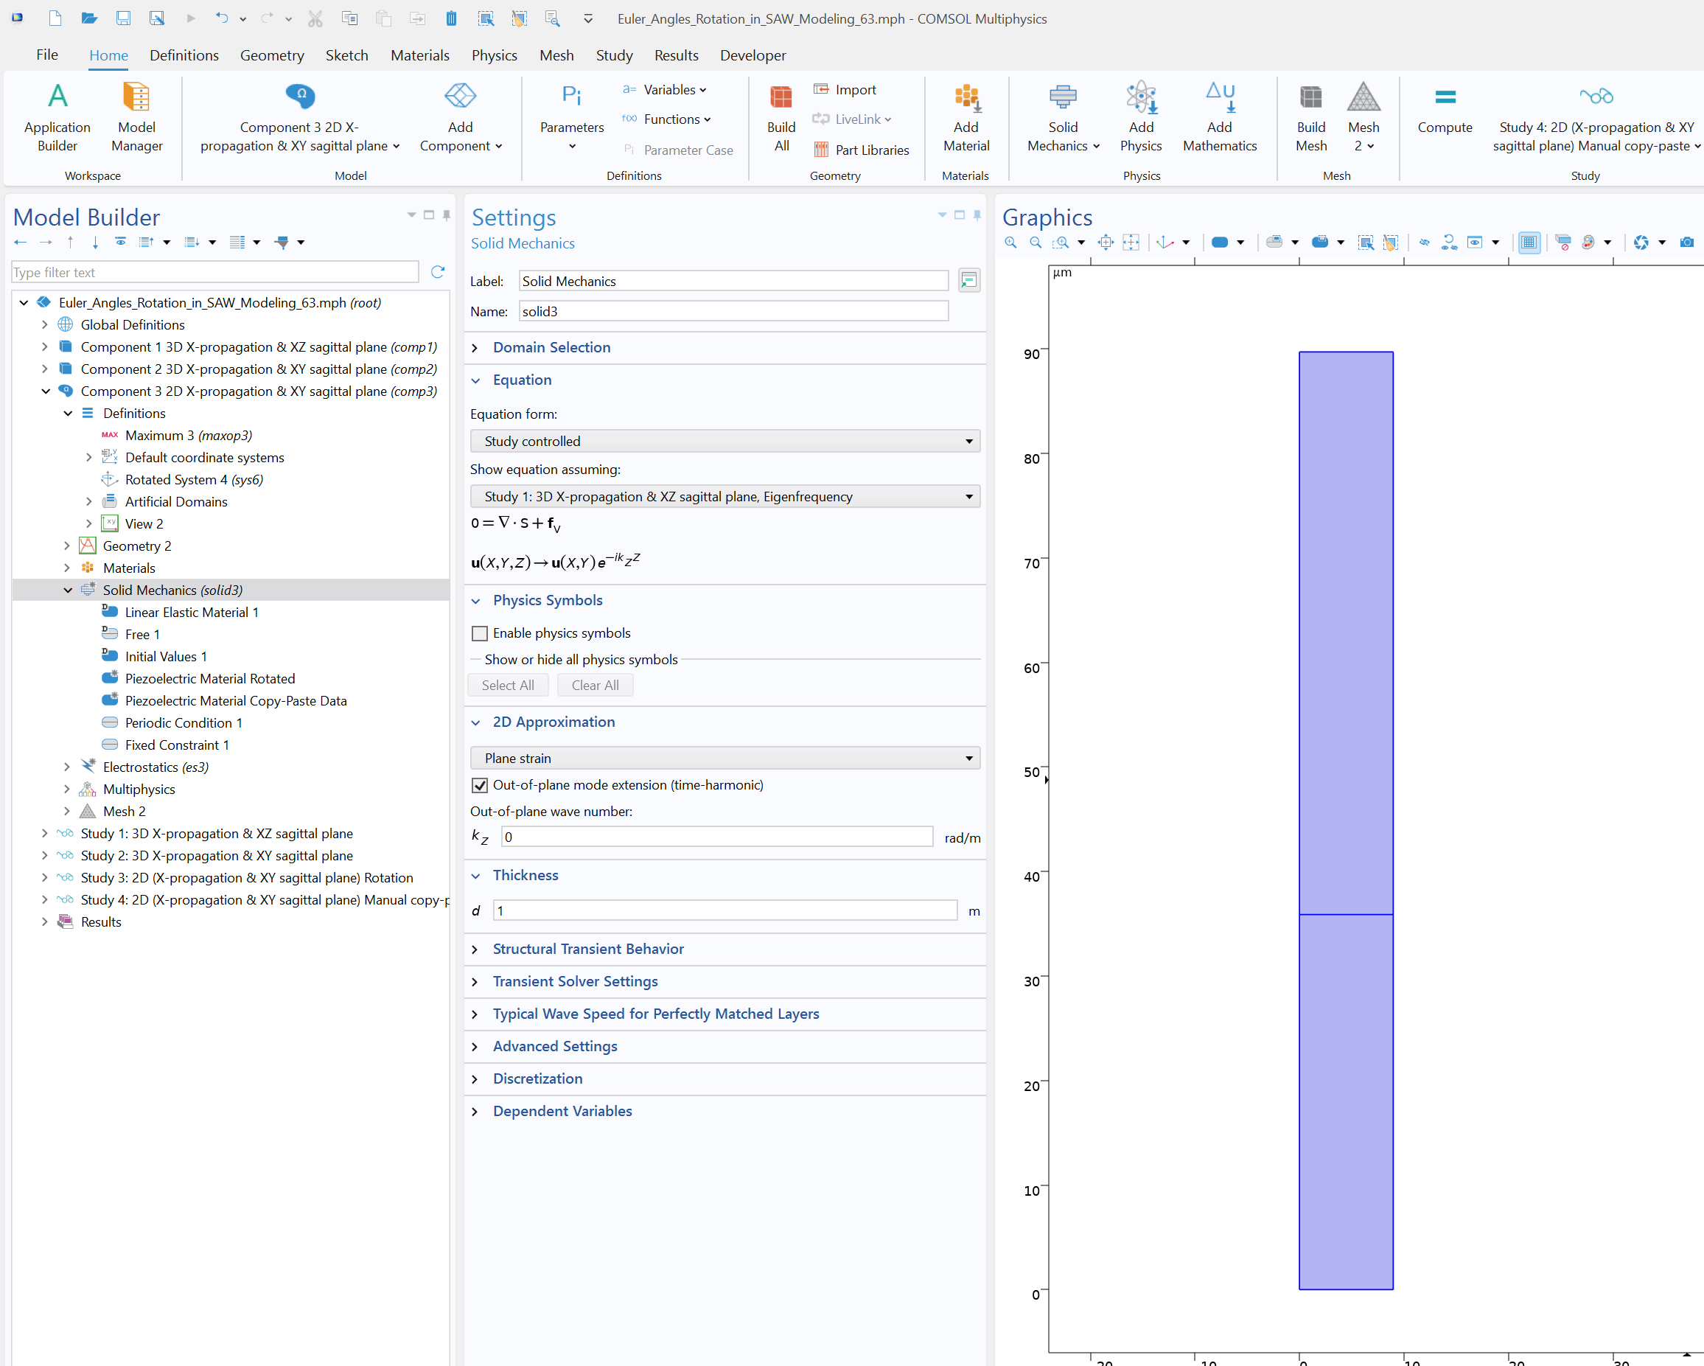
2.5D Approach
Activate the Out-of-plane mode extension (time-harmonic) check box in the Solid Mechanics interface for the 2d component
It might be used to obtain results for all three components of displacements
  Without it one component of displacements and corresponding derivates will be zero

Slide 6
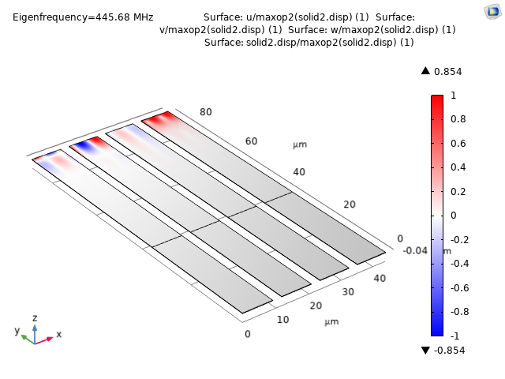
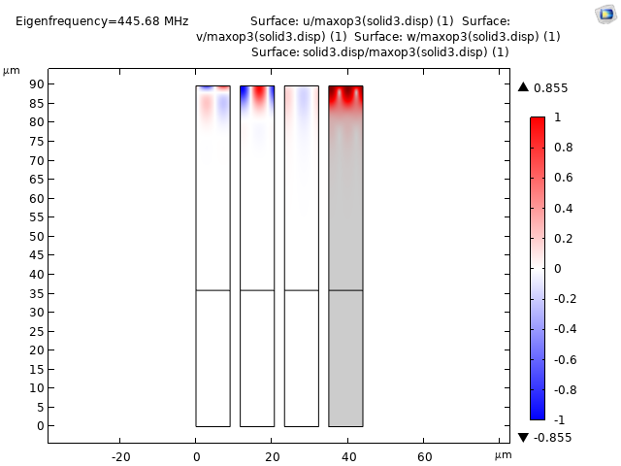
Results
Left: Surface plots of normalized x, y, z, and solid displacements across the XY sagittal plane from 3D model. Right: Surface plots of normalized x, y, z, and solid displacements across the XY sagittal plane from 2D model.

Slide 7
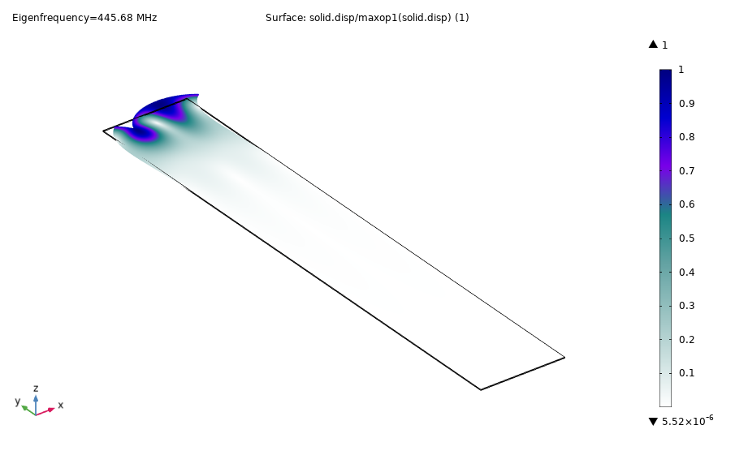
Conclusions
4 variants of conversion from the default "LiNb03" to "128 YX cut LiNbO3" crystal for a simple one-period unit cell are shown
With correct modifications they lead to correlated results: mode shapes, eigenfrequencies, material data, and SAW velocity
One should always keep in mind which propagation direction and sagittal plane are desired
We encourage users to perform a simple unit-cell verification before moving forward for more complex configurations
Surface plot of normalized solid displacements across the XY sagittal plane.

