Slide 1
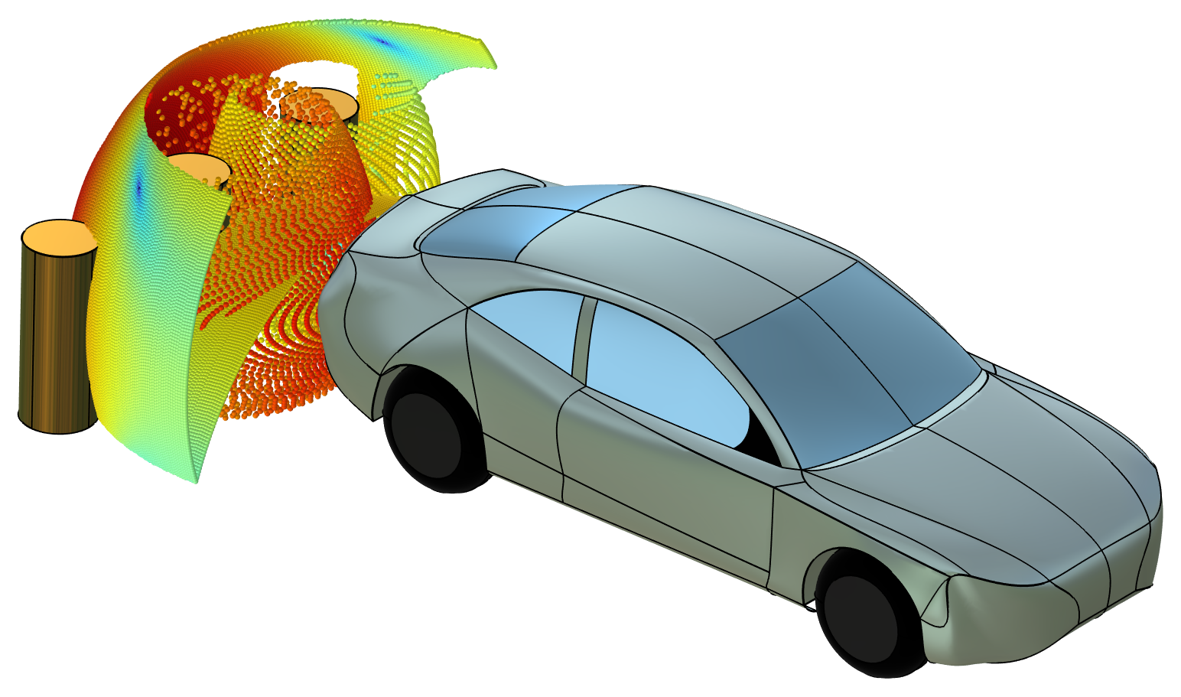
Ultrasonic Car Parking Sensor

Slide 2
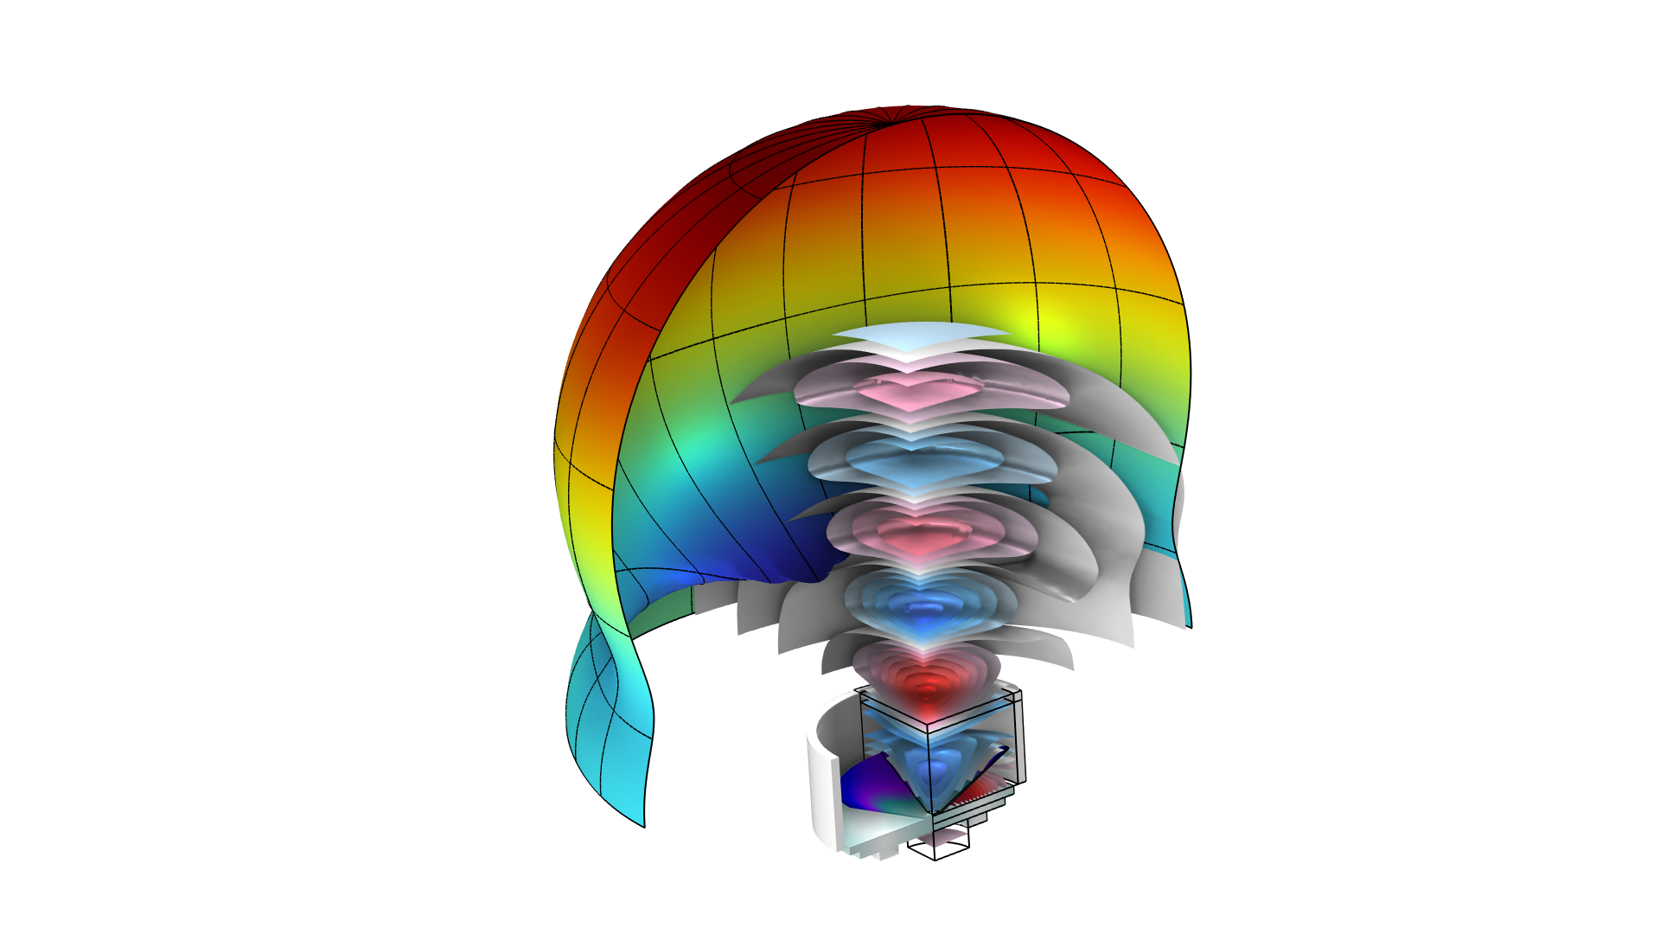
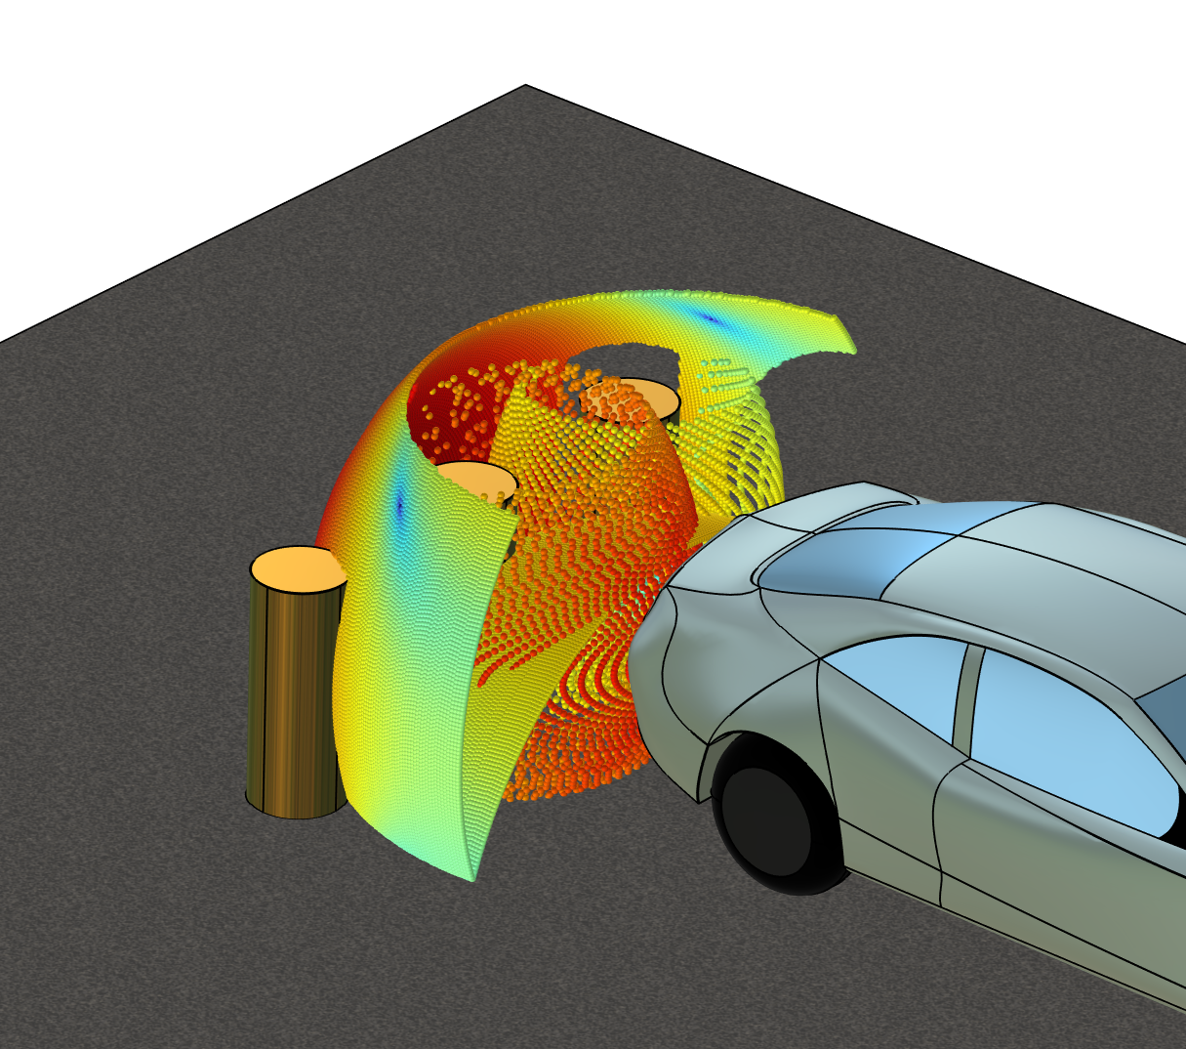
Abstract
This tutorial demonstrates how to compute the response of an ultrasonic car parking sensor transducer coupling Pressure Acoustics, Frequency Domain, Solid Mechanics, and Piezoelectric Materials.
The far-field radiation pattern of the transducer is then used as a source for a Ray Acoustics model, investigating a given parking scenario.
The coupling from FEM to ray tracing is performed using the built-in Release from Exterior Field Calculation feature.
FEM model
Ray Acoustics model

Slide 3
Results
Multiphysics
Solid Mechanics
Electrostatics
Pressure Acoustics
Multiphysics model of the parking sensor
Compute the exterior field (far-field limit)
Results
Response at 1 m
Exterior field radiation pattern

Slide 4
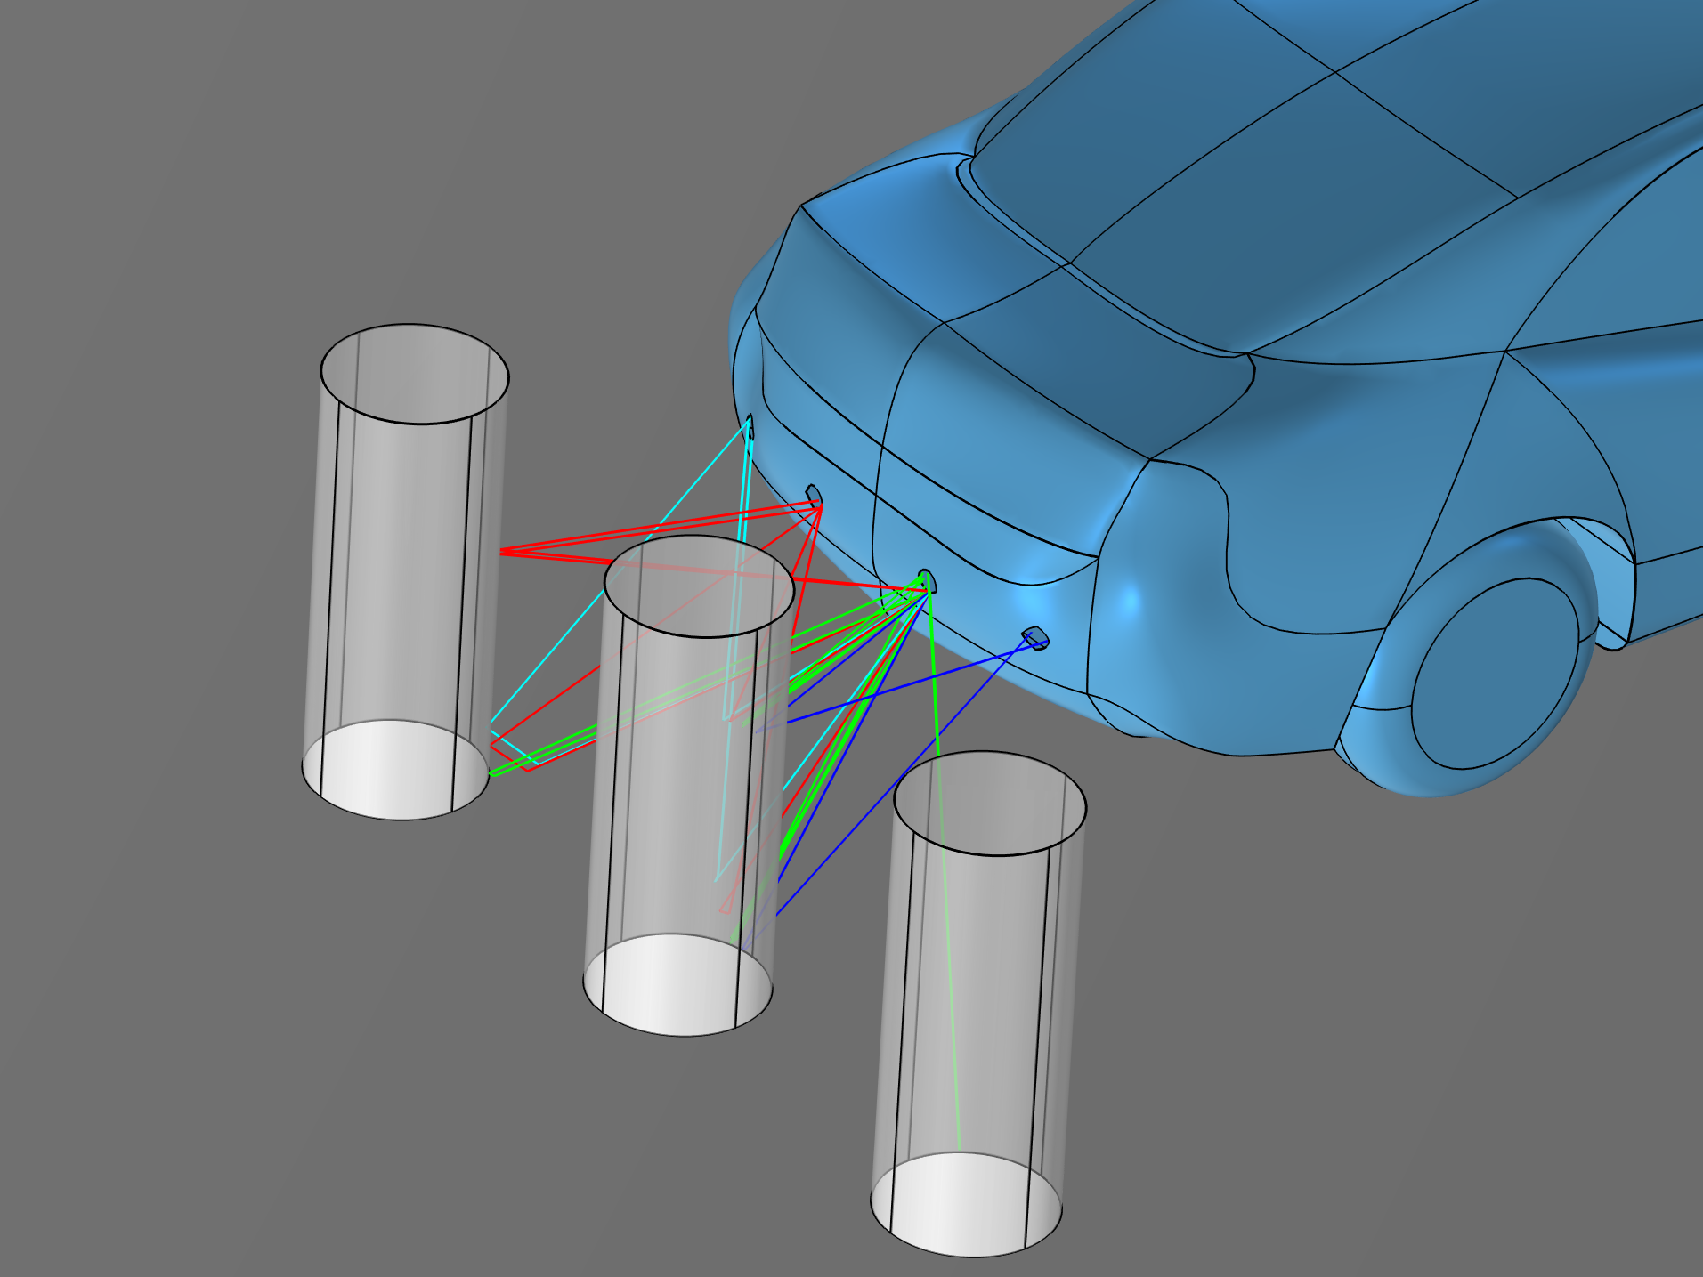
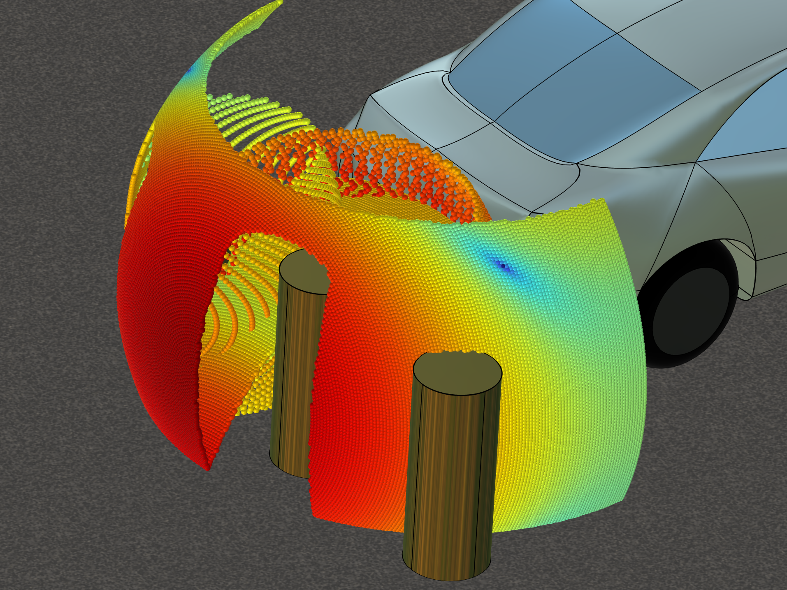
Results
Detected Rays
Ray Propagation
Rays that connect the source (receiver 3) and the 4 receivers.
Ray path of all simulated rays.
Colors represent the ray power.

Slide 5
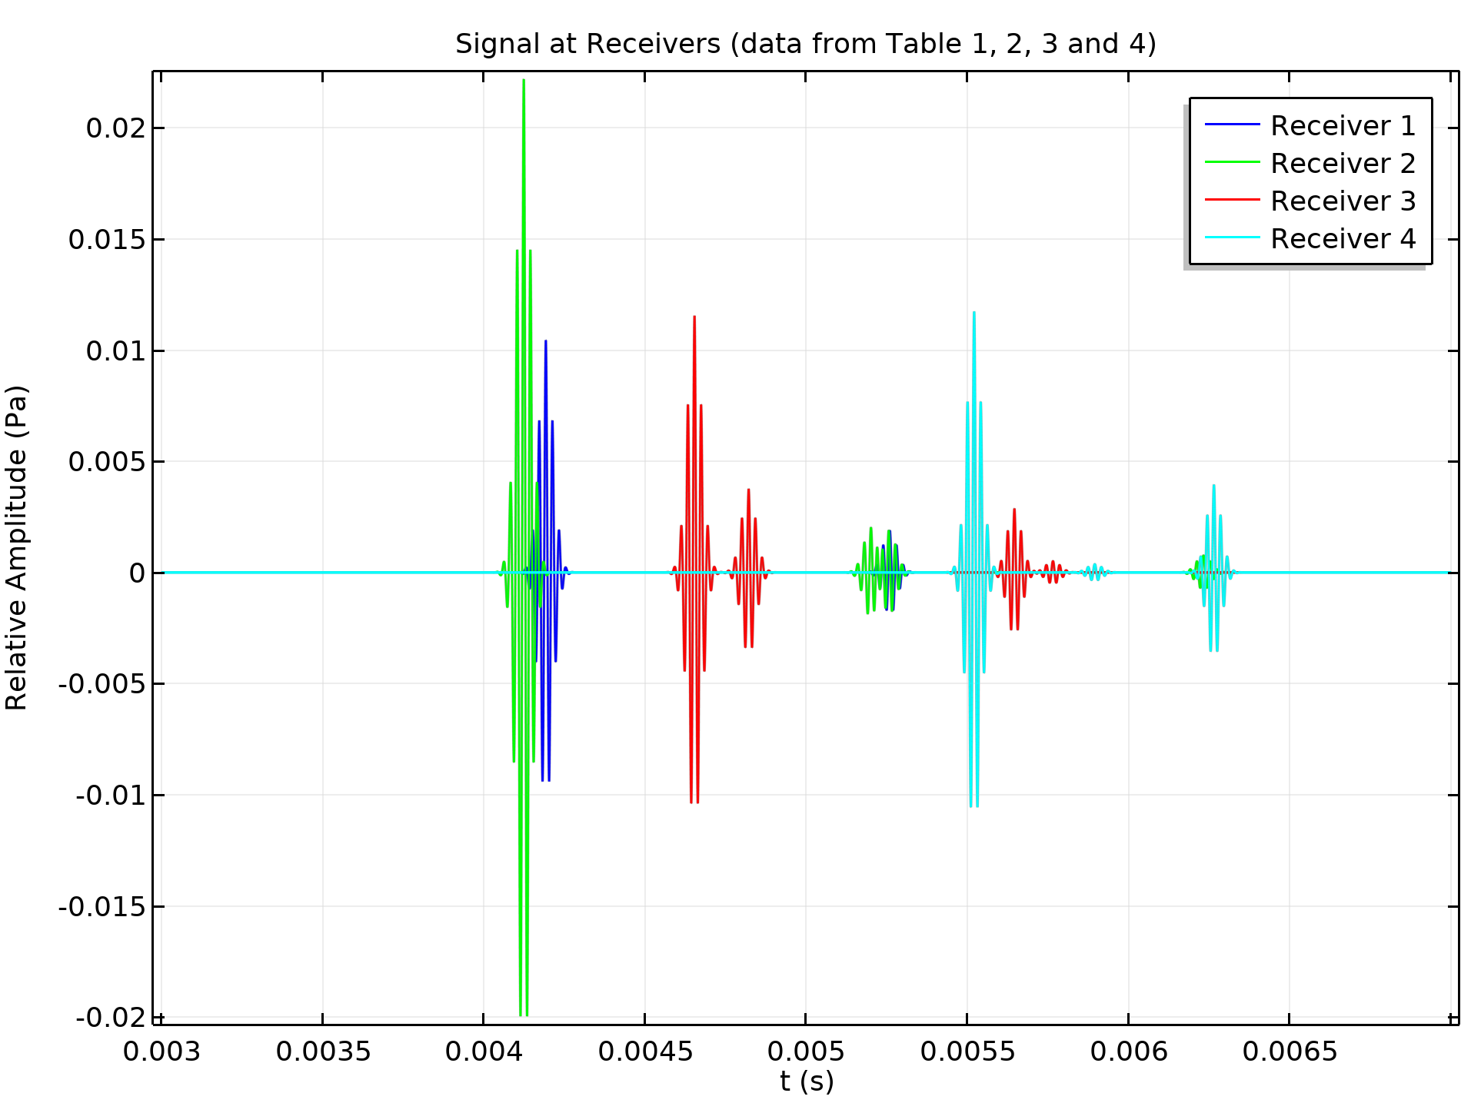
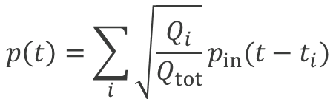
Results
The received signals are reconstructed manually by convolving the input signal with the discrete impulse response.
The data in the plot Ray Power vs. Arrival Time is exported to Table 1 to 4. This data is used to reconstruct the signals following:
$$p\left(t\right)=\sum_{i}{{\sqrt{\frac{Q_{i}}{Q_{tot}}}p}_{in}(t−t_{i})}$$

Slide 6
comsol.com

