Slide 1
Head and Torso HRTF Computation
COMSOL

Slide 2
Introduction
This tutorial model shows how to import a 3D scanned geometry of a human head and torso and compute the head related transfer function (HRTF)
The scan is imported as an STL-file and converted into a COMSOL geometry
The HRTF is computed using the reciprocity principle, locating the source at the ear canal entrance; this approach greatly reduces the computational cost to get a full 3D response
The acoustics are modeled using the Pressure Acoustics, Boundary Element interface of the Acoustics Module
The simulated results are compared to measured data form the actual subject and show good agreement

Slide 3
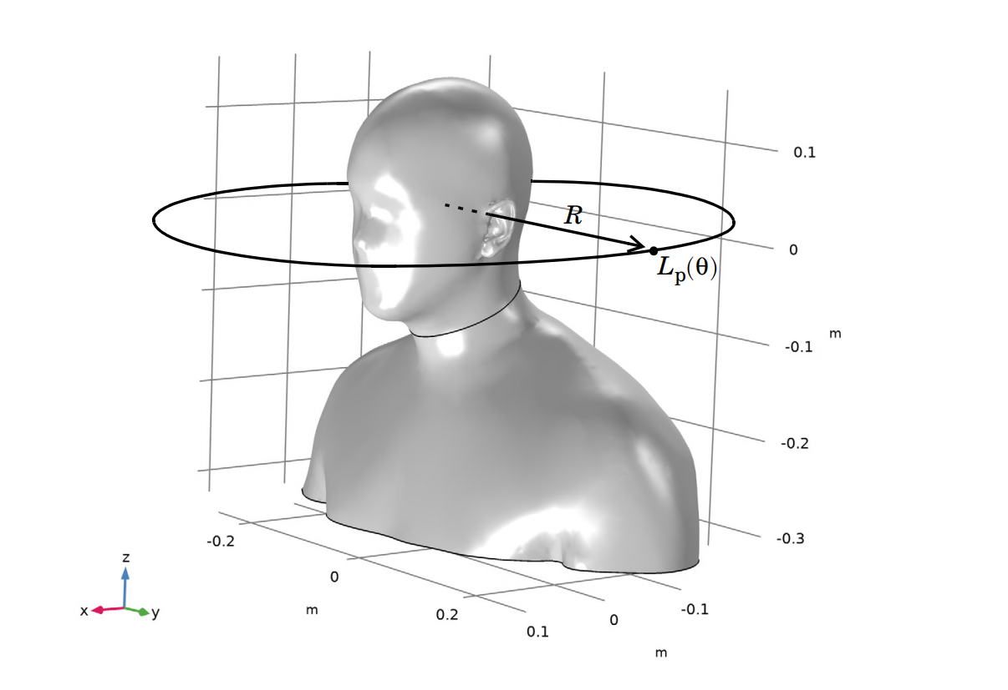
Model definition
Notice that the geometry has been moved and rotated (in the figure) to align the coordinate axis with the commonly used directions for directivity assessment
The evaluation circle for the HRTF that is use in the model, is represented in the figure
The evaluation is performed using a Radiation Pattern plot
The generated COMSOL geometry from the STL mesh. Representation of the location for the HRTF evaluation on a circle in the horizontal plane

Slide 4
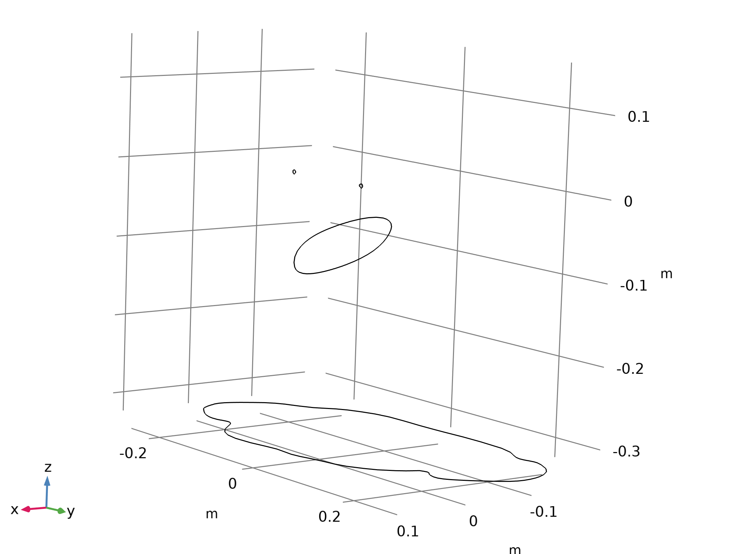
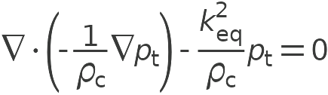

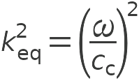
Model definition
Pressure Acoustics, Boundary Elements

Slide 5
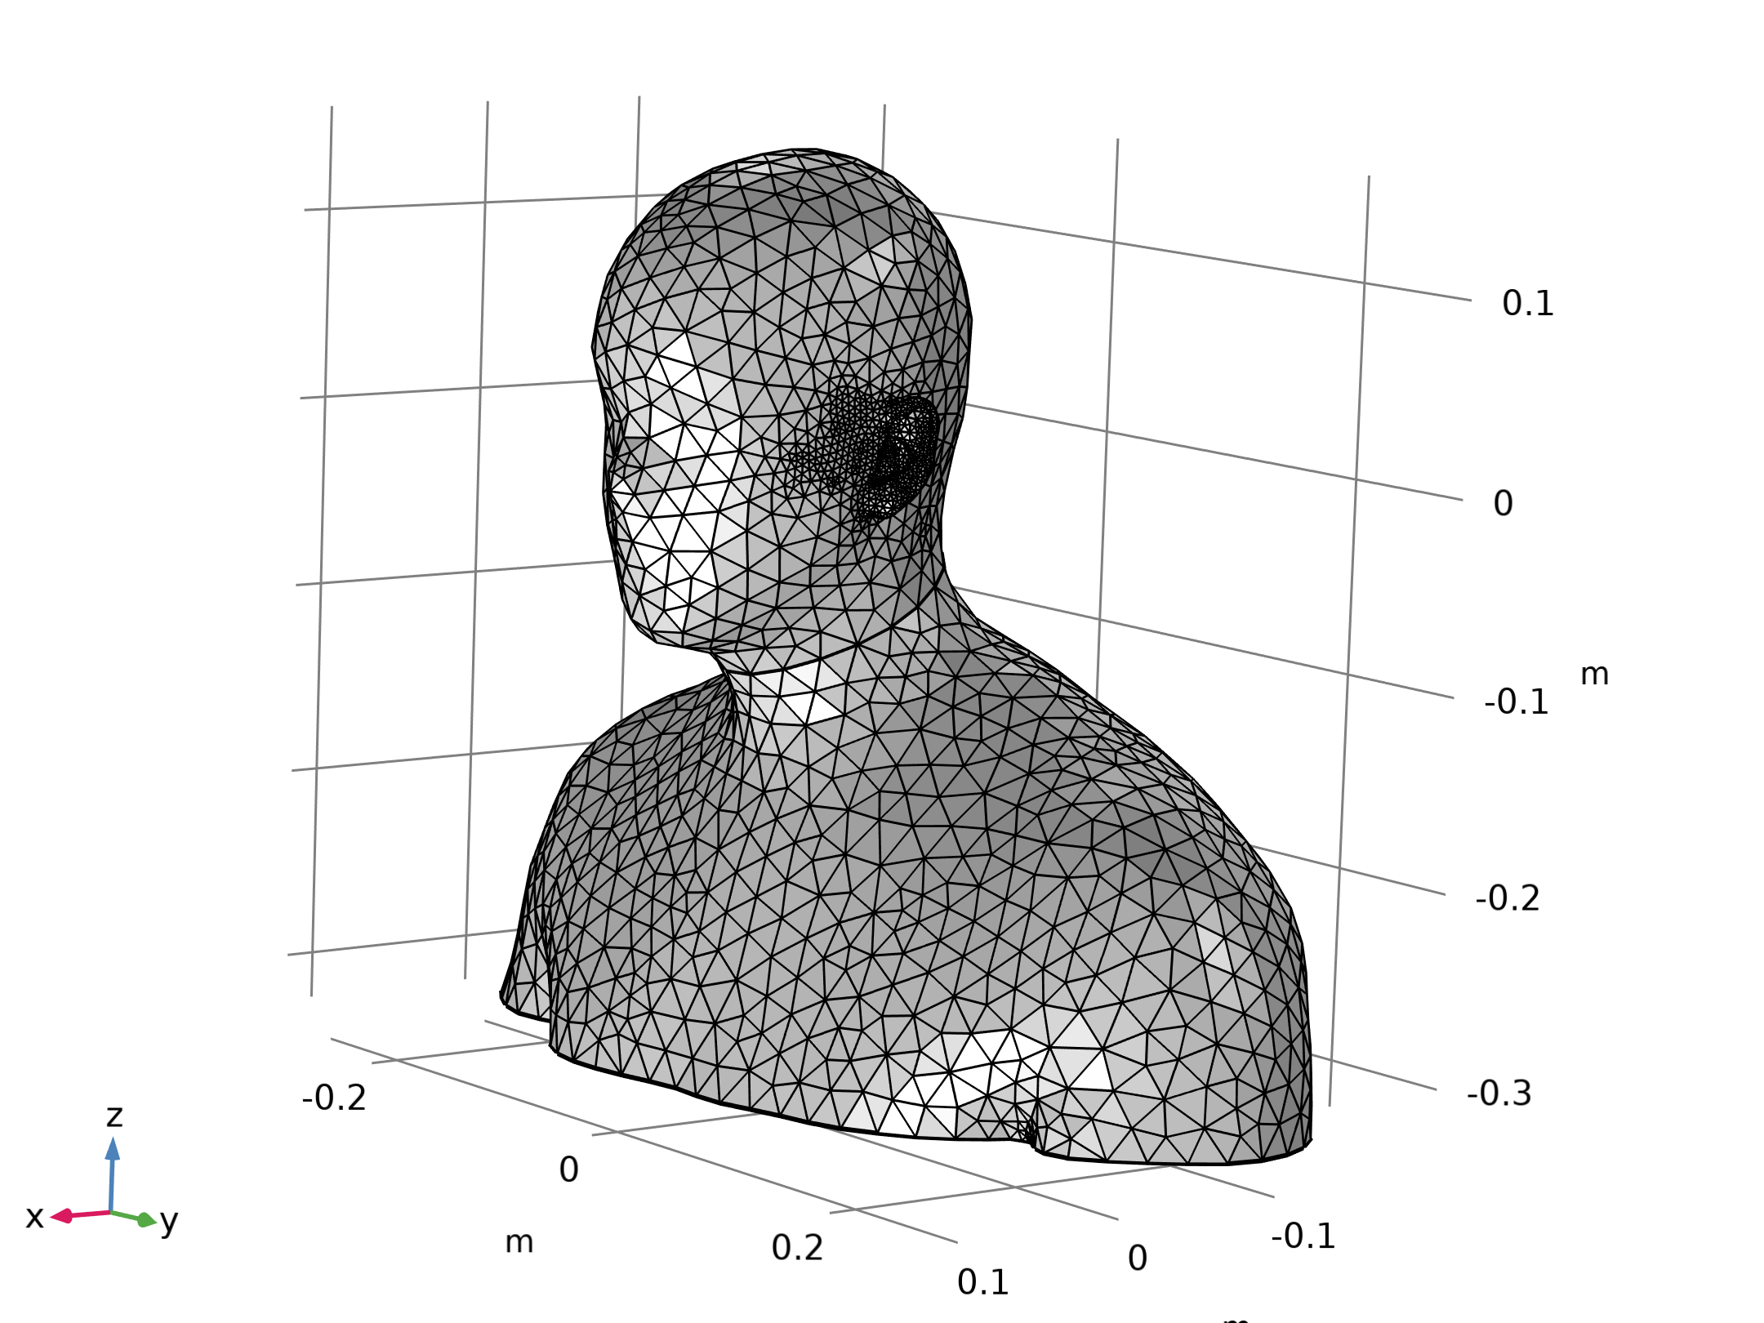
Model definition
The figure depicts the imported STL mesh
Mesh 1

Slide 6
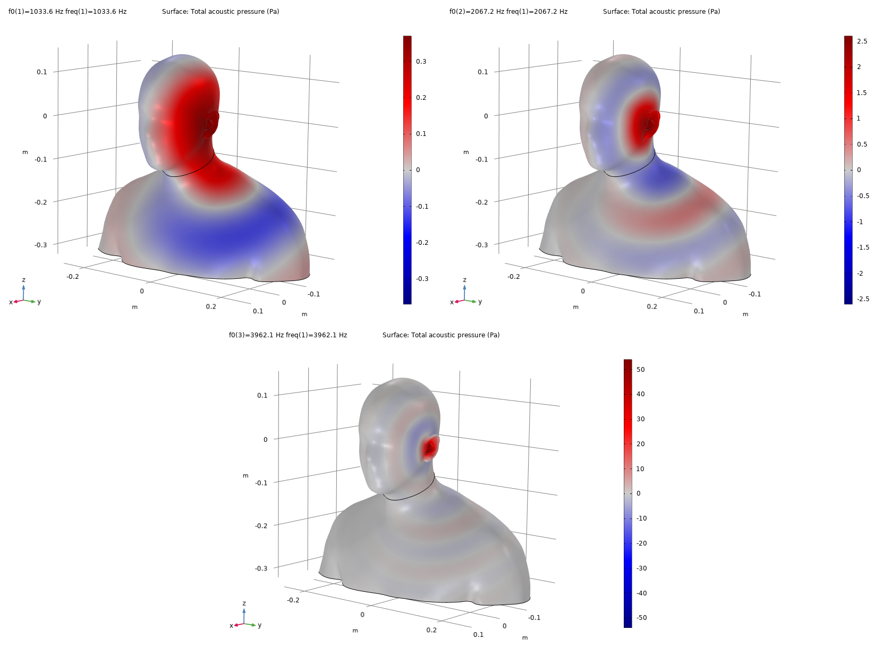
Results
The figure depicts the pressure field generated from the excitation at the ear canal entrance for the frequencies f = 1033.6 Hz, 2067.5 Hz, and 3962.1 Hz
These have been selected as they coincide with the measurement data (octave band center frequencies)
A unit normal velocity is assigned to the ear canal entrance
Acoustic pressure at the surface of the head and torso evaluated at three frequencies

Slide 7
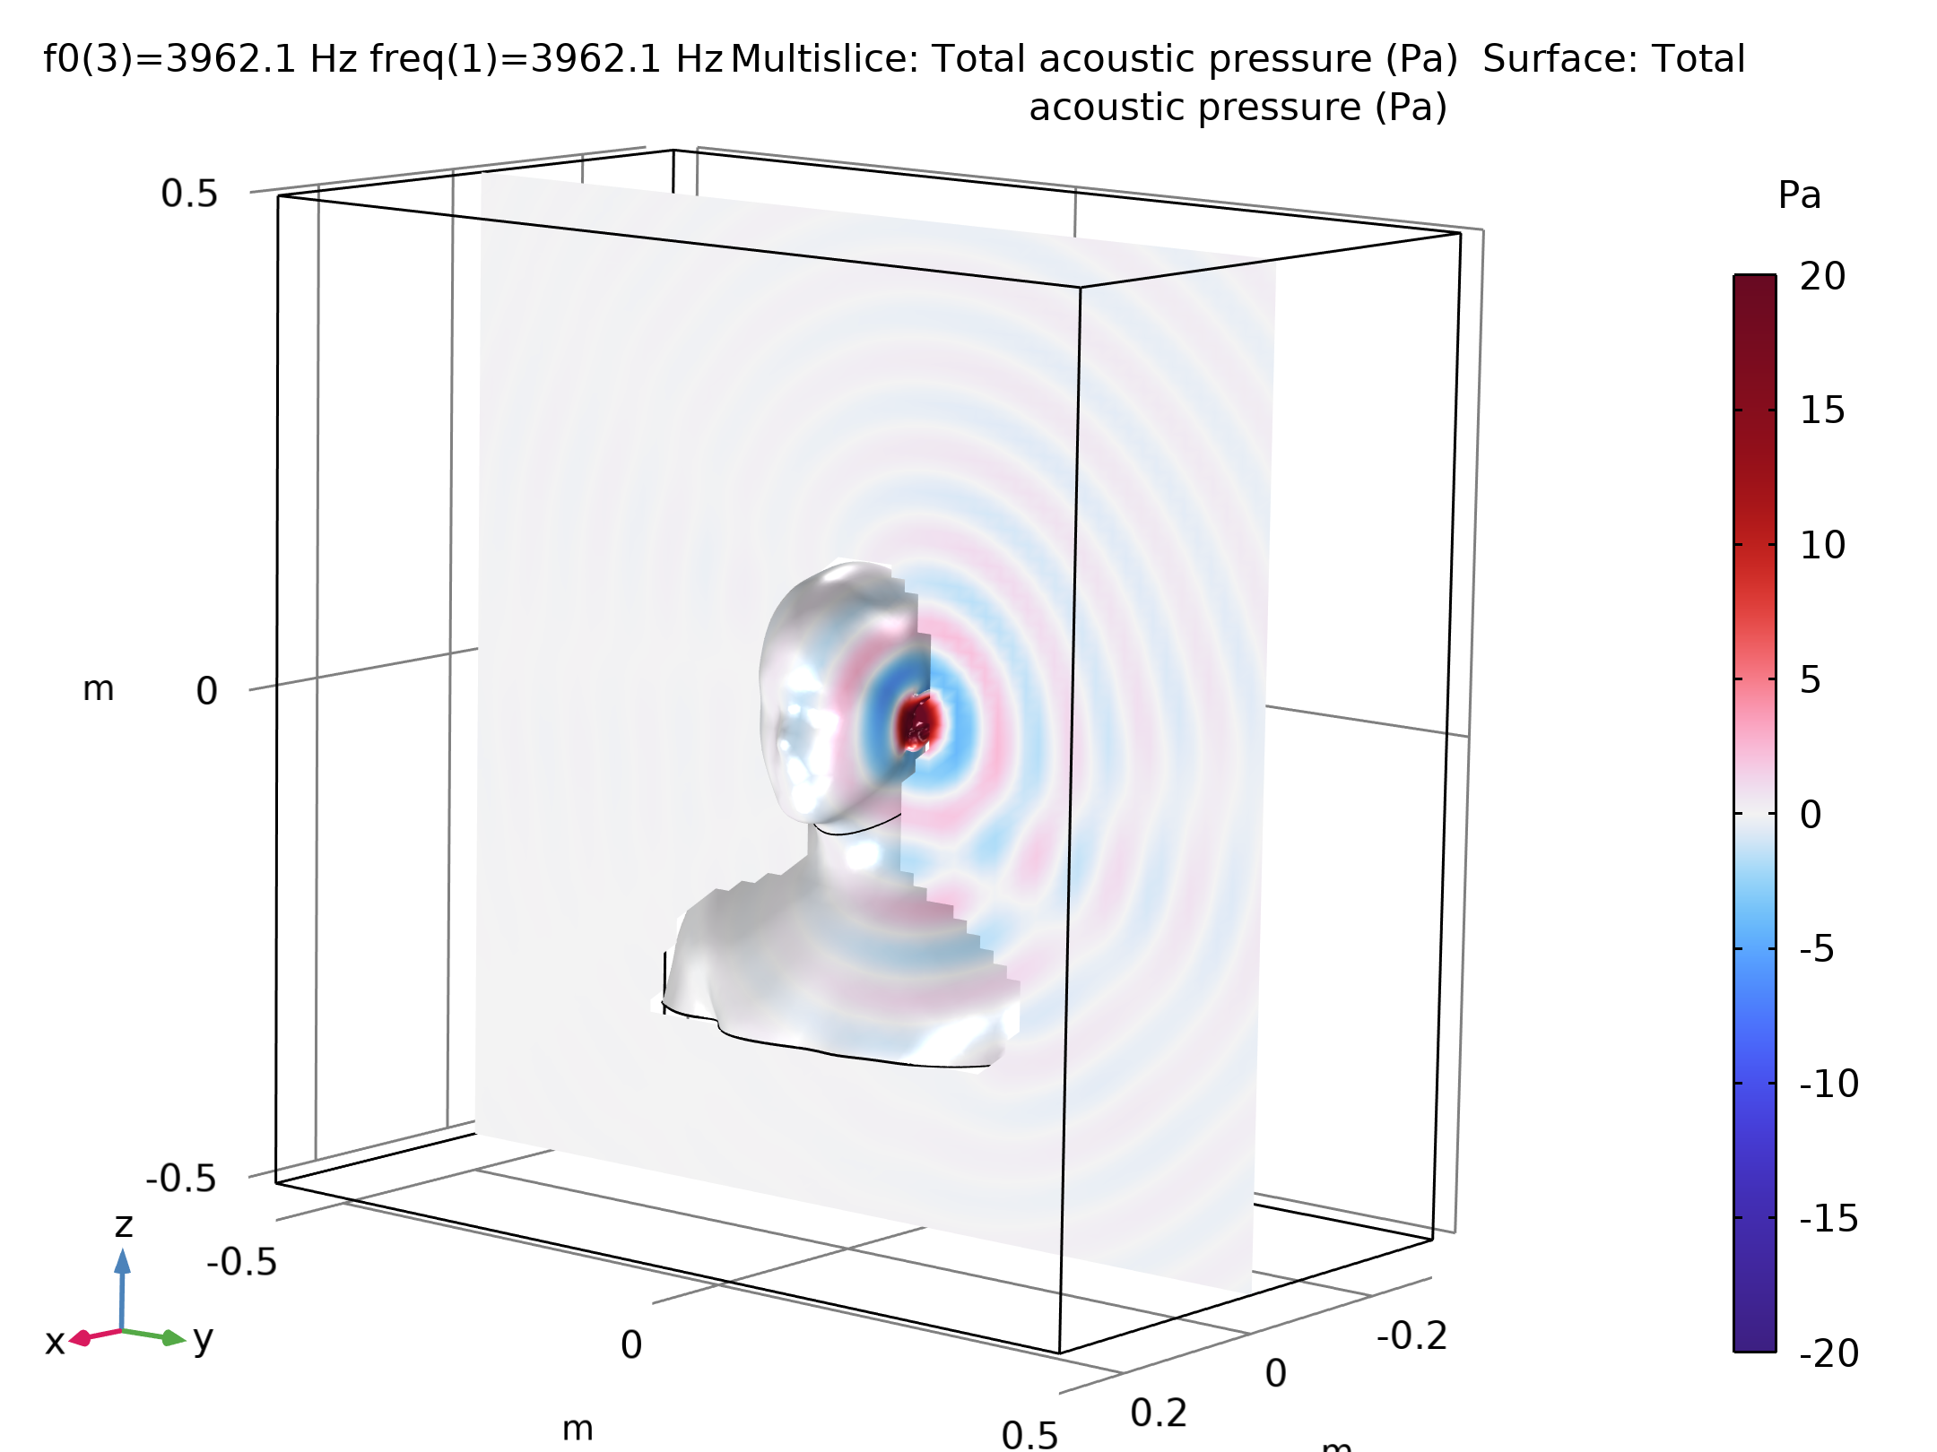
Results
The figure also depicts the acoustic pressure in a cross-section plane
Acoustic pressure on the head and torso and in a cut plane

Slide 8
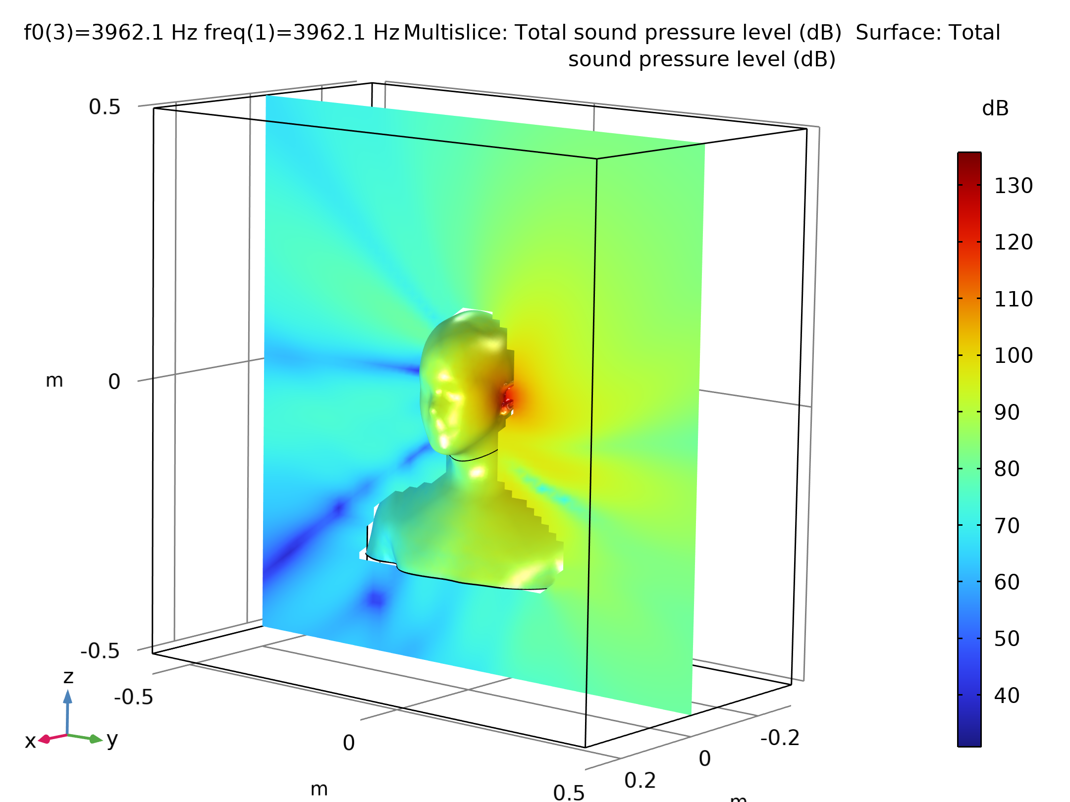
Results
The sound pressure level (SPL) is depicted in the figure
The acoustic pressure is evaluated at 4kHz octave band center frequency
The SPL plot clearly shows the presence of notches (cancellations) for certain directions
These are more evident at the higher frequencies
Sound pressure level on the surface of the head and torso and in a cut plane

Slide 9
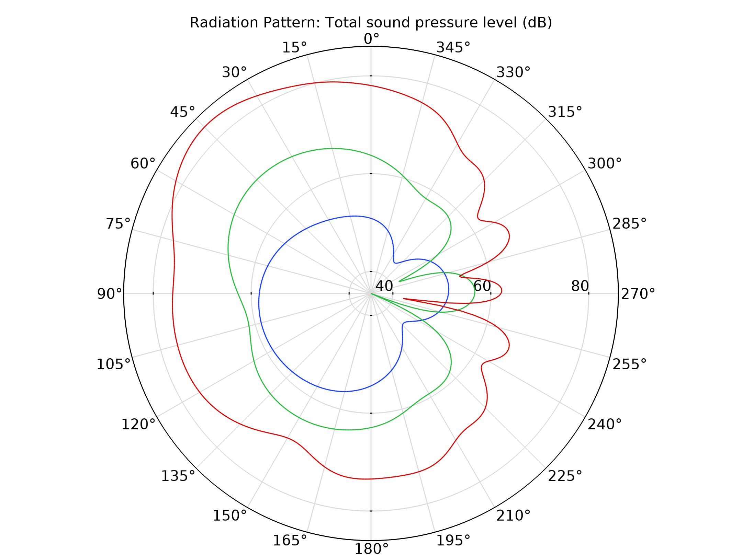
Results
The figure depicts the HRTF in the horizontal plane (the xy-plane) for the three evaluation frequencies
Comparison of the normalized HRTF evaluated at the three frequencies

Slide 10
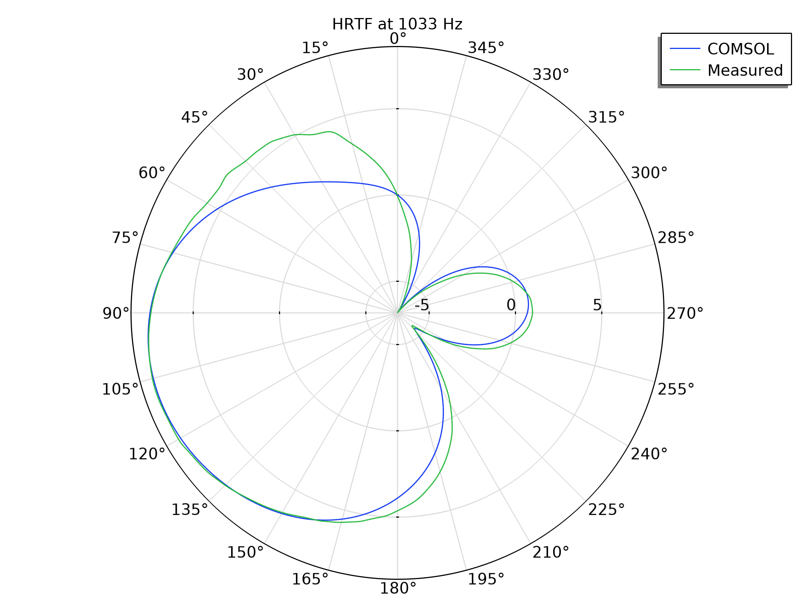
Results
The figure shows how the computed HRTFs are compared to the measurement data
Comparison of the simulated HRTF with measured data at 1033 Hz

Slide 11
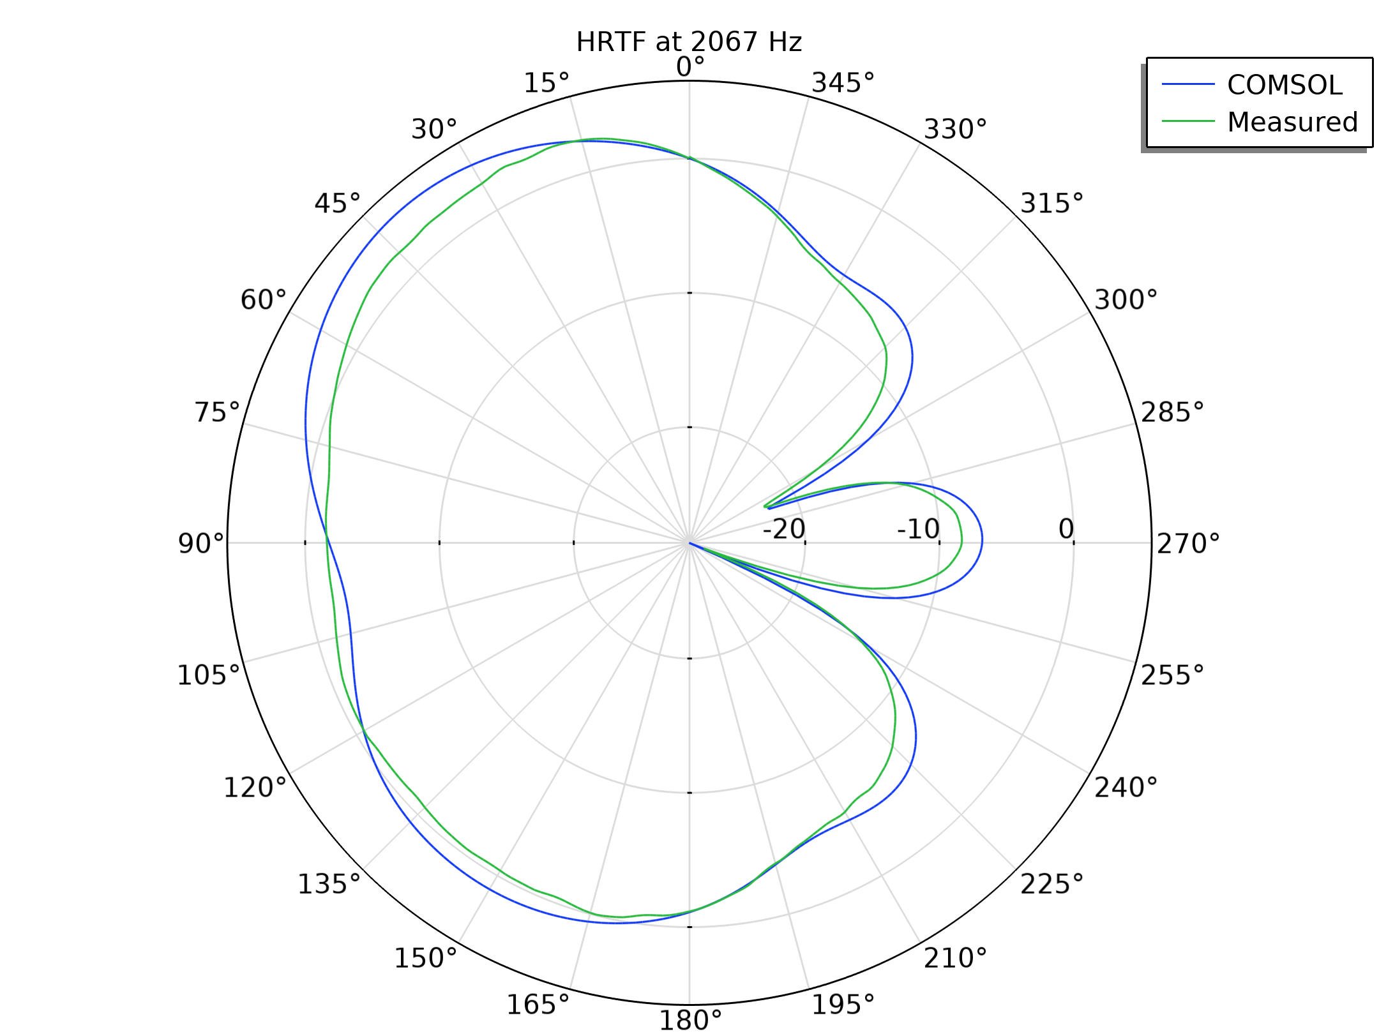
Results
The figure shows how the computed HRTFs are compared to the measurement data
Comparison of the simulated HRTF with measured data at 2066 Hz

Slide 12
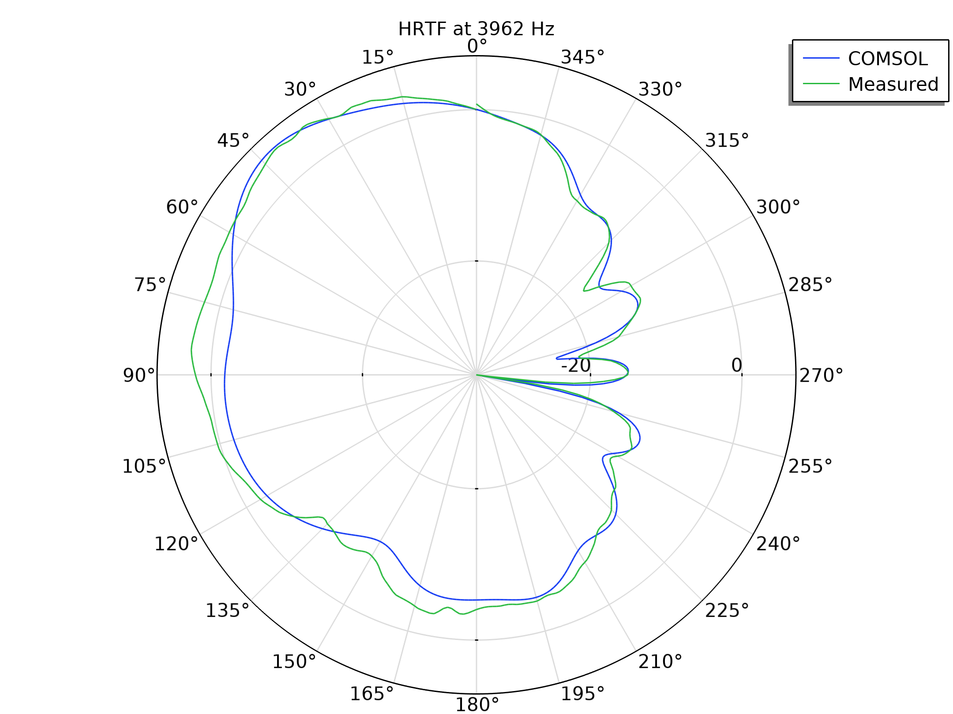
Results
The figure shows how the computed HRTFs are compared to the measurement data
Comparison of the simulated HRTF with measured data at 3962 Hz

