Slide 1
Liquid-Cooled Lithium-Ion Battery Pack
COMSOL

Slide 2
Introduction
This example simulates a temperature profile in a number of cells and cooling fins in a
liquid-cooled battery pack
The model solves in 3D and for an operational point during a load cycle
A full 1D electrochemical model for the lithium battery calculates the average heat source
The model is based on two assumptions:
The first one is that the material properties of the cooling fluid and battery material can be calculated using an average temperature for the battery pack, and the second one is that the variations in heat generation during the load cycle are significantly slower than the heat transport within the battery pack
The first assumption is valid if the temperature variations in the battery pack are small
The second assumption implies that the thermal balance is quasistationary for the given battery heat source and at a given operational point during the load cycle

Slide 3
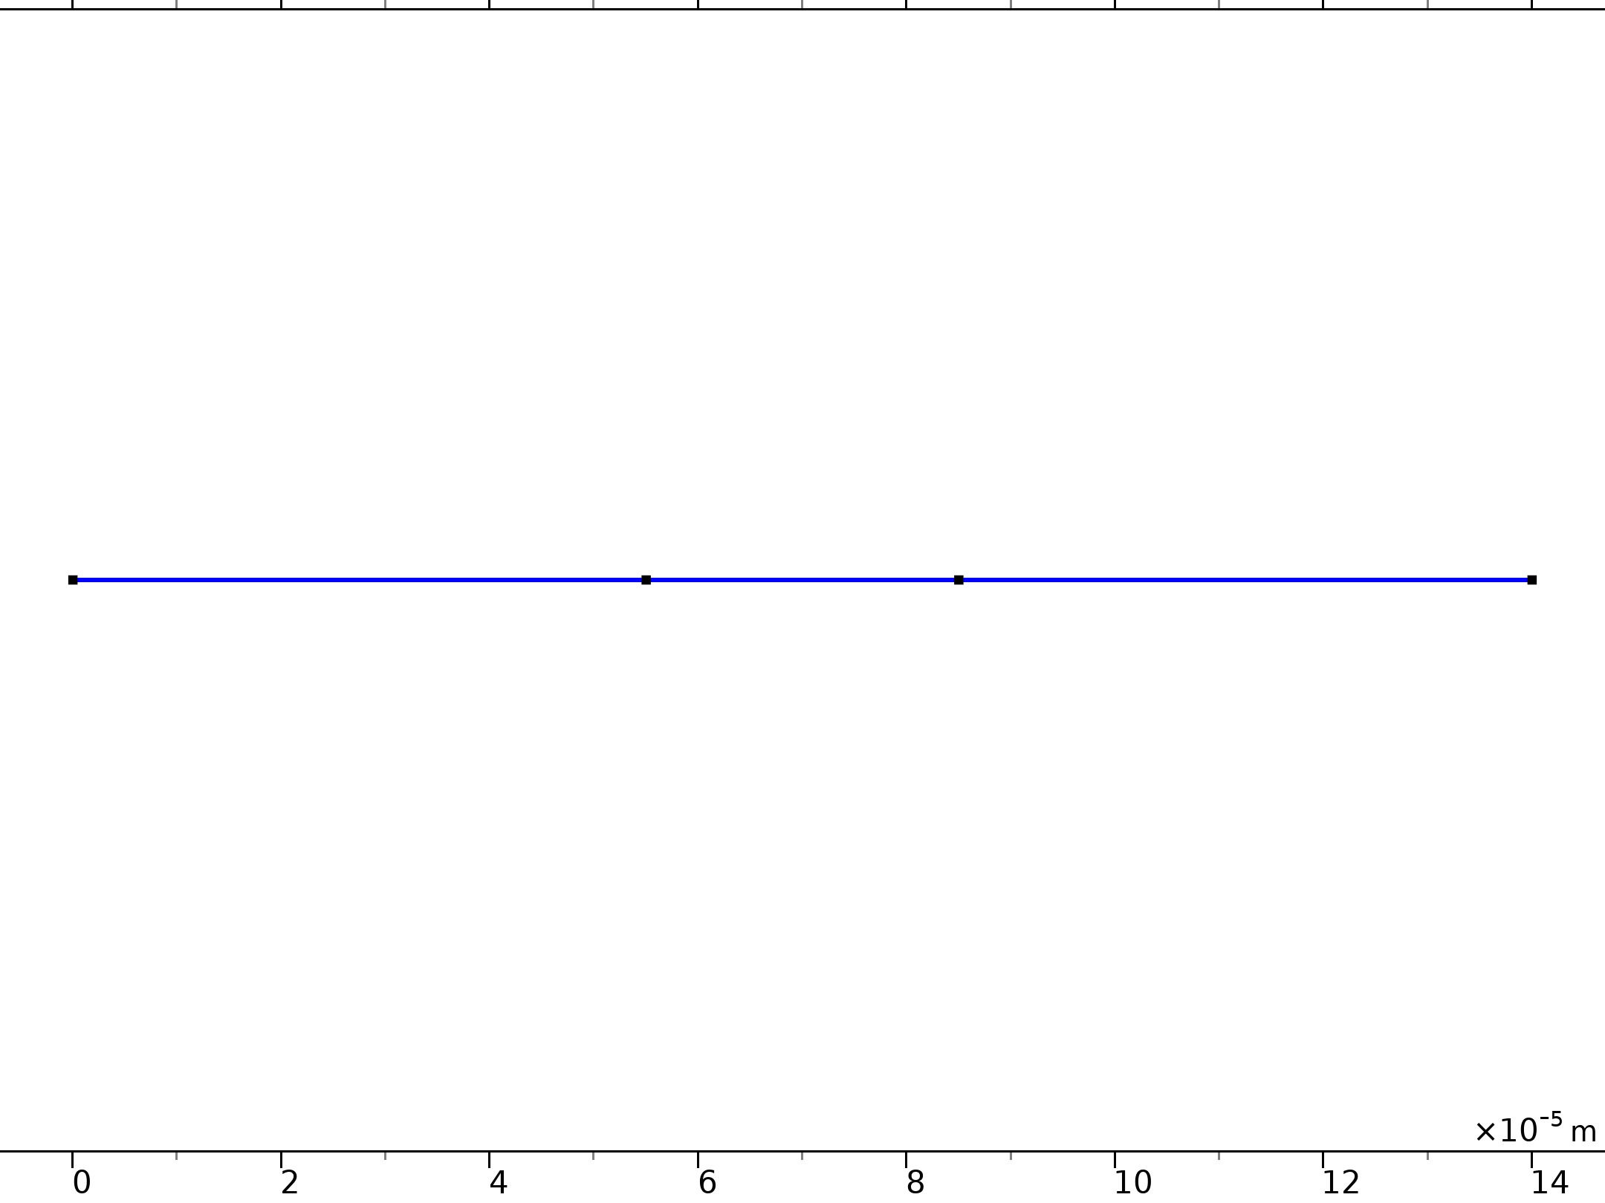




Model Definition
Lithium-Ion Battery

Slide 4
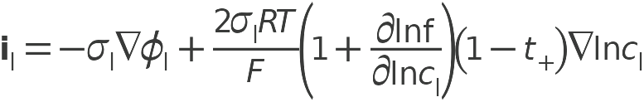

Model Definition
Lithium-Ion Battery

Slide 5
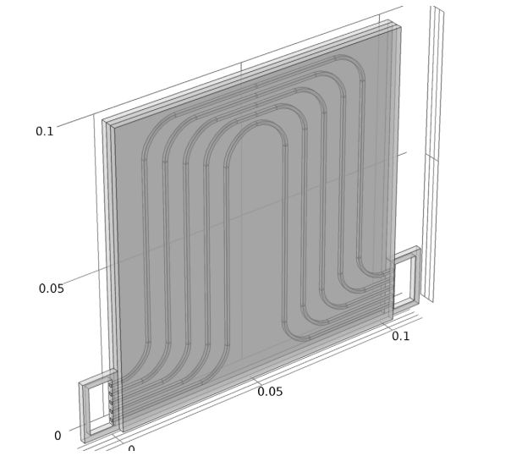
Model Definition
The repetitive unit cell of the battery pack consists of a cooling fin with flow channels, with one battery on each side; see the figure
The cooling fins and batteries are 2 mm thick each, summing up to a total unit cell thickness of 6 mm
Unit cell of the battery pack consisting of two prismatic batteries and a cooling fin plate with five cooling channels

Slide 6
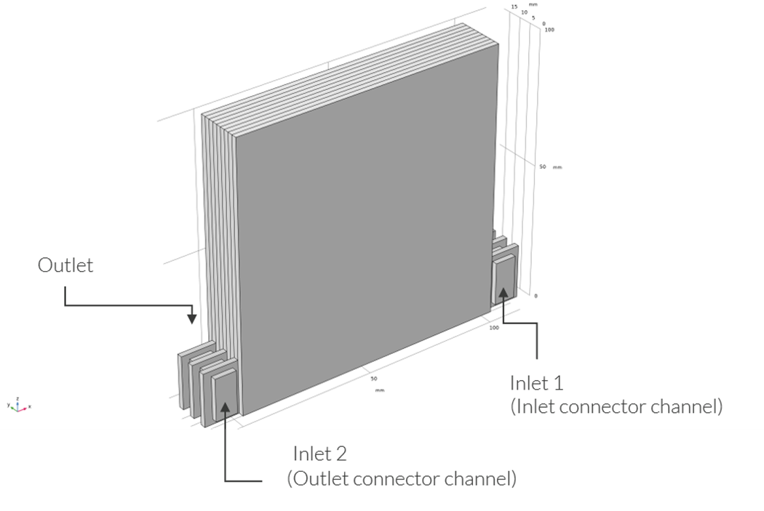
Model Definition
The modeled battery pack geometry consists of three stacked unit cells and two flow connector channels:
  one on the inlet and one on the outlet side of the cooling fins
The geometry represents the last cells toward the outlet end of a battery pack (the cells of the battery pack not included in the geometry extend from y = 0 in the negative y direction)
Battery pack geometry. Three unit cells, one inlet connector channel and one outlet connector channel

Slide 7
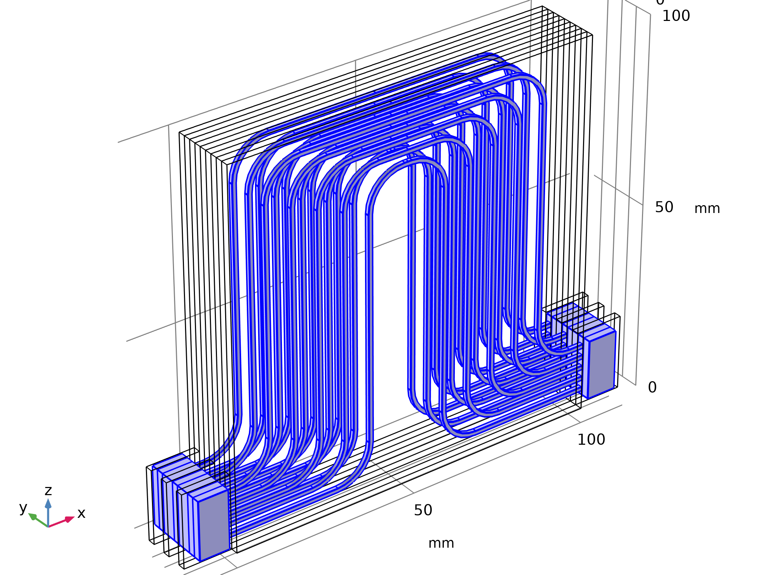


Model Definition
Laminar Flow

Slide 8
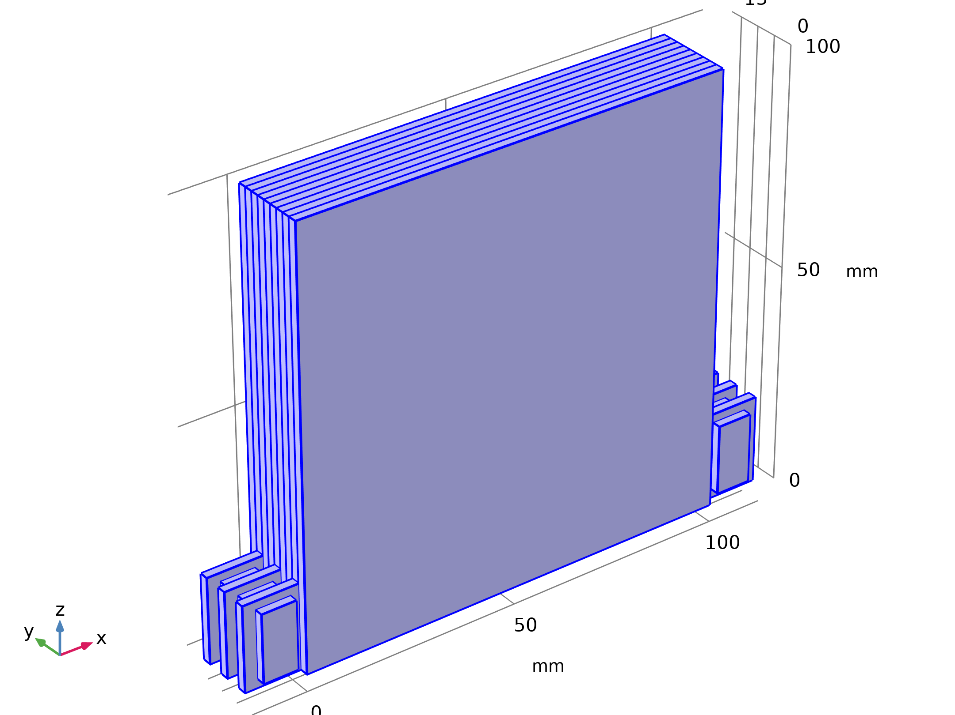


Model Definition
Heat Transfer in Solids and Fluids

Slide 9
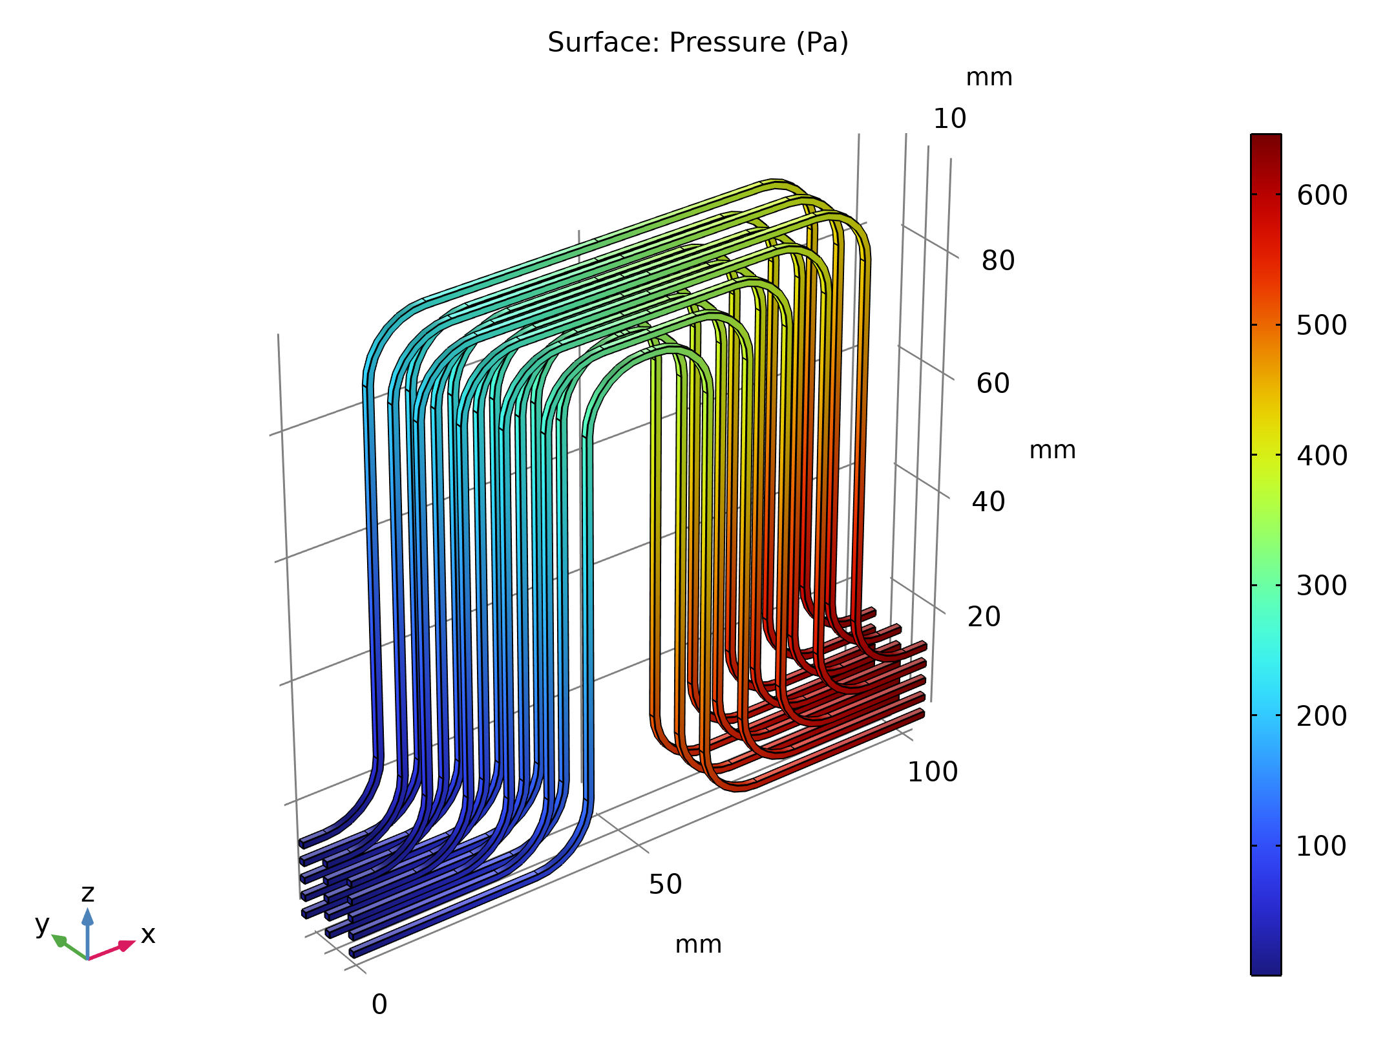
Results
The figure shows the pressure in the fluid compartment
Pressure in the flow compartment

Slide 10
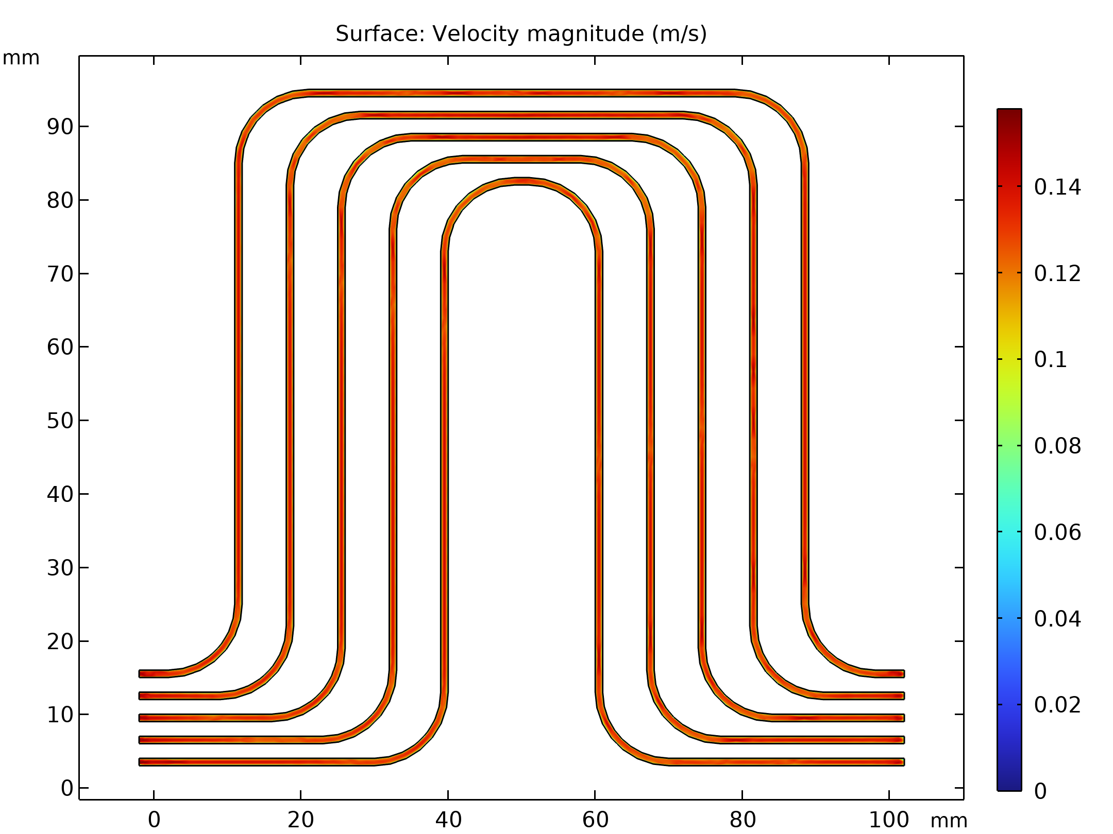
Results
The figure shows the velocity magnitude in a cut plane through the middle of one of the cooling fins
The velocity magnitude is about 0.2 m/s in the middle of the channels
This implies that the residence time for the fluid time in the plates is in the range of only a few seconds, giving support to the assumption that the battery pack reaches a quasistationary temperature profile quickly after a load change
Velocity magnitude in the first cooling fin

Slide 11
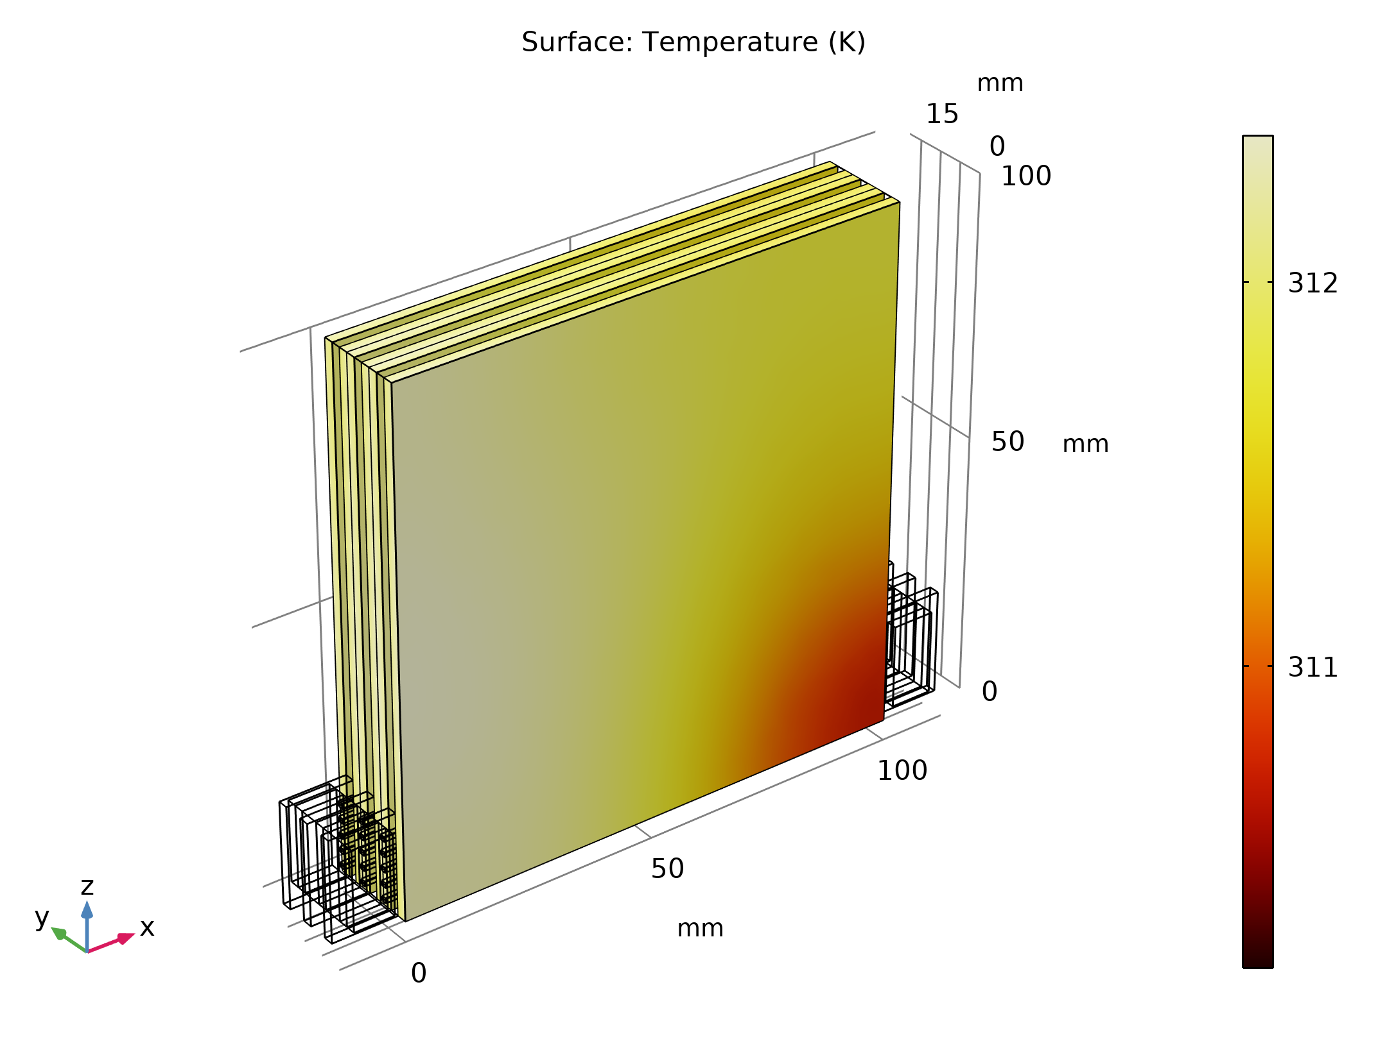
Results
The figure shows the temperature in the batteries
The difference between the highest and lowest temperature in the pack is about 3 K
The temperature variation between different batteries along the y-axis is smaller than the temperature variation within a single battery in the xz-plane
Temperature in the batteries

Slide 12
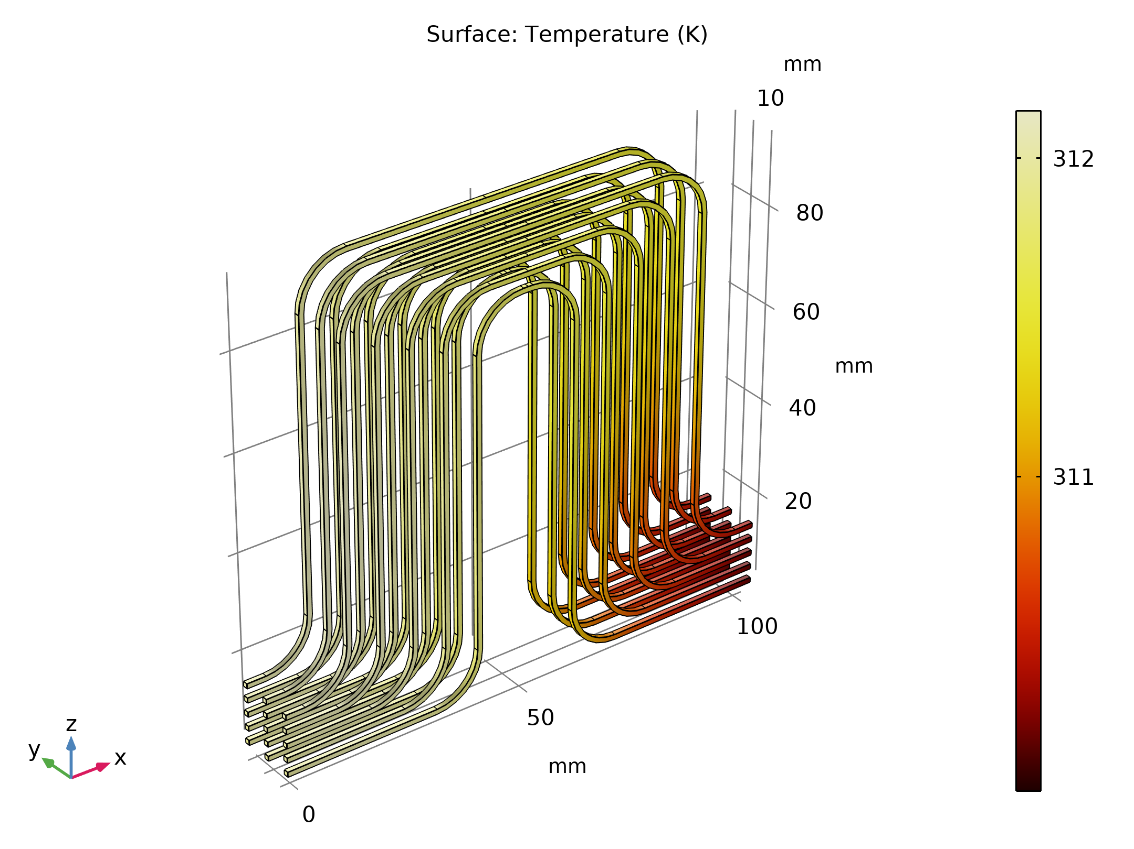
Results
The figure plots the temperature of the cooling fluid
The temperatures are slightly lower than in the battery
Temperature of the cooling liquid

Slide 13
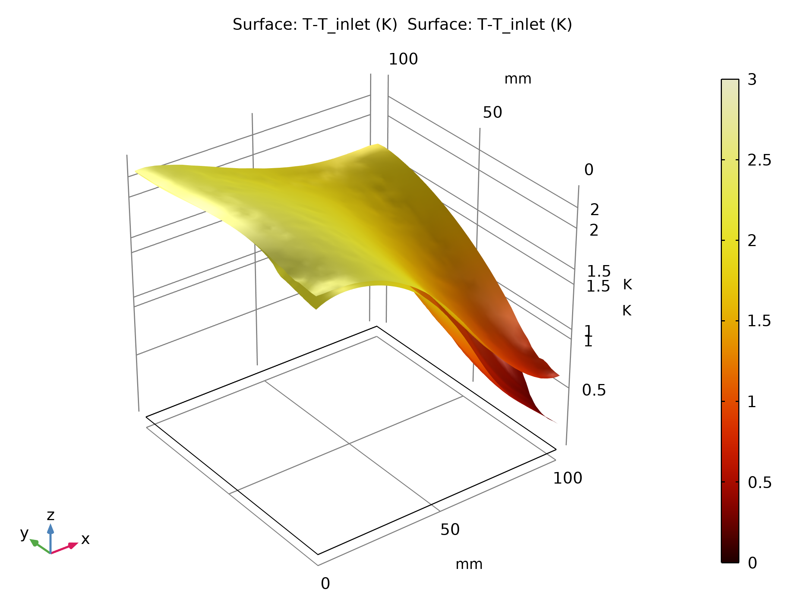
Results
The figure shows the temperature in the second battery by comparing the temperature at the surface facing the cooling fin (y = 4 mm) to the surface facing the third battery (y = 6 mm)
The surface toward the cooling fin is cooler, reaching a minimum at the corner toward the inlet
The temperature gradient over the battery is also at its maximum at this point
Temperature increase (in relation to the inlet temperature) of the second battery at the surface facing the cooling fin (y = 4 mm) and the surface facing the third battery (y = 6 mm)

