Slide 1
Friction Stir Welding of an Aluminum Plate
COMSOL

Slide 2
Background
Manufacturers use a modern welding method called friction stir welding to join aluminum plates
A rotating tool moves along the weld joint and softens aluminum by generating frictional heat. The rotation then stirs the softened aluminum so that the two plates are joined
This method allows dissimilar materials and plastics to be welded together
The result is a pore-free weld joint without residual stresses due to shrinkage
Heat transfer between the rotating tool and the plate during welding is considered in this model

Slide 3
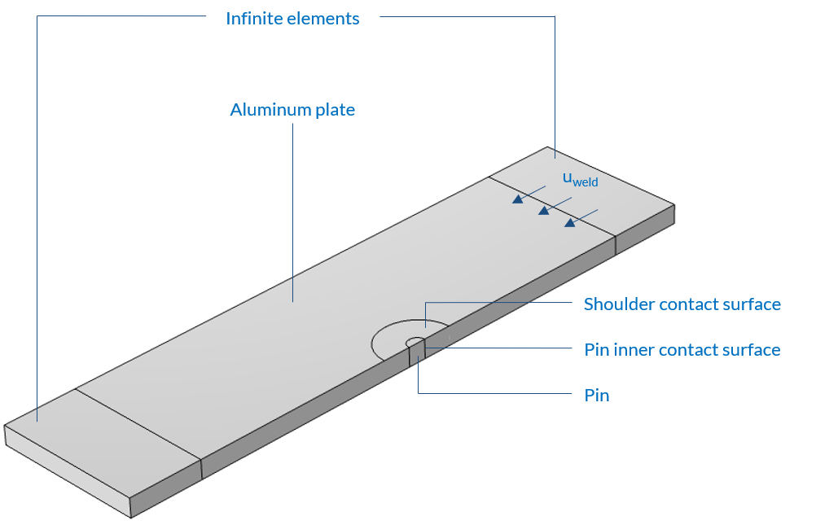
Model Definition
A symmetry is introduced to reduce the computational cost
Instead of modeling the tool as a moving heat source, a moving coordinate system fixed to the tool axis is used
Two infinite element domains , before and after the welding zone, are used to model an infinitely long plate
The rotating tool is divided into two parts: a pin with an inner contact, and a shoulder with a contact surface on the plate. The shoulder itself is not represented
Model geometry

Slide 4
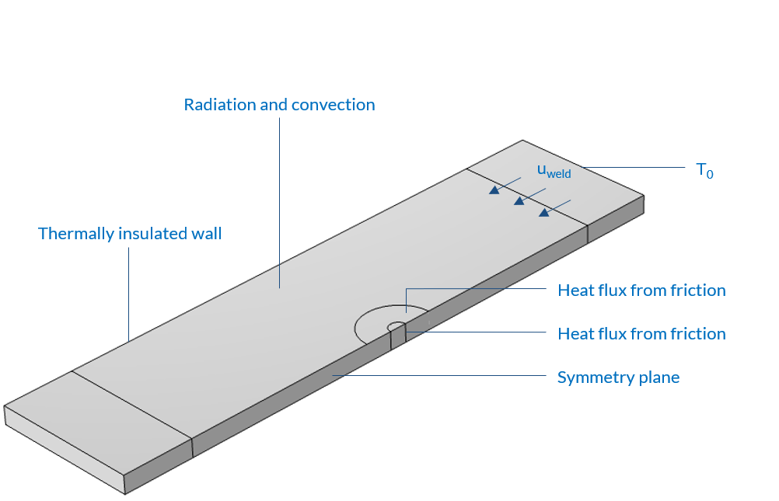
Model Definition
Heat fluxes from friction with the rotating tool are taken into account on both contact surfaces. They account for the rotating speed and the normal force
The heat fluxes from friction are set to 0 if the temperature exceeds the melting temperature
Surface-to-ambient radiation as well as convection are considered on the plate
The right side of the infinite plate, which corresponds to the supply side, is set to ambient temperature
Model boundary conditions

Slide 5
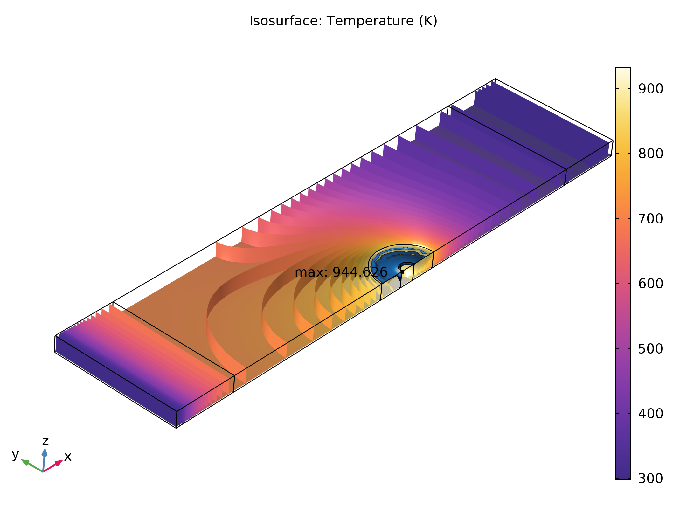
Results
In this configuration the maximum temperature is 944 K which is slightly higher than the melting temperature of aluminum (T=933 K)
There is a thin film of aluminum that melts at the very surface in contact with the shoulder and the pin
Cold material arrives on the welding tool as the plate moves
The high temperatures created by the friction with the tool are then transported
Isothermal contours in the domain - In blue, the area where the temperature exceeds 933 K

